Slide 1

The Changing Landscape for Renewable Energy Financing and Support
IRENA- International Renewable Energy Agency
Rabia Ferroukhi

Slide 2
Renewable energy shares in end-uses
Indexed renewable energy shares, 2010-2015 (2010 = 1)
Global energy consumption, shares by sector, 2015
Progress in the electricity sector is not being matched in transport and heating – which together account for 80% of global energy consumption.

Slide 3
Renewable energy investment
Renewable energy annual investment by technology type, 2013-2017 (2017: preliminary numbers)
Annual investment in renewables rose steadily in 2013-2015, peaking at USD 330 billion in 2015. Capacity installation continued to grow in 2016.
Investment need for renewables and energy efficiency for 2015-2050 is USD 75 trillion. This represents doubling of investment levels set out in current and planned policies.

Slide 4
Renewable energy investment by region
East Asia-Pacific region (specially China) was the dominant destination for renewable investments in 2013-2016, followed by Western Europe and OECD Americas.
21% OECD Americas
22% Western Europe
36% East Asia-Pacific (2016)

Slide 5
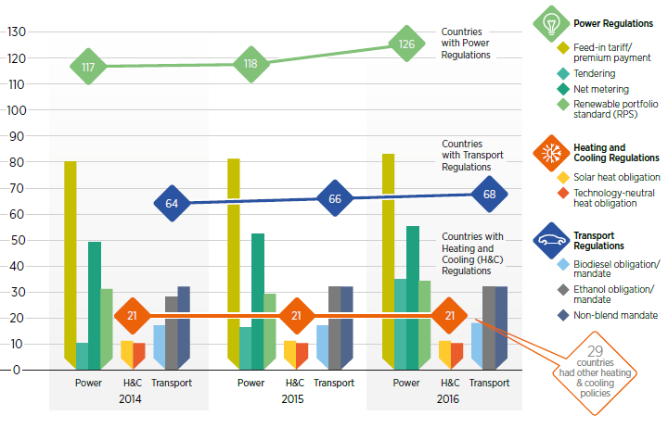
Renewable energy policies
Renewable energy policies have become increasingly widespread. Policy support focuses on power sector. Heating, cooling and transport are less dynamic.
Number of countries with renewable energy regulatory incentives and mandates, 2014-16

Slide 6
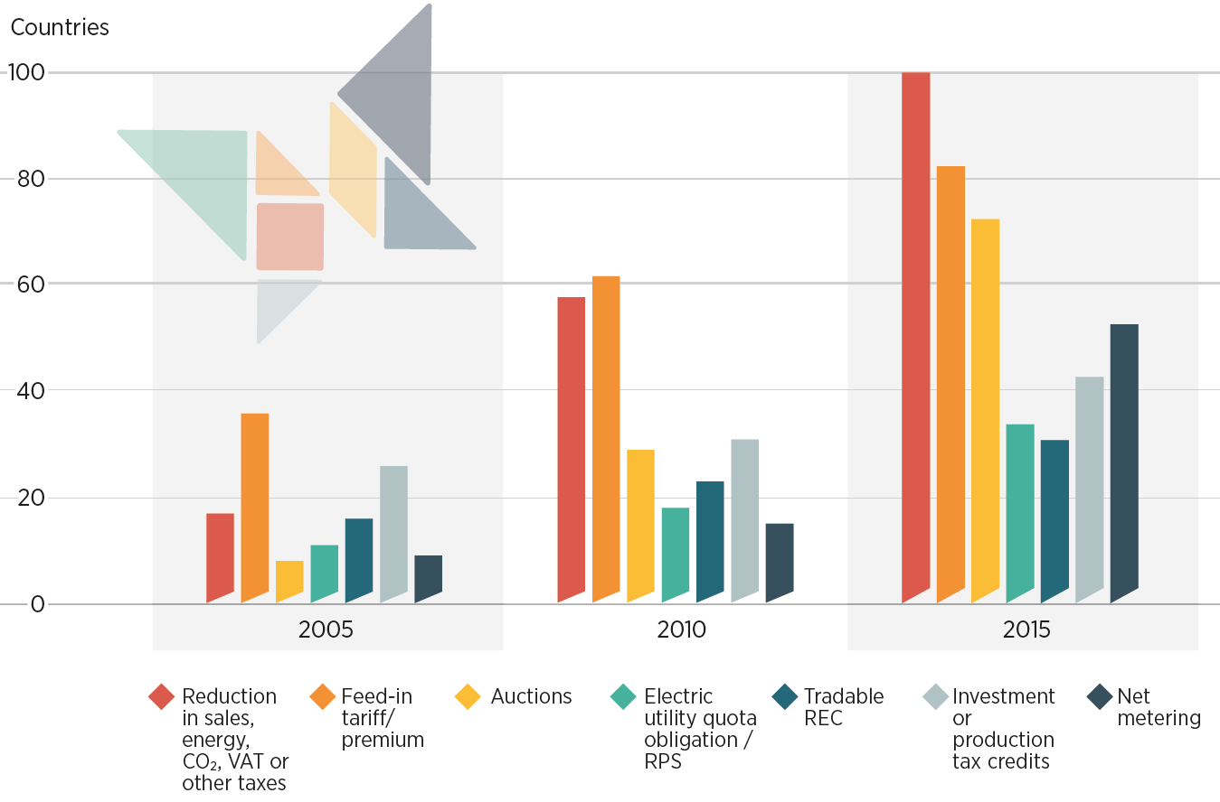










Policies to support renewables in power
Renewable policy in the power sector needs to continue to adapt to changing market conditions.
Trends in the adoption of selected policy instruments to support renewables in power, 2005-15

Slide 7
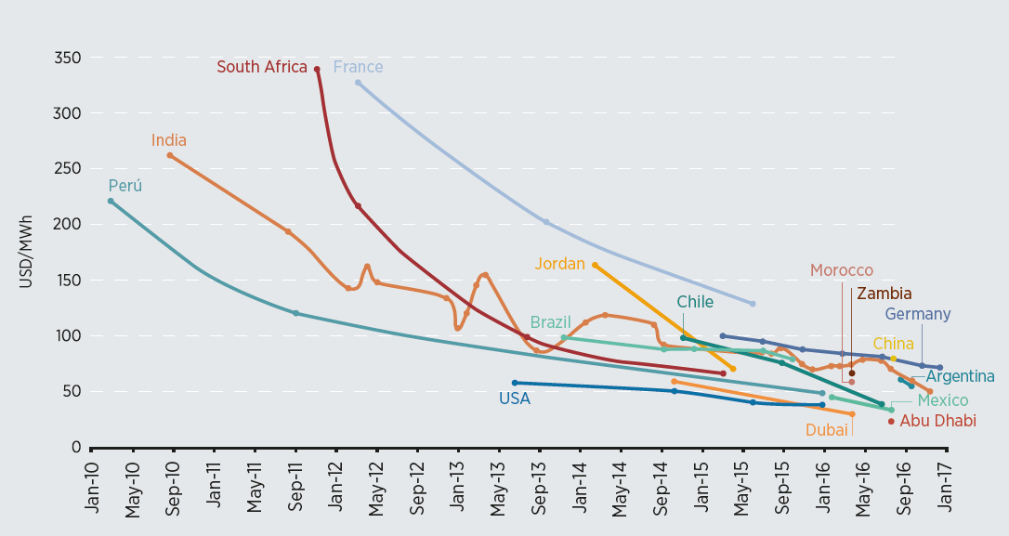
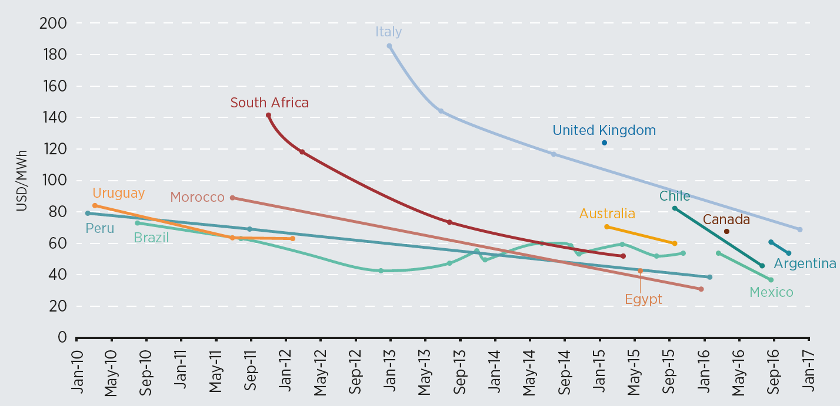
Trends in auction prices, 2010-17
Trends in auction prices for solar PV, 2010-17
Trends in auction prices for onshore wind, 2010-17

Slide 8
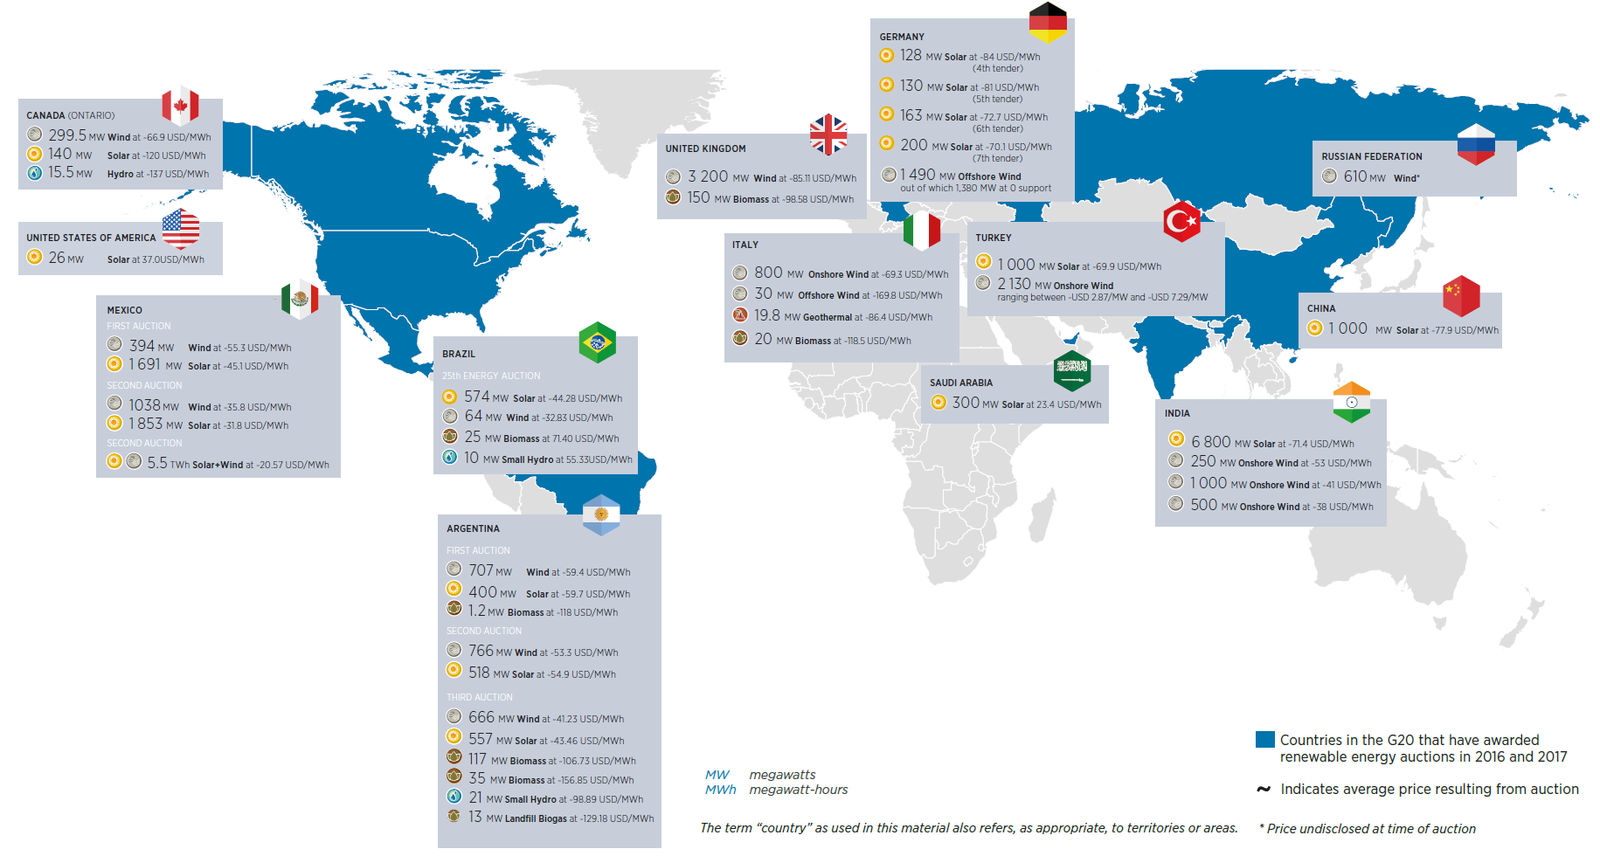
Latest auctions in selected countries

Slide 9
Public finance instruments
Although most DFIs appear to favour loans, there is evidence of increasing use of risk mitigation instruments in Africa and Asia.
<5% Risk mitigation instruments (2013-2016 avg.)
85% Loans (2013-2016 avg.)

Slide 10
Private investment by source
Majority of private direct investment in renewables came from project developers.
Institutional investors only make up about 1% of new direct renewable energy investments each year.
1-2% Institutional investors
(2013-2016 avg.)
40% Project developers (2013-2016 avg.)

Slide 11
Unlocking renewable energy investment
Public finance can play a key enabling role – covering early stage risks and helping new markets reach maturity.
Structured finance & capital market mechanisms
Risk mitigation instruments (RMIs)
Standardisation
Aggregation & securitisation
Green bonds
Initial assistance
Resource risk mitigation (e.g. geothermal)
Guarantees and liquidity facilities (political, offtaker risk)
Currency hedging instruments
Project preparation & development (technical support, grants)
Facilitating access to capital (on-lending and co-lending facilities, concessional loans)

Slide 12
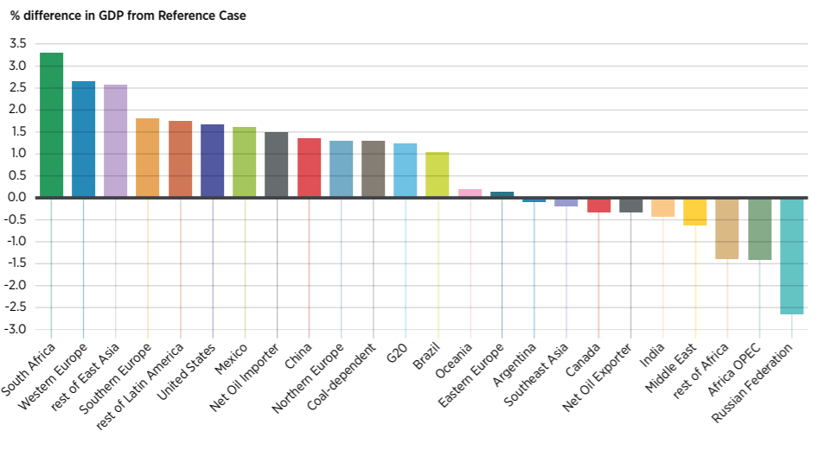


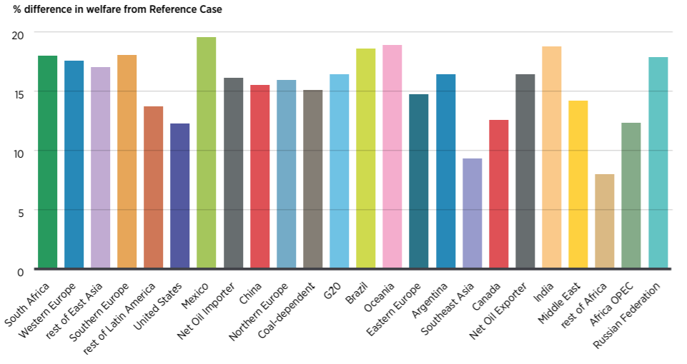

Socio-economic footprint of the energy transition
Country/Regional/Country groupings results
GDP
Global results
+ 1.0 % .
+ 2.06USD trillion
+ 0.14 %
+ 11 million
in the energy sector
Welfare
Jobs
+ 15 %

Slide 14
Updated policy classification
Captures the importance of the broader policy context - that goes well beyond the energy sector - required to achieve the energy transition in line with the appropriate socio-economic structures to support it.
Policies to achieve the energy transition |  | Deployment of renewables in the general context | Deployment of renewables in the access context | Maximisation of socio-economic development from renewable energy
Direct policies | Push | Binding targets Quotas and obligations Codes and mandates | Rural targets, strategies, programmes | Deployment policies designed to maximise benefits and ensure a sustainable transition (e.g., communities, gender) including requirements, preferential treatment and financial incentives provided to installations and projects that help deliver socio-economic objectives
 | Pull | Regulatory and pricing policies Tradable certificates Instruments for self-consumption Support voluntary programmes | Regulatory and pricing policies (e.g. legal provisions, price/tariff regulation)
 | Fiscal and financial | Tax incentives Subsidies Grants | Tax incentives Subsidies Grants Concessional financing Support for financial intermediaries
Integrating policies |  | Measures to enhance system flexibility | Integration of off-grid systems with main-grid Coupling with efficient appliances and services
 |  | Policies for infrastructure, sector coupling and R&D
 |  | Better alignment of energy efficiency and renewable energy policies Incorporation of decarbonisation objectives into national energy plans Adaptation measures of socio-economic structure to the energy transition
Enabling policies |  | Policies to level the playing field Policies to ensure the reliability of technology |  | Industrial, trade policy and environmental and climate policies
 |  | National renewable energy policy Access to finance, Education, Labour, Land-use, RD&D and innovation, Urban and Public health policies
Enabling and integrating policies |  | Supportive governance and institutional architecture Awareness programmes Social protection policies to address disruptions Measures for integrated resource management

