Slide 1

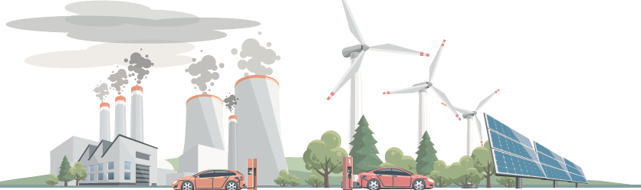
Reaching Zero with Renewables
Eliminating CO₂ emissions from industry and transport in line with
the 1.5-degree-C climate goal
COP26: 1-12 November 2021, Glasgow, UK

Slide 2

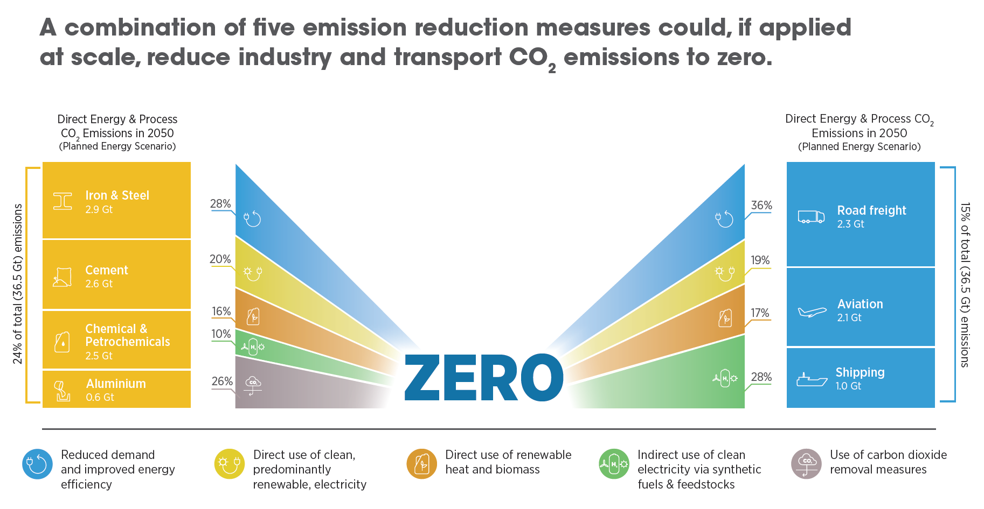
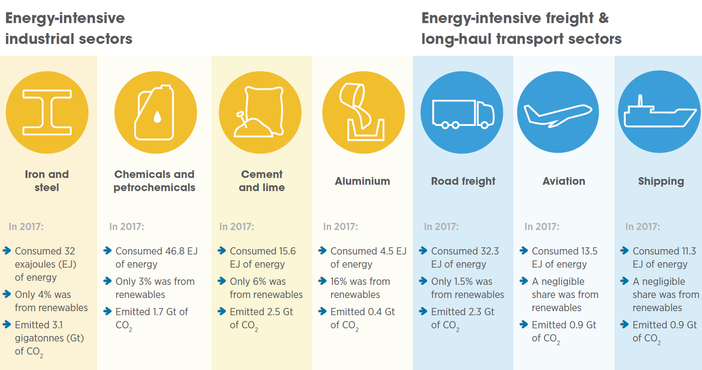
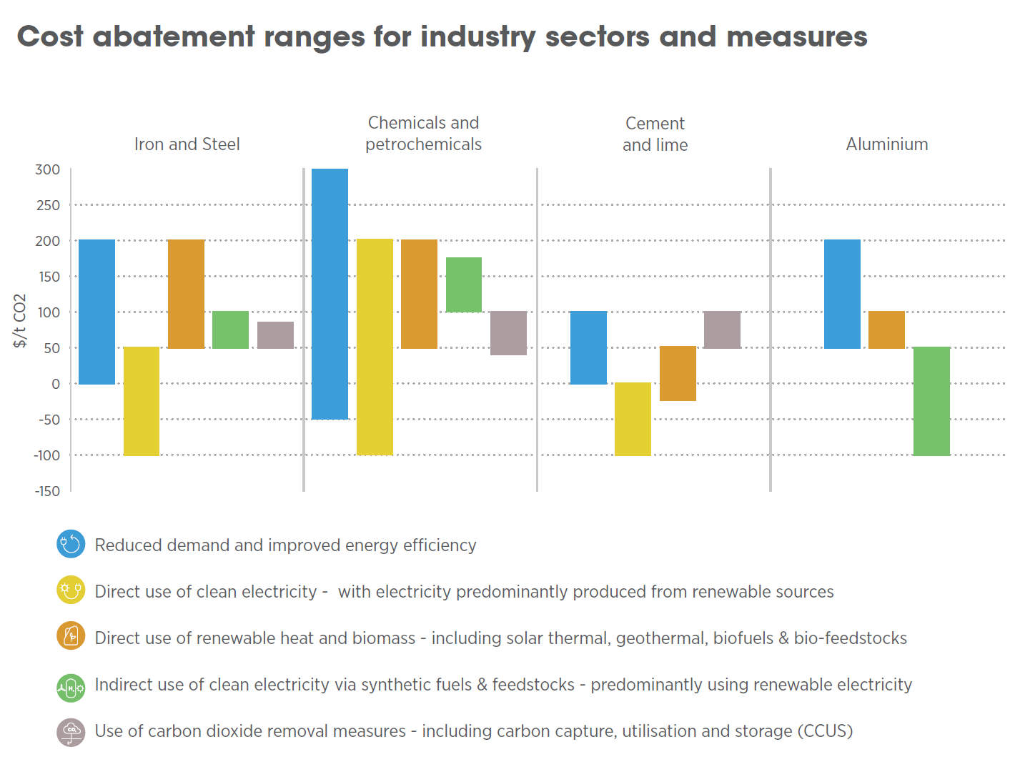
Reaching Zero with Renewables
Hard-to-decarbonise sectors currently account for 38% of energy and process emissions and 43% of final energy use by 2050
Progress to decarbonise these sectors limited – IRENA proposes a pathway as a combination of 5 emission reduction measures to reduce CO₂ emissions
Key scale-up challenges: high innovation costs; lack of enabling infrastructure; lack of long-established and integrated practices; uneven, large and long-term investment needs; gaps in carbon accounting; and business risks for first-movers
Primary need for inter-linked sector-level strategies at the local, national and international levels
Key steps at policy level include building confidence and knowledge among decision-makers, fostering early demand for green products and services, tailored financial approaches, global collaboration with evolving regulation and international standards, and support for RD&D and systemic innovation

Slide 3
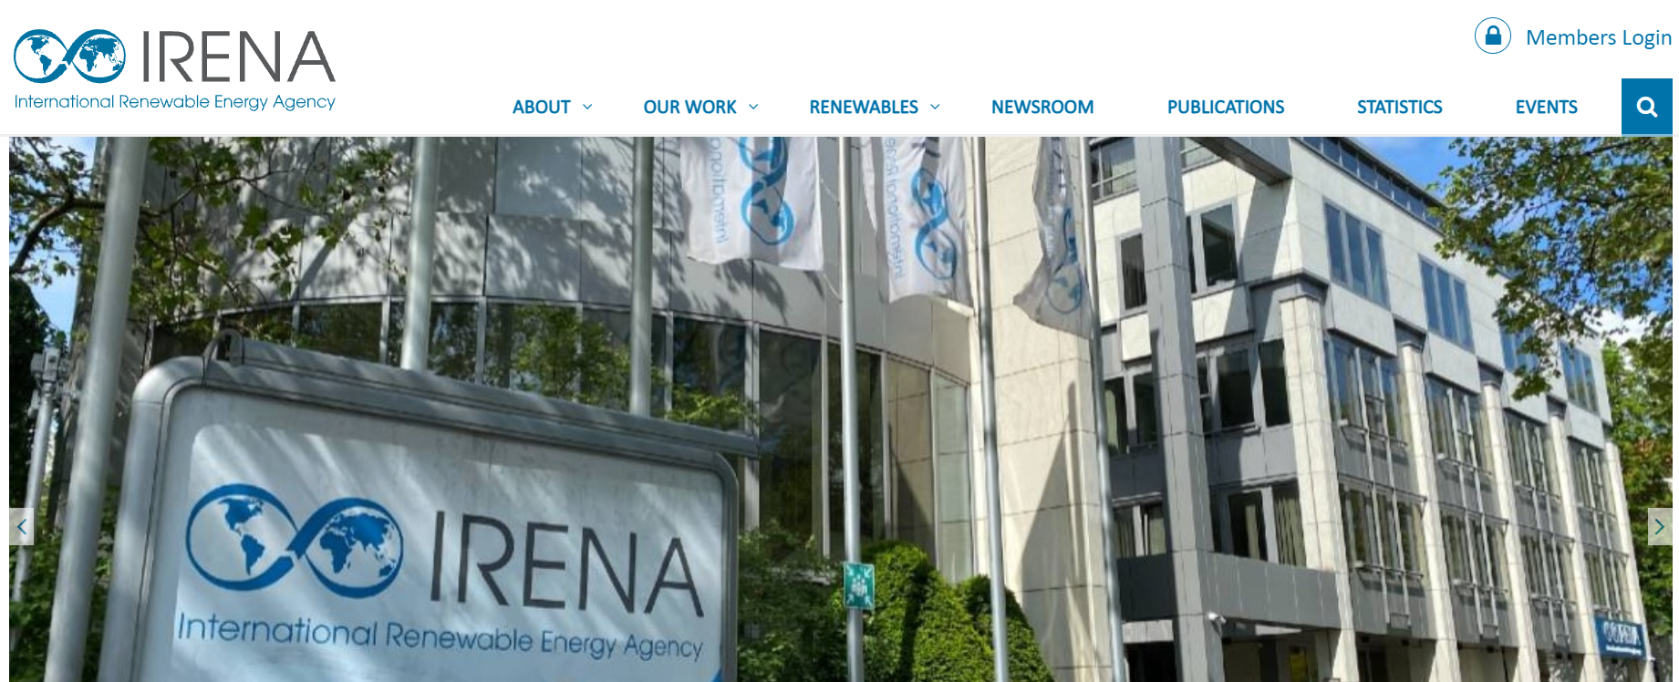
Global hydrogen trade in a 1.5C scenario
Forthcoming
Q4/2021
In a scenario with Optimistic technology performance by 2050, about about 30% of hydrogen would be traded internationally
Around half of the trade is through pipelines concentrated in two regional markets: Europe (85%) and Latin America and the other half largely in the form of ammonia shipping.
About 80% of the 2050 green production from green hydrogen (380 Mt out of 480 Mt) is globally traded
Of the ammonia traded, 80% is directly consumed as commodity and only 20% is reconverted to hydrogen.
A total investment of USD 4.3 trillion is needed across the entire green hydrogen value chain (from generation to re-conversion plants)
The capacities needed to supply this system are 10.7 TW of renewable capacity, 6 TW of electrolysis and 1.3 TW of batteries
The overall share of trade is relatively robust for a different set of assumptions, but the outlook for specific countries can change significantly for different scenarios.
This degree of hydrogen trade will be subject to global willingness to implement a 1.5 C pathway and to significant innovation to bring down cost of green hydrogen and hydrogen trade infrastructure.

Slide 4
Technology pathways to trade hydrogen
Technology pathways to trade hydrogen
Ammonia is the most attractive carrier for shipping due to its lower costs and existing infrastructure. In an optimistic scenario, its transport cost can be 40-50% lower than liquid hydrogen and liquid organic hydrogen carriers (LOHC).
The major cost component for ammonia is the heat supply for cracking which can be 30-40% of the total cost. This step can be avoided if ammonia is used directly (instead of hydrogen).
The transport cost could be lower than USD 0.5/kg_{H2} in a world where technology performance has improved, and the maximum economies of scale have been reached.
Pipelines are the most attractive for regional markets up to
3 000-4 000 km, with an option to redeploy natural gas pipelines.
Pipelines become cheaper with higher flows and single pipeline can easily handle flows larger than 3 MtH₂/yr.
Existing natural gas pipelines can also be repurposed to hydrogen reducing the capital cost by nearly two thirds.
Each shipping pathway has at least one step of the value chain that needs further de-risking before reaching commercial scale.
Due to energy losses for every conversion step, using commodities (ammonia, methanol, steel, synthetic fuels) directly is more attractive than re-conversion to hydrogen.
Therefore green commodity trade may grow faster than green hydrogen trade
Forthcoming
Q1/2022

Slide 5

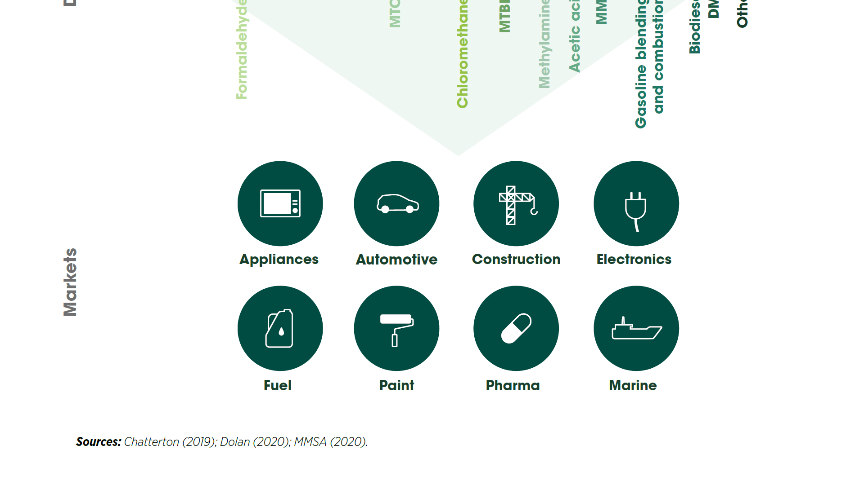
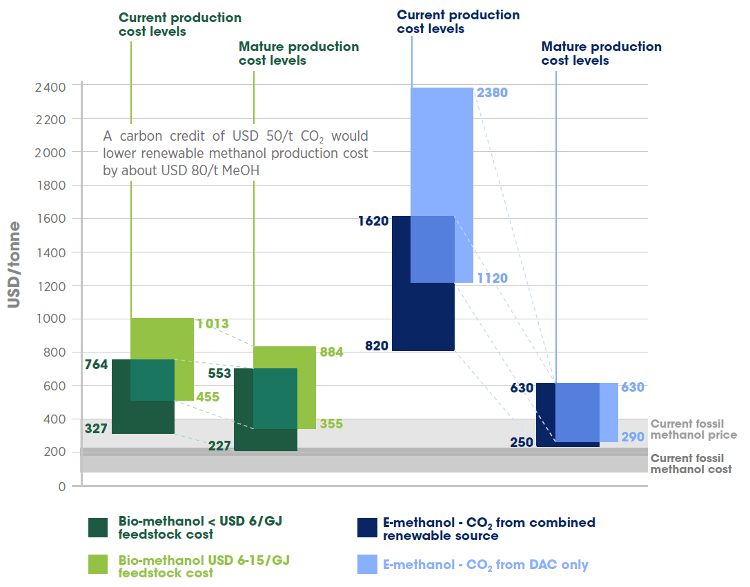
Renewable Methanol
Life-cycle emissions from current methanol production and use are around 0.3 Gt/year of CO₂ (about 10% of total chemical sector emissions) to grow 5 times by 2050
Methanol production nearly doubled in the past decade to reach about 98 Mt in 2019, with less than 0.2 Mt of renewable methanol produced annually
Low-emission methanol to play a large role in decarbonising sectors where options are limited:
  Feedstock in the chemical industry
  Fuel in heavy-duty road or marine transport
Renewable methanol via 2 production routes:
  Bio-methanol produced from different biomass feedstocks
  E-methanol produced from captured CO2 from renewable sources and green hydrogen
Easy to store, transport and distribute due to: liquid state at ambient conditions and compatibility with existing distribution infrastructure
Main market uptake barrier: higher production costs and price compared to fossil fuel-based alternatives
Policy interventions and support mechanisms, such as renewable fuel standards, incentives, carbon pricing, price floors, essential for renewable methanol market uptake
Current and future production costs of bio-methanol and e-methanol

Slide 6
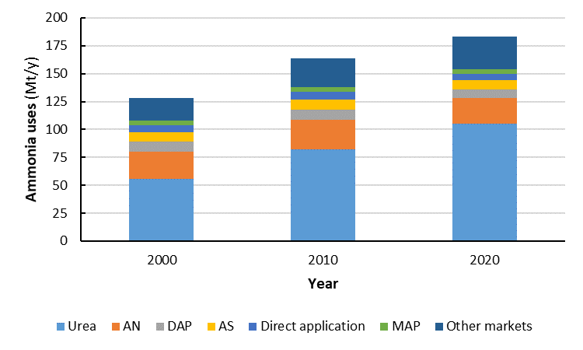
Renewable Ammonia
Renewable Ammonia
Life-cycle emissions from current ammonia production and use are around 0.5 Gt/year of CO₂ (about 15-20% of total chemical sector emissions) to grow 3 times by 2050
Ammonia production around 183 Mt per annum, with less than 0.02 Mt of renewable ammonia produced annually
Low-emission methanol to play a large role in decarbonising sectors where options are limited:
  Fertilizer production
  Hydrogen feedstock in the chemical industry
  Fuel in marine transport and stationary power
Ammonia: historically major hydrogen consumer (around 45% of industrial consumption of hydrogen)
Currently high generation costs and low production volumes of renewable ammonia (linked with green hydrogen status)
Significant experience with ammonia storage, transport and distribution. Existing international transport infrastructure that can be expanded
Main market uptake barrier: higher production costs and price compared to fossil fuel-based alternatives
Policy interventions, such as the carbon credit system, long-term price floors, and the approval of ammonia as a fuel by international regulatory bodies, and the revamping of existing assets are essential for renewable ammonia market uptake
Forthcoming
Q1/2022
Current and future production costs of renewable ammonia

Slide 7

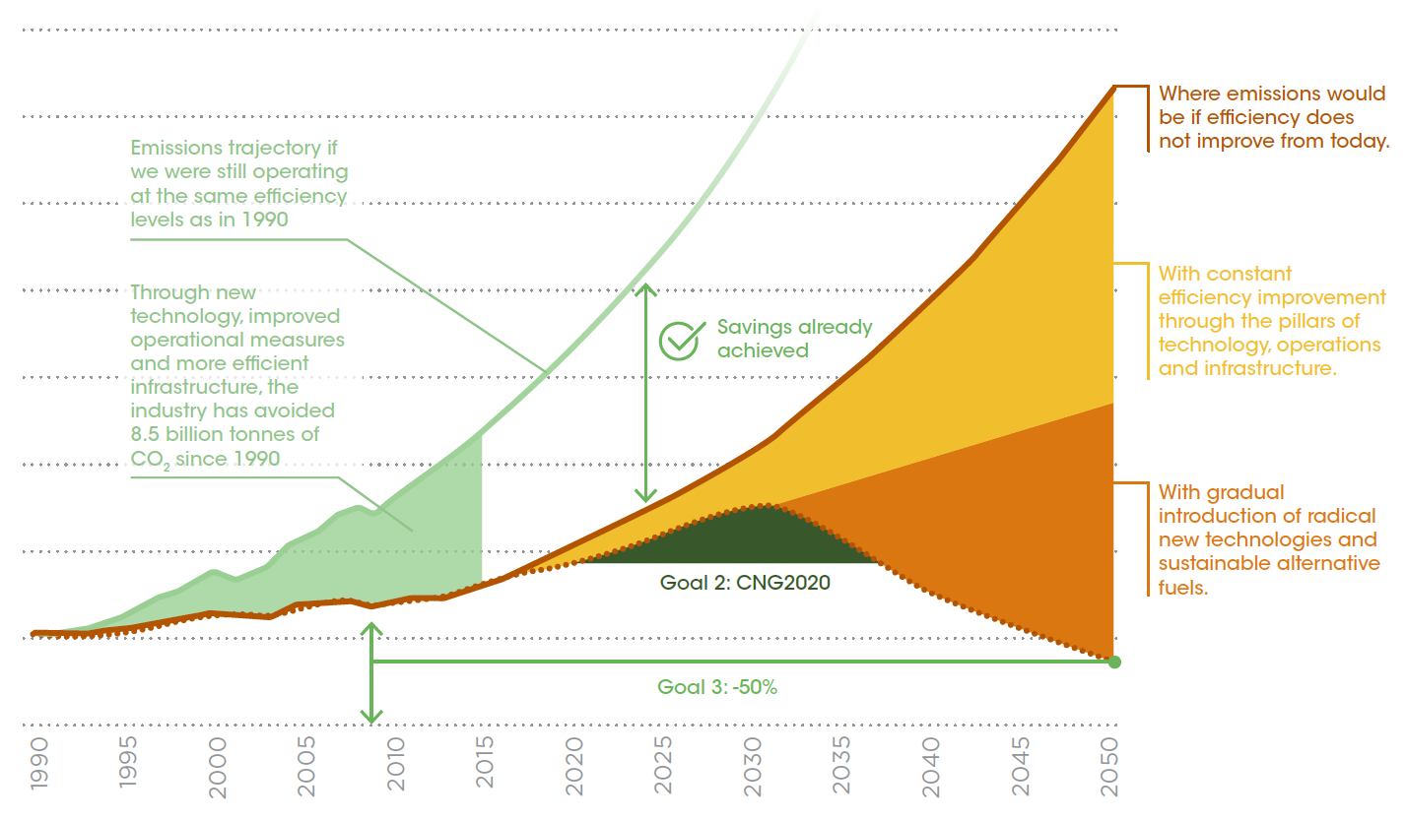
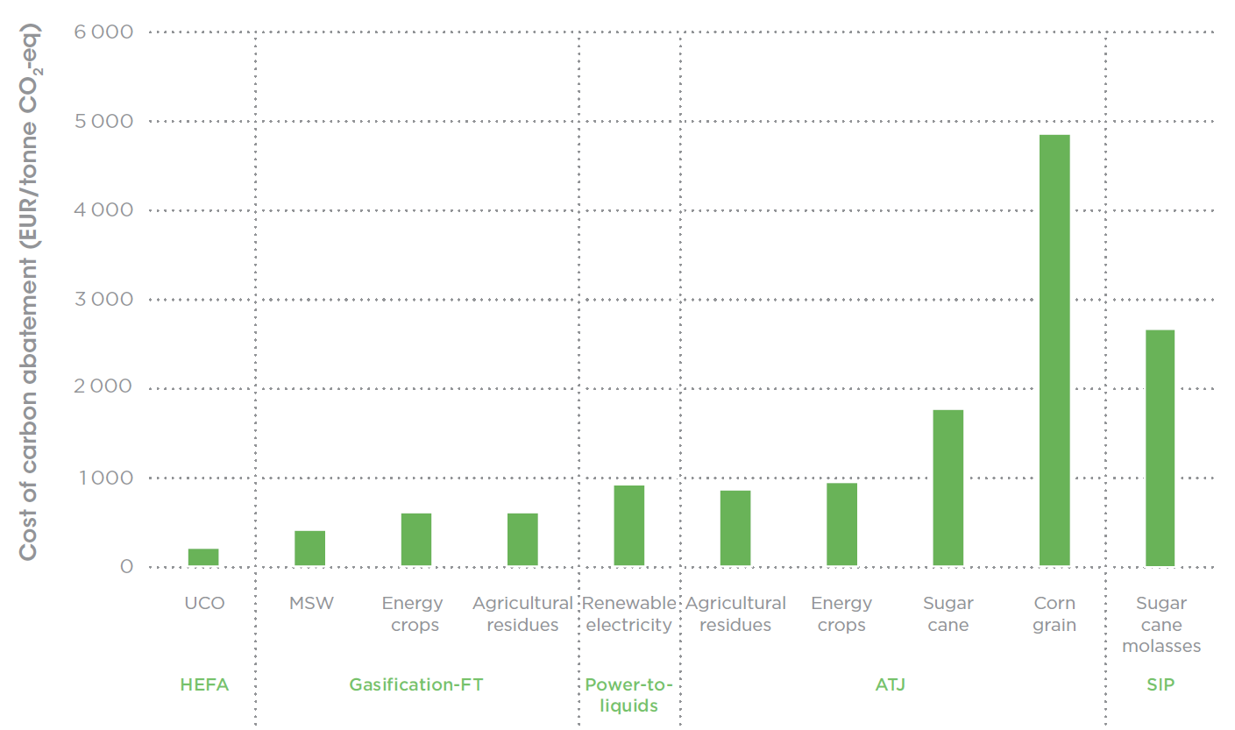
Biojet Fuels
Aviation produced 915 Mt of CO₂ in 2019 (≈2% of global CO₂ emissions) and projected to double by 2050
Biomass-derived aviation fuels (biojet) to play a critical role in decarbonising aviation
Biojet currently below 1% of use in aviation, its production increased from 7 million litres/year (2018) to 140 million litres/year (2019)
IRENA’s 1.5C Scenario estimates 200 billion litres/year of biojet by 2050 with needed investment of USD 5 billion/year
Several mature technology pathways to produce biojet exist
Main technology uptake barriers: slow rate of technology development; high production costs; high costs of feedstock, its availability and sustainability; high CAPEX of technologies; price-competitiveness with conventional fuels, etc.
Innovative and stable policies for a significant uptake of biojet essential at international and national level:
  Market pull policies, such as low-carbon fuel standards
  Technology push policies to support RD&D, supply chain, sustainability and feedstock assessment, such as grants and loan guarantees
Cost of carbon abatement for different biojet fuel technologies

Slide 8
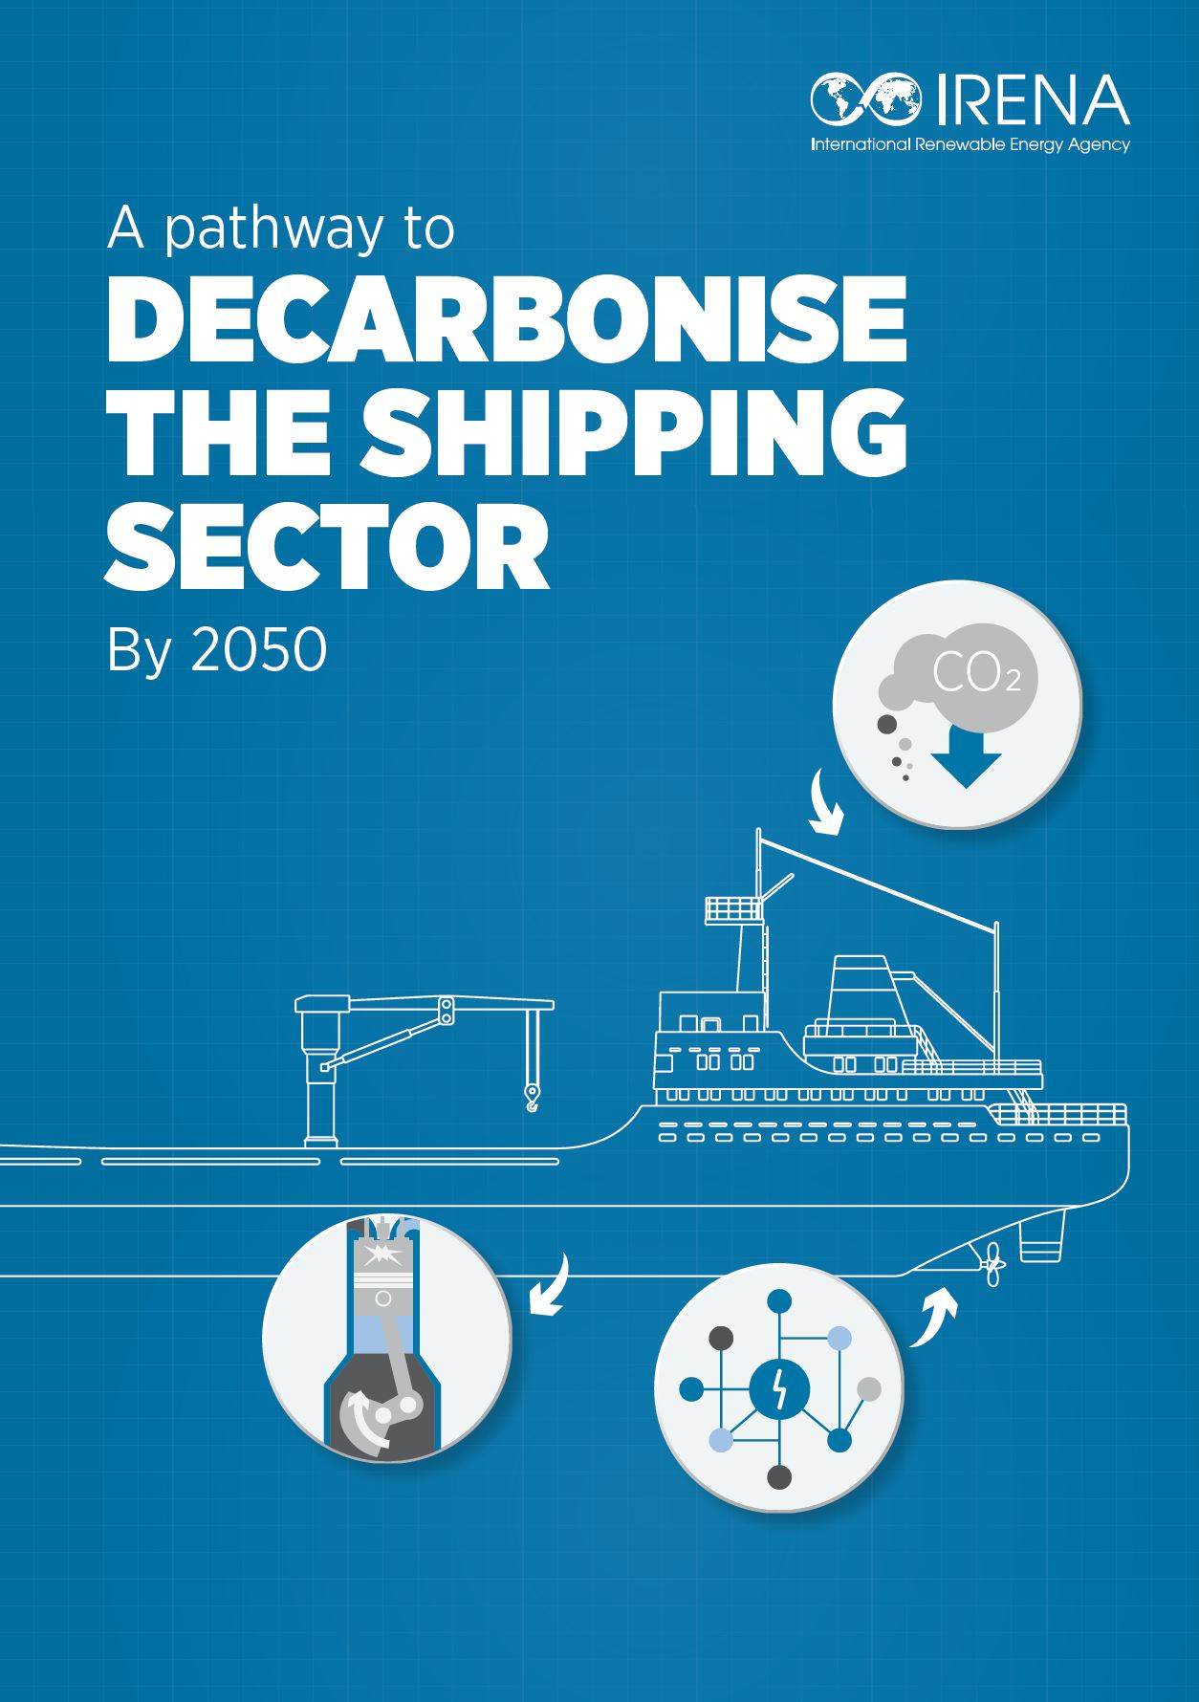
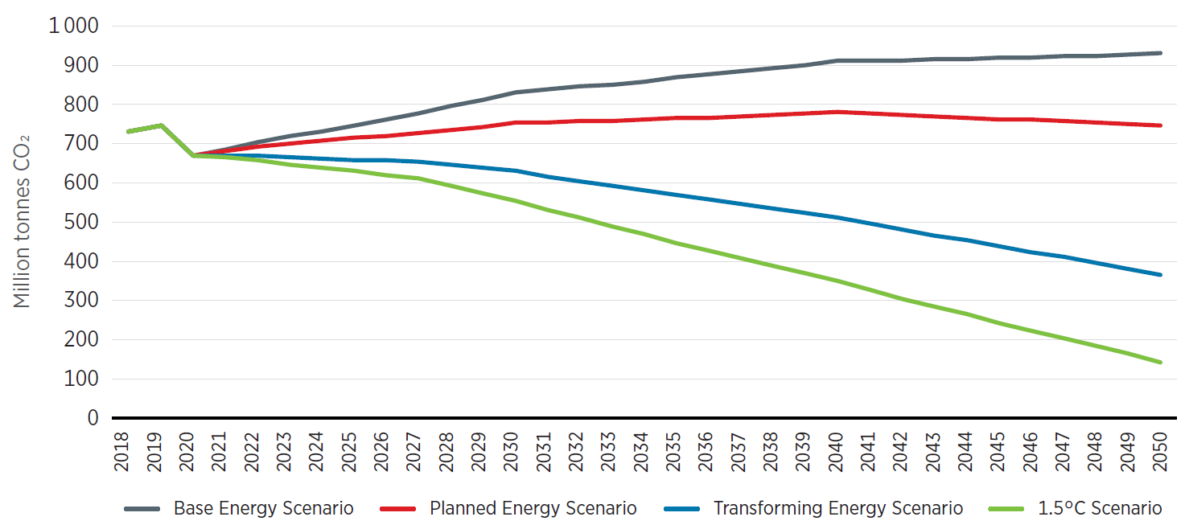
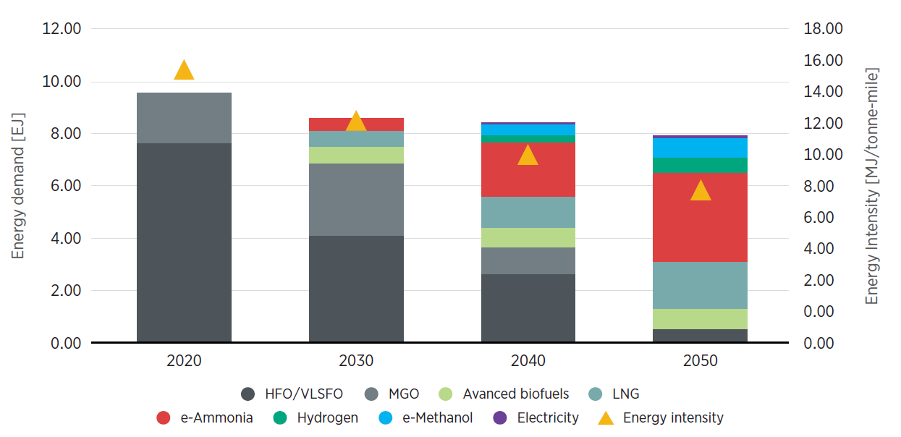
Pathway to Decarbonise the Shipping Sector
Shipping accounted for nearly 11 EJ of energy demand, resulting in 1 Gt of CO₂ in 2018 (≈3% of global CO₂ emissions)
Fossil fuels currently provide 99% of the final energy demand, but are also associated with high market price volatility
Green hydrogen-based fuels, specifically renewable ammonia, set to be the backbone for the shipping sector’s decarbonisation
  Renewable fuels most suited to international shipping are advanced biofuels and e-fuels, i.e. methanol and ammonia
  By 2050, shipping will require a total of 46 Mt of green H2
Energy efficiency to play a role in the near term for emission reductions in the sector
Main market uptake barrier: currently high production costs of renewable fuels for shipping
Green H2 costs will become cost competitive in some contexts from around 2030
100% methanol engines are a proven technology; hence, new ships can easily rely 100% on biofuels
IRENA’s 1.5C Scenario estimates a 70% share of renewable fuels by 2050, with an emission reduction of 80% compared to 2018 levels
Multi-stakeholder synergies, policy-driven actions, RD&I efforts and investments in renewables and energy efficiency essential for renewable shipping fuels market uptake
Comparison of CO2 emissions associated with each scenario for Shipping Sector, 2018-2050
1.5C Scenario Energy Pathway for Shipping Sector, 2018-2050

Slide 9

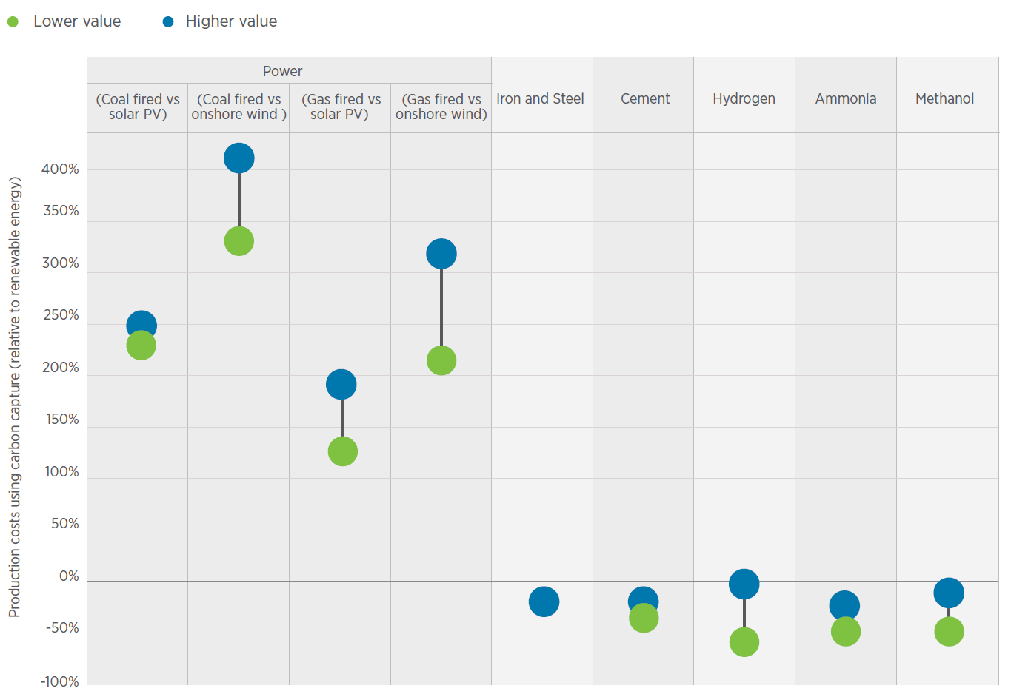
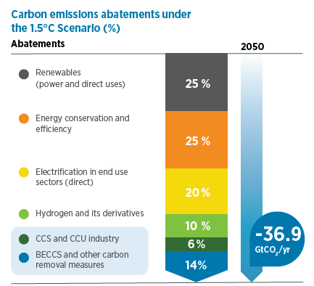
Reaching Zero with Renewables: Capturing Carbon
CCS, CCU and CDR (BECCS and DACCS) technologies are a component of net-zero pathways particularly for cement, steel and chemicals sectors
CCS, CCU and CDR have different roles and system values which are often contentious and poorly understood:
  CCS and CCU reduce CO₂ emissions,
  CDR (BECCS and DACCS) remove CO₂ emissions.
According to the IRENA’s 1.5C Scenario global CO2 capture and storage should reach 8.5 Gtpa by 2050, from current 0.04 Gtpa
  CCS to reach 3.4 Gtpa by 2050
  BECCS to reach 4.5 Gpta by 2050
  Bio-C recycling and concrete absorption to reach 0.5 Gtpa by 2050
Costs are uncertain and vary by applications, in the range from USD 20–25/tCO₂, for natural gas processing to USD 200/tCO₂ for ethylene with CO₂ capture
Main technology uptake barriers: limited infrastructure and regional mismatches for CO₂ transport and storage; limited operational experience; limited existing policies and regulations; high and uncertain costs; lack of business cases; and some societal reservations
Key actions necessary to scale-up RD&D activities, establish enabling conditions to speed up deployment, incl. clusters, hubs and transport networks and ensure sustainability of the process

Slide 10
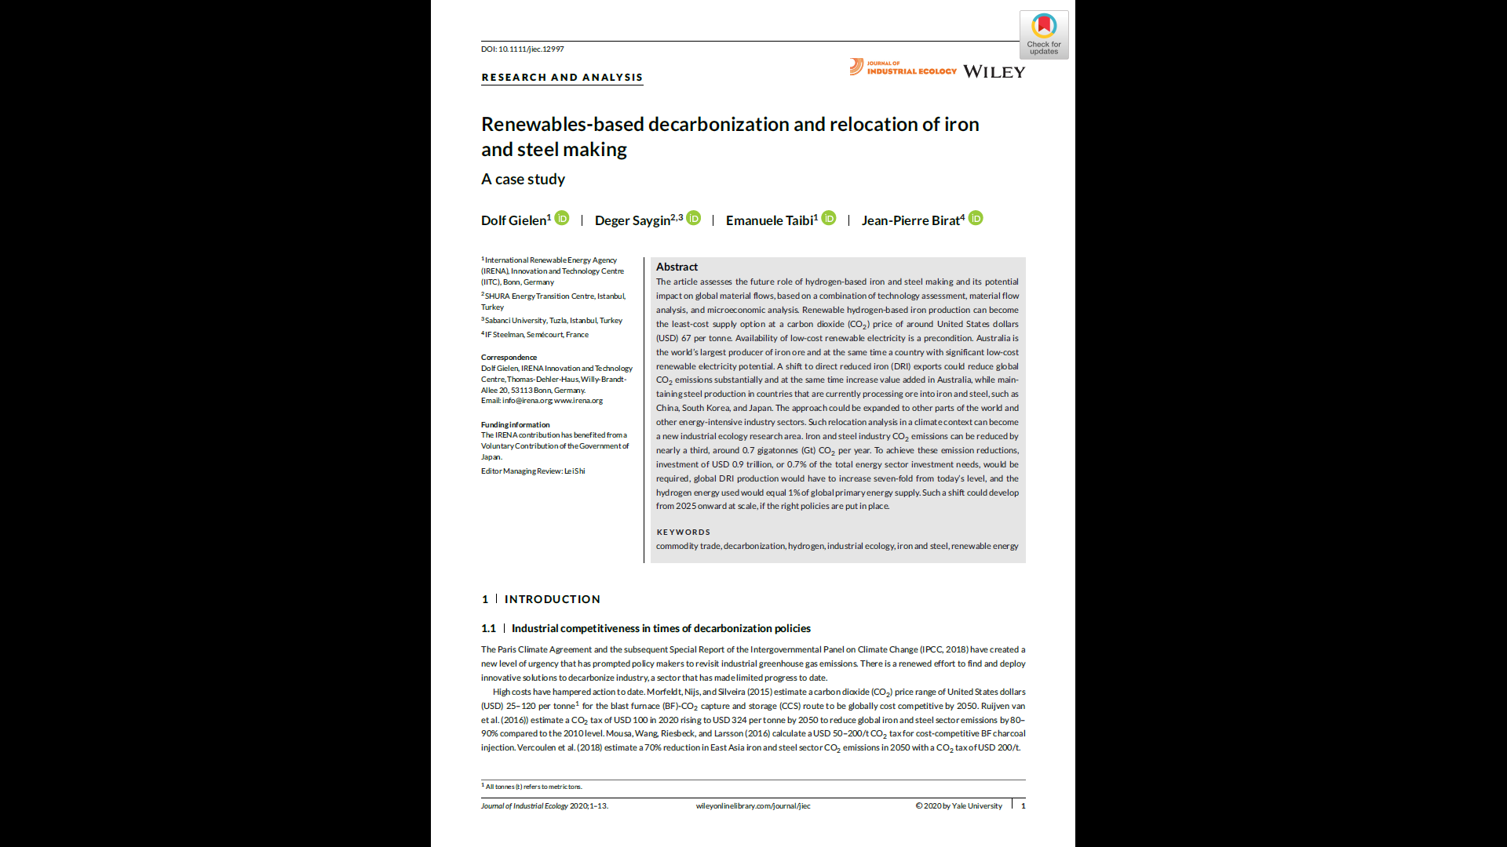
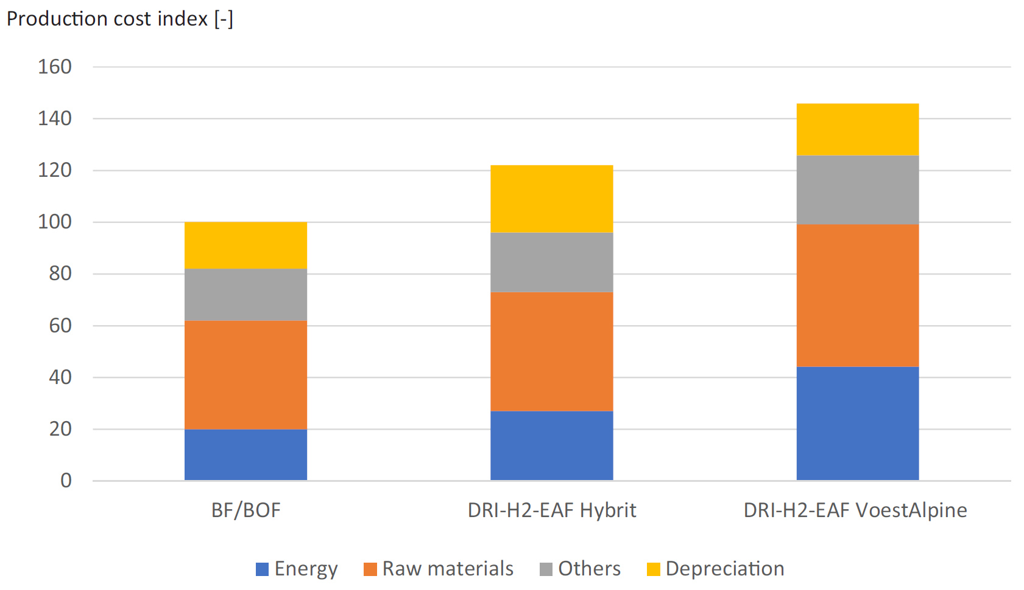
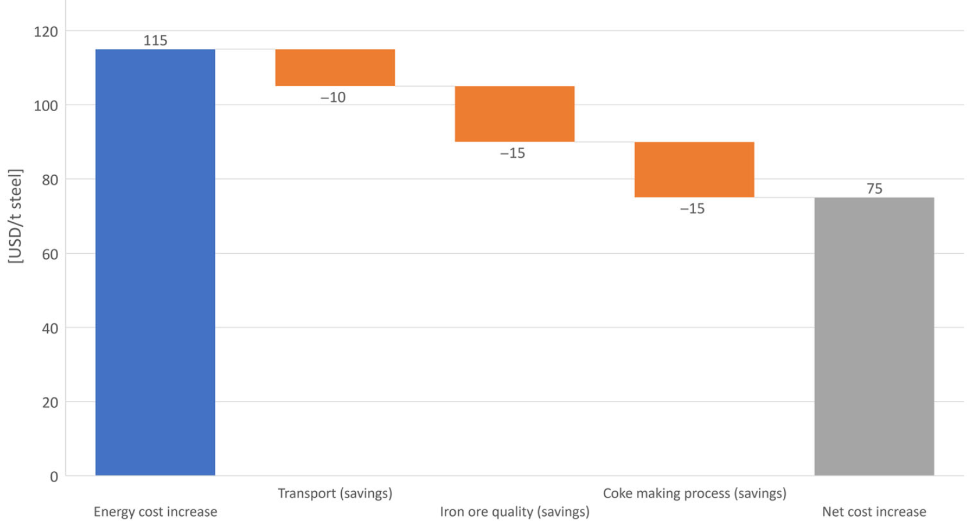
Renewable-based decarbonization and relocation of iron and steel making
Iron and steel production accounted for approximately 7–9% of total global fossil fuel CO₂ emissions in 2017
Relocation of key energy-intensive iron-making step (not steel making) to areas of low-cost renewable electricity can reduce CO₂ emissions by nearly a third → 0.7 Gtpa of CO₂
What it would entail:
  Investment required USD 0.9 trillion (= 0.7% of the total energy sector investment needs)
  7-fold increase of global DRI production from current levels (currently 100 Mt or 8% of all iron)
  5 EJ of hydrogen needed per year (= 1% of global primary energy supply)
Priority is an increase in development of commercial-scale hydrogen iron-making process
Depends on:
  the final demonstration of industrial feasibility of hydrogen production,
  energy cost,
  ore feedstock cost,
  economies of scale, and
  CO₂ price of more than USD 67/t.
Cost comparison for crude steel production in Europe
Cost differentials for steel production based on DRI using H2 versus BF

Slide 11
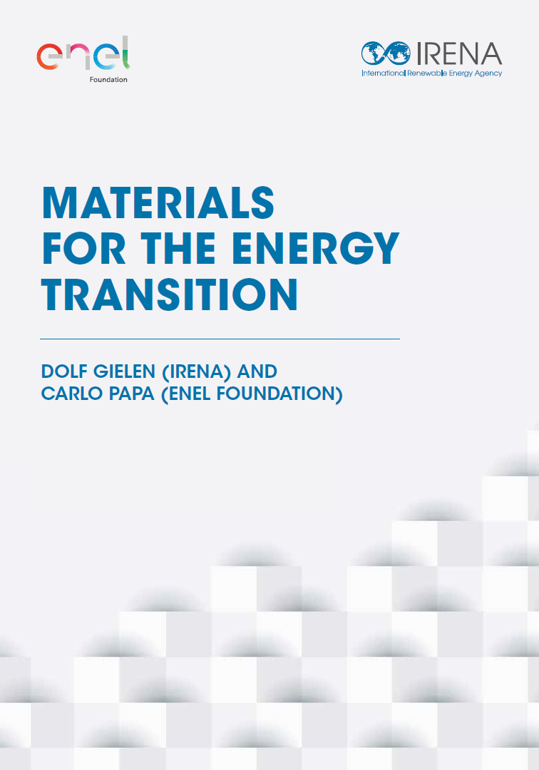
Materials for Energy Transition
Greenflation: rising prices for metals and minerals that are essential to the generation of renewable energy technologies
For many materials, quantities required for energy transition not that significant compared to total consumption
Significant substitution potential exists in new applications
Recycling can reduce the need for primary material production
Battery materials for EV and rare earth permanent magnets for EV and wind turbines
Copper demand for electricity systems may grow to 6 Mtpa, compared with today’s copper demand of 30 Mt per year
Automotive applications account for around 9% of today’s copper use and electric vehicles can double or quadruple copper use, which is equivalent to 14% to 28% of today’s copper use
Industry is wary due to experience with past supply cycles
  For lithium, today’s price are just back to 2017 price levels, as new supply came onstream faster than demand growth
  Other metals have seen similar demand-supply cycles, and the long-term price trend has been downhill
Key risks about geographical distribution of materials supply: cheap supply from abroad and geopolitical concerns
Short and mid-term expansion of mining poses a challenge
International governance must be enhanced for strategic critical materials essential for energy transition, with policy frameworks and design decisions to avoid future scarcity problems
Baseline projections for battery materials demand

Slide 12
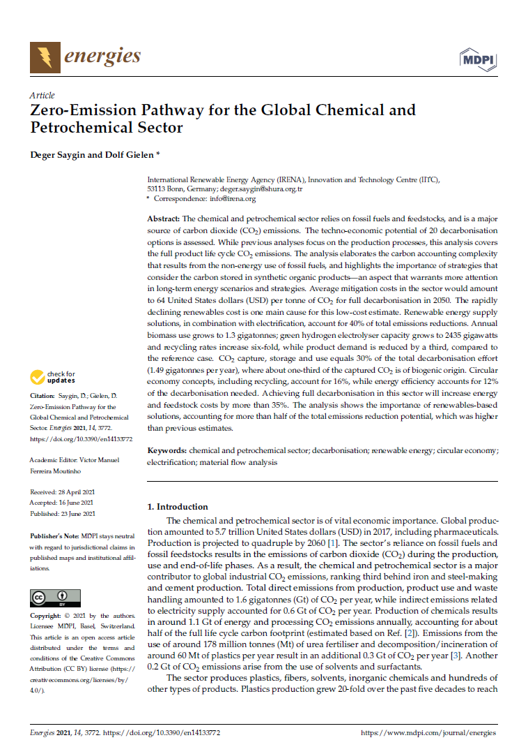
Zero-Emission Pathway for the Global Chemical and Petrochemical Sector
Global chemical and petrochemical production amounted to 5.7 trillion USD in 2017 and is projected to quadruple by 2060
Major contributor to global industrial CO₂ emissions, with a total of around 2.2 Gtpa of CO₂ and is expected to grow by c. 40%
Bioplastics constitute less than 1% of current plastics production
Major market barrier: high cost of low-carbon alternatives
Emissions reduction potential: materials systems optimisation 35%, energy use in materials production 65%:
  Circular economy (incl. recycling) account for 16%, while energy efficiency accounts for 12%
  Renewable energy supply solutions, in combination with electrification, account for 40% of total emissions reductions
    Biomass use expected to grow to 1.3 Gtpa; green hydrogen electrolyser capacity expected to grow to 2400 GW
  CCS/CCU represent 30% of total efforts (1.49 Gtpa) out of which 1/3 represent BECCS
Required total investment of USD 4.5 trillion: feedstock switching to biomass and hydrogen (61%), energy efficiency (18%), CCS (9%), recycling and energy recovery (8%)
Achieving full decarbonisation in this sector will increase energy and feedstock costs by more than 35%
Breakdown of the estimated CO2 emissions reductions
Estimated investment needs in the global chemical and petrochemical sector

Slide 13
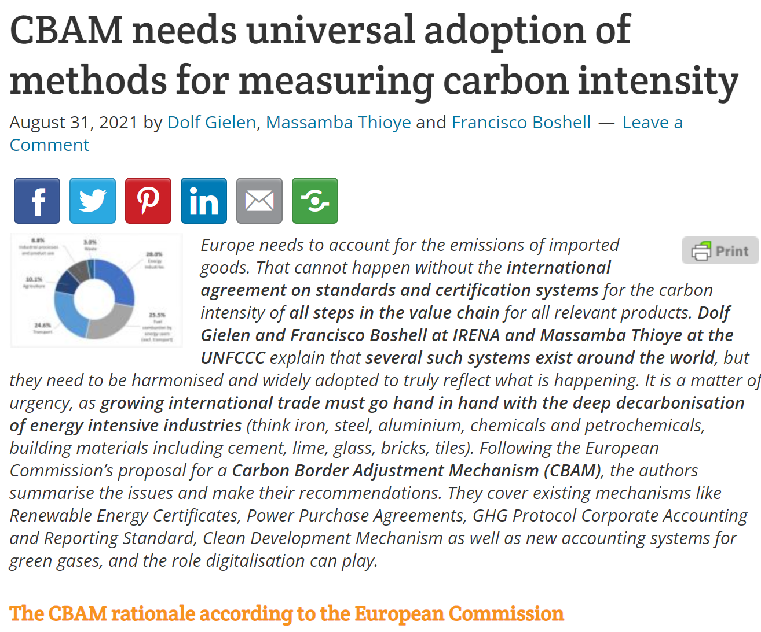
CBAM needs universal adoption of methods for measuring carbon intensity
CBAM to avoid carbon leakage by progressively removing free allocation (starting 2026)
CBAM certificate price equal to EU ETS certificate price
Impact of CBAM on CO₂ emissions limited – 0.1% drop in global CO2 emissions but higher trade costs for developing countries
Need for coherent carbon accounting systems particularly international agreement on standards and certification systems
Several accounting systems exist globally with different fields of application, but lack consistency
  EU Emissions Trading Scheme (ETS): existing mechanism for carbon pricing with certificates
  Renewable Energy Certificates (REC) / Guarantee of Origins (GO)
  Power Purchase Agreements (PPAs): existing renewable supply mechanisms
  GHG Protocol Corporate Accounting and Reporting Standard
  Clean Development Mechanism (CDM) under UNFCCC
  New accounting systems for green gases (green hydrogen, ammonia, renewable methanol or biomethane))
The development of new standards and systems can benefit from established practices
Role for digital technologies (blockchain) essential to facilitate the implementation of accounting schemes at a global scale
Breakdown of European GHG emissions

