Slide 1



Role of Renewables & Electrification for Europe’s Buildings
Dolf Gielen
Director, Innovation and Technology, IRENA
European Policy Centre online Policy Dialogue, 26 May 2021

Slide 2
Energy Consumption Projections for H&C
Source: JRC, 2021

Slide 3
The challenge of the existing building stock
Limited growth in building stock in Europe / North America
Majority of global construction will take place in Asia Pacific

Slide 4
Renewables for heating & cooling
Source: JRC, 2021

Slide 5
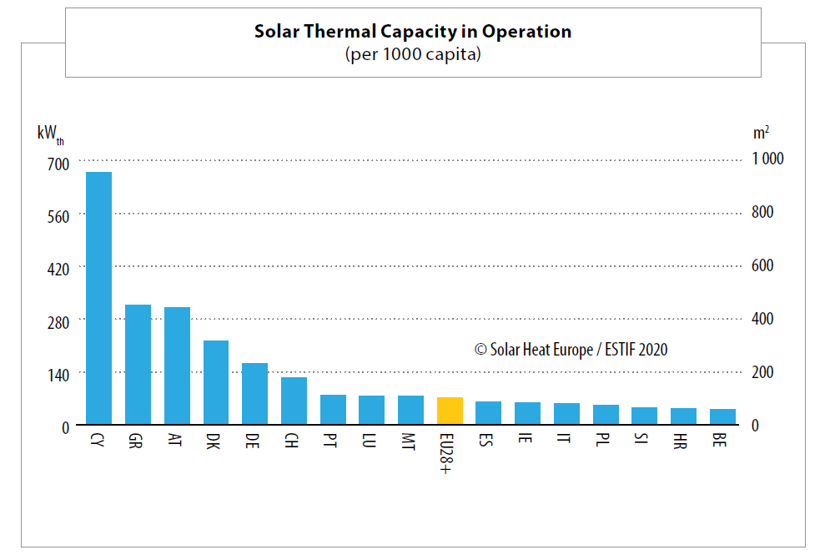
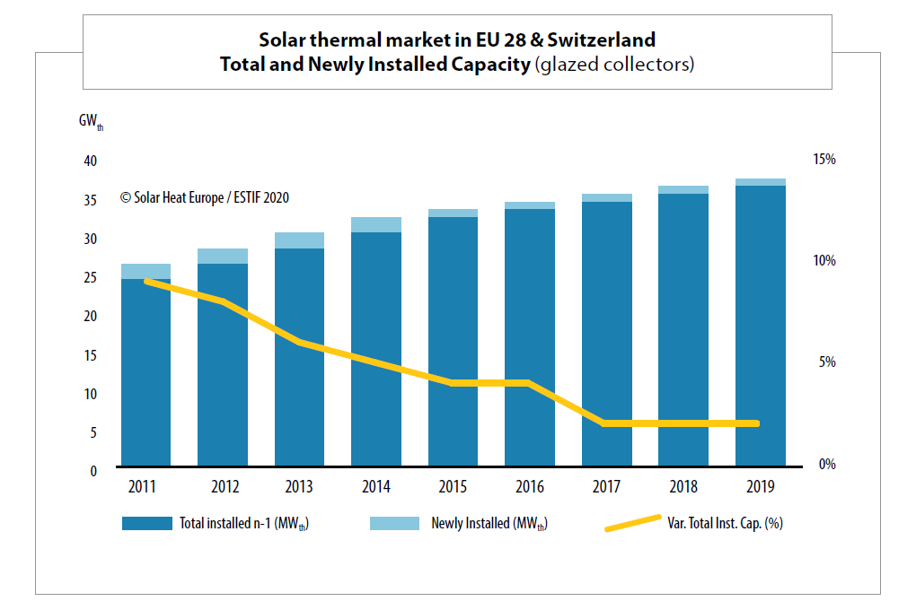
Renewables options
Heat pumps in combination with renewable power
  16.7 mln installed units – >106 mln units stock potential
More rooftop solar PV (680 TWh potential-1/4 energy current electricity use in Europe) (Bodis et al 2019)
More rooftop solar thermal – declining and slow growth
More district heating & cooling systems with renewable and waste heat supply
  Approximately 100 Mt CO₂ reduction potential
Greening the gas grid - biomethane and hydrogen
  20% biomethane in Denmark 2020
  A number of hydrogen trials
Source: Solar Heat Europe

Slide 6

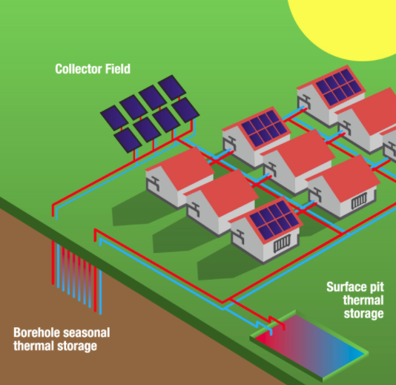
District Heating and Cooling
Lesson from Denmark is the opportunity to reap the efficiencies of district heating and cooling.
District systems can be much more efficient than the more common model of having every residence or business provide its own heat through decentralised systems.
A solar-based district heating system is in Denmark in Dronninglund: capacity of 26 megawatts (MW), covering around 40 % of the annual heat demand. Dozens more solar systems have been installed or are in the works across Denmark.
Copenhagen has launched a district cooling system that draws cool water from the city’s harbour to pre-chill water destined for buildings with large cooling loads. The city estimates district cooling reduces electricity consumption by 80 % compared to conventional air conditioning.

Slide 7
Heat pump market units sold per 1000 inhabitants
8-fold market growth potential
Heat pumps
Source: EHPA

Slide 8
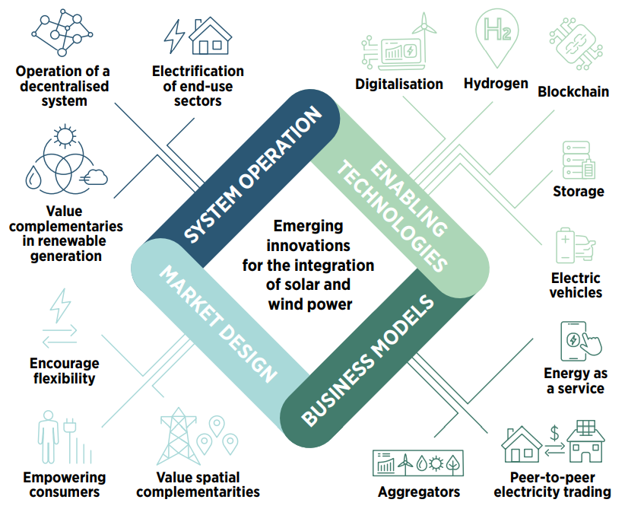
Emerging innovations for the integration of variable renewable energy sources
Increasing flexibility through:
enabling technologies
market design
business models
system operation
This creates new investment opportunities
A key role for digitalization and smart systems
Changing supply and demand patterns and more variable electricity pricing create new business cases
More attention for demand side flexibility
Based on IRENA (2019), Innovation Landscape for a Renewable-Powered Future: Solutions to Integrate Variable Renewables, International Renewable Energy Agency, Abu Dhabi.

Slide 9
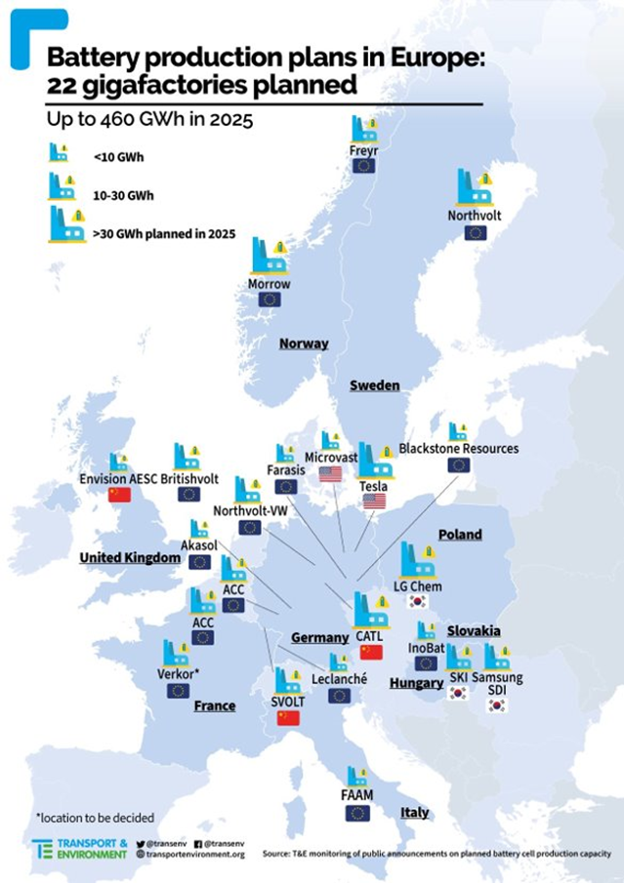
Battery storage: the potential is in smart charging
of vehicles
Behind-the-meter storage
Only 7% of home solar PV systems are equipped with a battery
Source: Solar Power Europe

Slide 10
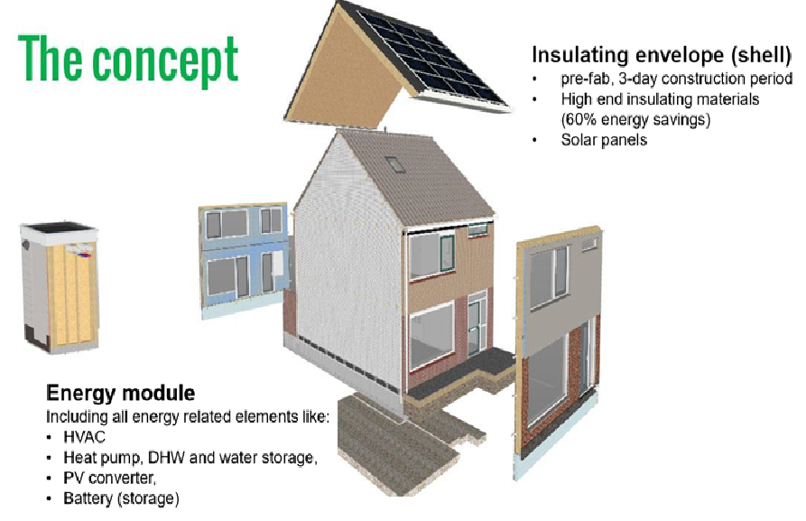
Energy neutral houses
Nul op de meter (‘zero on the meter’) is a Dutch national project initiated by the government to renovate already existing houses and apartments industrially so that they are energy neutral.
It is a holistic systemic deep renovation concept using smart services resulting in energy-neutral housing by reducing energy consumption and maximizing the use of renewable energy.
The houses are made energy neutral with the use of a heat pump, PV-panels, an air ventilation system with heat recycling, plastic window frames with triple glazing and façade isolation of 30 cm thick.
Source: Stroomversnelling.nl

Slide 11
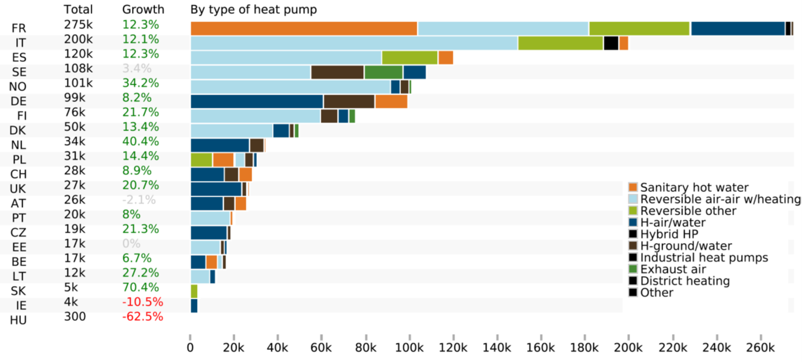
Heat pump sales

Slide 12




Innovation toolbox for ‘Smart Electrification Strategies’
Innovation Landscape 2 will focus on applying systemic innovation for a smart electrification of energy demand.
The objective is to disseminate innovative/ smart strategies to deploy innovations for as successful electrification with renewables.
                Smart Electrification for Transport
                Smart Production for Hydrogen and Derivatives
                Smart Electrification for Heating and Cooling
Renewable Electricity
Power-to-Hydrogen
Direct Electrification
Indirect Electrification
Power-to-Mobility
Power-to-Heat
Electric 2- and 3-wheelers
E-passenger cars
Light-duty commercial vehicles (LDCV)
Heavy-duty vehicles (HDV)
E-City-Buses
District Heating and Cooling
Individual heating and cooling
High temp. heating (industry)

Slide 13
Example: district heating and greening the gas system Denmark
In Europe, district heating systems account for ~100 MtCO₂ today
  Roughly half of these emissions still come from coal
  A targeted EU-wide plan to finance carbon neutral DH?
In Denmark, use of renewable energy in DH has grown from a share of 34.4 % in 2005 to 58.9 % in 2017
  Shift to biomass, geothermal and solar heat
  31 000 km district heating serving 65% of the population
  Increasing attention for innovation (e.g. solar systems with seasonal storage)
Goal: replacement of all fossil fuels by 2050
Rapidly rising shares of green gas
20% green gas (biomethane) in 2020
Emerging large players and consolidation on the biomethane production side
Price 78 EUR/MWh, half subsidy
13

