Slide 1
Offshore Renewables
Fostering a Blue Economy
Dolf Gielen
Director Innovation and Technology
G20 ETWG
26 April 2021

Slide 2
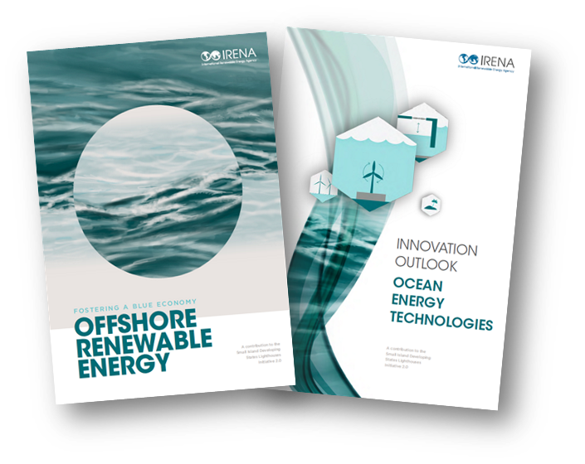
Offshore Renewables
What is meant by offshore renewables
Offshore wind – bottom fixed and floating
Floating PV
Marine technologies
Tidal range
Tidal stream
Wave technologies
Increasing attention for offshore hydrogen islands
Report for G20 Energy Ministerial Meeting
Support a G20 Action Agenda for global deployment of offshore renewables
Identify emerging innovations in technology, policy and business models to scale up offshore renewables
Timelines 2021:
May 10th to May 23rd – Review of DRAFT report by G20 WG
May 27th - G20 Side Event on Offshore Renewables
July 23rd - release of report at G20 Energy Ministerial Meeting

Slide 3
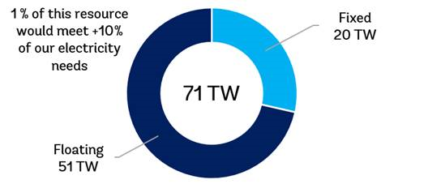
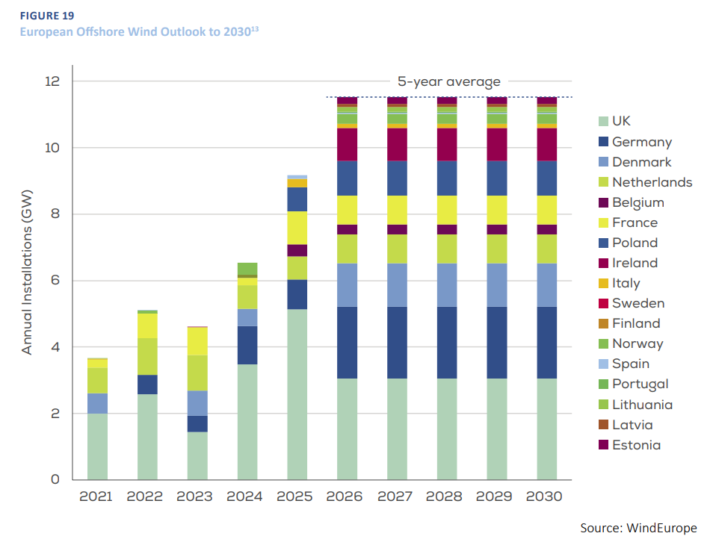
Offshore wind
34.4 GW installed end 2020, 6 GW added
Cost continue to fall
Developers pay for leases in UK
71 000 GW potential
Ten times todays global power generation capacity
IRENA World Energy Transitions 1.5C scenario: 2000 GW offshore wind by 2050, 7500 TWh production
Around 10% of total power generation in 2050
70% of the technical potential is in deeper waters suited to floating wind
So far around 30 MW floating wind installed, 13 announced projects in EU, Asia, US
Proven technology, high capacity factors
Cost need to be reduced further
5-30 GW floating wind by 2030, several 100 GW by 2050
Source: World Bank, 2021

Slide 4
Future wind energy costs drop significantly
Expected cost declines of 17%-35% by 2035 and 37%-49% by 2050
Source: IRENA, based on data from Lawrence Berkeley National Laboratory and DNV GL

Slide 5
Floating solar PV
Until the end of august 2020, a cumulative installed floating solar PV capacity was around 2.6 GW from active projects in more than 35 countries globally. The installed capacity has more than doubled since 2018 with 1.1 GW installed capacity.
Currently, 338 floating solar PV projects are installed in 35 countries and are mainly installed on freshwater artificial reservoirs. Top 10 projects are in China, Japan and the Republic of Korea. The largest plant globally is located in China with 150 MW.
The future demand for floating solar PV is expected to be driven by Asian countries. India plans a project of 1 GW, while the Republic of Korea plans one of 2.7 GW in the Yellow Sea. European countries are also aiming for several GW in coming years.

Slide 6
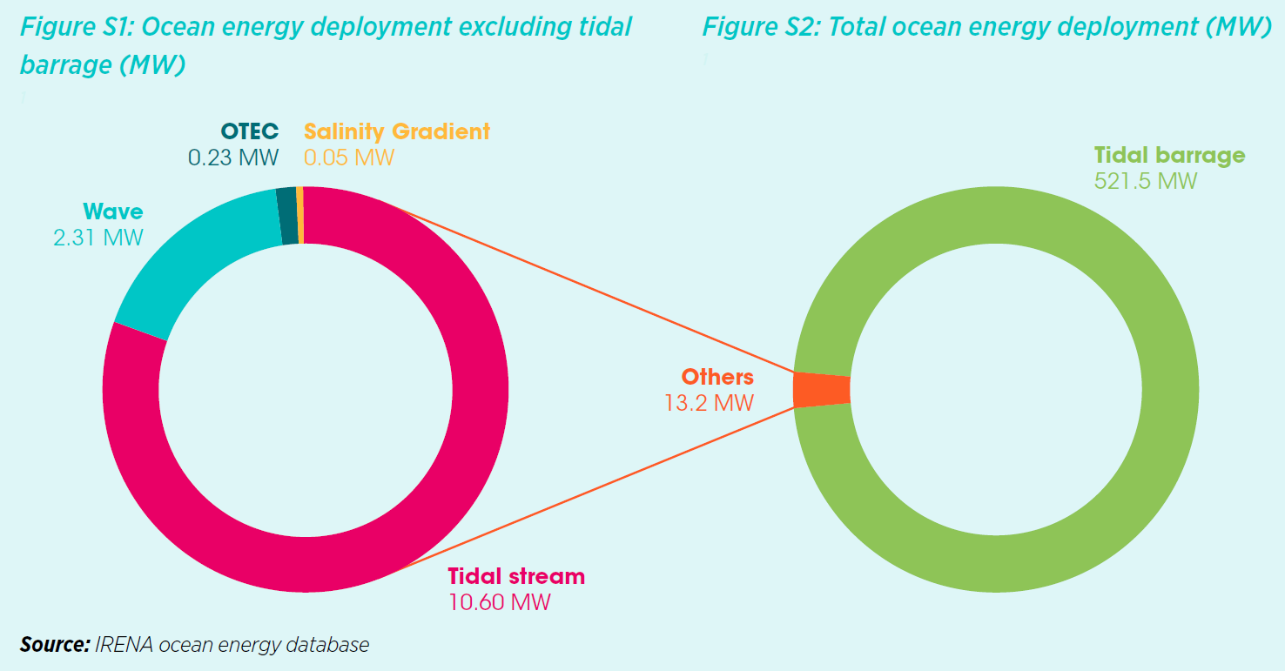
Status of ocean energy markets
Source: IRENA (2020), Innovation Outlook: Ocean Energy

Slide 7
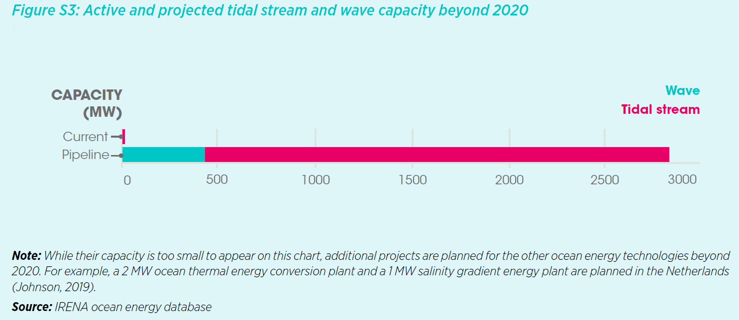
Outlook Ocean Energy markets
Current pipeline of projects
Market outlook (1.5ºC scenario)
2030 – 70 GW
2050 – 350 GW
Source: IRENA (2020), Innovation Outlook: Ocean Energy

Slide 8
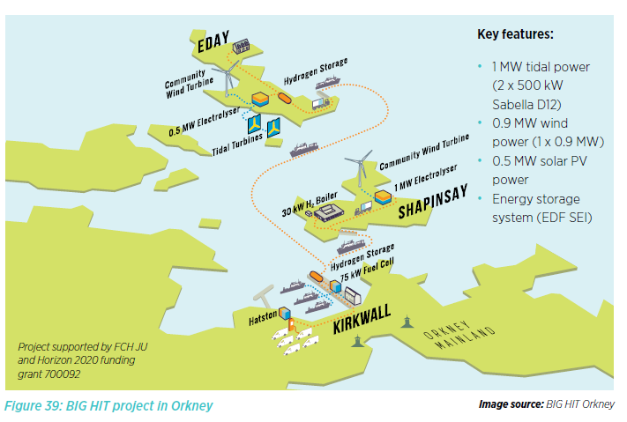
Example: Tidal energy + solar PV & wind for green hydrogen production (floating wind explored)
Source: IRENA (2020), Innovation Outlook: Ocean Energy Technologies
Notes:
Green hydrogen is used in Kirkwall for local mobility and for a fuel cell at Kirkwall harbour to provide auxiliary heat to a harbour building, as well as auxiliary power for up to three local ferries (cold ironing).
There are plans to introduce hydrogen ferries (HyDIME and HySEAS III projects) and in the future for hydrogen planes (HyFlyer) that will enable Orkney to use green hydrogen for decarbonising ‘hard to treat’ parts of the local
energy system.

Slide 9
Unlocking OE potential
Key Recommendations
Technology:
Technology convergence and standardization
Conduct resource assessment campaigns
Support test centres
Capital grant funding for R&D
Policy:
Premium price MWh
Promote innovative business models
Compensate additional services (regulation)
Innovative financial structures
Infrastructure:
Availability of Networks
Engage and inform the emerging supply chain
Synergies with other RE technologies – firm generation
Environmental and Social:
Improve access to baseline data
Consult and engage the public
Source: IRENA (2020), Innovation Outlook: Ocean Energy
Icons made by Freepik from www.flaticon.com

Slide 10
IRENA Collaborative Framework Ocean Energy & Offshore Renewables
In brief:
Collaborative Framework on Ocean Energy/Offshore Renewables covers:
Offshore and floating wind technology; ocean energy technologies; and Floating solar photovoltaic.
Co-facilitated by the Kingdom of Tonga and Italy
40 member countries engaged + industry associations
Suggested areas of work include exchange of good practices on: Marine spatial planning; Foster collaborative R&D programmes; Coupling of offshore renewables with power-to-X technologies; and Grid interconnection for offshore generation
Aim:
Agency to proactively function as a global network hub
Facilitate government peer-to-peer collaboration and exchange of knowledge

Slide 11
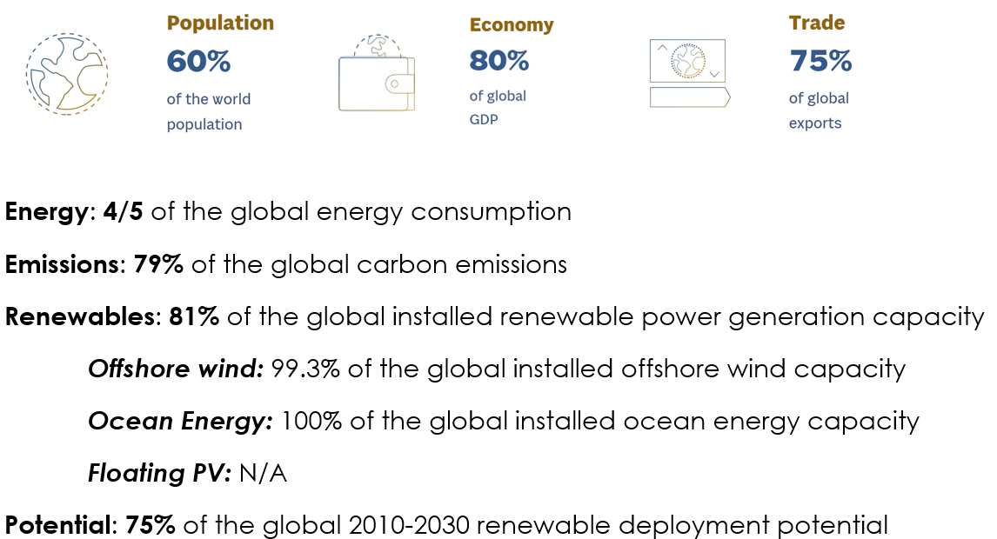
Recommendations for a G20 Offshore Renewables Action Agenda
Acknowledge the key role of offshore renewables at G20 ministerial level.
G20 to cooperate with IRENA’s Collaborative Framework to collect and disseminate key data on Offshore Renewables.
Promote G20 countries to include offshore renewables in national energy and climate policies - e.g. NDCs. and Recovery plans
Support increase public investments in RD&D for all offshore renewable technologies.
Design and implement joint RD&D projects at commercial scale
Promote public-private partnerships for innovative offshore renewables like offshore wind-to-hydrogen generation units.
Identify and promote innovative financing mechanisms for offshore renewable technologies within the “Finance Track” of the G20.
G20 strengths to push an Offshore RE Global Agenda

Slide 12
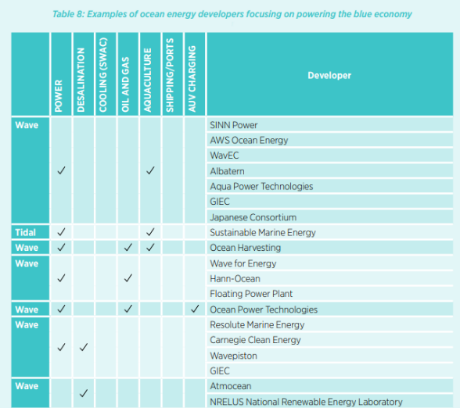
Examples
Source: IRENA (2020), Innovation Outlook: Ocean Energy Technologies

Slide 13
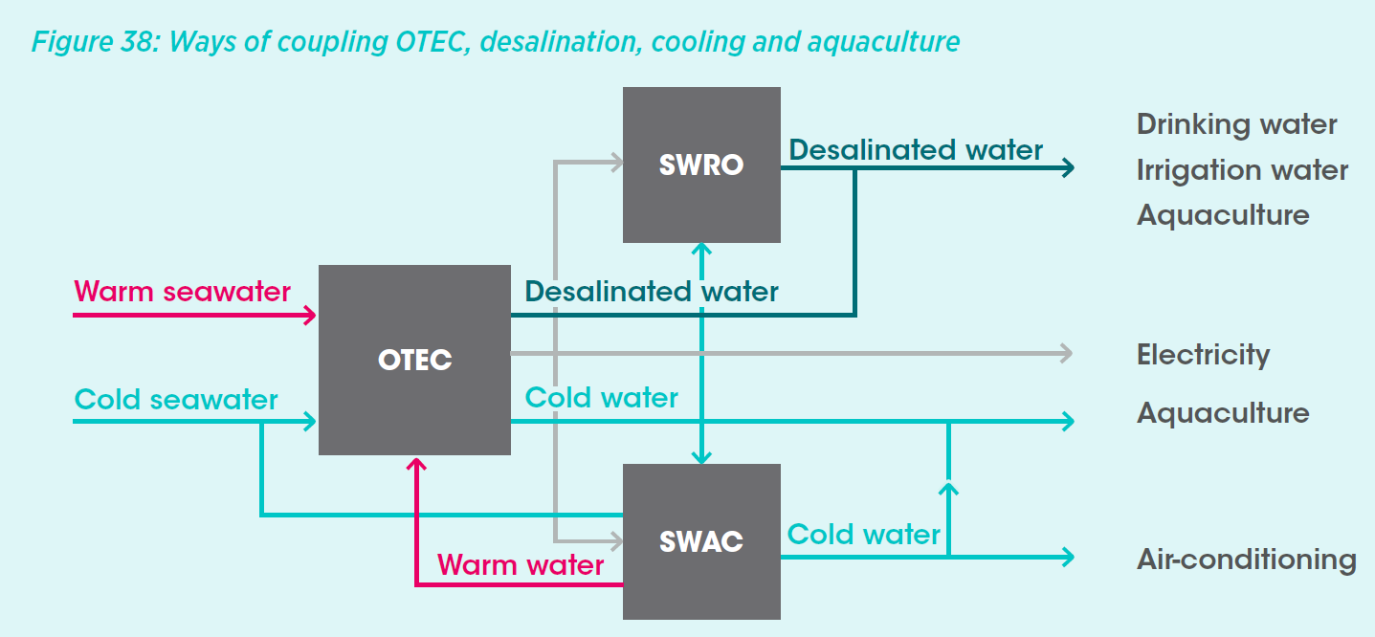
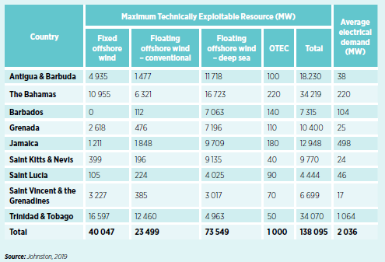
Example 1 - OTEC coupled with cooling and water desalination in islands
OTEC: electricity (kWh) + other revenues
OTEC technical potential in the Caribbean
Source: IRENA (2020), Innovation Outlook: Ocean Energy

Slide 14
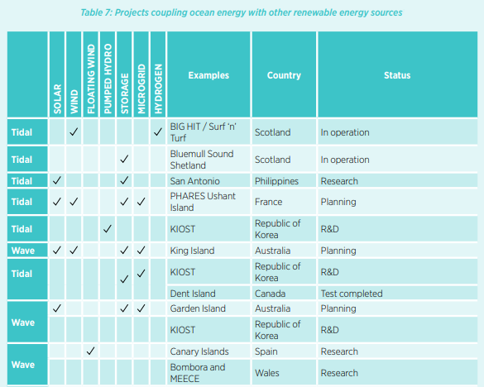
Innovative Business Model 2: Hybrid electricity generating systems
This matrix summarizes different hybrid systems that uses tidal and wave energy.
Source: IRENA (2020), Innovation Outlook: Ocean Energy Technologies

Slide 15
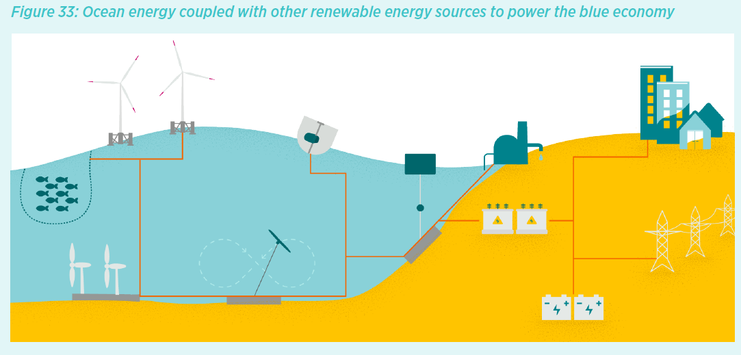
Innovative Business Model 1: Offshore renewables powering a Blue Economy
Cooling
Shipping
Aquaculture
Offshore O&G
Desalination
Source: IRENA (2020), Innovation Outlook: Ocean Energy Technologies

Slide 16
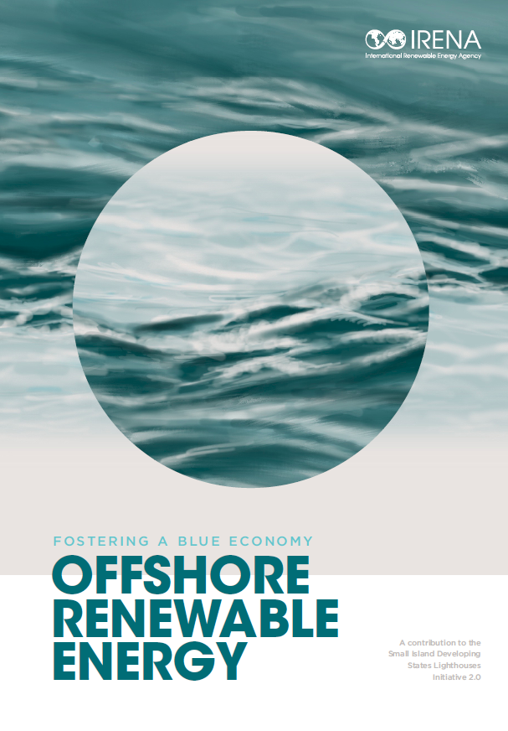
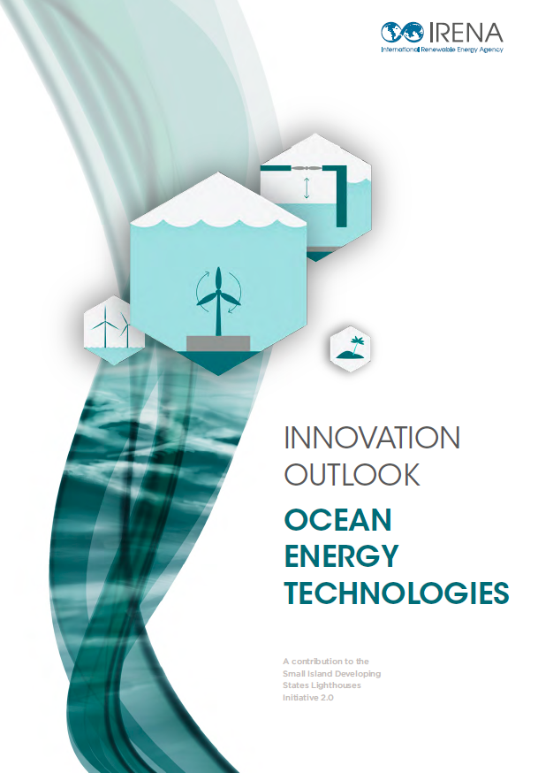
Thank you
^{www.irena.org}
^{www.instagram.com/irenaimages}
^{www.twitter.com/irena}
www.flickr.com/photos/irenaimages
^{www.facebook.com/irena.org}
^{www.youtube.com/user/irenaorg}

