Slide 1
Renewable Energy and Jobs
Presenters:
Michael Renner, Head Policy, Socioeconomics| Celia García-Baños, Policy, Socioeconomics and Gender
TUESDAY, 11 FEB 2025 • 2:00 pm – 2:30 pm CET

Slide 2
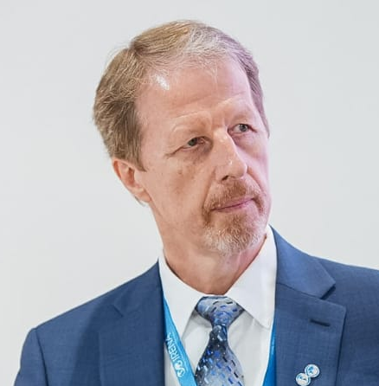

SPEAKERS
Michael Renner
IRENA
Celia García-Baños IRENA

Slide 3
Please make sure to mute yourself during the session to avoid background noise
If you have Questions to the speaker please use the Q&A
If you encounter any technical issues, please connect via phone or contact the Help Desk: 888.259.3826 or https://support.goto.com/webinar

Slide 4

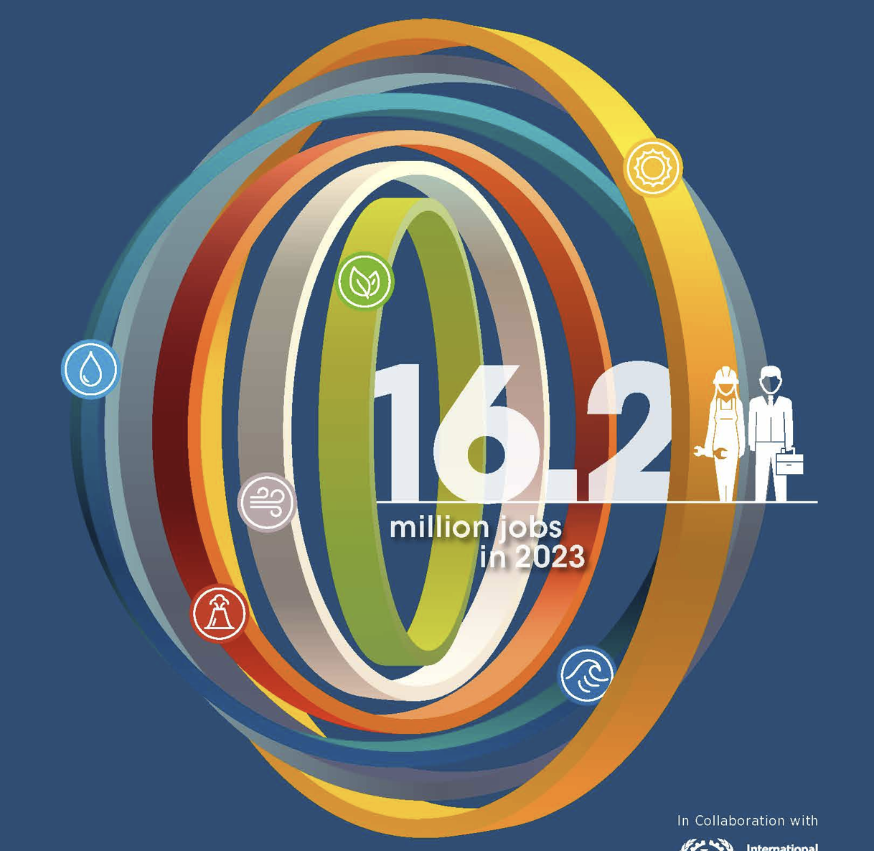

Renewable Energy and Jobs

Slide 5
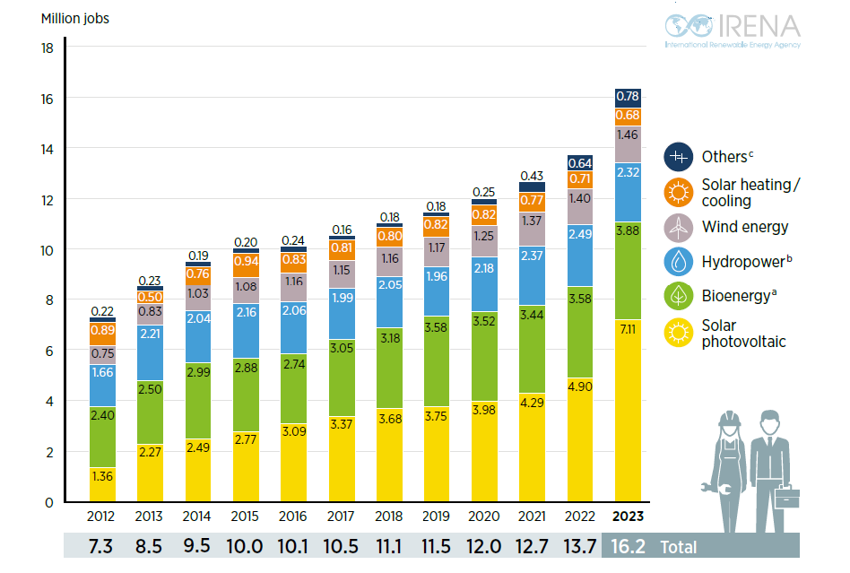
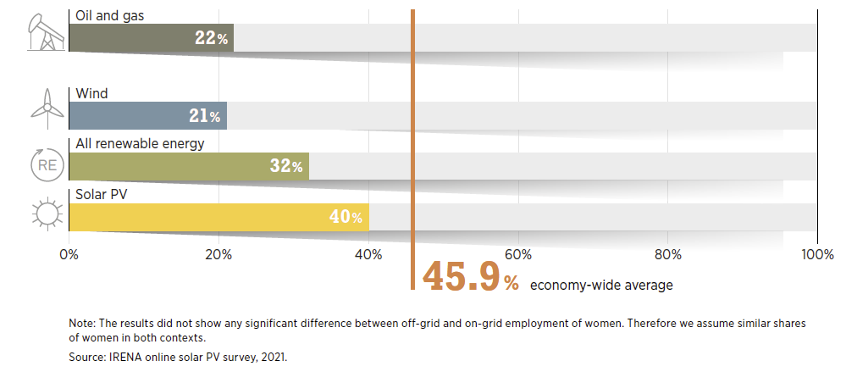
Jobs evolution across RE technologies over the years

Slide 6
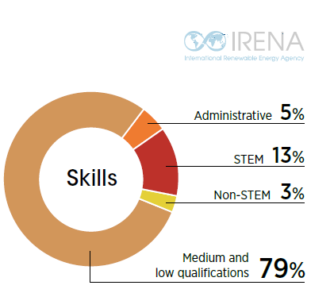
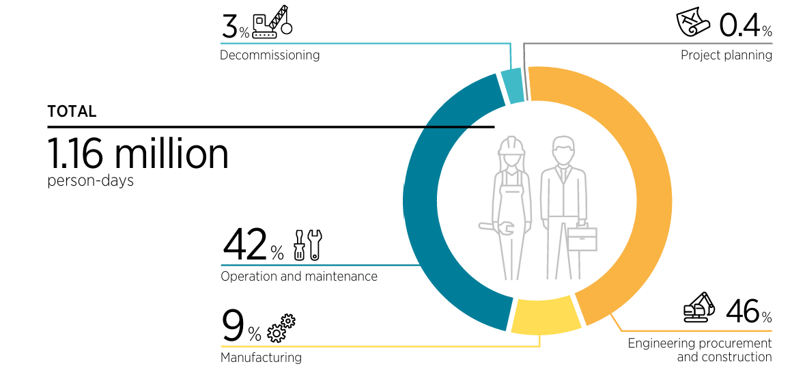

Untapped Technologies: CSP – Key to Storage and Jobs
Distribution of labour and skills required along the value chain for the development of a 100 MW + 10-hour TES CSP plant

Slide 7
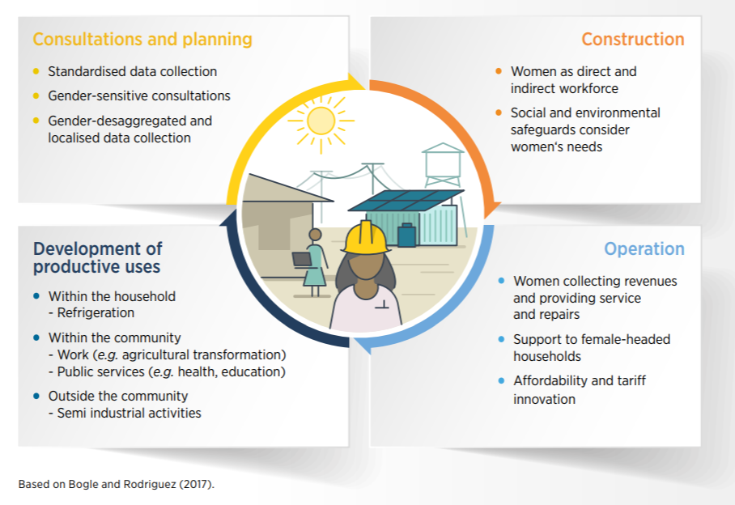
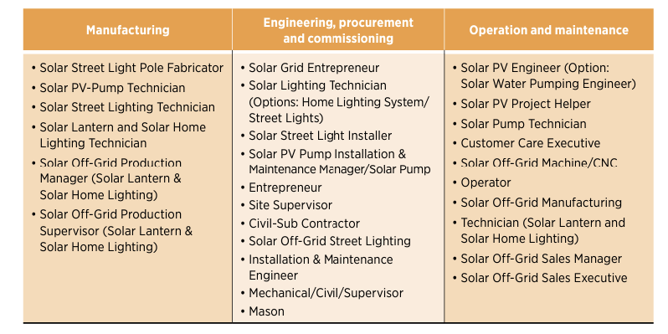

Decentralised renewables: empowering women

Slide 8
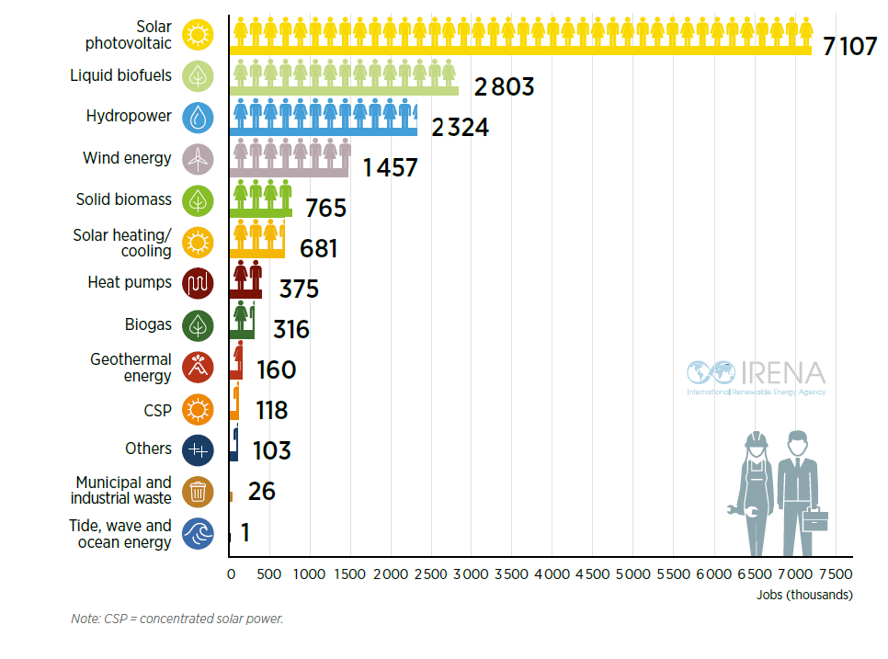
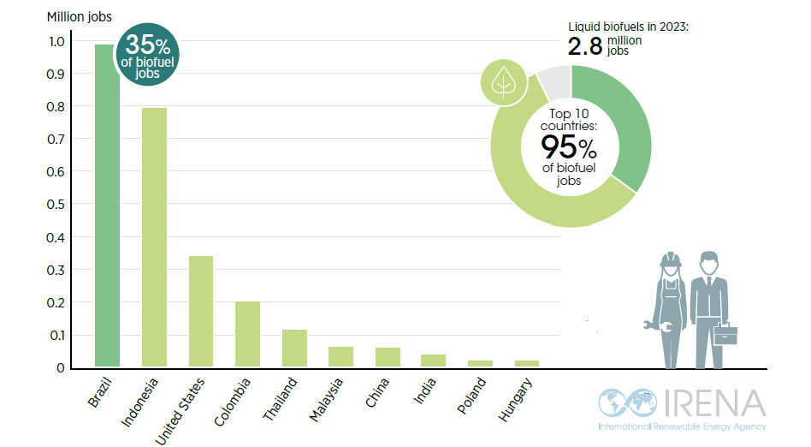
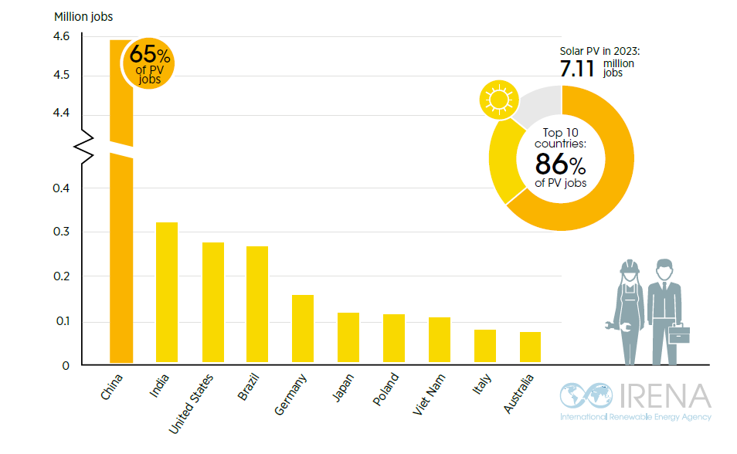
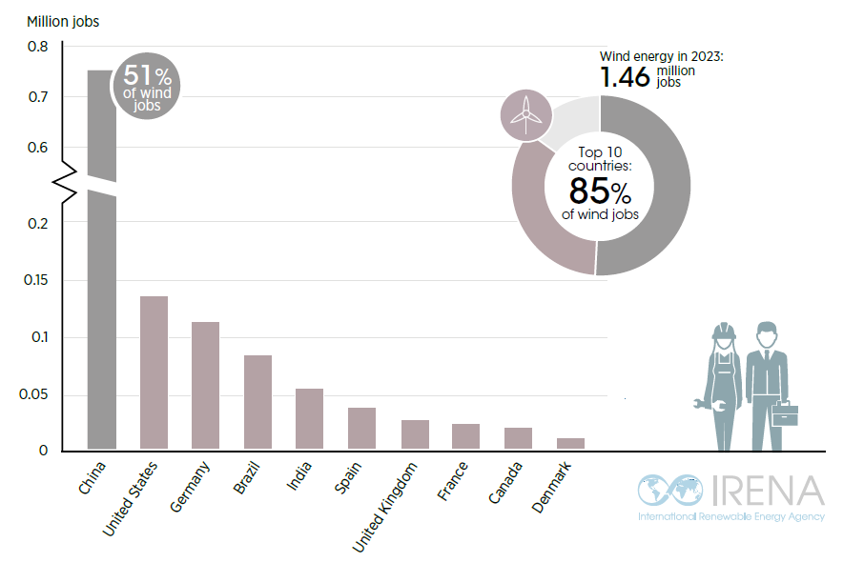
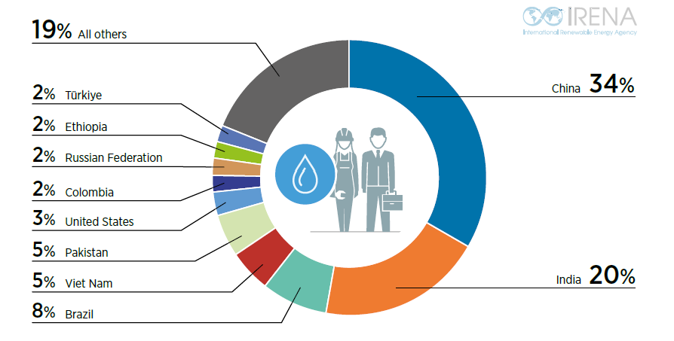
Distribution across technologies and top employers

Slide 9
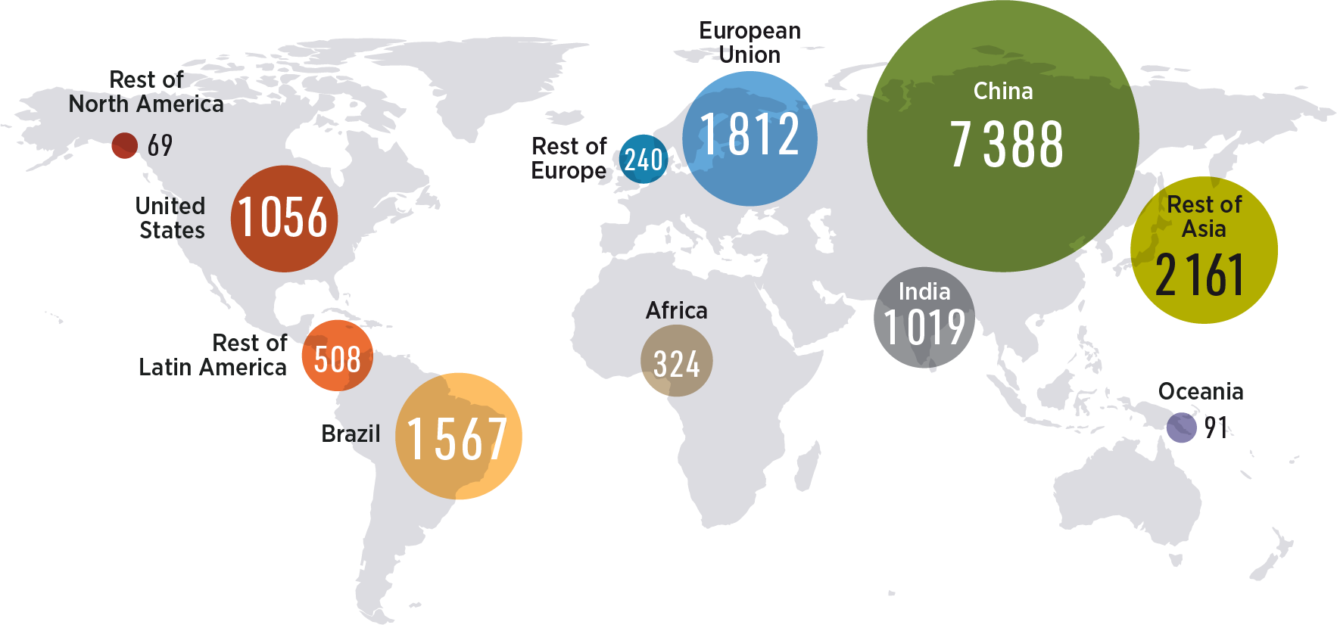
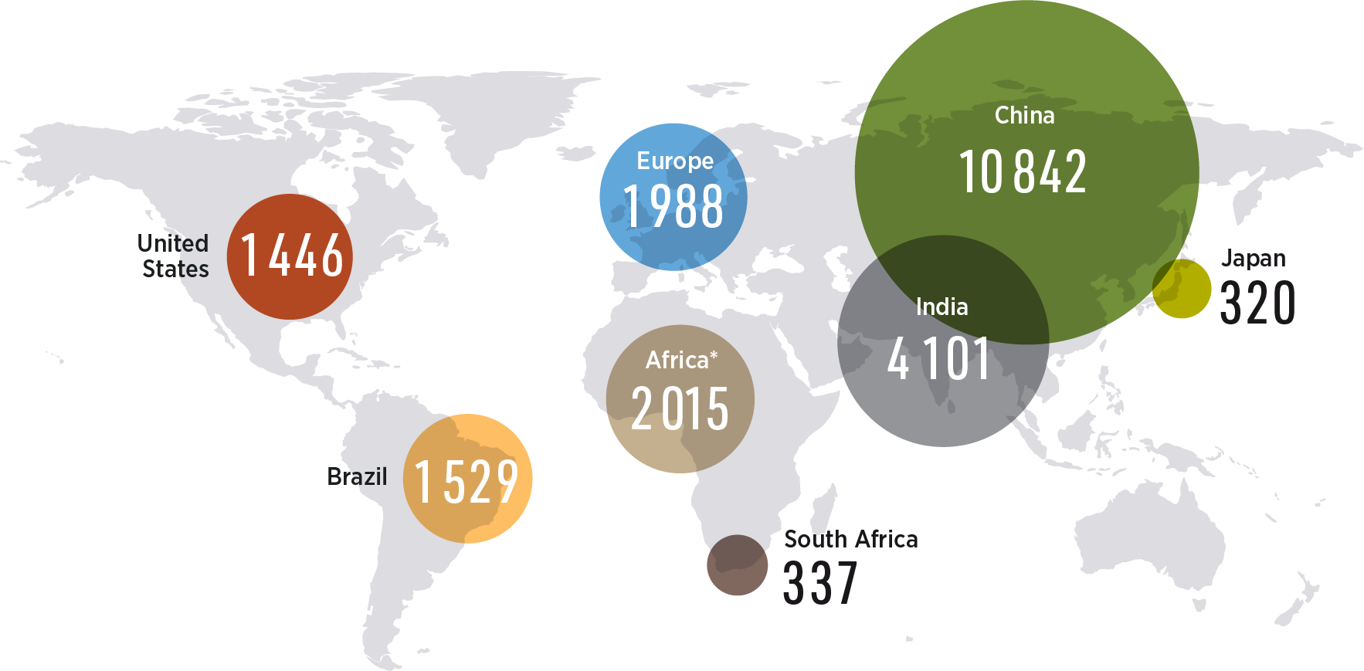

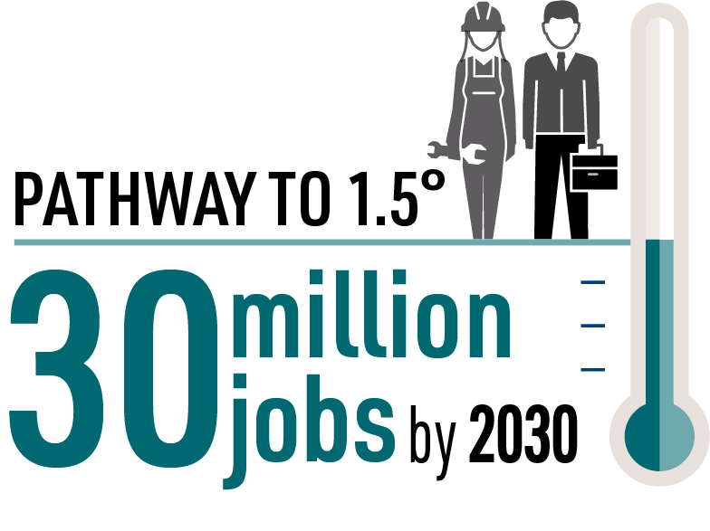

Pathway to 1.5°C, potential for jobs across all the world
Jobs in 2023 (in thousands)
Expected jobs under the 1.5°C scenario in 2030
(in thousands)

Slide 10
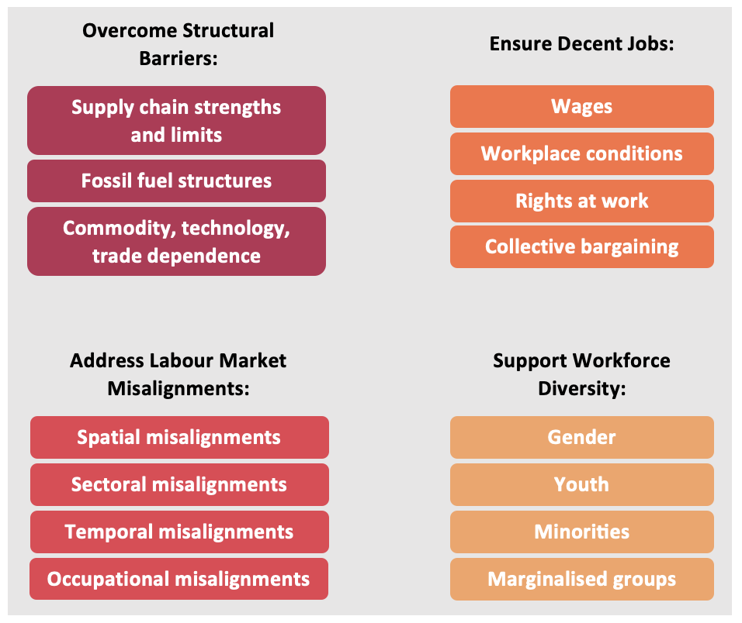
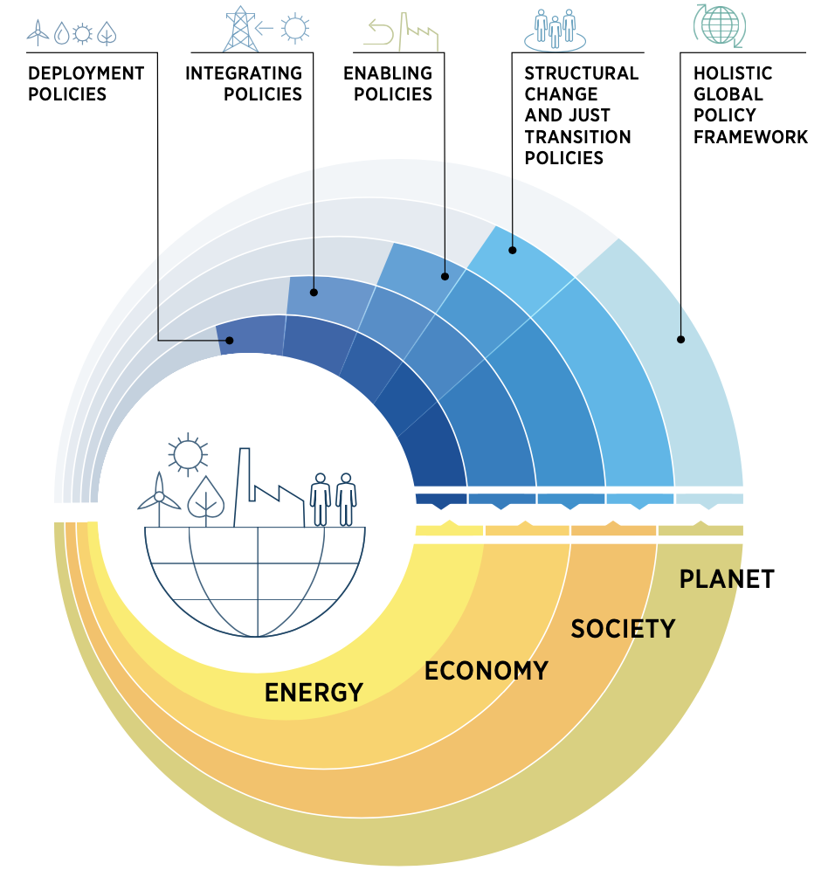
Challenges to address

Slide 11
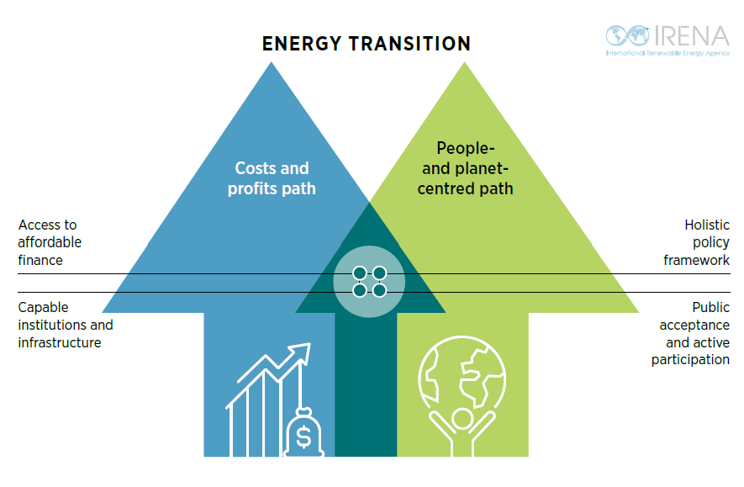
Pathways: Costs and profits vs people and planet centred

Slide 12
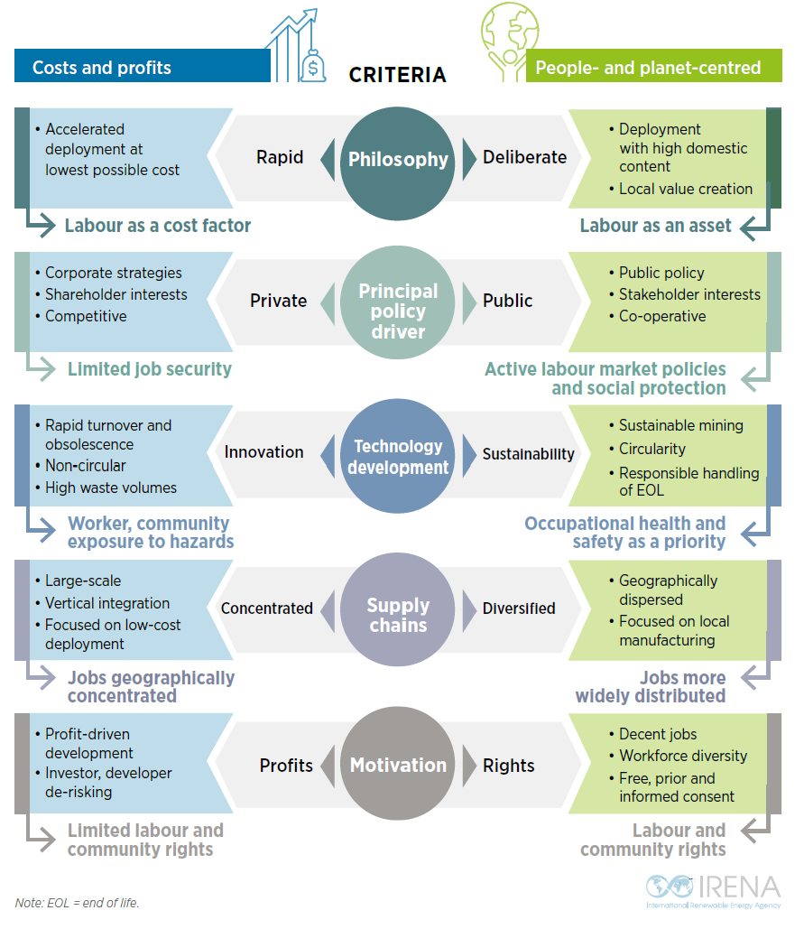
Pathways: Costs and profits vs people- and planet- centred

Slide 13
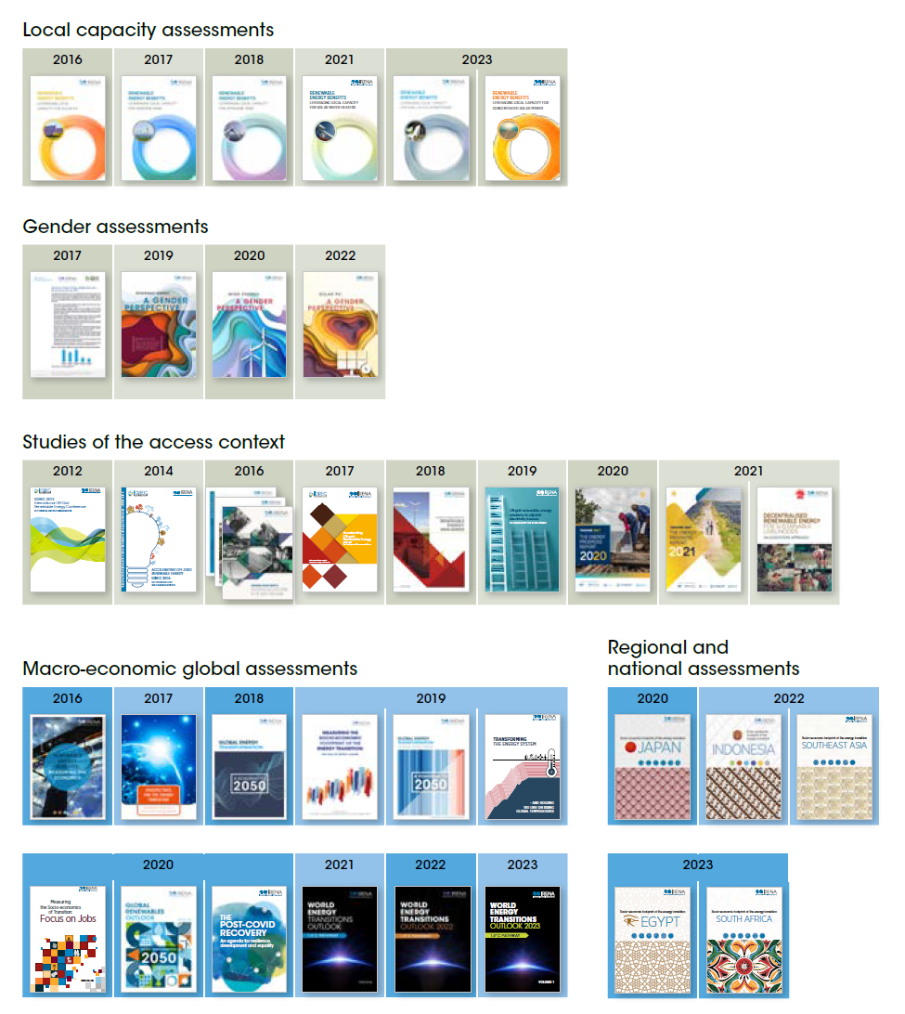
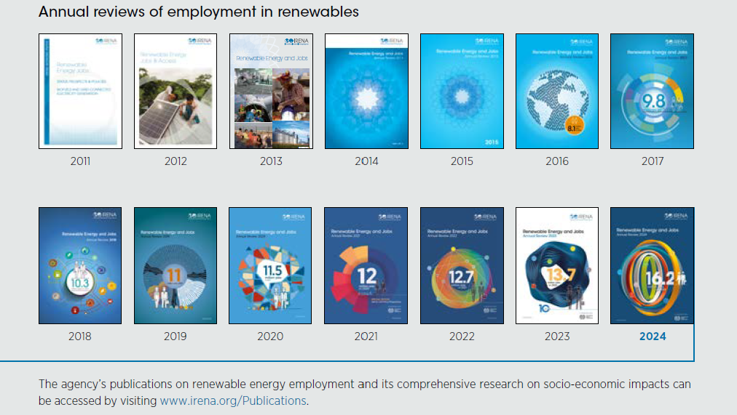


IRENA’s socioeconomic work presented today
2024
2024

Slide 14
Q & A
10 min

Slide 15
THANK YOU FOR JOINING US!
SEE YOU IN OUR NEXT WEBINARS
www.irena.org/events/2020/Jun/IRENA-Insights

