Slide 1

Renewable Energy:
A Gender Perspective
Rabia Ferroukhi
Director- Knowledge, Policy and Finance Centre
Celia García-Baños
Associate Programme Officer, Knowledge Policy and Finance Centre

Slide 2




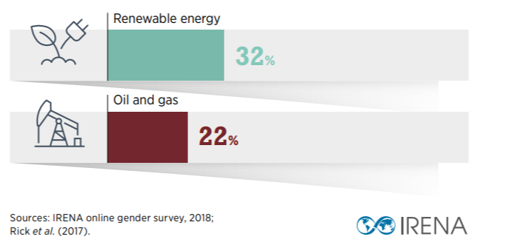

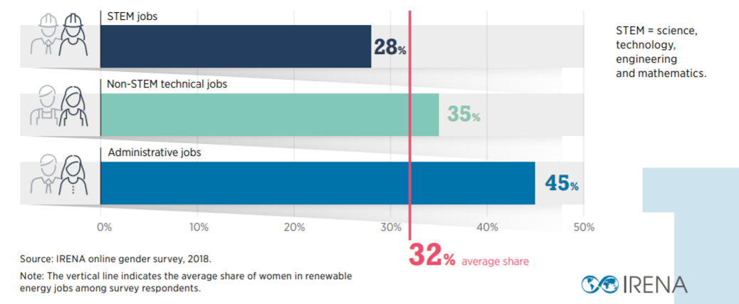
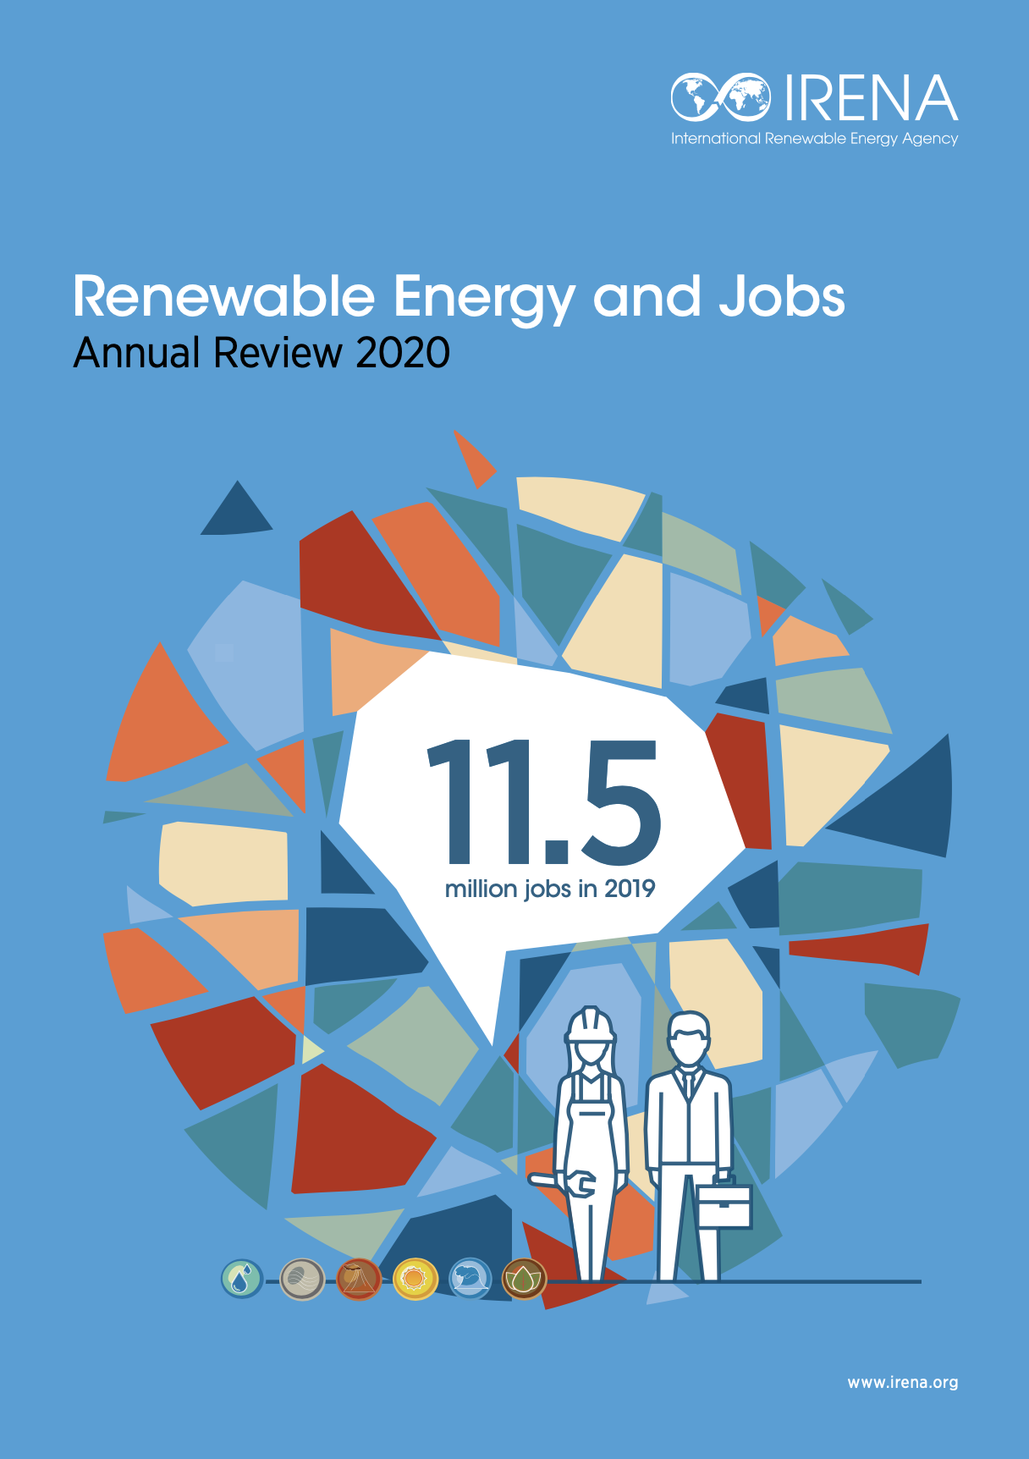
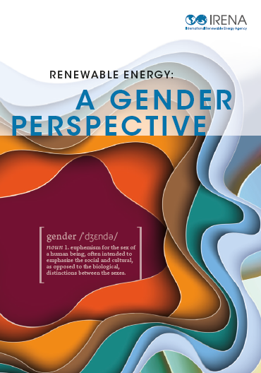

Renewable Energy Jobs: A Gender Perspective
43 million
jobs in 2050
11.5 million
jobs in 2019
32% in RE
21% in wind

Slide 3
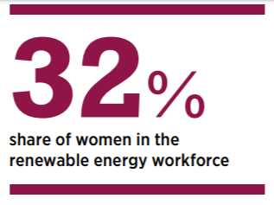
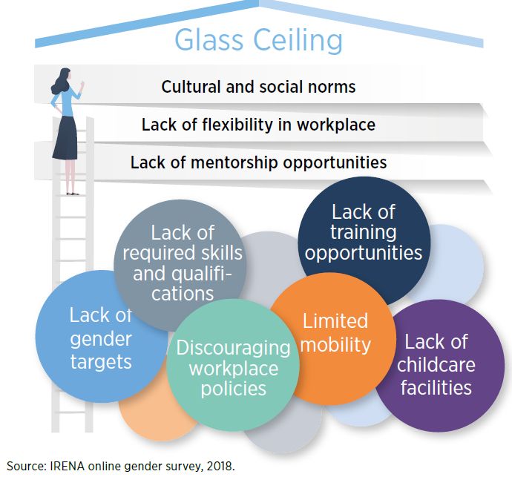
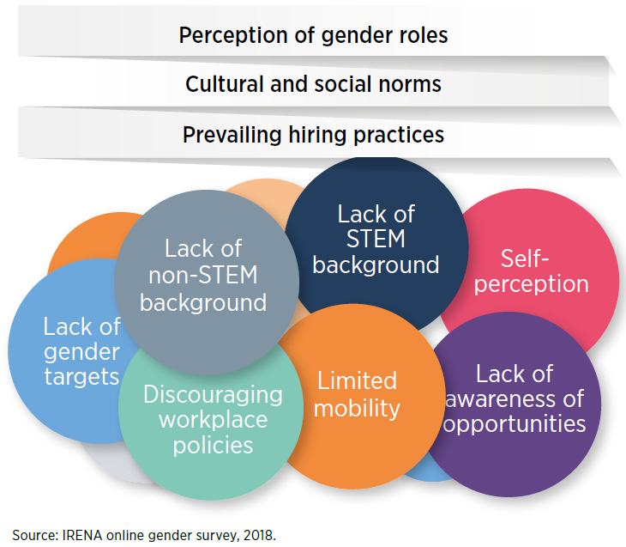
Modern RE Context: Barriers to Entry, Retention and Advancement
Barriers to entry
Barriers to retention and advancement

Slide 4
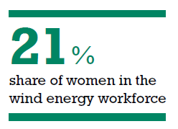
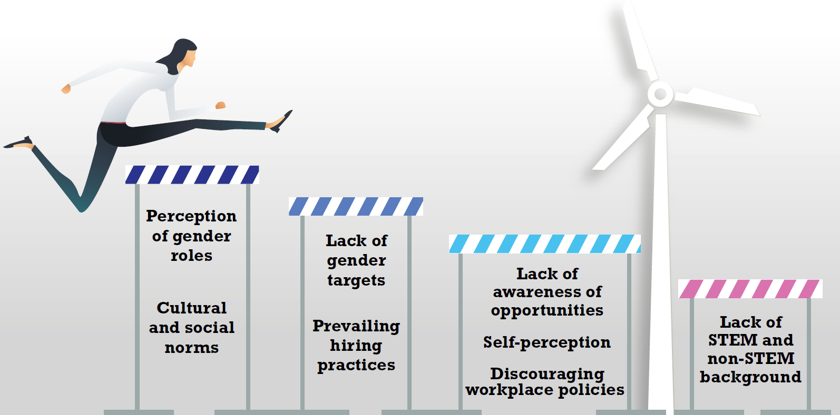
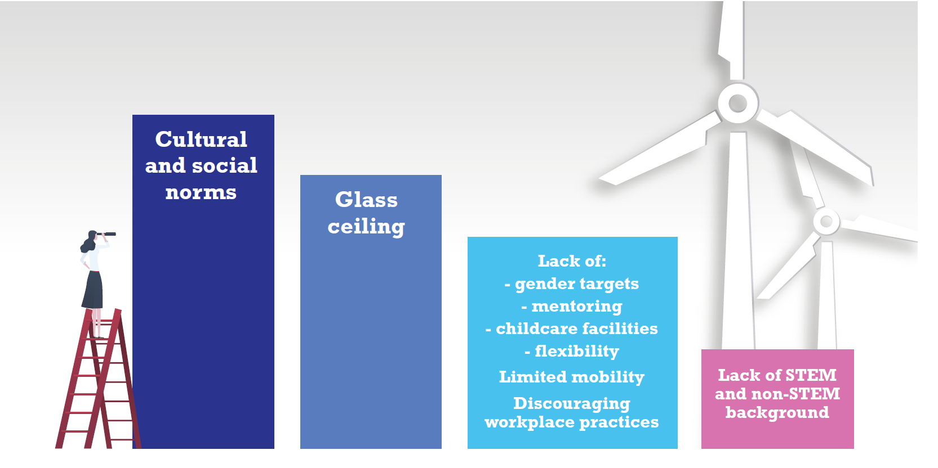
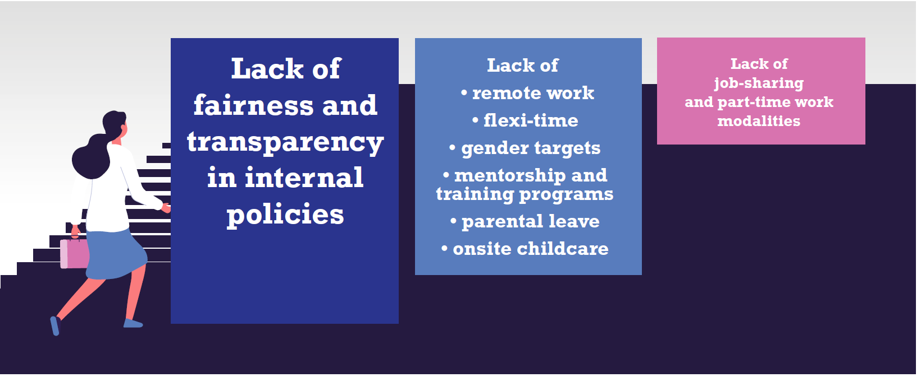
Wind Energy Context: Barriers to Entry, Retention and Advancement
Barriers to entry
Barriers to advancement
Barriers retention
www.irena.org/solargendersurvey
NEW SURVEY- Solar PV

Slide 5
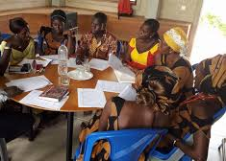
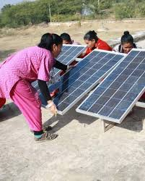
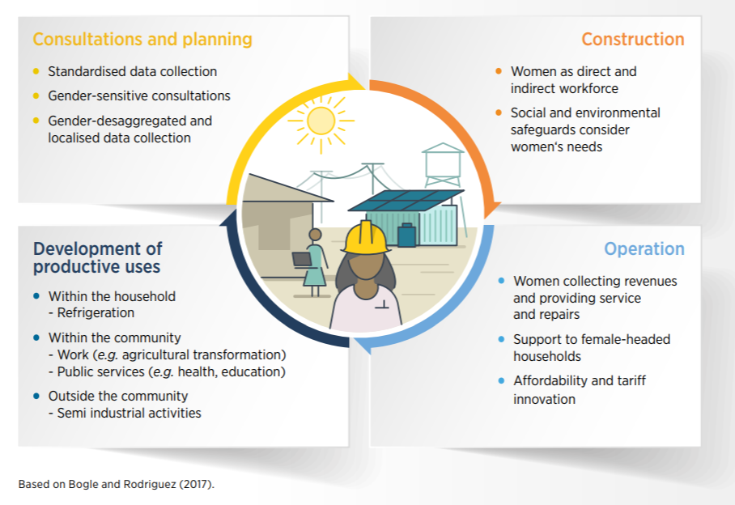
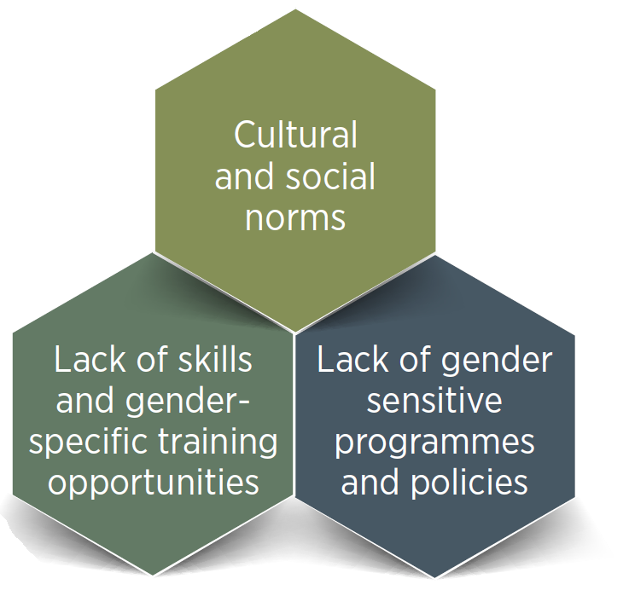
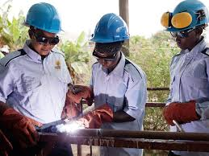
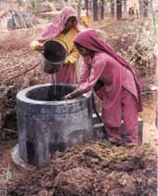
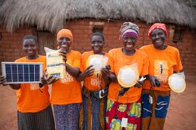
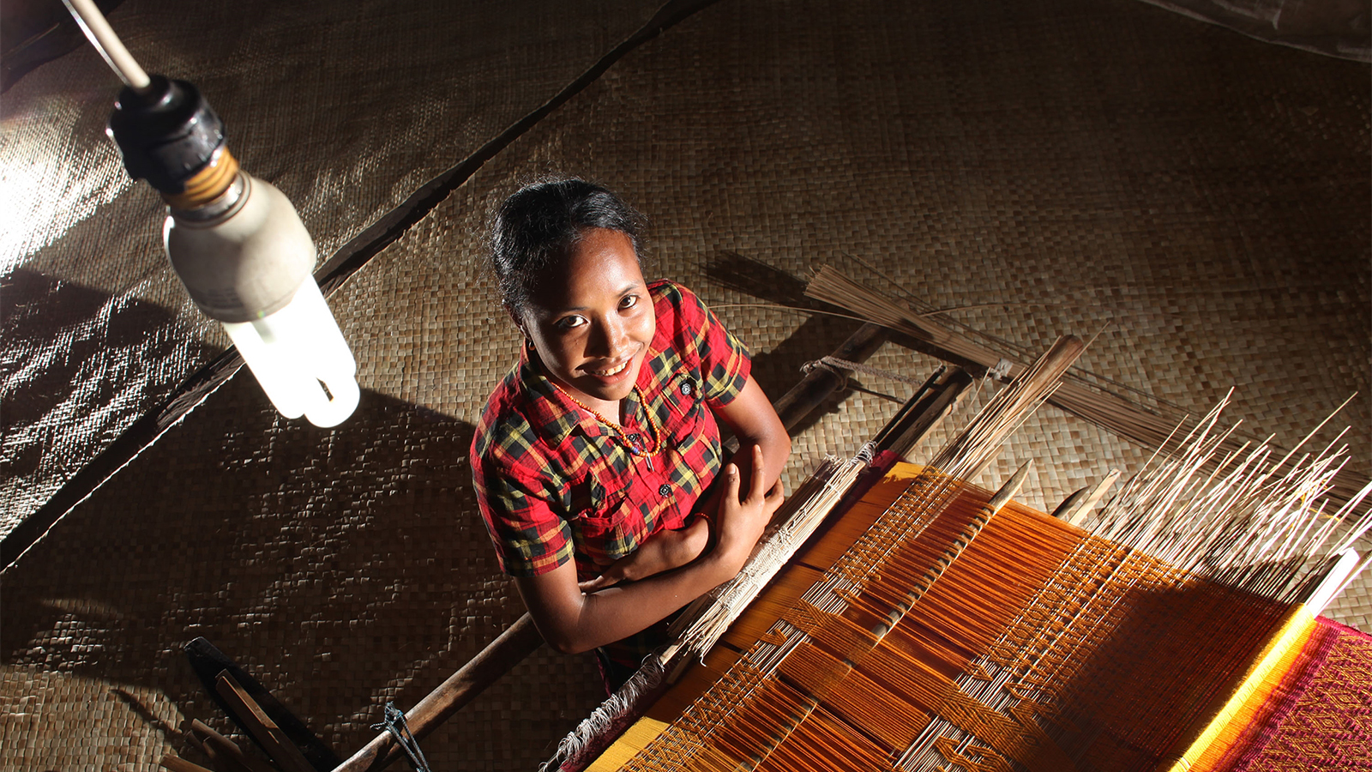
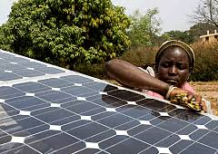
Access Context: Barriers and Opportunities Along the Value Chain

Slide 6
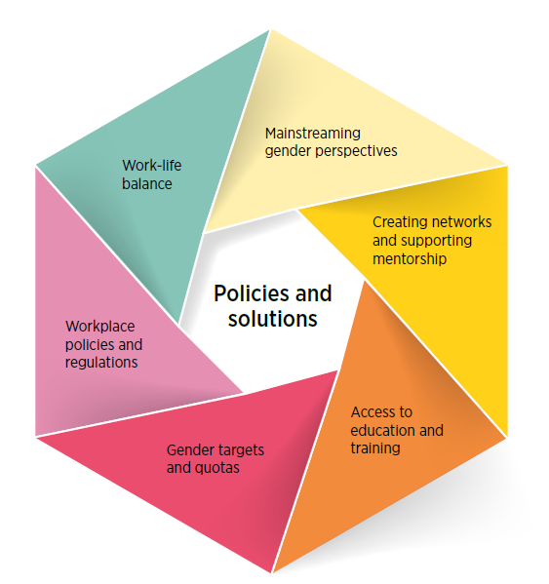
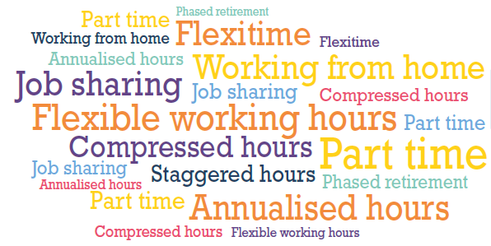

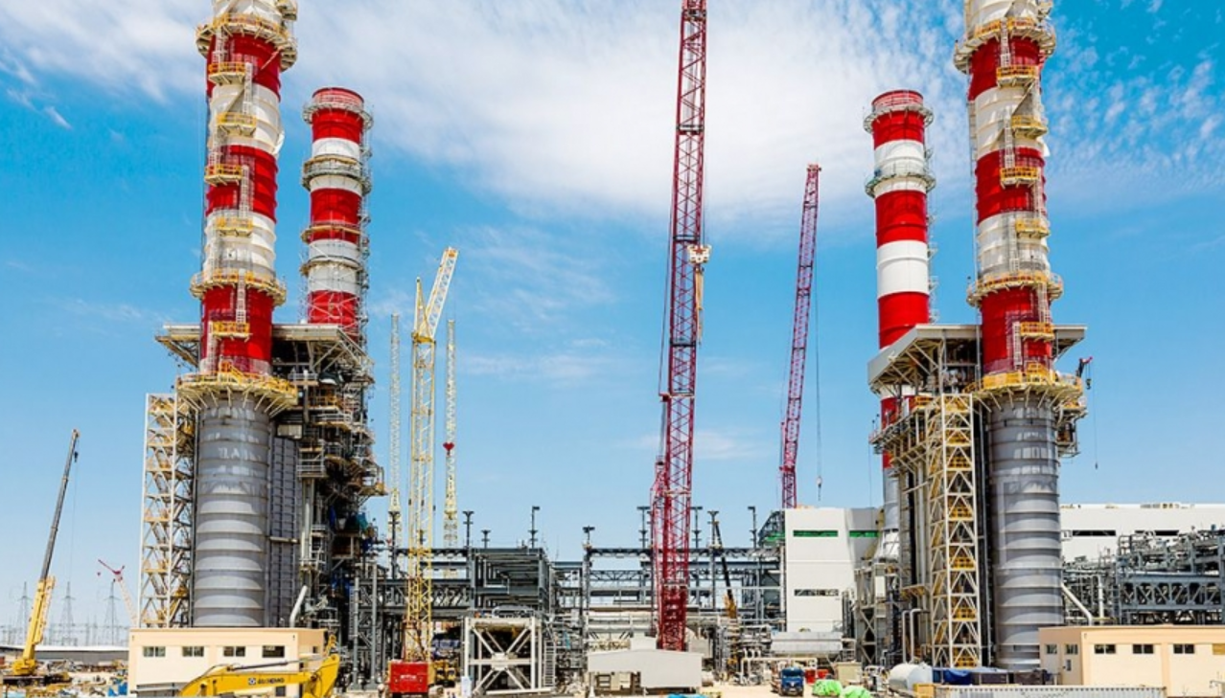















Policies and solutions to increase women’s participation in the sector
Part-time employment, flexi-time and job-sharing
Paid parental leave
Gender audit
Training in gender awareness
Fair and transparent internal processes (appraisal and promotion)
Mentorship programmes
Understand and addressing wage gaps
Awareness of opportunities
Mentorship programmes
Publishing training opportunities
apprenticeships
“30-by-30” programme Engineers Canada
Goals for gender
diversity and equity
Encourage gender through deployment policies (e.g. auctions)
University curricula
Scholarships, internships and enrolment targets
Vocational training

Slide 7


The way forward: Engendering the global energy transition
Advancing equality and diversity in the energy sector is a compelling proposition. Establishing gender as a pillar of energy strategies will produce a swifter and more-inclusive transition while accelerating the attainment of multiple
Sustainable Development Goals

Slide 8

Gender@irena.org

