Slide 1
Energy Planning and Implementation: Energy Scenario Planning Tool Overview
07 February 2017

Slide 2
Topics:
Importance of Planning Tools
Benefits and Applications
Initial Feedback Conversation
Tool Overview, Principles, and Concepts
LCOE Model Review
Wrap-up and Feedback

Slide 3
Importance of Planning Tools
Benefits of planning tools:
Provide key decision information about impacts of various technologies, overall system costs and renewable penetration levels
Allows stakeholders to understand the long-term impacts of investment choices
Allows for comparative analysis between scenarios on various components such as cost and renewable penetration levels
Benefits of using in-house planning tools:
Allows the user to create as many scenarios as needed and modify at any time when new or modified data becomes available
Users have access to the tool at any time, when updates are needed or to showcase scenarios to stakeholders

Slide 4
Benefits and Applications of the Scenario Tool
Benefits:
Automatically pulls in supply resource, financial cost data, and capacity factors
Easily exportable data inputs and outputs with one-click
Applications of the Tool:
Integrated Resource Planning
  Supplements the IRP Toolkit
  Tool provides data for: forecasting demand, energy generation, energy sources, renewable goal targets, etc.
Renewable Energy Integration
Energy Cost and Investment Analysis

Slide 5
Initial Feedback Discussion
Questions to Consider:
What is your function (utility, regulator, investor, etc.)?
What types of analyses are you currently working on (scenario analysis, load forecasting, feasibility studies, etc.)?
What types of analyses are you planning for in the future?
What renewable energy challenges do you face?
What challenges do you have in the IRP process?
Notes:
Purpose: Pulse the audience for input to tailor the training to their interests/needs
Can be structured as an interactive “ice breaker” – get people up and moving

Slide 6
Introduction
DOE’s EERE and various island utilities worked together to build the Scenario Tool and Levelized Cost of Energy (LCOE) Model
  Scenario Tool allows for the creating and analysis of generation scenarios in multiple locations
  LCOE Model can be used to supplement the Scenario Tool. It calculates a simple levelized cost for renewable energy solutions to the grid by technology for each island in Hawaii, the Caribbean, and the Pacific
Target Audience: island utilities, energy ministries, others with responsibilities for planning
Purpose of the session: To provide an appropriate background on the functionality of the Scenario Tool and LCOE model and its applications for future generation planning
Working with the Tool: A practical exercise working with the Scenario Tool is planned for Thursday

Slide 7
Scenario Tool Overview
High-Level Overview:
The Scenario Tool allows the user to model a generation scenario for up to a user-specified number of years, including various locations (i.e., islands) and designating amounts of current renewable and non-renewable generation and goals for renewable energy and energy efficiency targets for the future
Basic Inputs and Outputs
Inputs: scenario and locations, current demand (MWh), maximum resource potential by location (MW), renewable energy projects (resource, year online, capacity in MW, by project), total non-renewable generation capacity (MW or Mbtu), distribution among non-renewable energy types (%)
Outputs: Energy Targets (clean and RPS) met or not met, energy costs and investments, electricity demand and supply, supply and distribution by energy resource, energy efficiency outputs, financial details by energy source

Slide 8
Scenario Tool Principles and Concepts
Clean / Renewable Energy Targets: Clean energy targets include renewable generation and avoided demand due to energy efficiency. Renewable Portfolio Standard targets include renewable generation
Shared Resources: Shared resources can be used to model generation that is used by multiple grids, such as when a cable is used between islands. Assumption: Resources can be shared among location (up to 3)
Demand: Total demand is the sum of projected electricity demand and additional demand from electric vehicle consumption (optional), less avoided demand due to energy efficiency. Assumption: Energy efficiency is modeled as avoided demand
Non-Renewable Generation: Non-renewable generation can also be used to meet demand. The tool calculates the difference between annual demand and supply met by renewable generation projects to determine the generation required by non-renewable sources.
Energy Investments: planned renewable energy investments, energy efficiency, grid upgrade investments
Other Energy Costs: Existing renewable energy project costs, non-renewable energy costs
Levelized Cost of Energy: Generation cost per kWh
Note: The tool is not meant to provide absolute values or make any predictions about
the absolute costs of technologies; rather it provides value for comparative analysis
between scenarios

Slide 9
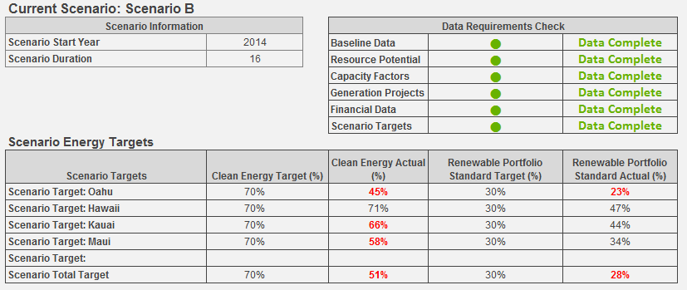
Outputs of the Tool – Dashboard
Data Check, Energy Targets

Slide 10
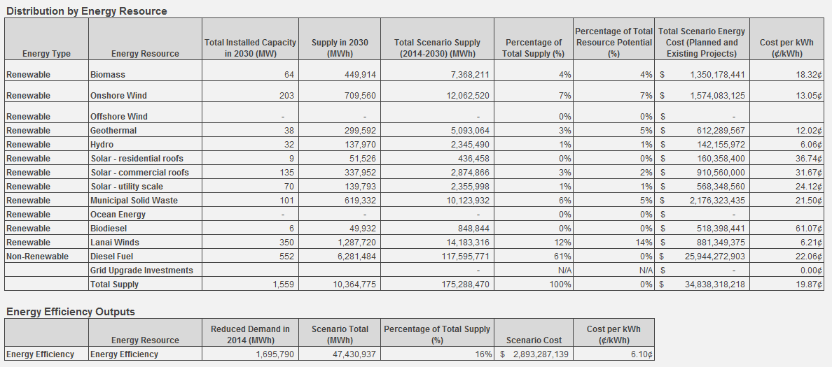
Outputs of the Tool – Dashboard
Energy Distribution by Energy Source & Energy Efficiency Impacts

Slide 11
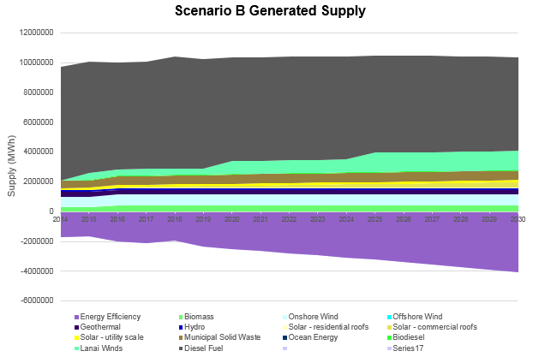
Outputs of the Tool – Dashboard
Generated Supply by Energy Source

Slide 12
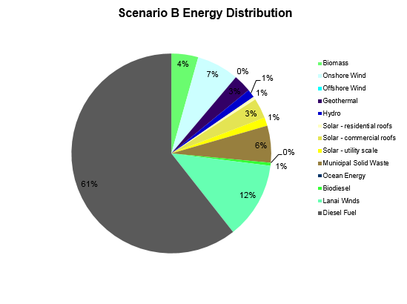
Outputs of the Tool – Dashboard
Energy Distribution Chart

Slide 13
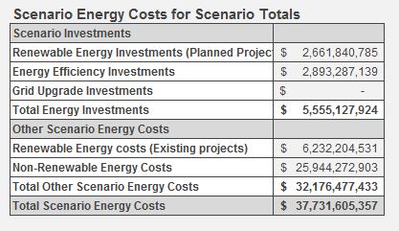
Outputs of the Tool – Dashboard
Scenario Energy Costs and Investments

Slide 14
Levelized Cost of Energy (LCOE) Model Review
The LCOE Model can be used to supplement the Scenario Tool
LCOE is calculated on the basis of a mock renewable installation and analyzing the costs per unit of energy produced
The model calculates the cost of delivering renewable energy to the grid (installation and maintenance)
Aggregates capital cost and capacity factor data by technology for each island in Hawaii, the Caribbean, and the Pacific
The optimal use of LCOE calculations is to compare differences in cost between technologies
LCOE should not be used for project level decisions as it does not include cost considerations like taxes/subsidies or the effects of depreciation

Slide 15
LCOE Data Points (included in back-end)
Data Point | Methodology | Data Selected
Capital Expenditure Cost | Installed MW capacity capex costs calculated for estimated year of RE project install using historical, reported or estimated timeline data (includes construction costs) | Varies by technology and island/region
Operation & Maintenance Cost | Operations and maintenance costs applied using percentages calculated by taking the median from several reputable sources | Varies by technology
Variable Costs | Variable costs applied using percentages calculated by taking the median from several reputable sources | Varies by technology
Capacity Factor | Factor applied to generating capacity of each technology | Varies by technology and island/region
Lifetime | Useful life periods applied to all RE technology projects to enable calculation of replacement cost | Varies by technology
Loan Tenor | Loan lengths for Solar and Wind projects projected at 20 years using bonds matched to PPA. | Varies by technology
Debt/Equity Financing | Capex costs for RE projects used to calculate detailed finance costs including application of debt/equity ratio | Varies by technology
Import Tariff | Tariff applied to equipment imports; applies only to the Caribbean | Varies by technology
Equipment Percentage of Cost | Portion of the capital cost that covers equipment costs; used for calculating import tariff | Varies by technology
Interest Rates | Interest rates applied for debt portion of financing throughout loan term (7%) | 7%
Cost of Equity | Cost of equity applied (10%) | 10%
General Assumption | Constant dollars (i.e., 2015 dollars) for all cost components – discounting and inflation not appropriate; no assumptions made about future price changes or effectiveness in RE technologies; no impact from subsidies or taxes; no estimate for cost of land, permitting, or other development costs | 2015 dollars

Slide 16
LCOE Technologies, Regions, and Islands
Technologies:
Geothermal
Biomass
Solar: Residential, Commercial, Utility
Wind: Small, Onshore, Offshore
Hydro: Small, Large
Municipal Solid Waste
Regions:
Hawaii
Caribbean
Pacific
Hawaiian Islands:
Hawaii
Maui
Lanai
Molokai
Oahu
Kauai
Caribbean Islands:
St. Lucia
Bahamas
Turks & Caicos
Grenada
Puerto Rico
USVI
BVI
Aruba
San Andres
Dominica
St. Kitts & Nevis
Belize
Pacific Islands:
American Samoa
Guam
Commonwealth of Northern Mariana
Federated States of Micronesia
Marshall Islands
Palau

Slide 17

LCOE User Inputs
User selects:
Region: Hawaii, Caribbean, or Pacific
Island: Name
Data Source: Region-specific, Island-specific, EIA, NREL, etc.

Slide 18
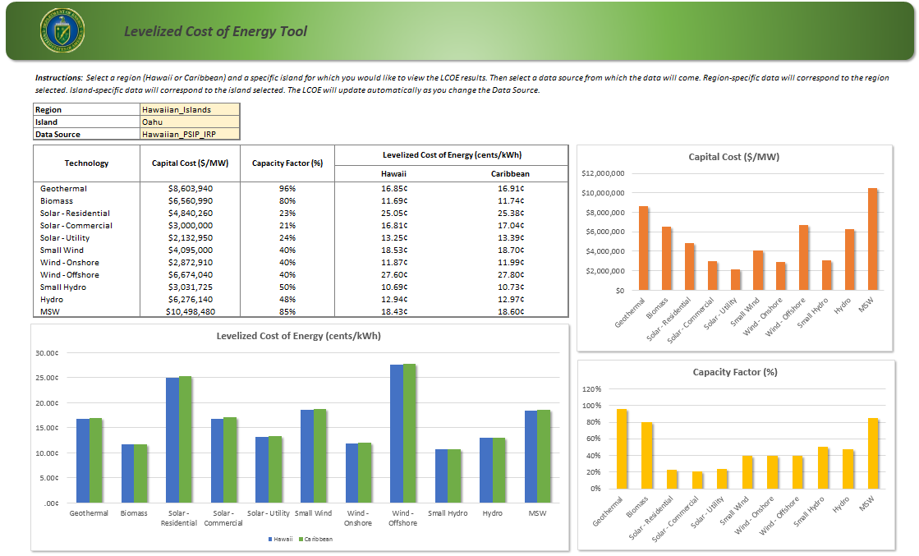
LCOE Output – Dashboard

Slide 19
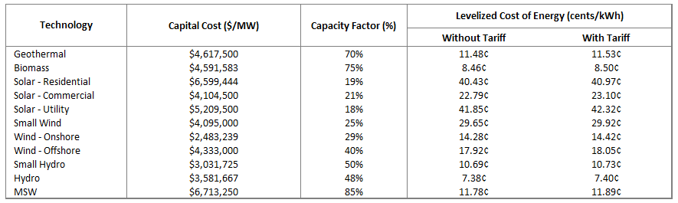
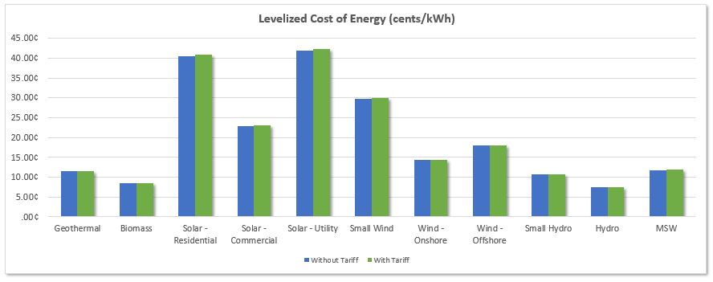
LCOE: Average of all Caribbean Data Sources

Slide 20
Wrap-Up: Summary and Review
Summary:
Scenario Tool: Allows to user to model a generation scenario for up to a user-specified number of years, including various locations (i.e., islands) and designating amounts of current renewable and non-renewable generation and goals for renewable energy and energy efficiency targets for the future
LCOE Model: Can be used to supplement the Scenario Tool. It calculates a simple levelized cost for renewable energy solutions to the grid by technology for each island in Hawaii, the Caribbean, and the Pacific
Benefits and Applications:
Automatically pulls in supply resource, financial cost data, and capacity factors
Integrated Resource Planning
Renewable Energy Integration
Energy Cost and Investment Analysis

