Slide 1
Energy Regulation: Roles and Responsibilities
February 2017

Slide 2
Overview
Do we need an Energy Sector Regulator?
Regulatory Roles
Strategies for filling the roles
Current Status Worksheet
Supporting
References

Slide 3
Common Regulatory Roles
Setting reasonable electricity rates that balance profit and public good
Planning the electricity system
Reliability standards and service quality
Consumer protection
In competitive markets:
Market oversight
Leveraging market forces
Sources: Role of a Power Sector Regulator (RAP), Clean Energy Ministerial

Slide 4
Centralized and Distributed Regulation Benefits
Centralized
Distributed
Uniform and transparent processes and decision making
Lower transaction cost for project development
Increased stakeholder engagement
Politically feasible
Wider variety of stakeholders for innovative thinking
Existing personnel
Institutionalized roles

Slide 5
Who is regulating now?
Regulatory Role | Agency Filling | Contact Person and information | Legal supports | Notes
Source: adapted from http://www.eere.energy.gov/islandsplaybook/pdfs/islands-playbook.pdf

Slide 6
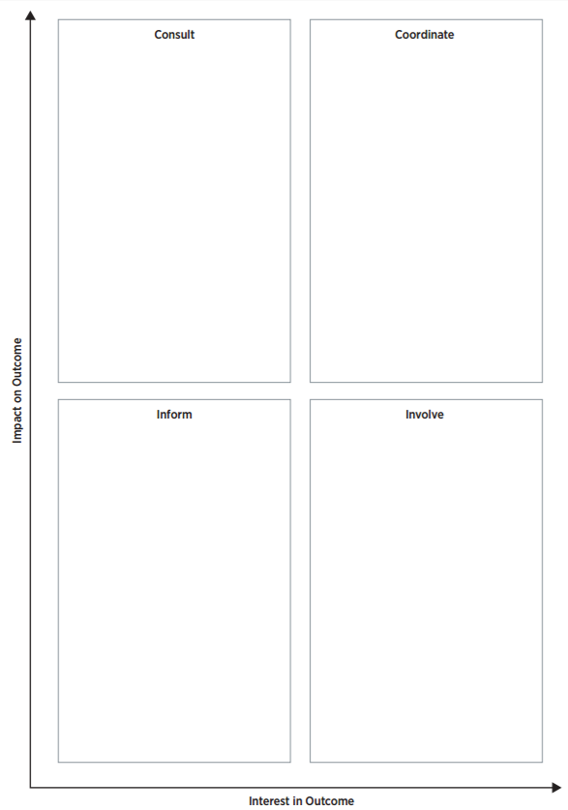
Building the Regulatory Team (decentralized)
Similar to broad stakeholder matrix, understanding where to involve players in the regulatory structure is critical to success of the effort.

Slide 7
References
The Body of Knowledge on Infrastructure Regulation (http://regulationbodyofknowledge.org/) from the Public Utilities Research Center provides links to a large library addressing the regulatory treatment of infrastructure, an extensive glossary, and self-testing features to facilitate learning.
The Energy Regulators Regional Association (ERRA) E-Library (http://www.erranet.org/Library) provides information and data related to energy regulation
The Sustainable Energy Regulation and Policymaking for Africa website (http://africa-toolkit.reeep.org/) from the United Nations Industrial Development Organization contains a variety of information on shaping energy policy.
Encouraging Renewable Energy Development: A Handbook for International Energy Regulators (National Association of Regulatory Utility Commissioners 2011). This guide seeks to help international regulators navigate the policy landscape for large scale renewable deployment.

