Slide 1
Sustainable aviation fuels in Southeast Asia:
A regional perspective on bio-based solutions
Presenters:
Chun Sheng Goh
TUESDAY, 28 JANUARY 2025 • 9:30 – 10:00 CET

Slide 2

SPEAKERS
Chun Sheng Goh
IRENA

Slide 3
Please make sure to mute yourself during the session to avoid background noise
If you have Questions to the speaker, please use the Q&A
If you encounter any technical issues, please connect via phone or contact the Help Desk: 888.259.3826 or https://support.goto.com/webinar

Slide 4
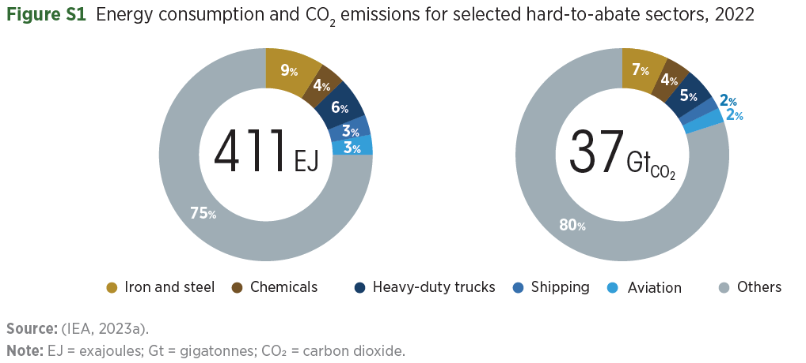
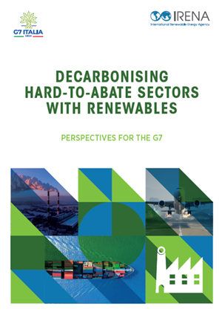
Aviation: A hard-to-abate sector
Not everything can be electrified
Dispatchable carriers are needed
4

Slide 5
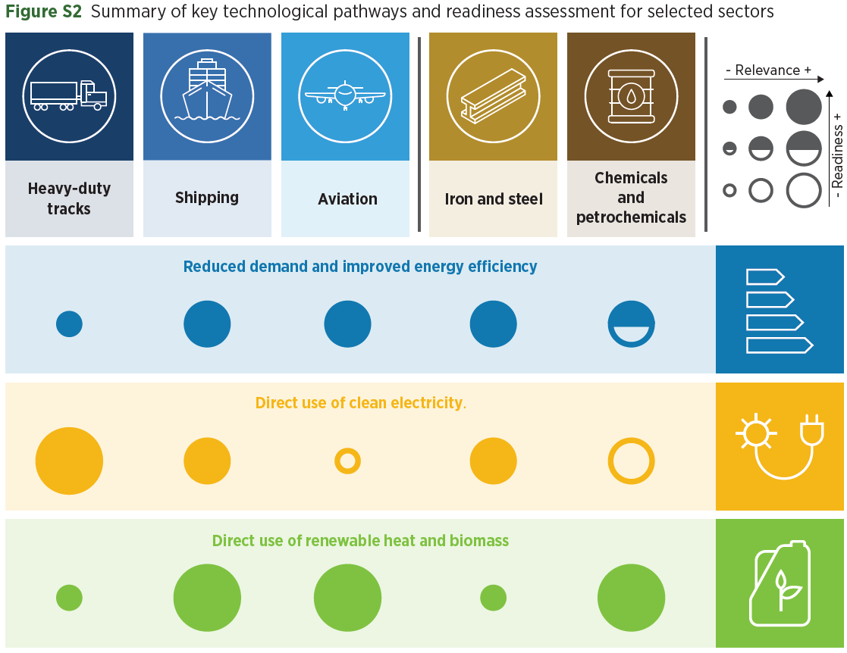
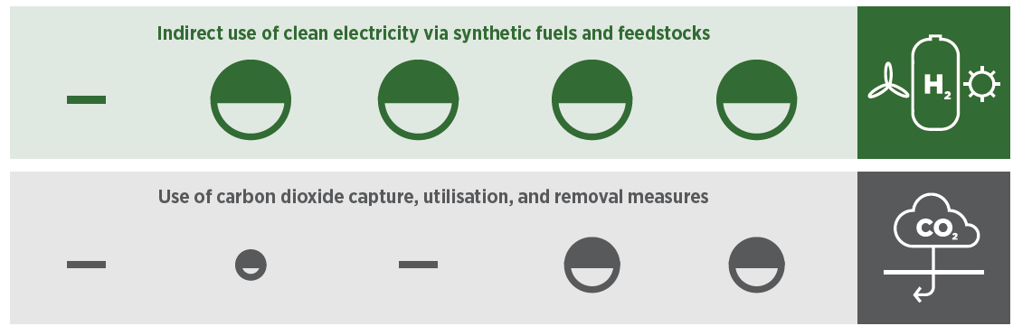
Bio-based solutions for the aviation sector
Bioenergy - the most technologically ready & relevant option
SAF may reduce up to 65% of the sectorial emission
5

Slide 6

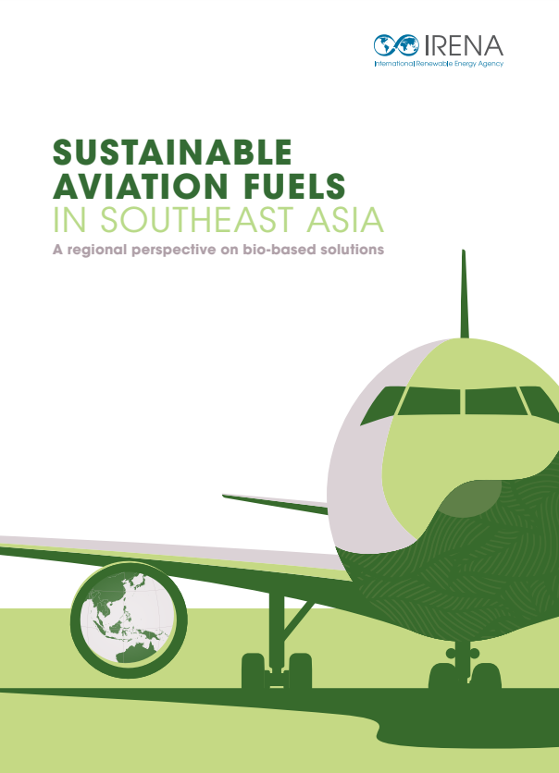

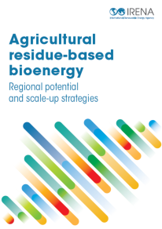
IRENA’s new report on SAF
https://www.irena.org/Publications/2024/Dec/Sustainable-aviation-fuels-in-Southeast-Asia-A-regional-perspective-on-bio-based-solutions
6

Slide 7
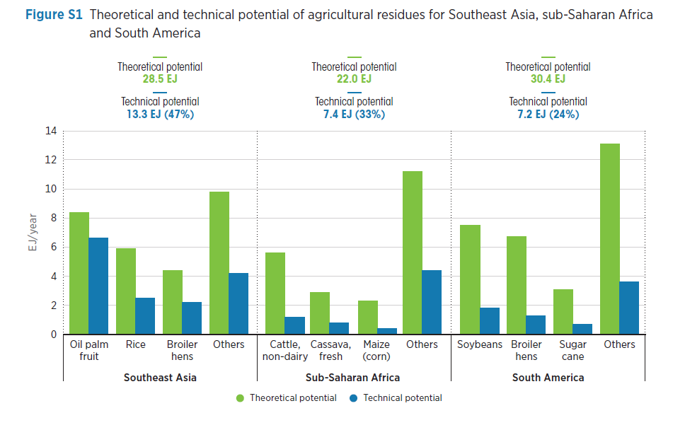
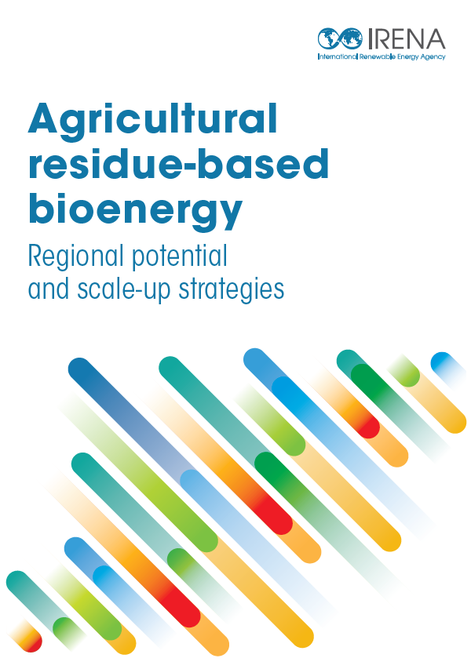
Potential volume of SAF from residues and wastes
7

Slide 8
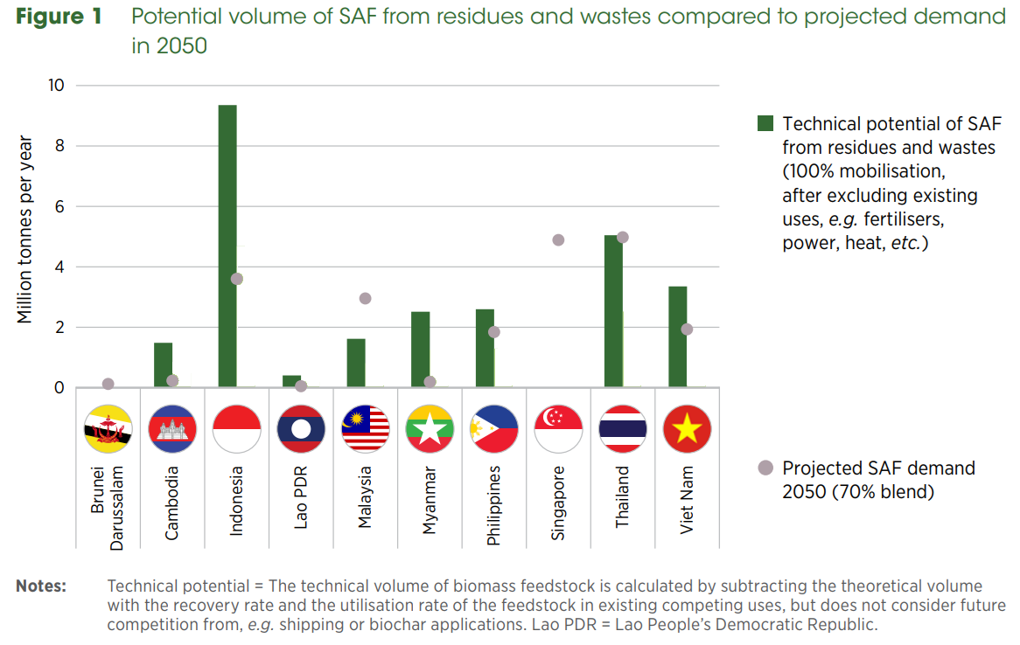
Potential volume of SAF from residues and wastes
Competitions for feedstock for different end-uses
8

Slide 9
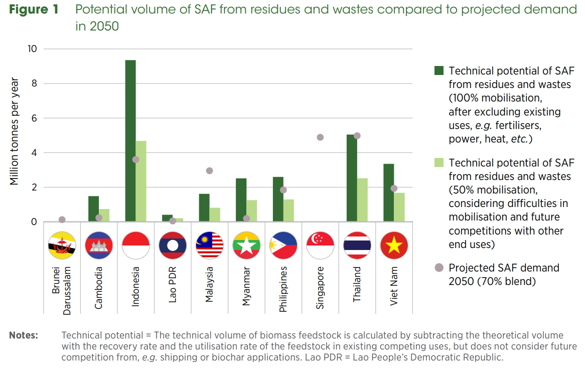
Potential volume of SAF from residues and wastes
Competitions for feedstock for different end-uses
9

Slide 10
Energy crops on under-utilised, low carbon land
Terms used - “abandoned”, “degraded” and “marginal” land
NOT forested
NOT rich in carbon and biodiversity
NOT being used for agriculture
Definitions vary by filtering criteria and local contexts
Global estimates vary widely – 1 to 6 billion ha, due to different databases and methodologies
10

Slide 11
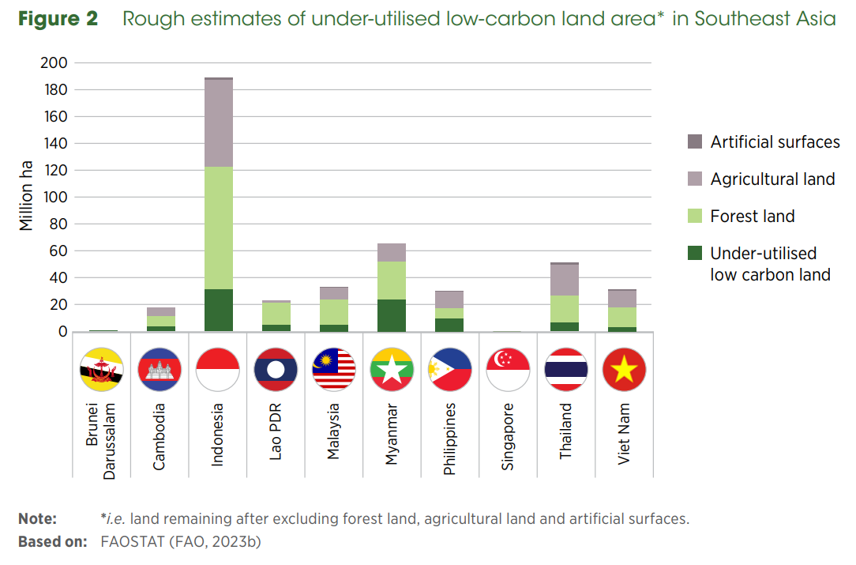
Energy crops on under-utilised, low carbon land
11

Slide 12
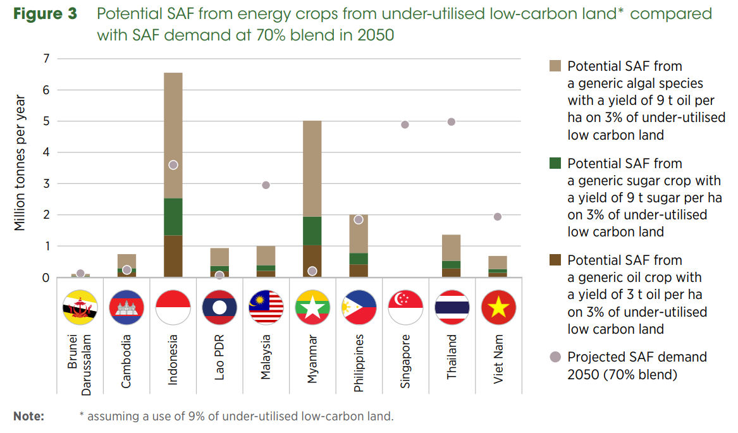
Potential SAF from energy crops
12

Slide 13

Potential SAF from energy crops
Develop clear guidelines to avoid unintended consequences
Integrate SAF production into broader land-use planning
The question is not yes or no, but how to do it in sustainable ways
Use minimal land and resources
At reasonable costs
Generate socio-economic benefits
Minimize environmental impacts
13

Slide 14
International trade and investment
Export to other regions – Japan, Australia, China…
14

Slide 15

Feedstock allocation between sectors
Power
Transport
Other energy uses, e.g., road transportation and power generation
Non-energy uses, e.g., materials, fertilisers, biochar, etc.
15

Slide 16
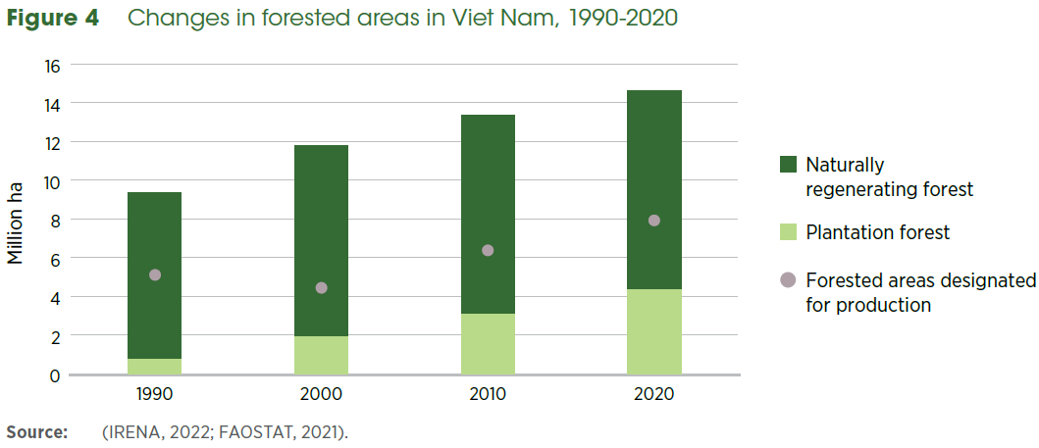
Local conditions and labour availability for energy crops production
Involving local stakeholders
Benefits and risks
Local conditions: familiarity, preference, labour availability…
16

Slide 17
Regional perspectives
Active players: Singapore, Malaysia, Indonesia, Thailand and Philippines.
Demand side:
  Reactive approach driven by market signals, not proactive policies.
  No subsidies; mandates funded by traveler surcharges.
Supply side:
  SAF linked to industrial growth; incentives attract investments.
  Policy bottlenecks due to multi-ministry coordination issues.
17

Slide 18
Regional perspectives
International Partnerships
  Australia, China, Japan partner with Southeast Asia on SAF.
  Export-oriented models intensify regional feedstock competition.
Feedstock Sustainability Concerns
  Palm oil reliance raises environmental and ethical issues.
  Exploring alternatives: microalgae, non-standard coconuts, other crops.
18

Slide 19
Recommendations
A regional framework to facilitate trade
  A harmonised framework for production and trade
  “Book & claim” system to balance targets and scalability
Regional collaboration for SAF deployments
  Cross-border investment in infrastructure and production facilities
  Joint SAF value chains
Tailored policy support to regional variations
  Cost benchmarking and knowledge sharing
  Specific incentives and support mechanisms
19

Slide 20
Q & A
5 min

Slide 21
THANK YOU FOR JOINING US!
SEE YOU IN OUR NEXT WEBINARS
www.irena.org/events/2020/Jun/IRENA-Insights

