Slide 1
Renewable Energy Roadmap: Nigeria
Presenters:
Seán Collins, REmap team
TUESDAY, 18 April 2023 • 14:00 – 14:30 CET

Slide 2

SPEAKERS
Seán Collins
IRENA

Slide 3
Please make sure to mute yourself during the session to avoid background noise
If you have Questions to the speaker please use the Q&A
The slides and a recording at https://irena.org/events/2020/Jun/IRENA-Insights

Slide 4



















REmap – Renewable Energy Roadmaps
Global
Regional
Country
Thematic
  Status of the energy transition and perspective for the global energy system to 2050 based on current and planned policies
  Detailed REmap transition pathways to 2050 – energy pathways aligned with the Paris agreement goals.
  9 global reports (‘14, ‘16, ‘17, ‘18, ‘19, ’20, ’21, ’22, ‘23)
  Assessment of technology options and regional disaggregation
  Identification of key technologies and trends, and cross-country opportunities
  5 regional reports (Africa, EU, CESEC, Central America, ASEAN 2.0)
  2 in preparation (South America, EU)
Insights for policy and decision makers for areas in which action is needed at a country level
15+ country reports for major economies
Provide detailed technical and economic analysis on specific topics (i.e. Future of Wind/Solar PV,RE investments, stranded assets, district heating and cooling etc.)
9+ thematic studies
4

Slide 5
REmap Nigeria study
Aims to support the energy transition debate in Nigeria by providing a full integrated energy system analysis of a wide range of national scenarios
Centred on stakeholder engagement so that it captures national concerns, challenges and opportunities to inform energy planning in Nigeria with relevant and meaningful insights

Slide 6
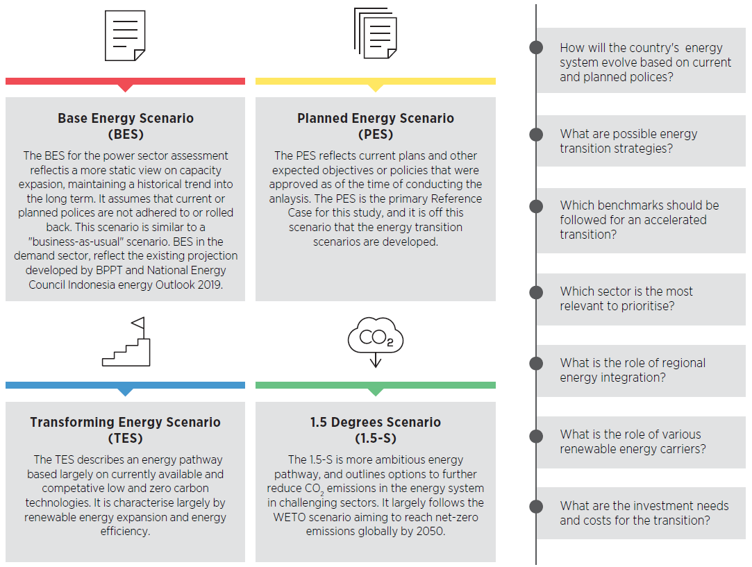
Description of the scenarios in the REmap study
This report provides multiple possible energy pathways increasing in energy transition ambition.
Several energy scenarios future were analysed painting the picture of business as usual and transformed energy future.
These were analysed for three average growth rates 5%, 7% and 10% across the horizon of the study out to 2050 (each denoted with a number after the scenario name in this presentation. e.g. PES7 and TES7)

Slide 7

The 6 key pillars of the energy transition in Nigeria
An integrated planning of the regional energy transition is key
Energy Efficiency
Expansion of renewables in electricity generation
Sustainable mobility
Modern cooking technologies
Direct use of renewables in industry
Increased mechanization of agriculture with RE

Slide 8
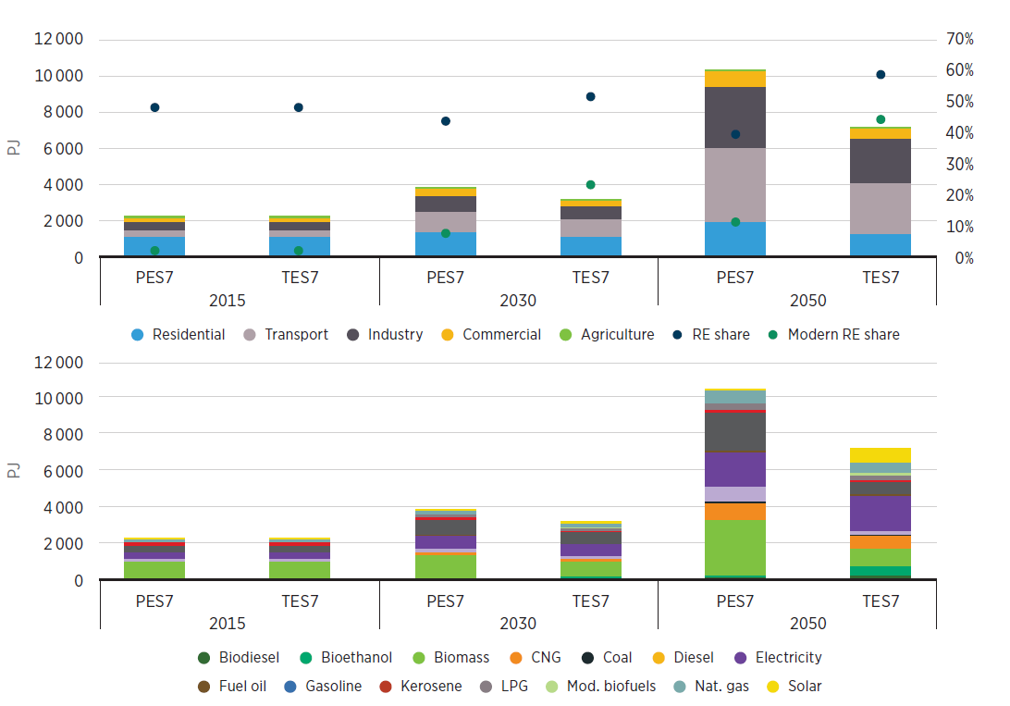
Energy efficiency in all end-use sectors can bring lower investment needs in primary energy supply
Energy Efficiency
The total final energy demand under current and planned polices grows from 2155 PJ in 2015 to 3 763 PJ in 2030 and 10 325 PJ in 2050, increasing nearly fivefold
In the TES, modern renewables meet just under 50% of demand with renewables supplying 60% overall
Nigeria’s electricity consumption is set to increase over 5-fold by 2050 in both cases, delivering very significant efficiency gains
Total final energy consumption
  Action plan for scaling of energy efficiency
  Mandate the use of the most efficient appliances and efficiency standards in building codes for new construction and retrofitting in the commercial sector, supported by financial schemes as incentive to implement.
  Minimum standards and emission limits for vehicles
  Adoption of circular economy principles and wider structural changes

Slide 9
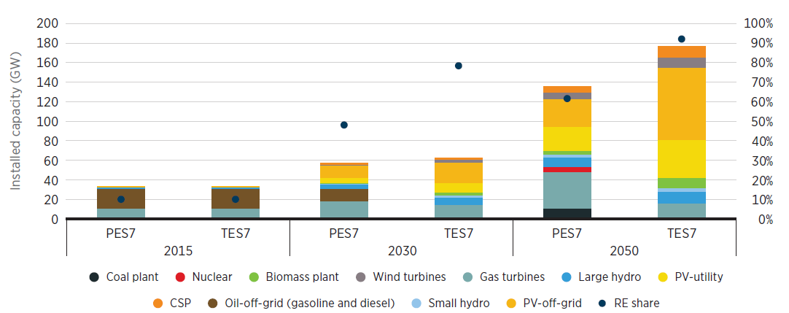
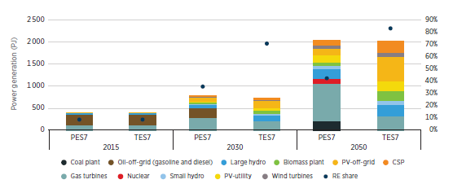
A combination of renewable solutions are needed to meet growing electricity demand including grid, off-grid and mini-grid systems
Expansion of renewables in electricity generation
  Electricity demand doubles by 2030 and over doubles again by 2050, renewable solutions are available, modular and cheaper.
  Installed capacity expands from 30GW to 180GW by 2050:
    Solar PV: 40 GW grid-connected and 75 GW mini/off-grid
    Hydro: 16 GW
    CSP: 12 GW
    Wind: 10 GW
  A paradigm shift in system operation would be needed with a solar dominated power system with a mix of grid, off-grid and mini grid solutions
  Solar PV and batteries can deliver power reliably and reduce costs when compared to diesel systems, increasing economic competitiveness
  Action plan for power sector
  Accelerate the development of integrated planning to meet expanding electricity demand by means of generation capacity, grid infrastructure, storage and decentralised systems.
  Foster innovative financing mechanisms for distributed renewables in off-grid and mini-grid settings such as blended finance and microfinance to deliver higher penetrations. (Also applicable to utility scale)
  Financing of feasibility studies for the development of a portfolio of renewable-based generation and transmission projects
  De-risking and adjusted contract models to reduce the cost of capital and promote investment attraction for RE
  Improve the existing financing mechanisms and explore further regulatory options.

Slide 10
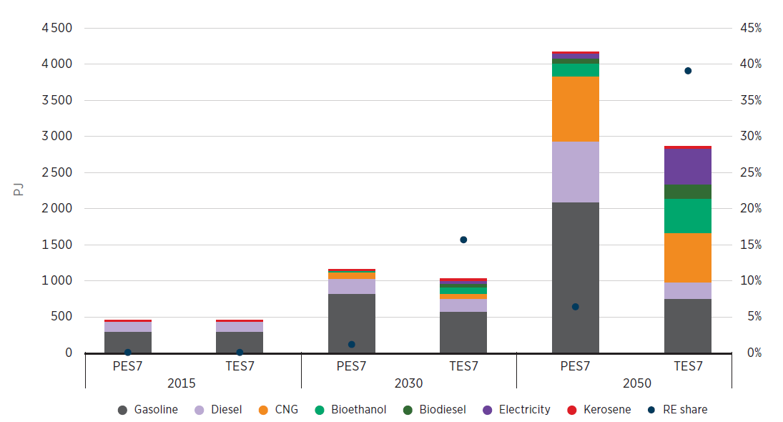
Electrification and increased adoption of biofuels can reduce fossil fuel demand growth by two-thirds using local renewable resources
  Transport is set to become the largest energy demand sector rising from 19% in 2015 to 40% in both PES and TES by 2050
  The transport sector in TES evolves such that gasoline- and diesel-run vehicles are increasingly replaced by biofuels, electricity and CNG-powered vehicles.
  Model shift also crucial, with shifts to local and regional mass transit as well as freight being shifted to rail
Sustainable mobility
Final energy consumption in the transport sector
  Action plan for scaling renewables in transport
  Faster adoption of biofuels. Nigeria has a biofuel policy in place, but it needs to be improved and implemented appropriately.
  Policies aimed at transport electrification and acceleration of the adoption of electric vehicles (EVs) should be put in place.
  Enhancement of public transportation offerings and rail infrastructure driven by renewables will be key to achieving the modal shifts and energy efficiency needed in transportation

Slide 11
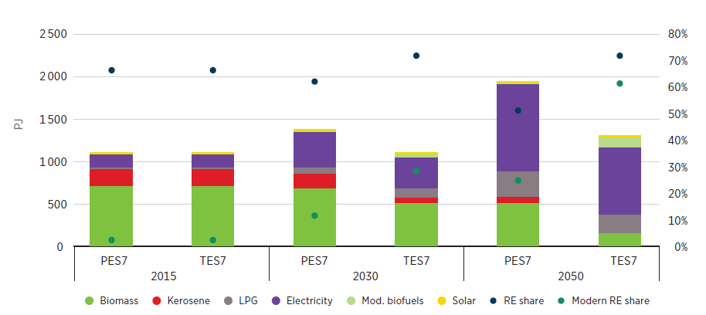
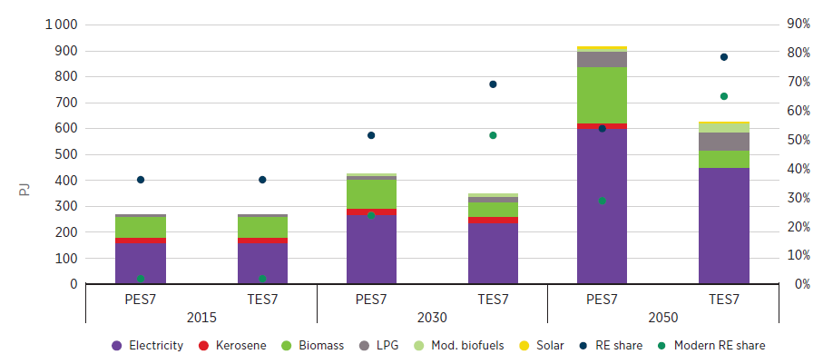
Provision of universal access to clean cooking technologies and fuels thanks to the introduction of electric stoves and improved cooking stoves
  At over 60% of TFC, the buildings sector (residential and commercial) was the largest energy sector in 2015, most of which was in the form of traditional biomass
  Electricity use could grow from 15% of demand to 60% in the residential sector and maintain a high share in commercial buildings of over 60%
  Cleaner technologies for cooking and water heating are key in delivering efficiency gains and improving air quality
Modern cooking technologies
Final energy consumption in residential buildings
Final energy consumption in commercial buildings
  Action plan for buildings sector
  Promote investment in modern clean cooking technologies with adequate financing
  Improve upon existing appliance efficiency and lighting programmes
  Promote energy efficiency policies such as stricter building codes, support for building retrofits and appliance standards
  Adoption of circular economy principles and wider structural changes

Slide 12
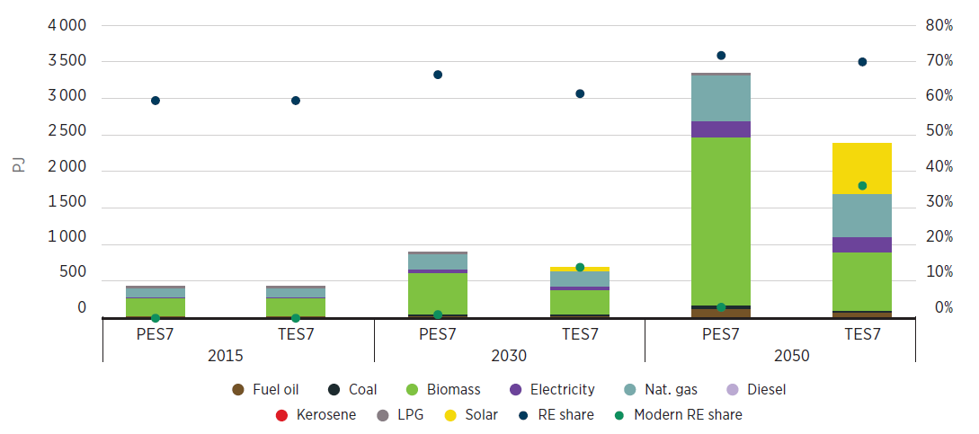
Substitution of biomass use in industry with direct use of solar thermal energy can reduce energy needs and exposure to fossil fuel price volatility
  Industrial energy demand is set to grow over 7-fold in PES but this is reduced to 5-fold in TES though deployment of efficient technologies to minimize use of inefficient bioenergy technologies
  This sees the share of modern renewables reach 14% in 2030 and 36% in 2050 in TES compared to nearly 0% in PES along the whole study horizon
Direct use of renewables in Industry
Final energy consumption in industry sector
  Action plan for industry sector
  Characterization of the industry sector and promotion of energy efficiency and direct use of renewables solutions
  Develop local renewable energy technologies manufacturing industries
  Focus on energy efficiency improvement in small and medium-sized enterprises (SMEs) by providing financial/fiscal incentives to boost their capacities to adopt state-of-the-art technologies.
  Promote the adoption of solar heating technologies in large industries where there are available spaces to deploy them.

Slide 13
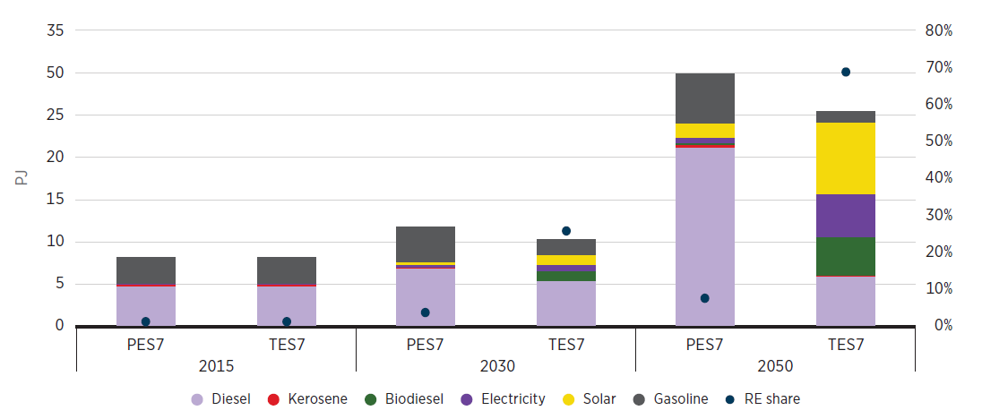
Increased mechanization with renewables and electricity could transform the agricultural sector and reduce costs
  The agriculture sector represents a small share of energy demand (representing less than 0.5% of energy use in both the PES and the TES)
  However, is a crucial part of the Nigerian economy with a very substantial share of the population employed in the sector at 35% in 2019.
  Solar-based and electric pump sets replace diesel/gasoline pump sets, which substantially increases energy efficiency of the sector and allows it to achieve a renewable share of 70%
Increased mechanization of agriculture with RE
Final energy consumption in the agriculture sector
  Action plan for agriculture sector
  Improve the affordability of solar irrigation pumps. While solar irrigation pumps are already cheaper than diesel and gasoline pumpsets in terms of levelised cost of energy, their initial capital outlay remains relatively higher.
  Policies to promote the adoption of efficient pumpsets.
  Incentives to promote adoption of alternative fuel tractors

Slide 14
Overall investment needs are lower on a high renewables pathway but need to be targeted and redirected to achieve it
The TES shows itself to be a cost-effective scenario with less capital investment required than for the PES.
Costing around USD 1.2 trillion in TES, similar to PES, between 2015 and 2050, while delivering the same energy service.
 |  | 2015 | 2050 PES | 2050 TES
Modern renewable energy share in final energy (excludes traditional bioenergy) |  | 1% | 10% | 44%
Electrification share of final energy |  | 16% | 18% | 27%
Renewable energy share in power generation |  | 9% | 42% | 84%
Solar | Utility (GW) | Negligible | 25 GW | 40 GW
 | Off-grid (GW) | 0.8 GW | 29.5 GW | 75 GW
Hydropower (GW) |  | 2 GW | 13 GW | 15.5 GW
Number of electric cars |  | Negligible | Negligible | 28 million
Number of efficient modern bioenergy cookstoves |  | Negligible | 11 million | 33 million
Number of electric cookstoves |  | 2.5 million | 11.7 million | 35 million
Renewable energy share in industry (excluding traditional biomass) |  | 59% (1%) | 72% (2%) | 71% (36%)
Number of electricity-powered pumps in agriculture (grid and off-grid) |  | 700 | 9 600 | 22 100
  Action plan for financing the energy transition
  A shifting of and scaling-up of investments in Nigeria in the short term to avoid locking in investment in fossil fuel infrastructure with long lifetimes
  Develop a well-functioning and comprehensive financial planning framework is needed for successful scaling-up of clean energy projects and solutions across the whole energy system of Nigeria
  Financial de‑risking mechanisms (such as blended finance) are needed to enable investments beyond development finance.

Slide 15

THANK YOU FOR JOINING US!
    Ricardo Gorini, rgorini@irena.org
    Seán Collins, scollins@irena.org

Slide 16
Q & A
10 min

Slide 17
THANK YOU FOR JOINING US!
SEE YOU IN OUR NEXT WEBINARS
www.irena.org/events/2020/Jun/IRENA-Insights

