Slide 1
Sector assessment for the electrification of primary health care facilities in Burkina Faso 4th Africa Energy Market Place (AEMP) Energy Solutions for Resilient Healthcare
Carlo Starace
Associate Programme Officer, IRENA
4th Africa Energy Market Place (AEMP), 8th May, Calgary

Slide 2
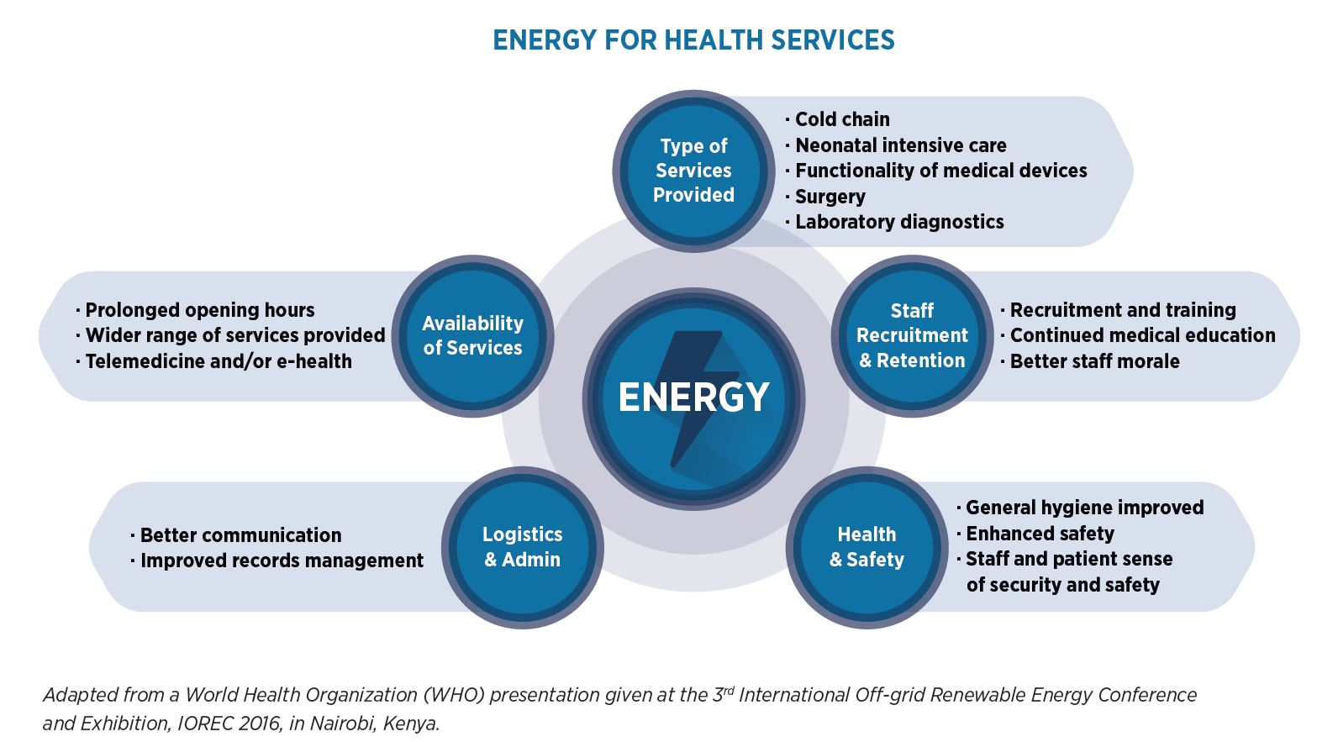
IRENA and the Energy-Health Nexus
IRENA began work on renewable energy-health nexus in late 2018 through the launch of the International Conference on Renewable Energy Solutions for Healthcare Facilities
IRENA is among the founding partners and permanent steering committee member of the Global Health and Energy Platform of Action (HEPA), convened by the World Health Organization
Teamed up with the African Union Commission to advance renewable energy solutions to bolster Africa’s response to COVID-19 and to bolster efforts in the electrification of health facilities in the African continent.

Slide 3
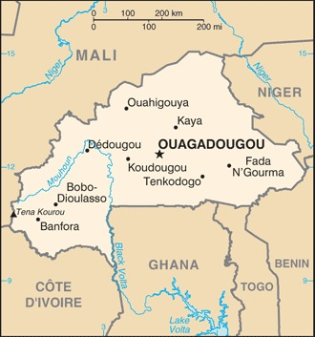
Overview of the Project in Burkina Faso
IRENA launched the project “Sector assessment for the electrification of primary health care facilities in Burkina Faso” to support access to energy in the country.
Together with the SELCO Foundation and in collaboration with the Health and Energy Ministries of Burkina Faso, the project envisages to:
Carry out a gap analysis of the rural health sector looking at policy, financial, technical and institutional gaps
Evaluate the energy needs across the rural medical value chain consider appliance use, energy efficiency and building design through an “ecosystem approach”
Develop a sector assessment report for the electrification of rural healthcare facilities, a “blue-print” of technical design with cost estimates for rural healthcare facilities with the optimised renewable energy solutions
The project is scheduled to be completed within Q1 2021 and will be replicated to other countries.

Slide 4
Project phases
Pre-Assessment
Assessment
Post-Assessment
Work with the Ministries of Health and Energy of Burkina Faso to:
Understand priorities, baselines, and gaps of the health and energy sectors of Burkina Faso
Undertake a landscape analysis of the sectors
Prepare a selection of sample facilities for the assessment
Carry out the assessment through a series of workshops and bilateral meetings
Provide technical trainings to local stakeholders to conduct the assessment
Develop recommendations and a way forward on the technical design of solutions for rural healthcare facilities
The recommendations to include financial, capacity building, policy and programme design aspects

Slide 5
Pre-assessment: Challenges of the health system
Challenges and opportunities of the Health System in Burkina Faso:
Intra-sectoral coordination and collaboration could be enhanced
Opportunities to further train health personnel
Improvements are required in the supply of quality health products (medicines, consumables, vaccines, blood products)
Lacking infrastructure
Relatively little availability of data and information
Possibilities to enhance the funding and coordination of research
Lack of funding
Pre-Assessment
Work with the Ministries of Health and Energy of Burkina Faso to:
Understand priorities, baselines, and gaps of the health and energy sectors of Burkina Faso
Undertake a landscape analysis of the sectors
Prepare a selection of sample facilities for the assessment

Slide 6
Pre-assessment: Structure of the health system
Health services structure
Level
Pre-Assessment
University Hospital Centres (CHU)
National/public
Regional/private
Regional Hospital Centres (CHR)
Work with the Ministries of Health and Energy of Burkina Faso to:
Understand priorities, baselines, and gaps of the health and energy sectors of Burkina Faso
Undertake a landscape analysis of the sectors
Prepare a selection of sample facilities for the assessment
Health District Hospitals (HDH)
Local/
traditional
Health and Social Promotion Centres (CSPS)
Medical Centres (CM)
Rural
Urban

Slide 7
Assessment: Overview of existing structures and next steps
No. of health facilities | Powered by SONABEL | Powered by Solar | Powered by other sources | Functioning facilities | Non-functioning | Un-electrified
2,330 | 603 | 1,330 | 26 | 1,551 | 392 | 387
Assessment
The data shows there is a significant number of health facilities powered by solar, through a combination of support from government packages, private donors, NGOs, and other means
Carry out the assessment through a series of workshops and bilateral meetings
Provide technical trainings to local stakeholders to conduct the assessment
There are around 400 un-electrified health care facilities, the majority of which are CSPS. These are to be prioritised when choosing CSPS for assessments.
Around 50 centres have been chosen for the final assessment. These comprise 10 CSPS, plus other centres from 5 sub-regions within the countries.
This will be preceeded by survey testing in 2-3 select centres to verify and validate the solidity of the data and of the assessment teams. A training of staff from Health and Energy Ministries will be conducted in April and the sample assessment will be carried out immediately.
The final assessment to be carried out in the remaining centres by the trained teams.

Slide 8
Assessment: Training of personnel for sample assessments
Following discussions with the Ministries of Energy and Health, 2-3 health facilities to be selected in the Centre (Capital) region to verify the quality and solidity of the teams. A full assessment of the remaining larger sample
Assessment
The sample assessments will be carried out by five teams comprising:
One energy technician or engineer per region
A practitioner or health administrator per region
Plus a supervisory team led by IRENA’s local expert, one energy technician and one health practitioner.
Carry out the assessment through a series of workshops and bilateral meetings
Provide technical trainings to local stakeholders to conduct the assessment
A training of these teams to be conducted in Ouagadougou on April 7, with sample assessments in selected 2-3 centres to follow immediately.
A first draft of the report has been published, currently undergoing review.

Slide 9
Post-assessment
The results from the report will be validated through consultations with stakeholders from the country and across the region
Post-Assessment
The validation workshop will result in a final assessment report including policy recommendations, delivery models and technical designs with cost estimates, based on the assessments that will have been carried out on the 50 selected centres
Develop recommendations and a way forward on the technical design of solutions for rural healthcare facilities
The recommendations to include financial, capacity building, policy and programme design aspects
IRENA will engage in a joint effort of dissemination of the results, in coordination with the Energy and Health Ministries of Burkina Faso, national and other partners for wider knowledge sharing and potential outreach for funding.
Notes:
Finally, what do we plan to do once the assessment phase has been completed?
As mentioned before, this work will feed into a Final Assessment Report that will include policy recommendations, delivery models, technical designs with cost estimates, compiled to suit the varying needs of the complex panorama of different health centres that we have observed before. The report will be validated through consultations with stakeholders from the country and across the region in a Validation Workshop.
Finally, I would like to discuss what I may refer to as the post-post-assessment phase, which answers the question of: what are we going to do with this report? The recommendations included therein and the data that will have been gathered within it will obviously be as useful as possible if they can attract funding from international financing institutions, acting as a feasibility study that can ususally function as a way to back up funding requests from countries. It will also benefit immensely from its dissemination.
This ties very well with the work that is currently being set up in the very country of Burkina Faso by our friends from Power for All. As Mongkogi already explained, their plan is to create a local platform and coalition of local stakeholders in the country and we believe that it might be very useful to have the recommendations included in our report in their very useful Solutions Briefs.

Slide 10
Thank you
^{www.irena.org}
^{www.twitter.com/irena}
^{www.facebook.com/irena.org}
^{www.instagram.com/irenaimages}
www.flickr.com/photos/irenaimages
^{www.youtube.com/user/irenaorg}

