Slide 1


Policies and Strategies for Combating Air Pollution in Commonwealth Countries
Promoting the adoption of renewable energy in Sub-Saharan Africa
Nopenyo E. Dabla
Programme Officer Sub-Saharan Africa

Slide 2
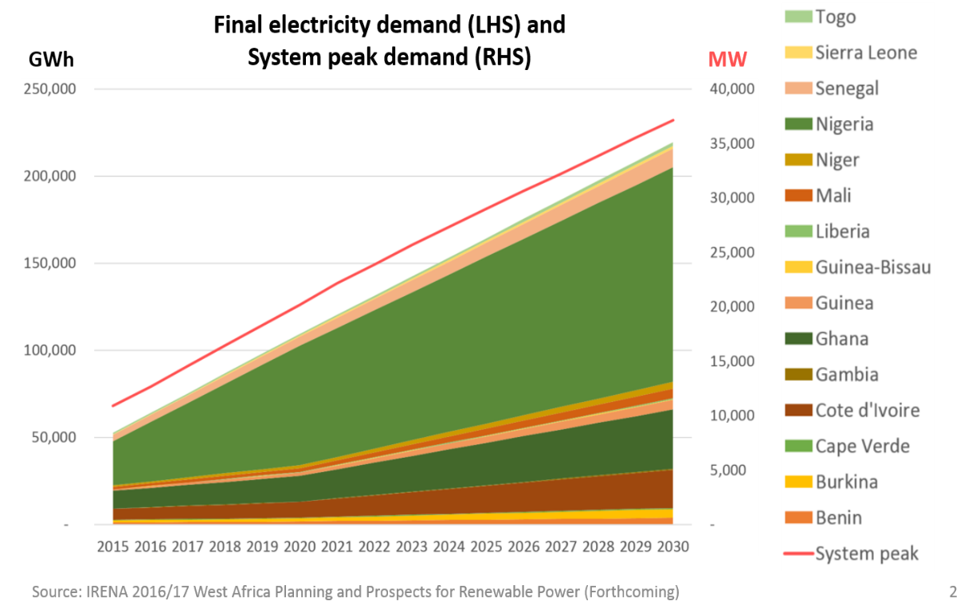
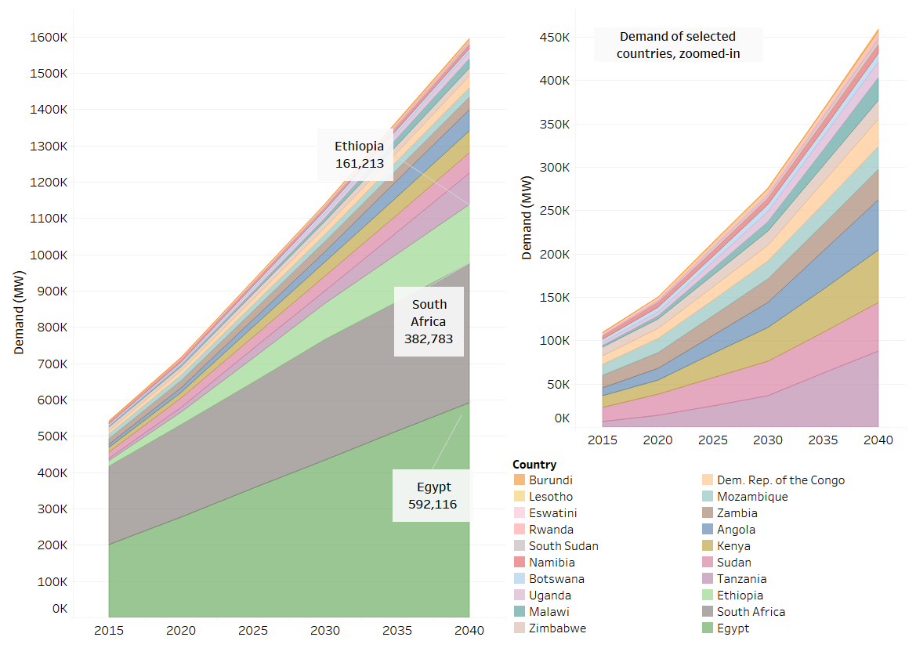
Electricity Demand Projections
West Africa (2030)
Eastern & Southern Africa (2040)

Slide 3
Clean Energy Corridors in Africa
Key Objectives
  Promote the development of cost-effective renewable power options
  Strengthen cross-border trade of renewable power
  Support regional efforts for the creation of regional power markets
Implementation:
  Africa Clean Energy Corridor: EAPP & SAPP countries (2014)
  West Africa Clean Energy Corridor: WAPP countries (2016)
5 Implementation Pillars:
  (i) Zoning and Resource Assessment
  (ii) National and Regional Planning
  (iii) Enabling Frameworks for Investment
  (iv) Capacity Building
  (v) Awareness-raising and Political Support
ACEC
Eastern Africa Power Pool (EAPP)
Southern Africa Power Pool (SAPP)
WACEC
West African Power Pool (WAPP)

Slide 4
Political Support
Africa Clean Energy Corridor (ACEC)
Approved by the Ministers of Energy for Eastern & Southern Africa in 2014
West Africa Clean Energy Corridor (WACEC)
Approved by the Directors of Energy of ECOWAS in April 2016 in Dakar
Adopted by the Ministers of Energy in December 2016 in Conakry
Endorsed by the Heads of State and Government in June 2017 in Monrovia and was annexed to the ECOWAS Treaty
Endorsed by the Specialised Technical Committee of the Africa Union through the Lomé (2017) and Cairo (2019) declarations

Slide 5
Support Planning Processes across countries & regions
Least-cost energy planning model configured and regional analyses done for all 5 sub-regions
Regional trainings delivered to >200 energy planners.
Inputs to regional power sector plans provided, incl.
  SAPP Power Plan to 2040.
  ECOWAS Power Generation and Transmission Masterplan to 2033.
National energy planning support/inputs to national energy sector plans
  Eswatini (Energy Masterplan 2034)
  Sierra Leone (draft Energy Masterplan 2040)
  Cameroon
Inputs to continental planning process
  Inputs to integration of solar PV and wind as part of process of PIDA Priority Action Plan revision.

Slide 6
Energy Access
530 million Africans will lack electricity in 2030 ≈ 80 million households

Slide 7

Energy Access
International Off-Grid Renewable Energy Conference and Exhibition (IOREC)
Collaborative platform for sharing knowledge and best practices on approaches to scale-up off-grid renewable energy
Promoting a Solar PV Market in West Africa
Strengthening and developing local capacities of policymakers, regulators and utilities, financial institutions and renewable energy entrepreneurs.
Renewable Energy Solutions For Healthcare Facilities
Country-level technical support for improving electricity access of rural healthcare facilities through renewable solutions
ECOWAS RE Entrepreneurship Support Facility​
ECOWAS
Certification for Sustainable Energy Skills
Regionally harmonised certification system recognised in all ECOWAS countries
SADC RE Entrepreneurship Support Facility​

Slide 8
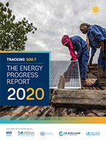
Solutions for access and the deployment of renewables
INTEGRATED ELECTRIFICATION STRATEGIES AND PLANNING TO DRIVE POLICY MAKING AND INVESTMENT DECISIONS
POLICY FRAMEWORKS, WORKABLE REGULATIONS, AND STRONG INSTITUTIONAL ARRANGEMENTS TO CREATE ENABLING ENVIRONMENTS
INNOVATIONS IN TECHNOLOGY AND BUSINESS MODELS TO REACH THE REMAINING UNSERVED POPULATION
LEVERAGED PUBLIC AND PRIVATE FINANCING TO FUND ELECTRIFICATION AT SCALE
Tracking SDG 7: The Energy Progress Report (2020)
LEAVING NO ONE BEHIND
ENERGIZING WOMEN
GOING BEYOND CONNECTIONS: IMPROVING LIVELIHOODS AND HUMAN CAPITAL

Slide 9
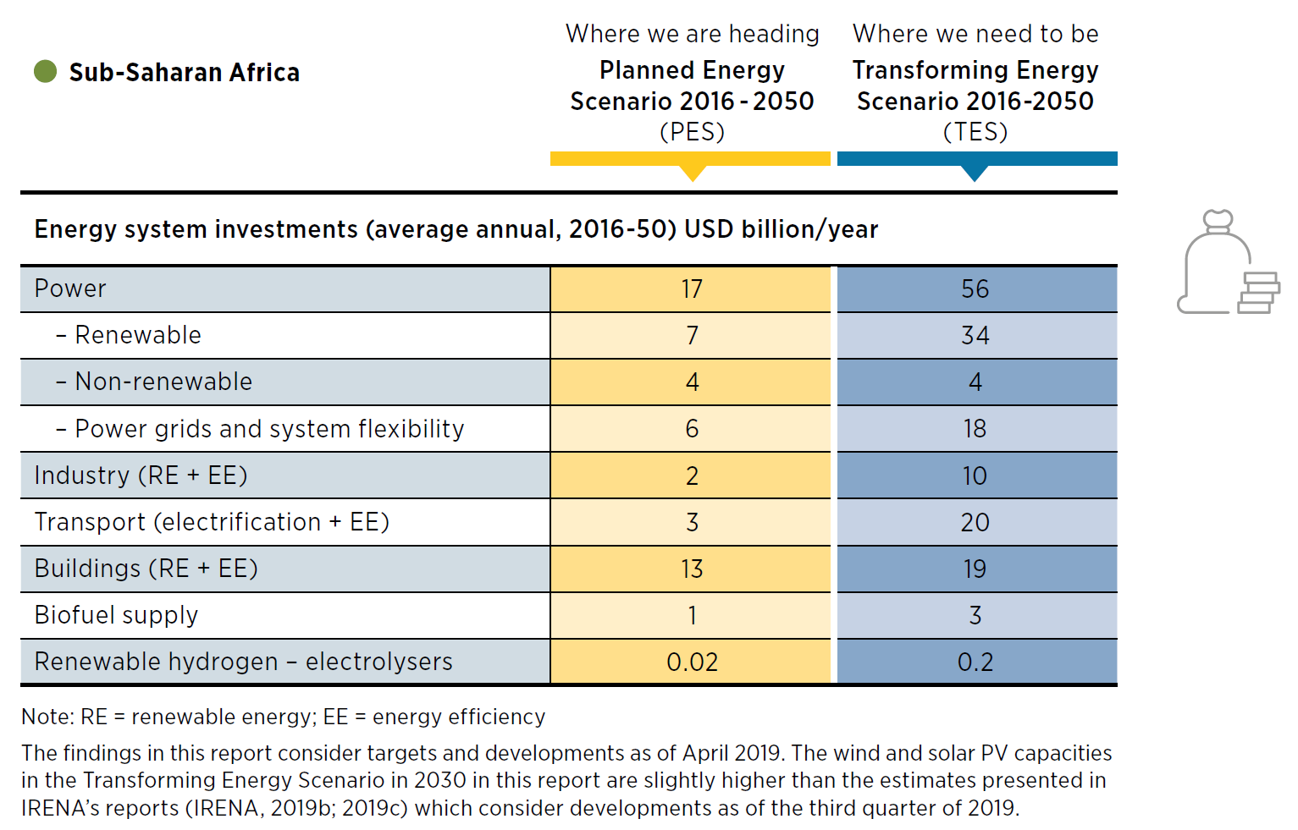
Renewable Energy Outlook to 2050

Slide 10

IRENA’s NDC Engagement
NDC Enhancement Support
Data and Statistics
Resource Assessment
Long Term Energy Planning (LTEP)
Power System Flexibility (FlexTool)
Renewable Energy Roadmaps (REmap)
Renewable Readiness Assessment (RRA)
RE Policy – Capacity Building
RE Technology – Capacity Building
NDC Implementation Support
Technical Assistance
Project Facilitation Support
EUROPE
Albania
Belarus
Georgia
N. Macedonia
Turkey
SIDS
Antigua & Barbuda Bahamas Barbados Belize Dominica Dominican Republic Fiji Grenada Guyana Nauru Palau Papua New Guinea Saint Kitts & Nevis Saint Lucia Samoa Sao Tome & Principe Seychelles St Vincent & Grenadines Tonga Vanuatu
LATIN AMERICA
Cuba
Ecuador
El Salvador
Nicaragua
Panama
Paraguay
Uruguay
SSA
Benin
Botswana
Eswatini
Gabon
Gambia
Liberia
Mali
Mozambique
Niger
Nigeria
Rwanda
South Africa
Uganda
Zambia
Zimbabwe
MENA
Egypt
Jordan
Lebanon
Sudan
Tunisia
ASIA
Azerbaijan
Bhutan
Cambodia
Indonesia
Kazakhstan
Kyrgyzstan
Mongolia
Myanmar
Philippines
Thailand
Uzbekistan
Input to NDC already provided (1)
Ongoing Implementation of Support (27)
Scope and work plan firmed-up (5)
Work plan under development (12)
Scoping/Initial Discussions (20)

Slide 11
THANK YOU

