Slide 1



Facilitating Small Island Developing States Access to Investment through the SIDS Lighthouses Initiative
Net-zero Investment Lab: Public and Private Sector Collaboration on Accelerating Green Investment in SIDS
30 March 2021

Slide 2
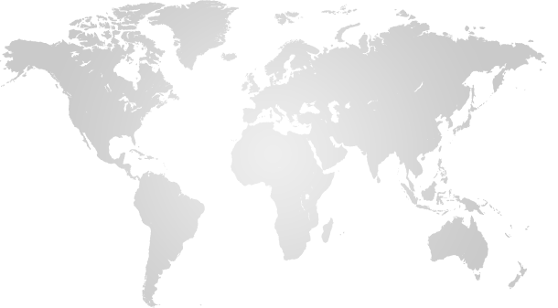
Overview of the SIDS Lighthouses Initiative
| 36 SIDS and 31 Development Partners | Framework to facilitate SIDS climate action through energy transformation |
| Addresses all elements of energy transition | Operationalises the Ambitious SIDS Climate Package and IRIE initiatives | NDC Support for 21 SIDS |
Caribbean
Pacific
Antigua & Barbuda
Aruba
Bahamas
Barbados
Belize
British Virgin Islands
Cuba
Dominican Republic
Grenada
Guyana
Montserrat
St. Lucia
St. Vincent and the Grenadines
Trinidad and Tobago
Turks and Caicos
Cook Islands
Federated States of Micronesia
Fiji
Kiribati
Republic of the Marshall Islands
Nauru
New Caledonia
Niue
Palau
Papua New Guinea
Samoa
Solomon Islands
Tonga
Tuvalu
Vanuatu
Atlantic, Indian Ocean and South China Sea
Cabo Verde
Comoros
Maldives
Mauritius
Sao Tome and Principe
Seychelles
This Photo by Unknown Author is licensed under CC BY-NC
Other Partners: Non-SIDS countries and Partner Organisations
Norway
United Arab Emirates
United States of America
Association of the Overseas Countries and Territories of the European Union
Caribbean Electric Utility Services
Clean Energy Solutions Center
Organisation of Eastern Caribbean States
Pacific Community
Pacific Islands Development Forum
Pacific Power Association
Rocky Mountain Institute - Carbon War Room
Solar Head of State
Sustainable Energy for All
Sur Futuro Foundation
United Nations Development Programme
United Nations Office of the High Representative for the Least Developed Countries, Landlocked Developing Countries and SIDS
World Bank
Denmark
France
Japan
Italy
Germany
Italy
New Zealand
Clinton Climate Initiative
ENEL
European Union
Greening the Islands
Indian Ocean Commission
International Renewable Energy Agency
Island Innovation

Slide 3
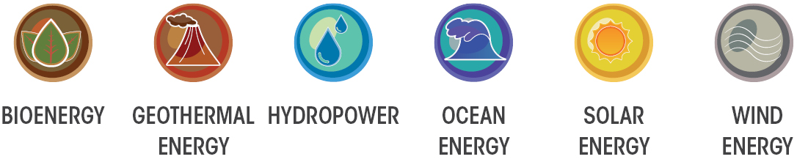
SIDS Lighthouses Initiative Priority Areas
Support SIDS in reviewing and implementing NDCs, with technical assistance and capacity building
Expand focus beyond power generation to include transportation and other end-use sectors
Expand from assessment and planning to implementing effective, innovative solutions.
Leverage synergies between renewables and energy efficiency
Nexus between RE and agriculture, food, health and water – to foster broad socio-economic development: job creation, gender equality and women’s empowerment through renewables.
Promote all renewable sources, including geothermal and ocean energy, and step up work on wind and PV
Support the development of bankable projects, access to finance and co-operation with the private sector
Link renewable energy uptake to climate resilience and more effective disaster recovery.
Strengthen institutional and human capacity in all segments of the renewable energy value chain
Enhance collection and dissemination of data and statistics, supporting informed decision-making
Expand focus beyond power generation to include transportation and other end-use sectors
Reinforce and expand partner engagement, leveraging synergies with other SIDS initiatives
Boost renewable power deployment, aiming for a target of 5 GW of installed capacity in SIDS by 2023

Slide 4
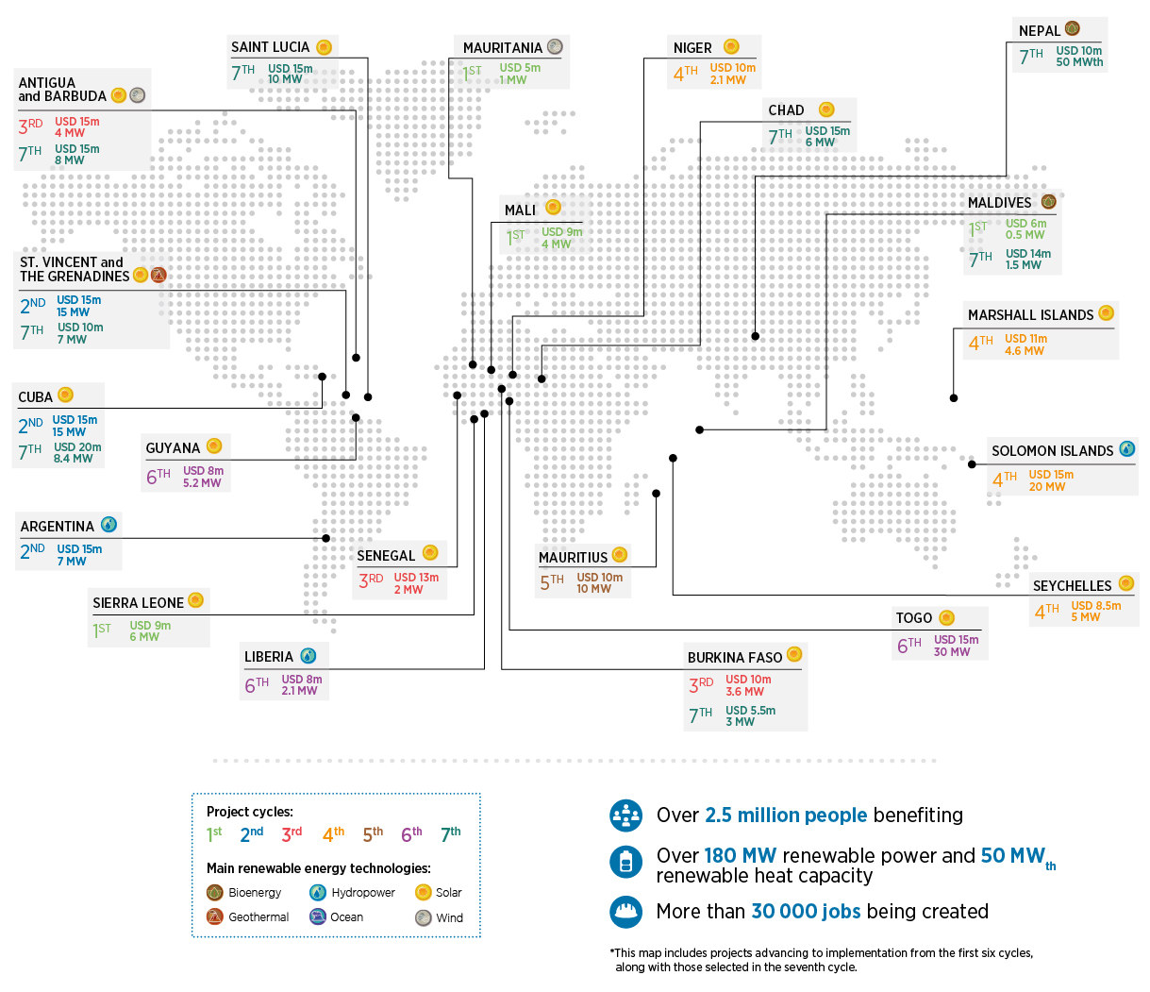
IRENA-ADFD Facility: SIDS Projects

Slide 5


Project Facilitation Workstreams
Workstreams
Member Requests
Climate Investment Platform
Climate Promise
Project Information Document
Technical Assistance
Upstream support to achieve the goal of matching climate finance with investment-ready projects.

Slide 6





Climate Investment Platform (CIP)
Facilitate integrated and streamlined support
Open to interested countries and institutions
Cross fertilization among partners
Inclusive partnership to promote accelerated,
transformative and scaled-up investments to support ambitious NDCs and the pursuit of the SDGs,
with the initial focus on energy transition.
Announced on the occasion of
the UN Climate Action Summit
(Sep 2019, New York)
6

Slide 7
Investment Forums: Scope of Activities
Investment Forum [in Cluster X]
Knowledge Dissemination and Capacity Building
Enabling Frameworks for Investment
Project Support
Highlighting needs to improve investment conditions
- Policy and regulation -
Matchmaking of bankable projects and financiers
Strengthening competencies of regional and local stakeholders on a wide range of policy, regulatory, technical topics -- tailored to specific needs
Climate Investment Platform
7

Slide 8
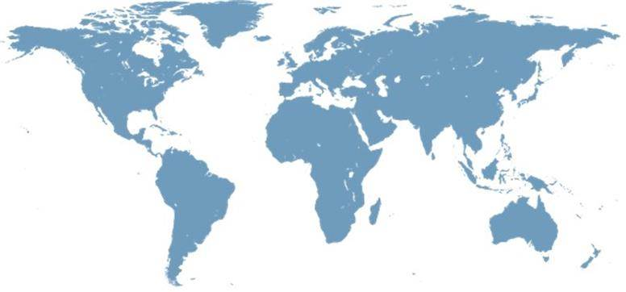
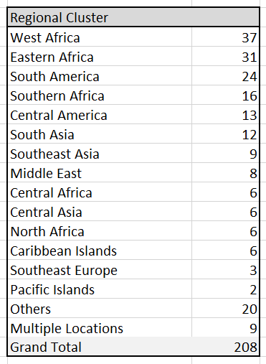
CIP registered projects
3
8
6
6
12
13
6
31
37
9
6
24
2
16
TARGET: increase efficiency and effectiveness of scaling up investment through facilitating development of bankable projects

Slide 9






Mr. Gurbuz Gonul Director Country Engagement and Partnership (CEP) GGonul@irena.org IRENA Headquarters, Masdar City P.O. Box 236, Abu Dhabi United Arab Emirates
SIDS Lighthouses Initiative Email: Islands@irena.org SIDS LHI Website: https://islands.irena.org
^{www.irena.org}
^{www.twitter.com/irena}
www.flickr.com/photos/irenaimages
^{www.youtube.com/user/irenaorg}
^{www.instagram.com/irenaimages}
^{www.facebook.com/irena.org}

