Slide 1
IRENA’s Initiatives for Advancing Renewables for Energy Access
Amjad Abdulla
Head-Partnerships, Country Engagement & Partnerships Division
Financing solar at the last mile: perceived challenges, risks and opportunities
21 June 2021, Abu Dhabi

Slide 2
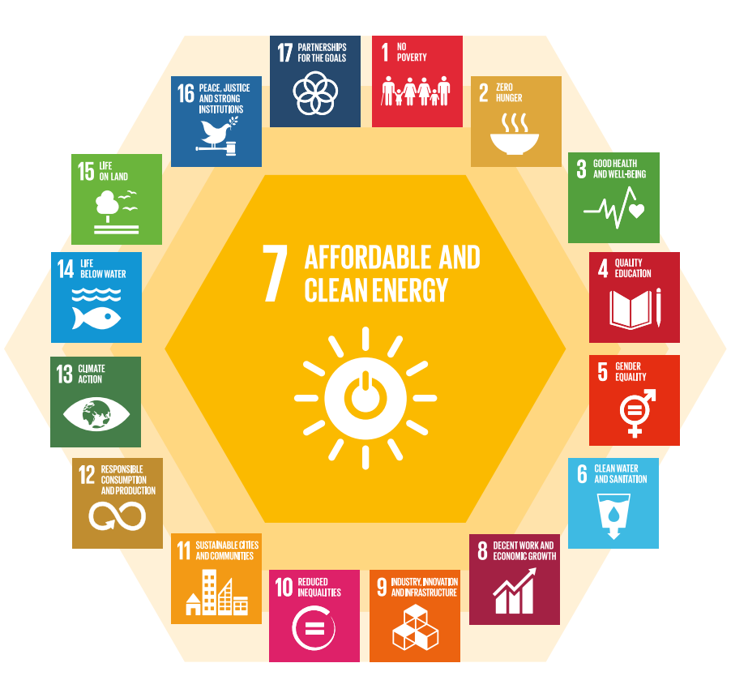
Decentralised RE for Last-Mile Electrification
Energy Access
Central to socio-economic development, contributing to multiple SDGs (health, education, poverty alleviation, climate, women empowerment, etc.)
Key consideration in ET of LDCs, SIDS and LLDCs with increasing prominence in NDCs
Decentralized RE:
Affordable, reliable, clean and rapidly deployable solution for electrification
Grid expansion technically & financially unfeasible for last mile electrification – estimated 2/3rd new access to be decentralised by 2030.
Offer effective solutions for electrification of healthcare, schools and agri-food
Despite the demand and viability, investments in DRE projects for access are hindered by perception of higher financial risk, lower profitability and higher operational costs

Slide 3
Decentralized Renewables in Cross-Sectoral Settings
Energizing Primary Healthcare
Energizing Agri-Food Value Chains
Promoting Entrepreneurship
Global Report Renewable Energy in Food Systems (FAO)
Global Report Assessment for Electricity in Healthcare (WHO, WB, SE4ALL)
Strengthening Partnerships
Global Advocacy International Off-grid RE Conference and Exhibition Ghana, Philippines, Kenya, Singapore
Regional Assessment DRE Solutions in Agri-Food HKH Region
Regional TA/CB ECOWAS RE Entrepreneurship Support Facility
2015
Regional TA/CB
SADC RE Entrepreneurship Support Facility
2017
Country Assessments DRE Solutions in Healthcare Burkina Faso, Mali, Sao Tome & Principe, Cameroon
Disclaimer: Boundaries and names shown on this map do not imply any official endorsement of acceptance by IRENA.

Slide 4
Viability Assessment of Decentralized RE Solutions in Agri-Food Value-Chains
Nodal Points for Decentralized Renewable Energy Interventions
Hindukush – Himalayan region:
Afghanistan, Bangladesh, Bhutan, China, India, Myanmar, Nepal, Pakistan
Buckwheat
DRE for Threshing and Winnowing Machine
Yak
DRE for Milking Machine
DRE for butter churning and cream separator
Potatoes
Vegetables
DRE Pump Irrigation
DRE for potatoes grading machine
DRE for cold storage and transportation
DRE for drip irrigation
DRE for Weeding Machine
Identification of value chains with need for DRE interventions
Estimation of energy supply and demand
Techno-commercial viability analysis
Experts Consultation Workshop – DRE Solution for Food Value Chains in HKH, 24 March 2021
Images Source: Online
4

Slide 5
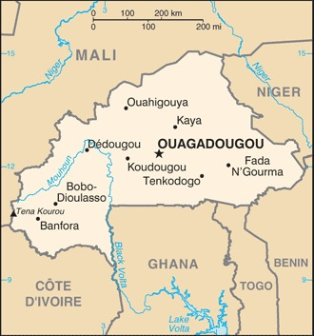
Overview of the Project in Burkina Faso
IRENA launched the project “Sector assessment for the electrification of primary health care facilities in Burkina Faso” to support access to energy in the country.
Together with the SELCO Foundation and in collaboration with the Health and Energy Ministries of Burkina Faso, the project envisages to:
Carry out a gap analysis of the rural health sector looking at policy, financial, technical and institutional gaps
Evaluate the energy needs across the rural medical value chain consider appliance use, energy efficiency and building design through an “ecosystem approach”
Develop a sector assessment report for the electrification of rural healthcare facilities, a “blue-print” of technical design with cost estimates for rural healthcare facilities with the optimised renewable energy solutions
The project will also be expanded to other four countries in the Sub-Saharan region

Slide 6
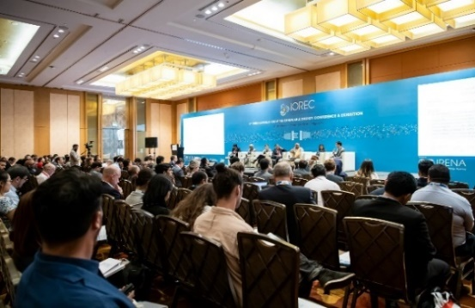
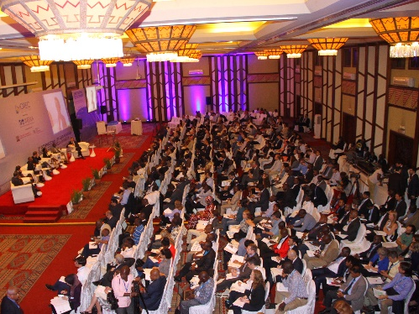
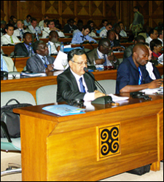
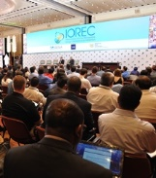
International Off-Grid Renewable Energy Conference and Exhibition (IOREC)
IRENA Flagship Event: Conference and Exhibition convened every two years – Could not be organised in 2020 due to pandemic.
To take place virtually in 4th quarter of 2021
Several hundred expert participants in each edition representing governments, international agencies, INGOs, financial institutions, practitioners and academia
Features side-events co-organised with government ministries, international agencies, INGOs, etc.
Launchpad for publications and initiatives on off-grid renewable energy for IRENA and external partners
Source of guidance for the Agency and external partners’ work in the off-grid renewables sector
Opportunity for private sector to showcase products and services, network and forge partnerships
IOREC 2018 : Singapore
IOREC 2016 : Kenya
IOREC 2014 : Philippines
IOREC 2012 : Ghana
www.iorec.org

Slide 7
Entrepreneurship Support Facility
Regional and Partnership initiative to support small and medium-sized renewable energy entrepreneurs to successfully bring their innovative project ideas to fruition and to access financing in affordable terms
ECOWAS
Implementers: ECREEE, 2iE, Centre of Renewable Energy and Industrial Maintenance (CERMI)
IRENA’s Role: Facilitator (Project Agreement with 2iE, MoU with ECREEE)
Convening technical committee and advisory board meetings, and trainings
SADC
Implementer: SACREEE
IRENA’s Role: Facilitator (MoU and Project Agreement with SACREEE)
Convening technical committee and advisory board meetings, and trainings
Support for Entrepreneurs
Special focus on youth promotion and gender mainstreaming
3 Calls for Proposal (2015-2017)
Over 280 applications received
SMEs from all 15 ECOWAS countries
Mentorship Support
Support for Entrepreneurs
Project Selection
Capacity Building
(SELCO, Project Navigator, Village Energy, etc.)
2 Calls for Proposal (2019 - 2021)
109 applications received
65 SMEs from all 12 SADC countries selected
Mentorship Support
Project Selection
Capacity Building (SADC DFRC, KGRTC)
Trainings for local Financial Institutions
Trainings for local Financial Institutions and 1st Cohort of entrepreneurs
Advisory Board meeting
Over 90 entrepreneurs supported
Total of more than USD 1 million in debt financing by local banks
SMEs from all 15 ECOWAS member countries
Training for 2nd Cohort of entrepreneurs
Continuous mentoring

Slide 8
IRENA for CIP – Key Features
Climate Invest Platform (CIP) is a joint initiative of IRENA, UNDP, and SEforALL in coordination with Green Climate Fund (GCF).
The CIP cover four key building blocks in the climate finance value-chain:
Track 1 - Climate targets
Track 2 - Policies and regulations
Track 3 - Market Place
Track 4 - Financial De-risking
IRENA is leading the CIP risk-mitigation and matchmaking activities
Through the “IRENA for CIP”
250 Registered Partners
57 Registered Financial Institutions*
218 Projects Submitted for Consideration 50 Projects Eligible for TA and
facilitation support
CIP’s mandate is to mobilise capital towards developing countries to accelerate the scale of RE technologies to meet NDCs targets and SDG compliance.
CIP is a platform to facilitate the financing matchmaking between registered financing institutions and registered RE projects’ proponents.
* Bilateral/Multilateral Financial Institutions and Private Investors (registered on the CIP website and/or have MOU with IRENA. **The statistics come from the analysis of the CIP partners application document
8
Notes:
CIP
CIP is a joint initiative of the International Renewable Energy Agency (IRENA), United Nations Development Programme (UNDP) and the Sustainable Energy for All (SEforALL), in collaboration with the Green Climate Fund (GCF).
CIP’s mandate is to increase capital mobilisation and RE impact investing in developing countries.
CIP Partners
Currently, we have 250 registered partners.
We have largest number of partners located in West Africa, followed by East Africa region.
CIP Projects
Specifically, IRENA is supporting renewable energy project developers who are looking for financial and technical supprot. So we have invited so far over 218 project to our platform.

Slide 9
CIP Registered Projects and IRENA’s Project Support
# Projects supported by PFS* 33 | # Projects for financing matchmaking 17 | # Projects introduced to partners 12 | # Projects matched to partners 6
Projects registered on the CIP (218), of which 84 categorized as “off-grid” and “minigrid”
Projected total installed capacity
470 MW
Project ownership
Estimated total investment (US$ million)
Estimated total capacity (MW)
4
1
Projected total capital mobilisation
1.1 US$ billion
1
1
16
1
1
Projected total GHG emission reduced
5 tCO2e million
2
Notes:
One of the main products of IRENA for CIP work is development of Project Information Documents (PIDs)
Till date, 33 projects which have been supported by IRENA.
This is equivalent to approximately 470 MW in capacity, which would lead to mobilisation of US$ 1.1 billion once matchmaking process is completed.
Most importantly, as our mandate is to mobilise capital towards renewable energy (RE) technologies to meet NDCs targets and SDG compliance, we also focus on projects that can contribute to clean energy transition. The total GHG emission reduction as result of our support is expected to be 5 tCO2e million once 33 projects are implemented.
Currently we have introduced 12 projects to the partners registered on the CIP; 7 partners expressed their interest.
Geographic coverage
Currently, largest number of supported projects are located in West Africa, as request for our support has been the highest in that region
In 2021 we will be expanding the focus of our support to projects located in SIDs, Southeast Asia, Southeast Europe and Latin America.

