Slide 1

Solar Power Development in Africa
Main Challenges and key Opportunities for development
Nopenyo E. Dabla
Programme Officer Sub-Saharan Africa
Global Solar Council Virtual Forum 2021 – Day 2: July 9, 2021

Slide 2
Electricity Demand Projections by 2030 (GWh)

Slide 3
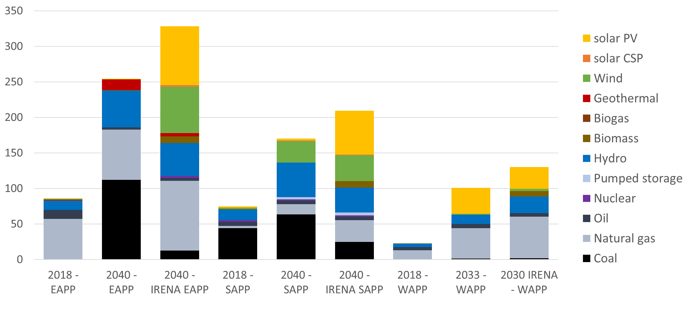
IRENA’s Analysis across African Power Pools
GW
3

Slide 4
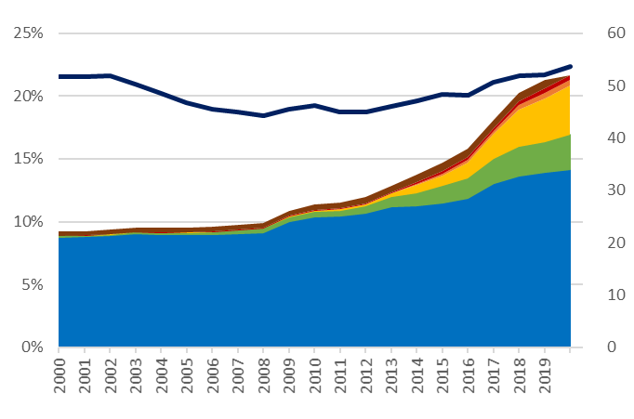
Renewable Energy Growth in the African Power Sector

Slide 5
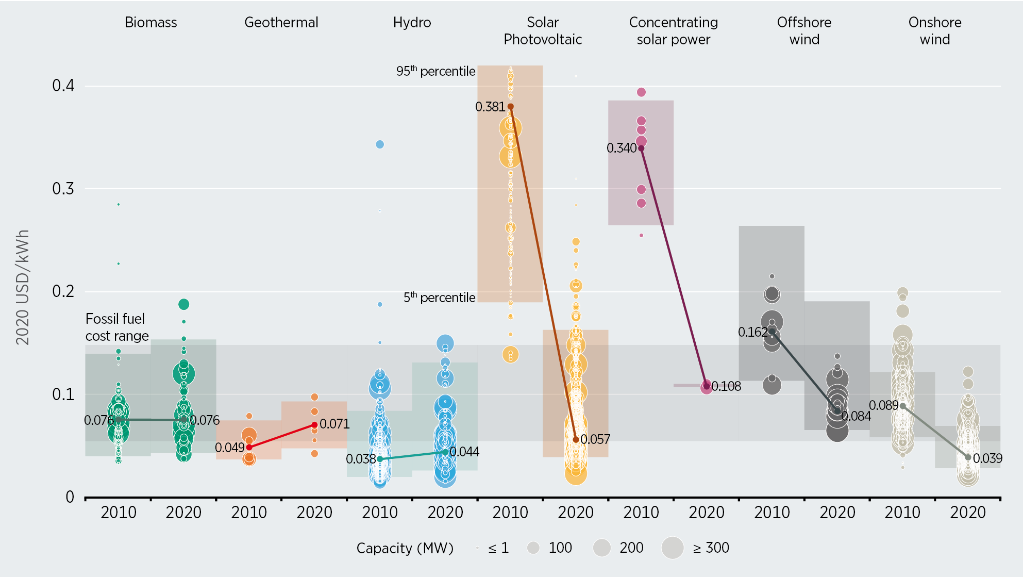
Ever-decreasing costs of renewable power

Slide 6
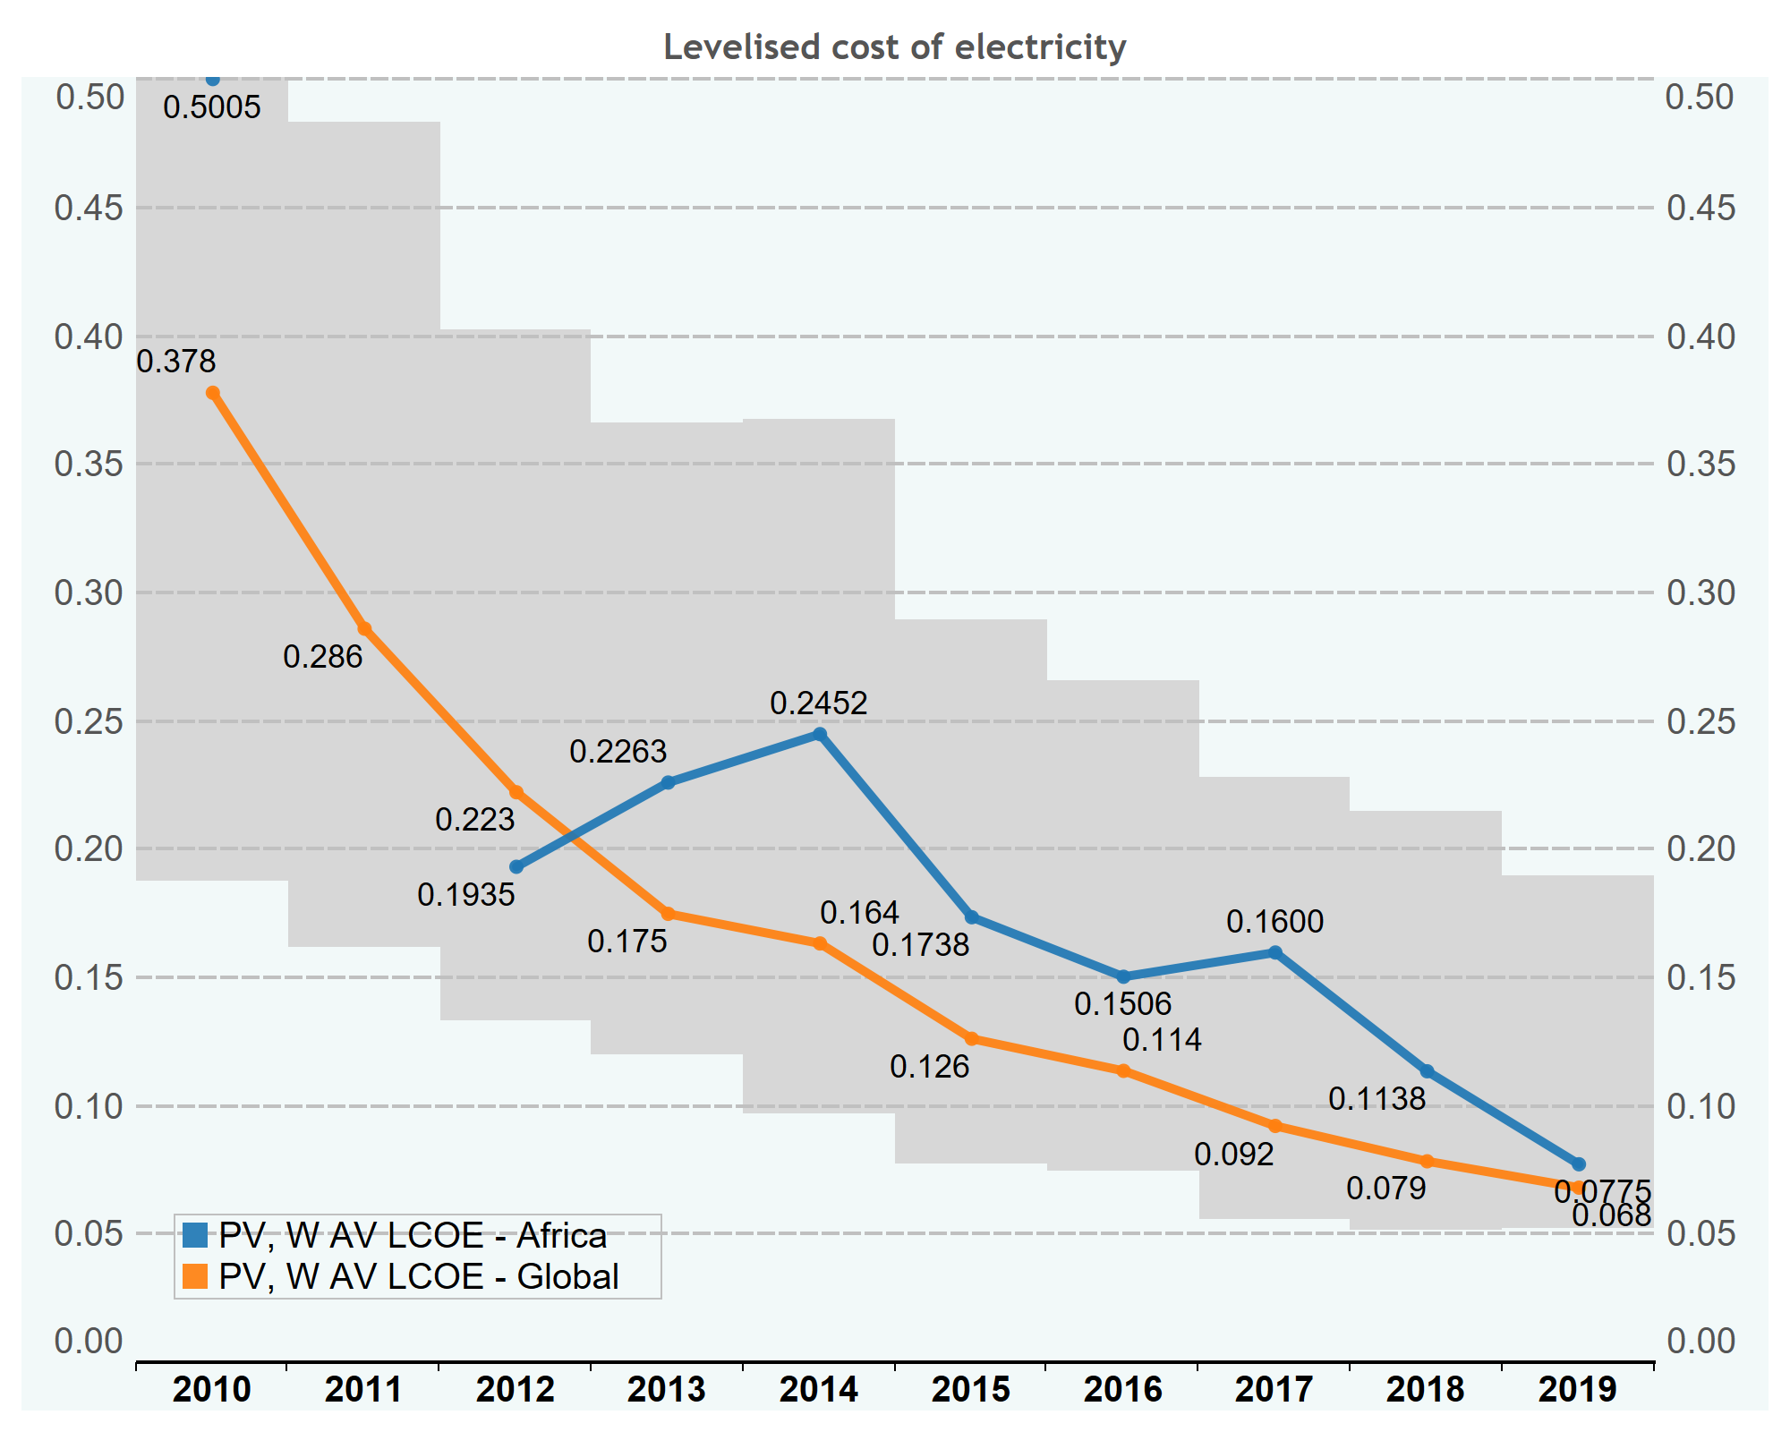
Ever-decreasing costs of renewable power

Slide 7
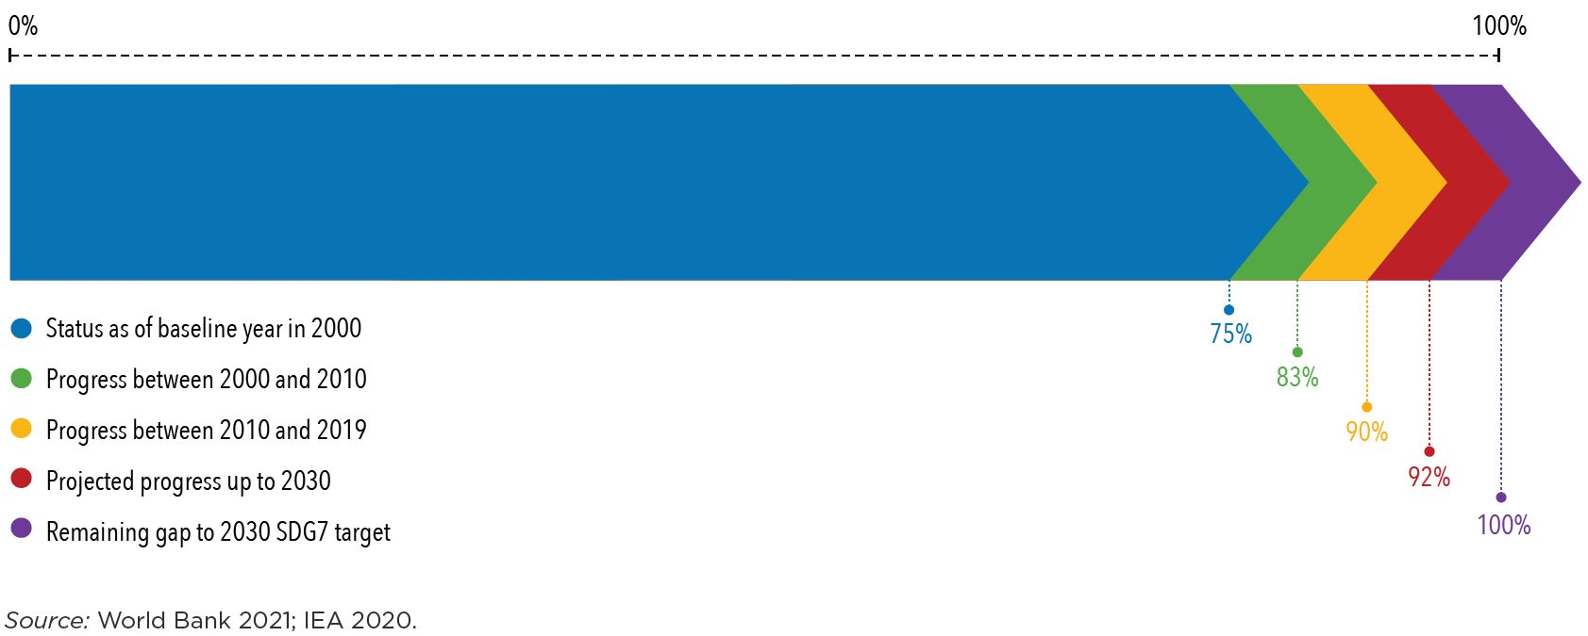
Solar PV to Power Electricity Access to 2030 and beyond

Slide 8
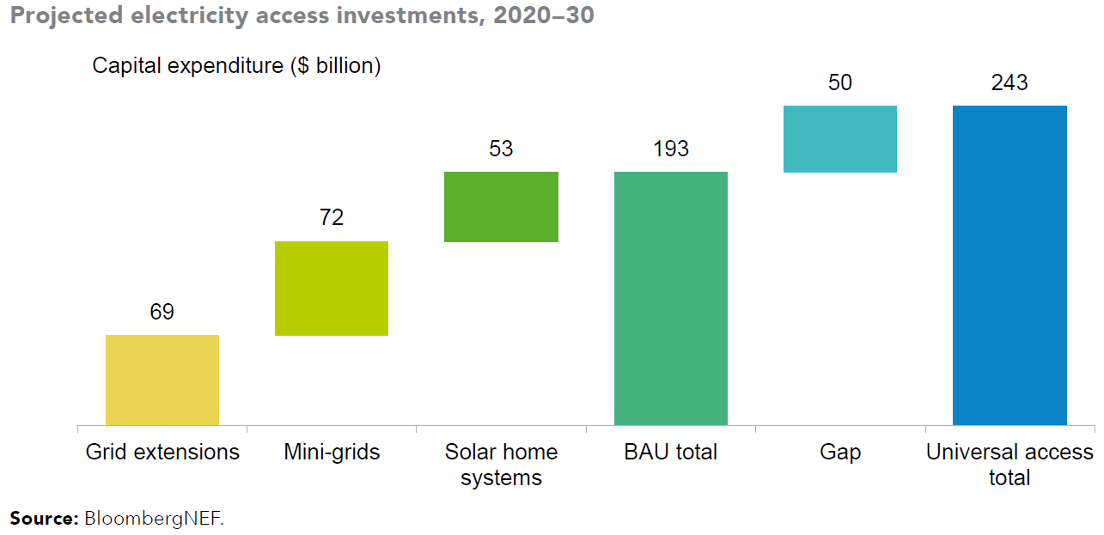
Solar PV to Power Electricity Access to 2030 and beyond

Slide 9
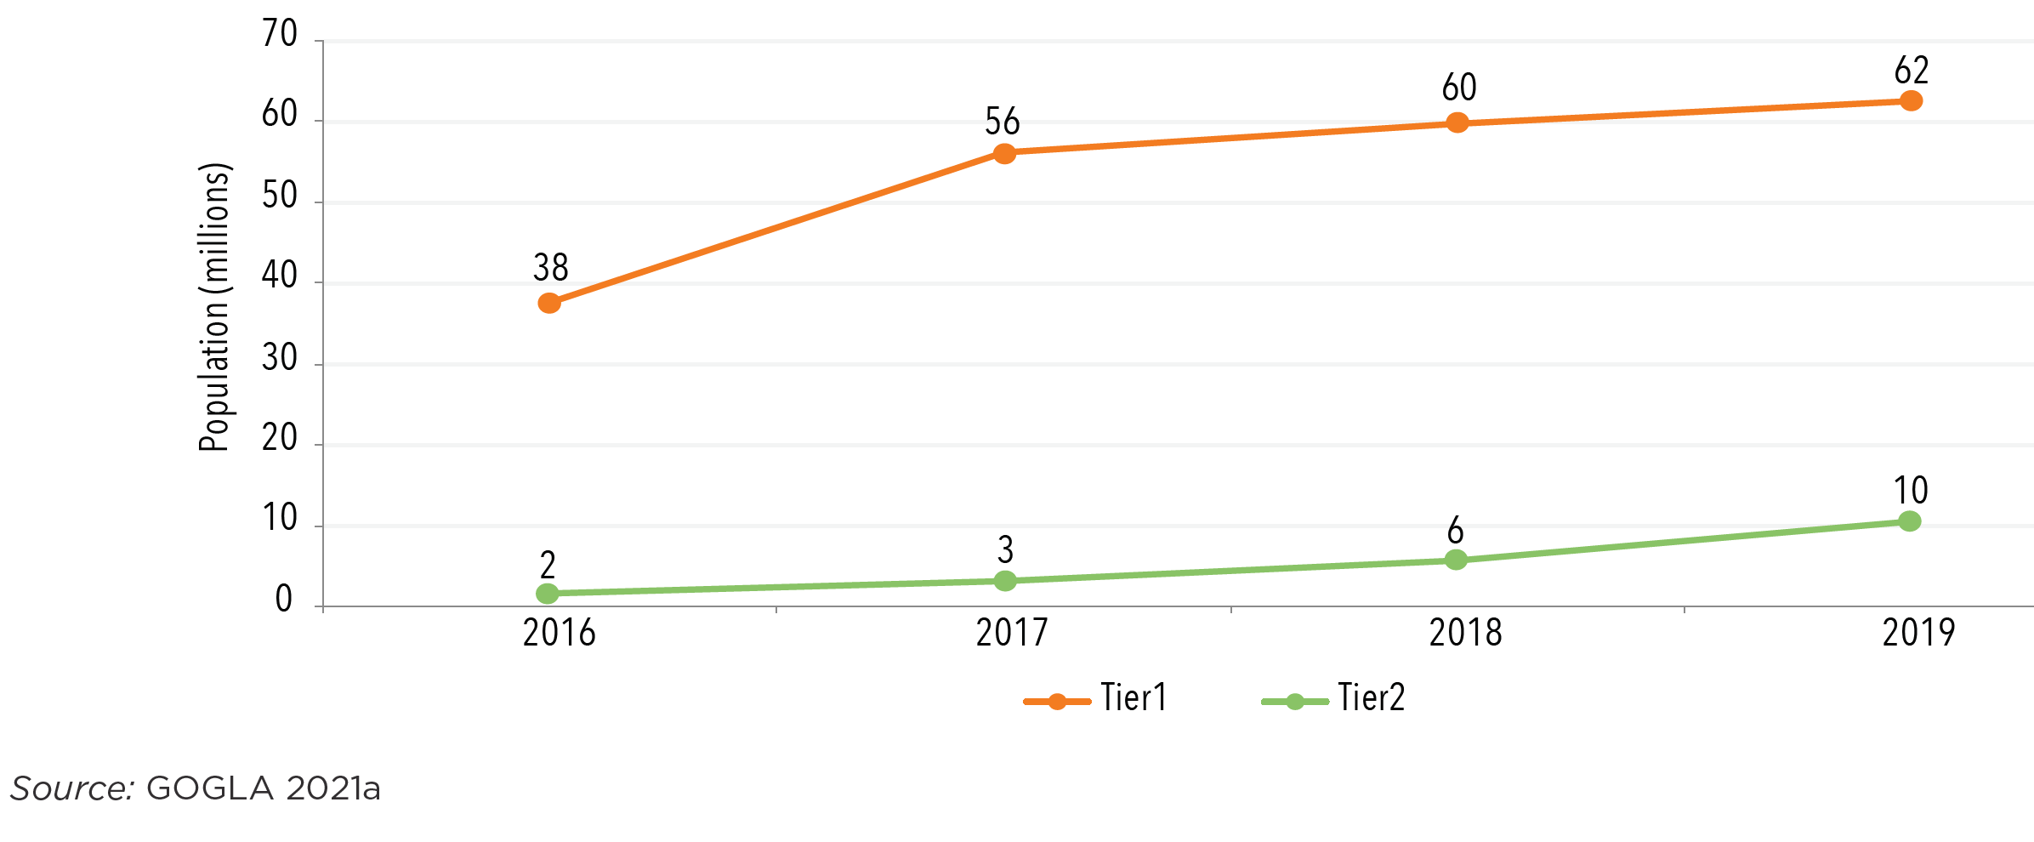
Number of people (millions) connected to off-grid solar products by tier, 2016-19

Slide 10


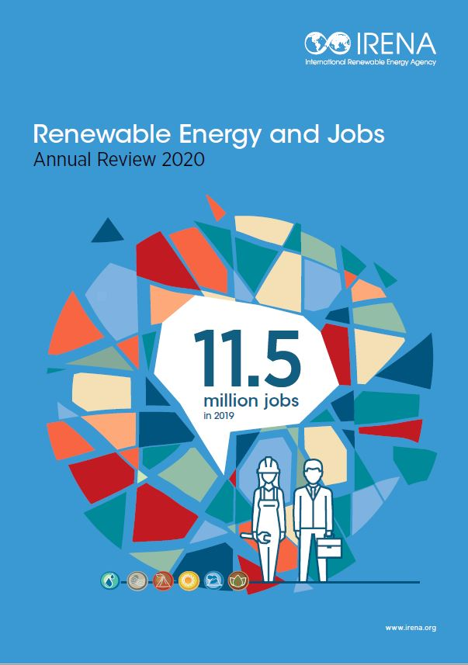
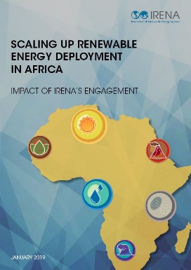
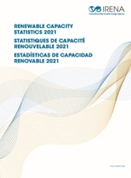
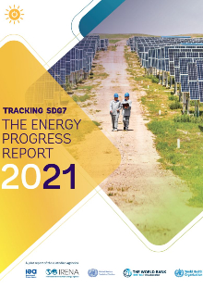
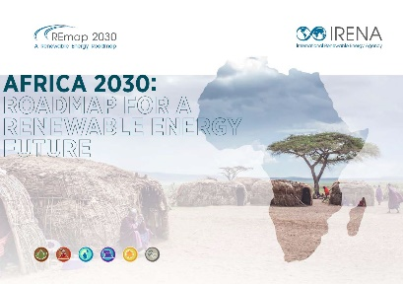
Country priorities and IRENA support offerings
Capacity Building
Resource Assessment
Planning and Operation of Grids with Higher Shares of VRE
Renewable Energy Power Purchase Agreements
Power Procurement
Data Collection, Management and Dissemination
Enabling Frameworks
Renewables Readiness Assessments (National)
REmap Analyses (National/Regional)
Renewable Energy and Planning Prospects (Regional)
Grid stability studies (National)
Regulatory Support (Regional and National)

Slide 11
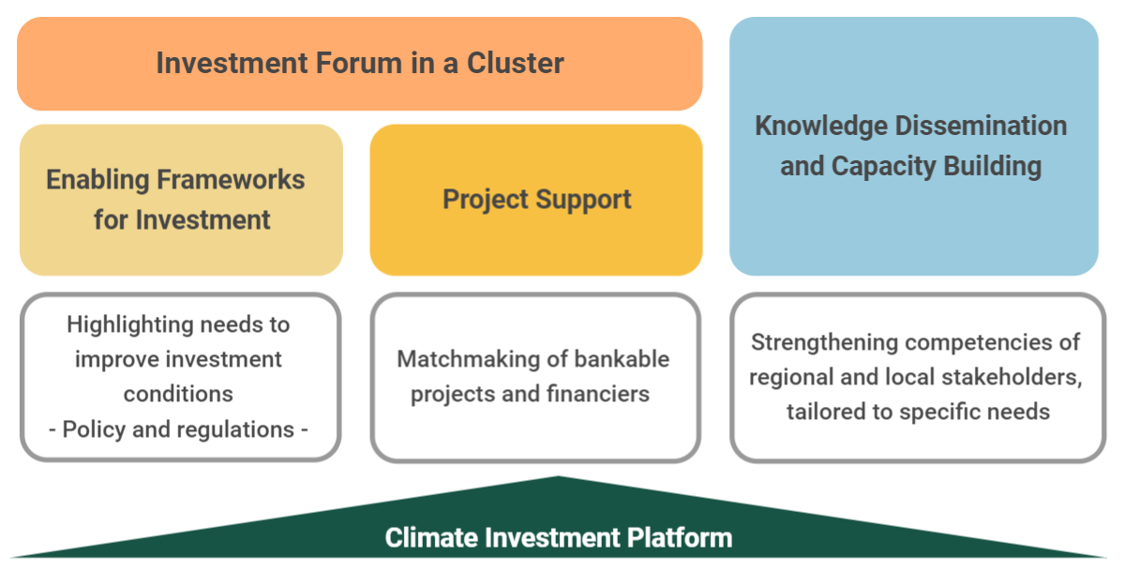


Climate Investment Platform: Investment Forums

Slide 12
Thank you
Nopenyo E. Dabla Programme Officer Sub-Saharan Africa NDabla@irena.org

