Slide 1


IRENA’s view on uptake, integration and harmonization of renewables in Albania
- RRA Albania key findings -
Hard Talks Albania
6-7 July 2021
Petya Icheva, Programme Officer South East Europe, IRENA
PIcheva@irena.org

Slide 2
World Energy Transitions Outlook: 1.5°C Pathway
Our latest report

Slide 3
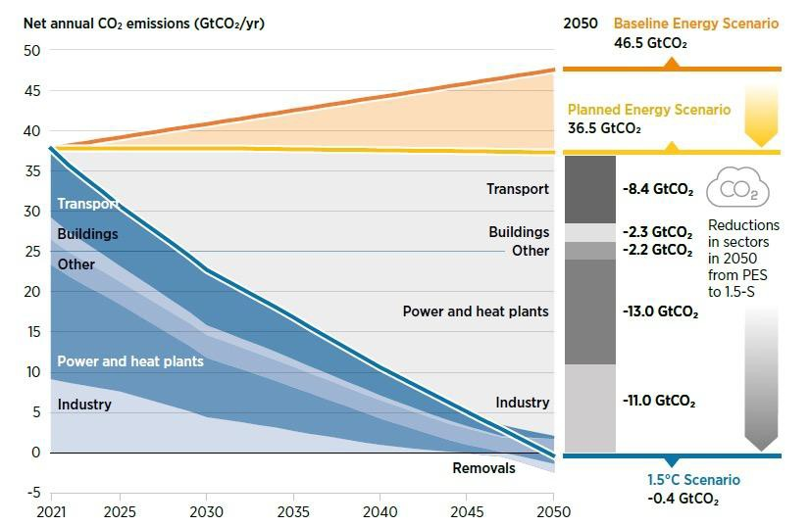
Net-zero emissions by mid century
Baseline emissions continue to rise, while the policies of Governments (Planned Energy Scenario) result in flatlining of emissions
For the 1.5°climate target, global CO2 emissions need to drop to net zero by 2050
Steepest decline necessary over the next 10 years – 2020 must be the decade of action

Slide 4
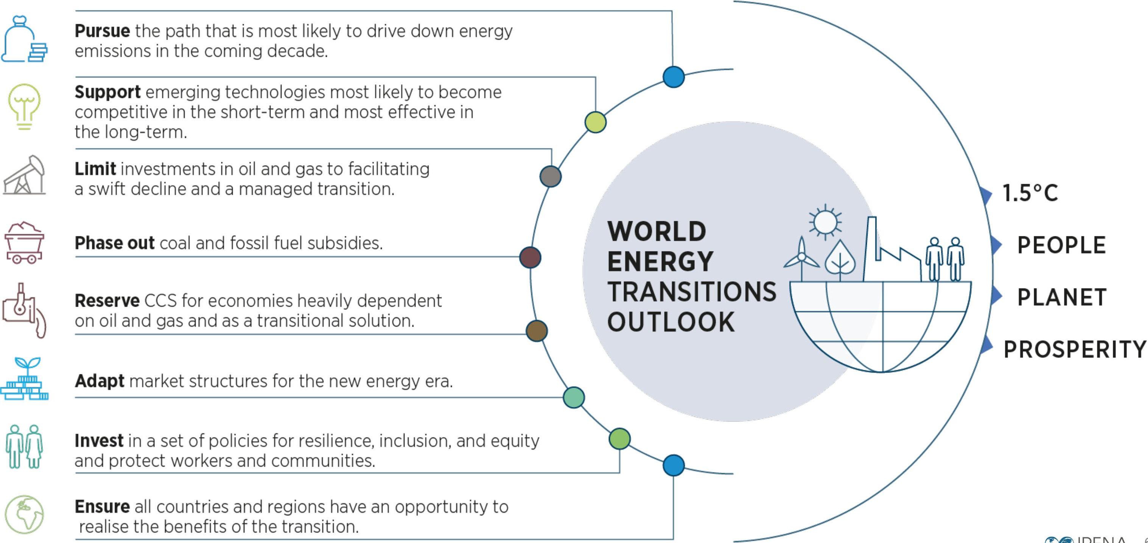
Investment and policy choices in the coming decade will define the pathway to 2050

Slide 5
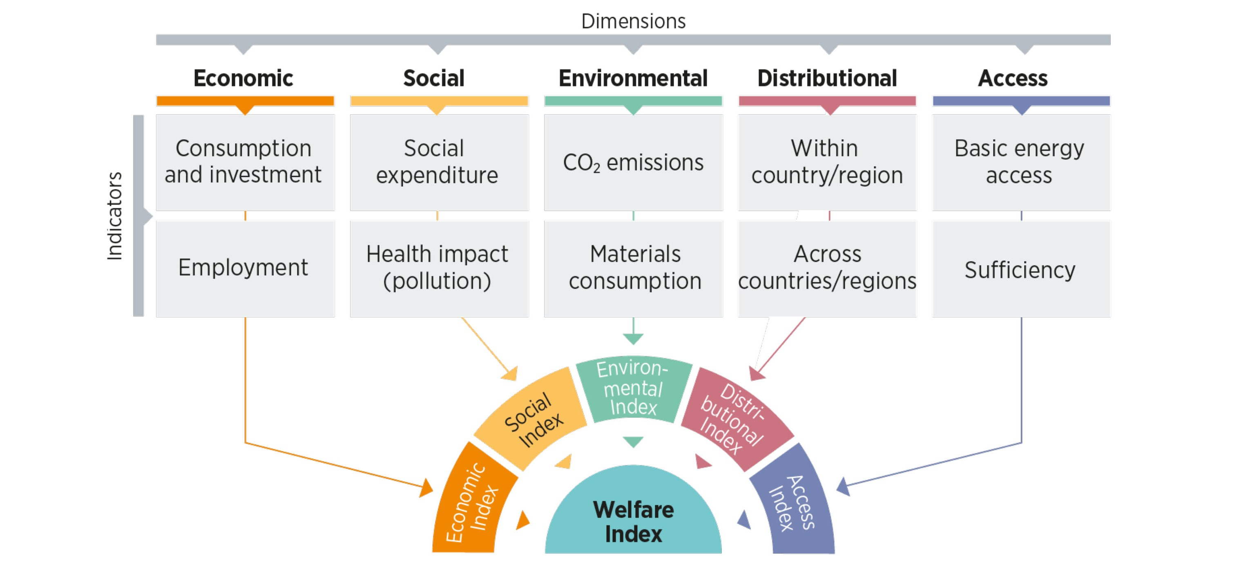
IRENA’s Energy Transition Welfare Index
IRENA’s Energy Transition Welfare Index captures economic, social, environmental, distributional and energy access dimensions. For the first time, the Index reports distributional and energy access dimensions that are often overlooked in other analyses.

Slide 6
Renewables Readiness Assessment (RRA) Albania
Overview

Slide 7

Renewables Readiness Assessment Albania
Comprehensive assessment of the key conditions for RE deployment
  Identification of obstacles of policy, regulatory or institutional nature hindering accelerated deployment of renewables
  Recommendations include short / medium-term actions needed to develop enabling frameworks conducive to renewable energy investments
Country-initiated, country-led process, where IRENA serves as facilitator
Inclusive and multi-stakeholder process promoting consensus
Joint analysis by the Albanian Ministry of Infrastructure and Energy (MIE) and the International Renewable Energy Agency (IRENA)
Objectives
Modality

Slide 8

More than 40 RRAs Worldwide
SEE
Moldova
Albania Belarus
Bosnia and Herzegovina
APAC
Bhutan
Mongolia
Marshall Islands
Fiji
Kiribati
Vanuatu
Philippines
Thailand
Indonesia
Malaysia
SCA
Azerbaijan
Pakistan
Kyrgyzstan
LAC
Antigua & Barbuda
Grenada
Nicaragua
Panama
Peru
El Salvador
Paraguay
SSA
Djibouti
Eswatini
Ghana
Mali
Mozambique
Niger
Senegal
Tanzania
The Gambia
Zambia
Botswana
Burkina Faso
MENA
Egypt
Lebanon
Mauritania
Oman
Jordan
Tunisia
Iraq
Kuwait
Sudan
COMPLETED
IN PROGRESS
UPCOMING

Slide 9
Renewables Readiness Assessment Albania
Key Findings and Recommendations

Slide 10
RRA key findings and recommendations
Key recommendations are found in five key thematic areas that address challenges for an accelerated deployment of renewable applications in the end-use sectors, renewable energy investments and local industry development.
Improve capacities, skills and awareness
Enhance
long-term
planning
Within the five key thematic areas, 11 recommended actions were identified.
Collective outcome for renewables to reach a higher share of Albanian’s energy mix while improving energy security and reduce cost of supply.
Recommendations are in line with the National Energy Policy and NDCs.
The implementation of recommendations help to attract investments, towards a climate resilient, low-emission development pathway.
Key thematic areas
Foster renewable energy financing
Strengthen legislative framework
Intensify the use of renewables in end use sectors

Slide 11
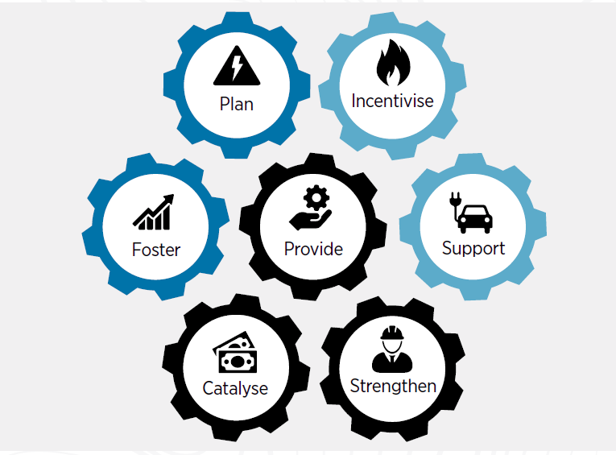
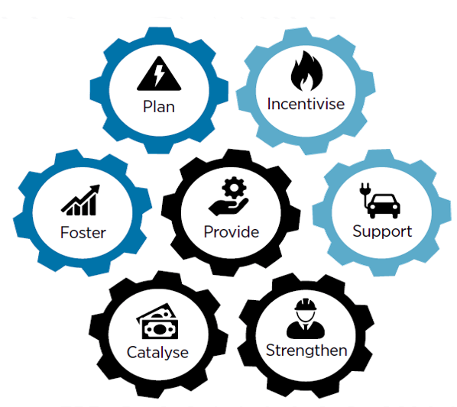

RRA key findings and recommendations
Foster renewable energy financing
Improve capacities, skills and awareness
Enhance long-term planning and assess the renewable energy sector potential
Strengthen legislative and regulatory frameworks
Intensify the use of renewables in end use sectors
Action 1: Develop renewable energy zones
Action 2: Develop a comprehensive least-cost energy master plan
Action 3: Strengthen the distribution network
Action 4: Strengthen support mechanisms for renewable energy deployment
Action 5: Establish a dedicated renewable energy agency
Action 6: Develop a strategy for a greener transport sector
Action 7: Develop a heat bylaw
Action 8: Facilitate financing of bankable project proposals
Action 9: Raise public awareness on the benefits of renewable energy
Action 10: Enhance institutional capacities and local human resources
Action 11:
Strengthen communication and cooperation among stakeholders

Slide 12







Thank you for your attention!
^{www.irena.org}
^{www.twitter.com/irena}
^{www.facebook.com/irena.org}
^{www.instagram.com/irenaimages}
www.flickr.com/photos/irenaimages
^{www.youtube.com/user/irenaorg}
12

