Slide 1
Central American Electrical Interconnection System (SIEPAC)
ESCAP-GTI Seminar on Energy Cooperation in North-East Asia:
Regional Power Trade and Connectivity in North-East Asia
7 July 2021
Fabian Barrera
Associate Programme Officer, Latin America and the Caribbean

Slide 2
The Central American region
Year: 2019
  Composed by 7 countries: Belize, Costa Rica, El Salvador, Guatemala, Honduras, Nicaragua and Panama
  Total population of around 49 million (2019). Guatemala accounting for the largest share - 34%
  Cultural and geographic similarities
  All countries are categorised as middle-income countries
  GDP coming mainly from services, commerce, tourism and trading sectors
Source: World Bank, World Development Indicators (July 2021)

Slide 3
Central American Energy Sector
Year: 2020
  The six countries part of the electricity market reached 19 GW of installed capacity in 2020.
  Renewable energy accounts for 81.9% of total installed capacity.
  Hydropower is the largest renewable energy resource accounting for 30% of installed capacity and almost 50% of electricity generation
  Since 2015, VRE plays an important role in the energy mix of the countries in the region
Source: IRENA Statistics

Slide 4
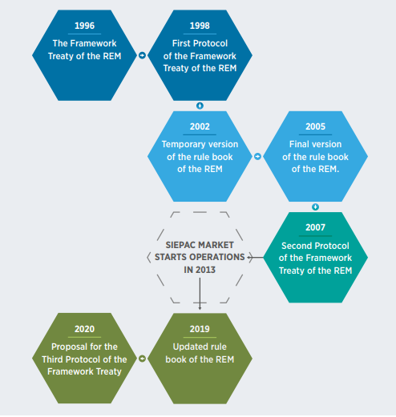
Evolution of interconnectivity in Central America
  Regional integration initiatives started in the 50s
  In 1993, the Central American Integration System (SICA) was created as a regional economic and political organisation
  The Framework Treaty established the Regional Electricity Market (REM), the creation of the SIEPAC line, and the regional organisations part of REM
  Drivers for regional market:
    Improve operational efficiency
    Reduce dependence to fossil fuels
    Improve competition (national and international)
    Reduce electricity prices
    Attract private investment
Source: IRENA and KEEI (2021), Renewable energy and electricity interconnections for a sustainable Northeast Asia, International Renewable Energy Agency, Abu Dhabi.

Slide 5
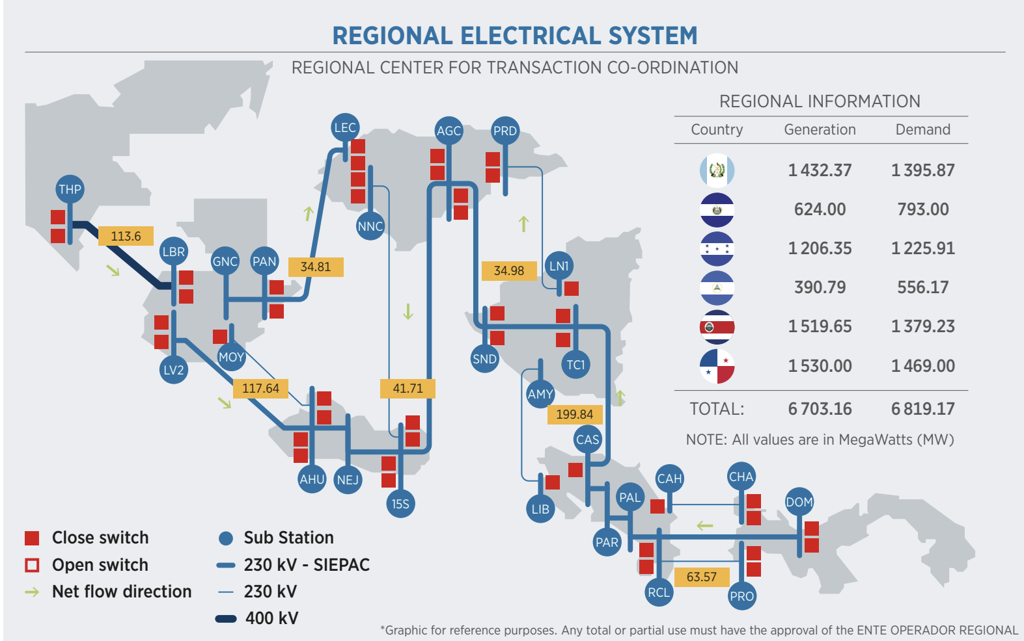
Regional market infrastructure
Cross-border interconnections has been developed in the region since the 70s
The SIEPAC line started construction in the late 90s by the Regional Operations Entity (EPR)
SIEPAC was finance by the Interamerican Development Bank (IDB), Central American Bank for Economic Integration (CABEI), Development Bank of Latin America (CAF), and private banks – total investment was around USD 505 million
First phase of construction aimed to reinforced existing national grids and cross-border interconnections
SIEPAC is a 230kV power grid from Guatemala to Panama, with a length of 1790km, and carrying capacity of the single-circuit line is 300 MW
SIEPAC started operations in 2013
Source: IRENA and KEEI (2021), Renewable energy and electricity interconnections for a sustainable Northeast Asia, International Renewable Energy Agency, Abu Dhabi.

Slide 6

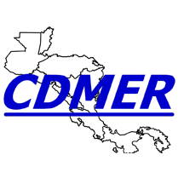



Institutional Framework
The Framework Treaty established all regional institutions for the development of the REM:
  SICA’s Council of Ministers of Energy: Develop guidelines for the regional energy policy.
  Regional Operations Entity (EPR): It is a public-private company aiming to design, build and sustain the SIEPAC interconnection system.
  Regional Operating Entity (EOR): The entity proposes procedures for the operation of the market and correct use of regional grid; ensure the correct criteria of operation and regional dispatch; undertakes commercial management of transactions; develops expansion generation and expansion plans, among others
  Regional Commission for Electrical Interconnections (CRIE): It is the independent regional regulatory agency, responsible for regulating commercial relations and for setting rates.
  Board of Directors of the Regional Electricity Market (CDMER): This body is the REM board of directors, which develops the REM and facilitates of the Treaty Framework’s commitments. Additionally, it coordinates interrelation between regional organisations.

Slide 7
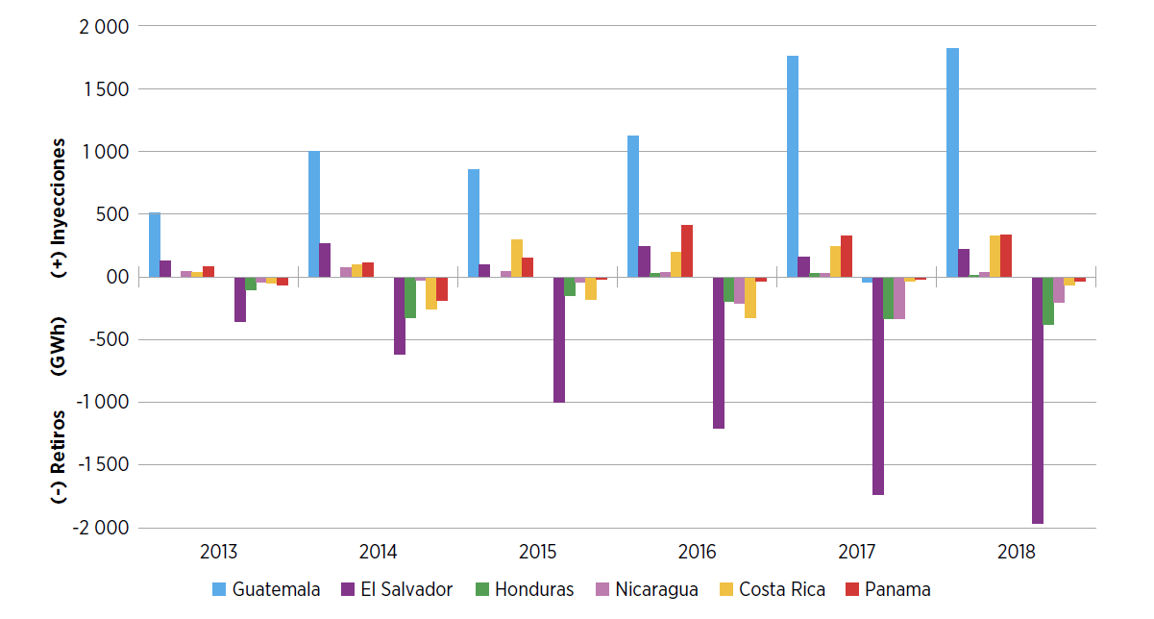
Operation of the REM
REM member-state agencies conduct transactions with each other in three ways: 1) spot transactions, 2) firm, or 3) non-firm contracts
The REM includes actors from each member country: generators, distribution companies, transmission entities, electricity dealers, agents, and large-scale consumers
To participate in the REM, all agents must have guarantees of payment at the liquidating bank
Every day, EOR issues the regional pre-dispatch where the allocated and non-allocated purchases and sales appear.
Source: IRENA (2020), IRENA Renewable Readiness Assessment: El Salvador, International Renewable Energy Agency, Abu Dhabi
REM utilises a 6+1=1 model: the six national markets plus one superposed regional market function the same as one regional market

Slide 8
Challenges and upcoming projects
Upcoming projects
Challenges
New draft protocol for REM aiming to:
  Strengthen governance and leadership
  Enhance coordination of planning processes (generation and grid)
  Establish mechanism for harmonisation of national markets
  Include interconnections and extra-regional exchange
SIEPAC line upgrades
Interconnection Panama-Colombia
Need to further develop national and regional infrastructure
Address growing implementation of VRE in the region
Insufficient coordination between national and regional generation plans

Slide 9

IRENA’s Clean Energy Corridor of Central America (CECCA)
Promote the accelerated development and cross-border trade of renewable power in Central America
endorsed by the Energy Ministers of the region in December 2015
piloted in Panama
key component of the 2030 Energy Strategy for the SICA countries

Slide 10
Pillars of Implementation
Five Pillars of Implementation
Enabling Frameworks for Investment
Support a reliable and affordable power system transformation (technical and regulatory)
Country and Regional Planning
Cost-effective renewable options in power generation in national and regional plans
Resource Assessment and Zoning
Identification of high resource zones for renewable energy development
Capacity Building
Increase skills to manage power systems with higher shares of renewables
Awareness-raising and Political Support
Public information on CECCA’s support for a regional energy transformation

Slide 11
Joint Study on RE and Electricity Interconnections in Northeast Asia
  IRENA has conducted a joint study with KEEI for faster-pace developments of power grid interconnections and power trade in Northeast Asia region.
  By reviewing the outcomes of selected interconnection plans for integrating power systems in NEA, this report aims to provide stakeholders with an updated view of NEA interconnection.
  The report has also reviewed existing cases for cross-border interconnections and regional markets, particularly capturing the case in WAPP (shallow integration), SIEPAC and Nord Pool (deep) to draw success factors and implications for NEA region.
Available at www.irena.org/publications

Slide 12
Thank you
Fabian Barrera
Associate Programme Officer, Latin America and the Caribbean
Fbarrera@irena.org

