Slide 1


COVID-19 impacts on the RE sector in Africa Challenges, Opportunities and Perspectives
Nopenyo E. Dabla
Programme Officer Sub-Saharan Africa

Slide 2


Impacts of the Covid-19 Pandemic on the Global Energy Landscape
Macroeconomics
Global economy contracted by 4.3% in 2020
Global Foreign Direct Investment fell by 42% in 2020
Disruption of global supply chains
Exposure of small and vulnerable economies
Job losses and increase of extreme poverty
Energy Sector
By mid-April 2020, weekly energy demand had fallen 18% - 25%
Drop in oil consumption and crude oil prices
Dip of the coal industry
Share of renewables in the electricity mix grew in many countries… curtailment in others
Delays for RE projects
Effects on RE value chains

Slide 3
Effects on Employment in Segments of the Renewable Energy Value Chain
Segment of value chain | Magnitude of impact of COVID-19 | Comments
Project Planning | Low | Jobs in consulting, administration and research lend themselves to remote working arrangements. However, there are delays to activities that require the presence of foreign expertise as well as on-site assessments.
Manufacturing and Procurement | High in short term | Factory workers, technicians and engineers have been heavily affected.
Transport and Logistics | High through medium term | Truck drivers and personnel responsible for shipping, delivery and loading have been significantly affected by a shortage of parts, social distancing measures and border controls.
Construction and installation | High | Engineers, technicians and workers have been strongly affected by shutdowns and delays in many locations. This has resulted in temporary and permanent job losses as well as slashed hours. Where countries have resumed construction and installation activities there are still limitations on the numbers of workers allowed on-site and requirements to observe stringent health protocols.
Operations and maintenance | Low | Because energy generation is an essential service, jobs in operations and maintenance have been relatively unaffected. The physical space available at wind and solar farms allows a degree of social distancing.
Distributed renewables | Very high | Job losses among rooftop solar installers and technicians are especially high owing to falling demand.
Biofuels | high | Many of the world’s two million biofuels jobs are threatened by a cratering of demand caused by the pandemic and associated lockdown measures. This is true all along the biofuels value chain. Ethanol plants are facing closure in several countries.

Slide 4
Impacts on the African Energy Sector
High-Level Dialogue: Pandemic Response and Recovery and Africa's Energy Transformation
Decreased demand of electricity
Several off-takers across the continent facing severe difficulties, citing force majeure
Project development, notably on access, heavily impacted due to delays in terms of movement of staff and procurement
They also raised the urgency of addressing the needs of off-grid operators
Reductions on electricity bills and free water supply provided in some countries
Tax breaks and subsidies to household expenses made available
“Whether it is our individual national policies or through harmonized regional policies, we need to make sure that whatever we come up with talks to SDGs, Agenda 2063, climate objectives as a combination to the response to the pandemic”

Slide 5
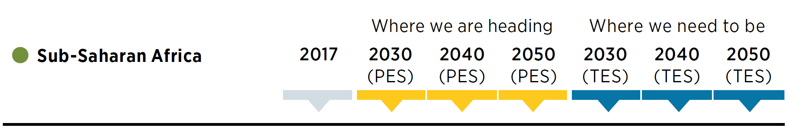
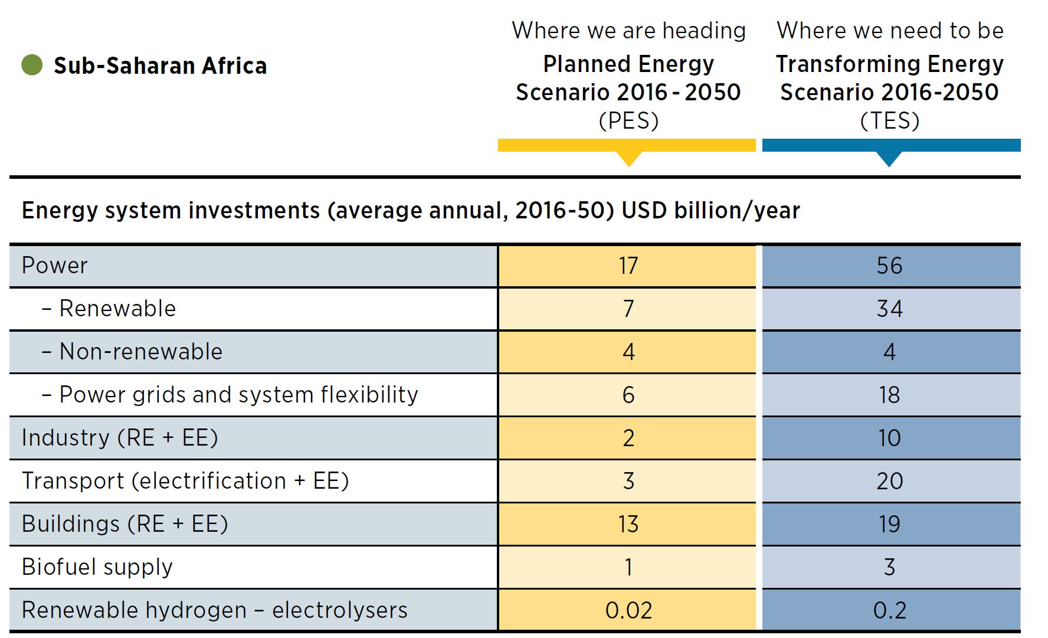
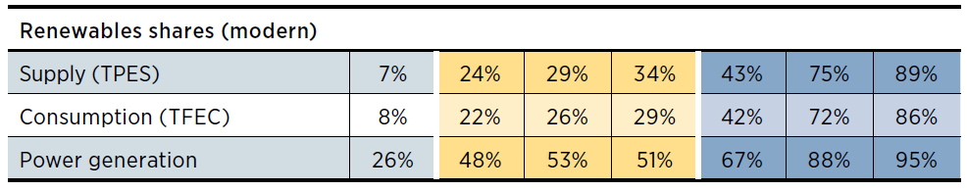
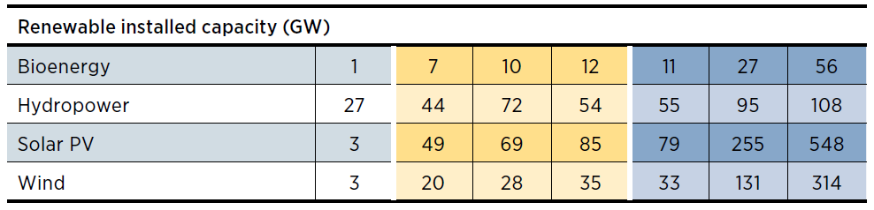
Energy Transition in Africa
More than 2 million jobs for RE, more than 1 million for EE and 700k for power grids and energy flexibility

Slide 6
Renewable Energy Growth in the African Power Sector

Slide 7
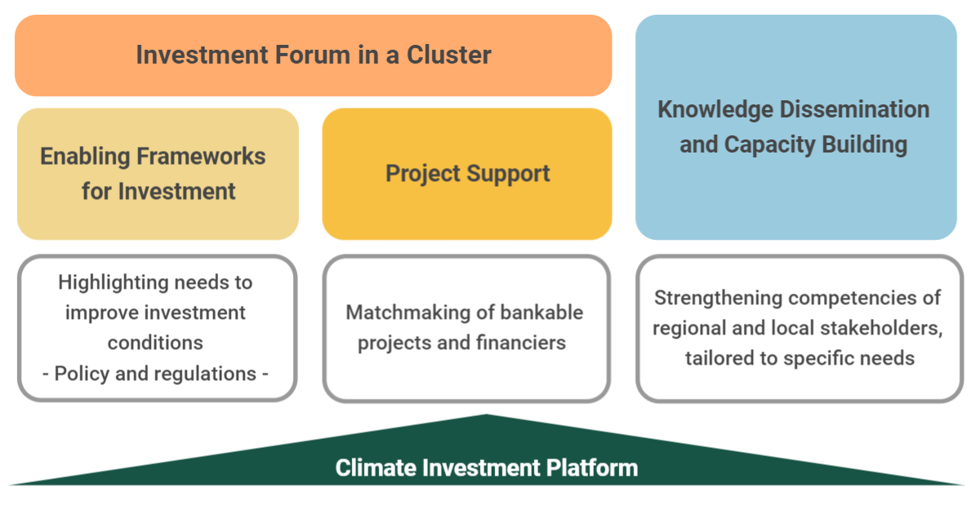


Climate Investment Platform: Investment Forums

Slide 8
Responses in the Context of Energy Access
Deploy distributed renewable energy solutions to support COVID-19 responses and strengthen the scale and resilience of health, sanitation, clean water and other critical infrastructure.
Work with the Ministries of Health and Energy to:
Understand priorities, baselines, and gaps of the health and energy sectors
Undertake a landscape analysis of the sectors
Prepare a selection of sample facilities for the assessment
Develop recommendations and a way forward on the technical design of solutions for rural healthcare facilities
The recommendations to include financial, capacity building, policy and programme design aspects
Carry out the assessment through a series of workshops and bilateral meetings
Provide technical trainings to local stakeholders to conduct the assessment
Ensure that vulnerable populations with access to electricity and clean cooking fuels do not fall back on traditional fuels due to income shocks.
Support utilities and distributed energy enterprises to introduce relief measures for vulnerable energy consumers, such as deferred or restructured payments.
Maintain and strengthen fiscal incentives and support mechanisms for expanding access to modern forms of energy.

Slide 9
THANK YOU
Nopenyo E. Dabla Programme Officer Sub-Saharan Africa NDabla@irena.org IRENA Headquarters, Masdar City P.O. Box 236, Abu Dhabi United Arab Emirates

