Slide 1
ENERGY INDUSTRIES COUNCIL – CONNECT
Clean Energy UAE 2021
Opportunities in the UAE Renewable Energy Sector
23-24 February 2021

Slide 2
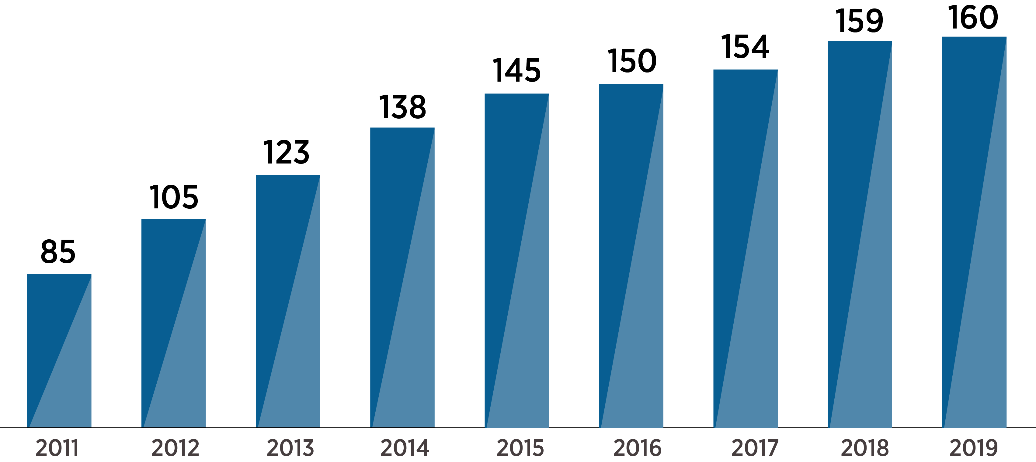
IRENA at a glance
Mandate
To promote the widespread adoption and sustainable use of all forms of renewable energy worldwide
Intergovernmental Organization (IGO)
Established in 2011
Headquarters in Masdar City, Abu Dhabi, UAE
Country Engagement & Partnerships (CEP)
Permanent Observer to the United Nations – New York, USA
Director-General – Francesco la Camera
Membership
2020:163 members + 21 in accession

Slide 3
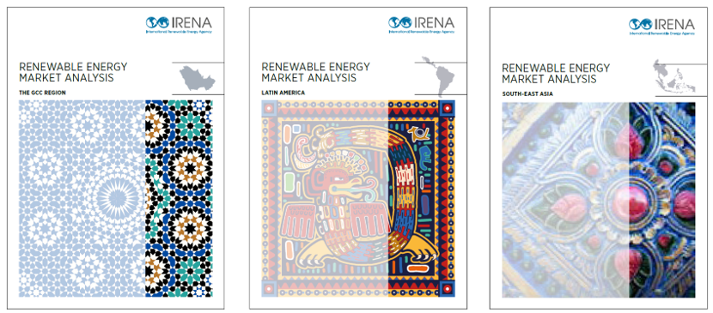
The Renewable Energy Market Analysis Series
IRENA © 2016
IRENA © 2016
IRENA © 2018
IRENA © 2019
Energy sector overview
Renewable energy landscape
Policy framework
Investment framework
The way forward
In-focus discussion

Slide 4
Rapidly growing energy demand of the GCC
Total final energy consumption by source in the GCC, 1990-2016
Total final energy consumption quadrupled since 1990
Drivers:
Economic growth
Population growth
Fuel and power subsidies
Energy demand per capita
higher in GCC countries than
most other industrialized countries
Energy supply: Oil and natural gas

Slide 5
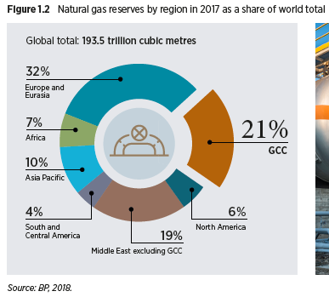
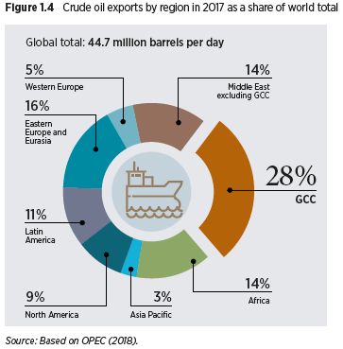
Energy resources: oil and natural gas
Crude oil reserves by region in 2017 as a share of world total
Natural gas reserves by region in 2017 as a share of world total
Crude oil exports by region in 2017 as a share of world total

Slide 6
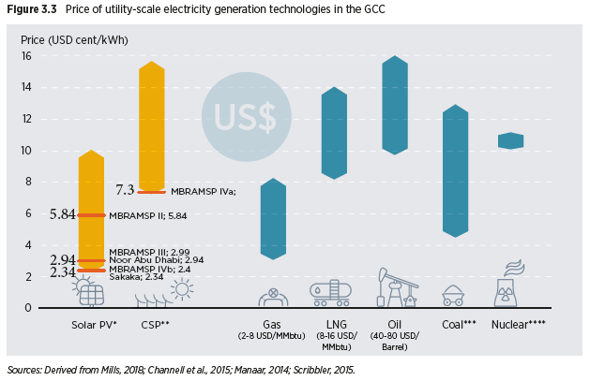
Drivers of renewable energy in the GCC
Rapidly growing demand due to economic and population growth
Promising resources
Falling costs leading to record-low prices
Socio-economic benefits
Price of utility-scale electricity generation technologies in the GCC
Auctions in GCC resulted in world record low prices for PV and CSP
Key factors for low prices
well-designed auctions
favourable financing conditions
declining technology costs
Investments in the value chain:
project developers
manufacturing companies
R&D
6
6
Notes:
IRENA’s database also compiles the benefits from the widespread adoption of renewable energy technologies. i.e. Employment benefits.
The widespread adoption of renewables creates employment opportunities up and down the supply chain. Worldwide, the sector employed 11 million people at the end of 2018, according to this sixth edition of the Renewable Energy and Jobs series.
Renewable Energy jobs by technology (in-slide comment):
Solar PV remained the top employer among RE technologies( 3.6 million jobs)
Renewable Energy jobs by Country (in-slide comment):
Asia is leading in terms of renewable energy jobs where 39% of RE jobs are in China
Gender (in-slide comment):
32% of all renewable energy jobs are held by women

Slide 7
The GCC’s promising energy resource: renewables
Suitability analysis results for on-grid solar PV (left) and on-grid wind (right)

Slide 8
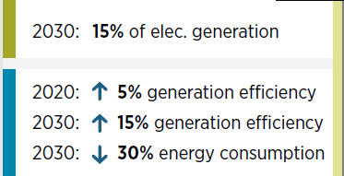
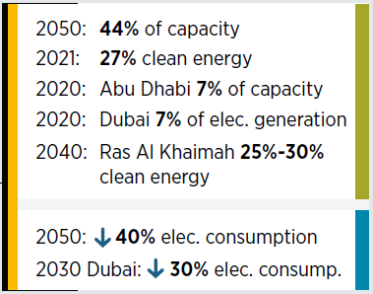
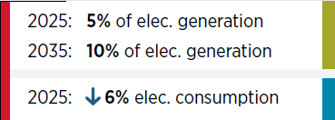
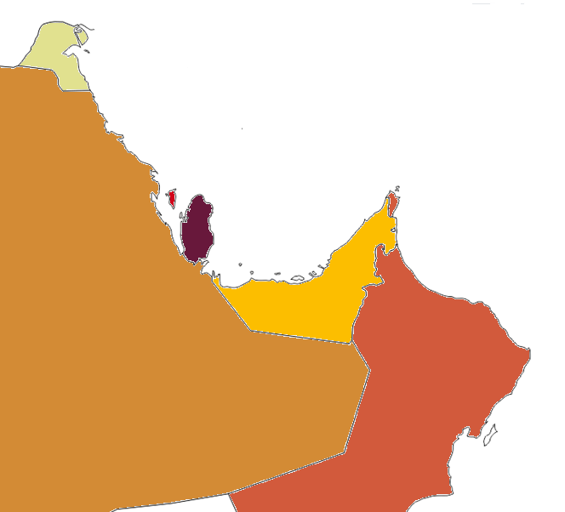
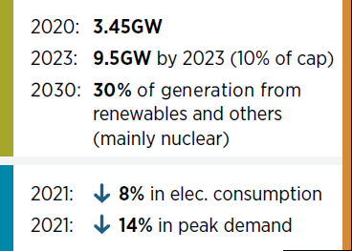
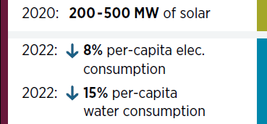
Sustainability plans in the GCC
Strong increase in renewable energy and energy efficiency plans, often integrated in national energy and/or climate strategies
Many targets not yet part of legislation
Long-term targets translating into concrete policies and medium-term projects

Slide 9
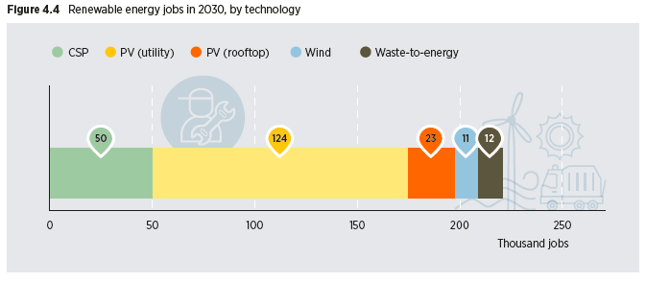
Benefits of renewable energy
Benefits of renewable energy deployment in the GCC
Renewable energy jobs in 2030, by technology

Slide 10
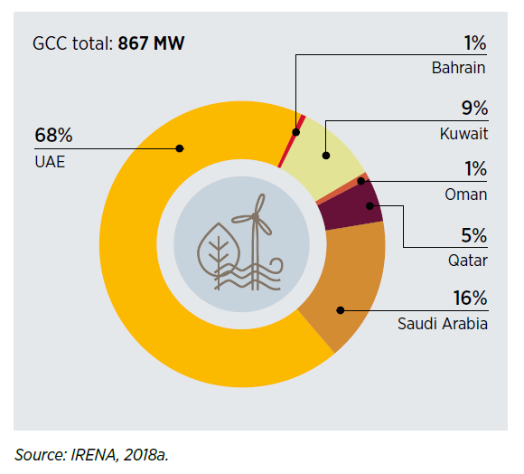
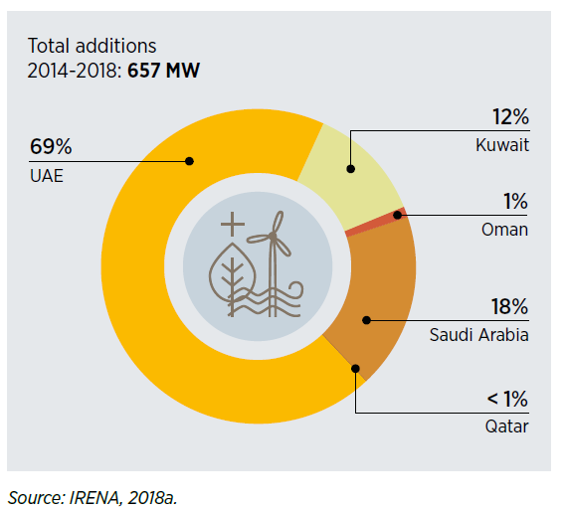
UAE leading relative to other GCC countries
Installed renewable energy capacity in GCC
countries as a share of the total by 2018
Growth in renewable energy capacity
in the GCC by country, 2014-2018

Slide 11
Sustainability plans in the UAE
Vision 2021
UAE Energy Strategy 2050
UAE Green Growth Strategy
UAE Future Strategy
UAE Centennial Plan
National Economic Strategy
Targets
Abu Dhabi
7% of installed capacity
from renewables
Dubai
7% RE of electricity generation
2020
2021
27% clean energy target
2030
Dubai
7% RE in electricity generation
Drivers
Economic Diversification
Technological innovation
Regional knowledge hub for research,
2050
44% renewable energy capacity
40% decrease in electricity consumption
Notes:
Emphsize municpaity targets

Slide 12
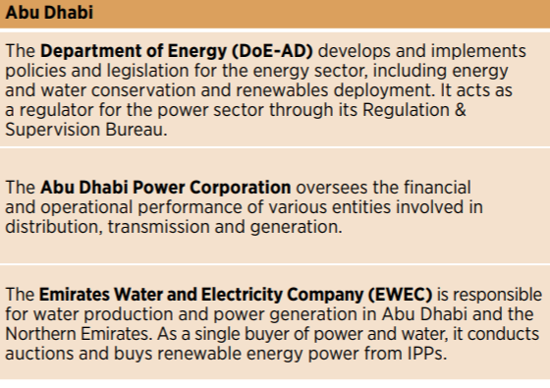
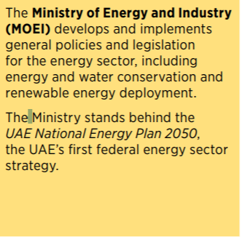
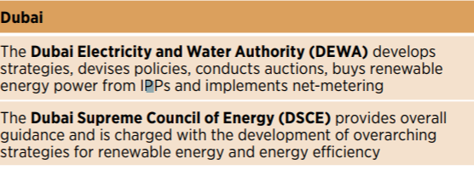
Institutional Framework
Emirate-level institutions
Federal level institutions

Slide 13
National and Regional Recommendations
Building a regional strategy for industrial development
Axis n°1
Coordinate RE plans and policies
Axis n°2
Support development of local industry
Axis n°3
Promote cross-border trade, R&D collaboration and training
Axis n°4
Establish regional financial framework & financing facility
Notes:
To enhance the regional attractiveness, the following actions have been identified:4 axes have been identified.
Axis 1: National RE strategy and public policies to coordinate national RE plans and policies for medium and long terms
Examples of recommended measures:
Formulate a long term RE strategy with national targets
Define an extensive RE regulatory framework
Define a national plan for RE equipment manufacturing
Reform fossil-fuel subsidies
Axis 2: Support development of local industry, to optimise development of RE resources and manufacturing capacities
Examples of recommended measures:
Provide information on market size and opportunities of production adjustments
Assess the feasibility of production line upgrades
Foster business linkages in particular through JV with international companies
Promote awareness-raising initiatives
Support the structuring of the sector
Axis 3: R&D and training, to promote cross-border trade and R&D collaboration
Examples of recommended measures :
Support research and development
Educate and train high-skilled workforce
Implement upgrading programs targeting specific industrial actors
Identify niche technologies and set-up national centres of excellence
Axis 4: Mobilization of investment to establish a regional financial framework and financing facility
Examples of recommended measures :
Encourage local banks to implement low interest loans and grants
Implement investment support mechanisms for adaptation or creation of production lines
Implement price, tax and other incentives

Slide 14
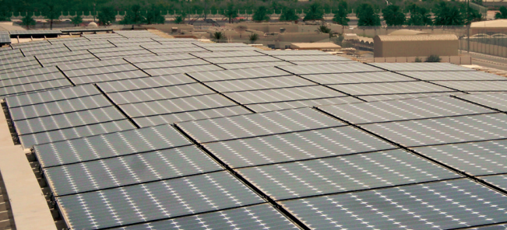
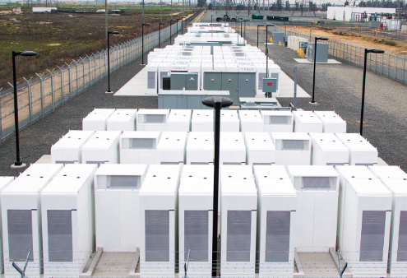
The way forward – an evolving energy sector
Market for distributed generation
Renewable energy and energy efficiency
Integrating variable RE in power systems
The overarching role of policy
Electricity storage
Electricity trade
Electric vehicles

Slide 15
Thank you for your attention

