Slide 1
Integrating low-temperature renewables in district heating and cooling systems
Focus on Belarus
February 3-4 2021
BELARUSIAN NATIONAL TECHNICAL UNIVERSITY
PROFESSOR V.A. SEDNIN and ALEXEI SEDNIN

Slide 2
HISTORY OF THE DEVELOPMENT OF DISTRICT HEATING
IN THE REPUBLIC OF BELARUS
Start: early nineties of the twentieth century.
1990.
Developed district heating systems with the extraction factors (cogeneration) of over 50%
1994 – 2000
Decentralisation (extensive construction of gas-fired boiler houses, disconnected from district heating systems)
Widespread implementation of heat metering and automation systems
Start of use of pre-insulated heat pipes
2000 – 2010
Construction of small and medium-sized gas-fired CHPs
2005 – 2020
Construction of boiler houses using local fuel
Construction of several mini-CHPs using local fuels.

Slide 3
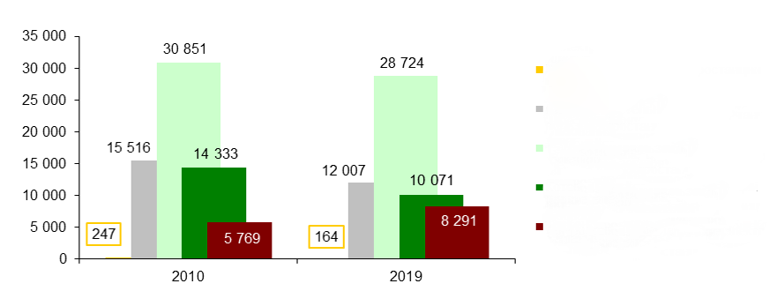
BELSTAT
million gigacalories
Utility condensing power plants
Utility district boiler houses
Utility CHPs
Boiler houses of organisations
CHPs and mini-CHPs of organisations
Heat production
by category of energy producer

Slide 4
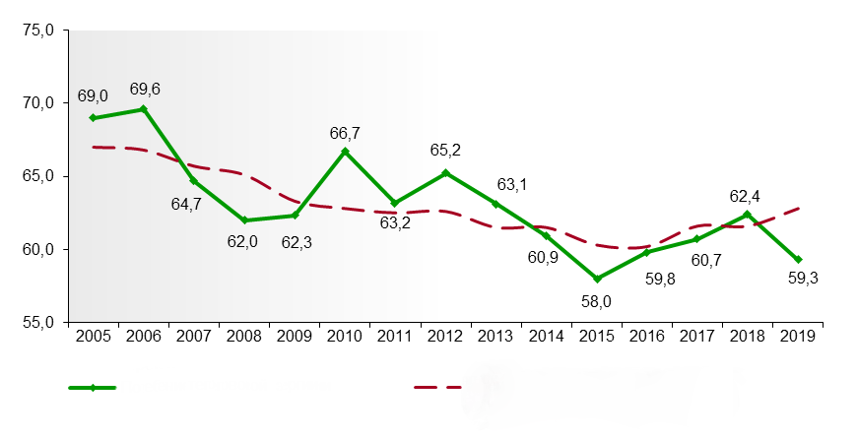
BELSTAT
million gigacalories
Heat consumption
Heat consumption \including climatic factor
Heat consumption
including climatic factors

Slide 5
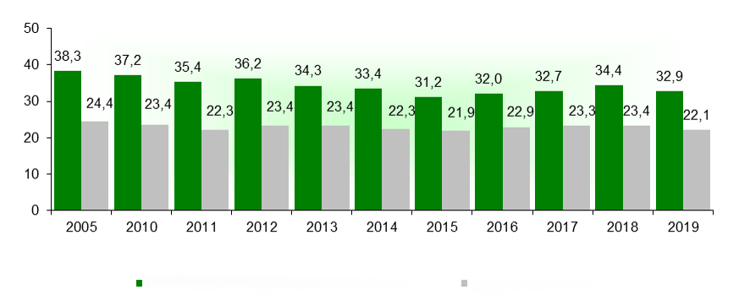
BELSTAT
million gigacalories
Used by organisations
Energy delivered to the population
Dynamics of end-use heat energy demand

Slide 6
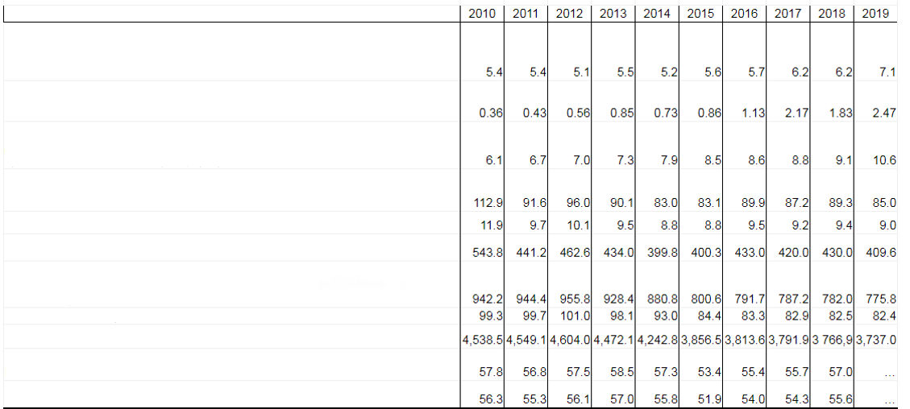
BELSTAT
Energy consumption from renewable energy sources in the Republic of Belarus
7.2.1.1 Share of primary energy generation (production) from renewable energy sources in gross consumption of fuel and energy resources, %
Share of electrical energy generation from renewable energy sources in total generation of electrical energy, %
Share of generation of heat energy from renewable energy sources in total generation of heat energy, %
Emissions of pollutants into the atmospheric air from fuel combustion for heat and electricity generation, thousand tonnes
per capita, kg per person
per unit area, kg/km2
Emissions of pollutants into the atmospheric air from mobile sources, thousand tonnes
per capita, kg per person
per unit area, kg/km2
Greenhouse gas emissions in the energy sector, million tonnes CO2-equivalent per year
of which СО2

Slide 7
Towards improving and developing district heating systems (Concept of the Development of District Heating in the Republic of Belarus to 2020)
Adopted in 2010.
Revised in 2017.
Amended in 2020 and extended to 2025.

Slide 8
Strategic directions for the development of district heating:
- Improving efficiency and ensuring continuous development of district heating systems by applying modern technologies, using local fuel and energy resources, secondary energy resources and alternative energy sources;
- reliable, economic and secure supply of thermal energy to organisations and the population;
- maximising the use of combined heat and power generation;
- keeping the balance between the economic interests of energy supplying organisations (thermal energy suppliers) and consumers;
- ensuring an economically justified return on investment capital under the conditions of state regulation of heat tariffs;
- establishing an optimal management structure for heat supply processes;
- eliminating intermediaries in the supply of heat energy to consumers;
- improving regulations.

Slide 9
Among the most representative solutions
the application of multi-rate district heating tariffs taking into account fuel taxes depending on their environmental properties;
increased use of alternative fuels in place of natural gas and oil (combustible refuse, biomass, solar energy, geothermal energy, secondary energy resources from industrial production, etc.).

Slide 10
Structure of energy generation sources in Belarus after 2020
NPP
_{Q = const}
_{To consumers}
_{W = const}
_{To consumers}
_{Q = var}
_{Boiler house}
_{Q = var}
Electric boilers in boiler houses
_{W = var}
_{Q = const}
_{CHP electric boilers}
_{W = var}
_{Power grid}
_{(W=const)}
_{Q = const}
_{W = const}
Network areas of the heating system
_{(Q = const)}
_{CHP}
_{Combined cycle} _{(CCGT-CPP)}
_{W = var}
_{Steam turbine}
_{CCGT-CPP}
_{CPP}
_{NPP}
_{W = const}
_{Isolated generating plant}
_{W = const}

Slide 11
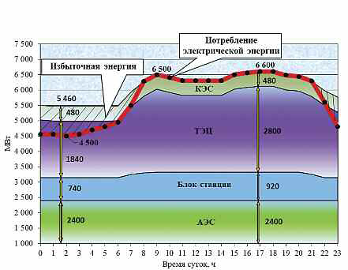
NPP
_{Electrical energy consumption}
_{Surplus energy}
_{[кэе]}
_{[тэн]}
_{mW}
_{[клок-стаячии]}
_{NPP}
_{Time of day, hr}
A scenario of the situation in the Belarusian energy system after
the commissioning of the BelNPP. Heating season

Slide 12
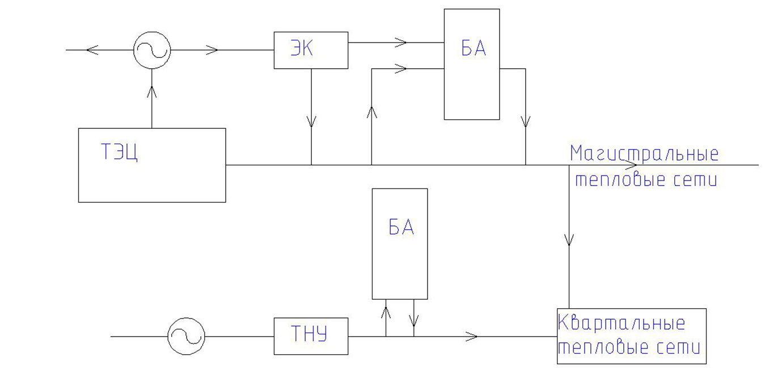
_{ЗК (to clarify)}
_{БА} _{(to clarify)}
_{Main heating networks}
_{CHP}
_{БА (to clarify)}
_{Heat-pump system}
_{Submain heating networks}
A SCHEMATIC DIAGRAM FOR INTEGRATING AN ENERGY COMPLEX AND A HEAT-PUMP SYSTEM INTO A DISTRICT HEATING SYSTEM

Slide 13
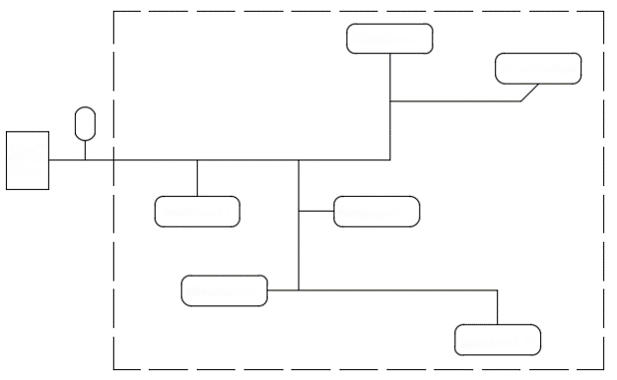
Consumer 2
Consumer 3
AT (to clarify)
thermal energy source
Consumer 1
Consumer 4
Consumer 5
Consumer 6
OPTIONS FOR INTEGRATING CUSTOMER TERMINALS INTO A DISTRICT HEATING SYSTEM: centralisation

Slide 14
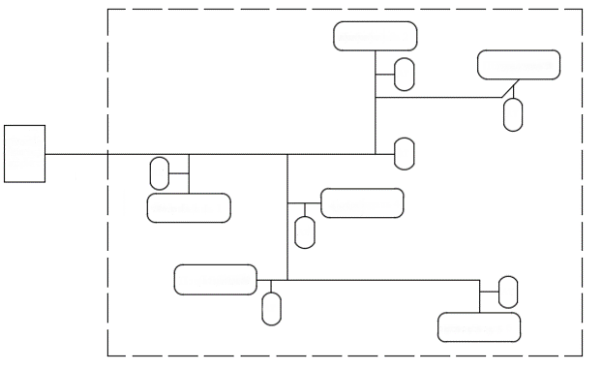
Consumer 2
AT (to clarify)
Consumer 3
AT (to clarify)
Thermal energy source
AT (to clarify)
AT (to clarify)
Consumer 1
Consumer 4
AT (to clarify)
Consumer 5
AT (to clarify)
AT (to clarify)
Consumer 6
OPTIONS FOR INTEGRATING CUSTOMER TERMINALS INTO A DISTRICT HEATING SYSTEM: decentralisation

Slide 15
EЭС
TH
Qair flow
Q
Qco
Central heat supply station
QTC
Qгвс
Q
Q
EЭС
energy complex
Q
AT (to clarify)
Structure of central heat supply station energy flows with energy complex and customer terminals, heat pump

Slide 16
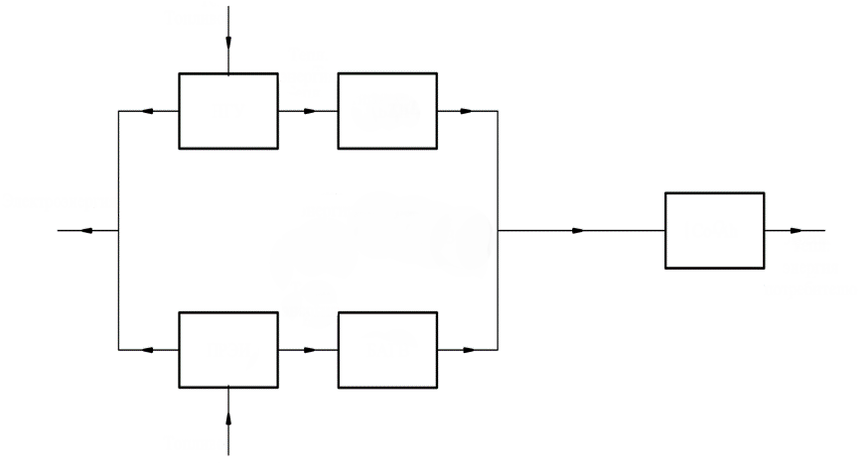
Fuel
Therm.
energy
_{CCGT}
_{Absorption heat pump}
Electricity
Therm.
energy (130°С)
_{Со-Аh}
Therm.
energy
to the consumer
Therm.
energy
_{peak-reserve energy source}
_{hot water storage tank}
Fuel
A schematic diagram of a combined heat and power unit

Slide 17
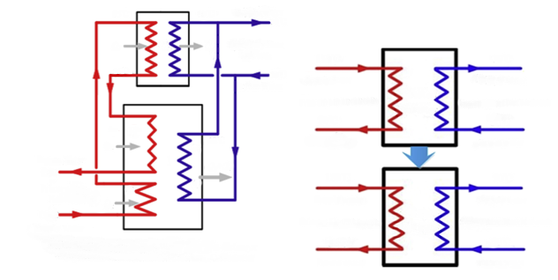
85°C
80°C
Supply water
70°C
2
Q₂
Q₂
Secondary Heat Network
130°C
70°C
55°C
50°C
Return Water
Supply water
Supply water
Plate Heat Exchanger
Primary Heat Network
Secondary Heat Network
70°C
50°C
E
Q_{e}
C
68°C
Return water
Return water
Return water
1
Q_{g}+Q_{e}
25°C
130°C
70°C
G
A
Primary Heat Network
Q_{g}
Supply water
Supply water
130°C
Absorption Exchanger
Supply water
Primary Heat Network
Secondary Heat Network
1-Absorption heat pump 2-Water/water heat-exchanger
G-generator E-evaporator A-absorber C-condensor
25°C
50°C
Return water
Return water
Co-generation-based absorption heat-exchange (Co-ah) system - a type of district heating system using absorption heat converters

Slide 18
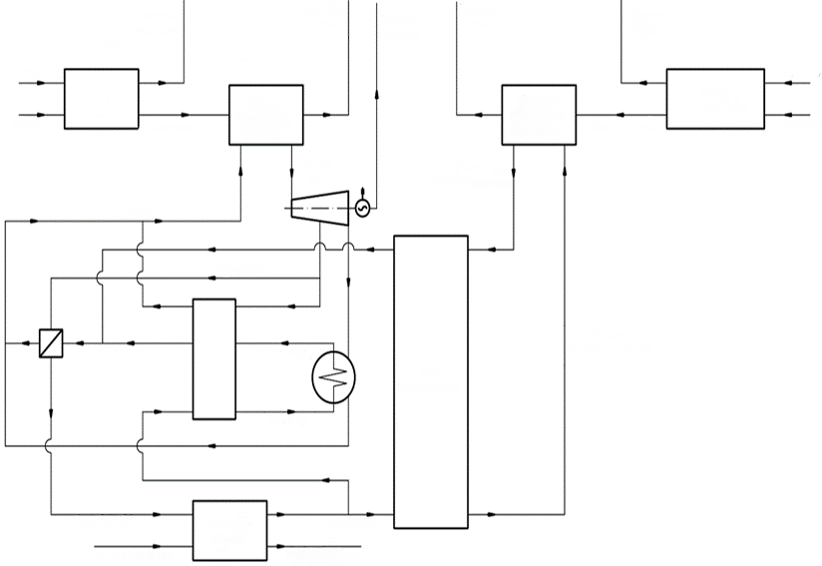
Electricity
Flue gases
Electricity
Flue gases
Electricity
Fuel
peak-reserve energy source
combustion turbine unit 6x53 MW
Fuel
combustion turbine unit
Heat recovery steam generator
Heat recovery system
Air
Flue gases
Flue gases
Air
Live steam
Water to
storage tank
Condensate
Heat extraction
Water from
storage tank
Absorption heat pump
return water
Storage tank
return water
industrial waste water 130°С
Boiler house
Со-Аh
wastewater treatment 25°С
from the consumer
to the consumer
A schematic diagram of a district heating peak-reserve energy source based on a combustion turbine unit
with a combined cycle gas turbine

Slide 19
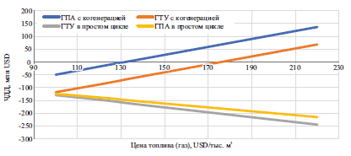
gas compressor unit with cogeneration
combustion turbine unit with cogeneration
combustion turbine unit in a simple cycle
gas compressor unit in a simple cycle
_{NPV [мая] USD}
[Цои текцлика (га)] USD/[thou.] m³
Net present value as a function of
the cost of fuel (natural gas)

Slide 20
Thank you for your attention!

