Slide 1
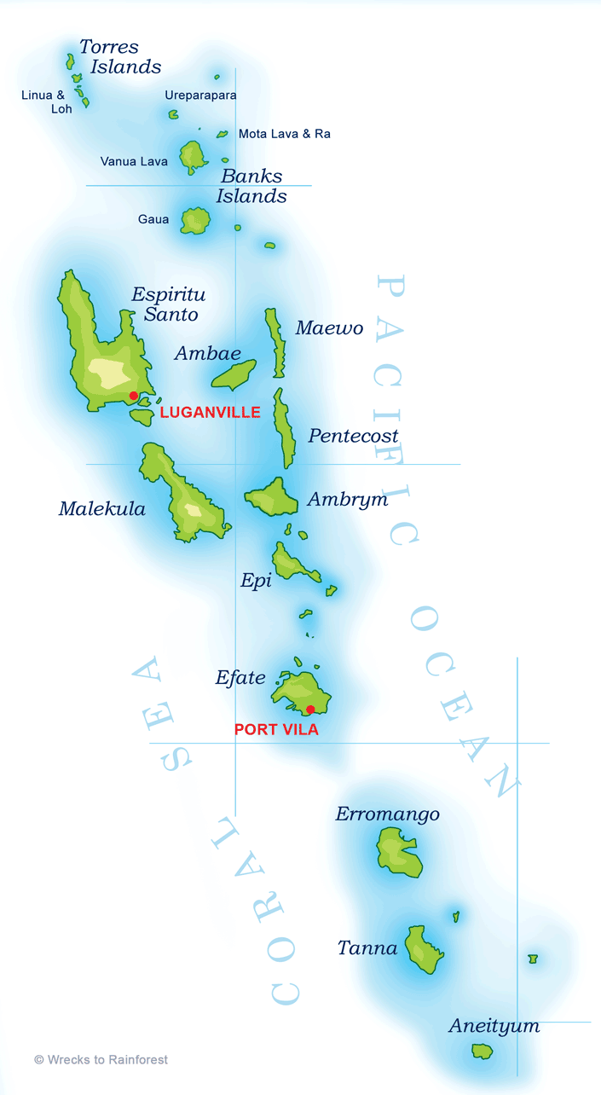
VANUATU
Joshua Chalapan Nari
Department of Energy
Vanuatu

Slide 2
1. VANUATU’S ENERGY SITUATION
Population: 290,000 spread across 82 islands (65 inhabited)
Rural: 75% with only 9% electrifed
Urban: 25%
Urban electricity providers : 4 electricity concession areas run by 2 companies
UNELCO – Port Vila (Efate island), Malekula & Tanna (3 concession areas)
VUI – Luganville (Espiritu Santo) (1 concession area)
Rural electricity providers: NONE (Individual households)

Slide 3
1.1 VANUATU CONCESSIONAIRES’ ENERGY MIX
Average energy mix in the concession areas
Energy mix in the 4 concession areas

Slide 4
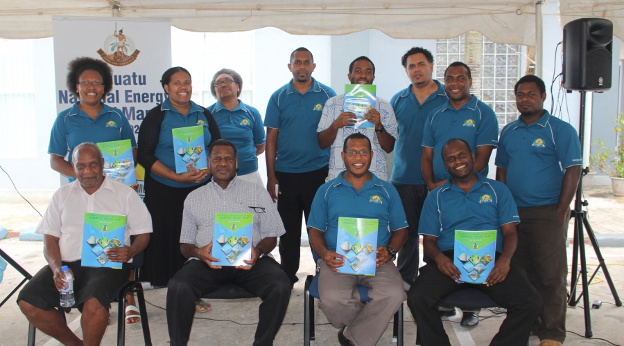
2. POLICIES/REGULATIONS TO SUPPORT ENERGY TRANSITION
2.1) NATIONAL ENERGY ROADMAP (2016 – 2030)
To achieve 100% generation by renewable energy by 2030
2.2) FISCAL INCENTIVES
Import Duty/ Customs Tax Exemption for renewable generation equipment importation
Vanuatu’s Department of Energy (DoE) team with the updated National Energy Roadmap (NERM) launched in 18th October 2016

Slide 5
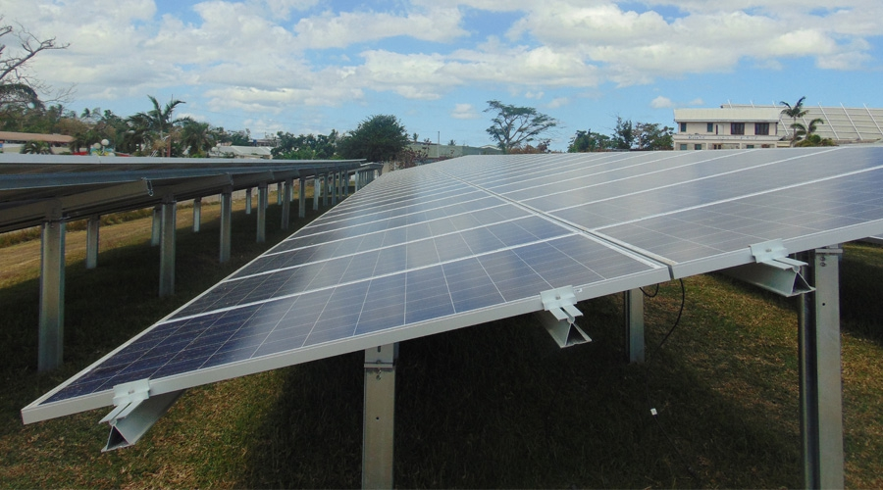
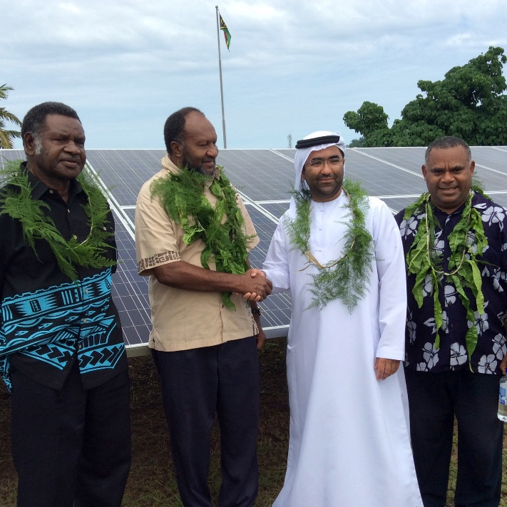
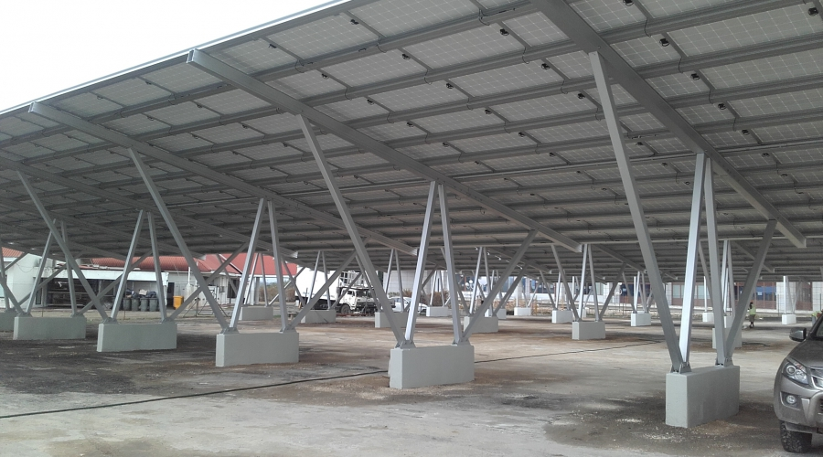
3. Renewable Energy Projects
3.1 MASDAR Solar PV Farm
Status: Completed and commissioned 2016
Technology: Solar PV
System Size: 767 kW
Location: Port Vila (On grid)
Ownership: Government of Vanuatu
% Capacity: 100% renewable (Solar PV)

Slide 6
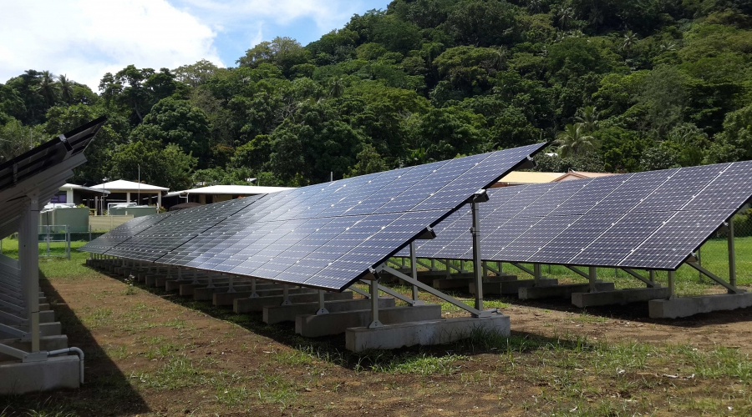
3. Renewable Energy Projects: Constructed
3.2 LOLOWAI SOLAR DESALINATION PLANT
Status: Completed 2014
Technology: Solar PV with diesel backup
System Size: 65 kW
Location: Ambae Island (Off-grid)
Ownership: Government of Vanuatu
% Capacity: 100% renewable with diesel backup

Slide 7
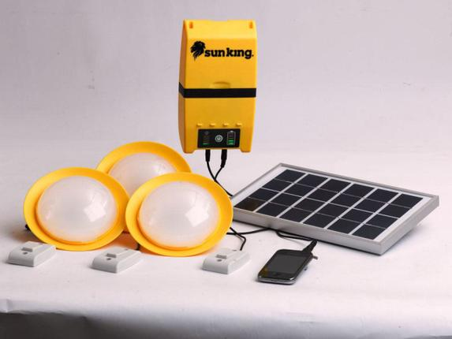
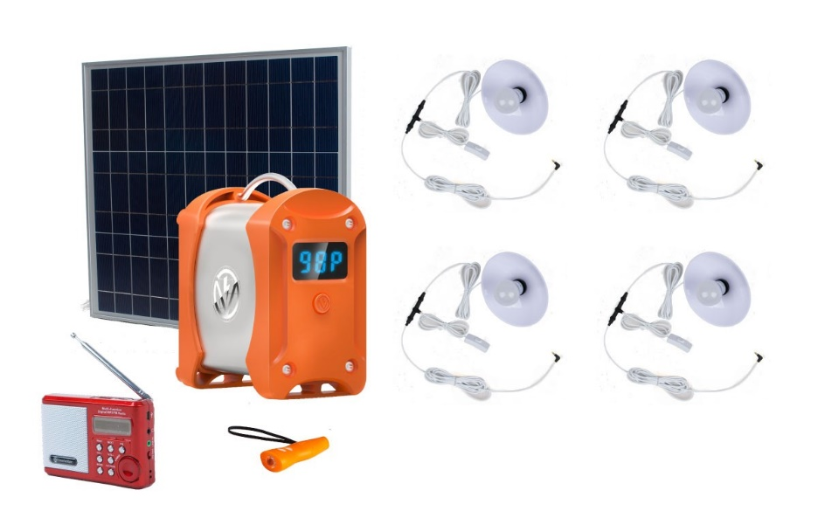
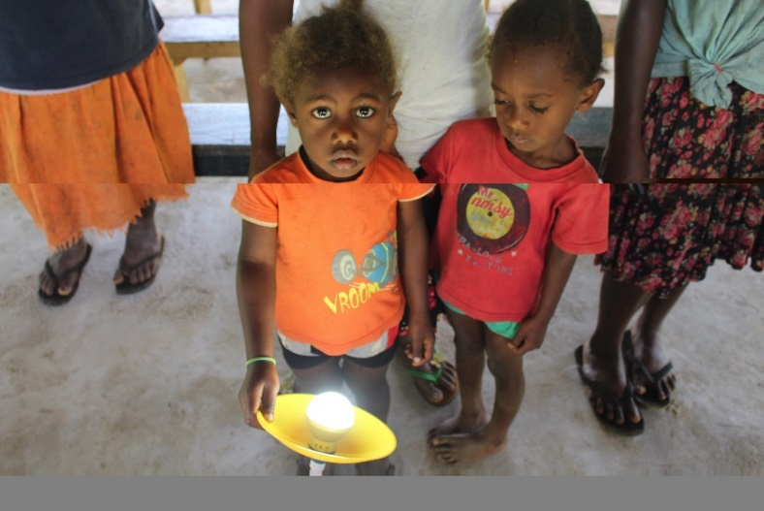
3. Renewable Energy Projects: Being implemented at present
3.3 VANUATU RURAL ELECTRIFICATION PROGRAM (VREP)
Status: Ongoing 2016 – 2019
Targeted population:
17,500 Households
2,000 Community facilities
230 Aid Posts
Technology: Solar PV
System Size: Pico Solar Systems (5W-30W)
Location: Rural
Ownership: Households,
Community facilities and Aid Posts
% Capacity: 100% renewable

Slide 8
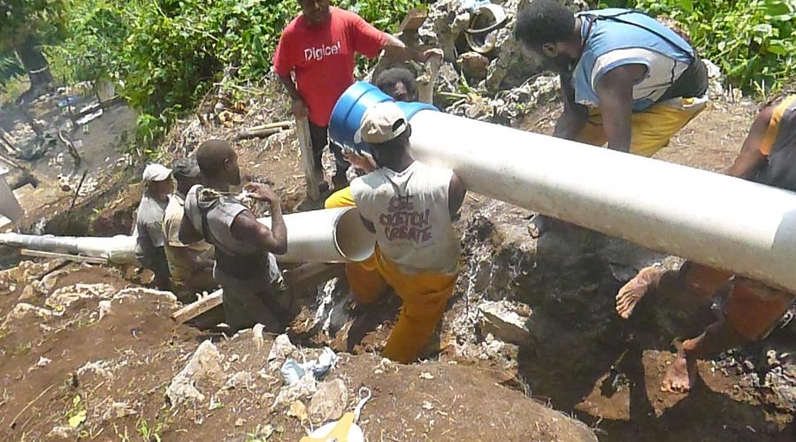
3. Renewable Energy Projects: Being implemented at present
3.4 TALISE MICRO HYDRO
Status: Generation phase completed 2014 and need to complete transmission and distribution network
Target population:
294 households to be electrified
11 schools
3 clinics
6 churches
Technology: Micro hydro
System Size: 75 kW
Location: Maewo Island

Slide 9
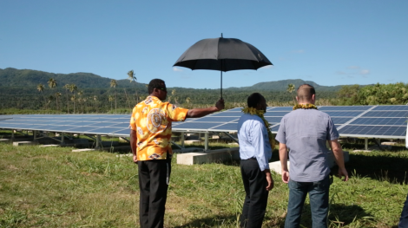
3. Renewable Energy Projects: Being implemented at present
3.5 UNELCO SOLAR PV FARM
Status: Completed and launched May 2016
Targeted population: Over 300 households
Technology: Solar PV
System Size: 501 kW
Location: Efate Island

Slide 10
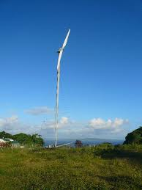
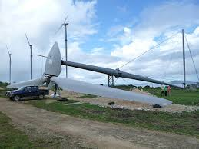
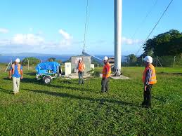
3. Renewable Energy Projects: Being implemented at present
3.6 UNELCO’S WIND FARM
Status: Completed 2007 upgraded in 2008 & 2010
Technology: Wind energy
System Size: 3MW
Location: Efate Island

Slide 11
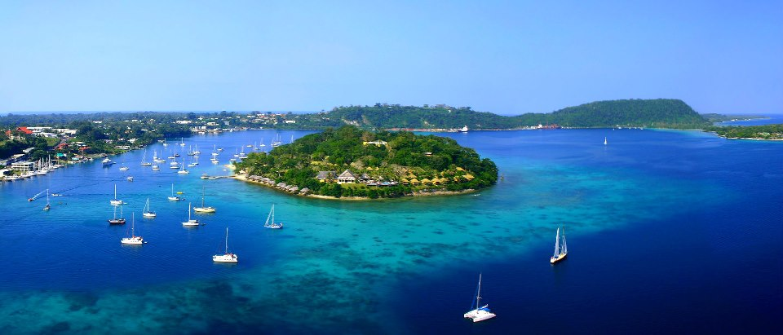
3. Renewable Energy Projects: Being implemented at present
3.7 IRIRIKI ISLAND RESORT’S SOLAR PV FARM
Status: Completed 2016
Target: Irririki Island Resort
Technology: Solar PV
System Size: 1.2 MW
Location: Irririki Island

Slide 12
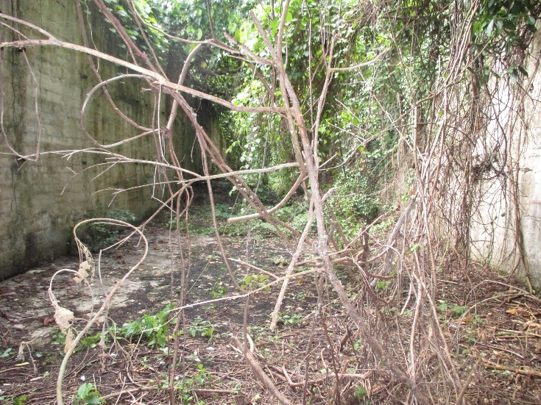
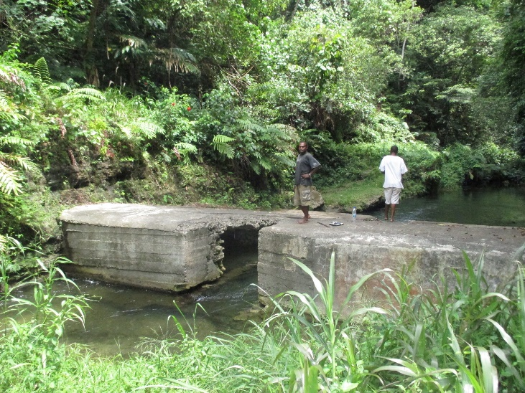
4. Notable Challenges
4.1 Lack of proper training and capacity building for locals
Locals have not been properly trained on the proper maintenance and operation of the renewable systems hence a lot of projects in the rural areas have not lasted for long.
4.2 No renewable energy financing available
Individuals and private sector do not have any access for funding to accommodate the high upfront cost of renewable generating equipment. Therefore the uptake of renewables is very slow.
4.3 No national standards for grid integration of wind and solar systems
Hence difficult to determine whether the above renewables have met the safety and technical requirements for integration into the grid
4.4 Land issues
Land disputes hinder renewable development e.g Brenwei hydro and Geothermal
Abandoned forebay
Abandoned weir

Slide 13
5. Workshop Expectations/Outcomes
Learn about the effective renewable energy policies and projects implemented in Japan
Learn about what is working and what is not working for other Pacific islands and Maldives
Build a stronger working relationship with IRENA, Japanese Government and people of the Pacific Islands and Maldives

