Slide 1
Tuvalu Transition to
Renewable energy Resources
Training Programme to Support Renewable Energy Deployment
in Asia-Pacific Island Nations
William Teipauli
06-10/02/2016
JAPAN

Slide 2
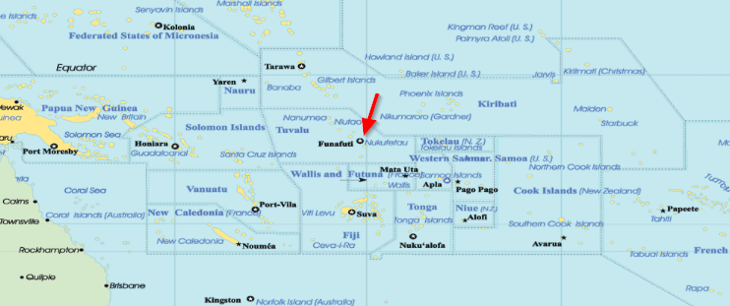
Tuvalu
Located approx. 100 km North of Fiji
West of International Date Line

Slide 3
Tuvalu
Consists of 9 Atoll islands
3 reef islands & 6 coral atolls
Population of approximately 11,000 (2012 census)
Highest Point is 4.6 m above sea level

Slide 4
Tuvalu Electricity Profile
8 Power Stations
Main Power Station – Funafuti
3 x 600kW – 1,800kW
Peak Load – 1,362kW
Outer Islands – all have solar PV’s with storage and 1 x Standby Genset of 164kW total capacity
Peak Load – during night time, varies from island to island and ranges from 20kW – 70kW

Slide 5
Tuvalu Transition to Renewable Energy
In 2009 Tuvalu Government developed a Renewable and Energy Efficiency Master Plan
This will guide all RE & EE developments in Tuvalu
RE TARGET – 100% by 2020
  GOAL
To generate electricity with 100% renewable energy by 2020
To increase energy efficiency on Funafuti by 30%

Slide 6
Implementation Strategy
  60 – 95% - Solar PV
  0 – 40% - Wind
  5% - Biodiesel
  30% - Energy Efficiency
Cannot achieve 100% renewable energy with ONE Renewable Energy source and need to include other potential PROVEN and MATURED technology, and
Energy Efficiency is also important to avoid additional renewable energy generation.

Slide 7
Renewable Energy Space
FUNAFUTI PLANS – PV GRID CONNECTED
Donor | UAE | MFAT (NZ) | Japan
Solar PV (Kw) | 500 | 170 | 86
Status | Operational | Operational | Operational
Total Capacities (kW)/Existing | 756
Diesel Consumed (ltrs/yr) | 1,395,000
Est. Diesel Saved (ltrs/yr) | 764,000 (54%)

Slide 8
Renewable Energy Space
OUTER ISLANDS PLAN – MINI-GRID SYSTEM
DONOR | NZMFAT |  |  |  | EU
Stations | N/maga | N/mea | Niutao | Vaitupu | N/laelae | N/fetau | Nui
PV Capacity(kW) | 205 | 195 | 230 | 400 | 45 | 88 | 70
Battery Capacity(AH) | 33,000 | 30,000 | 36,000 | 60,000 | 12,228 | 21,504 | 18,332
Total funding (million) | NZ$13.9 |  |  |  | euro1.875
Completed | Aug’15 | July’15 | Dec’15 | End Nov’15 | May’15 | Mar’15 | Apr’15
Total Capacities (kW) | 1,212
Diesel Consumption (ltrs/yr) | 312,000
Estimated Fuel Saved(ltrs/yr) | 253,000 (81%)
Notes:
May remove this slide / depending on content of presentation

Slide 9
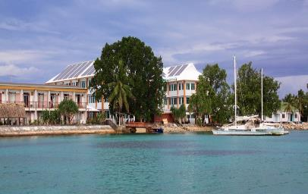
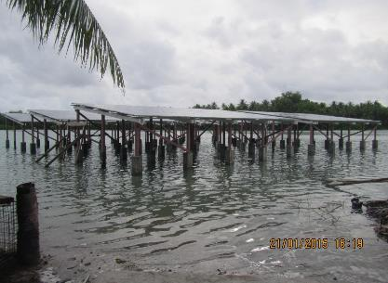
Barriers with the Development of Renewable Energy
Very limited land space.
cabinet has approved the concept of decentralized “Solar Roofs”.
the concept is to start with potential Govt buildings.
raised Structure to use space underneath
so far – 320kWp on Govt. Office building roof-tops
No legal framework for individual household to install PV’s on their rooftop
130kWp Solar PV on the Government main office building rooftop
Outer Islands – Panel Structures build in the lagoon

Slide 10
Where we will be at the end of 2017?
IMPLEMENTATION STRATEGIES
MASTER PLAN | END 2014 | END 2016 | END 2017
Solar PV : 60 – 95% | 4% | 29% | 43%
Wind : 0-40% | 0 | 0 | 2%
Biodiesel : 5% | 0 | 0 | 0
Energy Efficiency : 30% | 0 | On going | On going

Slide 11
What we are doing with Energy Efficiency?
Energy Efficiency Act – Passed by Parliament 2015
Energy Efficiency appliance subsidy scheme with the Development Bank of Tuvalu
started in 2016
Demonstration Fale
Completed end of 2016 and for showcasing energy efficient appliances – refrigerator, chest freezer, LED lighting and washing machine.
Prepayment meters
minimize doubtful debts and improve cash flows
Install sometime this year funded by the World Bank
Window tinting and shading for the Main Government Office.

Slide 12
BAU Vs REEE
Without REEE, the BAU will continue to increase.

Slide 13
Is the 100% target Achievable?
According to KEMA Consultancy Firm, POSSIBLE to achieve 100%, but
a. required huge investment, and
b. also required more detailed studies before specific large-scale renewable energy generation projects are begun.
We have reengaged KEMA again to carry out a more detail study on:
the impact of high RE penetration to the grid
the economics of RE and storage

Slide 14
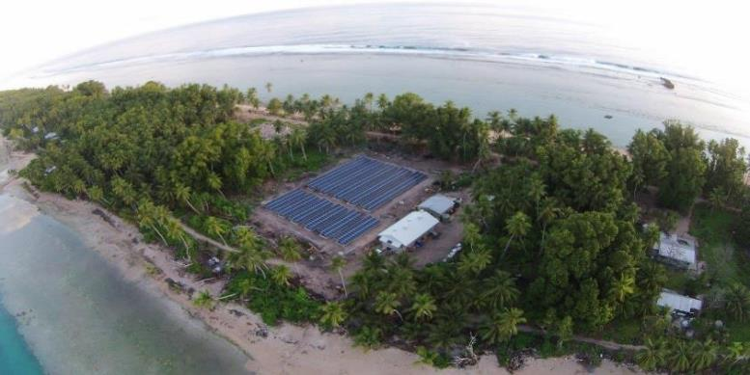
Thank you

