Slide 1

KINGDOM OF TONGA
“Training Programme to Support Renewable Energy Deployment in Asia-Pacific Island Nations”
6 – 10 February, 2017

Slide 2
1. POLICIES/REGULATIONS TO SUPPORT ENERGY Transititon
a) RE Target
Government of Tonga targeted to improve energy security by approving a policy to supply 50% of electricity generation through renewable resources by 2020.
NDCs
50% of electricity generation from renewable sources by 2020.
Improve EE through reduction of electricity line losses to 9% by 2020
70% of electricity generation from renewable sources by 2030

Slide 3
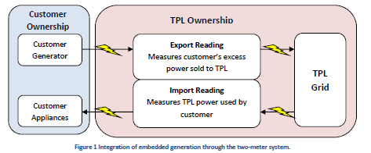
Con’t
c) Net metering (Tonga Power Ltd Policy for the Connection of Embedded Generation)
Tonga Power Ltd (TPL) Net Billing Policy aims to ensure that all their TPL’s customers have access to the benefits of promising renewable energy technologies.
It also aims to ensure that benefit of renewable energy are available to the owner without creating the situation where privately owned renewable energy generation leads to increased tariff for the rest of the population.

Slide 4
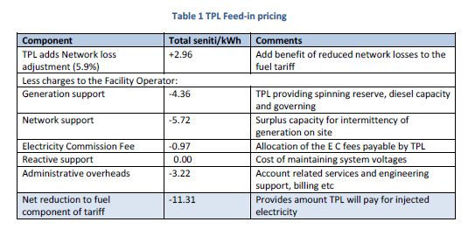
Con’t
d) Feed-in-tariff
All electricity purchased from TPL’s grid will be charged by TPL at its published rates.
TPL will purchase electricity from contracted generators at it’s feed-in-price which is based on the component of the published tariff.

Slide 5
2. RENEWABLE ENERGY PROJECTS: …….Constructed or In Process
  Mata ‘o e La’a solar farm (Tongatapu – Vaini)
  Project was a USD$14.7M funded by JICA and implemented by Tonga Power Ltd
  Installation was completed in December and commission in March 2015.
  Ownership– Tonga Power Ltd, Total capacity – 1MW.
2. Maama Mai Solar Facility (Tongatapu – Popua)
Project was funded by the NZ Aid Programme at a total of $7.9M NZD
it was commissioned in July, 2012
Legal ownership to Tonga Power Ltd, Total capacity – 1.3MW

Slide 6
Con’t……
3. La’a Lahi Solar Facility
This is the fist solar farm to be constructed in Vava’u and it was the 1st project to receive fund from UAE
In Nov, 2013 the solar farm was commissioned
Onwership – Tonga Power Ltd, total capacity of 0.42MW.
4. PEC Fund – Pacific Environmental Community Fund
under the JICA PALM financing programme with USD$4M for Tonga
Office space with USD$110,000 contributed by Government of Tonga to procure chest freezer, submersible pumps and other accessories of every system
Duration of 2 years from 27th June to December 2016 but extended to end of 2017.

Slide 7
Cont…
5. Outer Island Renewable Energy Project (OIREP)
The project has recently completed the construction of a 550kWp solar plant on Lifuka with a 660kW battery storage system.
Plant will reduce the amount of diesel consumed on Lifuka and Foa for power generation by approx. 50% as per the GoT target.
In addition, a 200kWp solar farm has also been completed on ‘Eua and ready to be commission on the 11th of this month.
Project has completed its solar plants on Lifuka and ‘Eua and it will move onto Nomuka, Ha’afeva, Uiha, Ha’ano, Niuatoputapu and Niuafo’ou (Tender documents have been advertised in January 2017) therefore construction is scheduled to start at the end of this year, 2017)

Slide 8
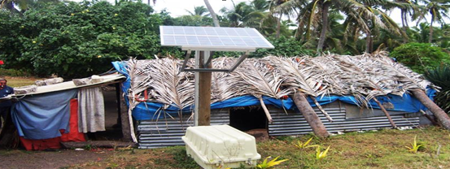
Con’t….
6. Project for Introduction of Clean Energy by solar Electricity Generation System in Tonga
Funding of this project amounts up to JPY 590Millions, under the Japanese Grant aid scheme called “Grant Aid Program for Environment and Climate Change” Multi-million project budget funded by JICA.
Project has implemented and well monitored by the staff of Energy Dept.

Slide 9
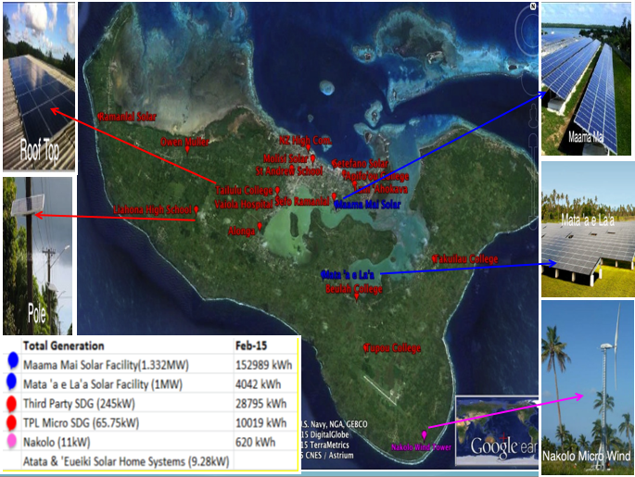

Slide 10
3. NOTABLE Successes and/or Challenges
1) Issues on Grid Integartion
Technical issues
Limited support for increasing local technical knowledge on RE
Limited opportunities for local engineering firms to carry out design, engineering and implementation of RE projects
Grid instability problems.
Financial issues
Procurement process sometimes take too long.
Incentives of government.
2) Donors/Development partner coordination on project/initiatives in Tonga
* Between Tonga Power Ltd, Government of Tonga & Donors.

Slide 11
4. Workshop Expectation/Outcomes
Expected to share with the rest of the participants from other Pacific Islands on ways to tackle challenges faced by Pacific Island Countries in regards to deploying renewable energy.
To have an insight during site visits on the advance technology in Japan and how they are being used.
Knowledge regarding the process of deploying renewable energy in SIDS to be enhanced.

