Slide 1
CURRENT STATUS - ENERGY TRANSITION
SOLOMON ISLANDS

Slide 2
BACKGROUND

Slide 3
GENERAL INFORMATION
Population - > 700,000 with over 80% of the population spread over tropical isolated islands
Resources – forestry, agriculture and fisheries
In 2009 the government acknowledge only 16% has access to electricity. If the rural areas are considered the percentage will fall below 5%
RE – electricity supply 0.6%
Heavily dependent on petroleum products
RE – great potential

Slide 4
ENERGY DIVISION
Vision - “Unlocking the development potential of Solomon Islands' economic base through a dynamic and effective energy sector”.
The Mission of Energy Division is: “Provides the base for appropriate coordination, planning, promotion, development and management, and efficient use of energy resources”

Slide 5
Energy sector broader policy outcome
Strengthen the energy sector leadership and planning
Increase access to electricity in urban households to 80% by 2020.
Increase access to electricity in rural households to 35% by 2020
Increase the use of renewable energy sources for power generation in urban and rural areas to 50% by 2020.
Improve energy efficiency and conservation in all sectors by 10.7% by 2019.

Slide 6
POLICIES AND STRATEGIES
1. PLANNING AND LEADERSHIP
1.1 Leadership is strengthened through an approved high-level multi- sectoral coordinating mechanism supported by legislation
Support the regulation of the energy sector – off-grid and on-grid electrification.
review the energy legislation and enacting of the Energy Act.
2. ELECTRIC POWER - URBAN
2.1 Improve the capacity and condition of the Honiara and outstations network
2.2 Develop and implement energy efficiency & conservation
2.3 Extend existing networks to surrounding rural communities where feasible

Slide 7
continue
3. ELECTRIC POWER – RURAL
3.1 Increase the supply of modern energy services in rural schools, telecommunication and health centers.
Improve and increase the use of solar and hydro power.
Encourage public / private partnership for power generation
3.2 Planned and sustainable energy development consistent with government objective
3.3 Develop a renewable energy policy and rural electrification policy
Implement the Rural Electrification Master Plan (JICA-funded project)

Slide 8
continue
4. RENEWABLE ENERGY
4.1Establish an appropriate, reliable, affordable and sustainable energy-based power supply systems.
Improve SIEA energy services through off grids (hydro and solar) and generating plants
Develop appropriate frameworks for independent power producers.
4.2 Increase productivity in rural communities with the use of
renewable energy services.
Encourage Renewable Energy Services Company (RESCO's) involvement in productive uses of renewable energy sources.
4.3 Develop renewable energy policy instruments to meet the renewable energy targets

Slide 9
continue
Net metering policies and standards
benefits to financial institutions to provide concessional loans and term extension funds for renewable energy electrification projects.
training and capacity building on new renewable energy technologies.
4.5 Develop an appropriate framework for access to land for renewable energy developments
5. PETROLEUM
5.1 A reliable supply of quality petroleum products at landed cost is supplied to all people in Solomon Islands.
6. EFFICIENCY & CONSERVATION
6.1 Promote energy efficiency and conservation measures at
government, residential, commercial and industrial sectors

Slide 10
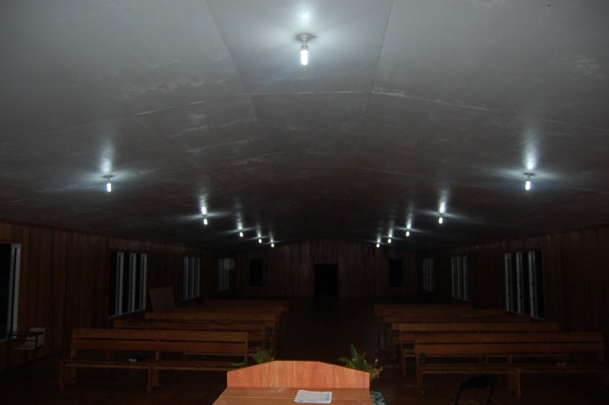
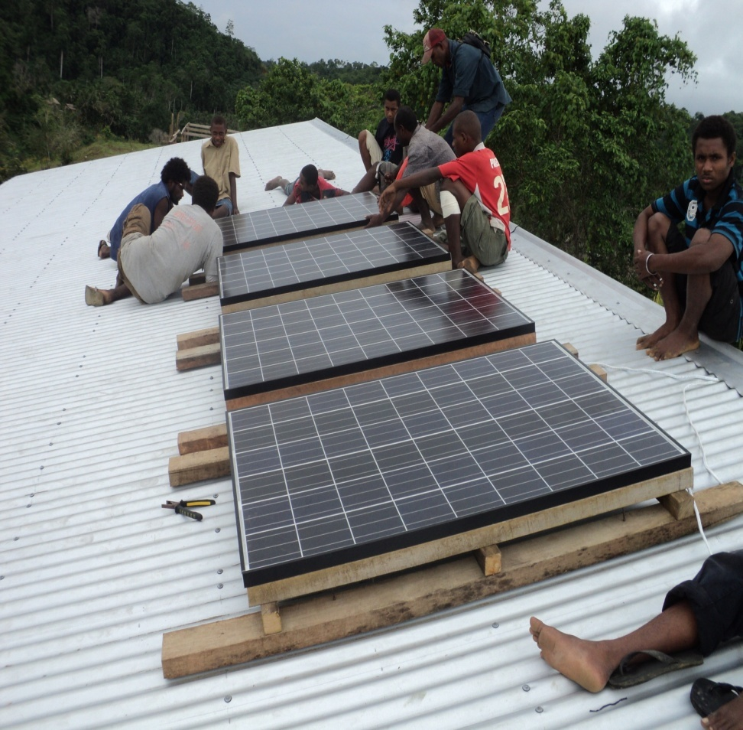
Renewable energy projects
1. SOLAR POWER
Lightings and water pumping - rural schools, clinics and communities – about 40 points of installation since 2008 with an average of 20kW output
Solomon Power 1MW grid connected funded by by the United Arab Emirates and the New Zealand Government.
50kw SPs head office funded by JICA

Slide 11
continue
2. HYDRO
2.1 Urban
2.2 Community owned mini hydro projects
LOCATION | CAPACITY | YEAR | FUNDING | REMARKS
IRIRI | 10 kW | 1993 | UNIDO/APACE | Out of service
VAVANGA | 12 kW | 1994 | AUSAID/APACE | RUNNING
RAEAO | 25 kW | 2002 | CHINA | RUNNING
MASUPA | 40 kW | 2010 | SIG | RUNNING
NARI’AO’A | 25 kW | 2004 | CHINA | RUNNING
MANAWAI | 50 kW | 1997 | CHINA | RUNNING
BULELAVATA | 29 kW | 1997 | AUSAID | RUNNING
GHATERE | 12 kW | 1997 | AUSAID APACE | Non Operational

Slide 12
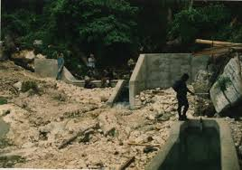
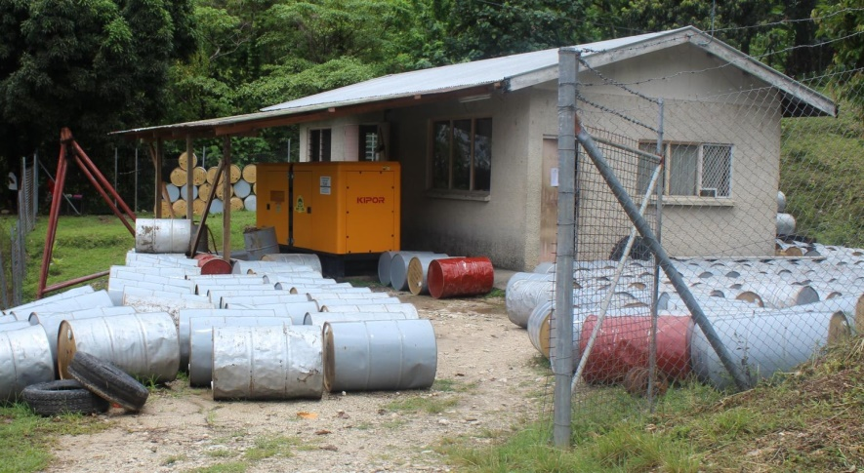
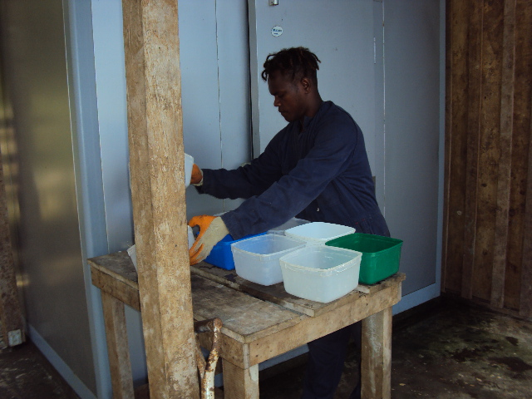
continue

Slide 13
continue
3. Biofuel
Solomon Power 350 kW generator (blend of 80% coconut oil and 20%) diesel for Auki funded by ADB

Slide 14
RE in progress
In progress are five (5) PV conversion projects at existing Solomon power Provincial Stations. These projects will be funded by the Asian Development Bank with a total capacity of about 2MW.
Solomon Power Hybrid projects (PV, Battery and Diesel back up) at three provincial sub station, two of these sites will be commissioned by the first quarter of 2017
Currently we are doing studies on about 15 sites for new hybrid sites to be funded under Italian government.
Tina hydro - 20 megawatt
Fiu Hydro 360kW, SIG and ADB funded project
Geothermal – Savo geothermal 20 MW

Slide 15
Success
Solomon Power - installation and commissioning of the PV grid connect at Honiara funded by the United Arab Emirates and the New Zealand Government.
PV installation in operation at the SP’s Head Office installed and funded by the Japanese Government.
Italian government funding for 15 hybrid sites
Tina river hydro project – first concessional loan awarded by IRENA and Abu Dhadi Fund for Development (ADFD)
Fiu hydro – ADB and SIG funded – ground work completed

Slide 16
Challenges
Geographical characteristics of the country
Land issues
No proper/lack of energy national database
Capacity for planning the development of the energy sector, set the right policy framework for investment, etc.
Finance and technical capacity to design, install and maintain RE systems

Slide 17
Expectations
To acquire knowledge and capacity in development of policies and plans to utilize available renewable energy resources.
The organization should be able to elevate capacity to plan, manage and identify the role of regulators to supervise energy transition through successful participants in such program.
The training will assist the Government in its plan to increase use of renewable energy and accessibility to grid –based electricity.

Slide 18
Thank you

