Slide 1

TRAINING PROGRAM TO SUPPORT RENEWABLE ENERGY DEVELOPMENT IN ASIA-PACIFIC ISLAND NATIONS.
MR. ANSCA PAKOP,LLB
ASSISTANT SECRETARY – LEGISLATIONS ADMINISTRATION BRANCH
POLICY REGULATIONS DIVISION
NATIONAL DEPARTMENT OF PUBLIC ENTERPRISES
Mobile: (675) 76400704/(675) 71113148
Telephone; (675) 3213739
Email: Ansca.Pakop@publicenterprises.gov.pg or apakop@gmail.com
Tokyo/Kobe, Japan
February 6-10, 2017

Slide 2
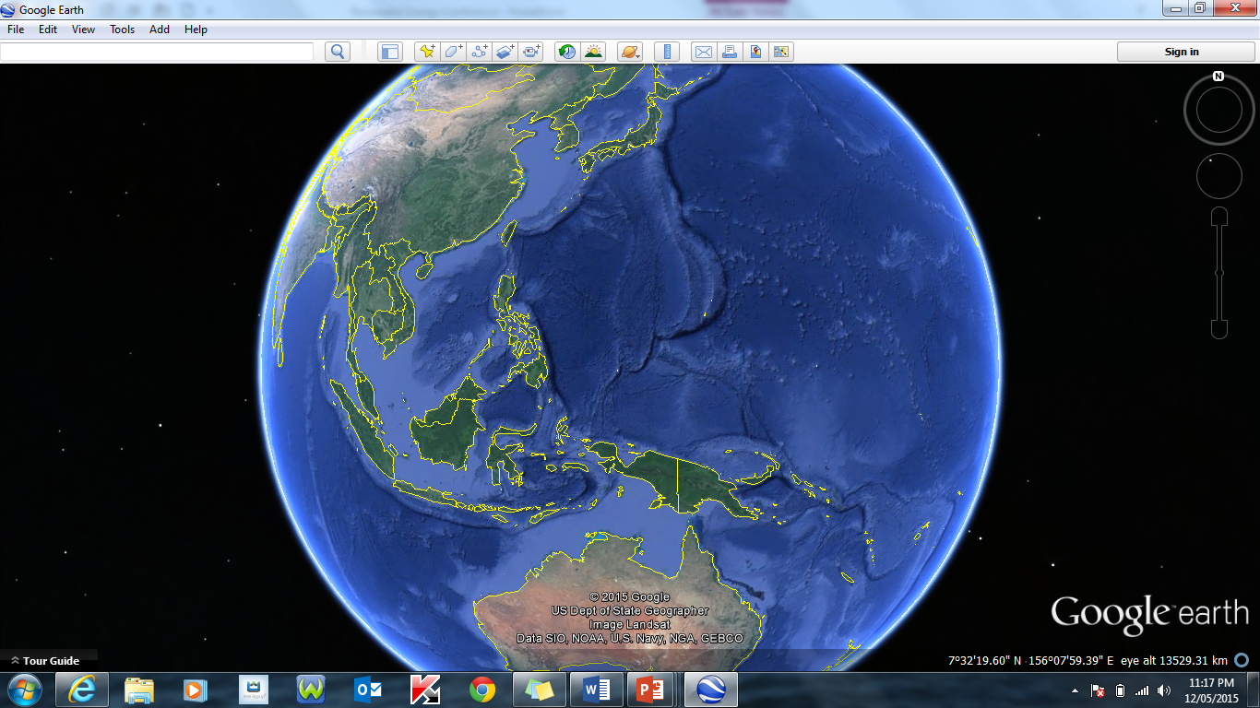
PNG PERSPECTIVE
PAPUA NEW GUINEA SOME COUNTRY FACTS
POPULATION: 7.4 MILLION
TOTAL AREA: 462,840 km²
        (KOREA : 100, 210 km²)
GDP GROWTH: ~8% (2002-2014)
~15% (2015)
ELECTRICITY: 580 MW (INSTALLED CAPACITY;
ENERGY SECTOR CONTRIBUTION TO GDP : 14%
NET EXPORTER OF ENERGY
MEMBER OF APEC
OBSERVER ON ASEAN
“LAST ASIAN COUNTRY”

Slide 3
CURRENT STATUS
Regulators:
DP&E
DMPGHM
MRA
ICCC
PPL
DPE
NISIT
CEPA
b)PNG Power sole national electricity company – 300MW
(generation, transmission, distribution & retail)
280 MW (IPPs)
c) 3 Islanded Grid (Ramu, Port Moresby, Gazelle)
d) 19 Provincial Centre powered by thermal generation.
e) 87% Of Population lack Access to Electricity.
f) 13% Access to Power often unreliable.
PNG Power Ltd, 2014

Slide 4
CURRENT PNG’S RENEWABLE ENERGY MIX
SOURCE | INSTALLED | PLANNED | POTENTIAL
HYDRO | 432 MW | 4,560 MW (mostly private sector) | ~15,000 MW
 | Ramu,Sirinumu,Warangoi,Baiune | Purari (lower) – 2,500 MW (feasibility completed)
 |  | Purari (upper) – 1,000 MW (feasibility completed, Geotech completed)
GEOTHERMAL | 56 MW Lihir | Japanese Consortium intends to access funding from GCF to complete Geothermal Survey | ~10, 000 MW
SOLAR |  | Resource Mapping Studies (World Bank, completion date 2018.
WIND |  | Resource Mapping Studies (World Bank, completion date 2018.
BIOMASS | 30 MW Markham | 69 MW (eucalyptus, sugarcane, king grass, wood chips,oilpalm)
GAS | 25 MW PNGLNG | 25 MW | ~40 TCF
 |  | (First LNG Project, 9 TCF, 2xTRAINS, Developed)
 |  | (Second LNG Project, 10 TCF, construction 2017)

Slide 5
Policies/Regulations to Support Energy Transition
OVERARCHING NATIONAL POLICY
PNG’S VISION 2050
  By 2050 PNG’s economy should attain 100% power supply from renewable and sustainable energy sources.
  Reduce greenhouse emission by 90 percent to 1990 levels;
  All households should have access to a reliable and affordable energy supply.
PNG’S STRATEGIC DEVELOPMENT PLAN 2010- 2030
  By year 2030, 70% of the country will have access to electricity.
  Development of biofuels as a renewable source of energy alternative to fossil fuels to grow the economy and reduce or stabilise greenhouse gas emissions.
PNG’S NATIONAL SUSTAINABLE AND RENEWABLE DEVELOPMEN STRATEGY.
  Promote Green Energy Investment in the renewable resources sector;

Slide 6
ENABLING POLICIES AND REGULATIONS
POLICY | PURPOSE | STATUS
NATIONAL ENERGY POLICY | RESTRUCTURE ENERGY SECTOR INSTITUTIONAL ARRANGEMENTS ENCOURAGE PRIVATE SECTOR PARTICIPATION | PREPARATION FOR CABINET AND PARLIAMENT 2017
NATIONAL ENERGY PLAN | PLAN ON ENERGY UTILIZATION | PREPARATION FOR CABINET 2017
PUBLIC PRIVATE PARTNERSHIP | ENCOURAGE PRIVATE SECTOR PARTICIPATION | ACCEPTED BY GOVERNMENT LEGISLATION ENACTED (2014)
COMMUNITY SERVICE OBLIGATION | ENCOURAGE COMPETITION AND PRIVATE SECTOR PARTICIPATION | ACCEPTED BY GOVERNMENT (2014)
BIOFUEL POLICY | ENCOURAGE BIOFUEL PRODUCTION & USE | READY FOR CABINET
THIRD PARTY ACCESS CODE | ALLOWS THIRD PARTY ACCESS TO GRID | IN PLACE
GRID ACCESS CODE | TECHNICAL SPECIFICATIONS | IN PLACE
GEOTHERMAL COMMERCIALIZATION | COMMERCIAL EXPLOITATION | PENDING CACC APPROVAL
RENEWABLE ENERGY | OVERSIGHT ON DEVELOPMENT OF RENEWABLE ENERGY | WILL START SHORTLY
RURAL ELECTRIFICATION | ELECTRICITY PENETRATION TO RURAL AREAS | WILL START SHORTLY
NEROP | ELECTRICITY PENETRATION TO RURAL AREAS | PROJECT TO END 2015
ELECTRICITY TARIFF REVIEW | NEW TARIFF REGIME TO IMPROVE COMPETIVENESS | CURRENTLY UNDERWAY
RENEWABLE & SUSTAINABLE GROWTH STRATEGY | FROM BROWN GROWTH TO GREEN GROWTH | POLICY APPROVED 2014
LANDOWNER PARTICIPATION | ENABLE LANDOWNER PARTICIPATION | DRAFT READY TO GO FOR CONSULTATIONS

Slide 7
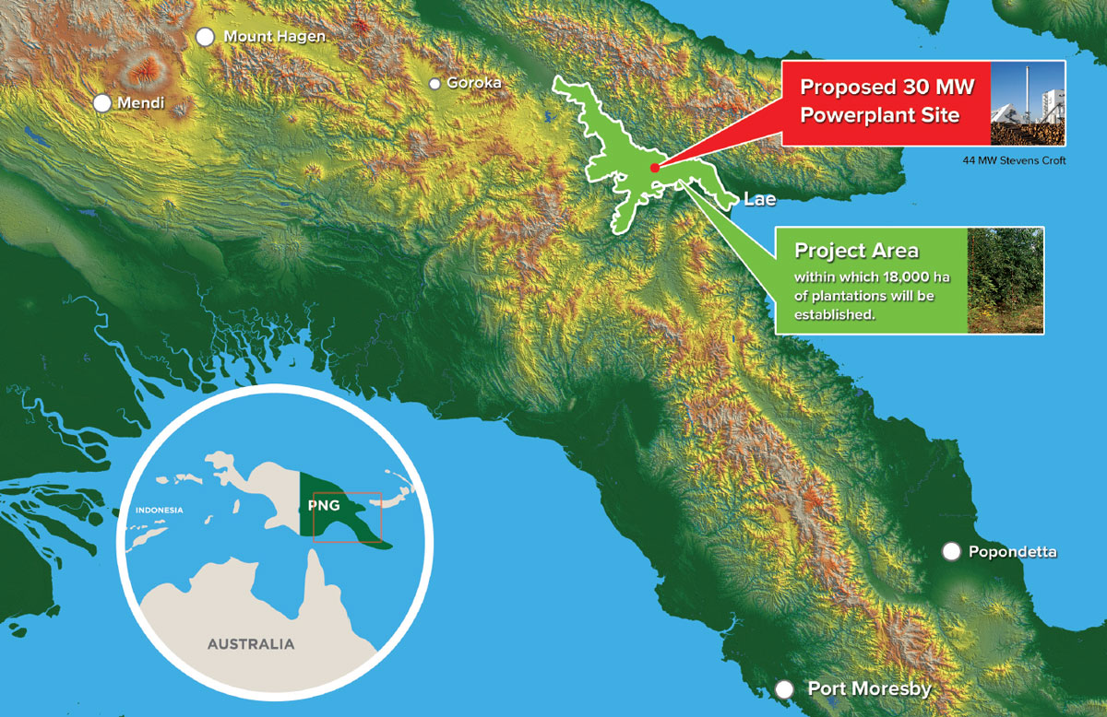
Renewable Energy Projects: Constructed or In Process
Project 1-PNG Biomass Project
I have chosen these three projects because of their peculiarity
Ownership, energy source and purpose.
Ownership The project involves the development of 18,000+ hectares of FSC certified forestry plantations, using underutilised Kunai grasslands in the Markham Valley, and the development of a 30 MW Biomass Power Plant to generate electricity for supply to the RAMU Grid.

Slide 8
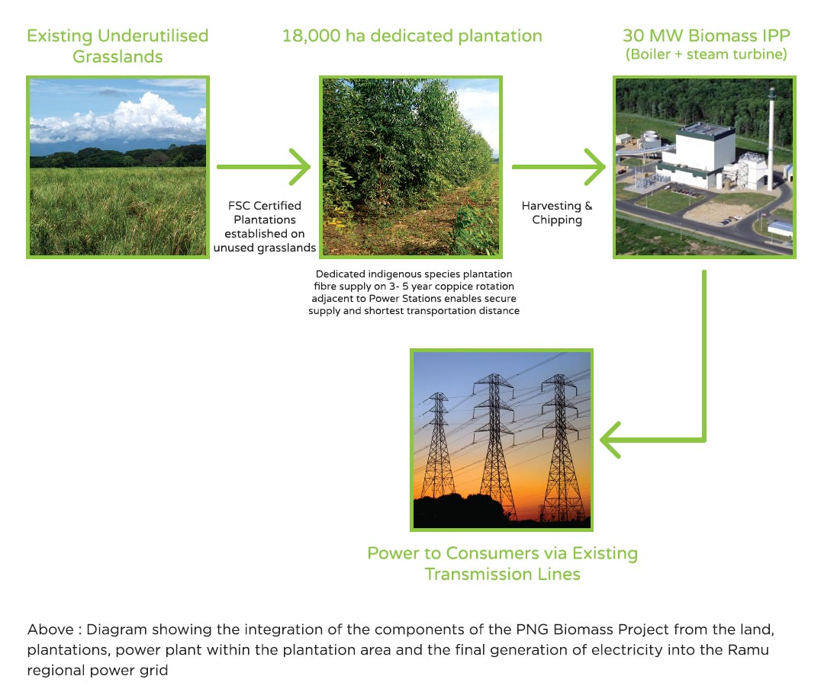
Renewable Energy Projects: Constructed or In Process
PNG Biomass Project..cont

Slide 9
Renewable Energy Projects: Constructed or In Process
PNG Biomass Project..cont
The forestry development will require the planting of more than 20 million trees and will be managed in an internationally sustainable manner. The plantations will provide a dedicated fibre source for the power plant, which will require the annual supply and harvesting of over 200,000 bone dry tonnes of wood to support the 30 MW power project. The trees will be harvested every 4-7 years.
The trees will be harvested in the plantation and then transported in large trucks to storage facilities at the power plant where they are dried and turned into wood chips for fuel.
The chips will then be burned in the power plant to generate high pressure steam that drives a turbine.
When the wood chips are burnt they release carbon dioxide (CO2) into the atmosphere. This CO2 is in turn consumed again by the trees in the surrounding plantations.
This process is known as photosynthesis, the by product of which is oxygen. The electricity generated from the turbines will then be transferred directly into the nearby Erap substation to provide power into the Ramu Grid.

Slide 10
Renewable Energy Projects: Constructed or In Process
Project 2-Lihir Geothermal
Mining Enclaves
Lihir Gold is an Australian listed firm engaged in the exploration, development and processing of gold assets. The company operates gold mines and processing facilities on the island of Lihir, Papua New Guinea.
It was recently acquired by Barrick Gold of Canada
In proximity to the gold mine the company operates a geothermal power plant, which provides approximately 75% of the operation’s current power needs, and additionally AU$ 4.5 million in revenues in carbon credit sales.
Given that the company in the past used diesel for electricity generation, generating three quarters of its electricity demand through geothermal provides tremendous savings for the company, despite a drop in oil prices has “decreased” the actual savings somewhat.
“The geothermal power capacity on Lihir Island is presently 56 MW (including 20 MW expansion of 2007)”, so the company. “Inconsistent steam supply from some steam wells during the year (of 2008) led to an expanded drilling program to maintain flows to the geothermal power plant. An additional drilling rig will be employed to enable the company to drill deeper wells as part of the exploration program to identify expanded steam field resources.”

Slide 11
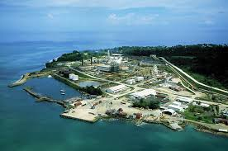
Renewable Energy Projects: Constructed or In Process
Lihir Geothermal…cont

Slide 12
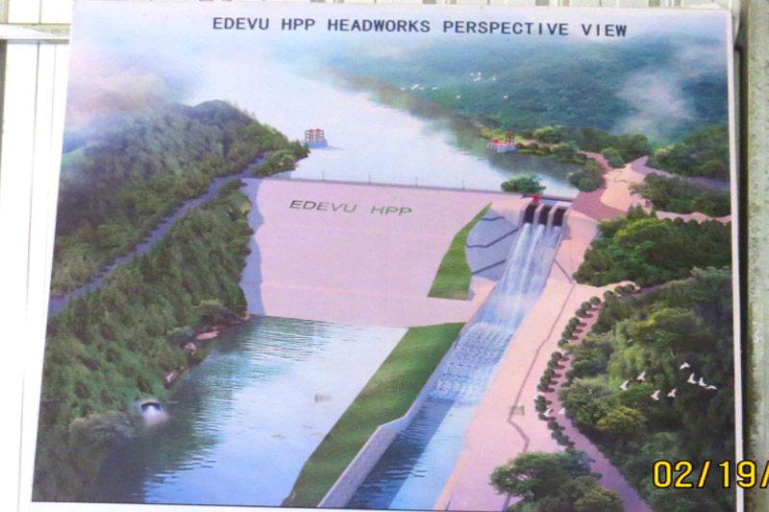
Renewable Energy Projects: Constructed or In Process
Project 3-Edevu Power Plant

Slide 13
Renewable Energy Projects: Constructed or In Process
Edevu Power Project-cont…
Energy Source-Mini-Medium Hydro Civil works for the Edevu hydro power plant has already begun and progressing well as planned.
This power generation project was identified in earlier studies as the Lower Brown power projects and has been promoted in the past few years by an independent power producer (IPP) developer.
Feasibility study including preliminary engineering, hydrology and geotechnical investigations have been done and an environmental permit obtained.
In November 2015, the PPL Board of Directors approved for this project subject to confirmation by Kumul Consolidated Holdings (KHC) and the National Executive Council (NEC).
This hydro plant is being constructed by PNG Hydro Development Ltd (PNGHDL) and will generate 50 Megawatts (MW) for the increasing load demand in Port Moresby.
PNGHDL Managing Director Allan Guo said the construction of the project is a challenge but his team will hopefully complete the project in the next two years.

Slide 14
Renewable Energy Projects: Constructed or In Process
Project 3-Edevu Power Project
The K640 million Edevu Hydro Power Project would provide an additional 50MW to boost current power supply in Port Moresby.
This project would not only benefit residents with power but would also be an alternative source of water.
PNGHDL will also be constructing the Edevu-Moitaka transmission line which will transport the 50MW from Edevu and 80 MW from Naoro-Brown hydro power plants.

Slide 15
WHAT ARE WE DOING
CHALLENGES vs OPPORTUNITIES
CHALLENGES | OPPORTUNITIES | FUNDING ARRANGEMENTS
GENERATION | Approved 1655 MW | New IPP’s to enter generation space.
TRANSMISSION Grid Upgrade Smart Distribution System | a) Tari – Mt Hagen approx. 142km (gas conversion) b) Usino – Kundiawa approx.100km c) Transmission line upgrade d) World Bank interconnection of Ramu and Port Moresby grid 307km. | China Exim Bank Korea Exim Bank JICA World Bank
DISTRIBUTION | Smart Distribution systems installation | Investment opportunities
GEOGRAPHY | Off-grid /micro grid renewable energy technologies. | Investment opportunities
PNG POWER LIMITED | Restructure

Slide 16
WHAT ARE WE DOING
CHALLENGES vs OPPORTUNITIES
CHALLENGES | OPPORTUNITIES | FUNDING ARRANGEMENTS
DATA ACQUSITION OF ENERGY SOURCES | Geothermal/Data acquisition | ADB has funded a geospatial survey to map out the
DONOR/DEVELOPMENT PARTNER COORDINATION | Lots of development partners including donors ,investors currently engaged in energy development initiatives on the mainland. It’s the island Provinces. most similar to PICs ,where energy need is critical. They have an abundance of solar, wind, tide and wave potential | GCF
REGULATORY
Technical assistance | Lack of trained personnel in the RE sector.
GRID CONNECTIVITY/INTEGRATION | Due to the geographical complexities of the main island ,as well as it being an archipelagic nation with lots of large islands, grid interconnection is a problem. We have two main grids ,the Ramu Grid and the Port Moresby Grid. There are a lot of micro grids mostly emanating out of government stations.

Slide 17
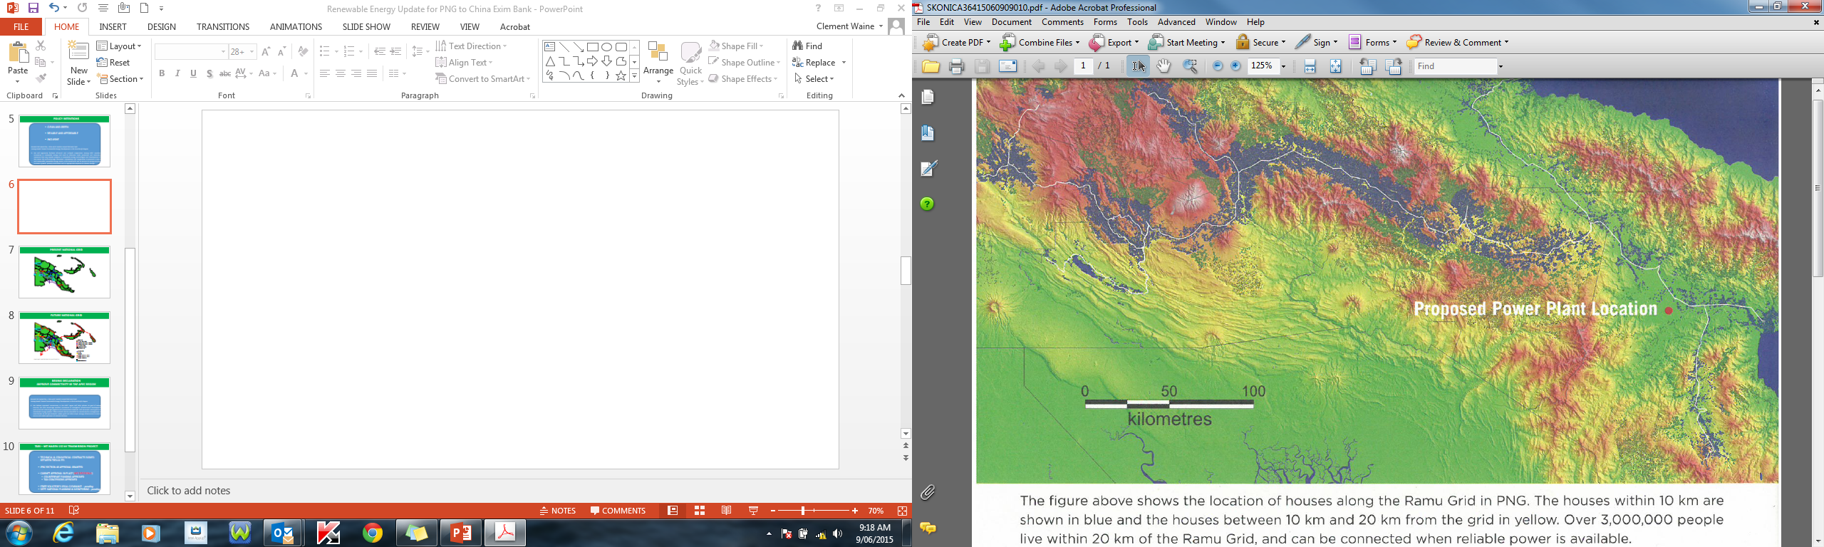
WHAT ARE WE DOING
CHALLENGES FOR CONNECTIVITY

Slide 18
WHAT ARE WE DOING
FUTURE NATIONAL GRID
Generation:
Existing hydro power
Proposed hydro project (<500MW)
Proposed hydro project (>500MW)
Existing gas power
Proposed gas power
Geothermal sites
Transmission:
Existing
Approved
Planned (terrestrial, <10yrs)
Planned (terrestrial, >10yrs)
Planned (submarine)
Mining project
PNG NET EXPORTER OF ELECTRICITY
LNG gas pipeline
Known coal reserve

Slide 19
Workshop Expectations/Outcomes
EXPECTATIONS
Would like to know about Japanese Policy and Regulatory mechanisms and more importantly financing of Renewable Energy initiatives.
Would like to know about the RE Technologies deployed by the Japanese in the island/similar communities ; a setting similar to PICs. Hydrogen fuel cells.
Information Sharing and networking with my fellow islanders to capture and build on to addressing the energy challenges faced by island countries.
Funding mechanisms available by Japan(through JICA),IRENA(Lighthouse Programmes, etc) and the GCF to promote energy development in the Pacific Islands.

Slide 20
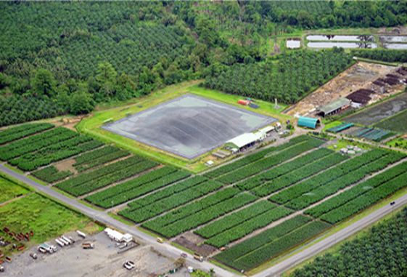
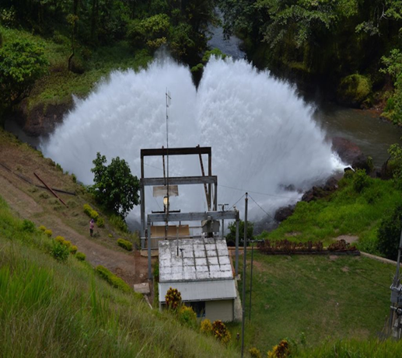
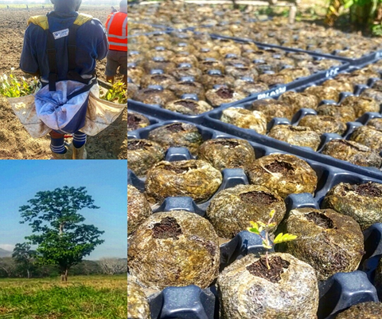
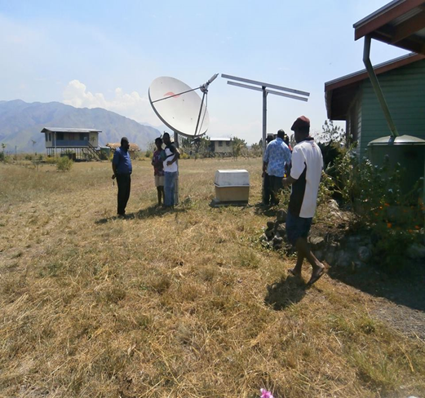
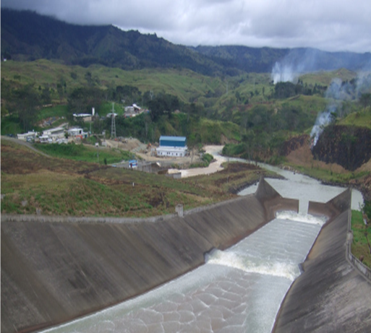
THANK YOU!
TENK YU
DOMO ARIGATO

Slide 21
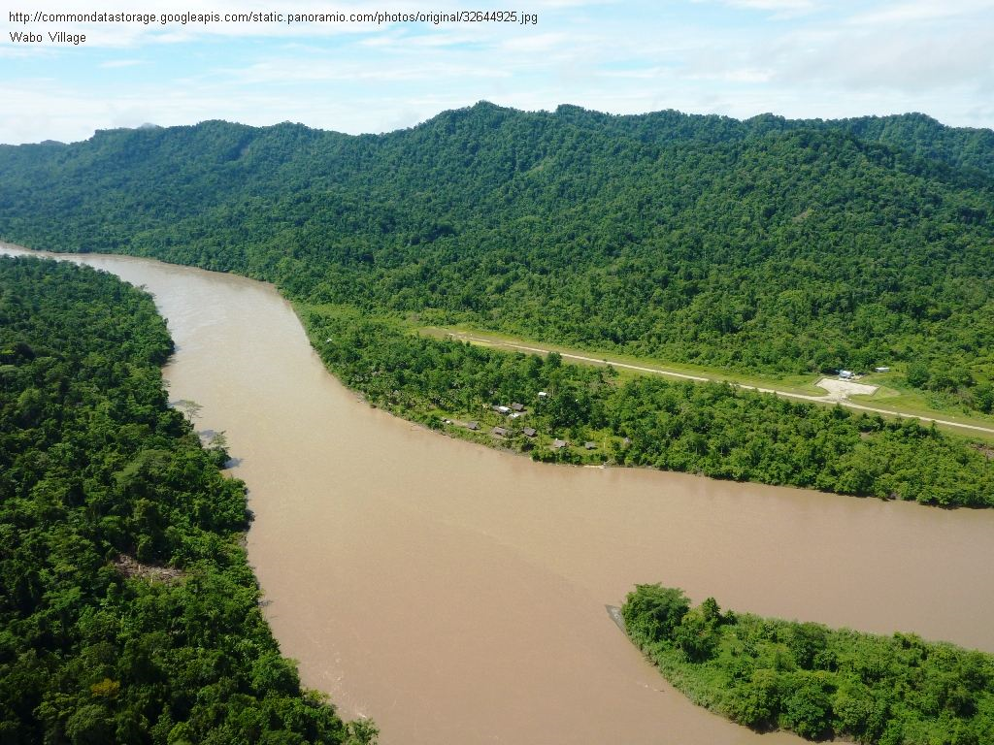
Miscellaneous

