Slide 1
COUNTRY PRESENTATION
TRAINING TO SUPPORT RENEWABLE ENERGY
DEVELOPMENT IN ASIA – PACIFIC ISLAND NATIONS
JAVIC DUBE
RENEWABLE ENERGY SUPERVISOR

Slide 2
Policies/Regulations to Support Energy Transition
To have 50% energy from renewable sources by 2020
Reduce electricity loss from 48% to 5% by 2020
Feed in tariff proposed at 20 cents per KWh
Low carbon fund policy

Slide 3
Renewable Energy Projects:
Constructed RE Project
TOPSIDE SOLAR FARM –
Technology - Ground mounted grid connect photovoltaic solar system
System size - 500KW
Ownership model – self ownership model
Percentage of capacity – 9 %
200KW ROOFTOP PV SYSTEMS –
Technology – Roof top mounted Photovoltaic solar system
System size – Individual rooftop has different sizes, but all rooftop totaled to 200KW
Ownership – Self Ownership model
Percentage Capacity – 4%
Notes:
Ownership model – The 500KW PV System was donated through UAE Aid to Nauru. The NUC is the custodian and looks after generation, distribution and retailing of electricity in Nauru. They are tasked to maintain and generate power from the PV solar farm. So, we can say that this PV solar installation is a “self ownership model”

Slide 4
Renewable Energy Projects:
Planned RE Projects
300KW EU Funded
An agreement for a 300KW PV grid connect was signed in Suva, Fiji, by the EU and Nauruan Government in December 2016. EU will be visiting the island nation in February to finalized arrangements and we envisioned the project to be completed before the end of this year.
We firmly believe that we will be able to mount this on the rooftop of new prison building. Otherwise, we will have it ground mounted.
8MW BATTERY BACKED PV SYSTEM GCF Funded(Green Climate Fund)
We have submitted our request to GCF for a 8MW Battery backed PV system. This is still in the process line and we don’t know the progress as yet.
1 MW proposed under NZ DFAT funding
The New Zealand DFAT funding program will visit the island this month to carry out the feasibility study on effect of PV system on grid stability.
Installation of 1MW grid connected solar PV system.

Slide 5
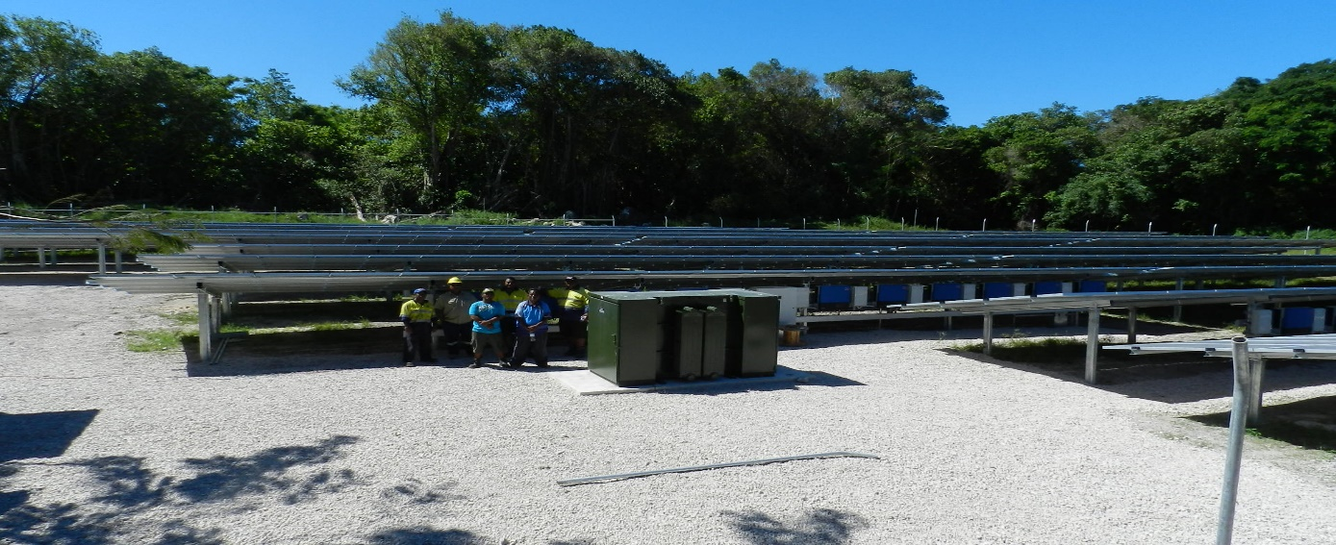
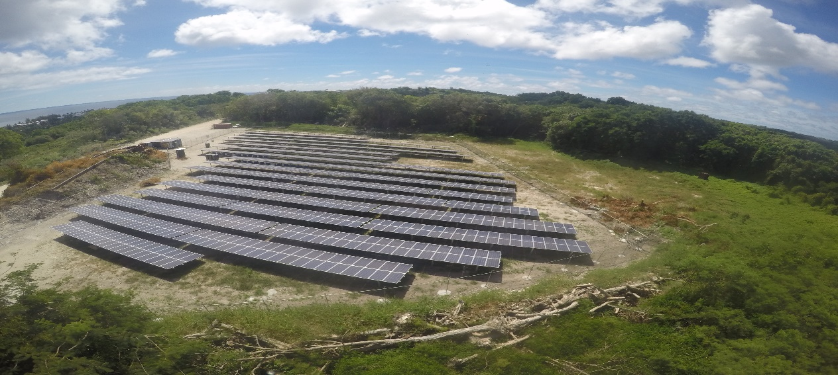
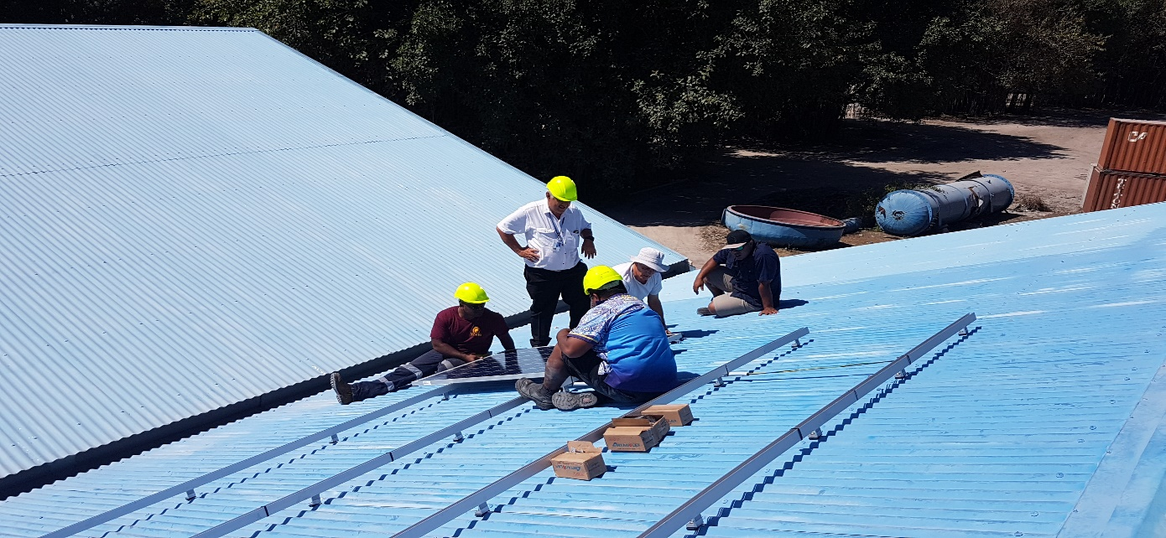
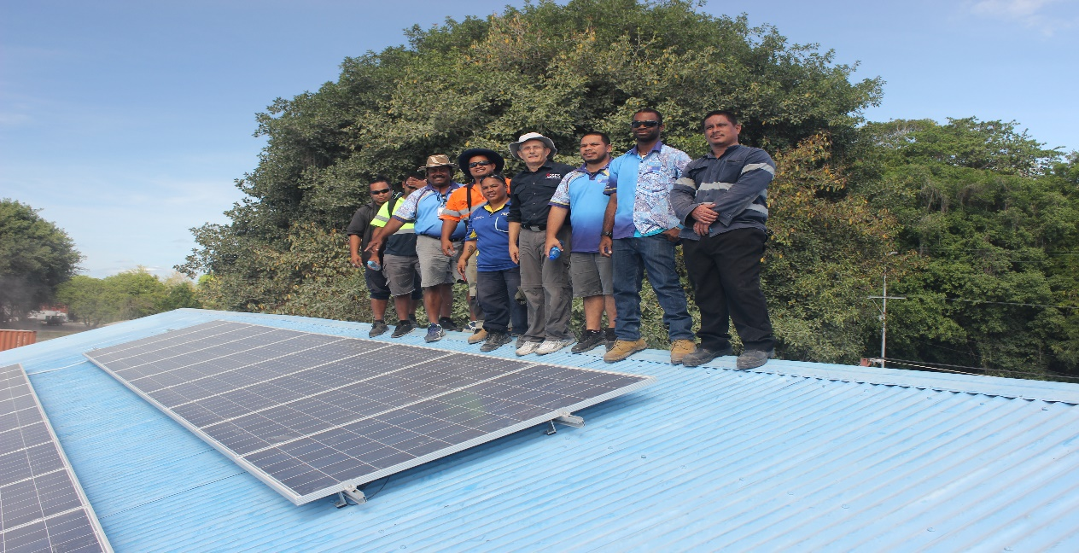
PHOTOS – CONSTRUCTED INSTALLATIONS/ ROOFTOPS

Slide 6
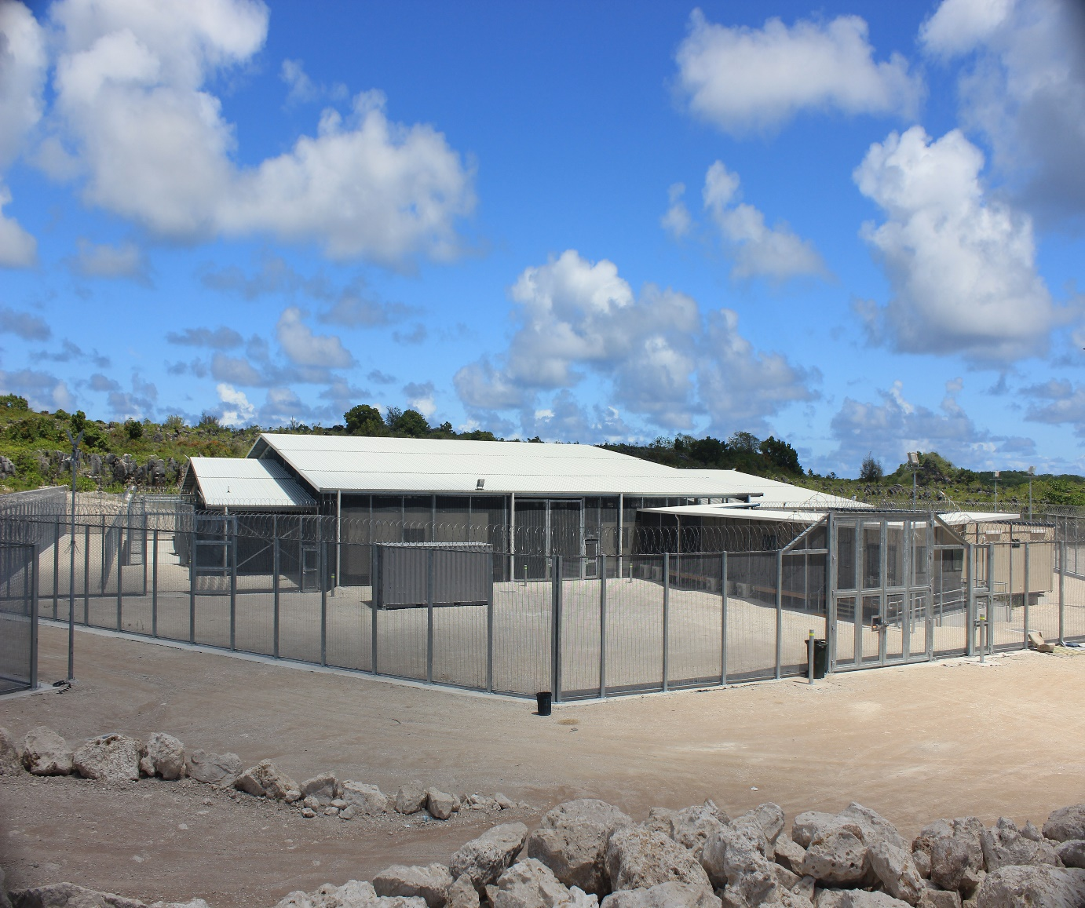
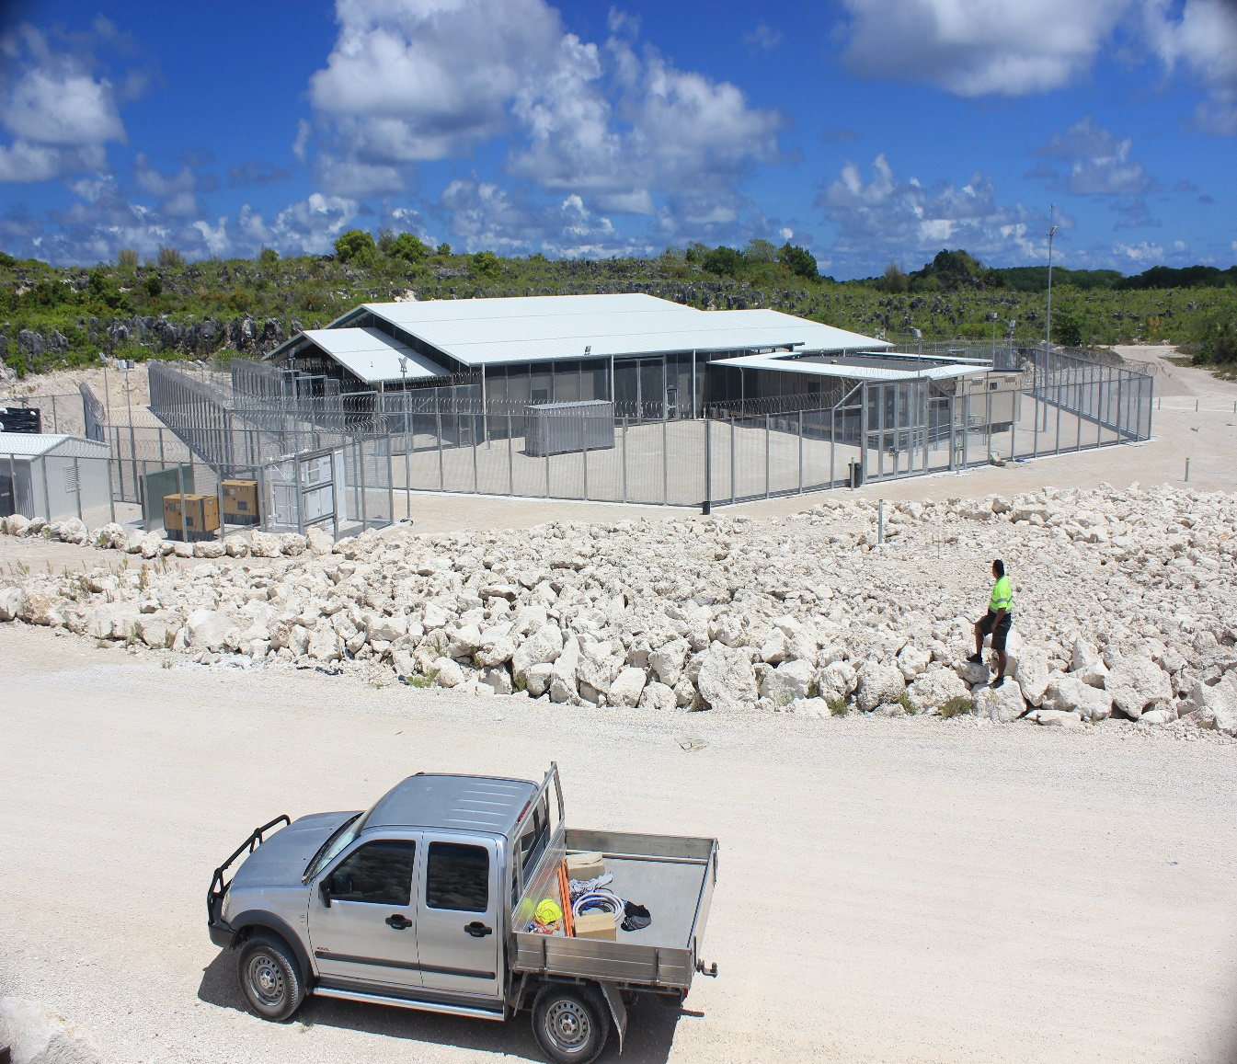
PHOTOS – PLANNED PROJECTS/ROOFTOP
Notes:
This is a picture of the new prison building where we planned to install the new 300KW rooftop grid connected PV system.

Slide 7
Notable Successes
Electricity loss current at 17%
Installation of 500KW Grid connected solar at BUADA DIST
Installation of 200KW Grid connected solar on rooftops including the power station
Implementation of the low carbon fund policy

Slide 8
Challenges
Highly dependent on Aid
No spare parts for repair or replacement
No maintenance program/checklist
Lack of awareness and training on renewable energy

Slide 9
Workshop Expectations/Outcomes
To compare solar designs with the current ones in Nauru and note the difference (advantages/disadvantages)
Maintenance programs
Maintenance checklist design
Problems and solution regarding renewable energy deployment

Slide 10
THANK YOU
IRENA AND MOEJ

