Slide 1
Republic of Maldives
Training Program to Support Renewable Energy Deployment
in Asia-Pacific Island Nations
6-10 FEBRUARY 2017

Slide 2
Country Overview
1192 beautiful tropical islands
188 inhabited islands
115 Tourist Resorts
Population of 341,256
6-8% GDP growth annually
Total land area: approximately 224 km²
Maldives Achieved Universal access of electricity in 2008
Notes:
As you all know Maldives is a country of islands scattered across Indian Ocean.
From the 1192 islands of Maldives 190 of them are inhabited while 107 of them are tourist resorts.
Our total population is 407660 with over one-third of the population living in the capital Male’ region.
And total land area is about 300 km2
GDP Annual Growth Rate in Maldives averaged 7.69 percent from 1997 until 2014.

Slide 3
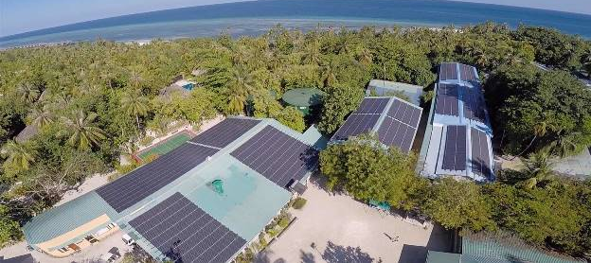
Energy Sector of Maldives

Slide 4
Energy Sector Highlights
Depend almost entirely on foreign imports
2015 imports
Total fuel: 506,334.29 metric tons
Diesel: 389,978.67 metric tons
Aviation gas: 65,317.12 metric tons
Petrol: 38,683.9 metric tons
cooking gas: 12,405.1 metric tons
Kerosene oil: 1012.67 metric tons
Notes:
Maldives is one of the most oil vulnerable countries in the world.
We depend entirely on imported fuels for our energy demand.
Presently we don’t have any natural resources to get fuel.
In 2012, Maldives spent over $470 million for oil imports of which fuel imports for electricity generation contributes significantly.
However I’m glad to highlight that Maldives is one of the few countries in the region with 100% electrification.

Slide 5
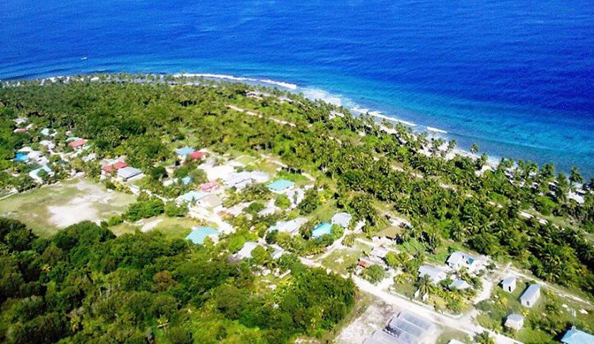
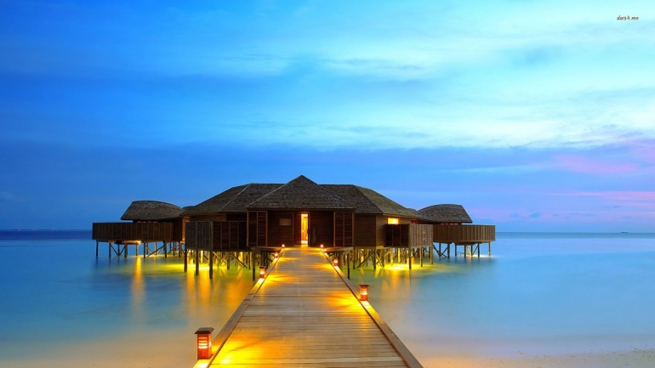
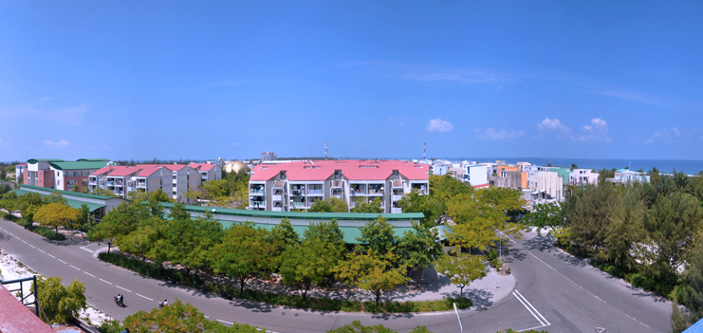
Electricity Installed Capacity
Inhabited islands
Installed capacity of diesel generators: 194 MW
Tourist Resorts
Installed Capacity: 105 MW
Industrial islands
Installed Capacity: 20 MW
Total Installed capacity: 270.5 MW
Notes:
In 1990, only about six islands had regular 24-hour access to electricity.
And it was in 2008, the Maldives achieved the milestone of providing households in all inhabited islands with access to 24 hour Electricity.
Electricity generation in the Maldives is by three main categories of islands. They are inhabited islands, tourist resorts and industrial islands.
From the total installed power generation capacity of diesel generators in the country 52 percent is installed in all the inhabited islands in which Male’ accounts for almost half of this.
39 percent (105 MW) is installed in the tourist resorts while only 7 percent (20 MW) is installed in industrial islands.

Slide 6
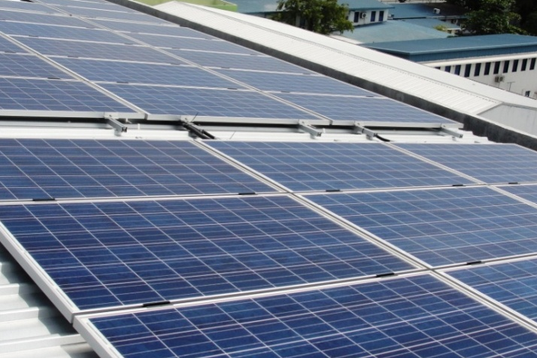
Solar PV Installed Capacity

Slide 7
Governance and Operation
Ministry of Environment
and Energy
Maldives Energy Authority
STELCO
MWSC
FENAKA
Consumers
Notes:
Under MEE is the MEA which is the energy regulatory body.
State owned STELCO and FENAKA are the main electricity utilities responsible for supplying electricity to the communities in inhabited islands except a few where Island Councils are still responsible for the electricity supply.
MWSE provide electricity to one island.

Slide 8
Energy Sector Policy
Maldives Energy Policy and Strategy 2016 consist of revised policies derived from Maldives Energy Policy and Strategy 2010. The 9 policies are reduced to 5 key policy statements, which are:
Strengthen the institutional and regulatory framework of the energy sector
Promote energy conservation and efficiency
Increase the share of renewable energy in the national energy mix
Improve the reliability and sustainability of electricity service and maintain universal access to electricity
Increase and maintain national energy security
Notes:
Energy Policy and strategy was published in 2010.
Key energy policies are …
Right now the this policy being revised.

Slide 9
Maldives SREP IP – Focused & Planned Interventions
Maldives SREP Investment Plan (2013-17) was adopted by Govt. Of Maldives in October 2012, to meet the policy priorities
All inhabited island of the Maldives will have solar PV installed equivalent to 30 percent of the daytime peak load
SREP IP
ASPIRE
POISED
Notes:
Maldives is one of the six pilot countries participating in the Scaling up renewable energy program in low income countries .
As a requirement of the SREP an investment plane was prepared demonstrating how SREP resources together with leveraging by co-financiers will be used to support scaling up renewable energy development in Maldives.
The main focus of this program is to meet the key energy policies.
The Government has initiated two
projects – Preparing Outer Islands for Sustainable Energy Development (POISED) and
Accelerating Sustainable Private Investments in Renewable Energy (ASPIRE) to support energy
efficiency and renewable energy investments.

Slide 10
ASPIRE – Accelerating Sustainable Private Investments in Renewable Energy
Administered by the World Bank (WB)
Scope
to create project structures conducive for private sector participation
install 20MW of solar PV
Geographical coverage: Greater Male’ Region
Notes:
Private sector investment projects to support solar photovoltaic investments
on larger islands are under consideration outside and complementary to the Project.
RE investments Under Feeding
20MW of RE generation installed

Slide 11
POISED – Preparing Outer Islands for Sustainable Energy Development
Administered by Asian Development Bank (ADB)
Public sector investments
Scope
rehabilitate existing power systems in the islands
installing about 21MW of RE in the islands
Geographical coverage: Outer Islands
Notes:
transform the existing grids through physical investments in renewable energy, energy management and control systems,
storage and improvements in distribution networks and significantly reduce the requirement for diesel to generate electricity.

Slide 12
Challenges in Energy Sector
Over dependence on high cost of imported fossil fuels
Lack of Financing available for RE applications as well as for RE- based livelihoods projects.
Limited involvement of entrepreneurs in producing and servicing RE systems
Limited development of indigenous energy sources
Inefficient use of energy
Notes:
The main Challenge in energy sector of Maldives is dependency on fossil fuels as we don’t have any known indigenous petroleum, gas or coal resources.
Investments for RE are inadequate which is the main constrain to meet the RE targets.
Maldives is blessed with renewable energy resources, however development of indigenous energy resources are limited.
Even though There is potential for supply and demand side energy efficiency through measures such as development of equipment codes and standards, measures for public buildings, and generator upgrades

Slide 13
Existing Renewable Energy Installations
Notes:
The Maldives has significant renewable energy resources namely solar power and in some pockets wind power.

Slide 14
Completed and Ongoing PV projects 2014 - 2016
R. Ungoofaaru 124 kWp
Lh. Kurendhoo 300 kWp
B. Goidhoo 200 kWp
Completed
K. Dhiffushi 40 kWp
Greater Male’ Region
740 kWp
4000 kWp
Ongoing
V. Rakeedhoo 29 kWp
27.5kWh battery
Adh.Dhidhoo 45kWp
90 kWh battery
Dh. Kudahuvadhoo 203 kWp
Th. Buruni 100 kWp
GA. Villingili 300 kWp
G.Dh. Thinadhoo
558 kWp
Addu 1600 kWp
Notes:
Marked in Blue are the completed projects.
Marked in Orange are Ongoing projects.

Slide 15
Solar PV Installations in Male’
Notes:
Pinned are the solar PV installations in Male’

Slide 16
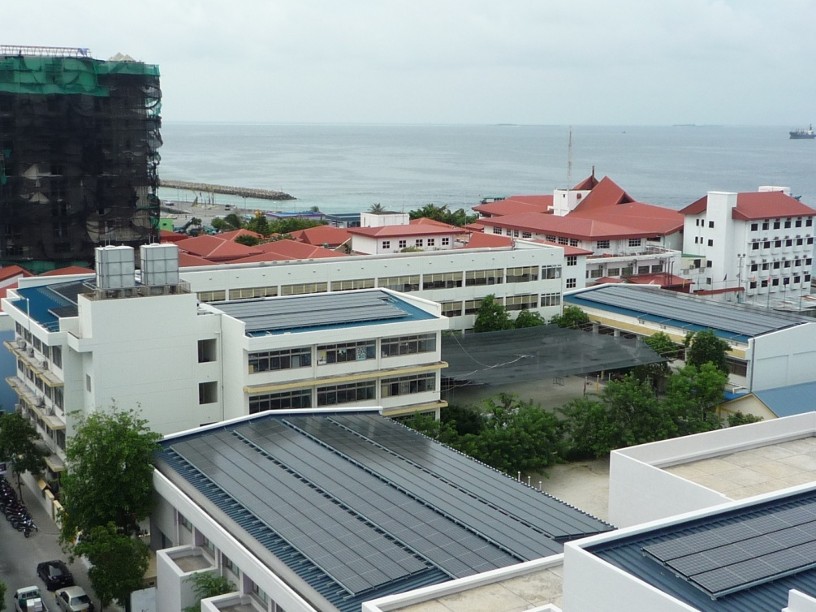
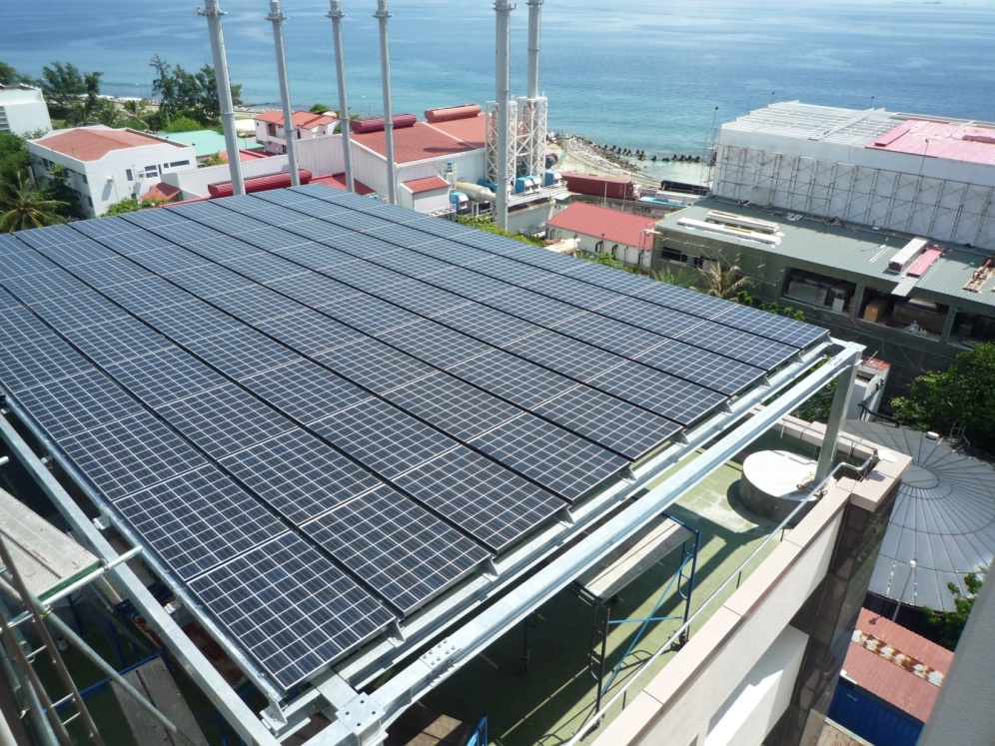
Project for Clean Energy Promotion in Male’
Solar roof-mounted grid connected PV systems in 12 public buildings in Male’ and Hulhumale.
Total: 740 kWp
Notes:
In this project a total of 740 KW in installed through solar roof mounted grid connected PV systems
In 12 public buildings in male’ and hulhumale. This project was completed last year.

Slide 17
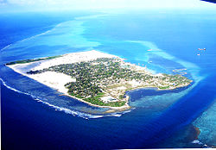
GDh. Thinadhoo Solar Project
GDh. Thinadhoo 550kWp Solar PV diesel-hybrid System with fuel saver technology
- Savings on Diesel : 800 Liters / Day
- Savings in MVR : USD 25,000/ Month
Notes:
This project was carried out in 2 phases. Under the first phase 308kWp solar photovoltaic systems were installed in 3 buildings (Thinadhoo School, Aboobakuru School and Powerhouse Building).
Under the second phase 250kWp solar photovoltaic systems were installed in additional 2 buildings (Dr.Abdul Samad Memorial Hospital and Mosque).
In addition to the solar PV component, energy conservation and efficiency activities were also carried out as part of this project.

Slide 18
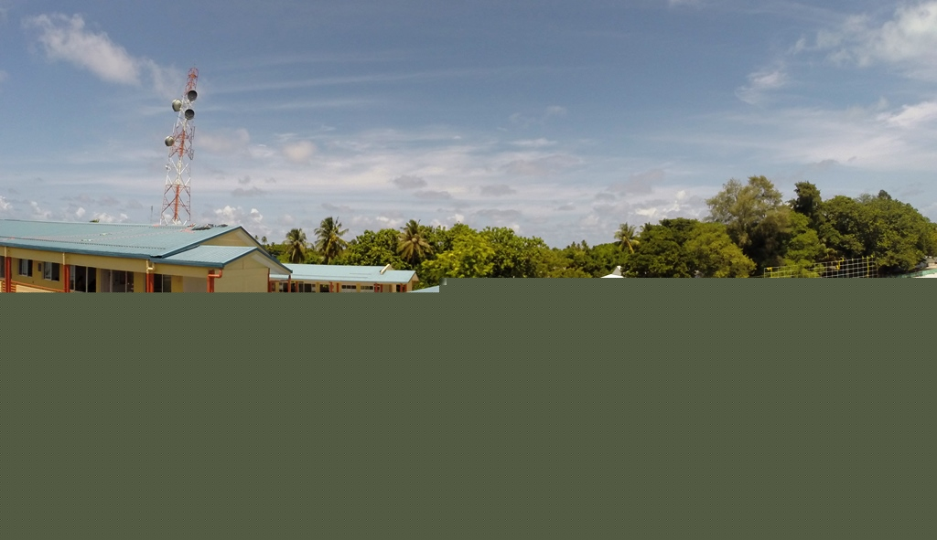
Dh. Kudahuvadhoo Solar Project
DH. Kudahuvadhoo 203 kWp Solar PV diesel-hybrid System with fuel saver technology
- Savings on Diesel : 200 Litres /Day
- Savings in MVR : USD 4,600/Month

Slide 19
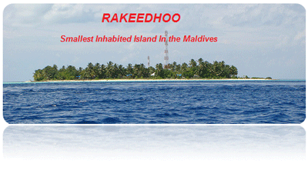
V. Rakeedhoo Solar Project
Solar energy of 29 kWp
Use of 27.5 kWh Li-Ion batteries
Diesel backup
Notes:
Ongoing project.

Slide 20
Adh. Dhihdhoo Solar Project
Existing Diesel Generators: 2 units of 32 kW each installed and another 32 kW as a backup.
PV panels: 45 kWp
Li-Ion based battery storage system: 90 kWh/45 kW
Notes:
This project is implemented by STELCO.
Ongoing
Levelised cost of energy
Lithium ion

Slide 21
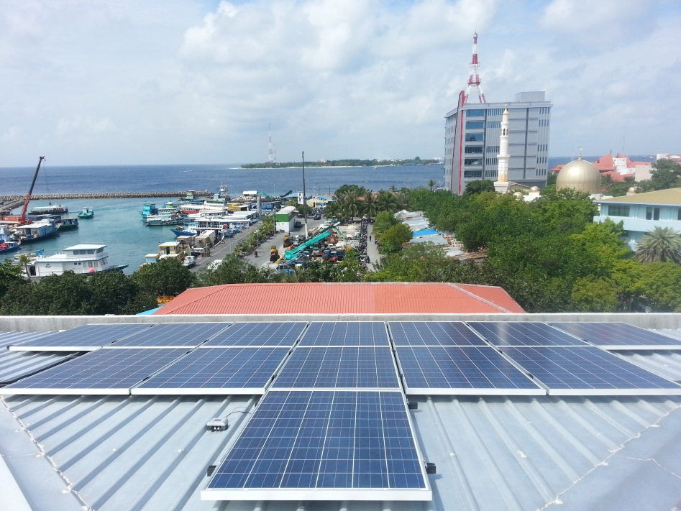
Green Building Solar Project
Solar roof-mounted grid connected PV system in the office building of Ministry of Envirnment and Energy.
Capacity: 25 kWp

Slide 22
Renewable Energy in the Tourism Sector of Maldives

Slide 23
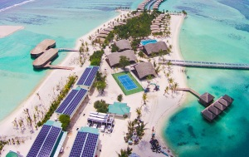
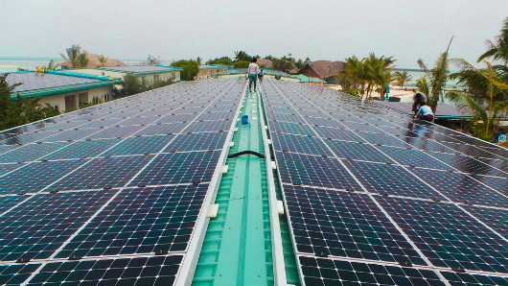
100% Solar Powered Island Resort
Resort Name: Gas finolhu Island
Solar PV capacity: 1.2MW
Notes:
Am proud to say that Gas finolhu island resort is the Maldives first resort with 100% solar Energy.
The resort has its electricity generated by solar panels that span on a surface of 6,000 square meters.

Slide 24
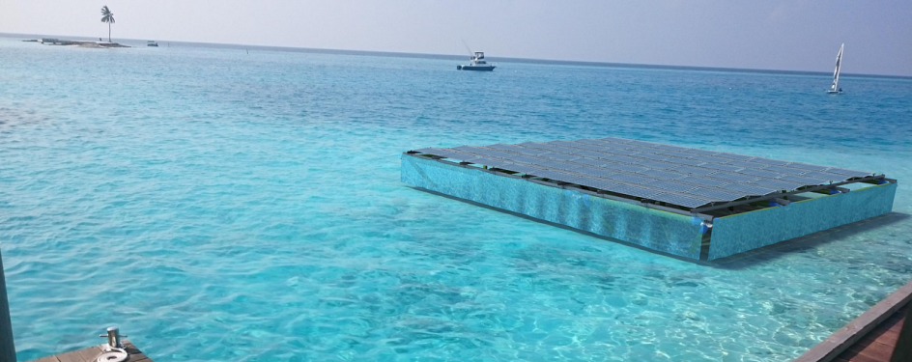
Floating Solar
Resort Name: Gili lankanfushi Resort
Solar PV capacity: Platform size: 15x15m
28kWp
Number of panels: 112
Notes:
This is the largest floating solar panel structure to be plugged in in the Maldives.
platform has a nominal capacity of 28 KW and on sunny days it will produce up to 200 kWh, which is enough to power all our pathway and jetty lights,
as well as the Main Office Building lighting for 12 hours! The platform will reduce our carbon footprint by 35 tonnes of CO2 per year.

Slide 25
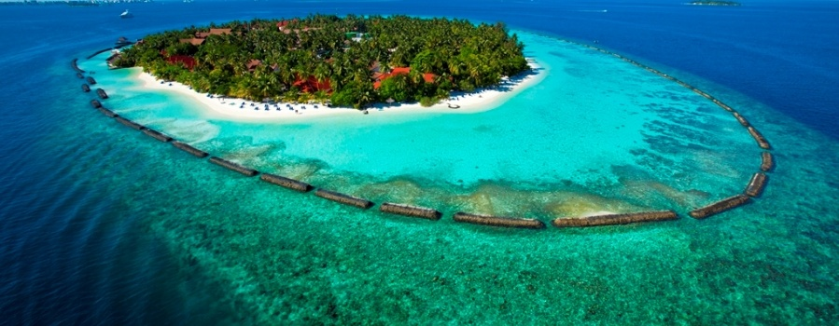
Thank You

