Slide 1
COUNTRY PRESENTATION
“TRAINING PROGRAMME TO SUPPORT RENEWABLE ENERGY DEVELOPMENT IN ASIA-PACIFIC ISLAND NATIONS
Vishal Prasad
Department of Policy & Planning
vishal001.prasad@govnet.gov.fj
Ph: +679 3384111

Slide 2
GENERAL INFORMATION
Independence: 10 October 1970
Republic: 7 October 1987
Population: 873,838
Area: 18,333sq.km
Language: English, Fijian, Hindi
Religion: Christianity, Hindu, Muslim
Political System: Unitary Parliamentary Republic
GNP (2013): $7575.8 FJD(millions)
GDP per capita(2013): $7071.2
Notes:
How presentation will benefit audience: Adult learners are more interested in a subject if they know how or why it is important to them.
Presenter’s level of expertise in the subject: Briefly state your credentials in this area, or explain why participants should listen to you.

Slide 3
Fiji’s Energy Sector
Fiji Department of Energy vision is for a sustainable energy sector in Fiji while its mission is to provide an enabling environment to achieve the vision.
Fiji Electricity Authority (FEA) – State owned electricity utility and operates on three major islands – Viti Levu, Vanua Levu & Levuka (Ovalau).
The FEA was established in 1966 under the Electricity Act with the basic function to provide and maintain a power supply that is financially viable, economically sound and consistent with the required standards of safety, security and quality of power supply
FEA is a Commercial Statutory Authority with 100% ownership by the Fijian Government
Notes:
Fiji Department of Energy established in 1981 and has been growing rapidly over the years.
Duties of the Authority under the Electricity Act are for the basic purpose of providing and maintaining a power supply that is financially viable, economically sound and consistent with the required standards of safety, security and quality.
FEA is responsible for the generation, transmission and retail of electricity in the larger islands of – Viti Levu, Vanua Levu & Ovalau, which account for approximately 90% of the country’s population.

Slide 4
Overall National Energy Situation
Fiji’s energy situation is characterised primarily by a high reliance on imported fuels.
Energy demand is driven by household consumption of electricity and transport fuels and by the need of its major industries, in particular agriculture, forestry, tourism, and mining.
Grid-based power supply has arguably the most immediate potential to make Fiji’s energy sector more efficient, cost effective, equitable, and environmentally sustainable.
Majority of the population has access to modern forms of energy (89%, 2007 Census), however challenges still remain to provide remote areas with access to electricity in a sustainable manner.
Transport sector is the main user of imported fuel in Fiji. Transport sector needs to increase its emphasis on energy efficiency in land and sea vehicles and vessels, while researching potential renewable energy options for land and sea transportation.
The issue of having the right data needs a concerted effort from everyone.
Despite the fact that Fiji has a relatively low energy-intensity economy, improving Fiji’s energy efficiency – in the transport sector and also in the power sector and amongst households, businesses and industry – is likely a cost-effective way to reduce the cost and increase the availability of energy in Fiji.

Slide 5
TOTAL IMPORTS - 2015
Mineral Fuels account for around 1/3 of Major Total Imports (but 1/5 on retained imports basis)

Slide 6
ELECTRICITY SECTOR – GENERATION MIX
Electricity Generation in Fiji by Source (FEA-2016 Data)
Notes:
The power generation mix for 2014 was 44.96% hydro compared to 44.90% in 2015
50.91% diesel and heavy fuel oil in 2014 compared to 52% in 2015
0.48% wind in 2014 compared to 0.63% in 2015
3.65% provided by the Independent Power Producers (IPPs) in 2014 compared to 2.47% in 2015; Reduction could be due to the not so satisfactory
performance of the sugar industry

Slide 7
Policies/Regulations to Support Energy Transition
Green Growth Framework
- Thematic area (vii) Energy Security
National Climate Policy
National Energy Policy and Strategic Action Plan
Rural Electrification Policy
Power Development Plan – FEA
Sustainable Energy for All (SE4All) Initiative
In progress…
Distributed Generation / Grid Connect PV Policy
National Biofuels Strategy
Electrification Master Plan
Renewable Energy/Electric Vehicles Transport Systems

Slide 8
National Energy Policy (NEP) 2014-2020
Outcomes: 1) Affordable energy for all
2) Sustainable energy supplies
3) Reduced import costs
Objectives
To provide all Fijians with access to affordable and reliable modern energy services
To establish environmentally sound and sustainable systems for energy production, procurement, transportation, distribution and end-use
To increase the efficient use of energy and the use of indigenous energy sources to reduce the financial burden of energy imports on Fiji
Key Strategic Areas
Grid-based power supply
Rural electrification
Renewable energy
Transport
Petroleum and biofuels
Energy efficiency

Slide 9
NEP & SE4ALL Targets
Indicator | Baseline | Targets
 |  | 2015 | 2020 | 2030
Access to modern energy services
Percentage of population with electricity access | 89% (2007) | 90% | 100% | 100%
Percentage of population with primary reliance on wood fuels for cooking | 20% (2004) | 18% | 12% | < 1%
Improving energy efficiency
Energy intensity (consumption of imported fuel per unit of GDP in MJ/FJD) | 2.89 (2011) | 2.89 (0%) | 2.86 (-1%) | 2.73 (-5.5%)
Energy intensity (power consumption per unit of GDP in kWh/FJD) | 0.23 (2011) | 0.219 (-4.7%) | 0.215 (-6.15%) | 0.209 (-9.1%)
Share of renewable energy
Renewable energy share in electricity generation | 60% (2011) | 67% | 81% | 100%
Renewable energy share in total energy consumption | 13% (2011) | 15% | 18% | 25%
^{[1]} Preliminary data from 2007 Census, Fiji Islands Bureau of Statistics.
^{[2]} 2002-03 Household Income and Expenditure Survey, Fiji Islands Bureau of Statistics. Reliance on wood fuels as the main fuel for cooking.
^{[3]} Based on 15% fuel substitution to local fuels and a 3% annual efficiency improvement.
^{[4]} Fiji Islands Bureau of Statistics based on average 36 MJ per litre of fuel.
^{[5]} Annual Report 2011, FEA.
^{[6]} Based on total energy consumption of 16,500 TJ (Fiji Islands Bureau of Statistics) and 60% power generation from renewables (FEA).
^{[7]} Based on 99% renewable power and 25,000 KL of biofuel.

Slide 10
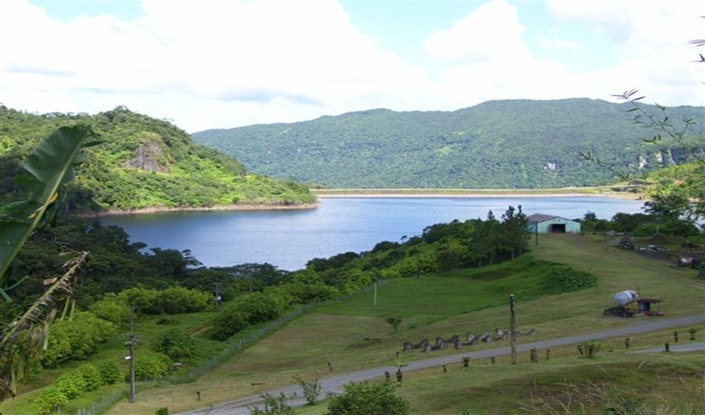
Renewable Energy Projects: Constructed
Monasavu Hydroelectric Scheme
Capacity – 80MW
Commissioned – 1983
Project Cost – F$300M
Average Fuel Savings per annum – F$160M (at today’s fuel price of F$2,000/MT)
Average Carbon Emission Reduction per annum– 248,000 tonnes

Slide 11
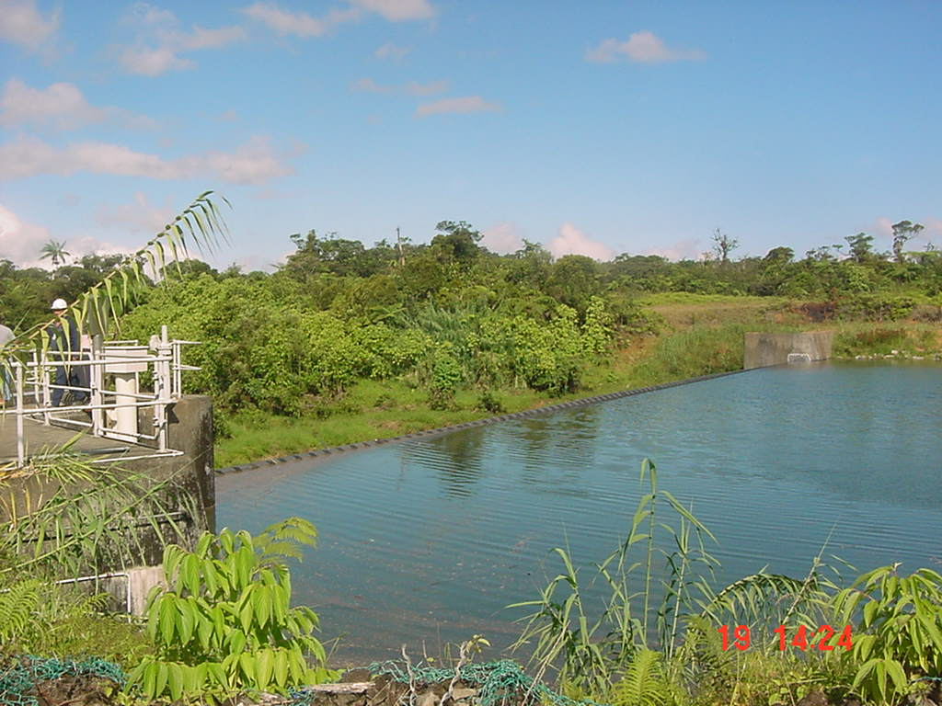
Renewable Energy Projects: Constructed
Wainikasou Hydroelectric Scheme
Capacity – 6.6MW
Commissioned – 2004
Project Cost – F$10M
Average Fuel Savings per annum – F$6M
Average Carbon Emission Reductions per annum – 12,000 tonnes

Slide 12
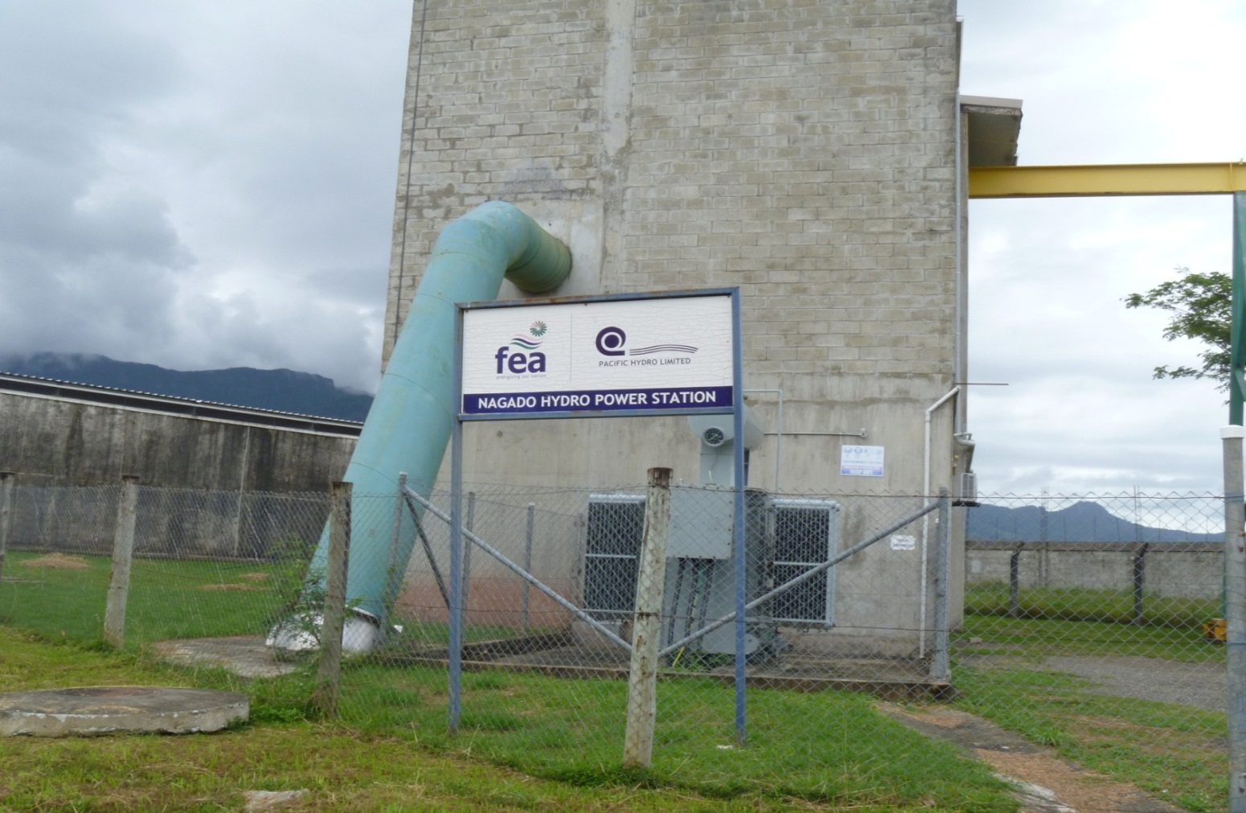
Renewable Energy Projects: Constructed
Nagado Hydroelectric Scheme
Capacity - 2.8MW
Commissioned in -2006
Project Cost – F$9M
Average Fuel Savings per annum – F$3M
Average Carbon Emission Reductions per annum – 6,000 tonnes

Slide 13
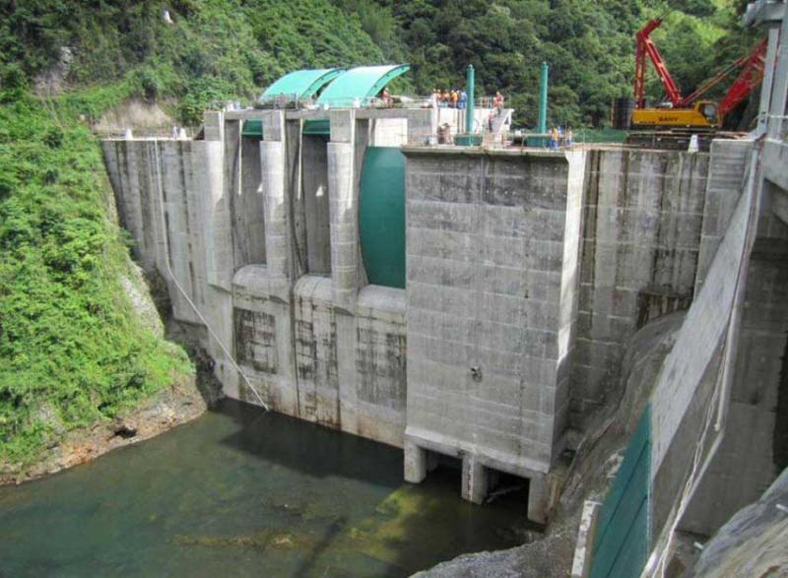
Renewable Energy Projects: Constructed
Nadarivatu Hydroelectric Scheme
Capacity - 40MW
Commissioned - September 2012
Project Cost - F$310M
Estimated Average fuel savings per annum – F$40M
Estimated Average Carbon Emission Reductions per annum – 62,000 tonnes

Slide 14
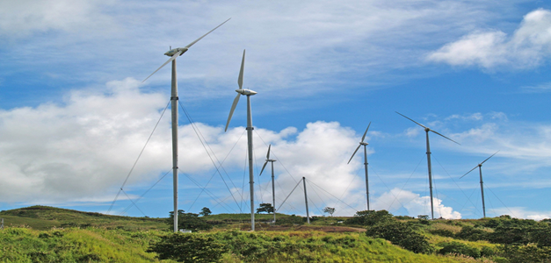
Renewable Energy Projects: Constructed or In Process
Butoni Wind Farm
Capacity - 10MW; 37 wind turbines with a unit capacity of 275 kW
Commissioned – 2007
Project Cost - F$40M; cost per unit is about F$1 million

Slide 15
PV Application in Fiji
Renewable Energy Projects: Constructed
Application | Quantity | Size
Solar Stand-alone Home Systems | 5900 units (in 2015) | 964 kW
Hybrid Systems ( Diesel generator – PV System) | 3 unit | 555 kW(This is only PV System)
Solar Water Pump | 2 unit | 500W
Centralized Island System | 1 unit | 20.25kW
NOTE:
The data above only represent the PV systems that were funded and co-funded by the government; it does include those systems that were installed by the private companies who are engaged in supplying and installing PV systems to private institutions, organisations and households

Slide 16
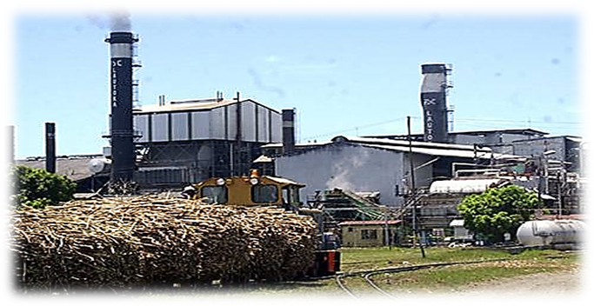
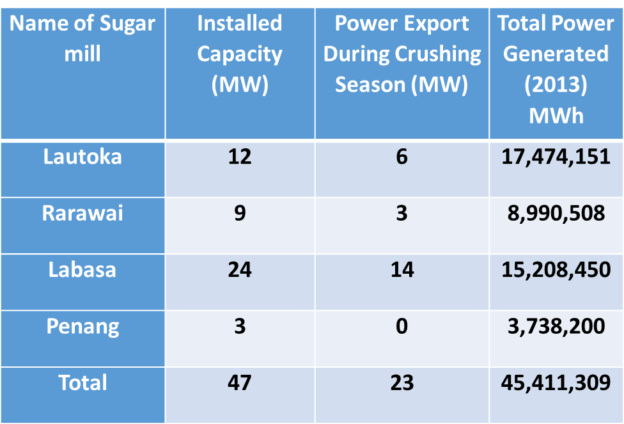
Renewable Energy Projects: Constructed
Biomass
Fiji Sugar Corporation (FSC) is the government-owned sugar milling company
It operates four sugar mills: the Lautoka mill, the Rarawai mill in Ba, the Penang mill in Rakiraki in Viti Levu, and the Labasa mill in Vanua Levu. Each mill has a co-generation system, and their total generation capacity is 47 MW

Slide 17
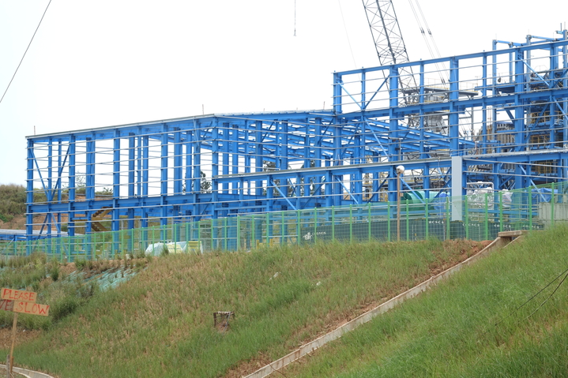
Renewable Energy Projects: In Process
Biomass Power Plant
Joint venture between Korea and Fiji
Capacity - 12MW
Commissioned – Under Construction ~ 75% complete
Project Cost - F$92M

Slide 18
Notable Challenges
One of the main challenges in the power sector is institutional in nature: there is no effective Independent Power Producer (IPP) framework in place that would attract the urgently needed private capital into renewable energy based power generation.
At present there are no feed-in tariffs, net metering provisions or incentive programmes that would promote such generation by households and Small and Medium Enterprises (SMEs)
Challenges often faced in implementing a project:
Planning
Availability of transport to installation sites
Technology adaption
Ensure grid stability since generation through renewable energy is often intermittent and unscheduled and as with the increased penetration of energy; there is a possibility of grid shut down

Slide 19
Workshop Expectations/Outcomes
Enhancing knowledge and information on how Japan has successfully deployed Renewable energy via policy and regulatory frameworks.
Gain insight of various RE technologies employed
Information sharing with other SIDs
Developing an Energy Transition Plan/strategy

Slide 20
Country Name Fiji
Policies/Regulations to Support Energy Transition
Example 1
Example 2
Example 3
Renewable Energy Projects: Constructed or In Process
Example 1
Example 2
Example 3
Notable Successes and/or Challenges
Example 1
Example 2
Example 3
Workshop Expectations/Outcomes
Example 1
Example 2
Example 3

