Slide 1



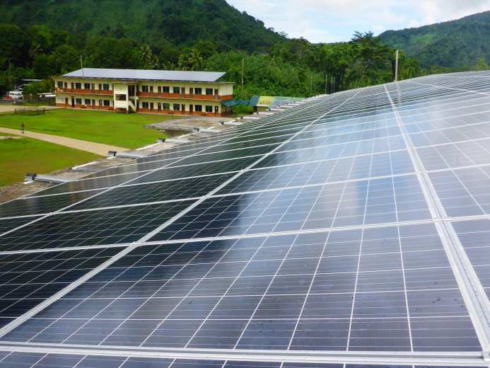
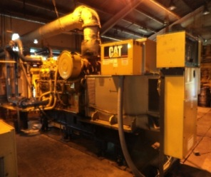
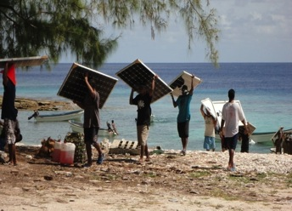
Energy Sector Overview
Federated States of Micronesia
Department of Resources & Development
Division of Energy
FSM National Government

Slide 2
Federated States of Micronesia
Federated States of Micronesia
1.3 mil sq. mile geographical area
271 sq. mile land mass
607 islands (74 inhabited islands)
102,843 total population (2010 census) +
  approximately 49,700 residing abroad

Slide 3
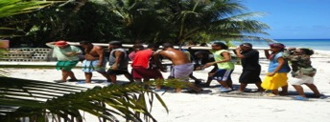
National Energy Policy
Adopted October, 2012
To improve the life and livelihood of all FSM citizens with affordable, reliable and environmentally sound energy.
To become less dependent on imported sources of energy by:
- (1) increased share of renewable energy sources
- (2) cross-sectorial energy conservation; and
- (3) efficiency standards in place
By 2020
- 30% of total energy production in RE
- 50% improvement in Energy Efficiency
- 90% electricity access

Slide 4
Energy Sector Overview
Energy: integral for social and economic development
Policy addresses almost entirely on electricity (transport and others not developed yet)
FSM’s dependency on imported fuels to meet overall energy requirements:
  Fuel imports → 15% of GDP
  Imported petroleum → supports 55% of households

Slide 5
Energy Use Distribution
39%
1. Utilities 2. System Losses 3. Government
4. Commercial & Industrial 5. Residential

Slide 6
FSM Energy Profile
State | Base (Diesel) KW Capacity | Peak (Diesel) KW Capacity | RE (done) KW Capacity | RE (On going) KW Capacity | Total RE KW Capacity
Kosrae | 600 | 1,200 | 353 | 6 | 359 (05%)
Pohnpei | 3,300 | 5,800 | 1,763 | -0- | 1,763 (05%)
Chuuk | 1,500 | 2,500 | 355 | 435 | 790 (05%)
Yap | 1,500 | 2,800 | 674 | 1,125 | 1,799 (17%)
Total | 6,900 | 12,300 | 3,145 | 1,566 | 4,711 (08%)
Renewable Target 30%
Need 4 MW (net) or about 20 MW (Solar PV) installed

Slide 7
Constraints & Challenges
Separate state-owned power utility for each of the 4 states
Coordination of Energy Development (1 National Policy w/5 Action Plans)
Limited domestic capacity
Access Expansion (social responsibility vs. sustainability – cost)
  Strong political will to push “access” but reluctance to support tariff to address sustainability of system.
Utilities unable to generate revenue to support further energy source development (limited resources to finance RE targets)
Land and infrastructure issues/limitations
Logistics – expensive

Slide 8
Expectation from Workshop
Learn best practices from other (countries) in addressing similar or common challenges
Learn strategies utilized by others in advancing their targets (RE, EE, Access, etc.)
Gain better understanding of assistance offered by Government of Japan
In sharing our situation, discuss how and where IRENA could offer technical support
Employ knowledge gained to help improve our share of the global outreach.

Slide 9
Thank you

