Slide 1
COOK ISLANDS
Ngateina Rani

Slide 2
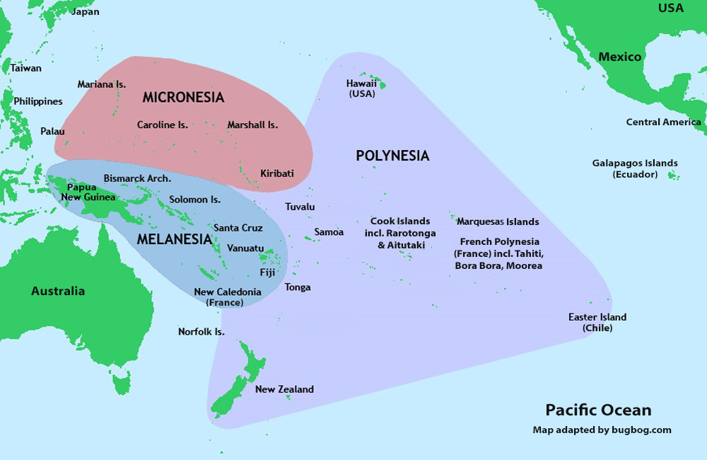
Background

Slide 3
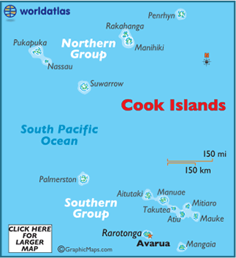
Some Basic Facts
Named after Capt. James Cook
15 small Islands (12 inhabited)
2 Groups (Northern and Southern)
Population approx. 13,000
New Zealand citizens
Tourism

Slide 4
Policies/Regulations to Support Energy Transition
RE Vision
“50% of Electricity Generation from RE by 2015 and 100% by 2020”
RE Targets/Strategy
“50% of Islands Electricity Generation from RE by 2015 and 100% by 2020”
Legal Framework
Amendment to Cook Islands National Energy Policy 2003
Institutional Framework
Office of the Energy Commissioner
Renewable Energy Development Division / Office of the Prime Minister

Slide 5
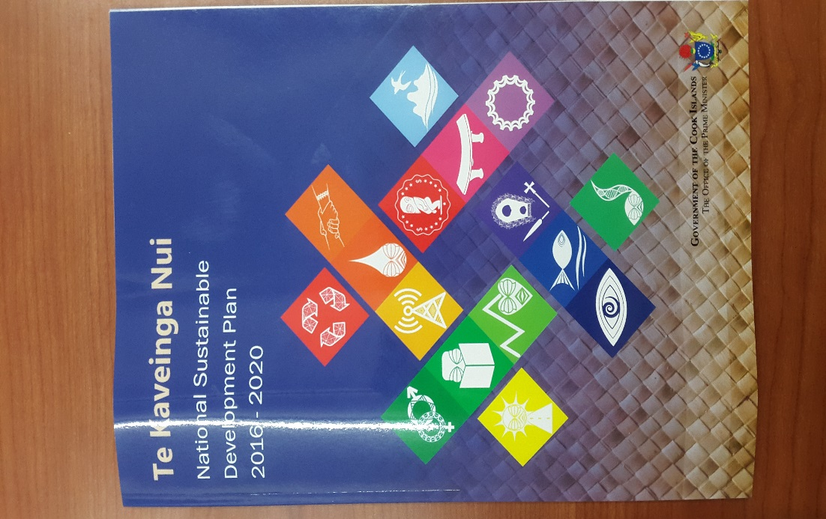
Policies/Regulations to Support Energy Transition – cont.
Policies
National Sustainable Development Plan 2011 – 2015 / 2016 – 2020
Cook Islands Renewable Energy Chart 2012/2015, Implementation Plan 2012 and Island Specific Implementation Plan 2012
Common Design Principles and Specifications 2012
Net Metering 2kWp
Gross Metering 10kWp

Slide 6
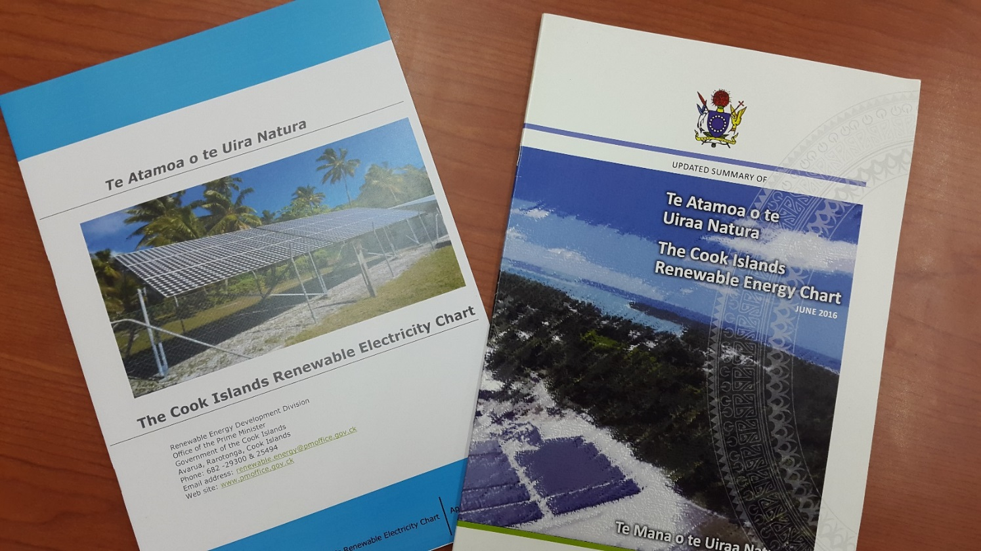
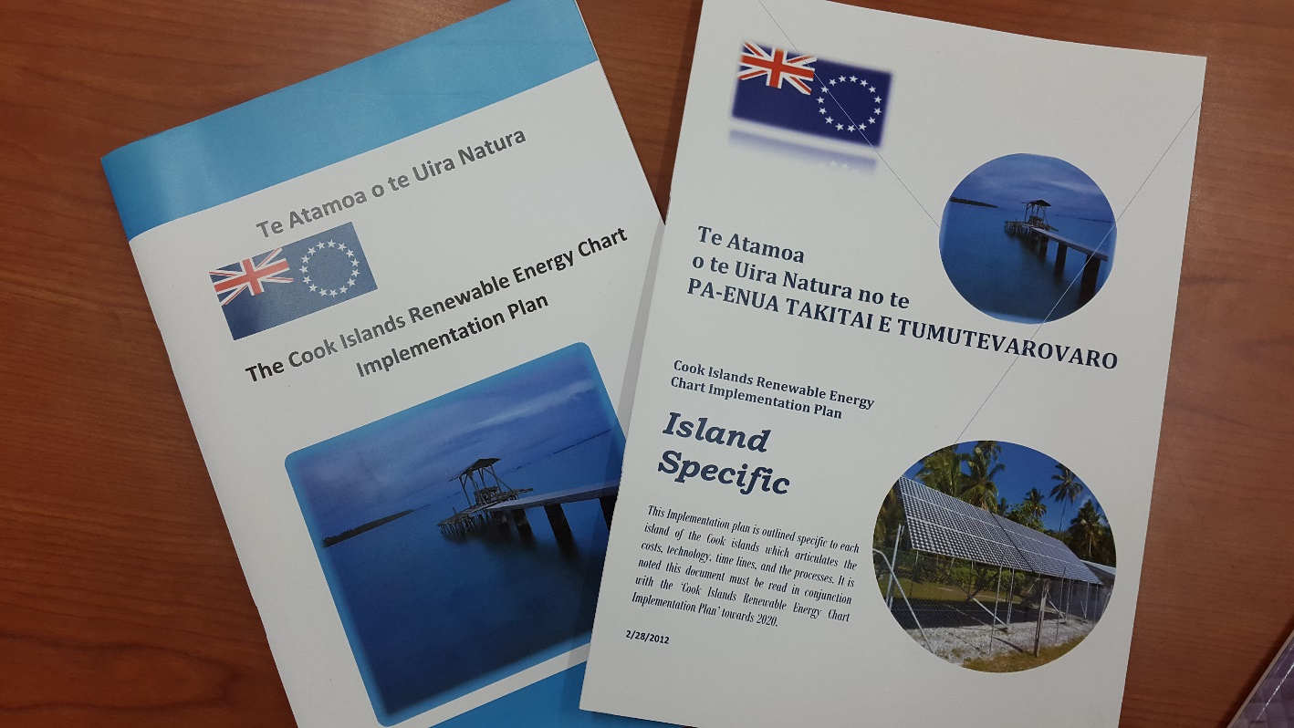
Policies/Regulations to Support Energy Transition – cont.
IPP 7 / 14 / 21kWp
IPP > 100kWp
Feed-In Tariff

Slide 7
RE Projects: Constructed
ISLAND | POP* | TECHNOLOGY | SYSTEM SIZE (kWp / kWh) | OWNERSHIP MODEL | % OF CAPACITY
PENRHYN - Omoka | 203 | PV Mini-Grid | 53 / 306 | CG/IG | 100
PENRHYN - Tetautua |  | PV Mini-Grid | 42 / 306 | CG/IG | 100
MANIHIKI - Tukao | 243 | PV Mini-Grid | 137 / 764 | CG/IG | 100
MANIHIKI - Tauhunu |  | PV Mini-Grid | 147 / 917 | CG/IG | 100
RAKAHANGA | 77 | PV Mini-Grid | 84 / 458 | CG/IG | 100
PUKAPUKA | 453 | PV Mini-Grid | 210 / 1,223 | CG/IG | 100
NASSAU | 73 | PV Mini-Grid | 53 / 306 | CG/IG | 100
PALMERSTON | 60 | PV Mini-Grid | 53 / 306 | CG/IG | 100
* 2011 Census

Slide 8
RE Projects: Constructed cont.
ISLAND | POP* | TECHNOLOGY | SYSTEM SIZE (kWp) | OWNERSHIP MODEL | % OF CAPACITY
RAROTONGA | 13,097 | Grid-connect | 1,079 | Net Metering | 16
 |  | Grid-connect | 1,293 | Gross Metering
 |  | Grid-connect | 425 | IPPs
 |  | Grid-connect | 1,049 | Utility
* 2011 Census
RE contribution for Dec 2016 = 16%
Peak demand for Dec 2016 = 4.8MW

Slide 9
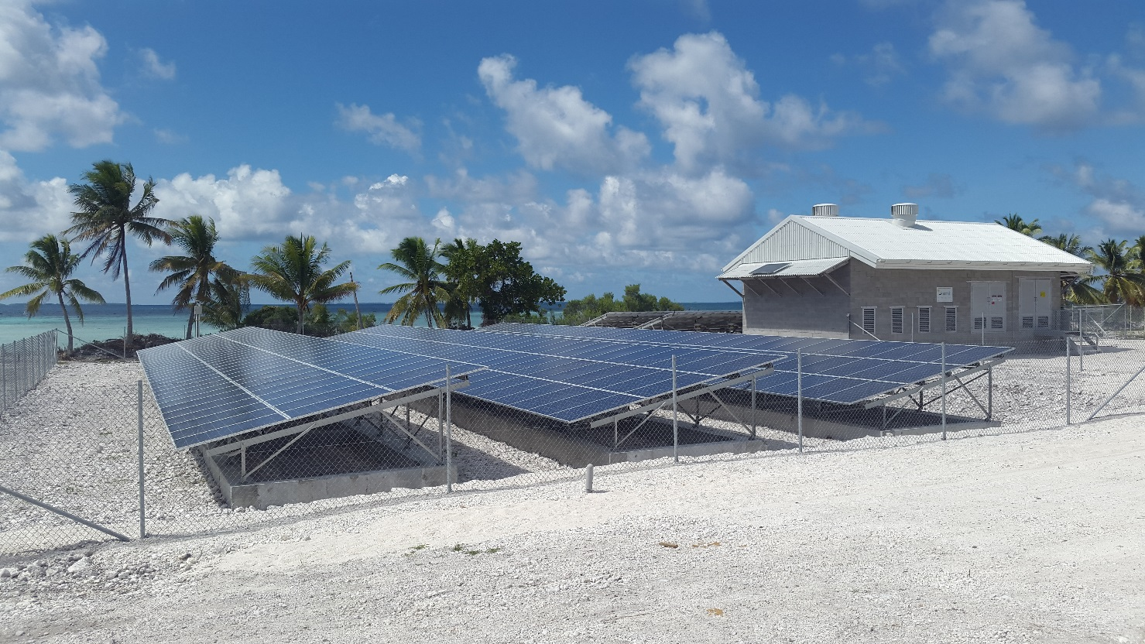
PENRHYN – Omoka (53kWp / 306kWh)

Slide 10
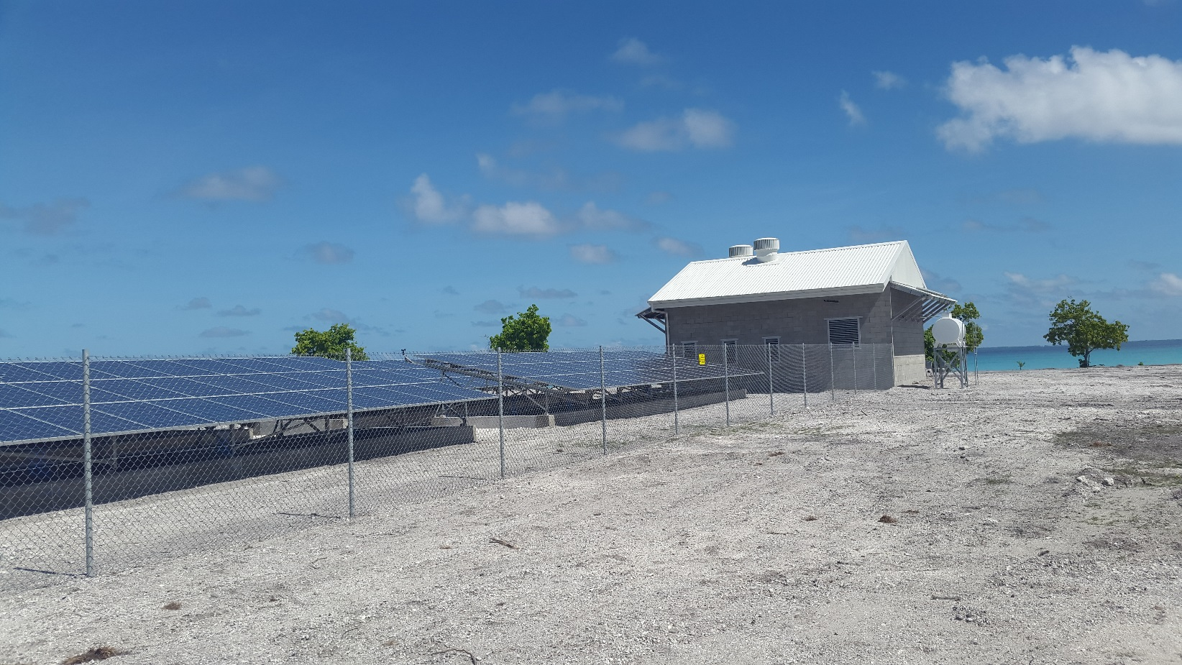
PENRHYN – Tetautua (42kWp / 306kWh)

Slide 11
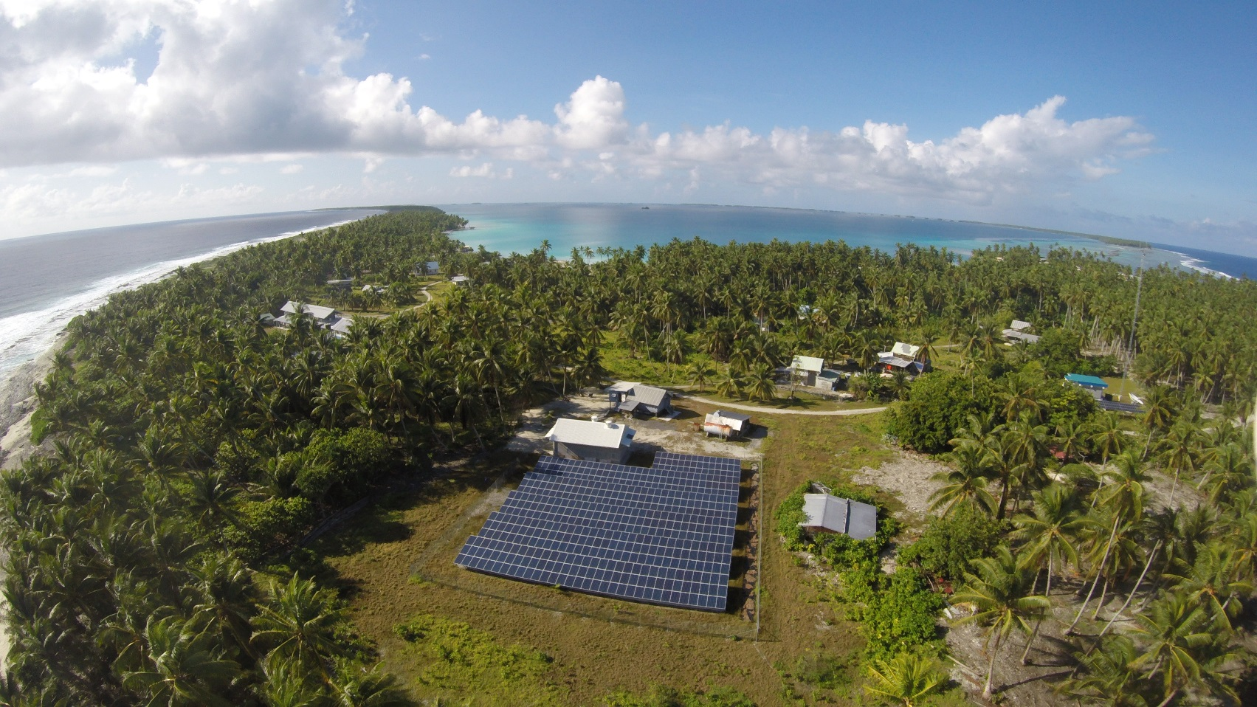
MANIHIKI – Tukao (137kWp / 764kWh)

Slide 12
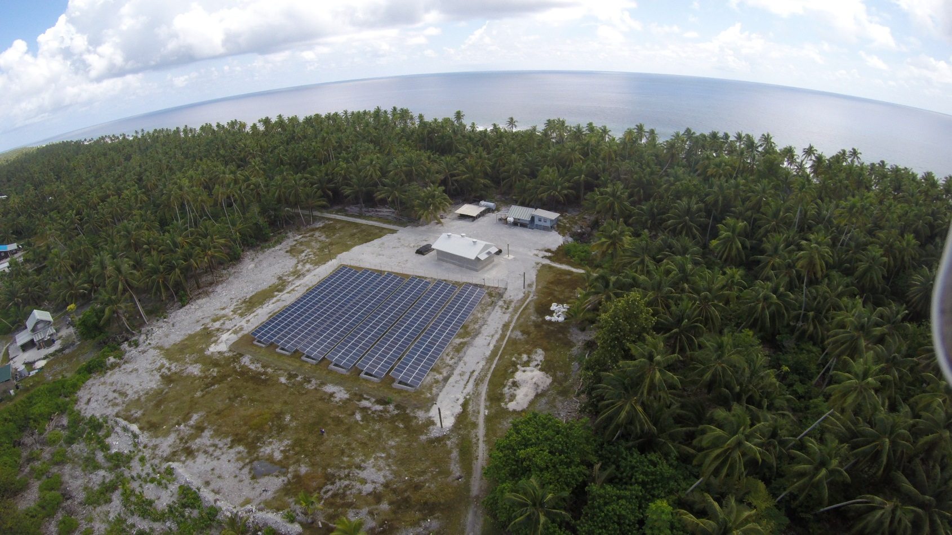
MANIHIKI – Tauhunu (147kWp / 917kWh)

Slide 13
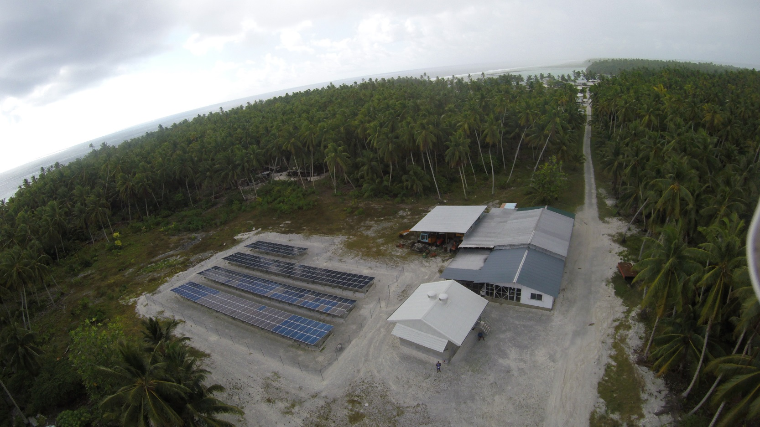
RAKAHANGA (84kWp / 458kWh)

Slide 14
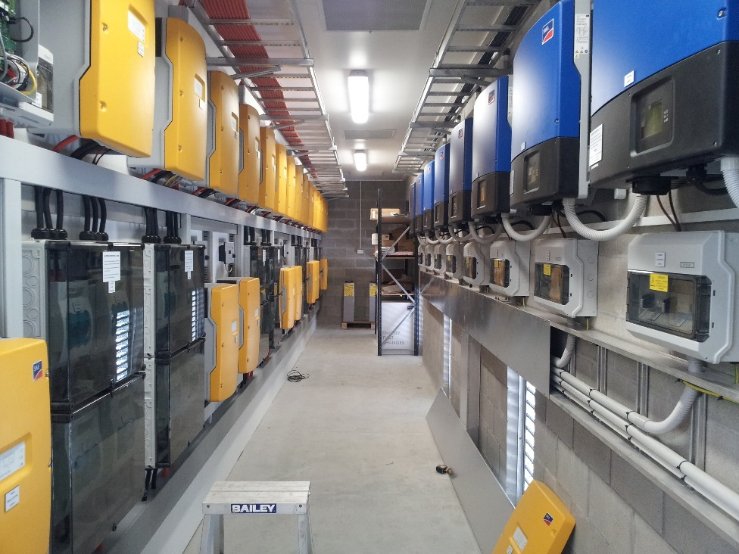
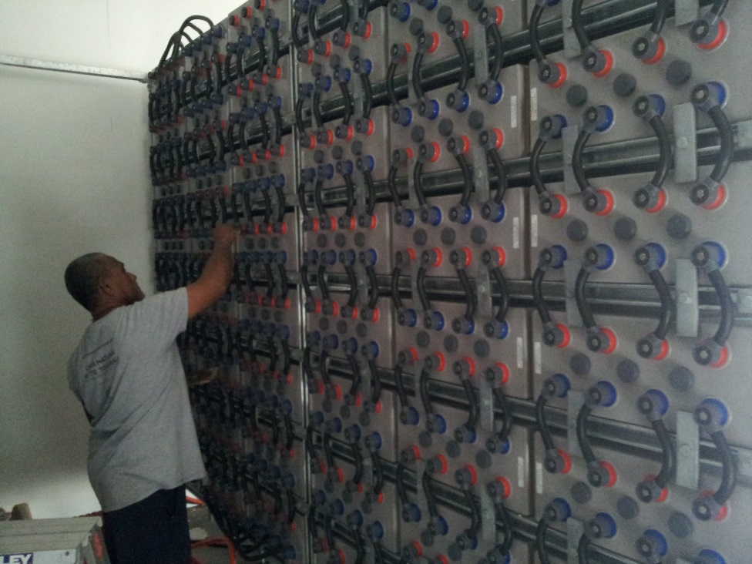
PUKAPUKA (210kWp / 1,223kWh)

Slide 15
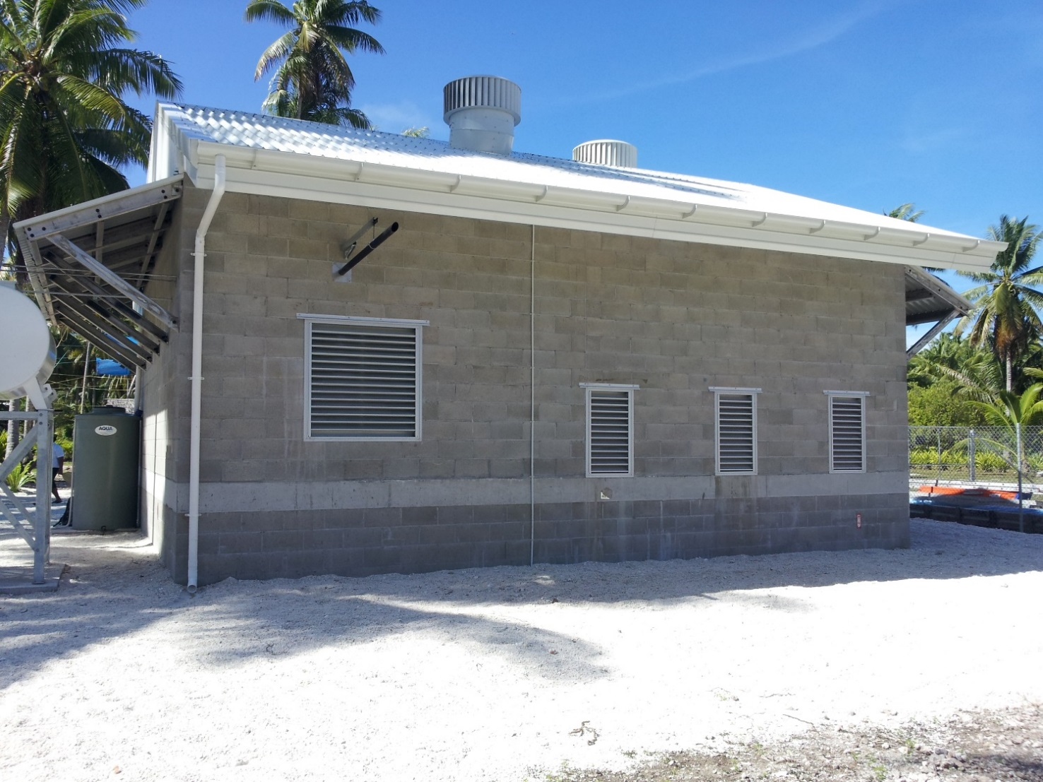
NASSAU (53kWp / 306kWh)

Slide 16
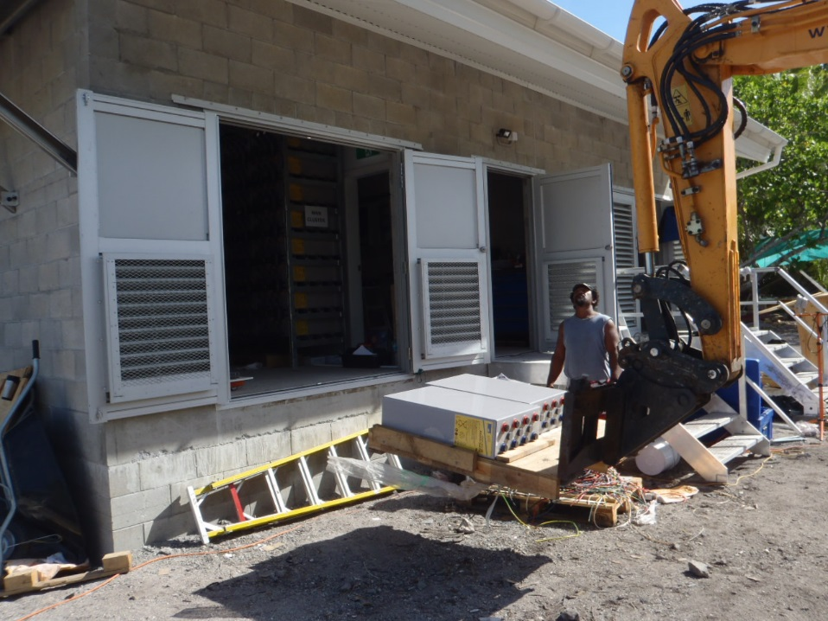
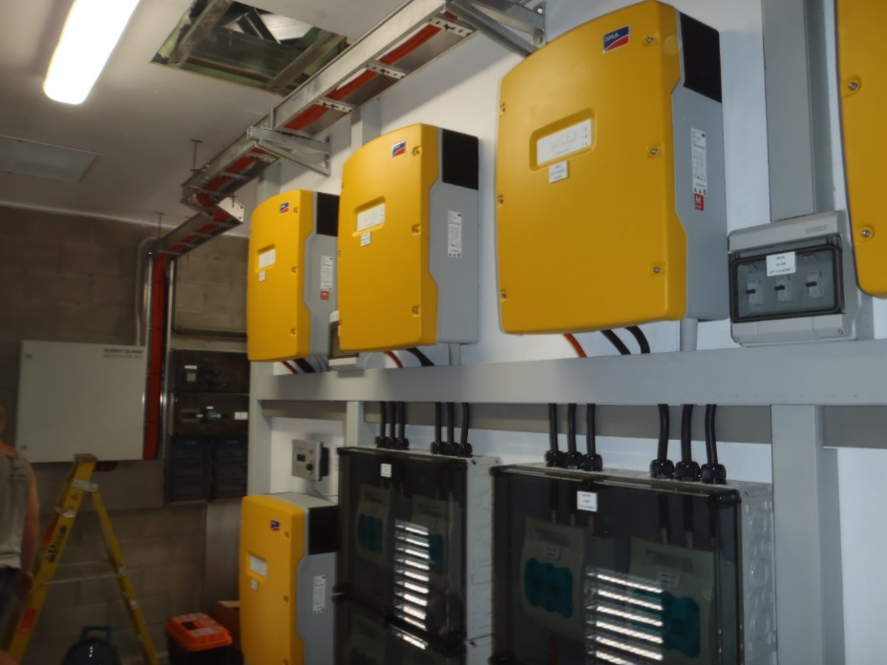
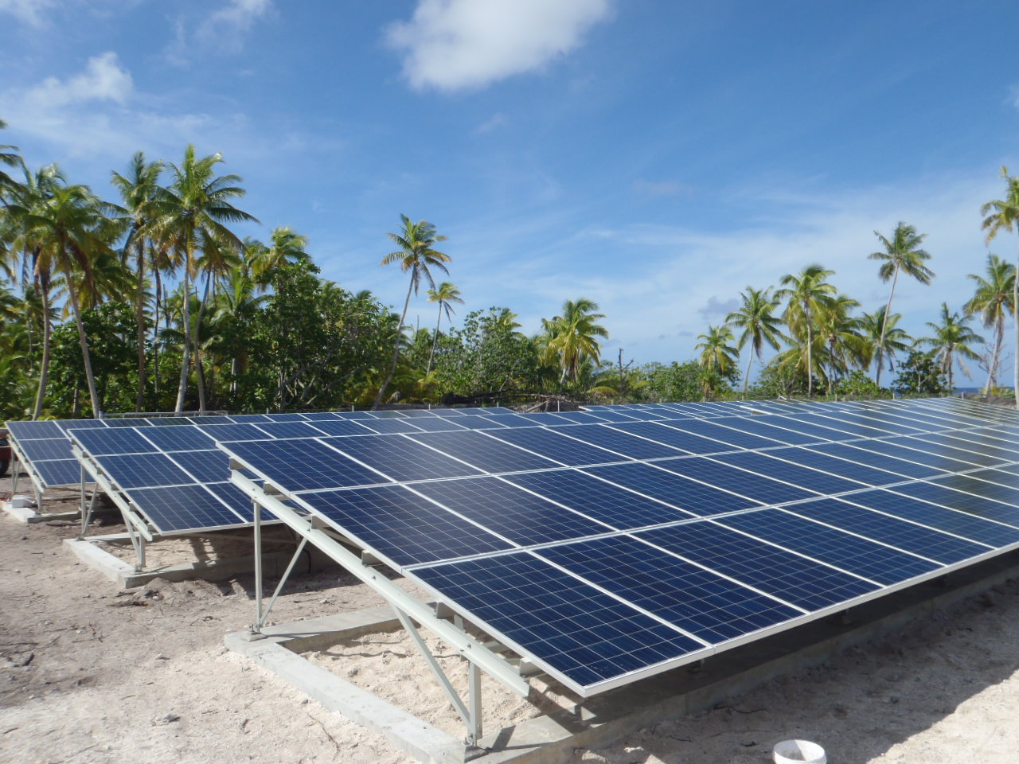
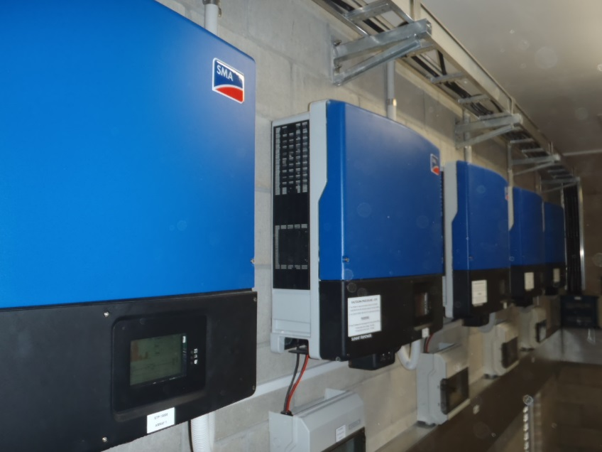
PALMERSTON (53kWp / 306kWh)

Slide 17
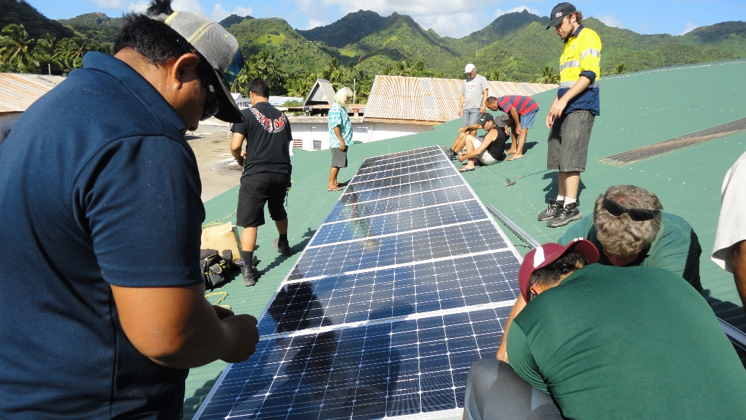
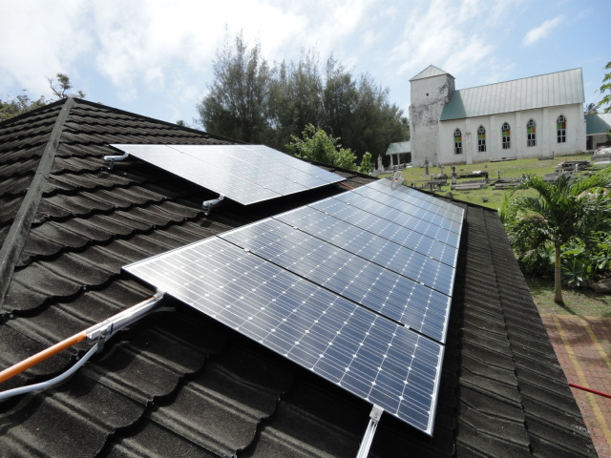
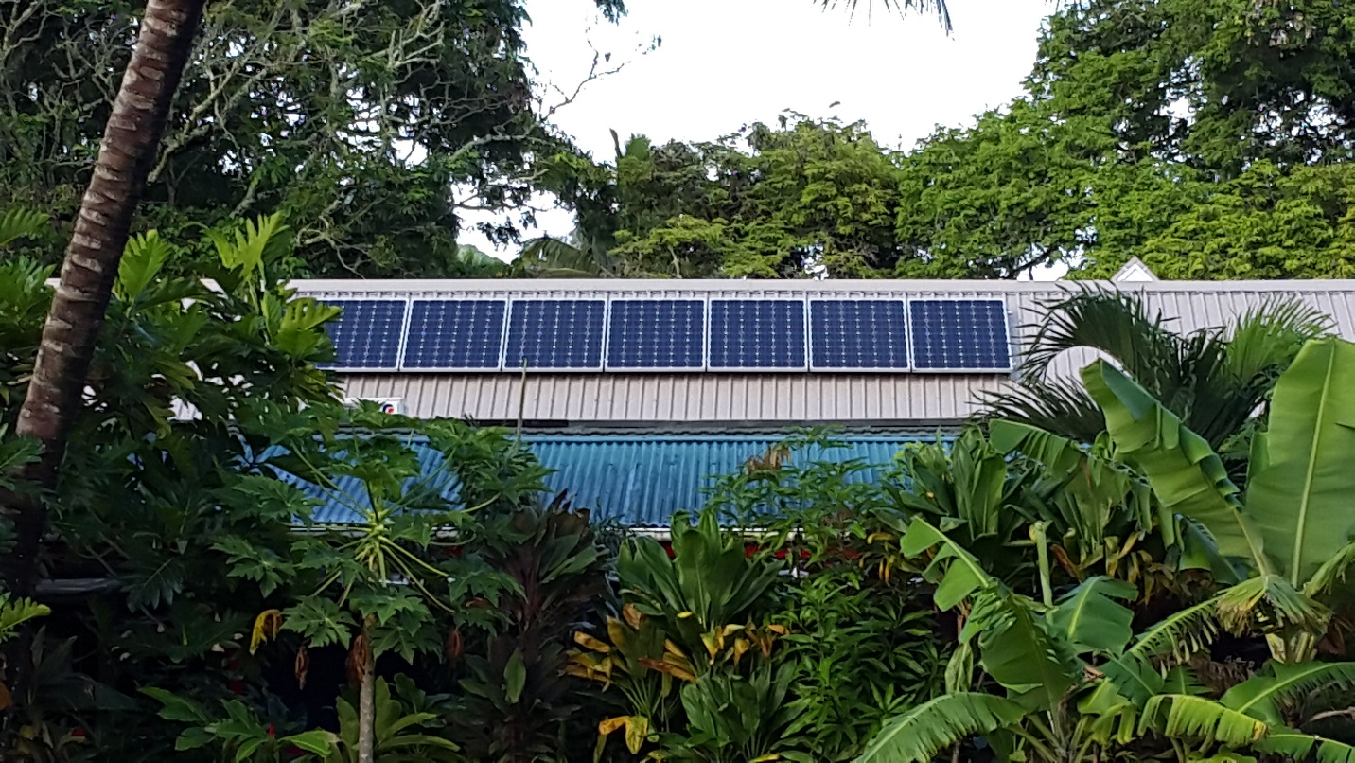
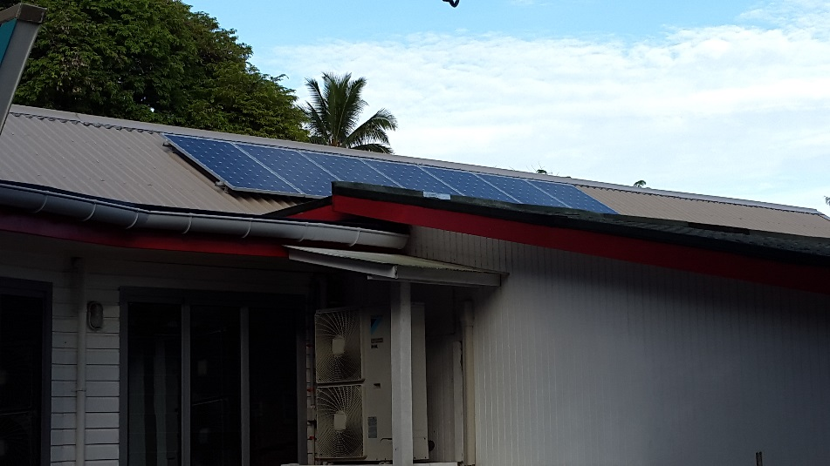
RAROTONGA – Net-Metering 2kWp

Slide 18
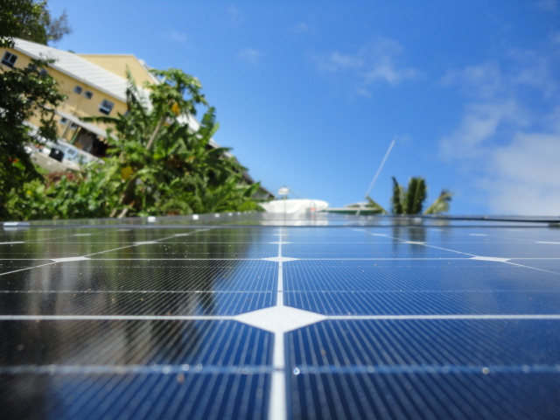
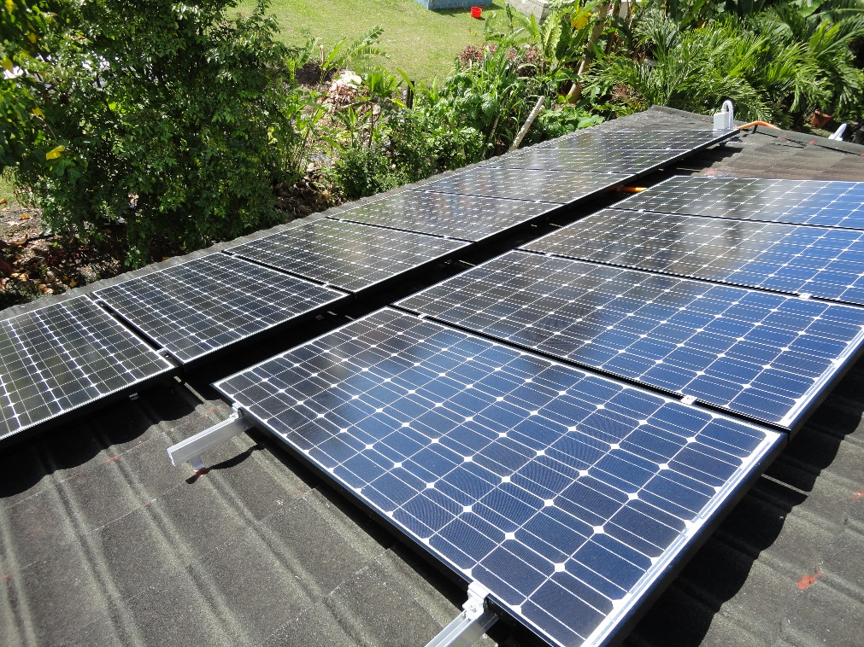
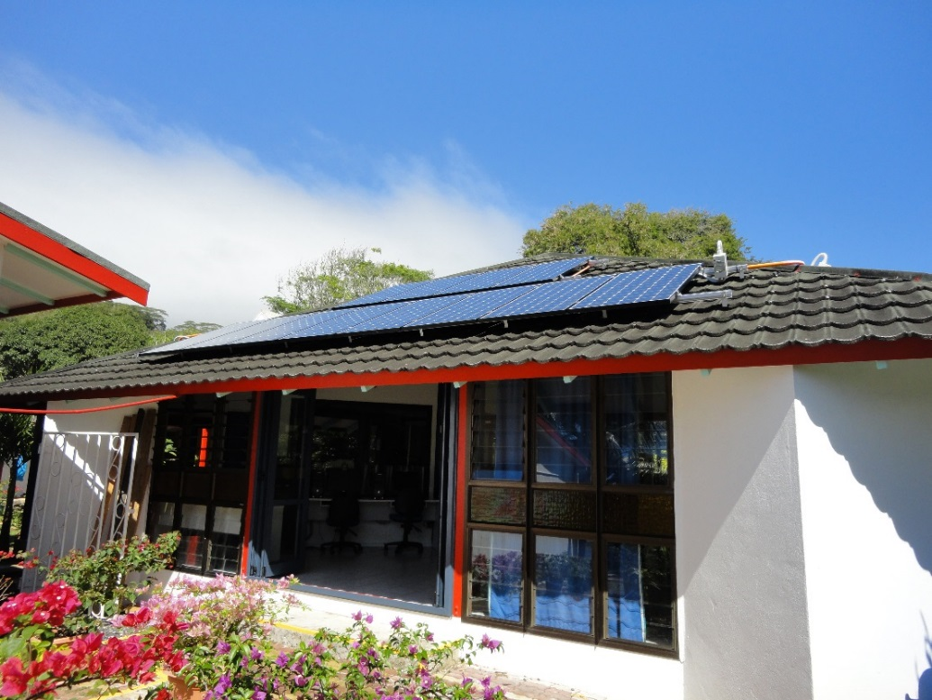
RAROTONGA – Gross Metering 10kWp

Slide 19
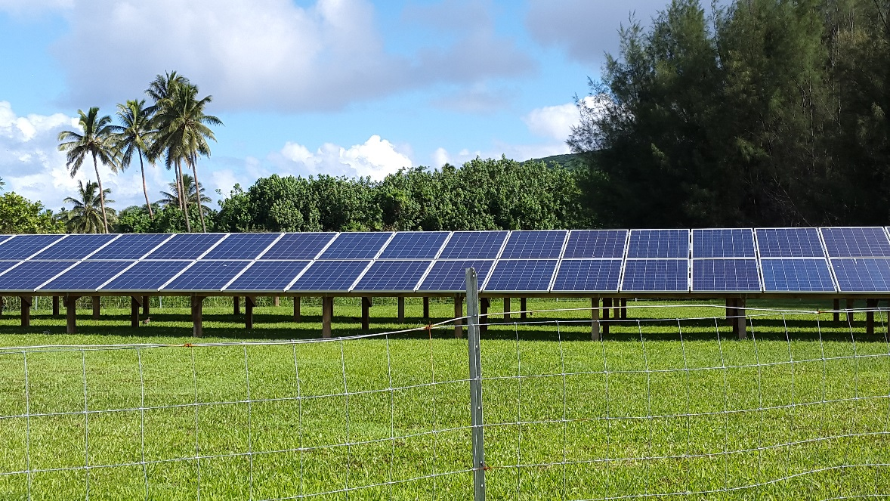
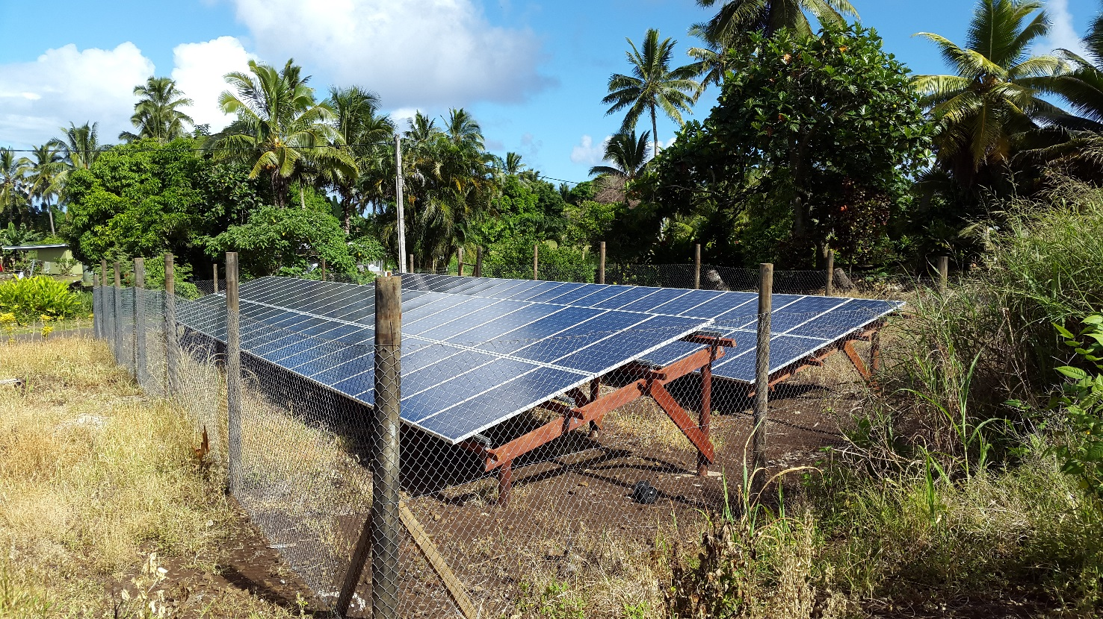
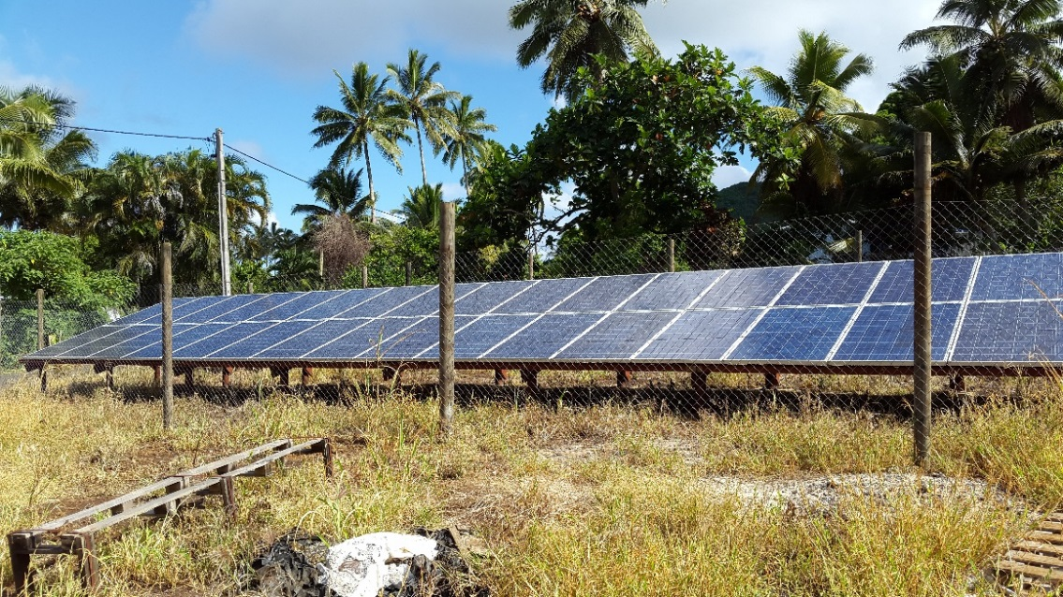
RAROTONGA – IPP 7/14/21kWp

Slide 20
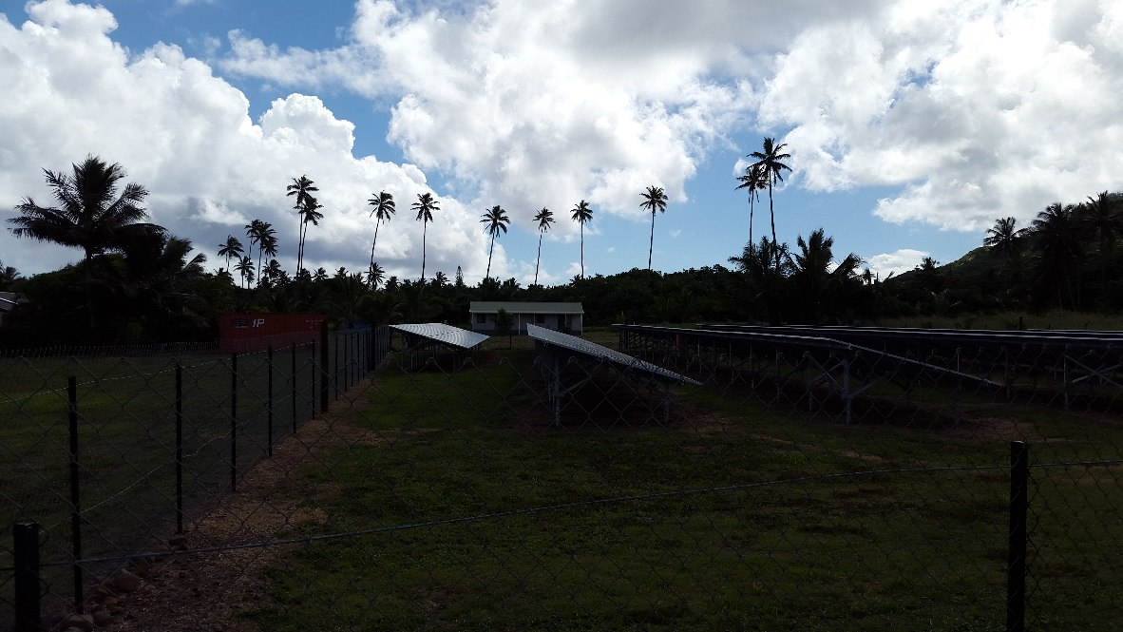
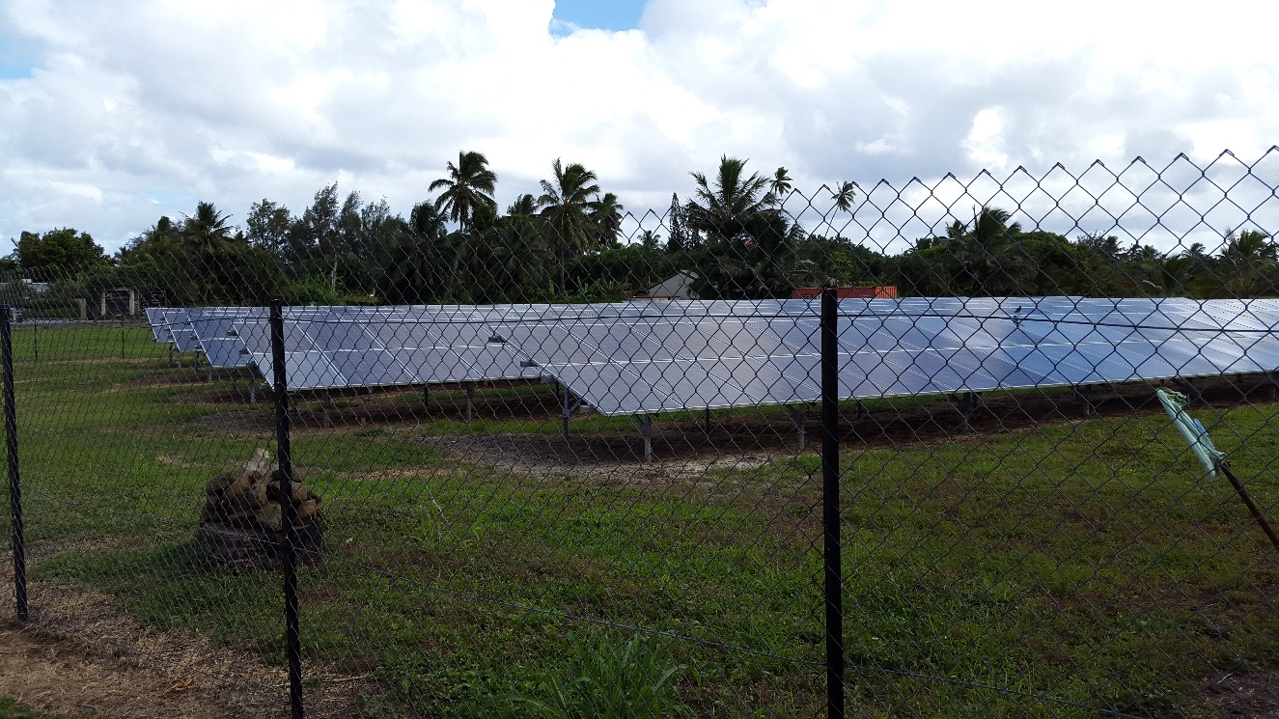
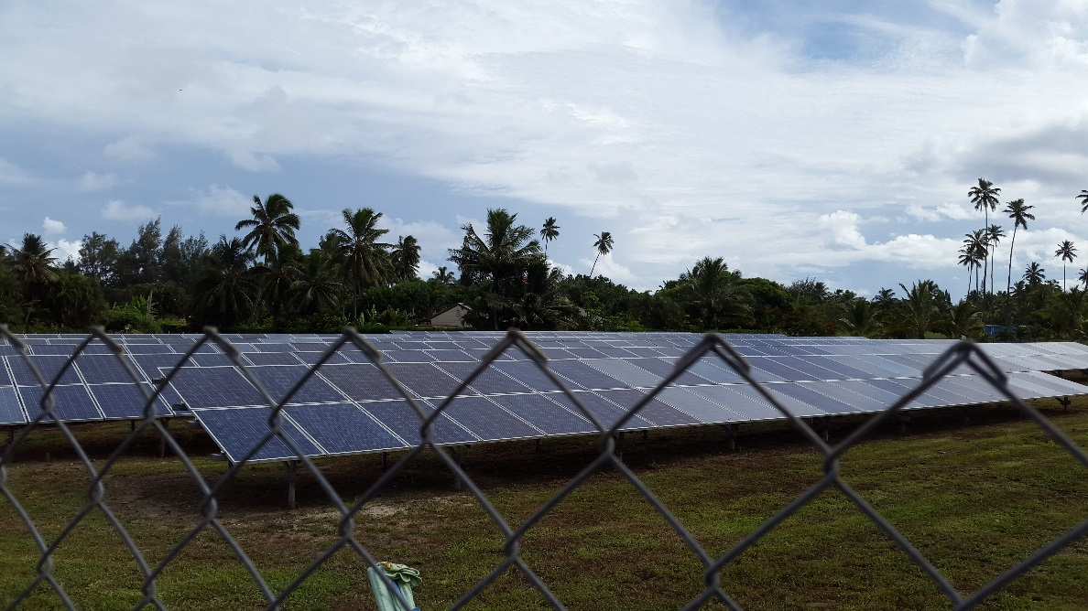
RAROTONGA – IPP 100kWp

Slide 21
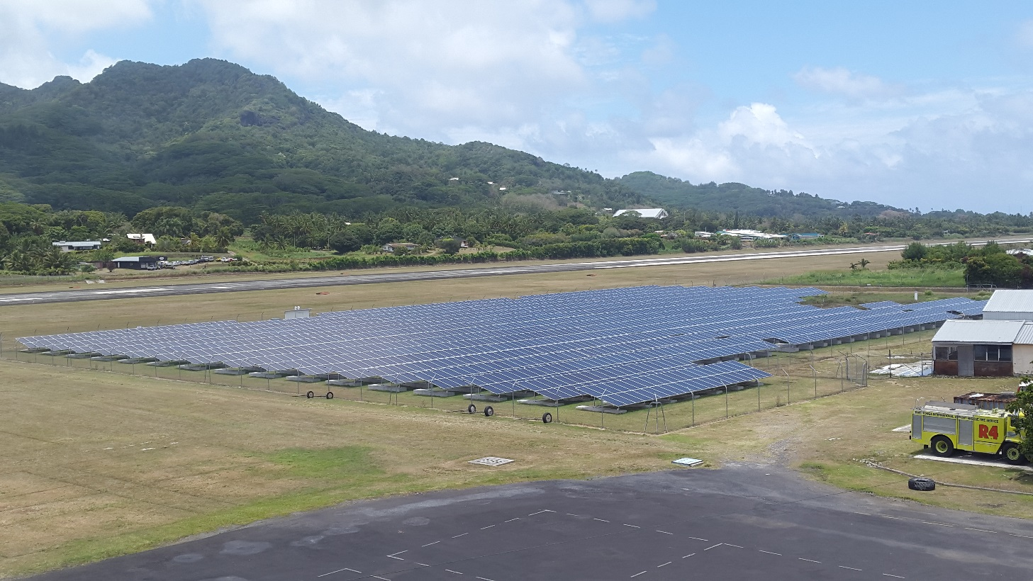
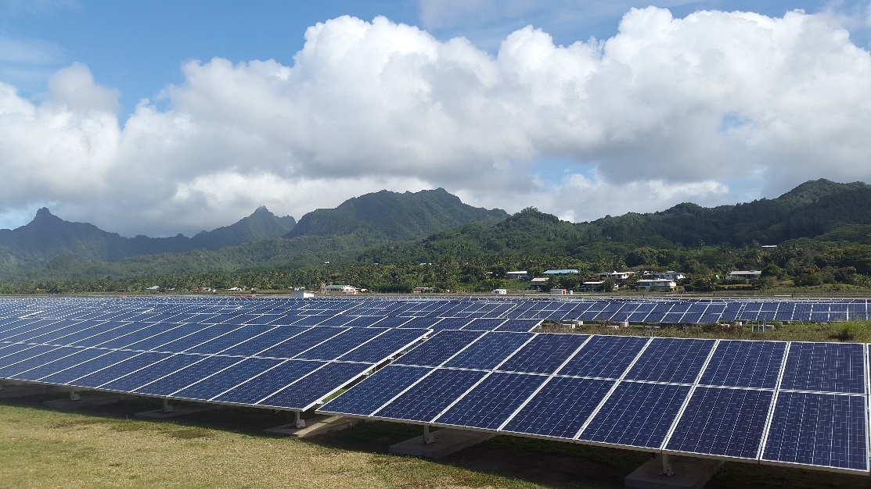
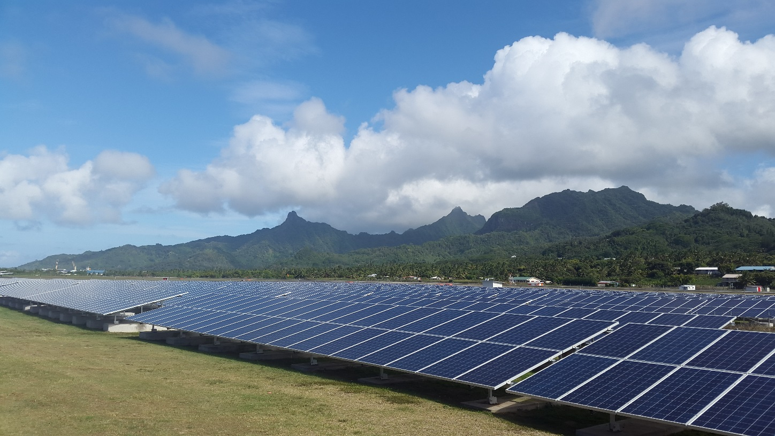
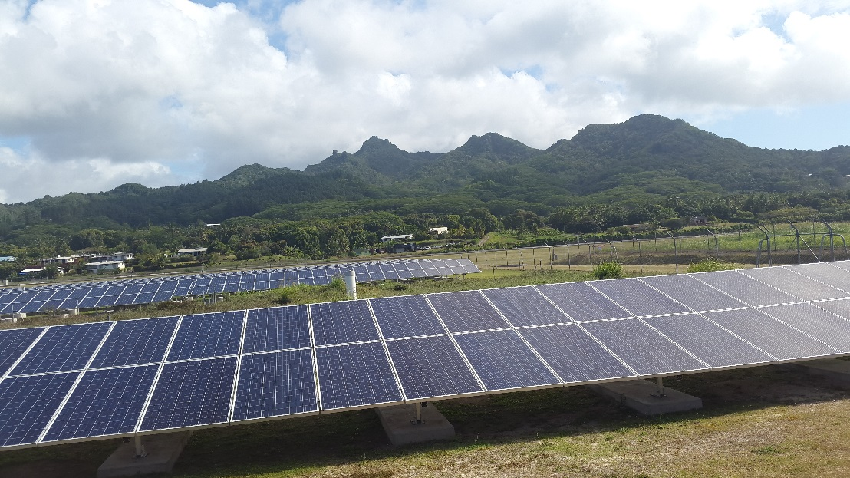
RAROTONGA – Rarotonga Airport 1MWp

Slide 22
Renewable Energy Projects: In-Progress
ISLAND | POP | TECHNOLOGY | SYSTEM SIZE (kWp) | OWNERSHIP MODEL | % OF CAPACITY
MITIARO | 189 | PV Mini-Grid | 100 | CG/IG | 100
MAUKE | 307 | PV Mini-Grid | 250 | CG/IG | 100
ATIU | 481 | PV Mini-Grid | 250 | CG/IG | 100
MANGAIA | 573 | PV Mini-Grid | 400 | CG/IG | 100
AITUTAKI | 2,035 | Grid-Connect & BESS | 750 | Utility | 30
RAROTONGA | 13,097 | Rooftops | 1MWp | Utility
 |  | BESS |  | Utility

Slide 23
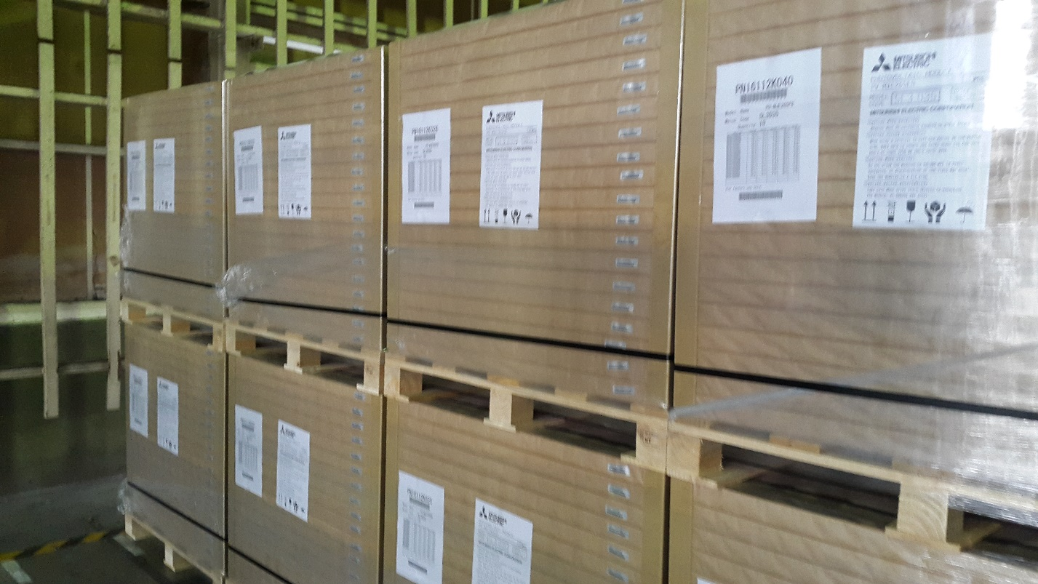
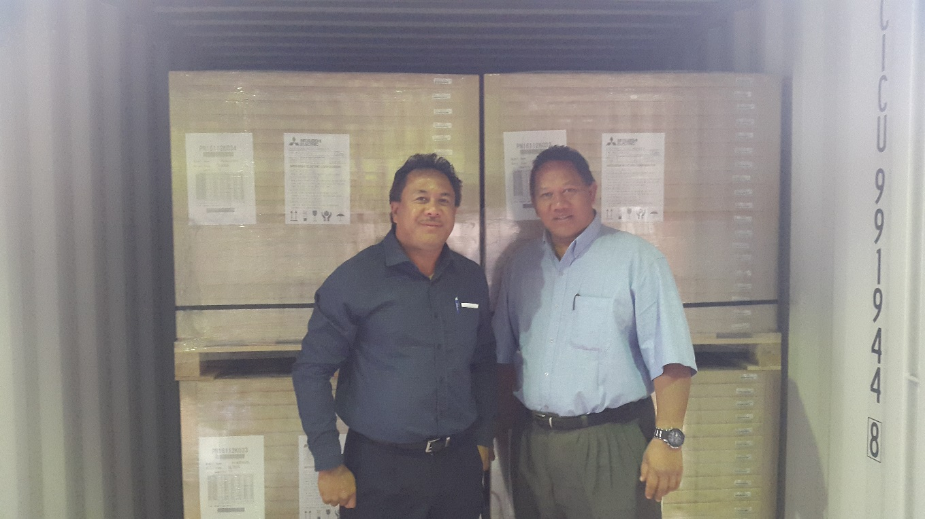
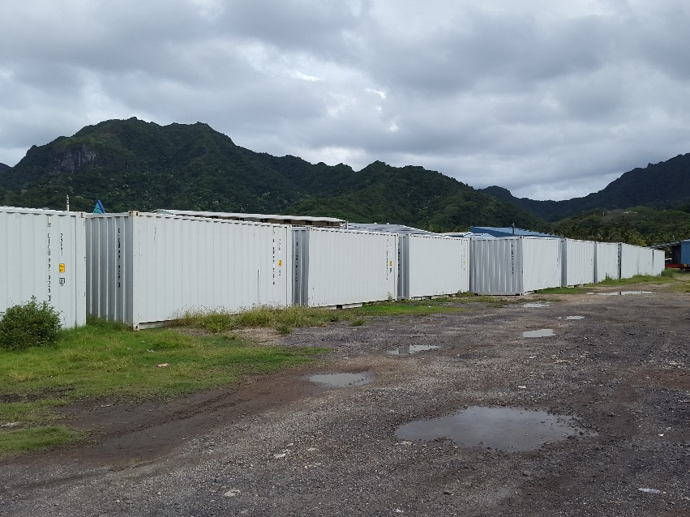
PEC Fund – 13,784 pcs 265Wp Solar Panels

Slide 24
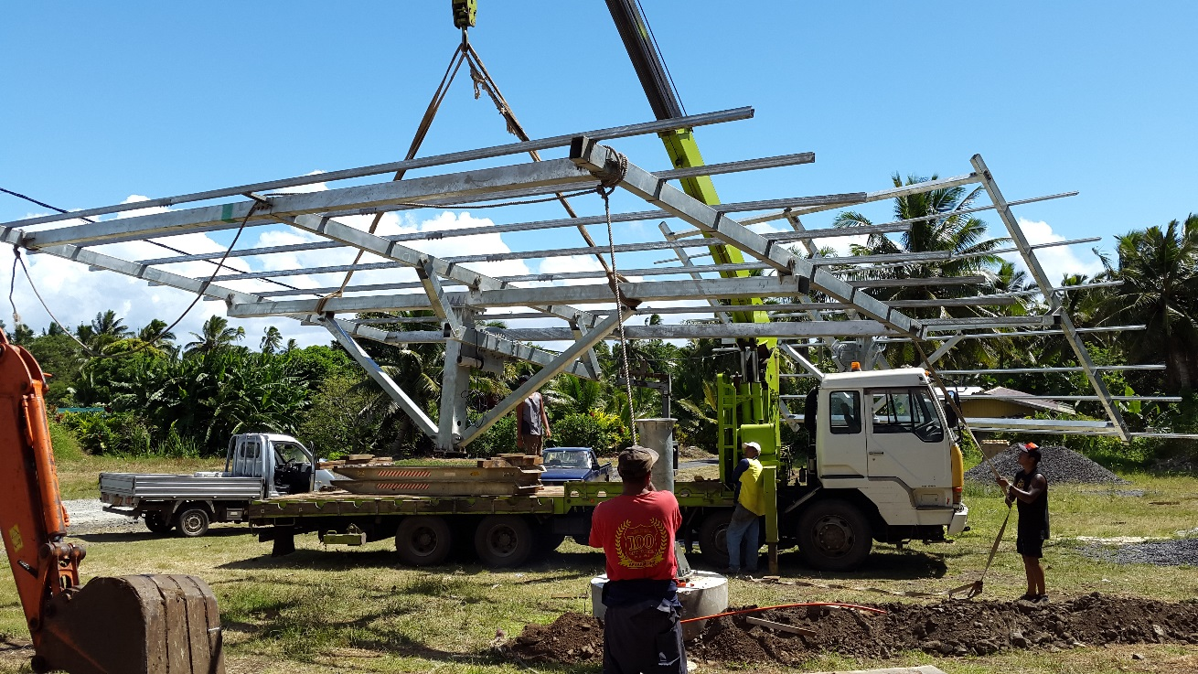
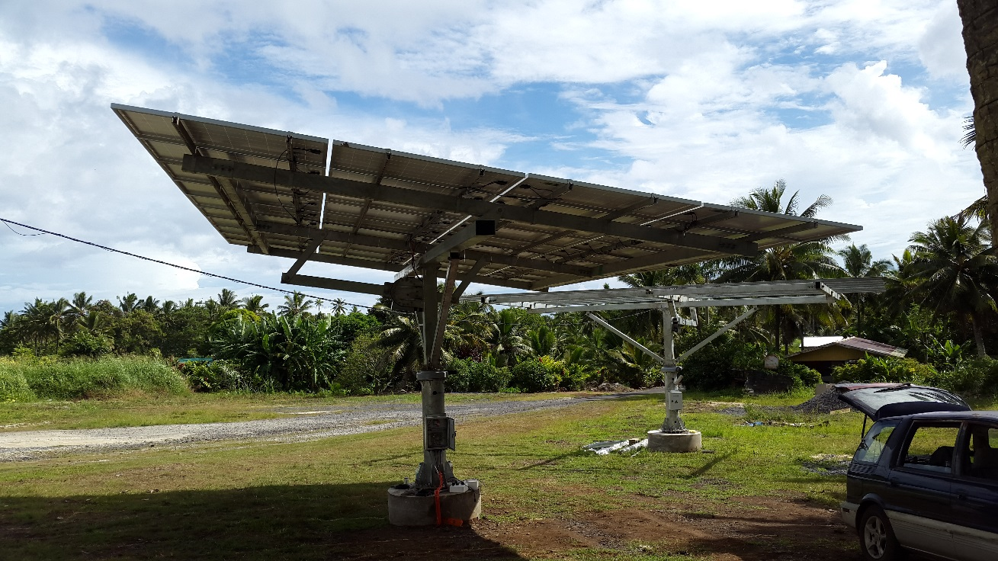
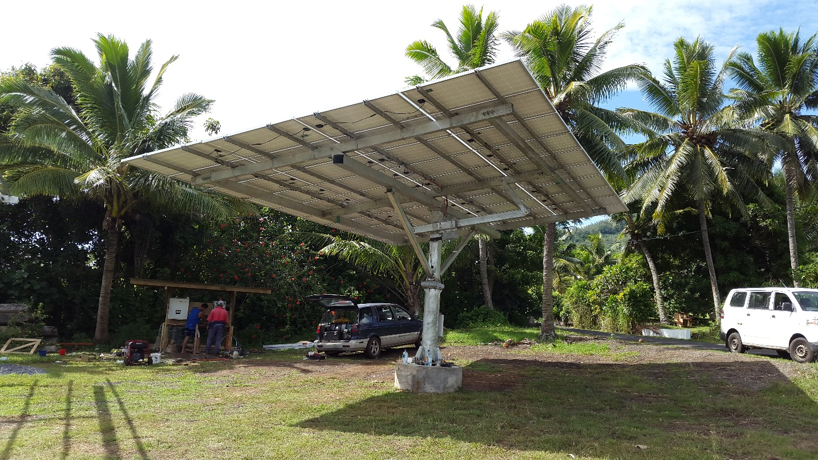
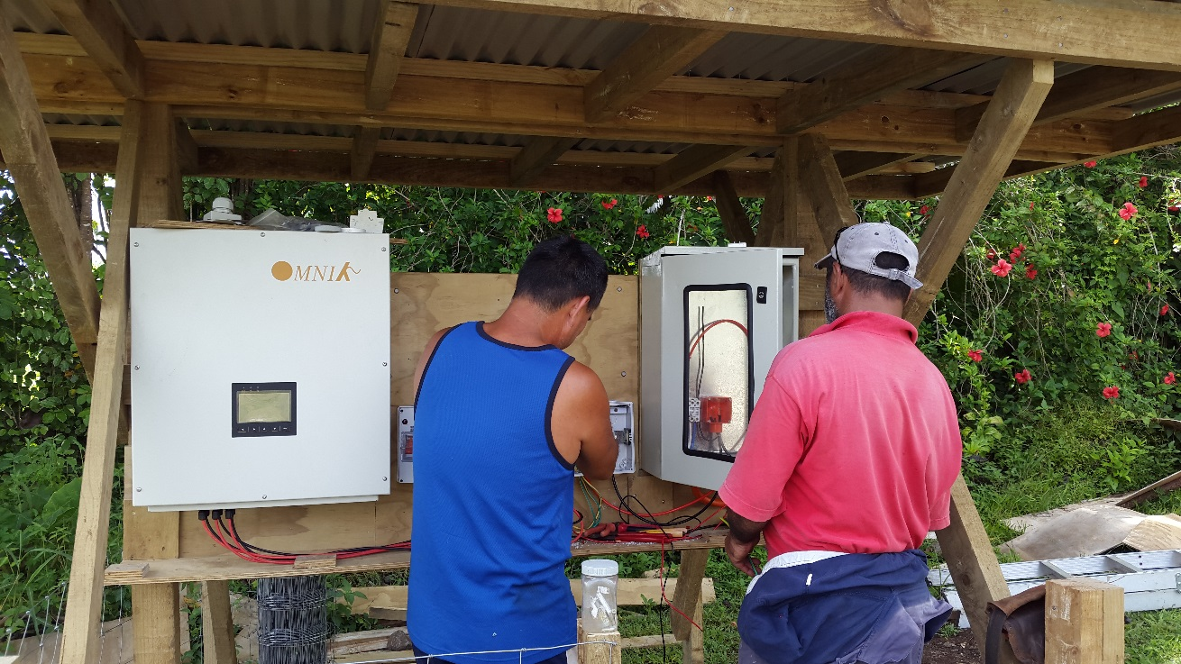
RAROTONGA – IPP 21kWp

Slide 25
Notable Successes
Procurement contract – turnkey, risks, etc.
Energy security
Improvements in way of living (similar to those on main island Rarotonga)
Economic development at community level
Improvements in service deliveries
Less expenditure on diesel fuels
Reduction in GHG emissions

Slide 26
Challenges
Land tenure system
Procurement contract – fragmented to attract local contractors, risks, delays, poor response, cost
Convincing public that getting ‘free’ energy from the sun into their homes is not FREE, hence cannot have zero tariff
Making the system sustainable
Energy efficient white goods (refrigerators, freezers, etc.)
Energy awareness & conservation practices
Power infrastructure readiness
Lack of buy-in from utilities
Budget insufficiency
Donor conditions

Slide 27
Workshop Expectations/Outcomes
Other sustainable technologies that can successfully be deployed in the Pacific Islands
Various source of funds that Pacific Island countries can tap into (Green Climate Fund, etc.)
Criteria and mechanisms on how to access these funds
Learn what other Pacific Island countries are doing in their commitments to Climate Change mitigations
Share experience on Climate Change mitigations (RE in particular) with other Pacific Island countries

Slide 28
Thank You

