Slide 1
Renewable Energy Zoning Tijana Radojicic IRENA – Associate Programme Officer Windhoek, 24 April 2017

Slide 2
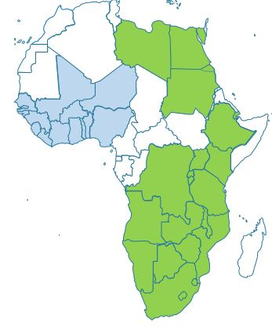
Africa Clean Energy Corridor (ACEC)
Develop RE resources and integrate renewable power into grid
Promote cross-border trade of renewable power
Build on PIDA as well as SAPP and EAPP work (WAPP from now on)
SAPP and
EAPP
WAPP

Slide 3
ACEC Action Agenda
Zoning and Resource Assessment
Identification of high resource zones for RE development.
Country and Regional Planning
Consideration of cost-effective RE options for power generation in national and regional plans.
Enabling Frameworks for Investment
Opening markets to IPPs, reducing the costs of RE financing and facilitating power trade.
Capacity Building
Development of skills to build, plan, operate, power grids with higher RE shares.
Public Information
Awareness raising and promotion of the ACEC and its benefit.

Slide 4
Renewable Energy Zoning
Spatial analysis of renewable energy resources
taking several criteria into account
to identify cost effective, realistically achievable RE resource development zones/project opportunity areas.
Objectives
Identify high-potential renewable energy zones for development.
Facilitate coordinated planning for development of RE resources.
Scope of the Study
Wind, solar PV, and solar CSP
Eastern and Southern African Power Pool countries.

Slide 5
Overview of RE Zoning process
THRESHOLD EXCLUSION CRITERIA:
Resource quality (e.g. <250 W/m²)
Elevation (e.g. >2500m)
Slope (e.g. > 5%)
Protected areas
Water bodies, airports, railroads etc.
Population density (e.g. >100/km²)
Land-use, land-cover.
Distance to existing/planned grid
Distance to road, substation
Distance to RE projects
etc.

Slide 6
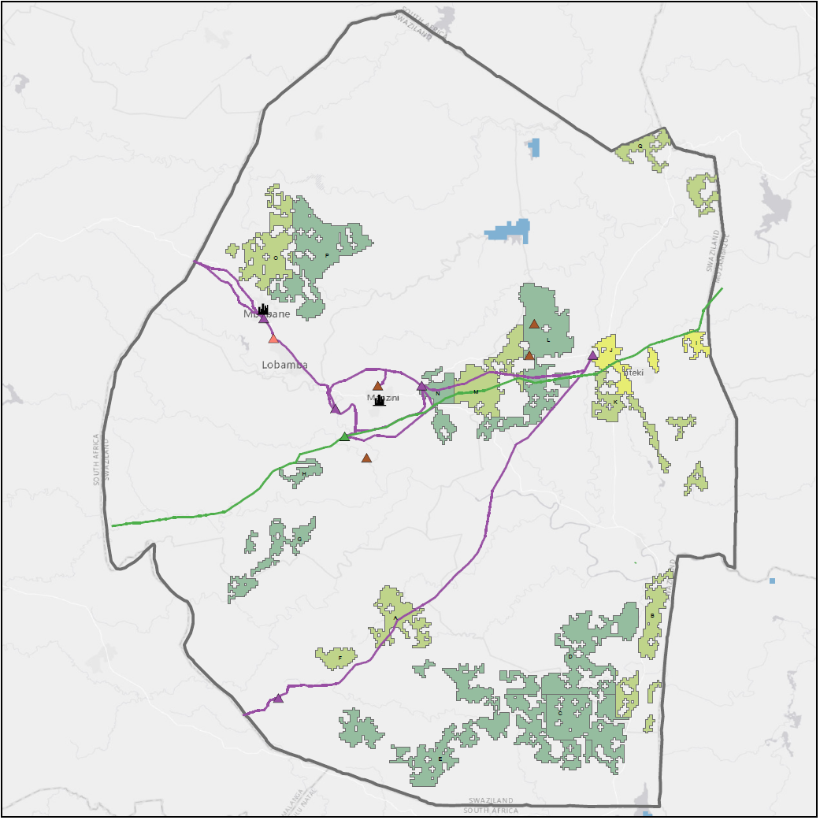
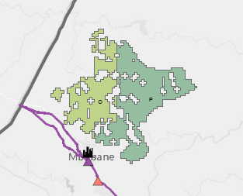
Interactive Zoning Map

Slide 7
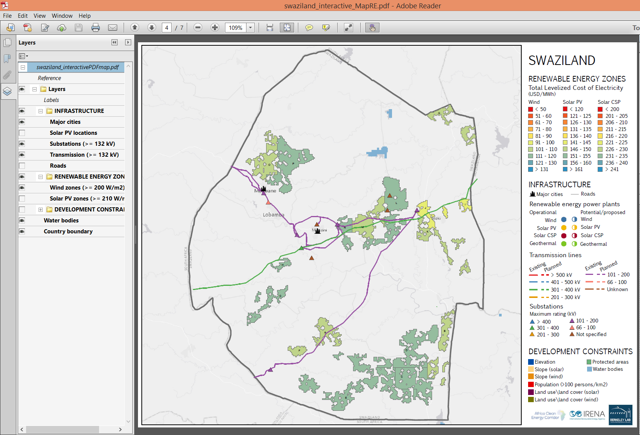
Interactive Wind Zoning Map

Slide 8
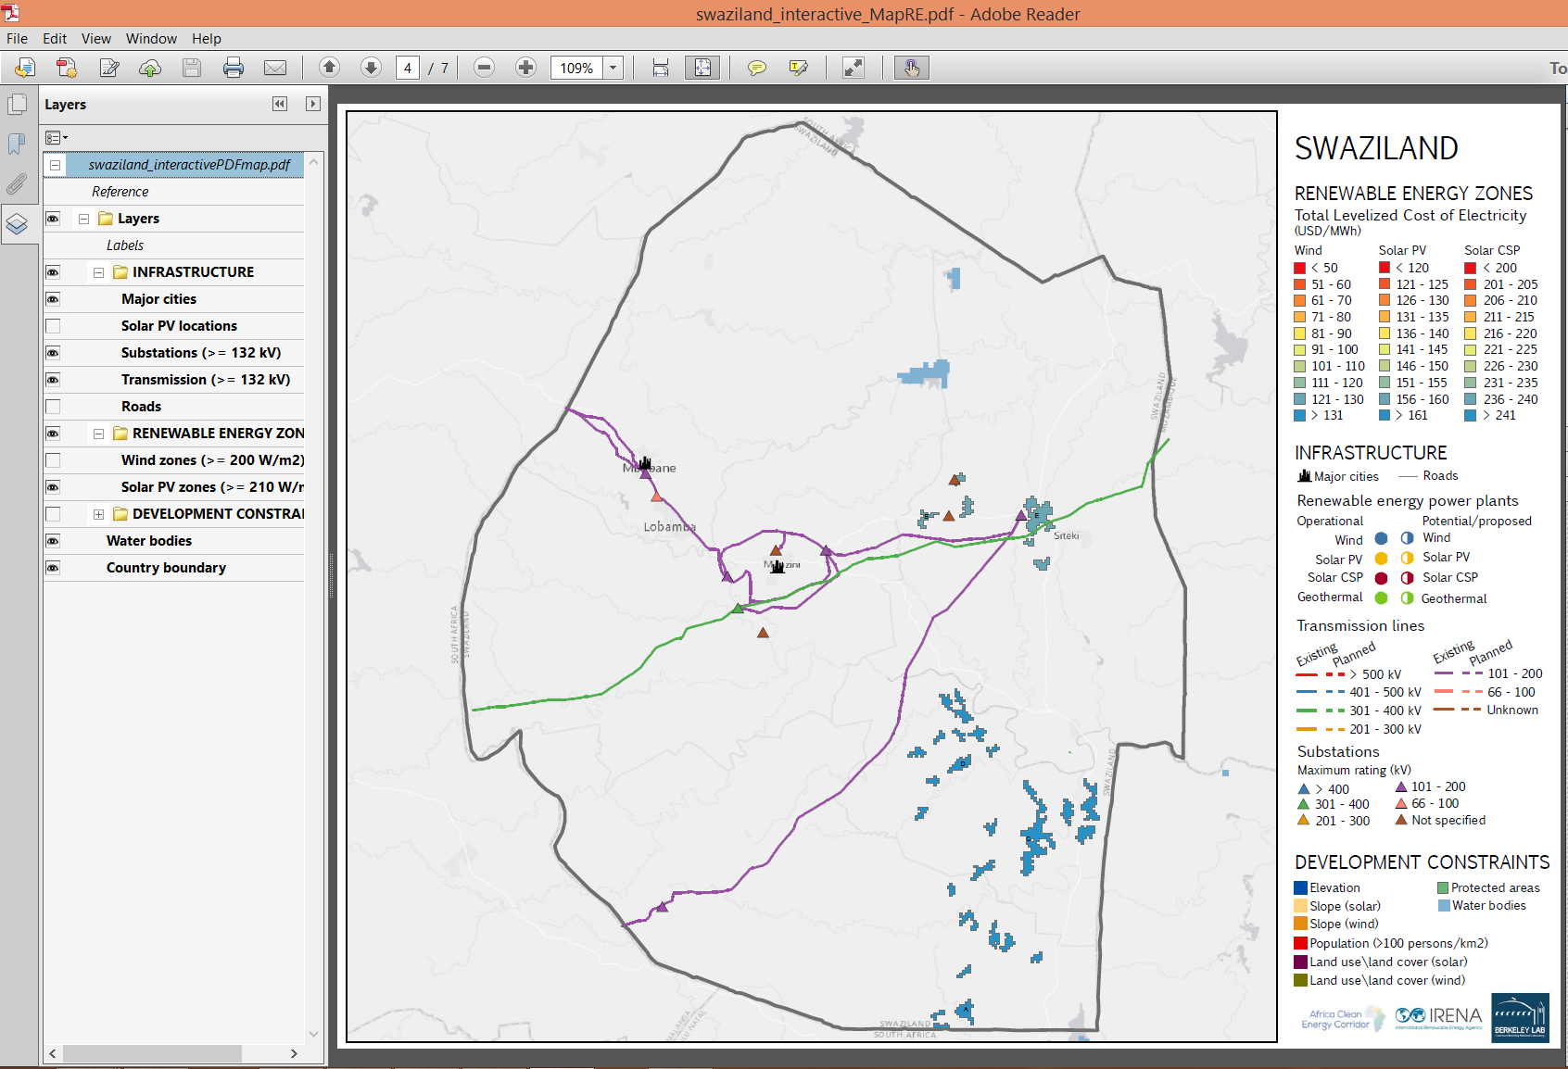
Interactive PV Zoning Map

Slide 9
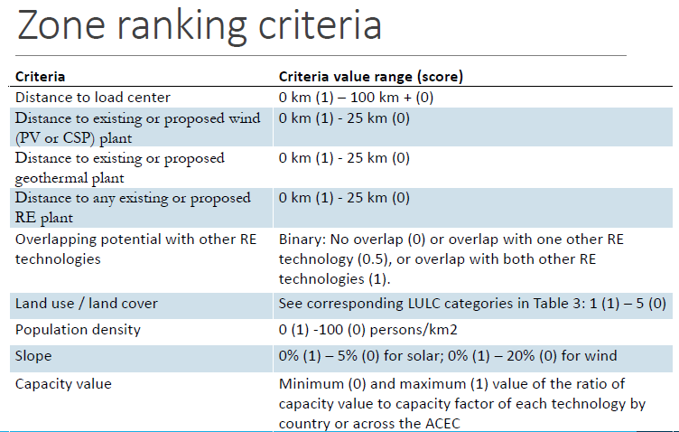
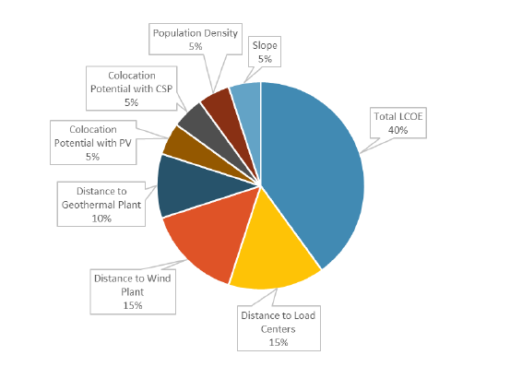

Slide 10
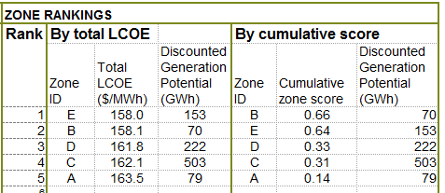
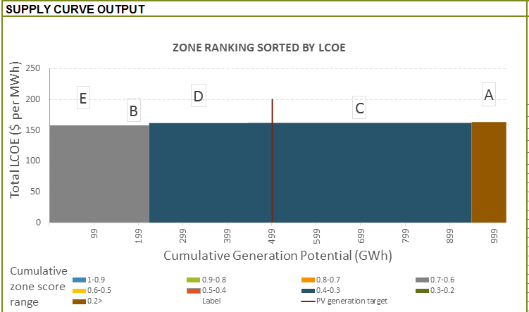
PV Zone ranking

Slide 11
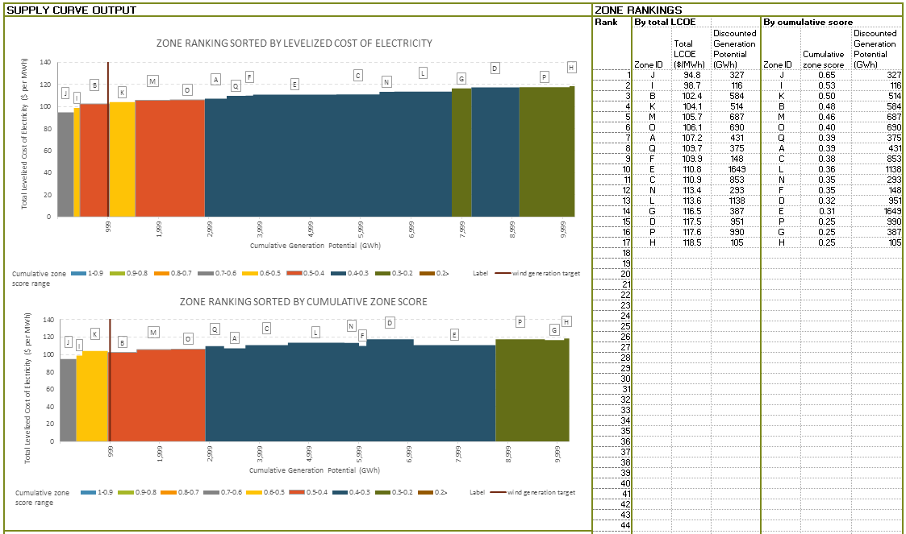
Wind Zone ranking

Slide 12
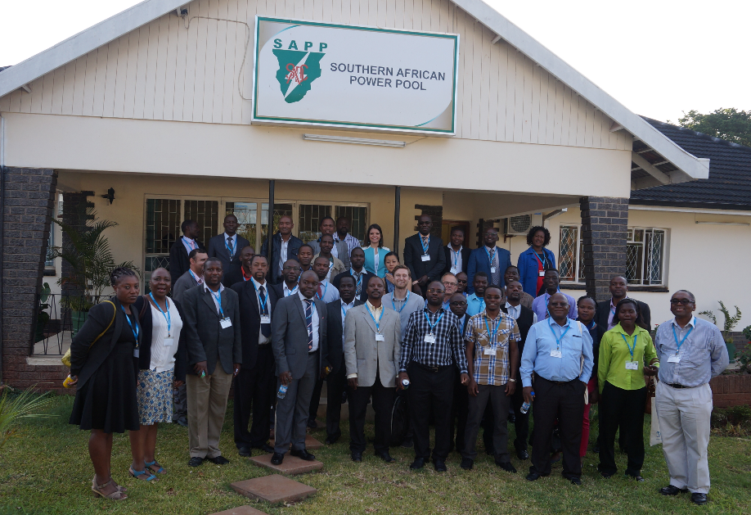
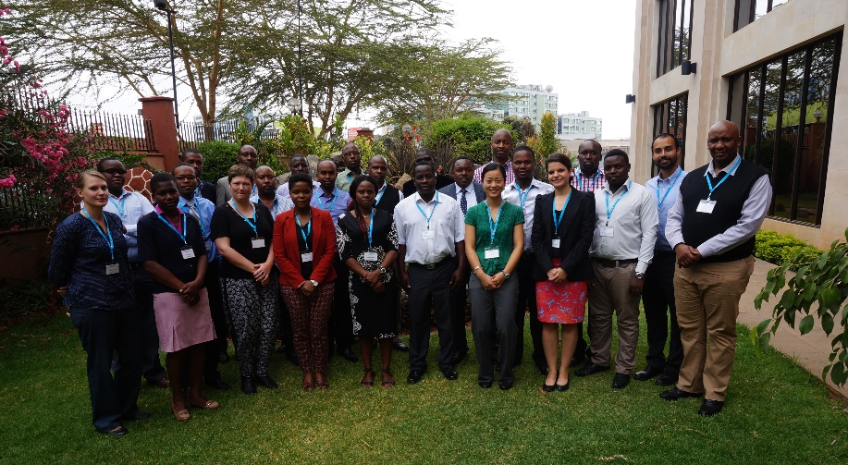
Capacity Building
Harare - September 2014
With SAPP
Nairobi - September 2015
With Ministry of Energy and Petroleum Kenya

Slide 13
Thank you!!
To view and download RE zones maps: mapre.lbl.gov

