Slide 1
Energy planning as part of a strategic whole-of-government climate response to enhance investment readiness
November 2024

Slide 2

Planning for systemic transformation …
    As the global economy transitions to a just, low-emissions, climate-resilient and nature-positive future, every sector will need to transform.
    Energy planning informed by Long-Term Energy Scenarios is integral to national climate action.
    Embedding energy planning in wider strategic national transition planning can help to accelerate progress and mobilise capital, by anchoring:
    a costed whole-of-government action and investment plan for the transition
    coordination efforts, both within government, and between government and the private sector

Slide 3
Accelerating progress …
  Taking the lead on climate action and sustainable development sets out recommendations for national transition planning at the centre of a whole-of-system climate response
  Transition planning in the private sector has important dependencies on government policy: Private actors want clearer policy signals and incentives, and well-targeted catalytic interventions can unlock innovation and investment
    This argues for transition planning at both national and private sector levels. The building blocks for national transition planning are in place in NDCs, LT-LEDS, country platforms, national energy plans and other country-level plans and strategies
    G20 ministers have committed to advancing national transition plans and the Coalition of Finance Ministers for Climate Action is engaging on this topic; civil society campaigns such as Mission 2025 are similarly calling for government leadership

Slide 4
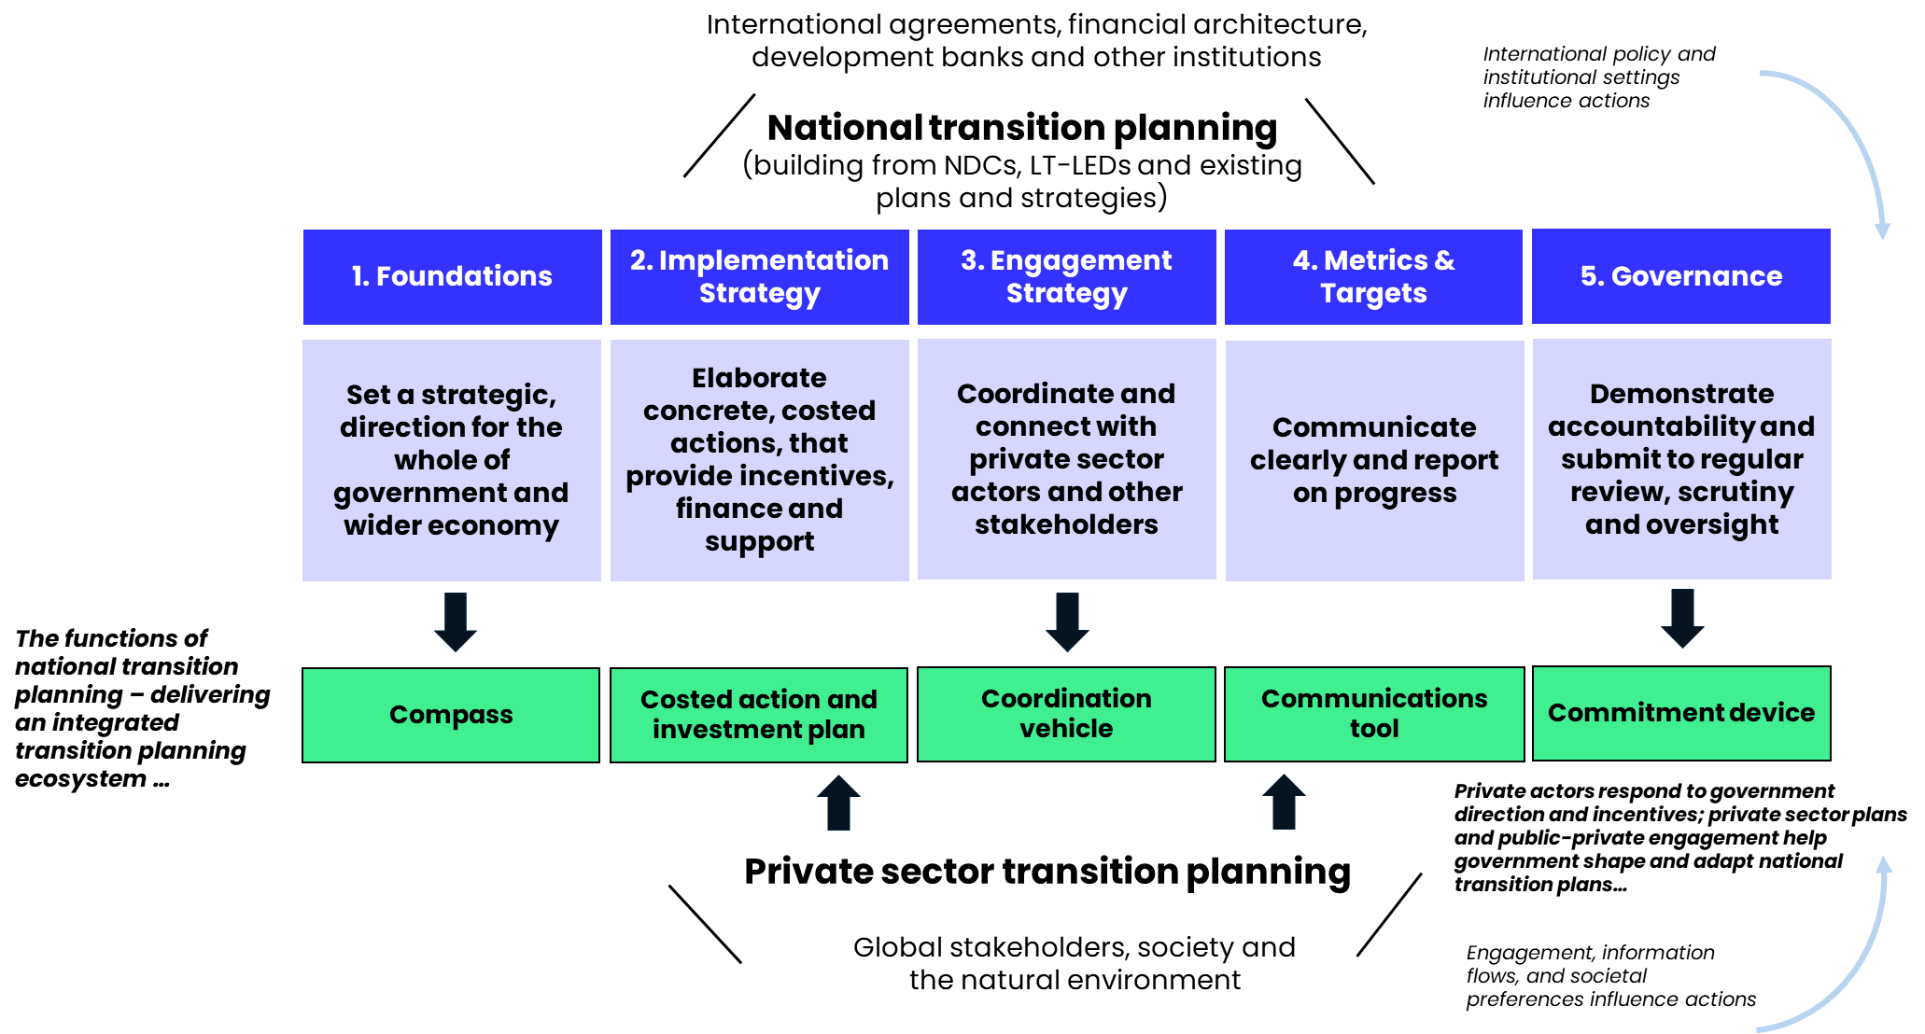
National transition planning at the centre of a system response …

Slide 5





Key functions of national transition planning: the 5 Cs …
Compass: set a strategic direction for the whole of government and actors across the wider economy
Costed action and investment plan: detail concrete, costed actions that provide incentives, finance and support for actors across the economy, attracting investment aligned with the Strategic Ambition
Coordination vehicle: coordinate and partner with private sector actors, the public and other stakeholders to drive action in line with the Strategic Ambition
Communications tool: communicate in a clear, decision-useful and accessible way across the five pillars of our recommendations, with annual reporting at the minimum
Commitment device: demonstrate commitment and accountability and submit to regular review, scrutiny and oversight

Slide 6
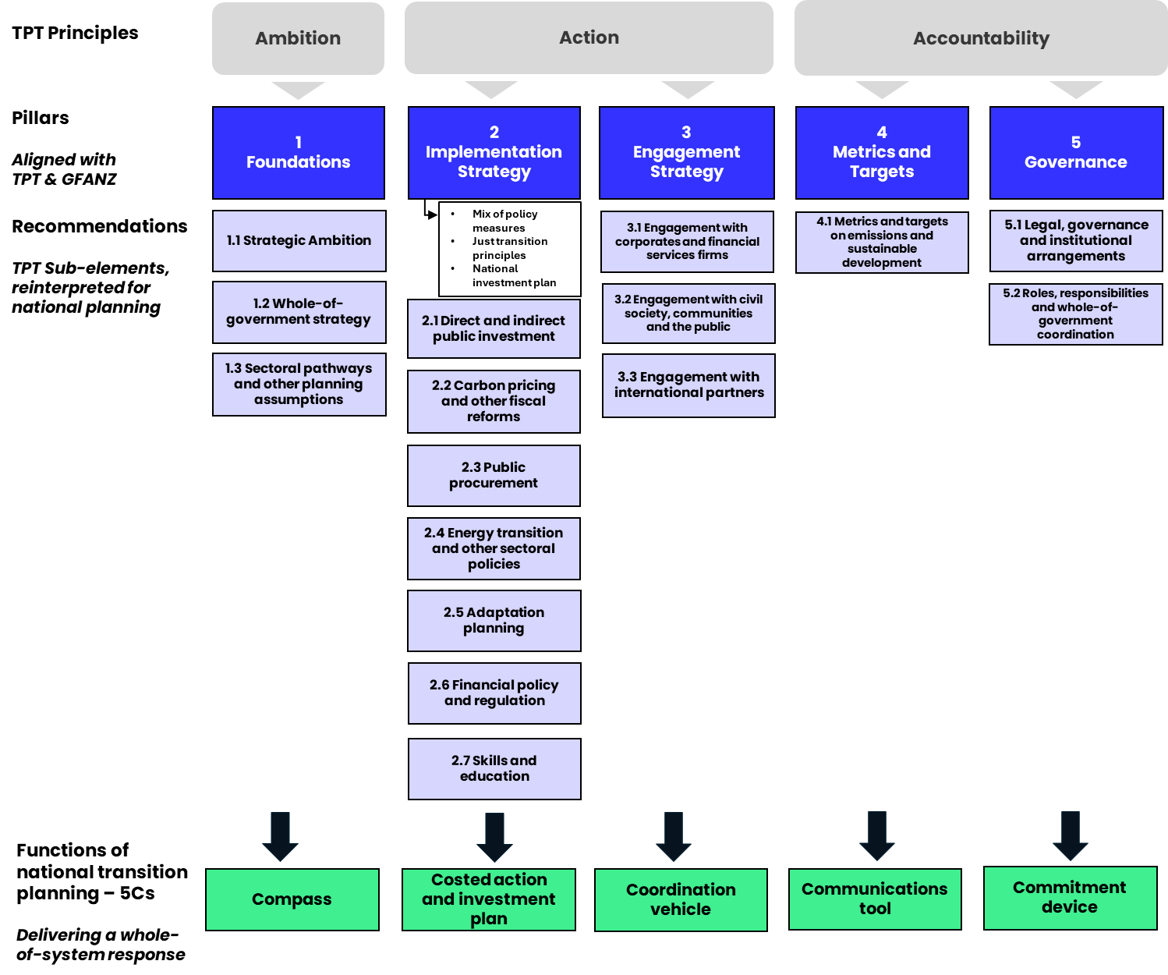
Key considerations and action areas …

Slide 7
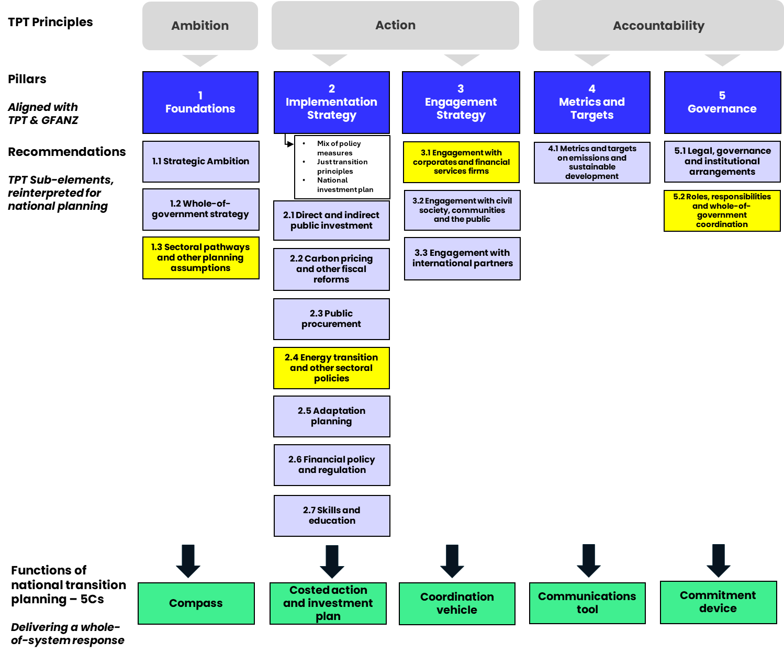
Integrating effective energy planning …
Effective engagement will entail trusted, inclusive, conflict-free, mission-aligned mechanisms and structures for government, business and finance to collaborate and cocreate
Mechanisms for effective whole-of-government coordination will be integral to ensuring that all layers, branches and functions of government are contributing to the national Strategic Ambition
National energy plans will reflect the Strategic Ambition and inform other sectoral pathways
Energy plans and other sectoral pathways will inform dedicated policy measures as part of a wider implementation strategy – delivering a concrete action and investment plan

Slide 8
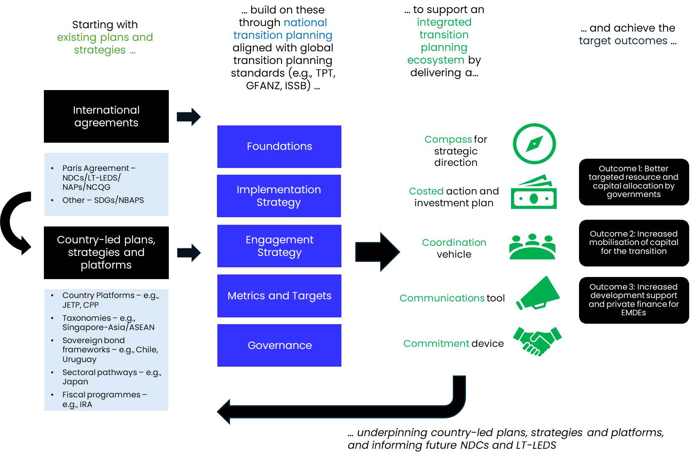
Leveraging existing plans and strategies …
“NDCs 3.0 which double as national investment plans can steer economies towards growth-driving industries and services fuelled by renewable energy”
Simon Stiell, UNFCCC Executive Secretary `

Slide 9
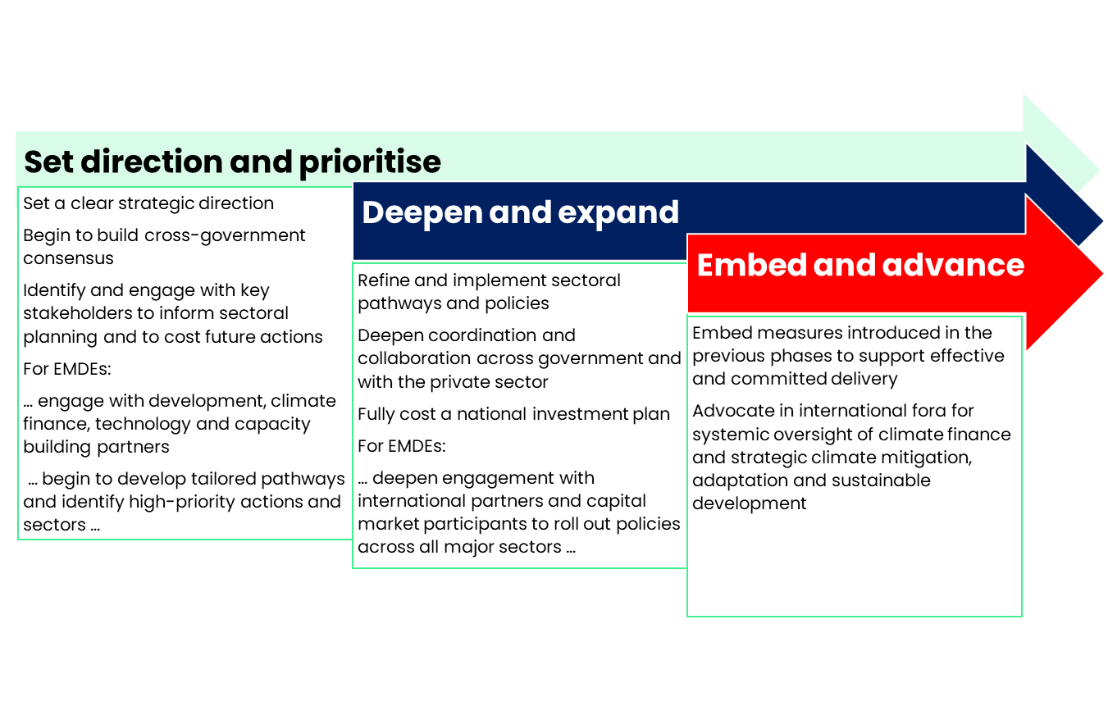
Phased implementation of national transition planning …
  Build out over time, based on the country’s:
  starting point, including the existing stock of plans and strategies, and the socio-economic and political context
  prevailing legal, institutional and planning frameworks
  resources, capacities and priorities
  Next steps
  work with existing, complementary initiatives to ensure the tools are in place and to smooth the implementation path

Slide 10

References …
Taking the lead on climate action and sustainable development (CETEx policy publications, joint with authors from Aviva Investors, CCSI, King’s College London, University of Zurich and the World Bank)
Policy report
Handbook
T20 Policy Brief

Slide 11
Find out more about the
Centre for Economic Transition
Expertise (CETEX):
visit https://www.lse.ac.uk/cetex/

