Slide 1

Making Energy Transition “Bankable”
Tomo Ishikawa
Chief Regulatory Engagement Officer
MUFG
November 2024

Slide 2

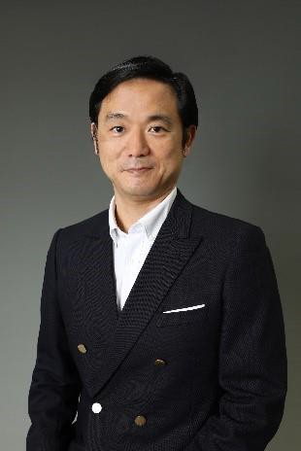
MUFG Tomohiro (Tomo) Ishikawa
2
Bio
Tomo Ishikawa is Chief Regulatory Engagement Officer at MUFG. Ishikawa is responsible for orchestrating MUFG’s group-wide advocacy strategy on financial regulatory policies, including prudential regulations and climate change. He oversees recovery/resolution planning for the group, and government relations across the regions. Prior to his current role, Ishikawa headed MUFG’s Government and Regulatory Affairs (August 2018 - March 2023) based in Tokyo, and MUFG’s Regulatory Strategy for the EMEA region (March 2017 – July 2018) based in London. As part of MUFG’s sustainability/climate change program, Ishikawa serves as a member of the Steering Group of NZBA (Net Zero Banking Alliance). He chairs the “NZBA Transition Finance” working group, which published the “NZBA Transition Finance Guide” in October 2022, “Transition Finance KPI” in December 2023, and “Capital market target setting supporting note” in October 2024. Ishikawa serves as a board member of GFMA (Global Financial Markets Association), representing MUFG. He is a member of Singapore MAS Sustainable Finance Advisory Panel (SFAP) since 2023. Until January 2017, Ishikawa headed the advocacy team on digital/technology policies within the Government & Regulatory Affairs Division at Deutsche Bank AG (based in London). Prior to joining Deutsche Bank in London, Ishikawa served as Deputy Director of Prudential Policy Office at Financial Services Agency of Japan (Japan FSA), where he led the derivative reform implementation. He chaired a work stream under the Working Group on Margin Requirement (WGMR), reporting to the BCBS & IOSCO Board, with the mandate to harmonize margin rules across the regions. Ishikawa started his professional career at Merrill Lynch as an investment banker. After 12 years at Merrill Lynch (Tokyo and NY), he moved to RECOF Corporation (a Japanese M&A boutique), and then to Deutsche Bank (financial institutions coverage banker based in Tokyo). He has 15 years of experience as a “FIG” investment banker, prior to becoming a regulatory policy expert. Ishikawa graduated from Keio University (Tokyo, Japan) in 1996. He lived in Toronto, Canada, prior to studying economics at Keio.

Slide 3

Part 1:
Introduction

Slide 4
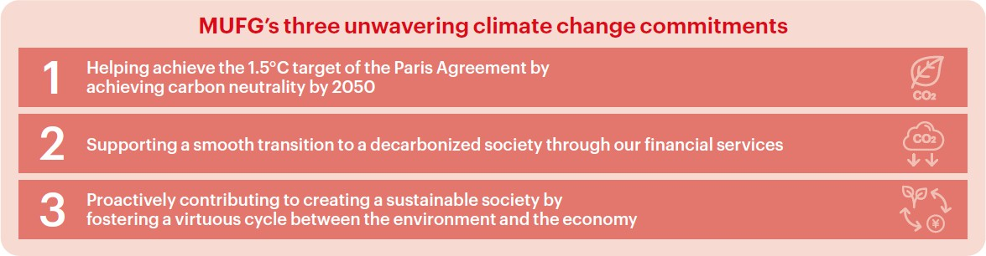
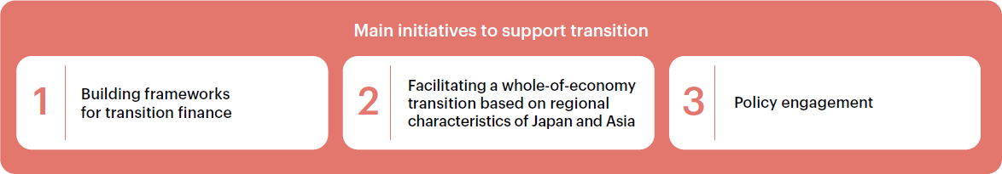
MUFG’s Net Zero Commitment
4

Slide 5
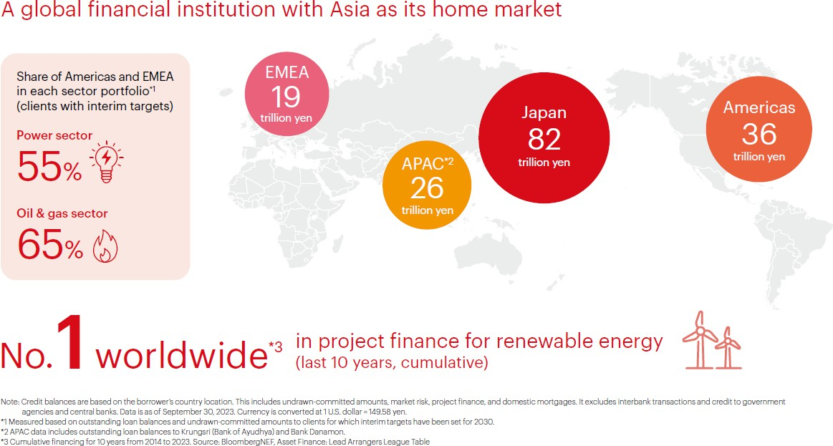
MUFG’s Global Footprint
5

Slide 6





MUFG’s presence in ASEAN
6
Since 2013, MUFG has invested more than US$14 billion in four strategic regional banks in Asia, creating a distinct MUFG advantage in this region.
Through partner banks, MUFG has an expanded network of around 3,000 offices and branches combined that offer full corporate banking services.
 | Vietnam | Thailand | Philippines | Indonesia
MUFG’s Ownership ¹ | 19.7% | 76.9% | 20.0% | 92.5%
Domestic Ranking² | 3 | 5 | 10 | 7
Branches & Offices³ | 1,113 | 615 | 316 | 864
Total Assets ⁴ (US$mil) | 76,240 | 72,123 | 15,234 | 12,655
Bank’s Rating ¹ | MDY : Ba2 Fitch ：BB+ | MDY : A3 S&P : BBB+ Fitch : BBB | MDY：Baa2 JCR ：A- | MDY : Baa1 Fitch : BBB
Country’s S&P Rating ¹ | BB+ | BBB+ | BBB+ | BBB
Number of employees | 22,789 (as of Dec 22/standalone) | 34,806 (as of Mar 23/group basis) | 7,882 (as of Mar 23/group basis) | 25,883 (as of Mar 22/group basis)
As of end Mar 2023
VietinBank, Security Bank: Based on Partner Bank’s total asset (As of end Sep 2022); Krungsri: Based on Partner Bank’s total asset (As of end Dec 2022); Danamon: Based on Partner Bank’s profitability (revenue and NPAT as of Dec 2022)
VietinBank: As of end Dec 2020(Single); Bank of Ayudhya : As of end Dec 2022(Bank and auto subsidiary, two branches in Laos); Security Bank : As of end Dec 2022(Single); Danamon: As of end Dec 2022(consolidated),
As of end Dec 2022

Slide 7
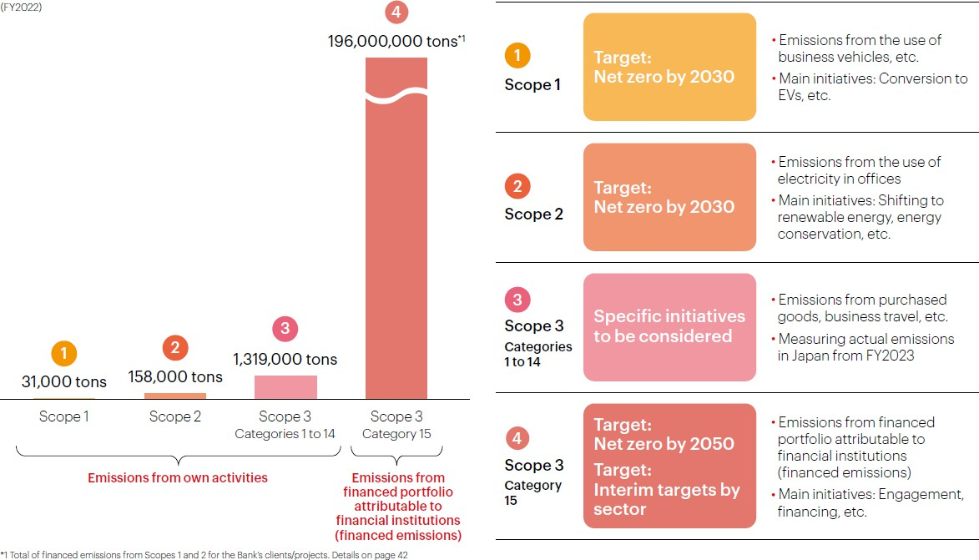
MUFG’s Carbon Footprint
7

Slide 8
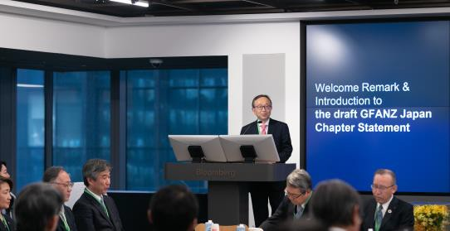
MUFG’s Involvement in the Global Net Zero Initiatives
8
Net Zero Banking Alliance
GFANZ
MUFG has been reappointed for Steering Group (SG) member. The number of seats for Asia increased from 2 to 4, with CIMB and Maybank newly joining. Total number of SG members is 14.
First Abu Dhabi Banks the chair and Amalgamated
Bank serves as the Vice Chair of SG.
MUFG has been chairing the transition finance working group.
MUFG is participating in all 5 workstream, including co-chairing the Public Policy workstream
Workstreams targeting either NY Climate Week or COP29 for announcing draft of consultations (nature + index), and reports
Focus on newly formed “Nature in Net-Zero Transition Plans” with consultation draft WIP
GFANZ Japan
World Bank Private Sector Investment Lab
MUFG serves as a chair of GFANZ Japan
The purpose of GFANZ Japan : “Bringing GFANZ Global to Japan, and Japan to Global”
MUFG has been the member of the Lab since the inception in September 2023..
The recommendation from the Lab to the World Bank leadership team led to the consolidation of the guarantee within the World Bank Group
MIGA became the “one stop shop” platform for guarantee products. More tangible action to come.

Slide 9
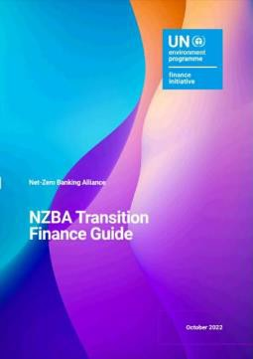
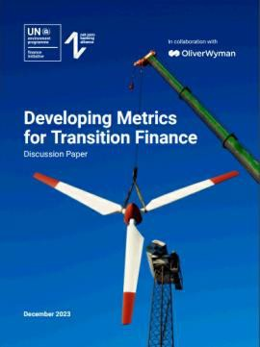
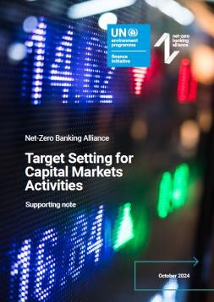
Being a Rule-maker, not a Rule-taker
9
MUFG has led discussions as the chair of the Transition Finance Work Track, and Capital Markets Working Group which NZBA established. Below 3 reports has been published
October 2022, NZBA Transition Finance Guide
“NZBA Transition Finance Guide” provides member banks with principles to use as a reference for their approach to transition finance and proposes policy measures to mainstream transition finance.
December 2023, Developing Metrics for Transition Finance
Aiming to scaling up transition finance, “Developing Metrics for Transition Finance” proposes that financial institutions quantify, grasp, and disclose the impact of transition finance to complement financed emissions metrics
October 2024, Target Setting for Capital Markets Activities
“Target Setting for Capital Markets Activities” builds on the PCAF Facilitated Emissions Standard while exploring options for the scope and methods of target setting, particularly for underwriting activities. Unlike lending, underwriting is characterized by its flow business nature, where the actual holding of the securities by financial institutions instantaneous, and subject to market volatility in terms of new securities issued. The report addresses these differences in the nature of lending and underwriting activities.

Slide 10
Part 2:
Demystifying “Bankability”

Slide 11

Bank’s “Triple” Missions
― A “Trilemma”?
11
REAL ECONOMY
(2) Bank to Real Economy
BANK
(1) Net Zero Strategy
(3) Real Economy to Bank
Mission 1: Pursue net zero target
Mission 2: Support real economy transition (opportunity & growth)
Mission 3: Manage & mitigate climate related financial risks of existing exposures

Slide 12




The Role of Banks in Transition Finance … Providing “New Money”
12
Primary Market
Capital Market Financing
Bank Lending
Corporate
Corporate
Secondary Market
Equity/Debt
Proceeds
Money will not flow to the corporate
(but provides market liquidity)
Lending
Investment Bank
Investors
Bank
Equity/Debt
Proceeds
Equity/Debt
Purchase
Primary Market
Banks provides money to corporates (or projects), contributing directly to transition/decarbonization
Investors
Investors
Financing opportunities hinge on
corporates’ demand for finance
Investment assets are always available in the market (investors can allocate capital anytime)

Slide 13
Enablers & Attributes of Transition Finance
13
Capital Market Financing
Bank Lending
•
Disclosure
being key factor for investors •
Engagement
being the key lever
✓
Transition plan is the basis for the
Identification of financing opportunities
investment decision
Need to financing ideas and "win”
“pitch”
✓
Standardization & comparability
✓
Combination of client relationship &
Third party verification preferable
Various investment strategies
  Equity/bond (Green Bond)
  Active/passive
  Impact based / financial returns
Engagement approach: “Stewardship”
  Engagement as an owner (equity
investors)
innovating financing solution
Continuous engagement before & after financing transactions
Role of transition plan & disclosure
  Transition plan (which is a living document) is the start of the conversation
✓
Engagement allows an access to
additional information
(more than
disclosed)

Slide 14




Transition Finance: Transaction Lifecycle for Banks
14
Identification of
financing
Mandate for a transaction
Structure and terms agreed
3
opportunities
(e.g. new capex)
4
•
Financing ideas proposed
/ credit decisions
Due diligence
RFP process (in some instances)
(see next slide)
•
Understanding client’s
•
Follow up engagement
after the
2
transition plan
(inc. capex plan)
5
transaction closed (e.g. KPI monitoring for sustainability-linked loans)
Benchmarking against peers & alignment with policy direction
•
Dialogues on transition
1
opportunities
start
Client relationship provides an
access to senior management
Continue to monitor (1) financial viability (sufficient cashflow is generated), and
(2) emission reductions (thereby financed emission) decrease according to transition plans

Slide 15
Due Diligence Considerations – Corporate Level & Transaction Level
15
Corporate level transition plan
“credibility” assessment
Transaction level
“bankability” assessment
Vision & ambition
Governance & senior management accountability
●
●
Financial “bankability”
Cashflow analysis (repayment risk analysis)
Technology/operator track record on cashflow
generation
Collateral (including physical risk analysis)
Financial lens
Business strategy (product offering)
Cashflow projection
Key technologies
Capex plan
Risk scenarios
“Traditional” approach
●
Non-financial (environmental/net zero) “bankability”
Analysis of use of proceeds (for project-finance)
Alignment with the macro-level policy
(e.g. government policy, technology roadmap)
Application of the “MUFG Environment & Social Policy”
Environmental (net zero-focused) lens*
Baseline emission profile analysis
Emission reduction strategy (short, medium and long term)
Alignment with 1.5c scenario (or other targets)
Engagement strategy (supply chain, consumers, public policy)
Key takeaways:
Need to proactively engage our clients to “pitch” financial solutions and “win” the opportunities
Corporate level & transaction level assessment necessary
Need to satisfy (1) financial “bankability”, and (2)
environmental/net zero “bankability”
* While this slide only covers “environmental/net zero” related impact (ie. mitigation), additional sustainability (and social)
lens will be applied as appropriate (e.g. adaptation, nature, bio-diversity, circular economy, human rights)

Slide 16
Conclusion:
Making Energy Transition “Bankable”

Slide 17
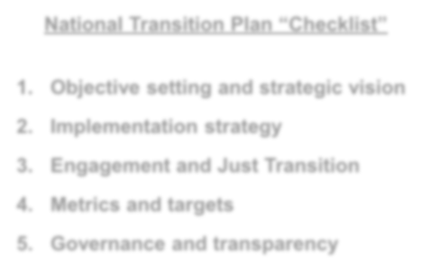
Making Energy Transition “Bankable”
17
Capital Mobilization (Transactions)
Demand for finance
Supply for finance
National Transition Plan “Checklist”
Objective setting and strategic vision
Implementation strategy
Engagement and Just Transition
Metrics and targets
Governance and transparency
Macro-level assessment
Growth/industrialization vs. decarbonization
Industrial/fiscal policy levers to accelerate transition
Micro-level assessment
Risk-adjusted return & impact
Financial risk (credit, market etc)
Reputational risks
Competitive dynamics

