Slide 1

Financing Green Grids
Marcus Stewart
Head of Secretariat
No Transition Without Transmission

Slide 2
Our priority areas
Pillar 1
Finance
Grids are not yet considered the low-risk investable assets that they should be. Stable regulation and risk mitigation is needed to attract the necessary investment. By convening financiers and setting out common principles for grid investments and sharing good practice the GGI facilitates the doubling in grid investment needed by 2030.
Pillar 2
Planning, permitting & Operation
Effective long-term planning is not widespread and too many states do not plan far ahead enough to provide certainty to the market. Cumbersome permitting slows progress where plans exist. Existing grid capacity needs to be maximised, and grid made capable of accommodating high renewables. Through knowledge share and capacity building GGI is helping states develop their own plans.
Pillar 3
Supply Chains
Supply chain capacity for grids components has been flat, with limited ability to ramp up at pace. Buyers need affordable supply to plan projects and suppliers need commitments that enable them to invest in new manufacturing capacity. The GGI is working hard to coordinate supply and demand to deliver on grids.

Slide 3







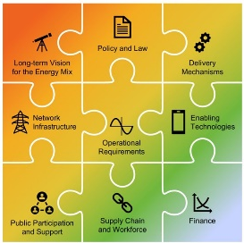


How we deliver
The GGI coordinates international action and mobilises technical expertise to accelerate the development of electricity grids essential to enable the integration of variable renewable energy.
1. Secretariat
2. Working Groups
3. Programmes & tools
Good practice sharing
Electricity Transition Playbook
Data2Deal
Interconnector Principles
Regulator and cross-regional knowledge sharing
2a. Thematic
Finance
Supply Chains
2b. Regional
Africa
Asia-Pacific
4. “Ecosystem” of actors (Govs, IFIs, regulators, operators, industry, civil society, etc.) and campaigns.
Notes:
Demand driven, to complement existing activities.
The offer includes:
Country-level support / coordinating tech. assistance via GGI Ecosystem and WGs
Regional coordination and direct support to accelerate key interconnector projects: e.g. through Africa WG
Developing the enabling environment & GGI toolkit
This includes online and in person training.

Slide 4
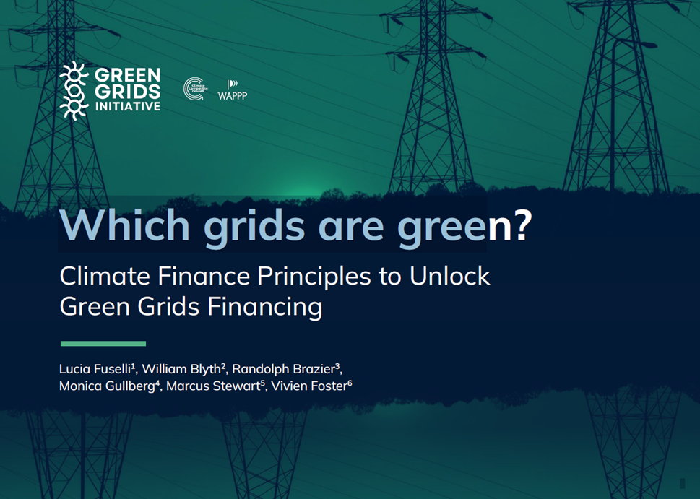
GGI Climate Finance Principles launched at COP29
Grid investments in EMDE require concessional finance to make projects investable and attract private finance
However, under current taxonomies only 40% of those projects would be eligible for climate finance.
We have developed a set of 10 principles with the climate finance industry to address the issue, and if adopted would unlock the remaining 60% of projects.
We are currently running a formal consultation.

Slide 5
GGI Climate Finance Principles – Launched COP29
CURRENT STATUS
WITH CLIMATE PRINCIPLES
projects P-Z
projects A-Z
projects A-C
projects D-F
Initial Principles
projects G-K
projects L-O
Guidelines
EU Taxonomy
ASEAN Taxonomy
Common Principles
motivated choice of one methodology
EU Taxonomy OR Common OR Hybrid OR Other
IFI 2
IFI 3
IFI 1
private finance
climate financiers
IFI 1, 2, 3
private finance
financing
financing
financing
green bonds
financing
climate financiers
Performance-Based financing
respects choice of different methodologies
difficulties in co-financing, some projects left out
climate financiers are reluctant
green bonds
respects choice of different methodologies,
facilitates co-financing and securitization
enables access to climate finance
60% of EMDE grid projects not eligible

Slide 6
The 10 Climate Principles
  PROJECT ALIGNMENT
MATERIALITY
5
6
THE NATIONAL CONTEXT
Project indicators must be aligned with Sector and Climate* Planning
Project indicators must be material, relevant, strategically significant
1
SECTOR TIMELINE
Sector planning must
cover a relevant timeline
SECTOR PLANNING
Generation + T&D
CLIMATE PLANNING
by the NDA
8
  PROJECT CONTRIBUTION
PROJECT
MEASURABILITY
7
2
SECTOR ALIGNMENT
Project targets must represent a Net Positive Contribution
to sector targets
Project indicators’ progress towards targets must be measurable/verifiable
Sector targets must
be aligned* with Climate targets
THE PROJECT
3
SECTOR CONTRIBUTION
THE CHOSEN METHODOLOGY
9
Sector targets must include a
Net Positive Contribution
to decarbonization
JUSTIFIED CHOICE
Choice of methodology to calculate carbon footprint indicators must be reasonably justified
4
SECTOR MEASURABILITY
REPORTING
10
Sector indicators’ progress
towards sector targets must be measurable/verifiable
FINANCIERS
Project indicators’ progress towards targets
must be periodically reported

Slide 7
Thank you
www.greengridsinitiative.net

