Slide 1



Unlocking Renewable Energy Investments
IRENA for the Climate Investment Platform
Tarig Ahmed, Programme Officer, IRENA

Slide 2
Contents
What the Climate Investment Platform (CIP) what need it addresses
Who can access the CIP and how to access the CIP support
Eligibility criteria
CIP Registered Projects and IRENA’s Project Support
CIP Partners
CIP Project Facilitation and Support lifecycle
Who to Contact and Where to Apply

Slide 3
IRENA for CIP – Key Features
250 Registered Partners
57 Registered Financial Institutions*
Climate Invest Platform (CIP) is a joint initiative of IRENA, UNDP, and SEforALL in coordination with Green Climate Fund (GCF).
The CIP cover four key building blocks in the climate finance value-chain:
  Track 1 - Climate targets
  Track 2 - Policies and regulations
  Track 3 - Market Place
  Track 4 - Financial De-risking
IRENA is leading the CIP risk-mitigation and matchmaking activities
Through the “IRENA for CIP”
218 Projects Submitted for Consideration
50 Projects Eligible for TA and facilitation support
CIP’s mandate is to mobilise capital towards developing countries to accelerate the scale of RE technologies to meet NDCs targets and SDG compliance.
Geographical distribution of the projects (218)
CIP is a platform to facilitate the financing matchmaking between registered financing institutions and registered RE projects’ proponents.
3
* Bilateral/Multilateral Financial Institutions and Private Investors (registered on the CIP website and/or have MOU with IRENA. **The statistics come from the analysis of the CIP partners application document

Slide 4
Who can access the CIP and how to access the CIP support
CIP Projects
CIP Partners
The project proponents requesting IRENA for CIP support, from public sector, private sector, and/or public private partnership, will receive TA to prepare their Project Information Documents PIDs to be shared with the potentially matching partners.
IRENA invites multilateral, bilateral and local financial institutions, other development organizations and other institutions that are prepared to provide financial resources, technical assistance and/or support the realization of projects, along with private companies and private investors, to become partners of the Climate Investment Platform (CIP).
Project proponents seeking support for technical assistance or for access to funding are invited to apply through Submit a Request at https://irena.org/irenaforcip
Organizations aiming to become a partners to the CIP and would like to support/invest CIP projects or have access to the CIP pipeline of projects are encouraged to apply through Become a Partner at https://irena.org/irenaforcip

Slide 5
Eligibility Criteria
To be eligible for the IRENA CIP support, the project must (be):
Contribute to Clean Energy Transition
Aligned with relevant Sustainable Development Goals
Consistent and aligned with national* climate action priorities**
Beyond conceptual stage and completed pre-feasibility or preliminary studies.
* country the project is located
**NDCs, national energy or climate strategies, policies and action plans and related national communications, etc.

Slide 6
CIP Registered Projects and IRENA’s Project Support
# Projects supported by IRENA* 33 | # Projects for financing matchmaking 17 | # Projects introduced to partners 12 | # Projects matched to partners 6
Projects registered on the CIP (218)
Projected total installed capacity
470 MW
Project ownership
Estimated total investment (US$ million)
Estimated total capacity (MW)
4
1
Projected total capital mobilisation
1.1 US$ billion
1
1
16
1
1
Projected total GHG emission reduced
5 tCO2e million
2

Slide 7

CIP registered projects
4
17
2
1
6
19
8
43
1
1
1
16
1
36
11
14
5
6
33
1
Support requested
1
13
2
Currently supported
TARGET: increase efficiency and effectiveness of scaling up investment through facilitating development of bankable projects

Slide 8
Partners Registered at “IRENA for CIP”
Partners by institution type (total : 250)
Types of funding provided by CIP financing partners
Contribution/Services/Support of Partners
Key Financing Partners
Research & Technology (17)
Financing (57)
Technical Advisory Services (56)
Similar Platforms (3)
Manufacturers Suppliers & Service Providers (45)
Strategic Partners (14)
Other partners (58)
World Bank, AIIB, COFIDES, Dutch Development Bank, Islamic Development Bank, North American Development Bank, JICA, Cassa Depositi e Prestiti S.p.A, Intesa Sanpaolo, Africa Trade Insurance Agency,

Slide 9
CIP Project Facilitation and Support Lifecycle
Project register
Prescreening of the registered projects
Panel Review on the decision to support
Development of the Project Information Document (PID)
Review/Revision of the PID
Financial Matchmaking with CIP Partners (once PID is complete)
The CIP is a demand-driven platform that facilitates the development and scale up of RE technologies through tailored technical assistance to Member countries.
Project proponents, registered in the platform, are considered for technical assistance and project facilitation support to reach commercial feasibility readiness for financing matchmaking with registered financial institutions

Slide 10
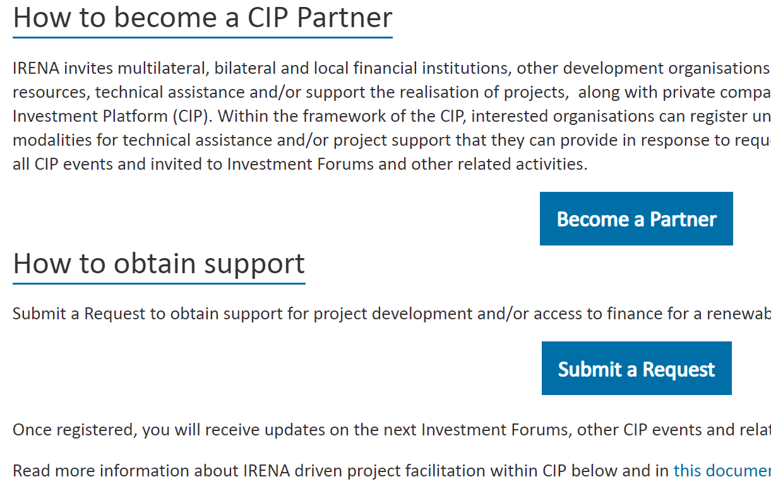
Who to Contact and Where to Apply
Organizations aiming to become a partners to the CIP and would like to support/invest CIP projects or have access to the CIP pipeline of projects are encouraged to apply through Become a Partner at https://irena.org/irenaforcip
Or send an Email to CIP@IRENA.org;
Abartley@irena.org
Project proponents seeking support for technical assistance or for access to funding are invited to apply through Submit a Request at https://irena.org/irenaforcip
Or send an Email to CIP@IRENA.org;
JJeong@irena.org

Slide 11



























Key Partners
Notes:
This slide is a visual snapshot of some key partners with whom we are working with through the CIP.

