Slide 1


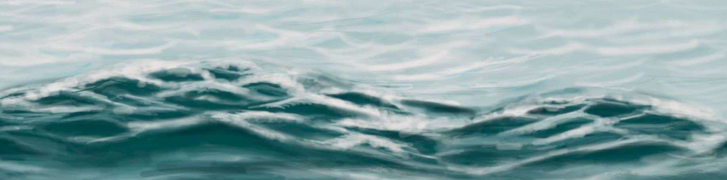
Energy from the sea: an action agenda for deploying offshore renewables worldwide
Dolf Gielen
Director IRENA Innovation and Technology Centre
3rd Meeting Collaborative Framework Offshore Renewables
June 8th, 2021

Slide 2







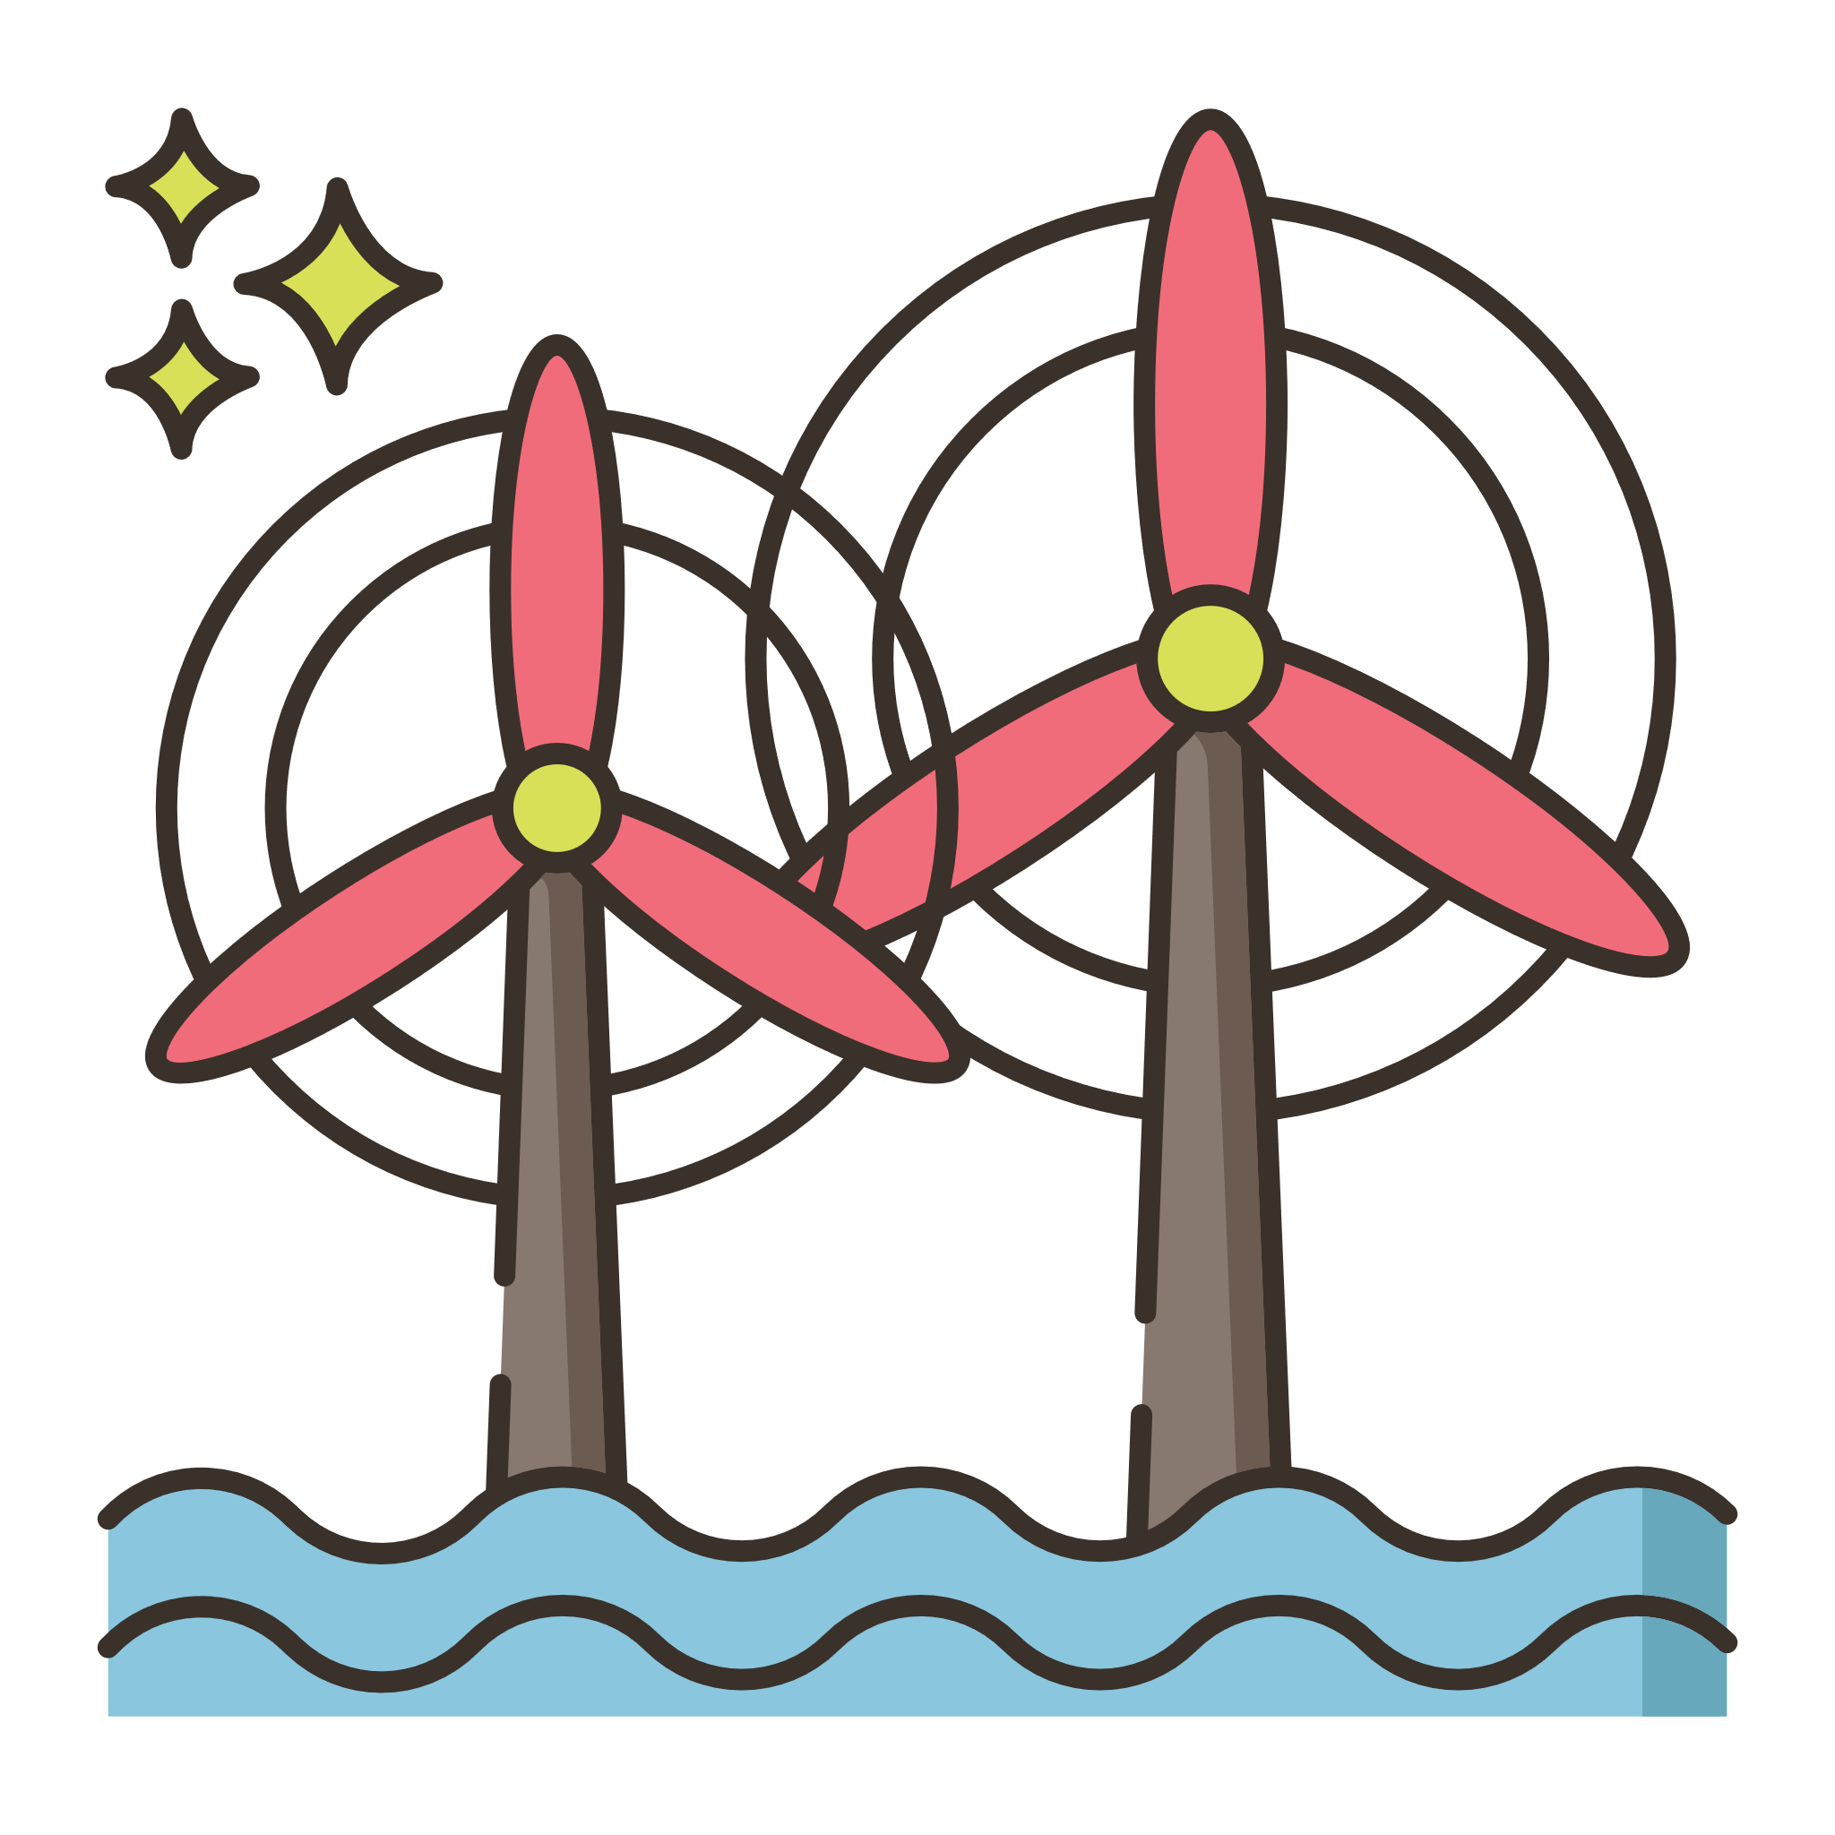


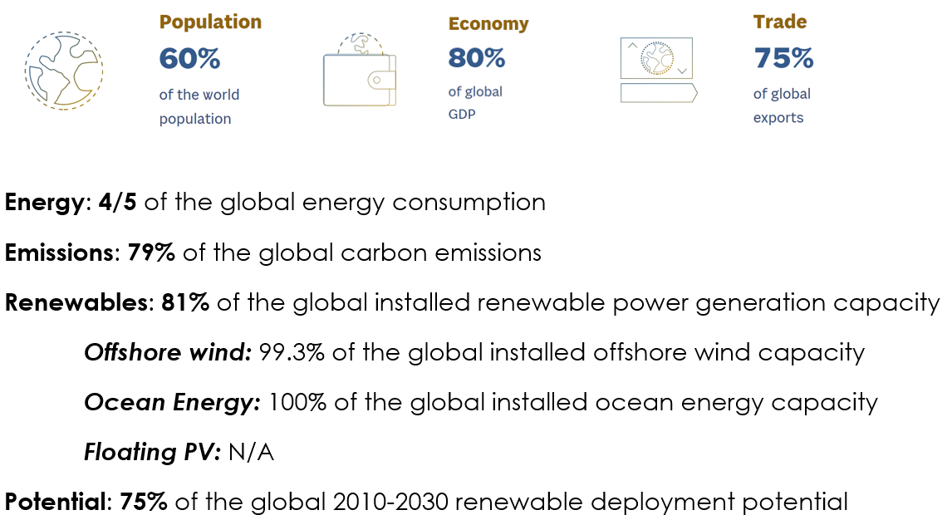
Importance of G20 supporting Offshore Renewables
Population
Economy
Trade
60%
of the global population
80%
of global GDP
75%
of global exports
Renewable Energy
Energy
General
Potential
4/5
of the global energy demand
81%
of the global installed renewable generation capacity
75%
of the global 2010 - 2030 renewable deployment potential
Emissions
Offshore wind
Ocean Energy
Floating PV
79%
of the global carbon emissions
99.3%
of the global installed capacity
100%
of the global installed capacity
N/A
(However plenty deployed projects are in G20 countries)

Slide 3
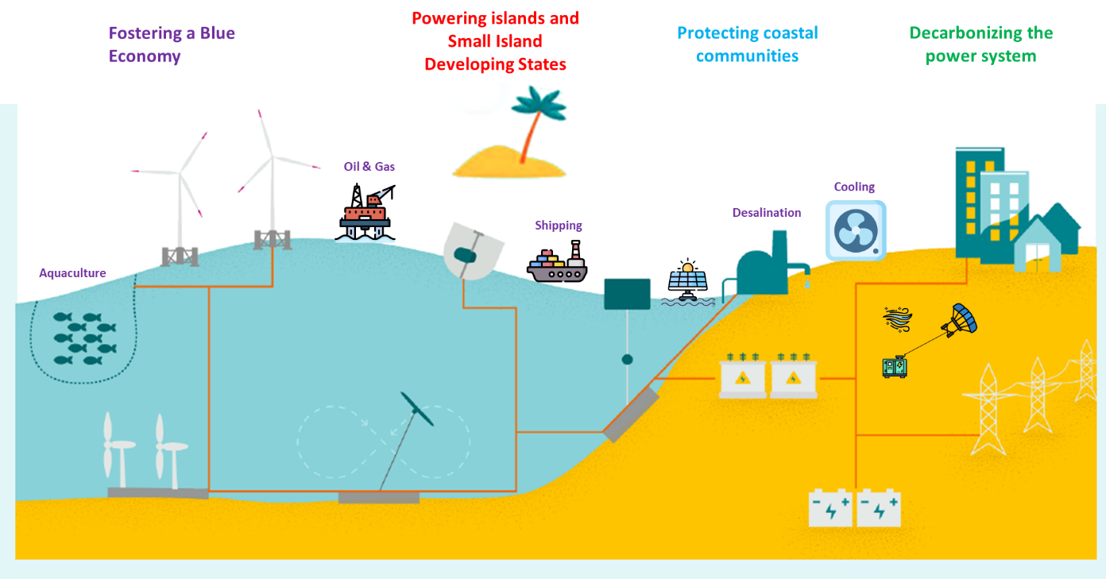
Contributions of offshore renewables to the Blue Economy and the Energy Transition

Slide 4
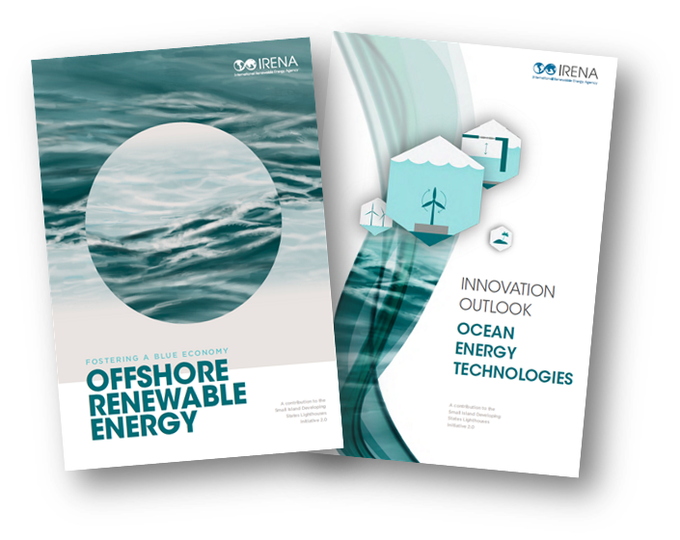
IRENA’s support to G20 on Offshore Renewables
What is meant by offshore renewables
Offshore wind – bottom fixed and floating
Floating PV
Marine technologies
Increasing attention for offshore hydrogen islands
Today’s event
Objective: collect insights from experts to support G20 Action Agenda for offshore renewable energy
IRENA’s Report for G20 Energy Ministerial Meeting
  July 23rd - release of report at G20 Energy Ministerial Meeting

Slide 5
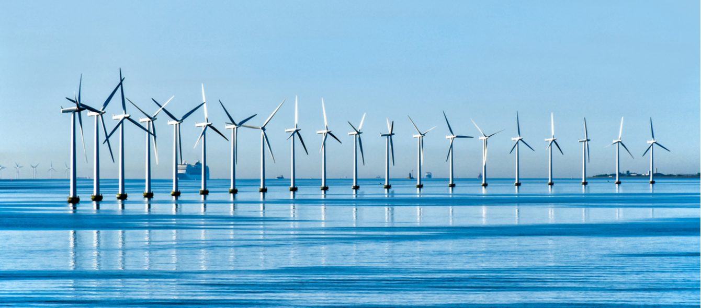
Offshore Wind Market
Global capacity: 380 GW in 2030 and 2,000 GW in 2050
Needed annual investments: ~ 150 to 200 USD billions per year
Fixed foundations:
Growth between 2019 and 2020: 18%
Leading region: Europe 90% of global capacity
New markets: China half of new additions in 2020 (3 GW China)
Global floating wind capacity: 30 MW
Needed annual installations: ~ 70 GW per year
Floating ~ 30 GW in 2030 and ~ 300 GW 2050
2019 Global average: USD 0.115/kWh
2023 outlook based on auction data: USD 0.05 – 0.10/kWh
Floating foundations:
2019 Global average: USD 0.160/kWh
2024 outlook based on auction data: average USD 0.13/kWh
EU Offshore strategy ~ 300 GW in 2050
India: 30 GW in 2030
China plan for a 50 GW wind farm by 2030 in Fujian province
Korea plan for a 6 GW floating wind farm by 2030
Japan: 45 GW by 2040
USA: Vineyard Wind 800 MW project
Global installed capacity in 2020: 34 GW
Capacity factor: Hywind > 50%
Outlook in 1.5oC Scenario
Recent Developments
Market status
Competitiveness

Slide 6

Ocean Energy Market
Global capacity: 70 GW by 2030 and more than 350 GW by 2050
Tidal: USD 0.20-0.45/kWh
12 countries pursuing tidal and wave energy
Global installed capacity 2020: 535 MW
Tidal range dominates capacity but technology trend shifts towards tidal stream and wave energy
Leading region: 31 countries with projects in pipeline, mostly in EU
Needed annual installations: ~ 12 GW per year
Needed annual investments: ~ 35 to 45 USD billions per year
Wave: USD 0.30-0.55/kWh
2030: USD 0.11/kWh
Canada grid-connected tidal stream project of 9 MW
The European Commission targets at least 40 GW by 2050.
Emerging markets include China, Japan and Republic of Korea.
The world’s largest tidal stream turbine 2 MW operational in Scotland.
Outlook in 1.5oC Scenario
Recent Developments
Market status
Competitiveness

Slide 7
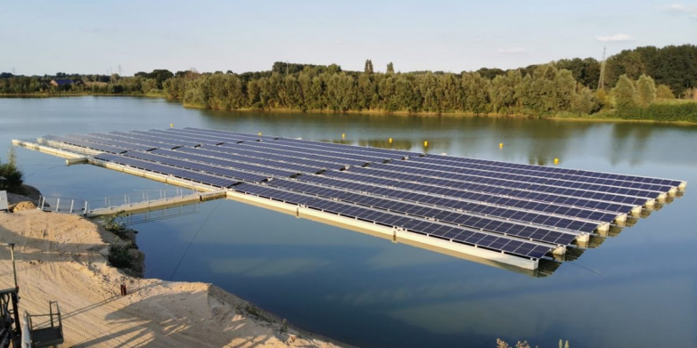
Floating PV Market
future demand driven by Asian countries
2020 estimated: USD 0.354/kWh
The largest plant globally is located in China with 150 MW
Global installed capacity 2020: 2.6 GW
339 projects in 35 countries
Accelerated growth in last 3 years – 1.5 GW additional capacity
India plans 1 GW
Korea plans 2.7 GW in the Yellow Sea
Ghana has installed 5 MW in 2020
Netherlands has a 27.4 MW plant
Singapore plans 50 MW
Outlook in 1.5oC Scenario
Recent Developments
Market status
Competitiveness

Slide 8
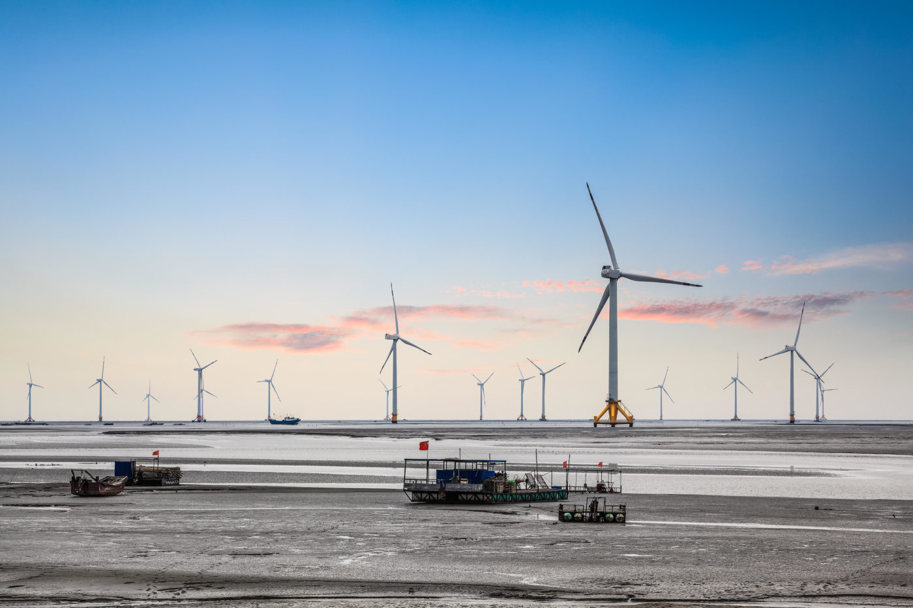
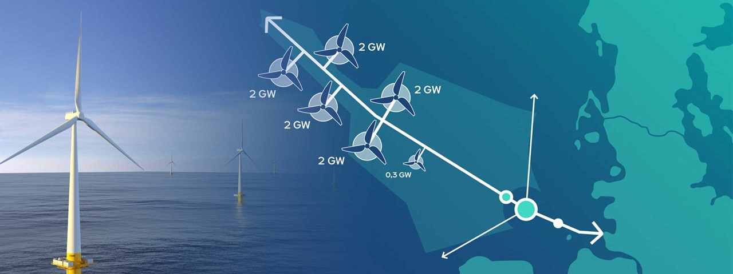
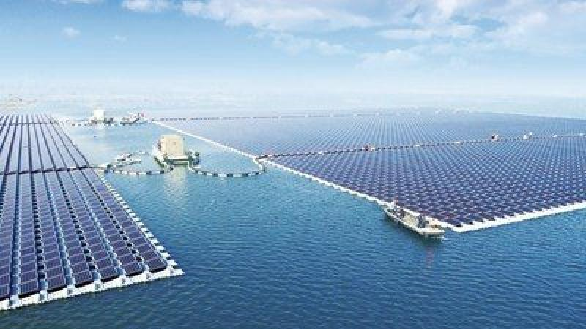
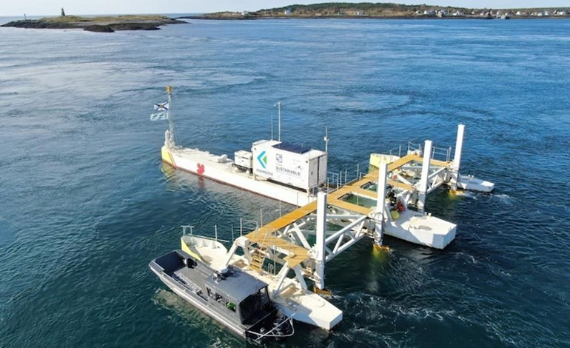
Upcoming developments
Image source: Chinadialogue
Image source: RWE
50 GW Offshore wind in Fujian province, China (2030)
10 GW Aquaventus offshore wind and green hydrogen project, Germany (2035)
Image source: world-energy
Image source: renews
2.1 GW Floating solar PV at Saemangeum Seawall, Republic of Korea (2025)
9MW tidal array in Nova Scotia, Canada (2021)

Slide 9
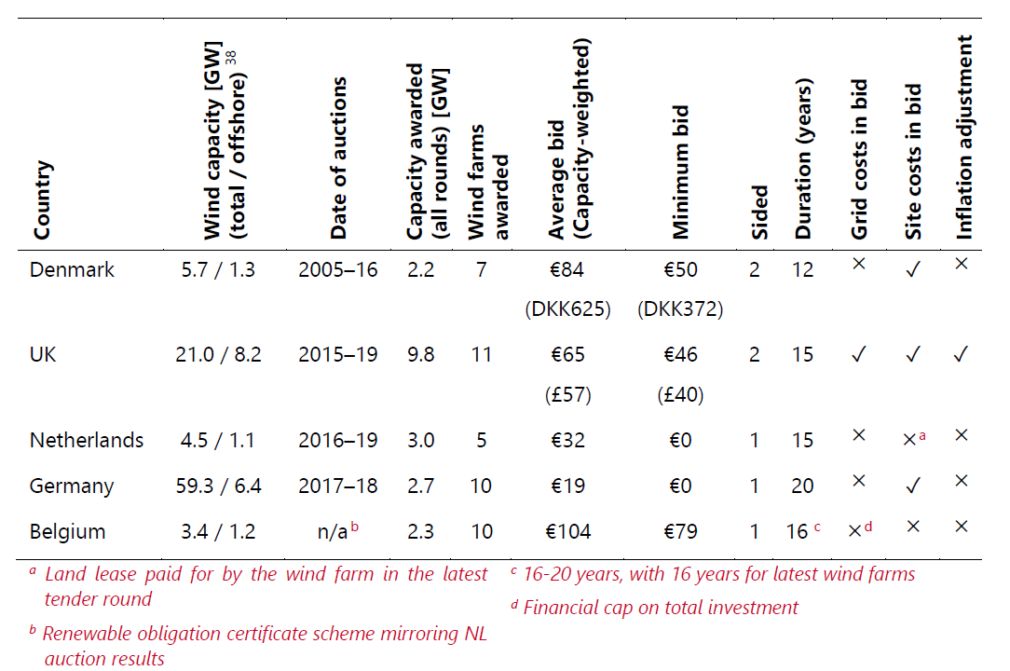
Different policy instruments – different results
Auction design for Offshore Wind varies and has an impact on results
Feed-in-tariffs, feed-in-premiums, auctions - CfD, PPAs
  EU Offshore wind auctions
  China feed-in-tariff for tidal energy of USD 0.39/kWh
  Canada feed-in-tariffs for tidal energy
Provide public capital investment support
  Welsh Government (UK) provides USD 1.7 million (GPB 1.2 million) for a tidal energy project off North Wales
  Korea plans to invest USD 43 billion for an 8.2 GW offshore wind power plant.
Source: Jansen et al (2020) Offshore wind competitiveness in mature markets without subsidy

Slide 10
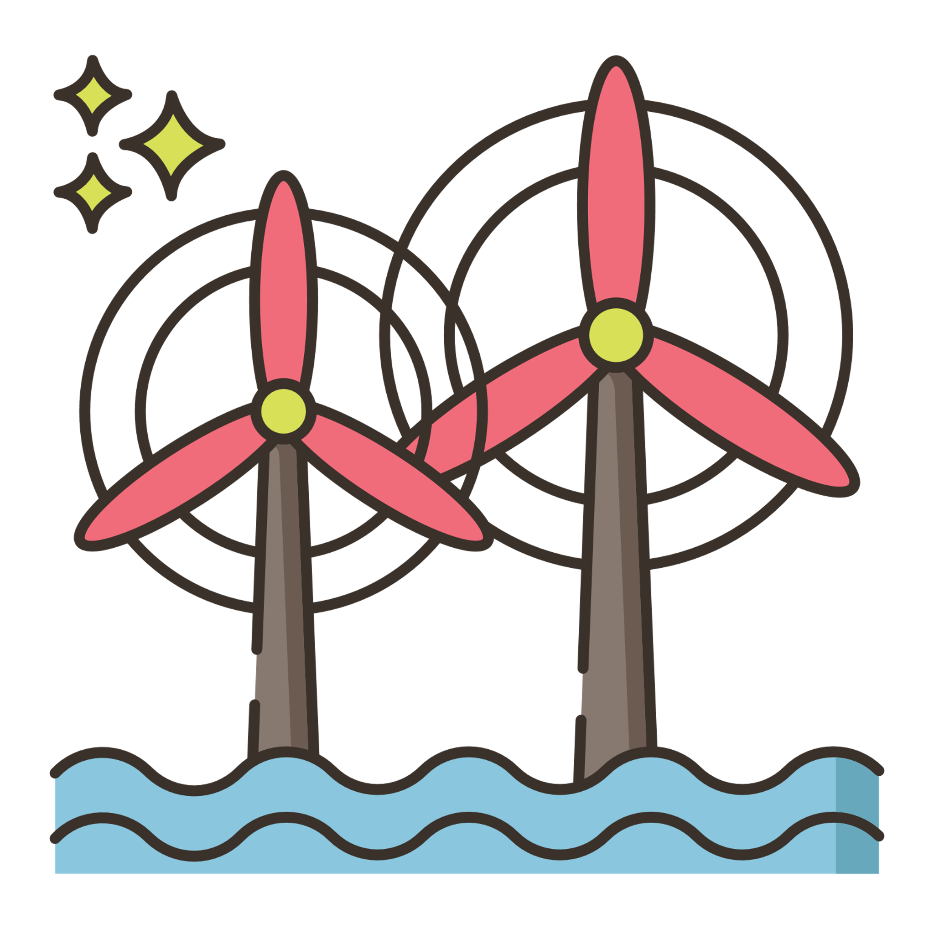



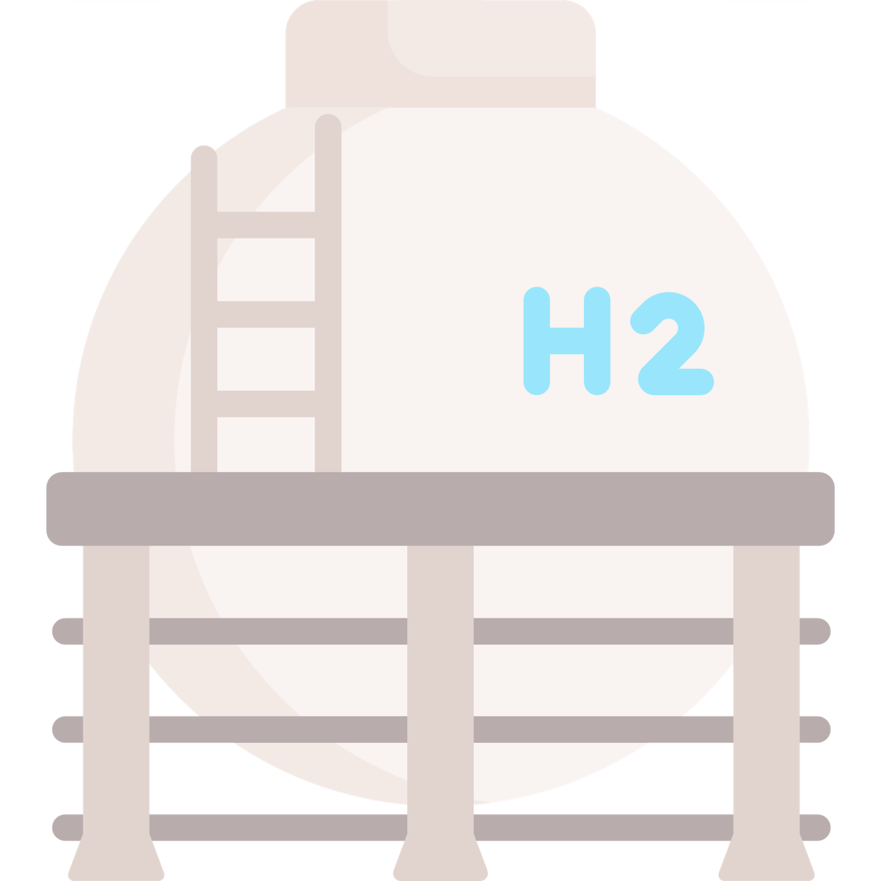












Innovative trends
Technology
Application
Conventional
Trend
Example
Conventional
Trend
Vestas 15 MW wind turbine will start production 2024
Larger turbines and deeper waters
Islands and small
Island states
NorthH2 offshore wind – hydrogen production project with 200 MW electrolyzer capacity in the Netherlands
Generation of green hydrogen
Norway’s Hywind Tampen 88 MW floating offshore farm
Industrial and local consumption
Fixed offshore wind
Floating foundations
Oil & Gas
Cooling
Denmark’s two artificial offshore wind islands with a 12 GW total capacity
Blue economy activities
Artificial Islands
Shipping
Aquaculture
Skypower100 airborne wind system in Germany with a capacity of 100 kW
Airborne wind energy systems
Desalination

Slide 11

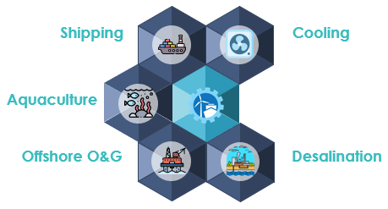
Recommendations for a G20 Offshore Renewables Action Agenda
Acknowledge the key role of offshore renewables at G20 ministerial level.
G20 to cooperate with IRENA’s Collaborative Framework to collect and disseminate key data on Offshore Renewables.
Promote G20 countries to include offshore renewables in national energy and climate policies -e.g. NDCs.
Support increase public investments in RD&D for all offshore renewable technologies.
Design and implement joint RD&D projects at commercial scale
Promote public-private partnerships for innovative offshore renewables like offshore wind-to-hydrogen generation units.
Identify and promote innovative financing mechanisms for offshore renewable technologies within the “Finance Track” of the G20.
G20 strengths to push an Offshore RE Global Agenda

Slide 12
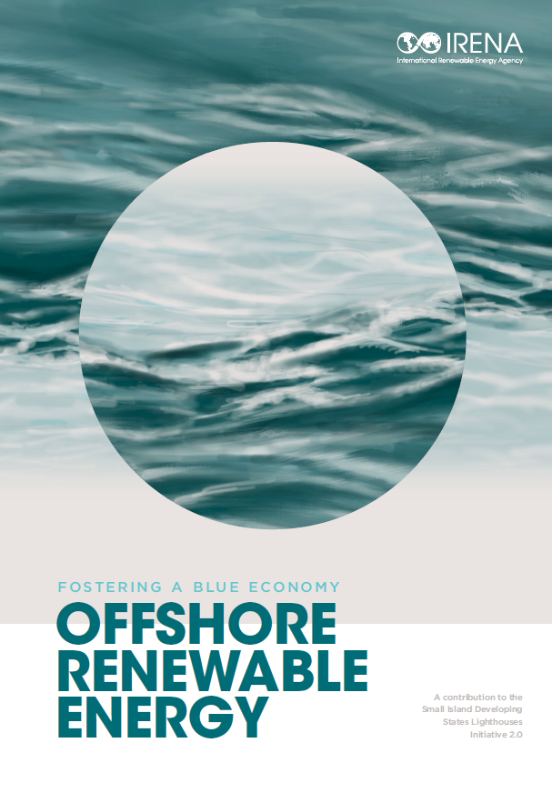







Thank you
^{www.irena.org}
^{www.instagram.com/irenaimages}
^{www.twitter.com/irena}
www.flickr.com/photos/irenaimages
^{www.facebook.com/irena.org}
^{www.youtube.com/user/irenaorg}

