Slide 1
Offshore Wind Energy: Patent Insight
Presenters:
Jaidev Dhavle, IRENA| Geert Boedt, EPO
TUESDAY 06 Feb 2024• 14:00 – 14:30 CEST

Slide 2
Please make sure to mute yourself during the session to avoid background noise
Use the Chat feature to introduce yourself and talk to other attendees
If you have Questions to the speaker please use the Q&A

Slide 3
The slides and a recording at https://irena.org/events/2020/Jun/IRENA-Insights
Tell us how we did
in the survey to help us improve
If you encounter any technical issues, please connect via phone or contact the Help Desk: 888.259.3826 or https://support.goto.com/webinar

Slide 4
SPEAKERS
Jaidev Dhavle
IRENA
Geert Boedt
EPO

Slide 5
Part 1: Global Offshore Wind Trends (IRENA)

Slide 6
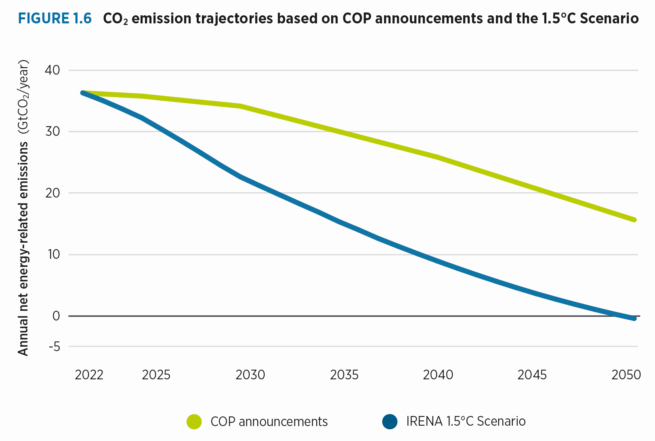
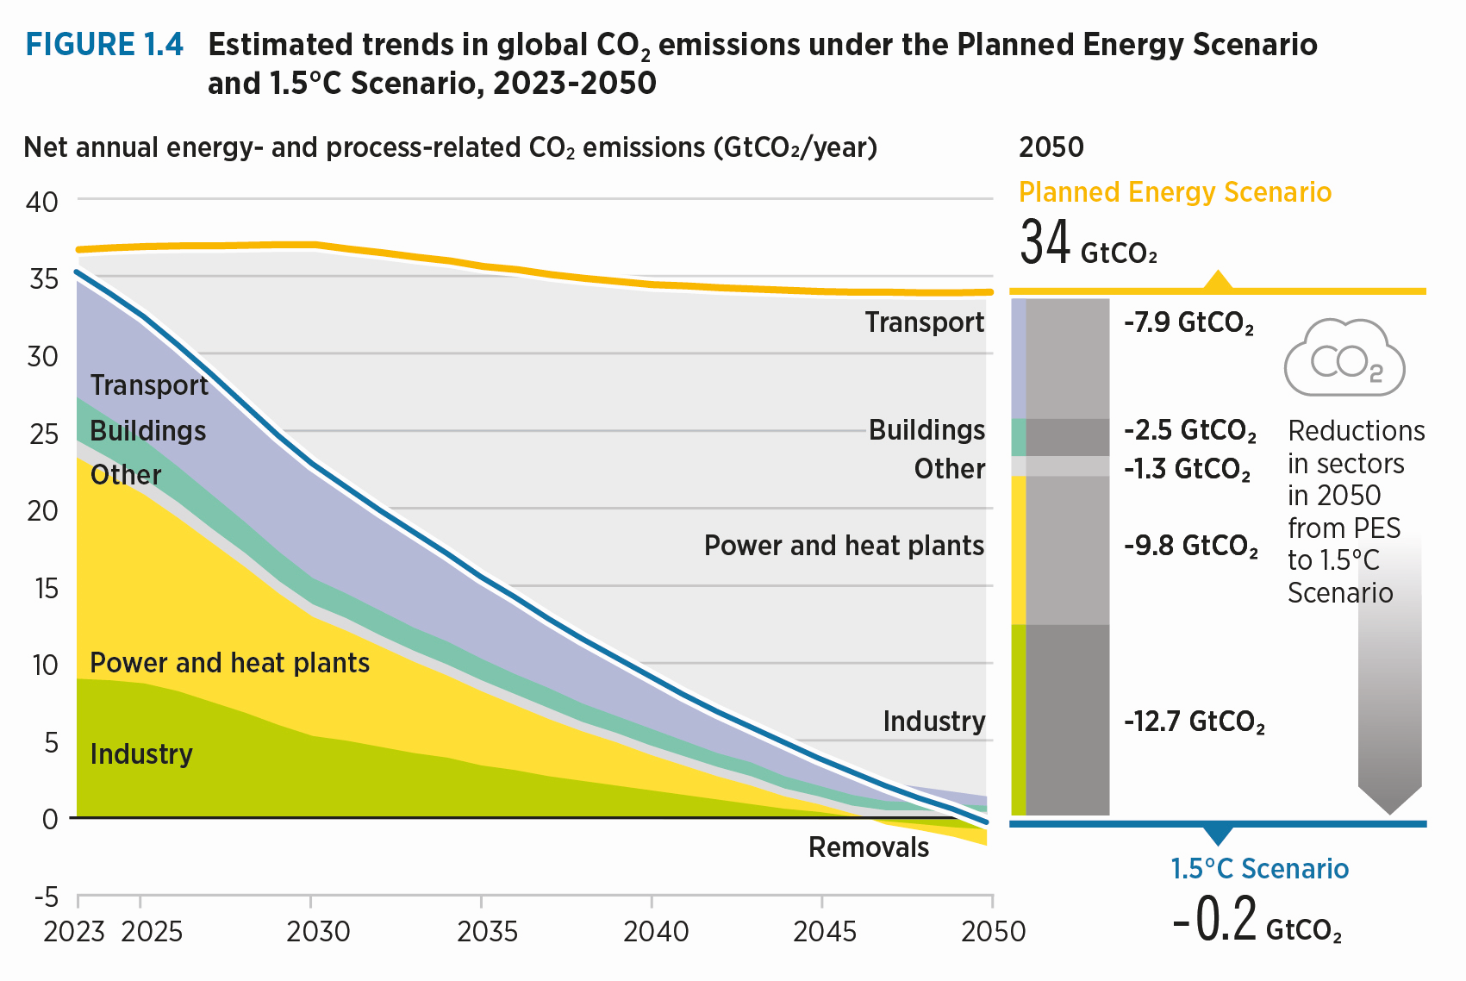
Energy Transition Stocktake: Triple Renewables and Double Efficiency
Current climate pledges are insufficient to reach net zero by mid-century and substantial efforts required to bridge the gap towards the 1.5°C target
Renewables will play a crucial role in decarbonization efforts – 295 GW added in 2022 however, we need to 3x renewable capacity and 2x energy efficiency by 2030!

Slide 7
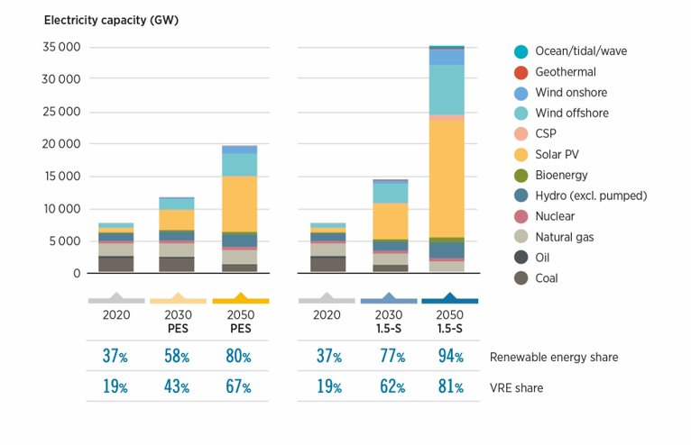
Global Trends Offshore Wind – IRENA WETO 2023
275 GW and 1197 GW
IRENA PES
2030/2050
63.2 GW
494 GW and 2465 GW
IRENA 1.5 Scenario
2030/2050
Global Offshore Wind Capacity 2022
USD 0.081/kWh
LCOE offshore wind in 2022
(59% reduction from 2010)
China, Denmark, Belgium, Germany, UK
Offshore Wind Global Leaders
7

Slide 8
Offshore Wind Supply Chains Challenges
Supply Chain Volatility
Poor Auction Designs and Component Defects are main volatility drivers
COVID-19 Impacts
Increase in CAPEX costs have resulted in labor and raw material cost increases
High Interest Rates
Banks have made stringent fiscal policies impacting lending capacity
Varying Policy Signals
Differing policies from governments prevent efficient supply-demand matching
Fluctuating Project Costs
Dramatic market swing impact revenues and financial close prospects
Source: Mission Critical: Building the Global Wind Energy Supply Chain for a 1.5°C World (2023) – Global Wind Energy Council and Boston Consulting Group

Slide 9
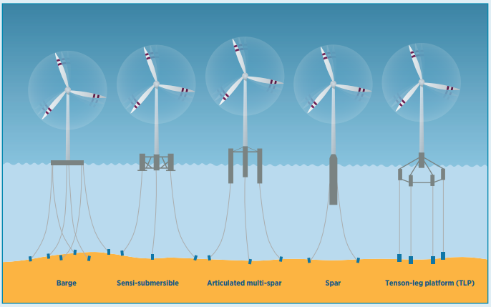
Innovation: Floating Offshore Wind
13 TW
Technical Potential
~ 270 MW
Operational Floating Wind Capacity 2022
0.1% of global wind installations
Norway, UK, Japan, China
^{Floating Offshore Wind Leaders}
~2 to 4 GW
Source: IRENA Report on Floating Offshore Wind (Forthcoming) and Floating Wind: Turning Ambition into Action (2023) - DNV
Projected global capacity by 2030
Commercial viability by 2035 onwards

Slide 10
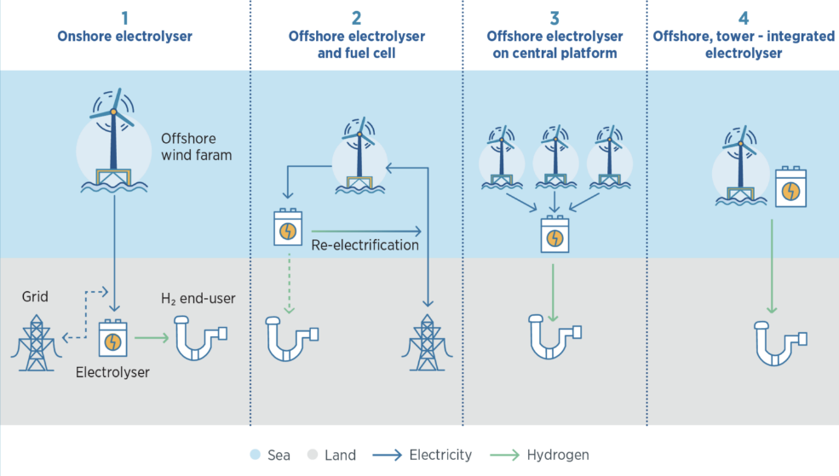
Offshore Wind to Hydrogen Coupling
Region | Project description/Initiative | Proposed capacity for offshore wind | Commission Year (expected)
Germany – North Sea | AquaVentus: The initiative plans to generate 10 gigawatts of electricity from offshore wind farms to power electrolysis units in the North Sea. | 10 GW (production of 1 million metric tons of green hydrogen) | 2035
Netherlands | NortH2: Eneco, Equinor, RWE, and Shell have formed a consortium to explore the potential for producing, storing, and transporting green hydrogen on a large scale. | 4 GW 10 GW (750,000 tons of green hydrogen per year) | 2030 and 2040
Canada | Spirit of Scotia: Green Hydrogen International has secured rights to develop green hydrogen production hub in Nova Scotia. Offshore wind will be a key energy provider. | 500GW total capacity 43000 kilo tonne per annum of H2 ~302GW Electrolyser capacity | 2030
  Offshore wind farm has a higher capacity factor than many renewables which entails that electrolysers can operate for a greater proportion of time and increase hydrogen production capacities.
  70 million tonne of current global grey hydrogen production would require 900 GW of dedicated offshore wind energy production substitution

Slide 11
Offshore Wind Ancillary Considerations
Port Infrastructure
Many markets lack the necessary ports and infrastructure to support assembly of large foundations and blades associated with of floating wind technologies.
WindEurope has estimated that European ports will require an investment of €6.5 billion over the period to 2030 to facilitate the growth of offshore wind and reach the goal of 110 GW by 2030
Grid Infrastructure
High-voltage direct current (HVDC) transmission is preferred over high-voltage alternating current (HVAC) transmission due to reactive resistance caused by long grid connections, both offshore and onshore.
Energy islands: Innovative approach to gather energy from offshore wind farms and supply it to various end use and storage sectors.

Slide 12

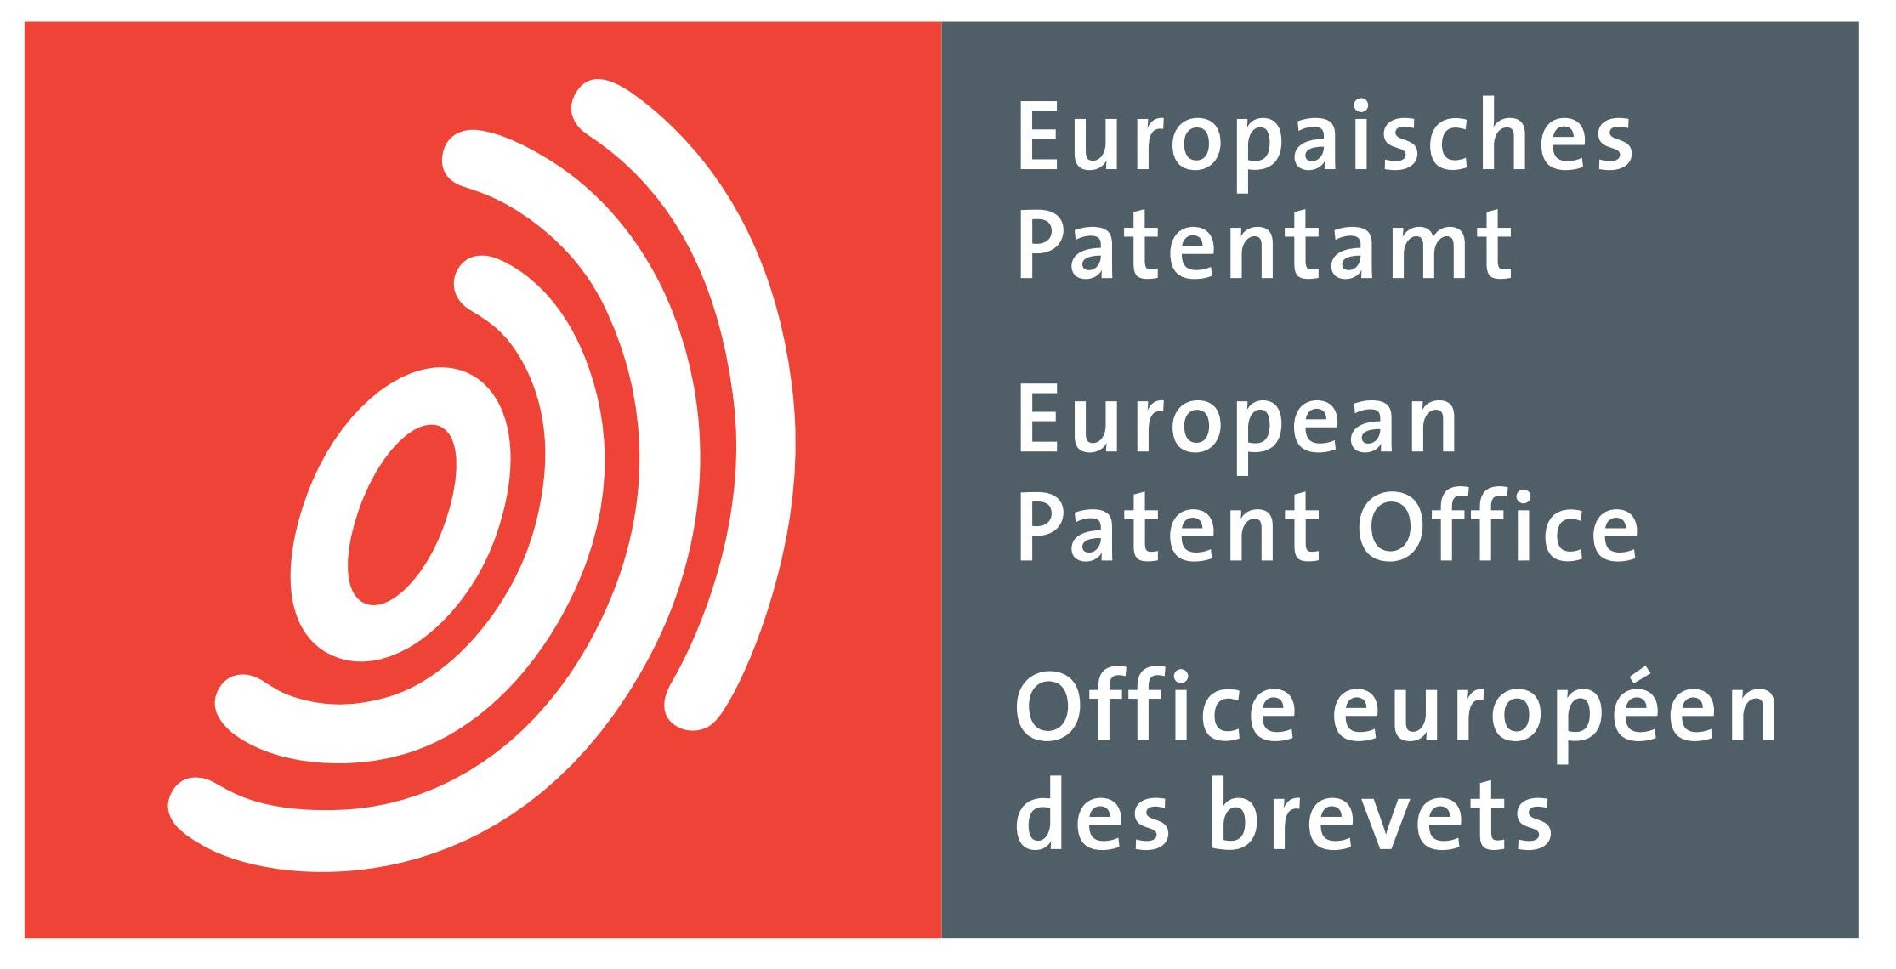
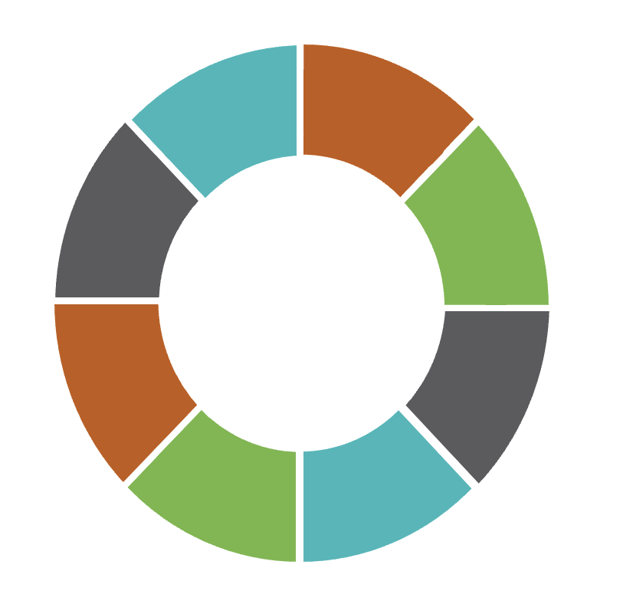
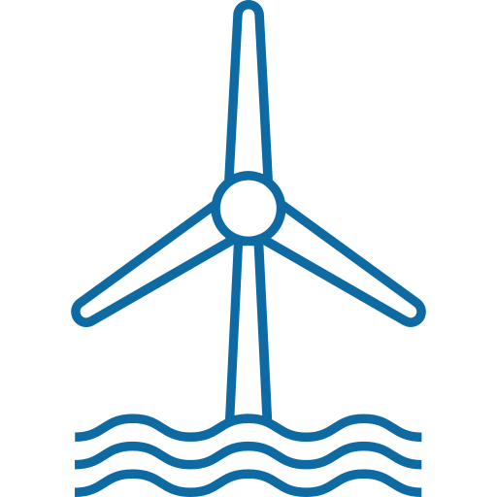
Invention trends in offshore wind
“Offshore Wind Energy: Patent Insight Report”
8. Moderate interest in hybridising offshore wind with other energy generation sources.
Efforts are increasing to combine offshore energy with PV and ocean energy. Patent insights show consistent innovation activity since 2013.
1. Increased invention in offshore wind with dominance in Europa, Asia and USA emerging as future market.
Seven European countries top the International Patent Families (IPFs) list. The USA is third, with China and Japan at fourth and fifth, and Korea at 11th. China leads in non-IPF patents due to its reliance on the domestic offshore wind market.
7. Uptake of submarine electrical infrastructure.
The need for transmission infrastructure is also driving innovation activities and patent data reveals that there are many corresponding innovations in submarine cabling to connect supply and demand cost effectively.
2. Floating foundation, logistics and green hydrogen attract invention activity.
Offshore wind innovations primarily focus on floating foundations, transportation equipment, and turbine installation. Notably, there's a growing trend in combining offshore wind with electrolysers.
6. On-site energy storage and hydrogen production to balance power systems and create additional value.
A growing focus on flexible energy systems is evident to address renewable technology variability. Offshore wind energy patent data indicates a rising interest in energy storage, particularly in combining offshore wind with hydrogen production to aid decarbonization.
3. Floating foundations pose to expand offshore wind Markets.
Market trends show increasing interest in developing floating foundations for placing turbines in deep, wind-rich waters. Patent data confirms active innovation in this technology sector.
5. Trend to increase use of rare earth materials in drive trains.
The trend shows continued interest for direct-drive systems due to their cost-effective power density, but this leads to more use of permanent synchronous magnet generators and increased demand for rare earth materials.
4. Tower and blade designs to reduce steel demand and enhance sustainability.
In the offshore wind sector, players are investigating concrete and lattice towers, as well as sustainable, recyclable blades to reduce steel demand, tackle manufacturing and transportation challenges, and promote circularity.
Source: EPO and IRENA (2023), Patent insight report. Offshore wind energy, EPO, Vienna

Slide 13
Part 2: Offshore Wind Patent Trends (EPO)

Slide 14
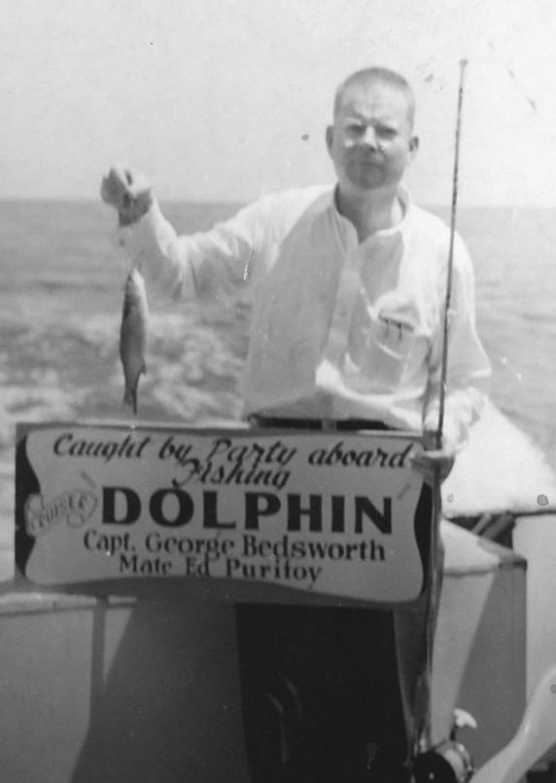
"Without data, you're just another person
with an opinion."
W. Edwards Deming
"Without an opinion, you're just another person
with data."
Milo Jones and Philippe Silberzahn (Forbes)
Photo courtesy of The W. Edwards Deming Institute®
Notes:
The value of the data lays in the value of the insight it provides.
But equally important will the “value of the insight” depend on the quality of the data you are working with.
Coverage, correctness, correct interpretation, etc....
And from the picture, you can see that Deming liked fishing, though his catch was not so impressive.
So maybe he was using the wrong rod, or the wrong tool.
And to continue the analogy, with fishing
Next slide

Slide 15
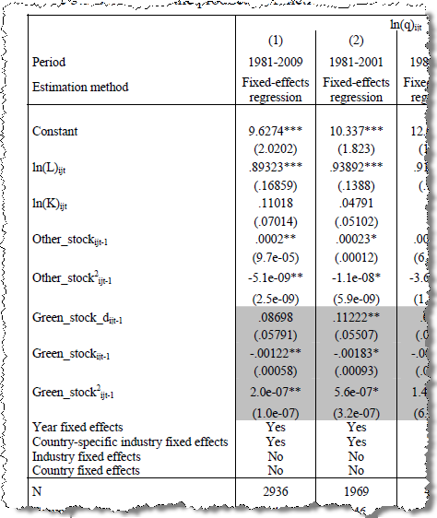

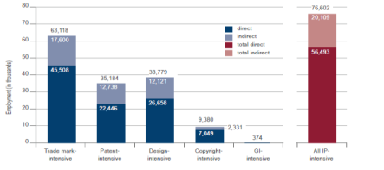
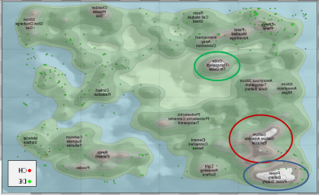
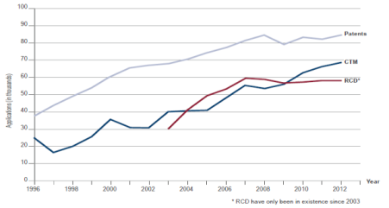
The basic procedure
Basic search
Statistical analysis
Processing results
  patent classes
  search concepts
  applicants
  countries of residence
  [...]
  further analyses/processing
  visualisation
  reporting
Thomson Reuters ®
Group 1
Group 2
Report
Executive
Summary
Notes:
OECD → statistical analysis.
No worry, we will not go doing regression analysis or complex statistical modelling today. But many researchers do use patent data for their modelling and hypothesis testing.

Slide 16
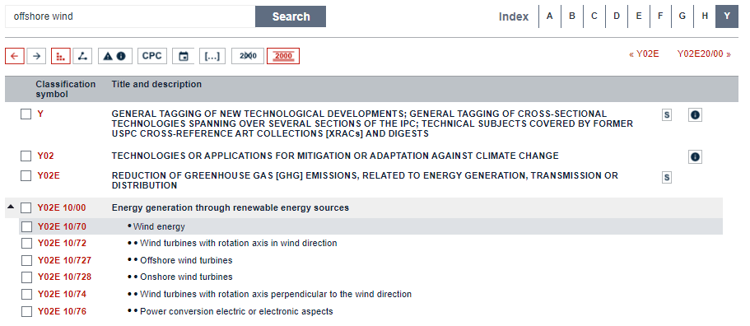
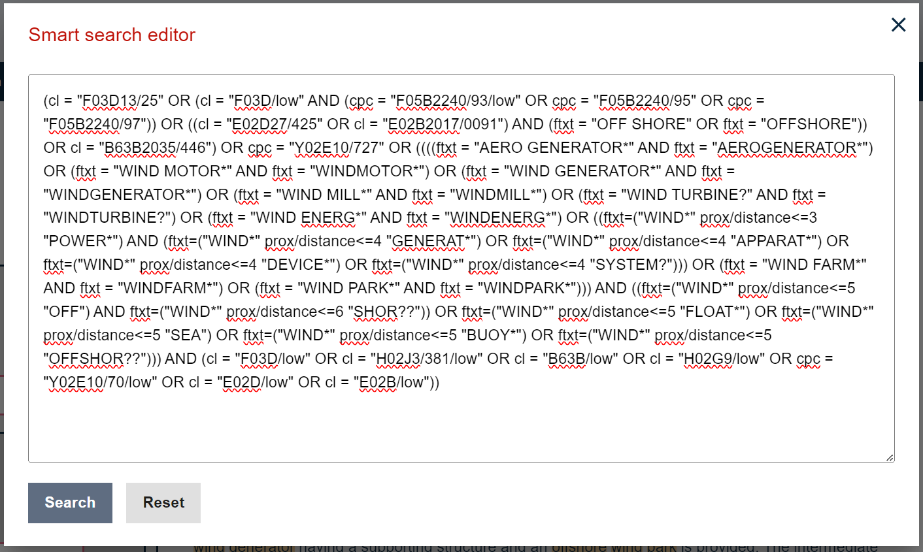
Steps in the procedure: basic search
Notes:
On this slide you see a more detailed overview on how the “general” offshore wind patents were identified.
This also made use of the F03D general classification codes for wind energy, in combination with keywords to narrow down to offshore wind energy.
The purpose is to obtain a start data set of relevant patent families with maximum recall as well as maximum precision (hard to obtain)
This resulted in just 17,000 patent families used for the report (2002-2022), that in the meanwhile have increased to the current 23,000. (still strongly increasing area of patent filings)

Slide 17
Steps in the procedure: basic search
Basic search
Statistical analysis
Processing results
Energy storage
[QD]
Hydrogen
[QD4]
concept description
concept label (excel sheet)
*Q0
AND (F03D9/19,
F05B2220/61,
H02J15/008,
C25B1/04 /LOW ,
(stor+ AND (hydrogen?, "h2"))
General concept for offshore wind energy
storing chemical energy, e.g. using electrolysis
for hydrogen and/or oxygen production
using hydrogen as energy vector
by electrolysis of water
Storing, storage, hydrogenation, hydrogenolysis,... H2
Notes:
F03D : WIND MOTORS
F05B: engine and pumps , INDEXING SCHEME RELATING TO WIND
H02J15: Systems for storing electric energy
C25B1: Chemistry → ELECTROLYTIC OR ELECTROPHORETIC PROCESSES
We also looked at desalination as using seawater directly also produces Sodium hypochlorite (bleach)

Slide 18
Offshore wind energy
Q0
Concept
grouping
Fixed and floating foundations
Towers
[QH]
Mechanical power transmission
[QC]
Blades and Rotors
Hybrid System [QE]
Energy storage
[QD]
Grid, submarine cables and protection
Concepts
Fixed
[QA]
Welded or tubular steel
[QH1]
Blades/rotors
[QI]
Solar
[QE1]
Compressed air [QD1]
Direct drive
[QC1]
Grids
[QJ]
Sub-concept
Suction caisson
[QA1]
Blades/rotors
→ modular
[QI1]
Ocean energy
[QE2]
Kinetic
[QD2]
Lattice
[QH2]
Gearbox
[QC2]
Battery
[QD3]
Submarine Cables [QL]
Gravity
[QA2]
Concrete
[QH3]
Hydrogen
[QD4]
Protection
[QL1]
Monopile
[QA3]
Floating
[QB]
Thermal
[QD5]
Stabilisation
[QB1]
Detail views
Transportation/ installation/ erection
[QK]
Corrosion protection
[QF]
Generators
[Espacenet]
Recycling
[Espacenet]
Monitoring waves
[QG]
Aquaculture
[Espacenet]
Desalination
[Espacenet]
Notes:
Overview of relevant concepts.
Cartography.
Concept mapping.
Mapping of technology
Each concept is defined by a well defined patent search strategy, a query that is used to extract patents from EPO data bases.
Not all concepts were discussed or used in the final report: example is the data on how submarine cables are protected against damage for example by external tampering. (1800 patent families)
First Q0 query

Slide 19
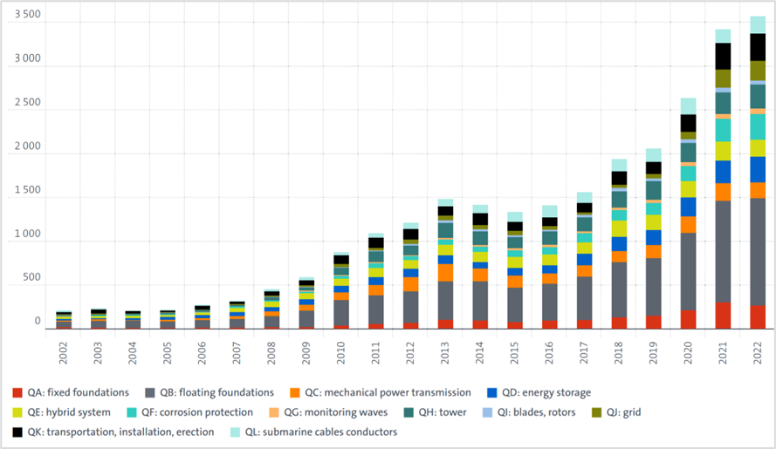
Basic search
Statistical analysis
Processing results
Offshore wind energy
Worldwide patent families
Notes:
Lets have a look at the results and findings.
All patents , IPF and none ipf

Slide 20
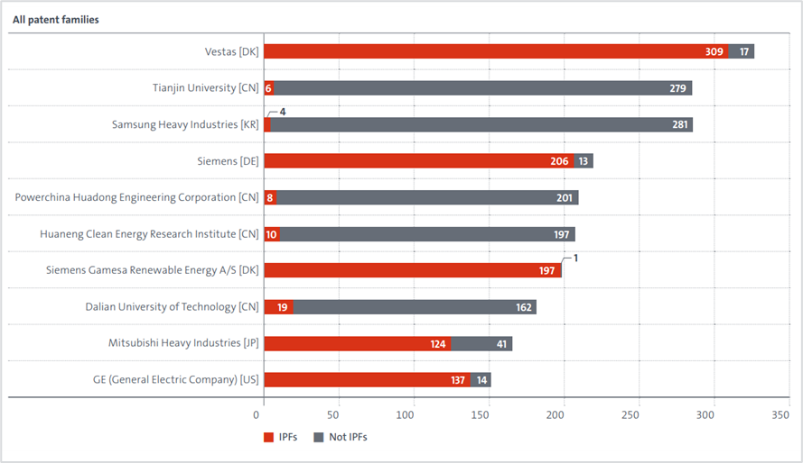
applicant ranking
Notes:
All patents , IPF and none ipf

Slide 21
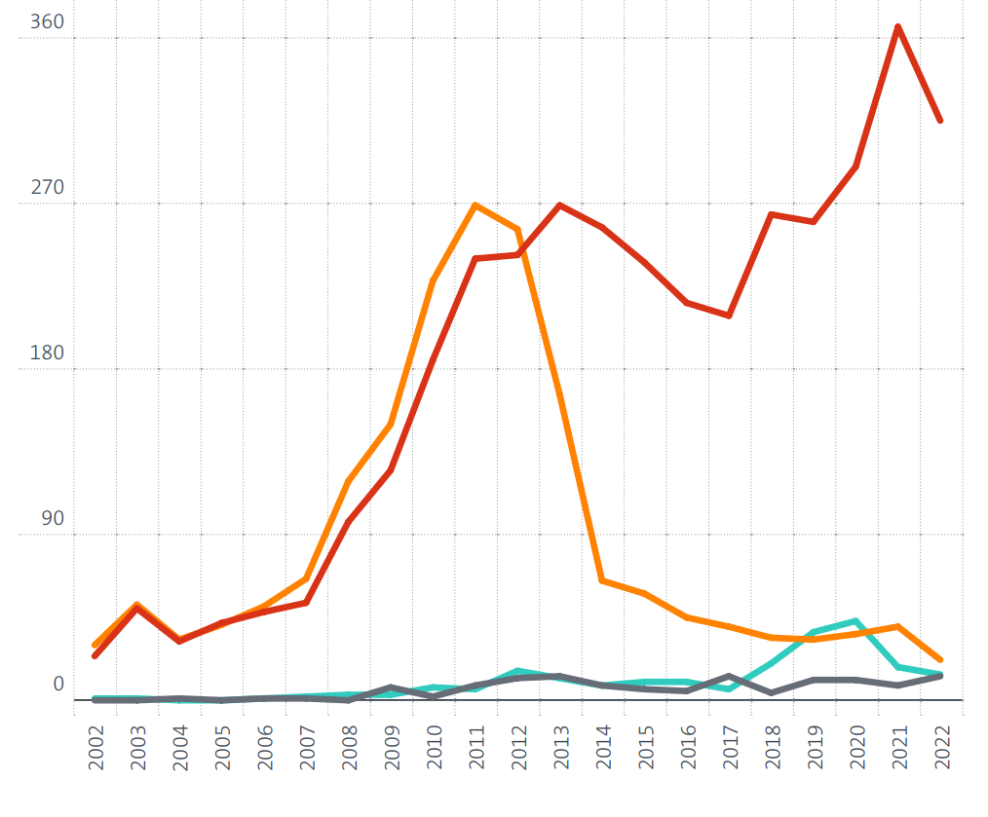
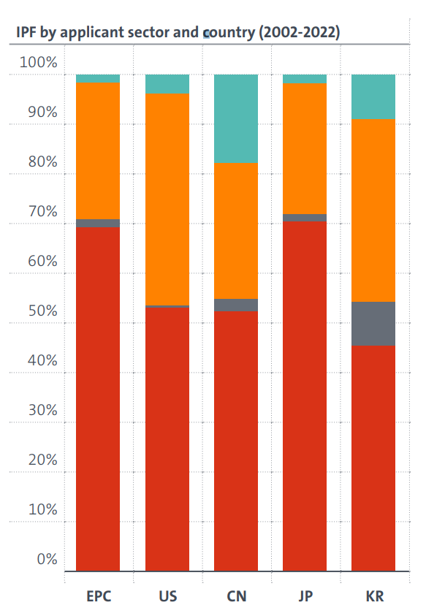
Applicant sector
Company
Gov Non-profit
Individual
University
Notes:
Consolidation, individual inventors have moved to companies, (need for large investments)
Aloys Wobben (Enercon)
henrik stiesdal (Danish Concept inventor, , 175 iventions, Siemens)
Kyoto protocol entered into force 16/02/2005

Slide 22
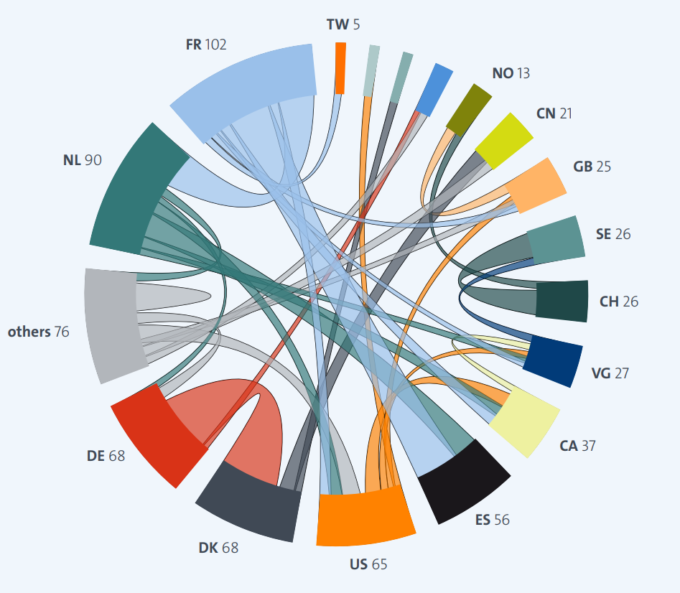
International patenting co-operation
  France has the highest number of patent families with international co-operation
  The United States of America has the most diverse co-operation picture, pairing with 24 countries on a total of 81 patent families.
  Germany cooperates with 15 countries on a total of 79 patent families.
  Co-operation with China is marked by co-applicant filings with mainly Denmark, Hong Kong (SAR), and Chinese Taipei

Slide 23
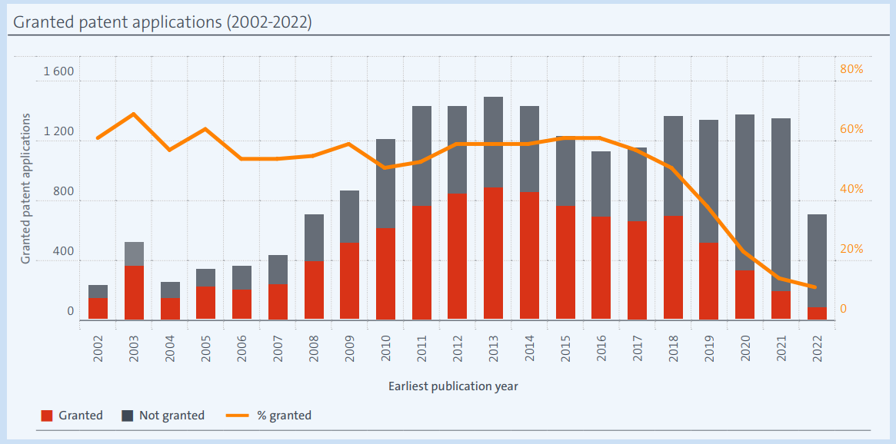
Grant ratE
Number of international patent families
Notes:
Average of grant is about 60% which is about 3 % higher then the general average, which is a good measure of patent quality and economique importance.

Slide 24
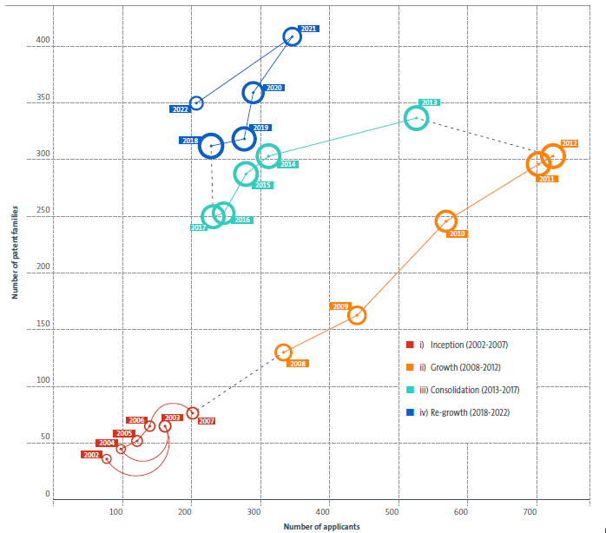
Maturity map
Number of international patent families
Number of applicants
Notes:
Maturity map is based on ipf filings.
(the picture including non IPF looks completely different,

Slide 25
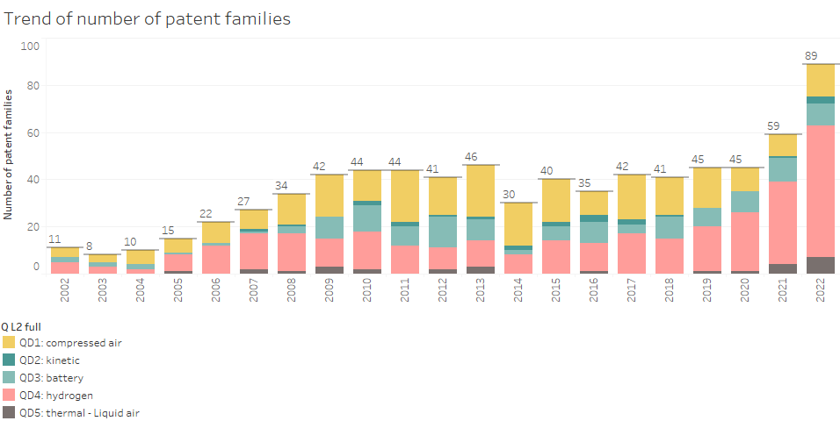
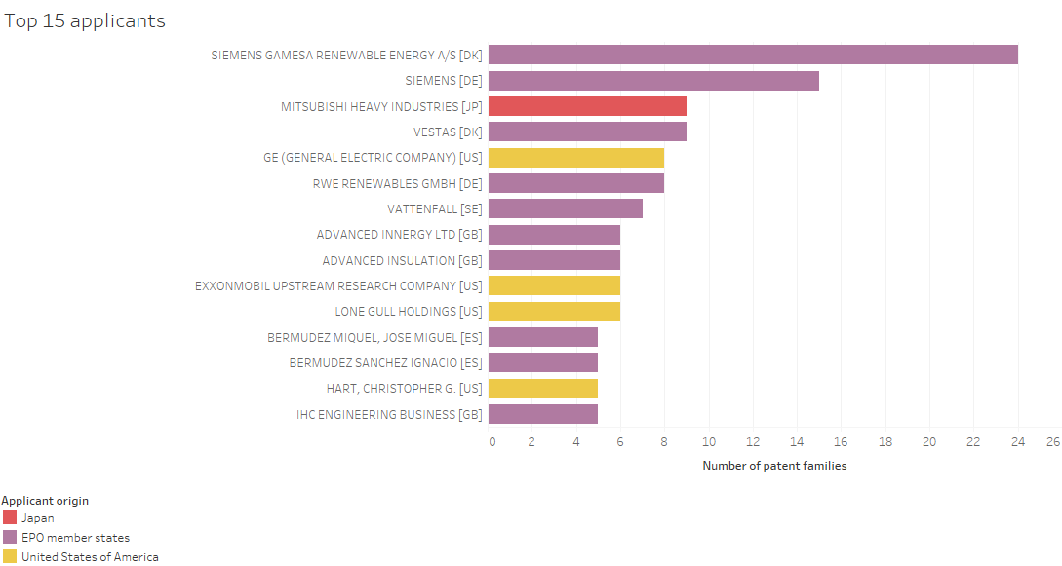
Offshore wind energy: Energy storagE (QD - IPF)
Notes:
IPF on energy storage

Slide 26
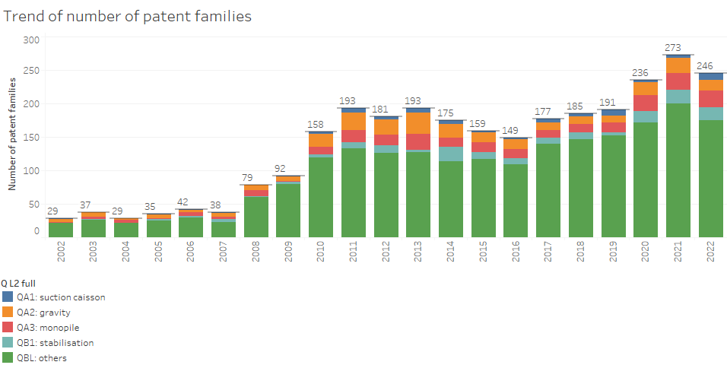
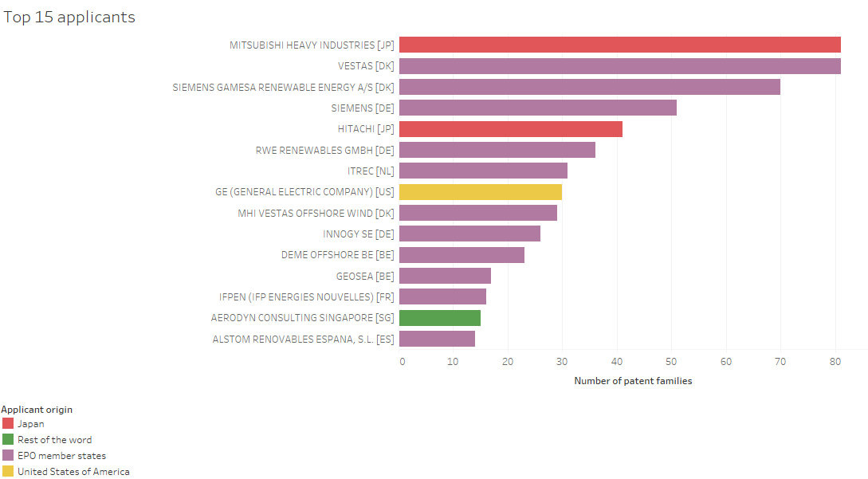
Offshore wind energy: floating foundation (QB - IPF)
Notes:
Observe the last 7 years, systematically 2/3 patents are direct drive.

Slide 27
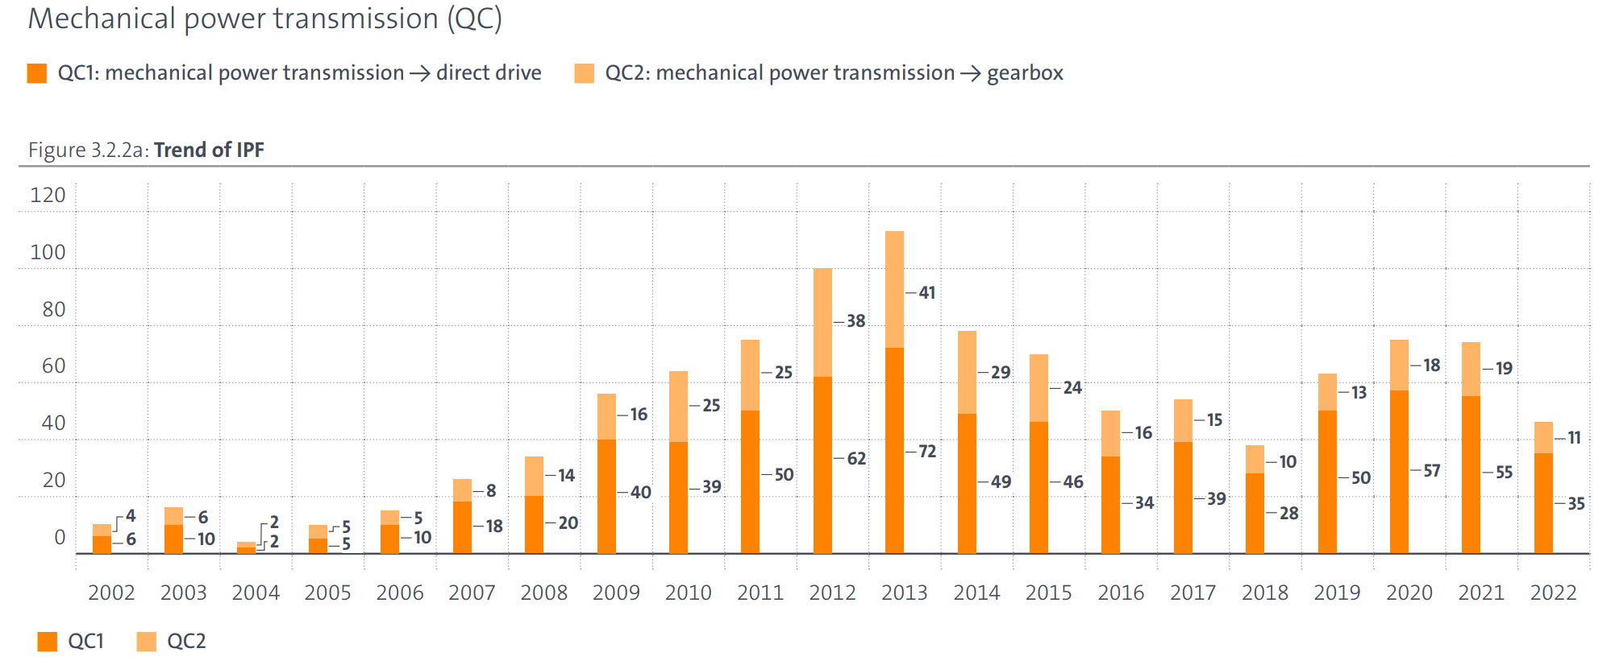
Offshore wind energy: Power Transmission - Technology
Notes:
Observe the last 7 years, systematically 2/3 patents are direct drive.

Slide 28
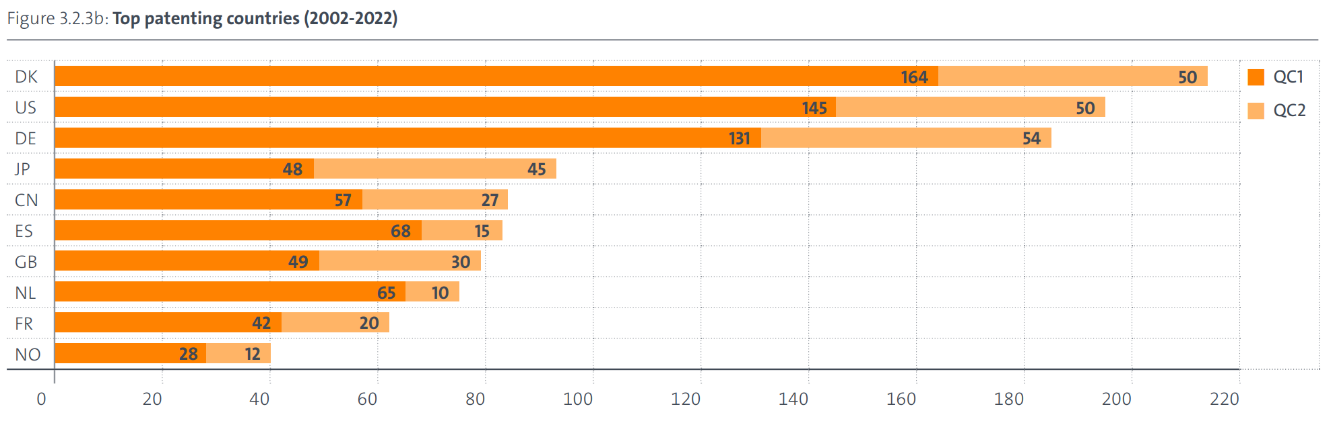
Offshore wind energy: Power Transmission - Countries
Notes:
The three key types of information coming from patent data (technical, legal and business) are elaborated in greater detail in the following three slides, so no need to stay long on this one.

Slide 29
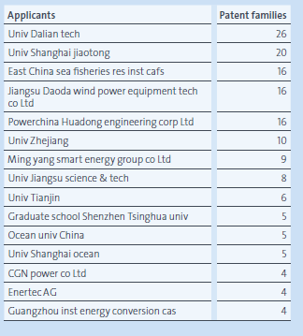
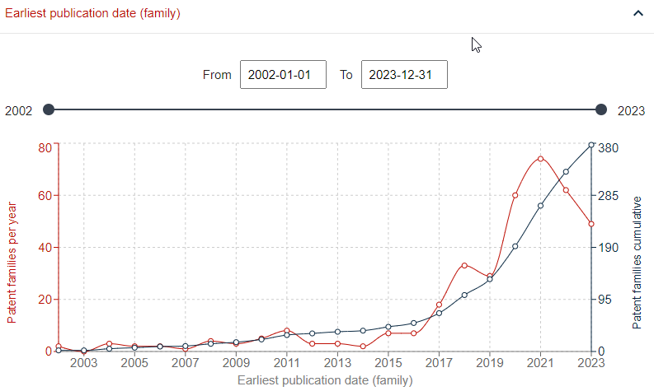
Combining Offshore wind energy with aquaculture
Notes:
The three key types of information coming from patent data (technical, legal and business) are elaborated in greater detail in the following three slides, so no need to stay long on this one.

Slide 30
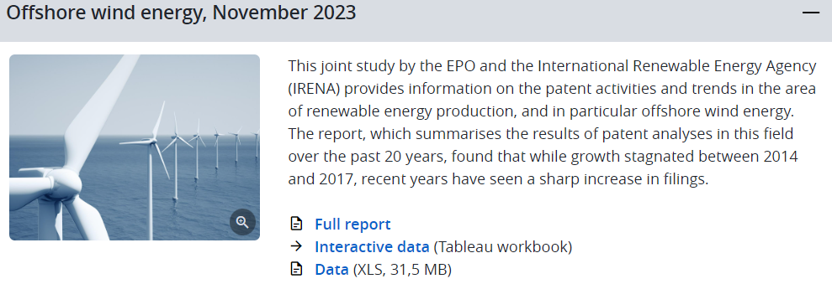
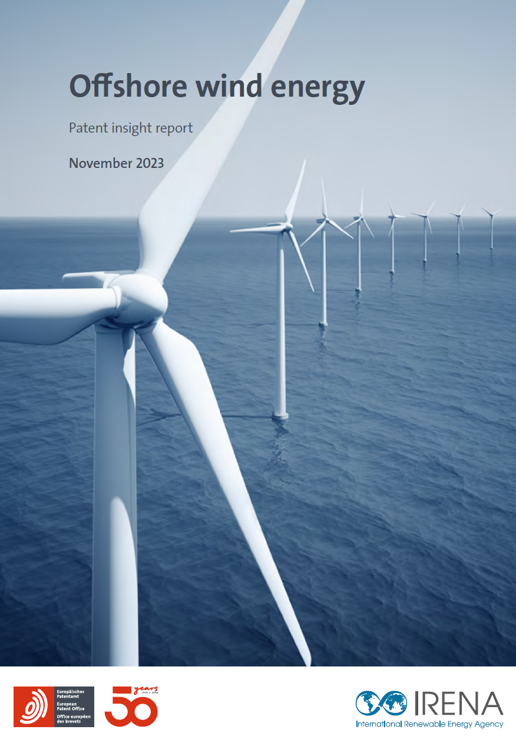
Full Report
Offshore wind in Tableau
Geert Boedt
European Patent Office
patstat@epo.org

Slide 31
Q & A
10 min

Slide 32
THANK YOU FOR JOINING US!
SEE YOU IN OUR NEXT WEBINARS
www.irena.org/events/2020/Jun/IRENA-Insights

