Slide 1

April 2024
Scan to get the report

Slide 2
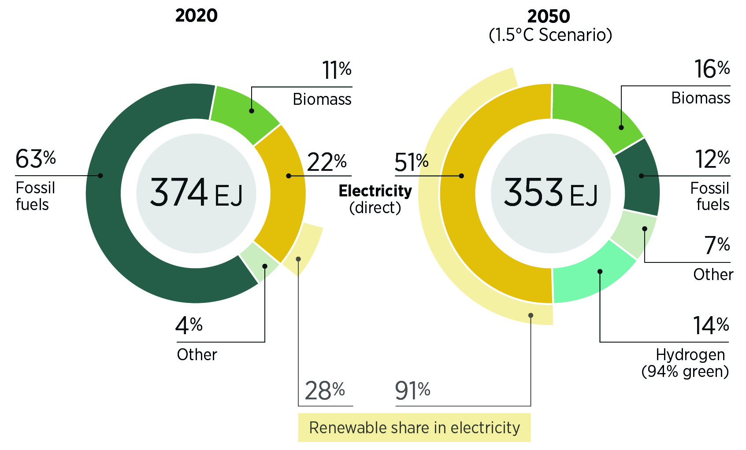
Total final energy consumption by energy carrier according to IRENA's 1.5°C Scenario, 2020 and 2050
Source: (IRENA,2023b).
Note: EJ = exajoule.

Slide 3
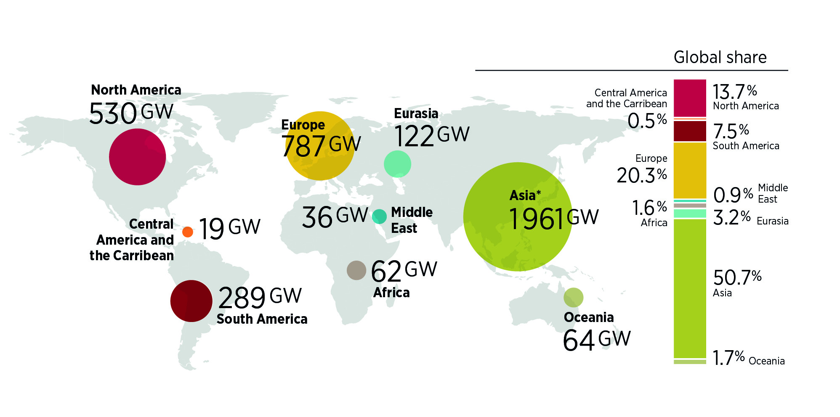
Renewable power capacity by region, 2023
Source: IRENA (2024b).
Notes: *China accounts for 1 457 GW; GW = gigawatts.
Disclaimer: This map is provided for illustration purposes only. Boundaries and names shown on this map do not imply any endorsement or acceptance by IRENA.

Slide 4
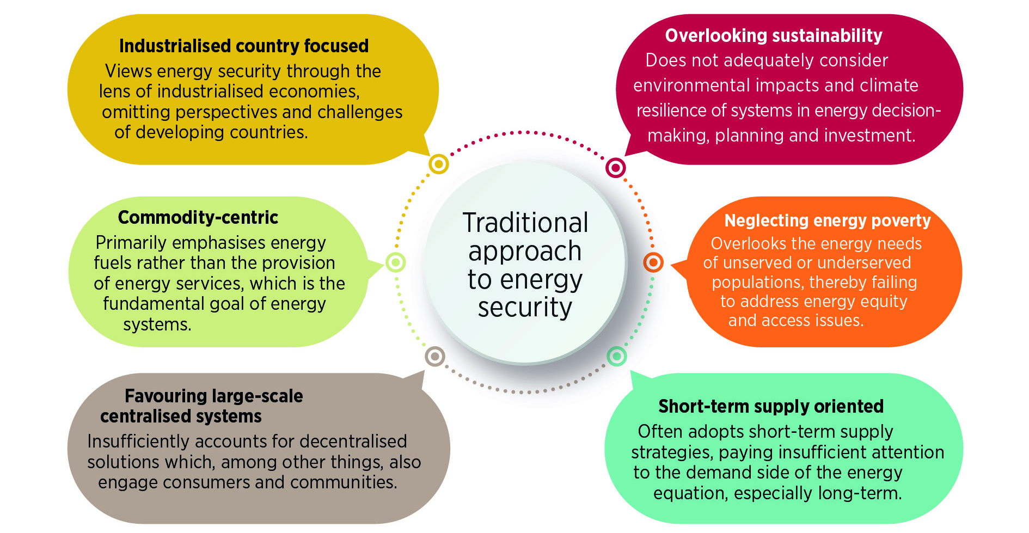
Traditional approach to energy security

Slide 5
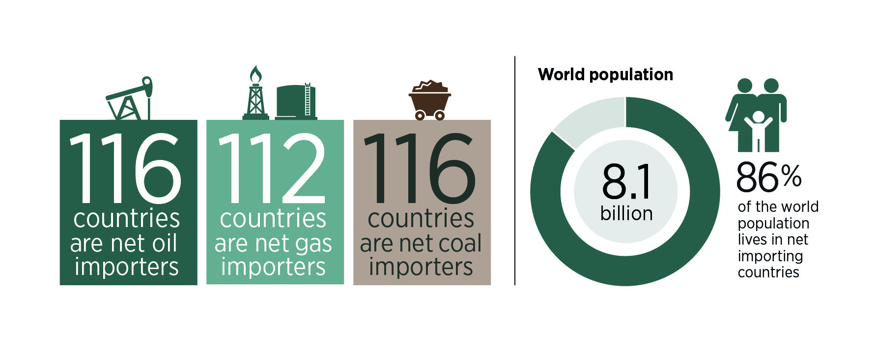
Share of countries and global population dependent on net imports of fossil fuels
Source: (UN Comtrade Database, 2022)

Slide 6
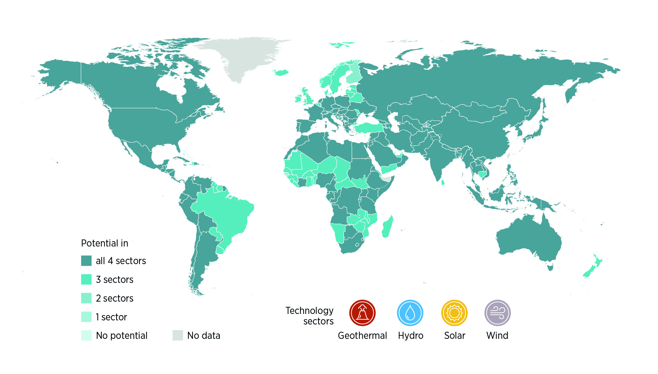
Techno-economic potential of geothermal, hydro, solar and wind
Source: (IRENA, 2024c).
Notes: Figure is based on IRENA Global Atlas datasets. Only geothermal, hydro, solar and wind sources are included. Data for calculating the techno-economic potential of bioenergy and marine sources is currently unavailable.
Disclaimer: This map is provided for illustration purposes only. Boundaries and names shown on this map do not imply any endorsement or acceptance by IRENA.

Slide 7
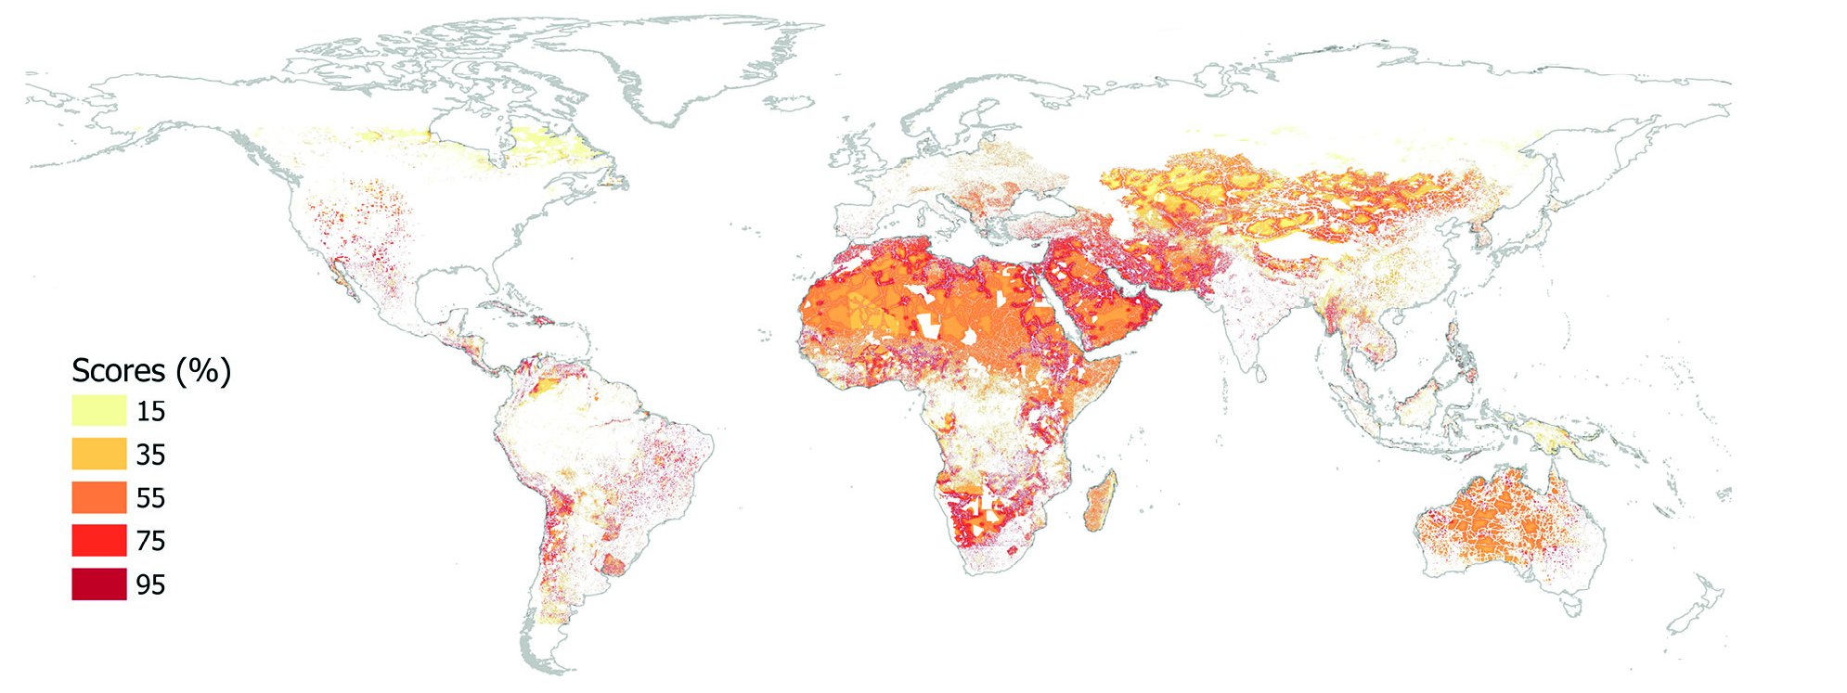
Suitable area for utility scale solar
Source: (IRENA, 2024c).
Disclaimer: This map is provided for illustration purposes only. Boundaries and names shown on this map do not imply any endorsement or acceptance by IRENA.
Notes: The scores express the suitability of areas to develop solar PV and wind projects, with the scale of 0–100% corresponding to the worst and best areas, respectively. Suitable areas exhibit high resource potential and low technical, financial and socio-environmental impacts.

Slide 8
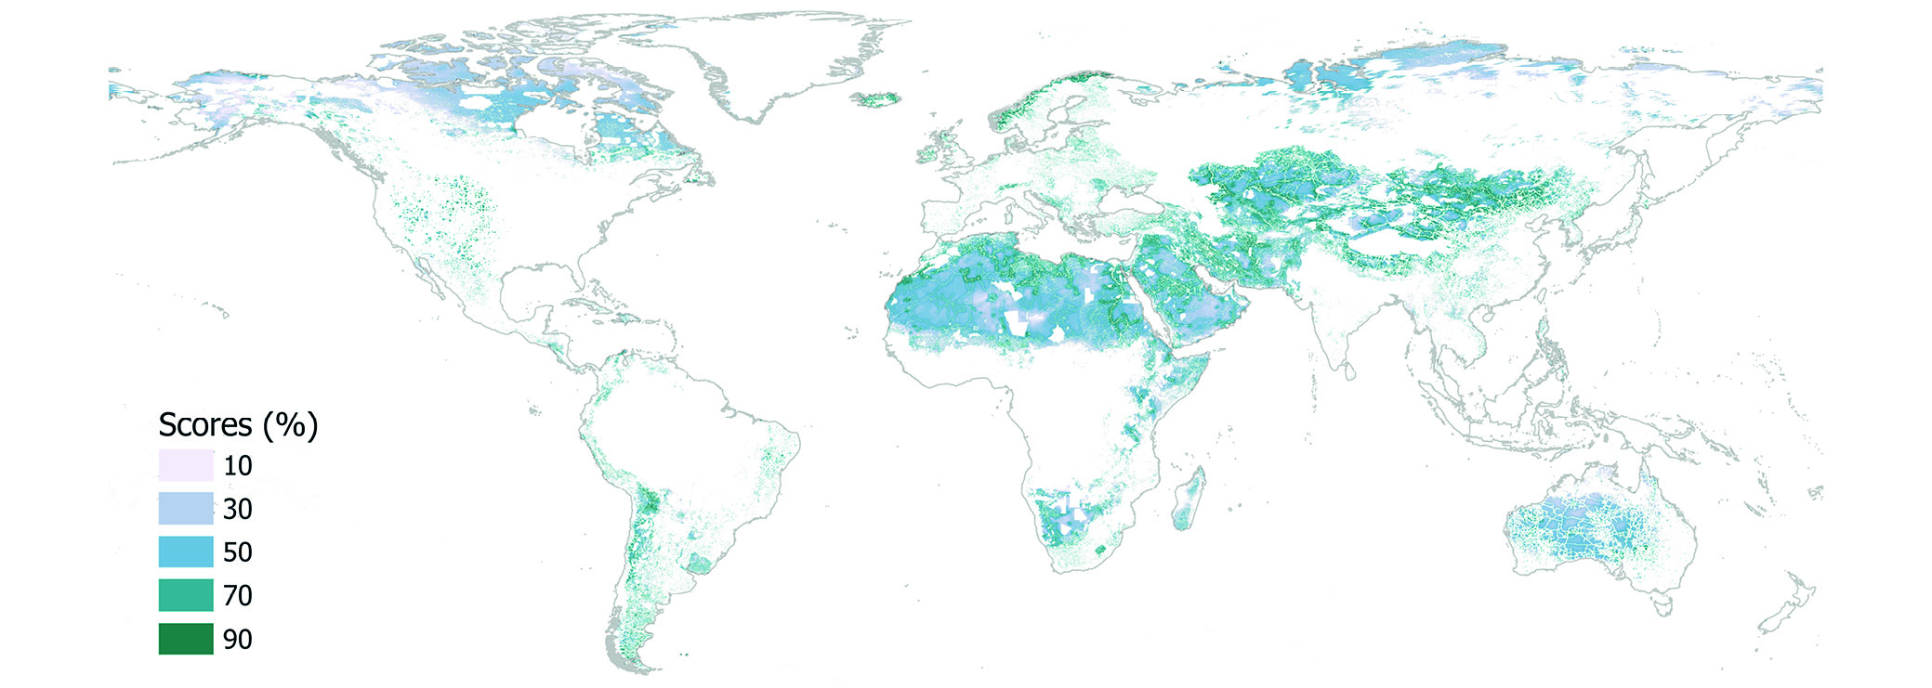
Suitable area for on-shore wind
Source: (IRENA, 2024c).
Disclaimer: This map is provided for illustration purposes only. Boundaries and names shown on this map do not imply any endorsement or acceptance by IRENA.
Notes: The scores express the suitability of areas to develop solar PV and wind projects, with the scale of 0–100% corresponding to the worst and best areas, respectively. Suitable areas exhibit high resource potential and low technical, financial and socio-environmental impacts

Slide 9
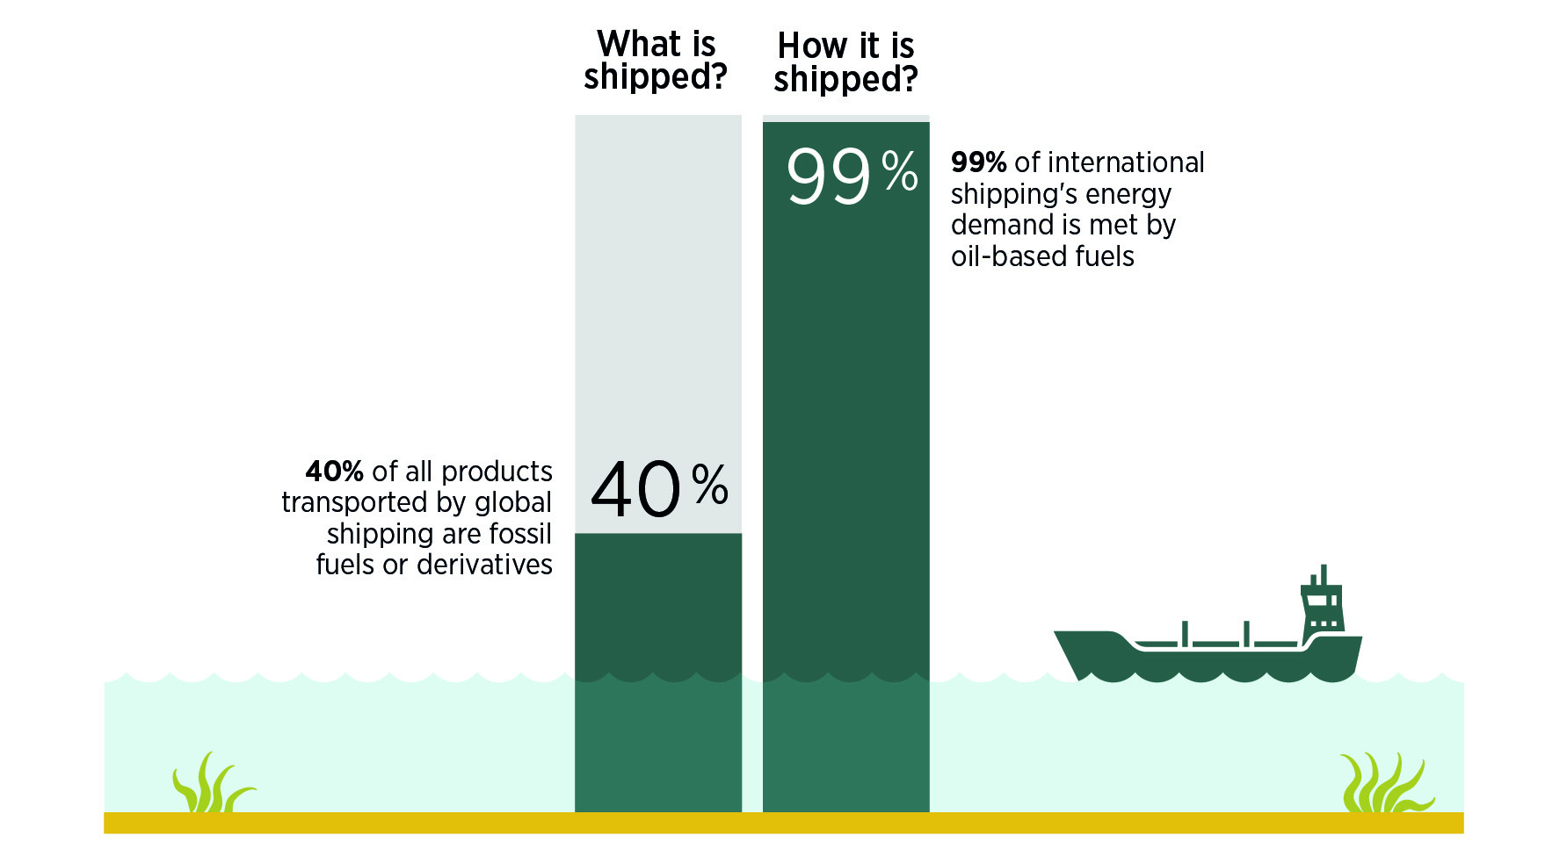
Global shipping is closely intertwined with fossil fuels
Source: (UNCTAD, 2022); (IEA, 2023a).

Slide 10
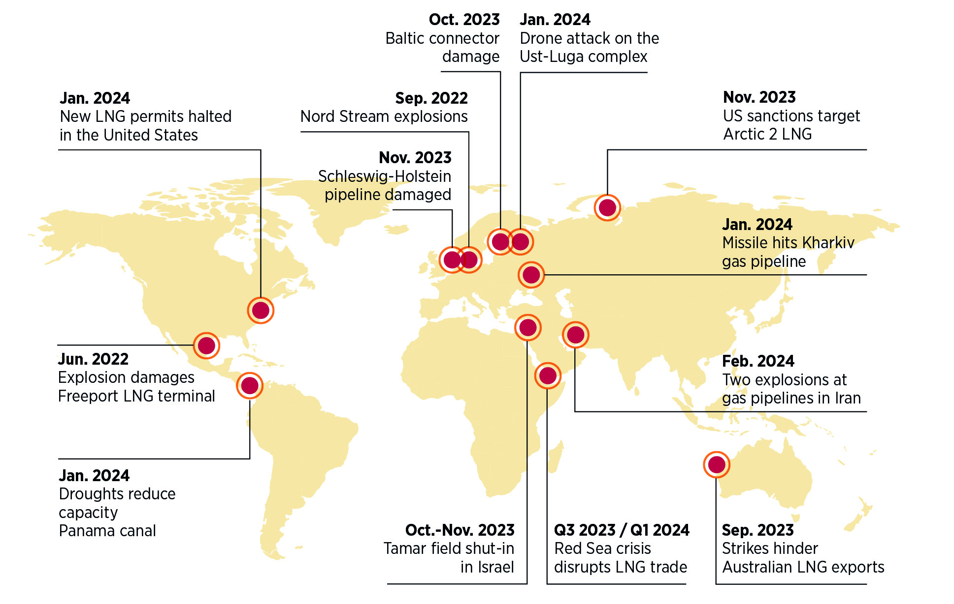
Recent disruptions of natural gas supply
Source: Compiled by IRENA from public sources. Note that this list is just for illustrative purposes and may not be exhaustive.
Disclaimer: This map is provided for illustration purposes only. Boundaries and names shown on this map do not imply any endorsement or acceptance by IRENA.

Slide 11
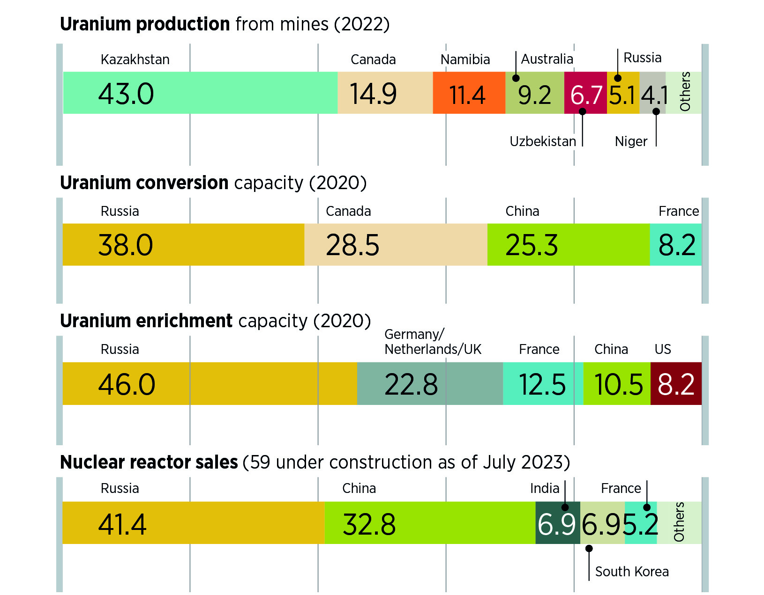
Geographic concentration in the nuclear fuel cycle (% of the global total)
Source: (World Nuclear Association, 2022 ; WNISR, 2023).
Notes: UK = United Kingdom; US = United States.

Slide 12
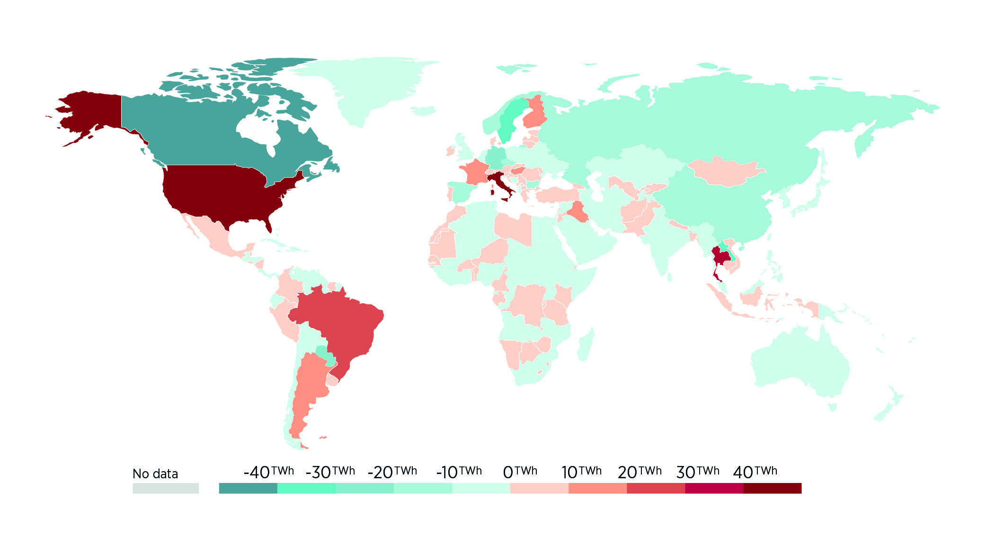
Net electricity imports (2022)
Source: (Our World in Data, 2023).
Disclaimer: This map is provided for illustration purposes only. Boundaries and names shown on this map do not imply any endorsement or acceptance by IRENA.

Slide 13
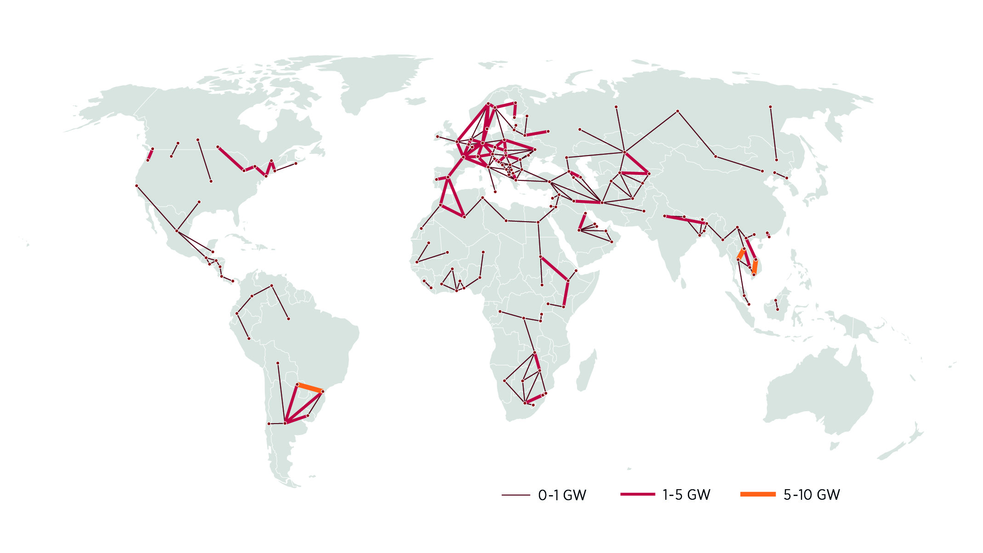
Existing electricity interconnectors (as of 1 Feb 2024)
Source: (Brinkerink et al., 2024)
Note: Maps include only cross-border interconnections.
Disclaimer: This map is provided for illustration purposes only. Boundaries and names shown on this map do not imply any endorsement or acceptance by IRENA.

Slide 14
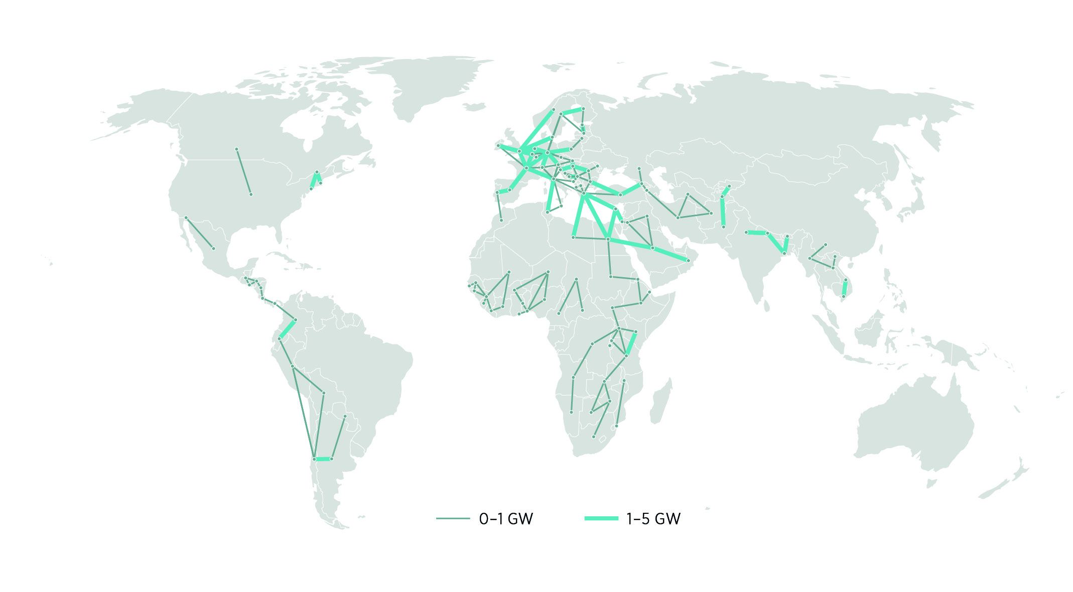
Planned electricity interconnectors (as of 1 Feb 2024)
Source: (Brinkerink et al., 2024)
Note: Maps include only cross-border interconnections.
Disclaimer: This map is provided for illustration purposes only. Boundaries and names shown on this map do not imply any endorsement or acceptance by IRENA

Slide 15
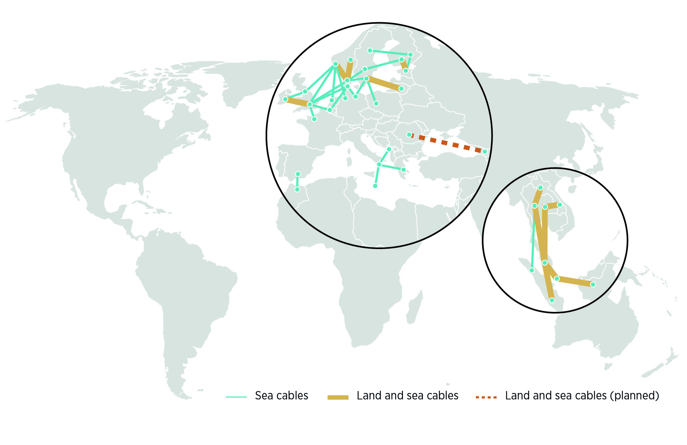
Subsea interconnections (existing and planned, as of 1 Feb 2024)
Source: Compiled by IRENA from public sources.
Note: Maps include only cross-border interconnections; this figure is intended for illustrative purposes and might not be exhaustive.
Disclaimer: This map is provided for illustration purposes only. Boundaries and names shown on this map do not imply any endorsement or acceptance by IRENA.

Slide 16
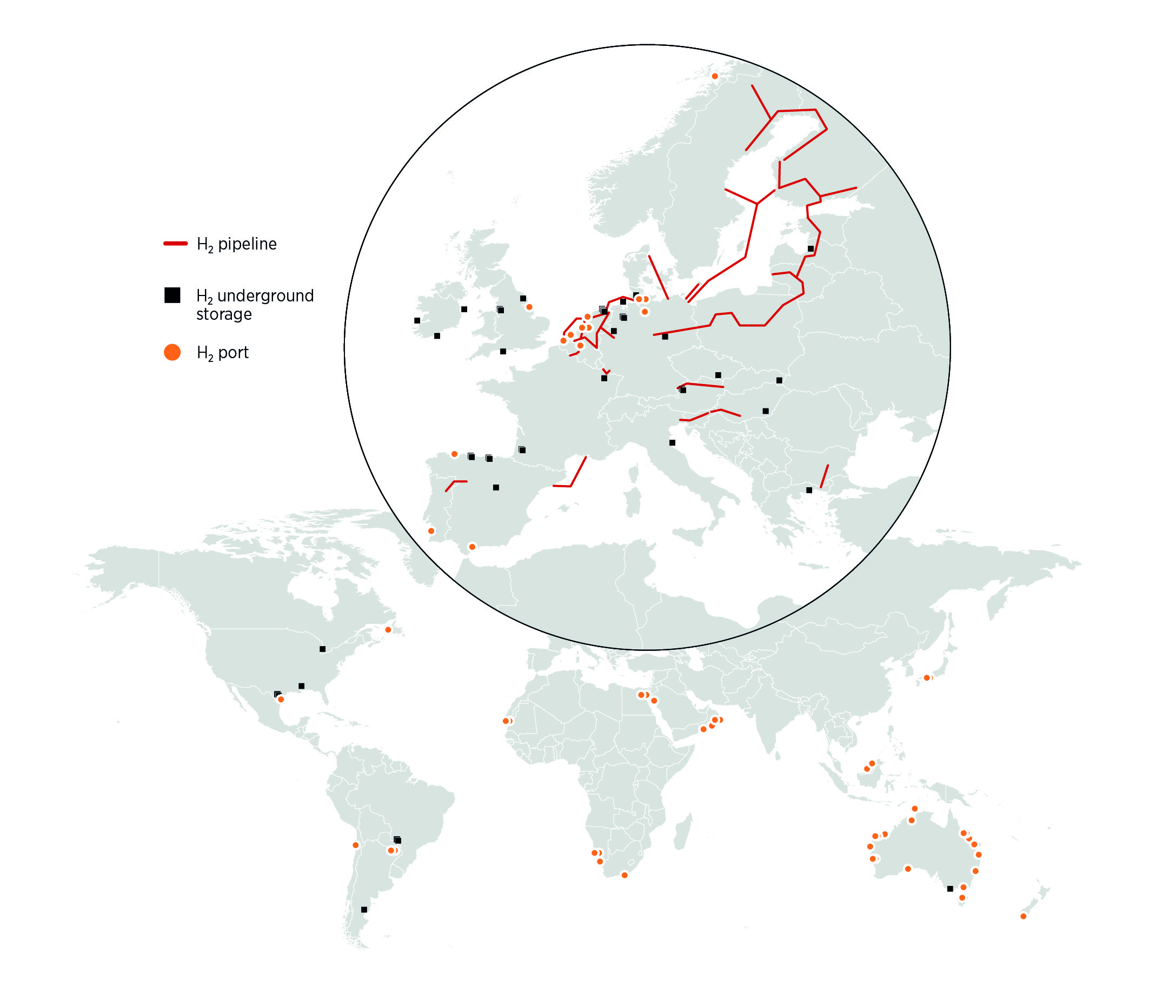
Hydrogen pipelines, storage and ports (existing and planned, as of Oct 2023)
Source: (IEA, 2023b).
Note: The figure displays hydrogen pipelines spanning distances greater than 100 km.
Disclaimer: This map is provided for illustration purposes only. Boundaries and names shown on this map do not imply any endorsement or acceptance by IRENA.

Slide 17
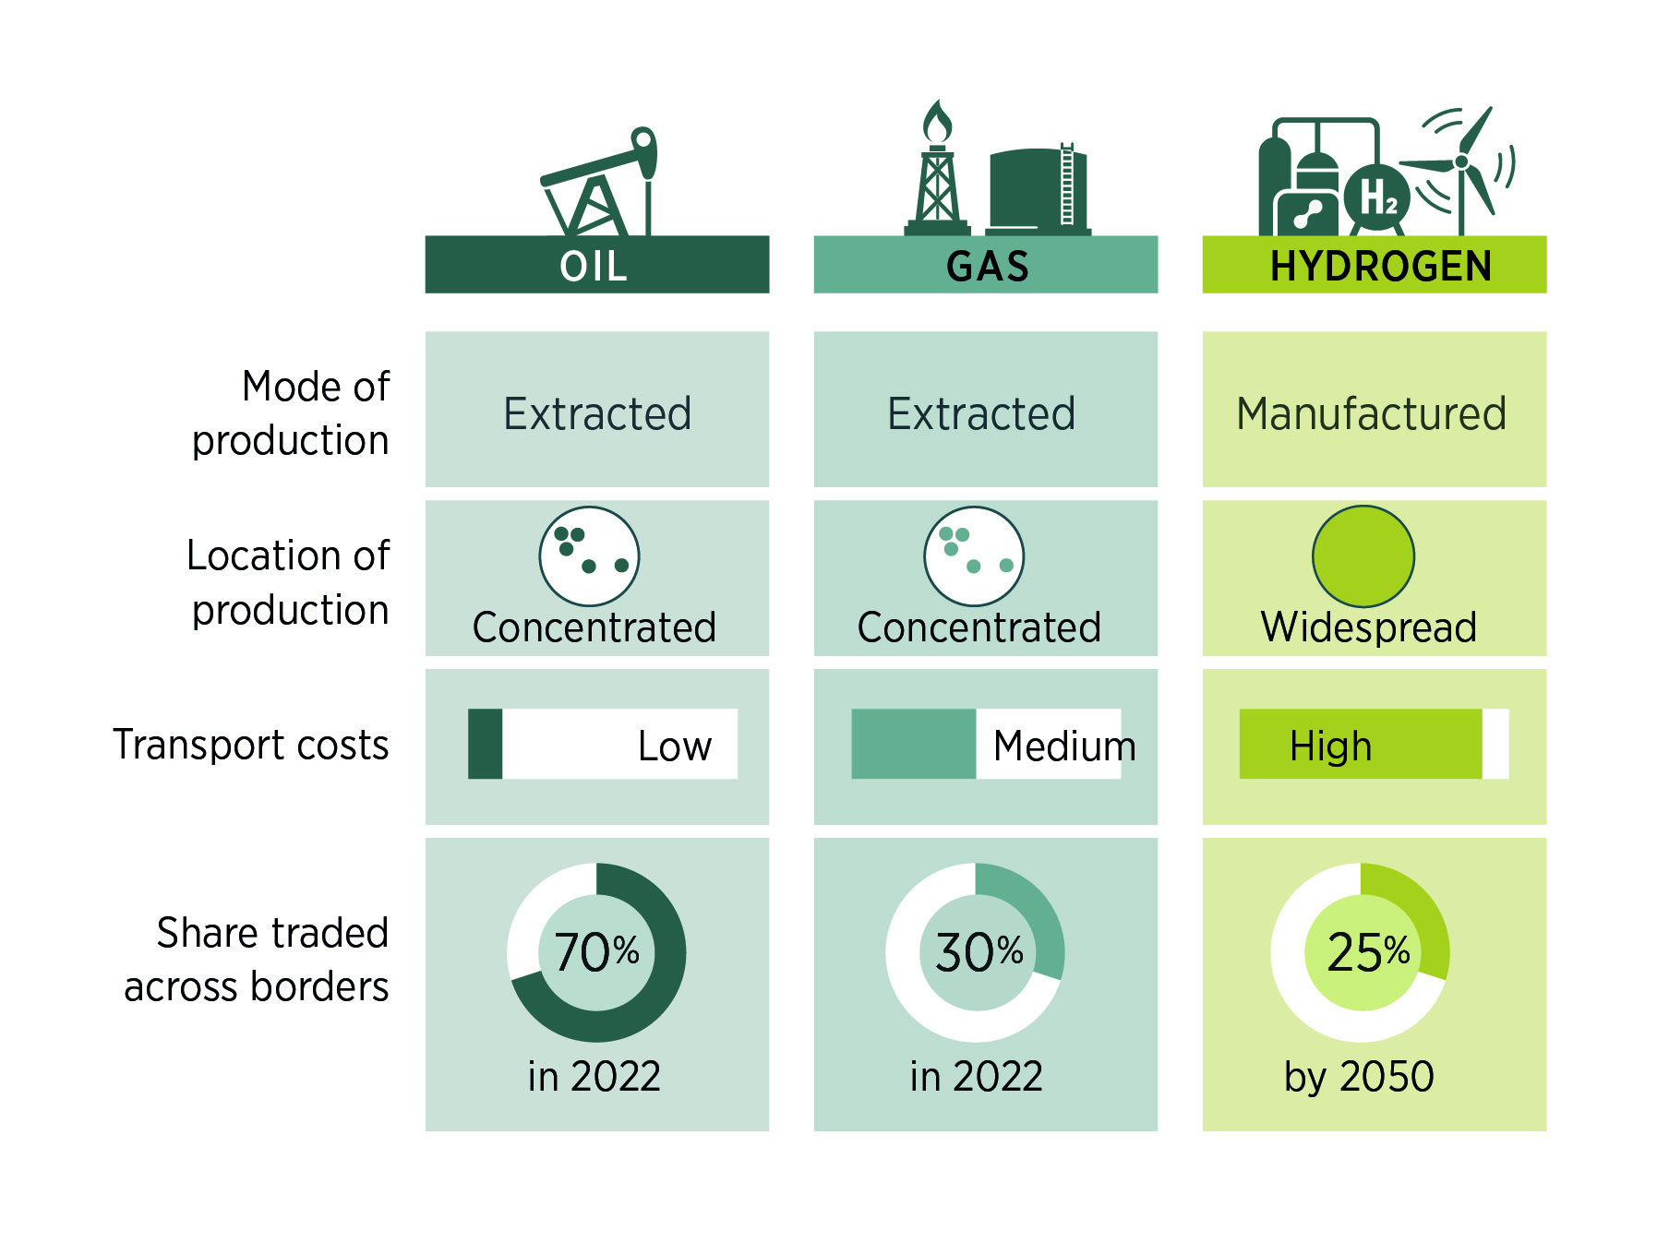
The geopolitics of hydrogen and fossil fuels are fundamentally different
Note: The oil and gas shares are calculated from the EI’s Statistical Review of World Energy (Energy Institute, 2023). The share for hydrogen is an IRENA estimate.

Slide 18
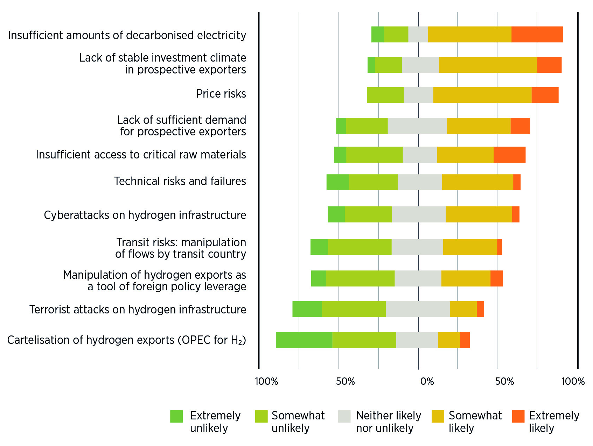
Expert views on hydrogen energy security risks
Source: (IRENA, 2022b).

Slide 19
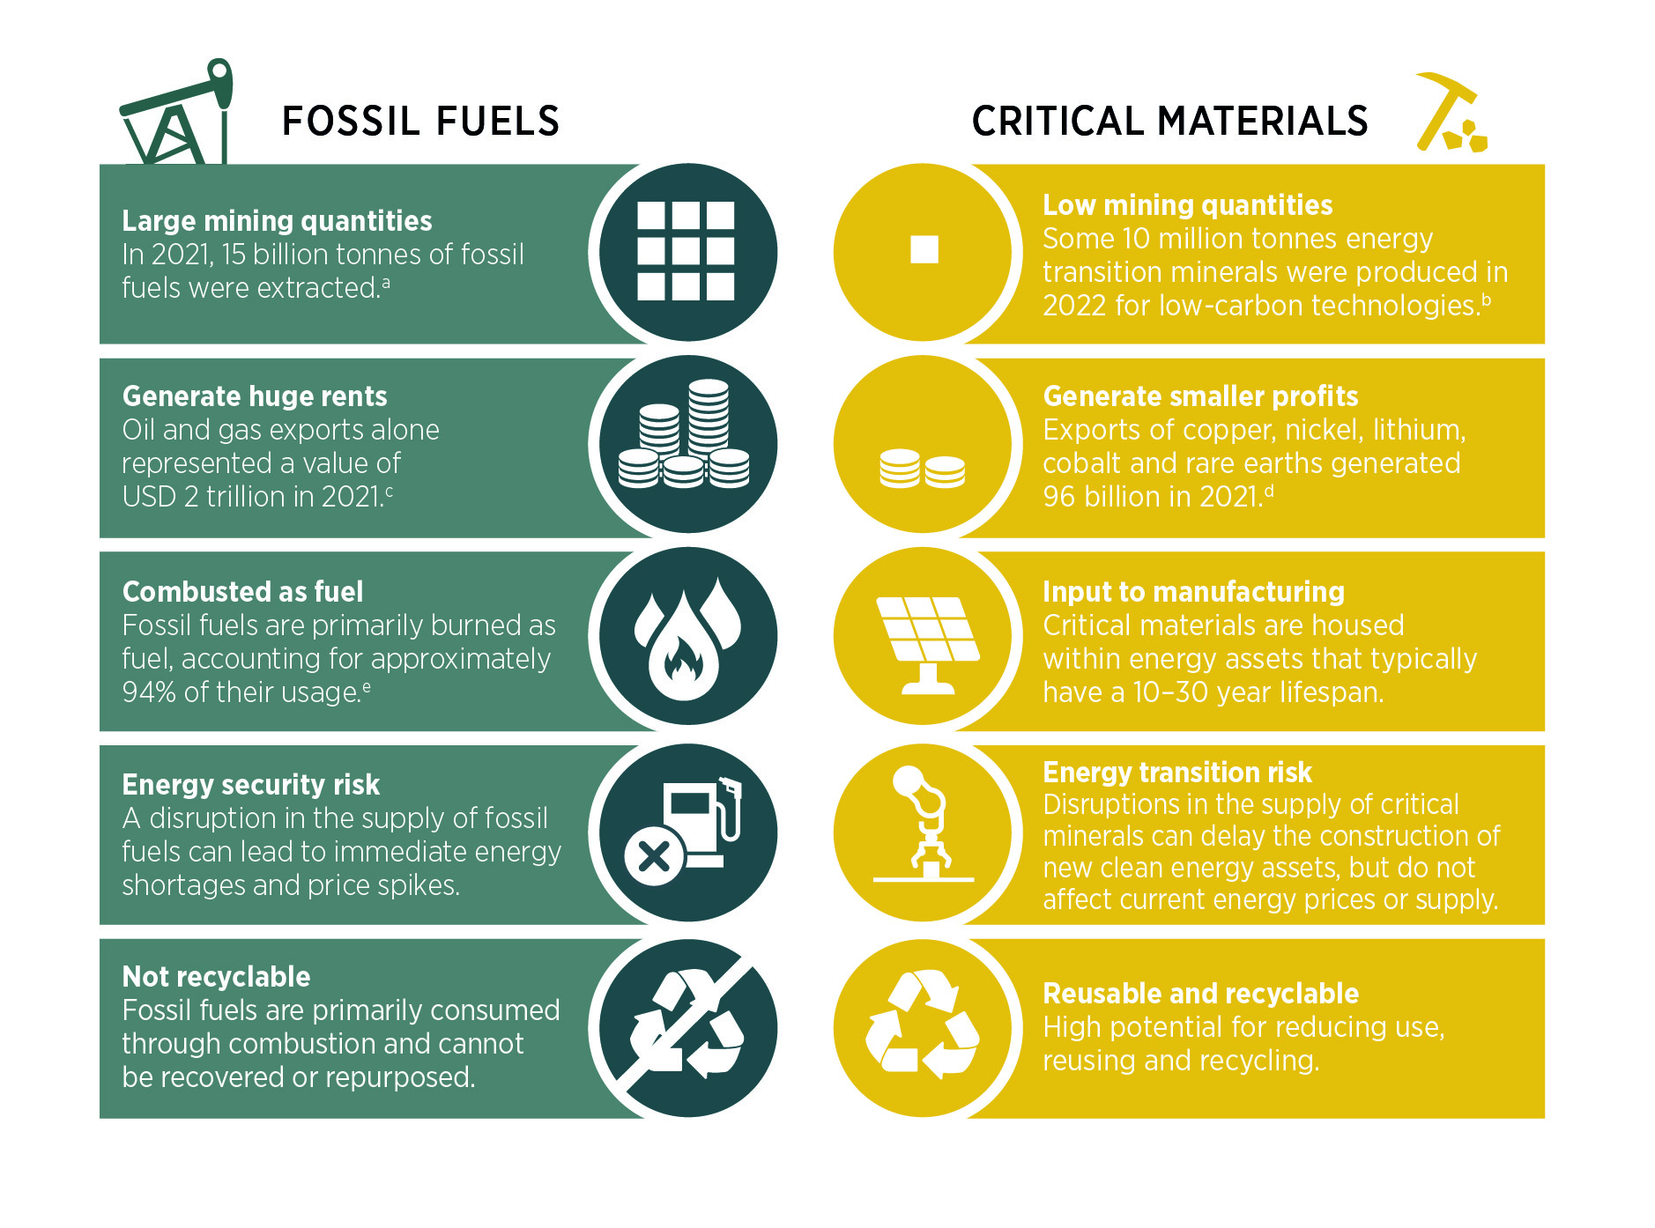
Critical materials are fundamentally different from fossil fuels
Source: (IRENA, 2023a).

Slide 20
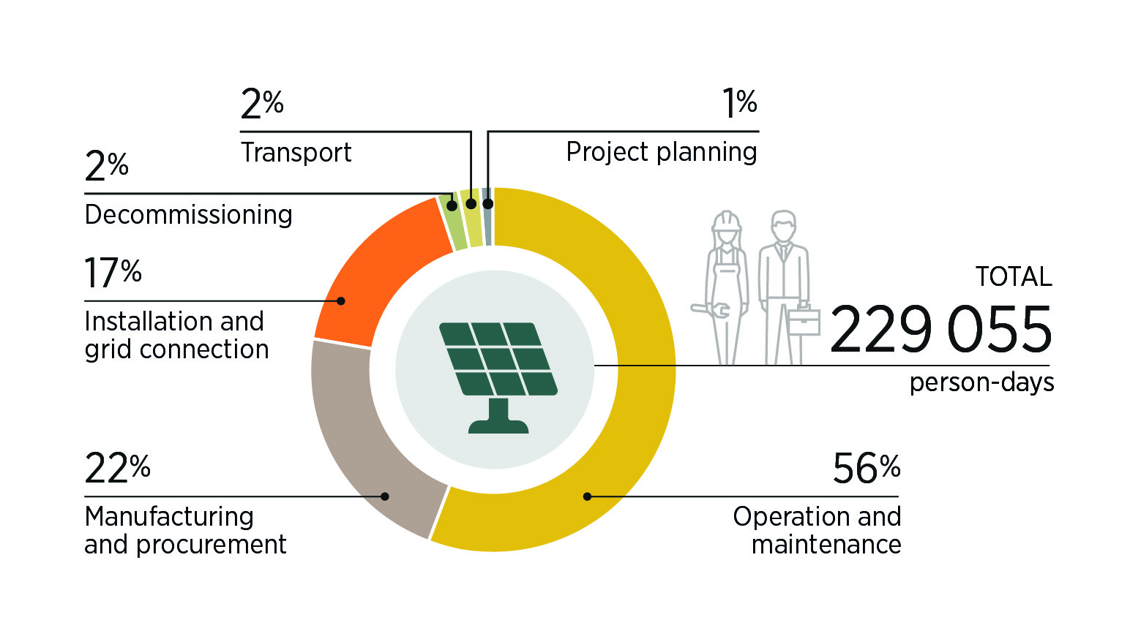
Distribution of human resources required along the value chain for the development of a 50 MW solar PV plant, by activity
Source: (IRENA, 2017)

Slide 21
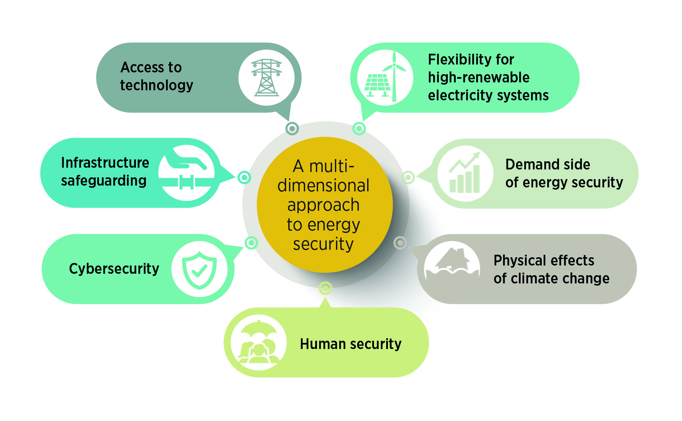
A multi-dimensional approach to energy security

Slide 22
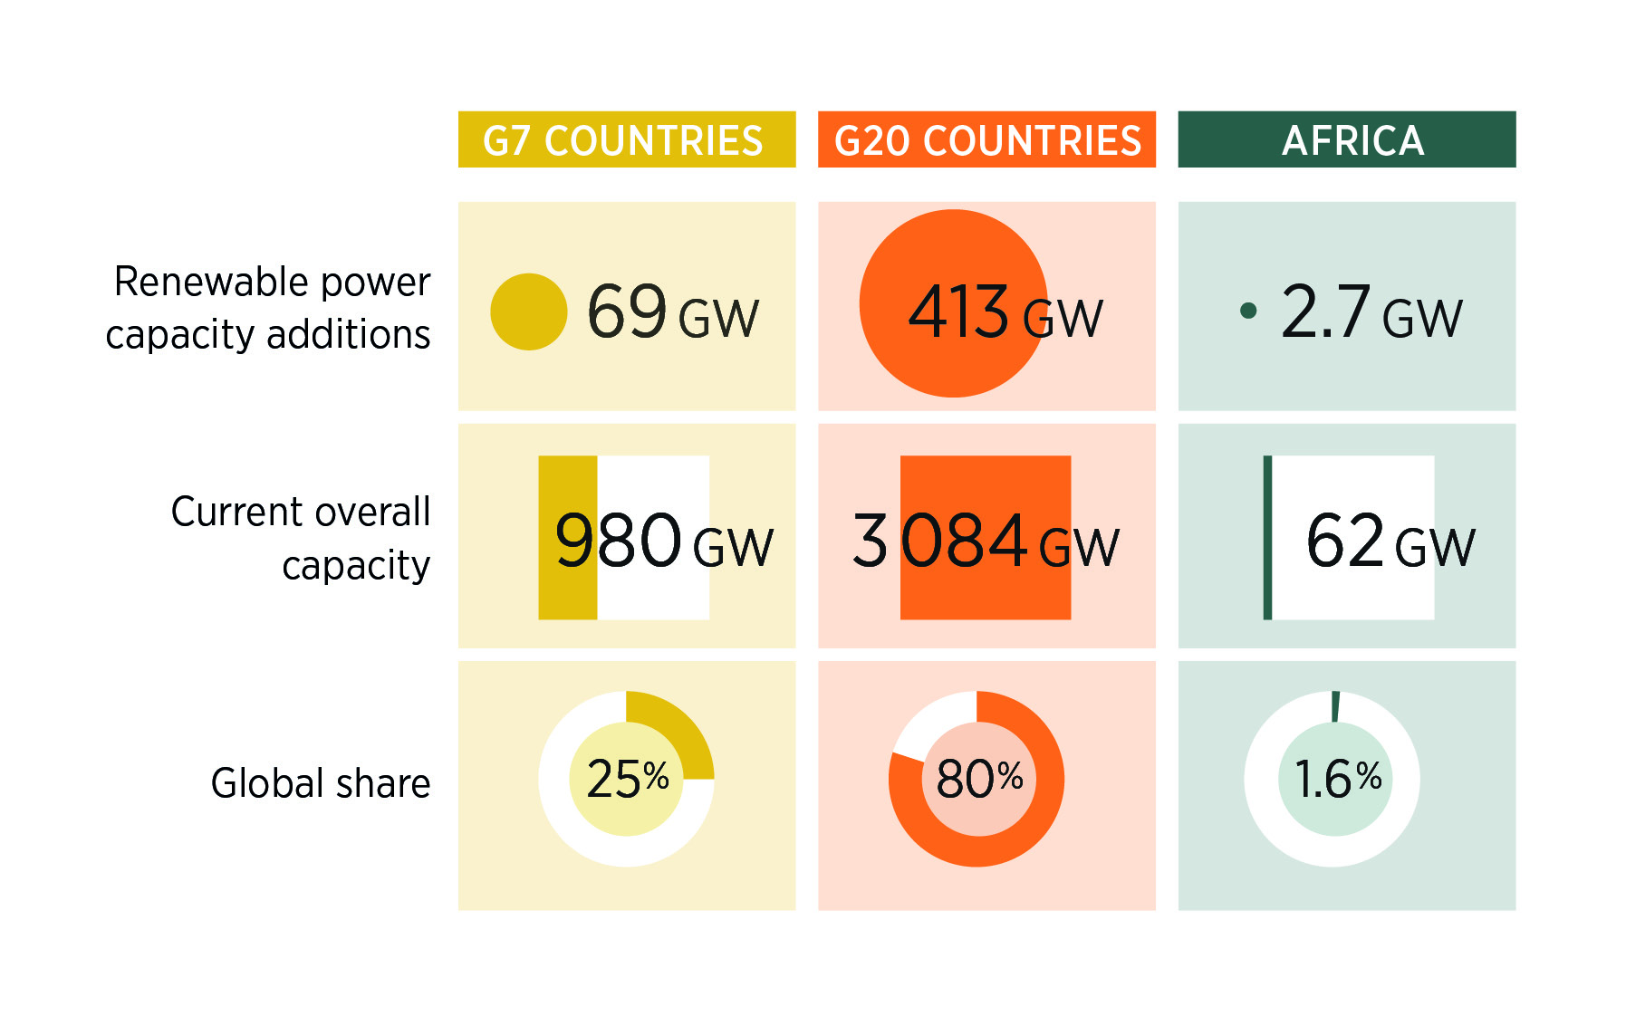
Disparities in growth of renewable capacity, by selected country groups, 2023
Source: (IRENA, 2024e).

Slide 23
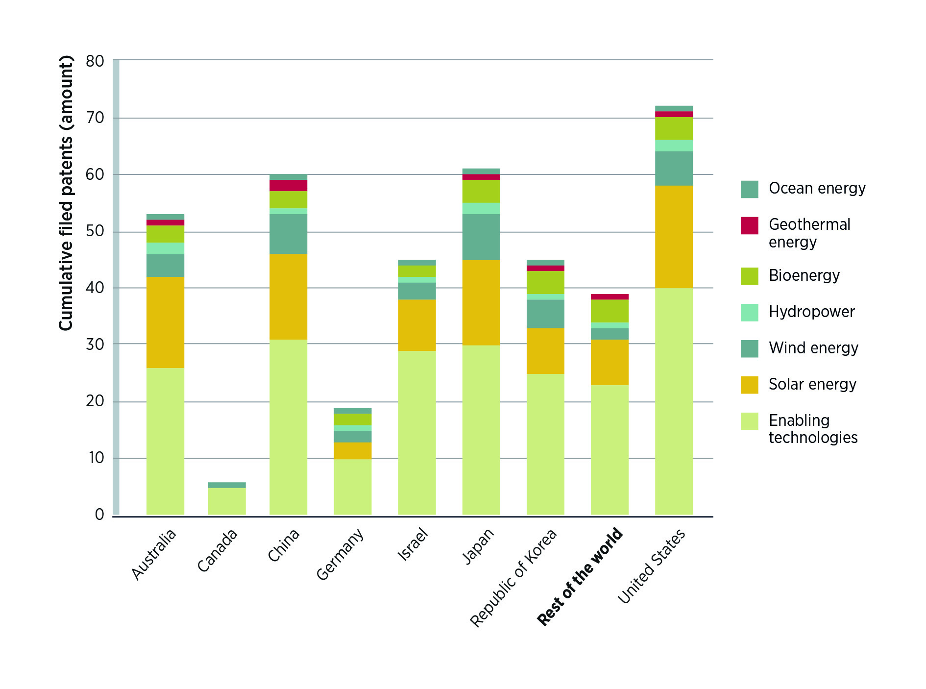
Top countries filing patents, by technology, 2023
Source: (IRENA, 2024f).

Slide 24
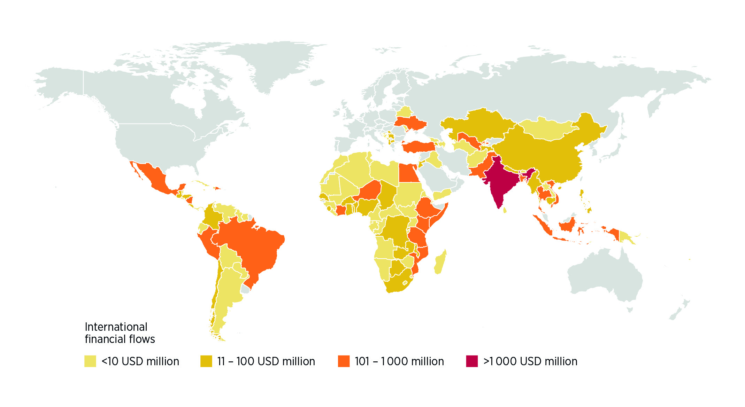
International financial flows to developing countries
In support of clean and renewable energy (USD million, 2020 PPP), 2021
Source: (IEA, IRENA et al., 2023).
Disclaimer: This map is provided for illustration purposes only. Boundaries and names shown on this map do not imply any endorsement or acceptance by IRENA.

Slide 25
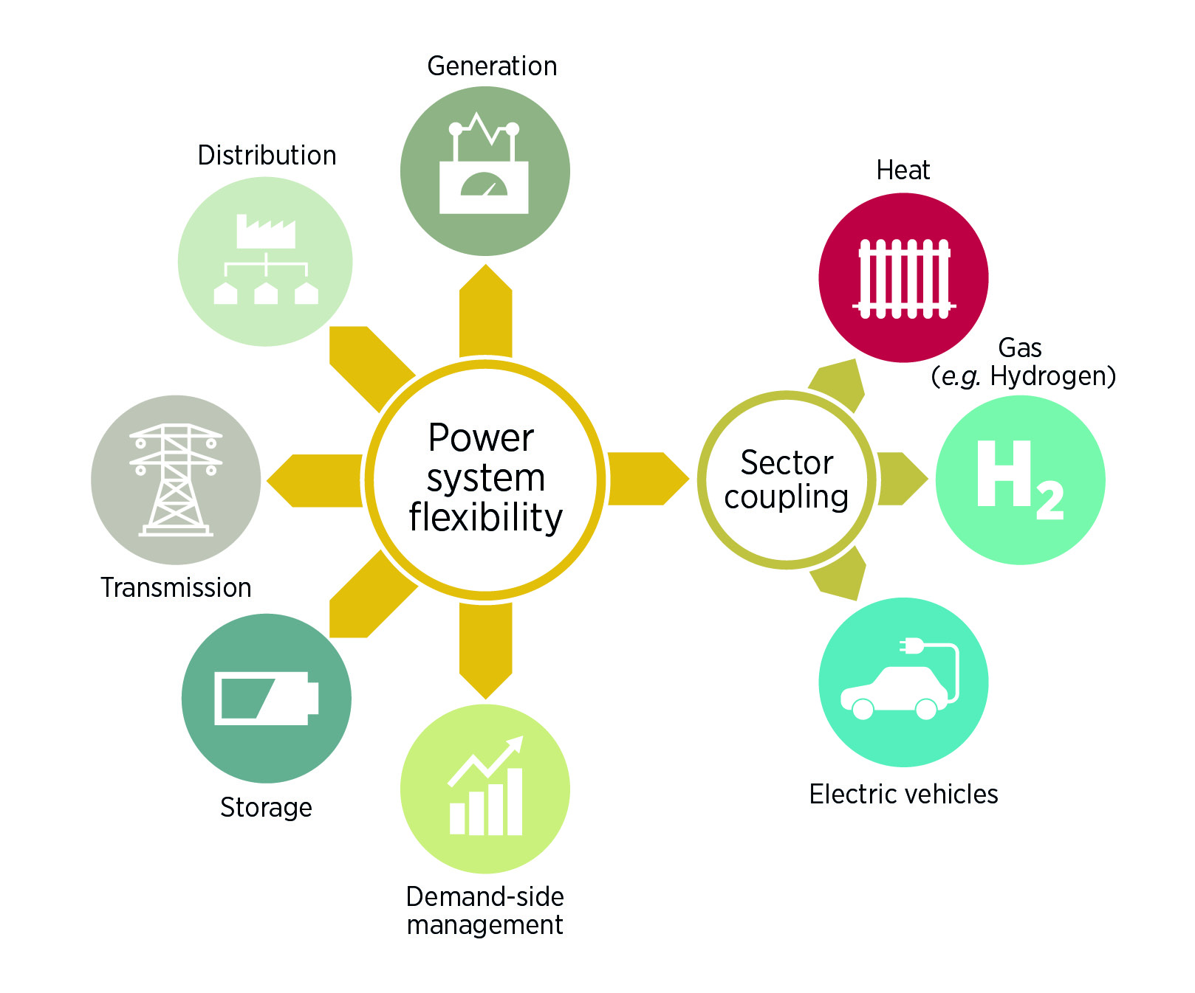
Enablers of power system flexibility in the energy sector
Source: (IRENA, 2018a).

Slide 26
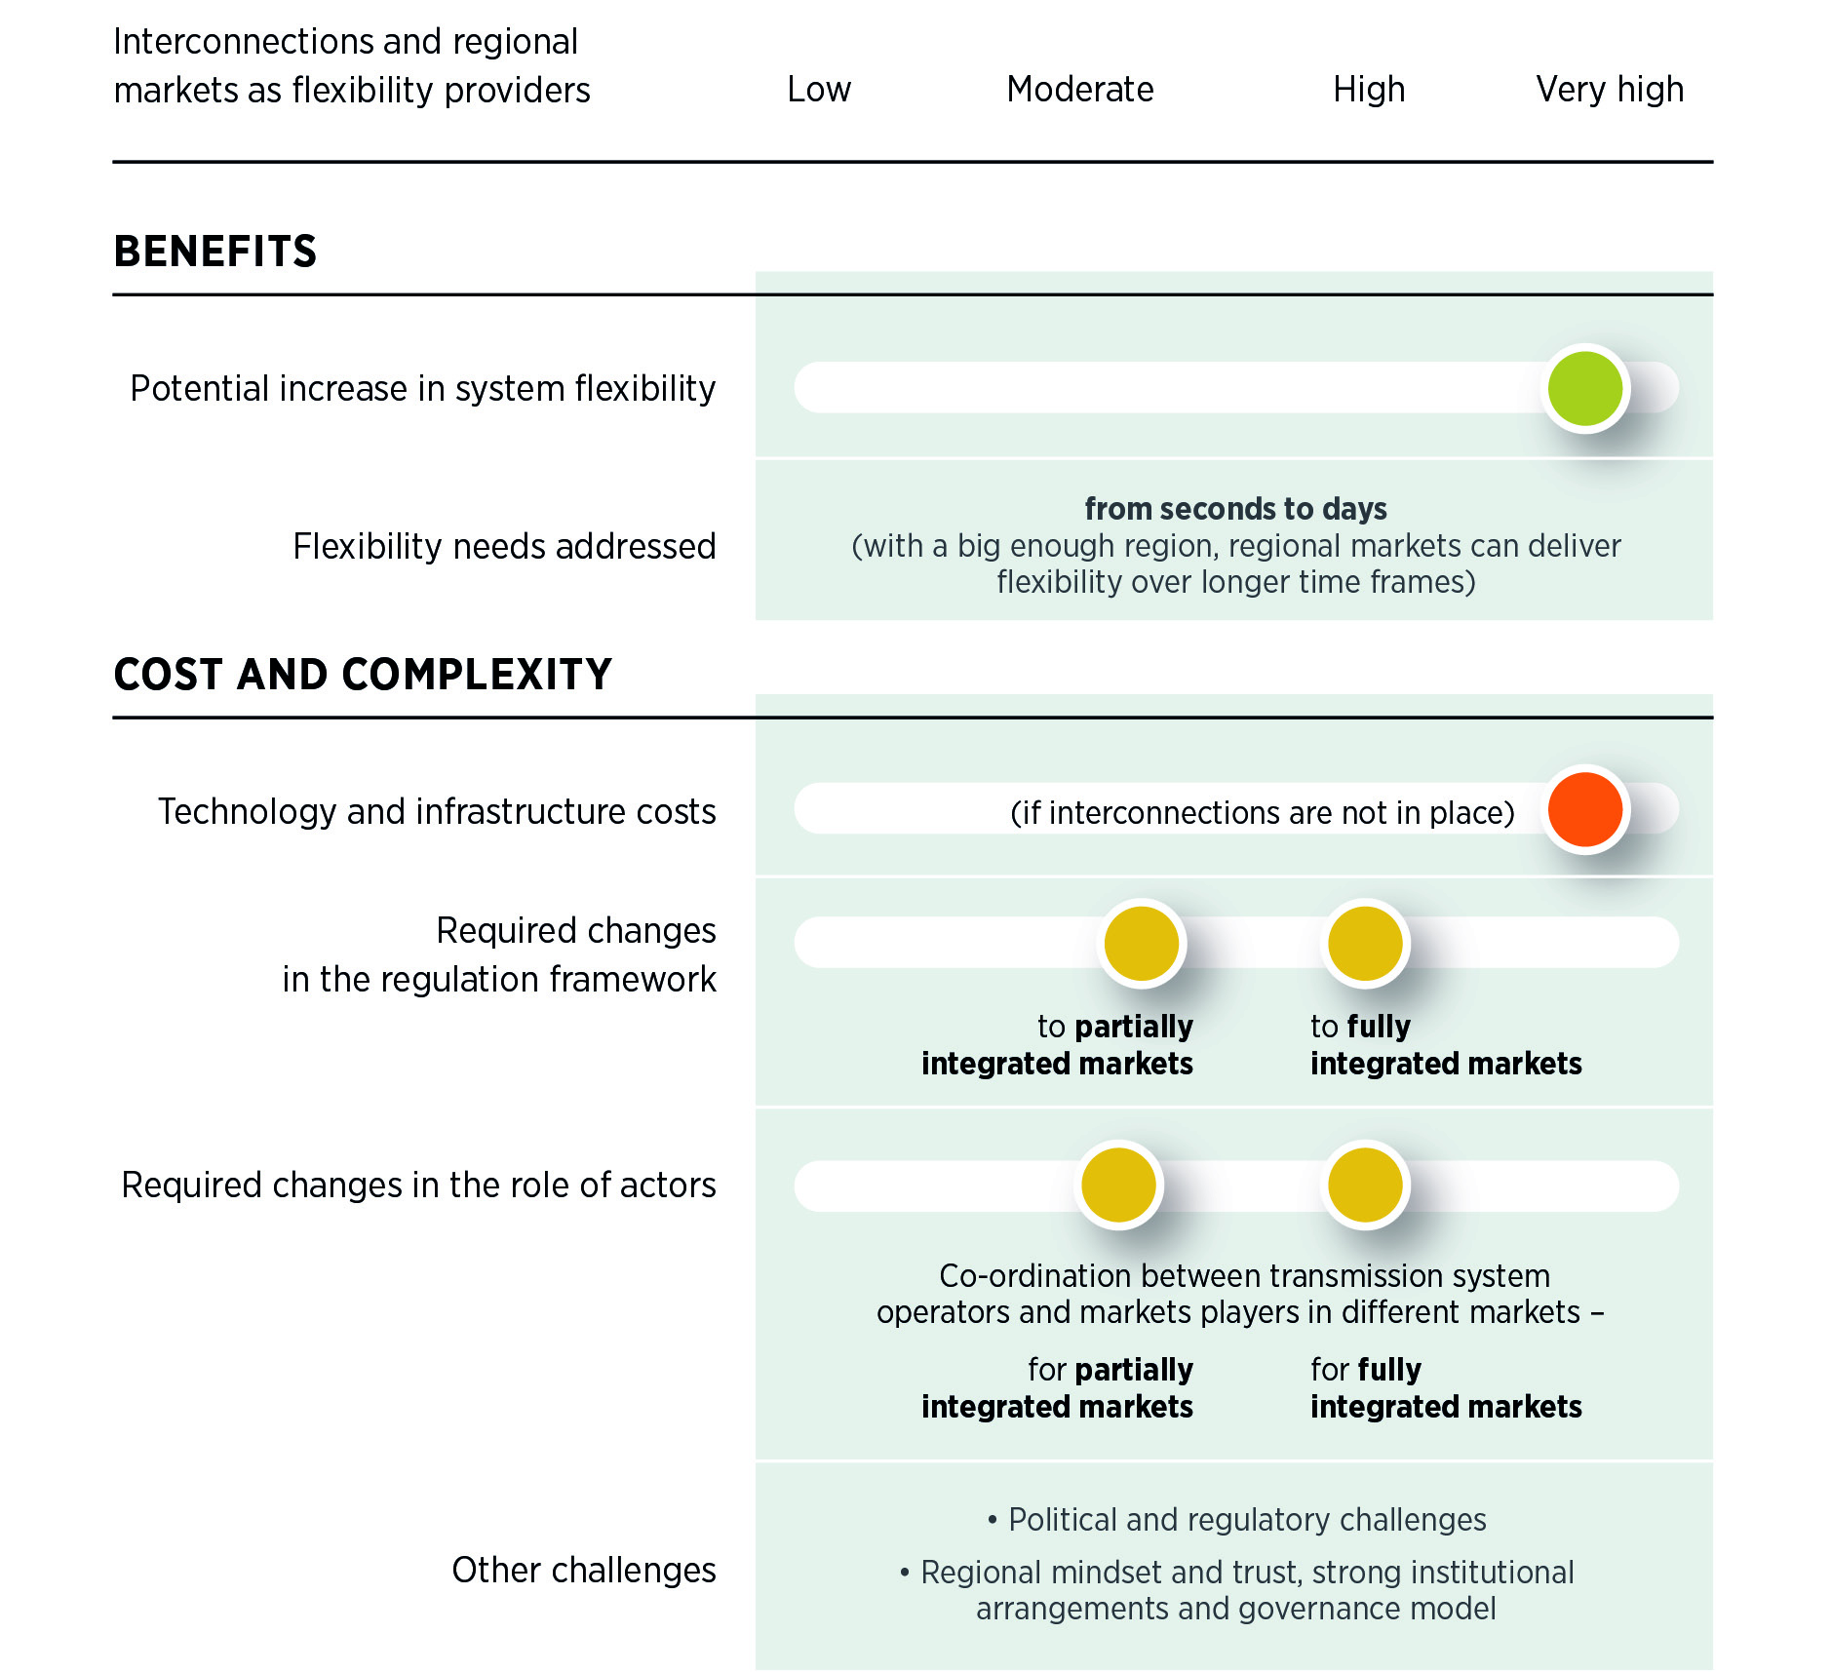
Benefits and costs of interconnections and regional markets as flexibility providers
Source: (IRENA, 2019).

Slide 27
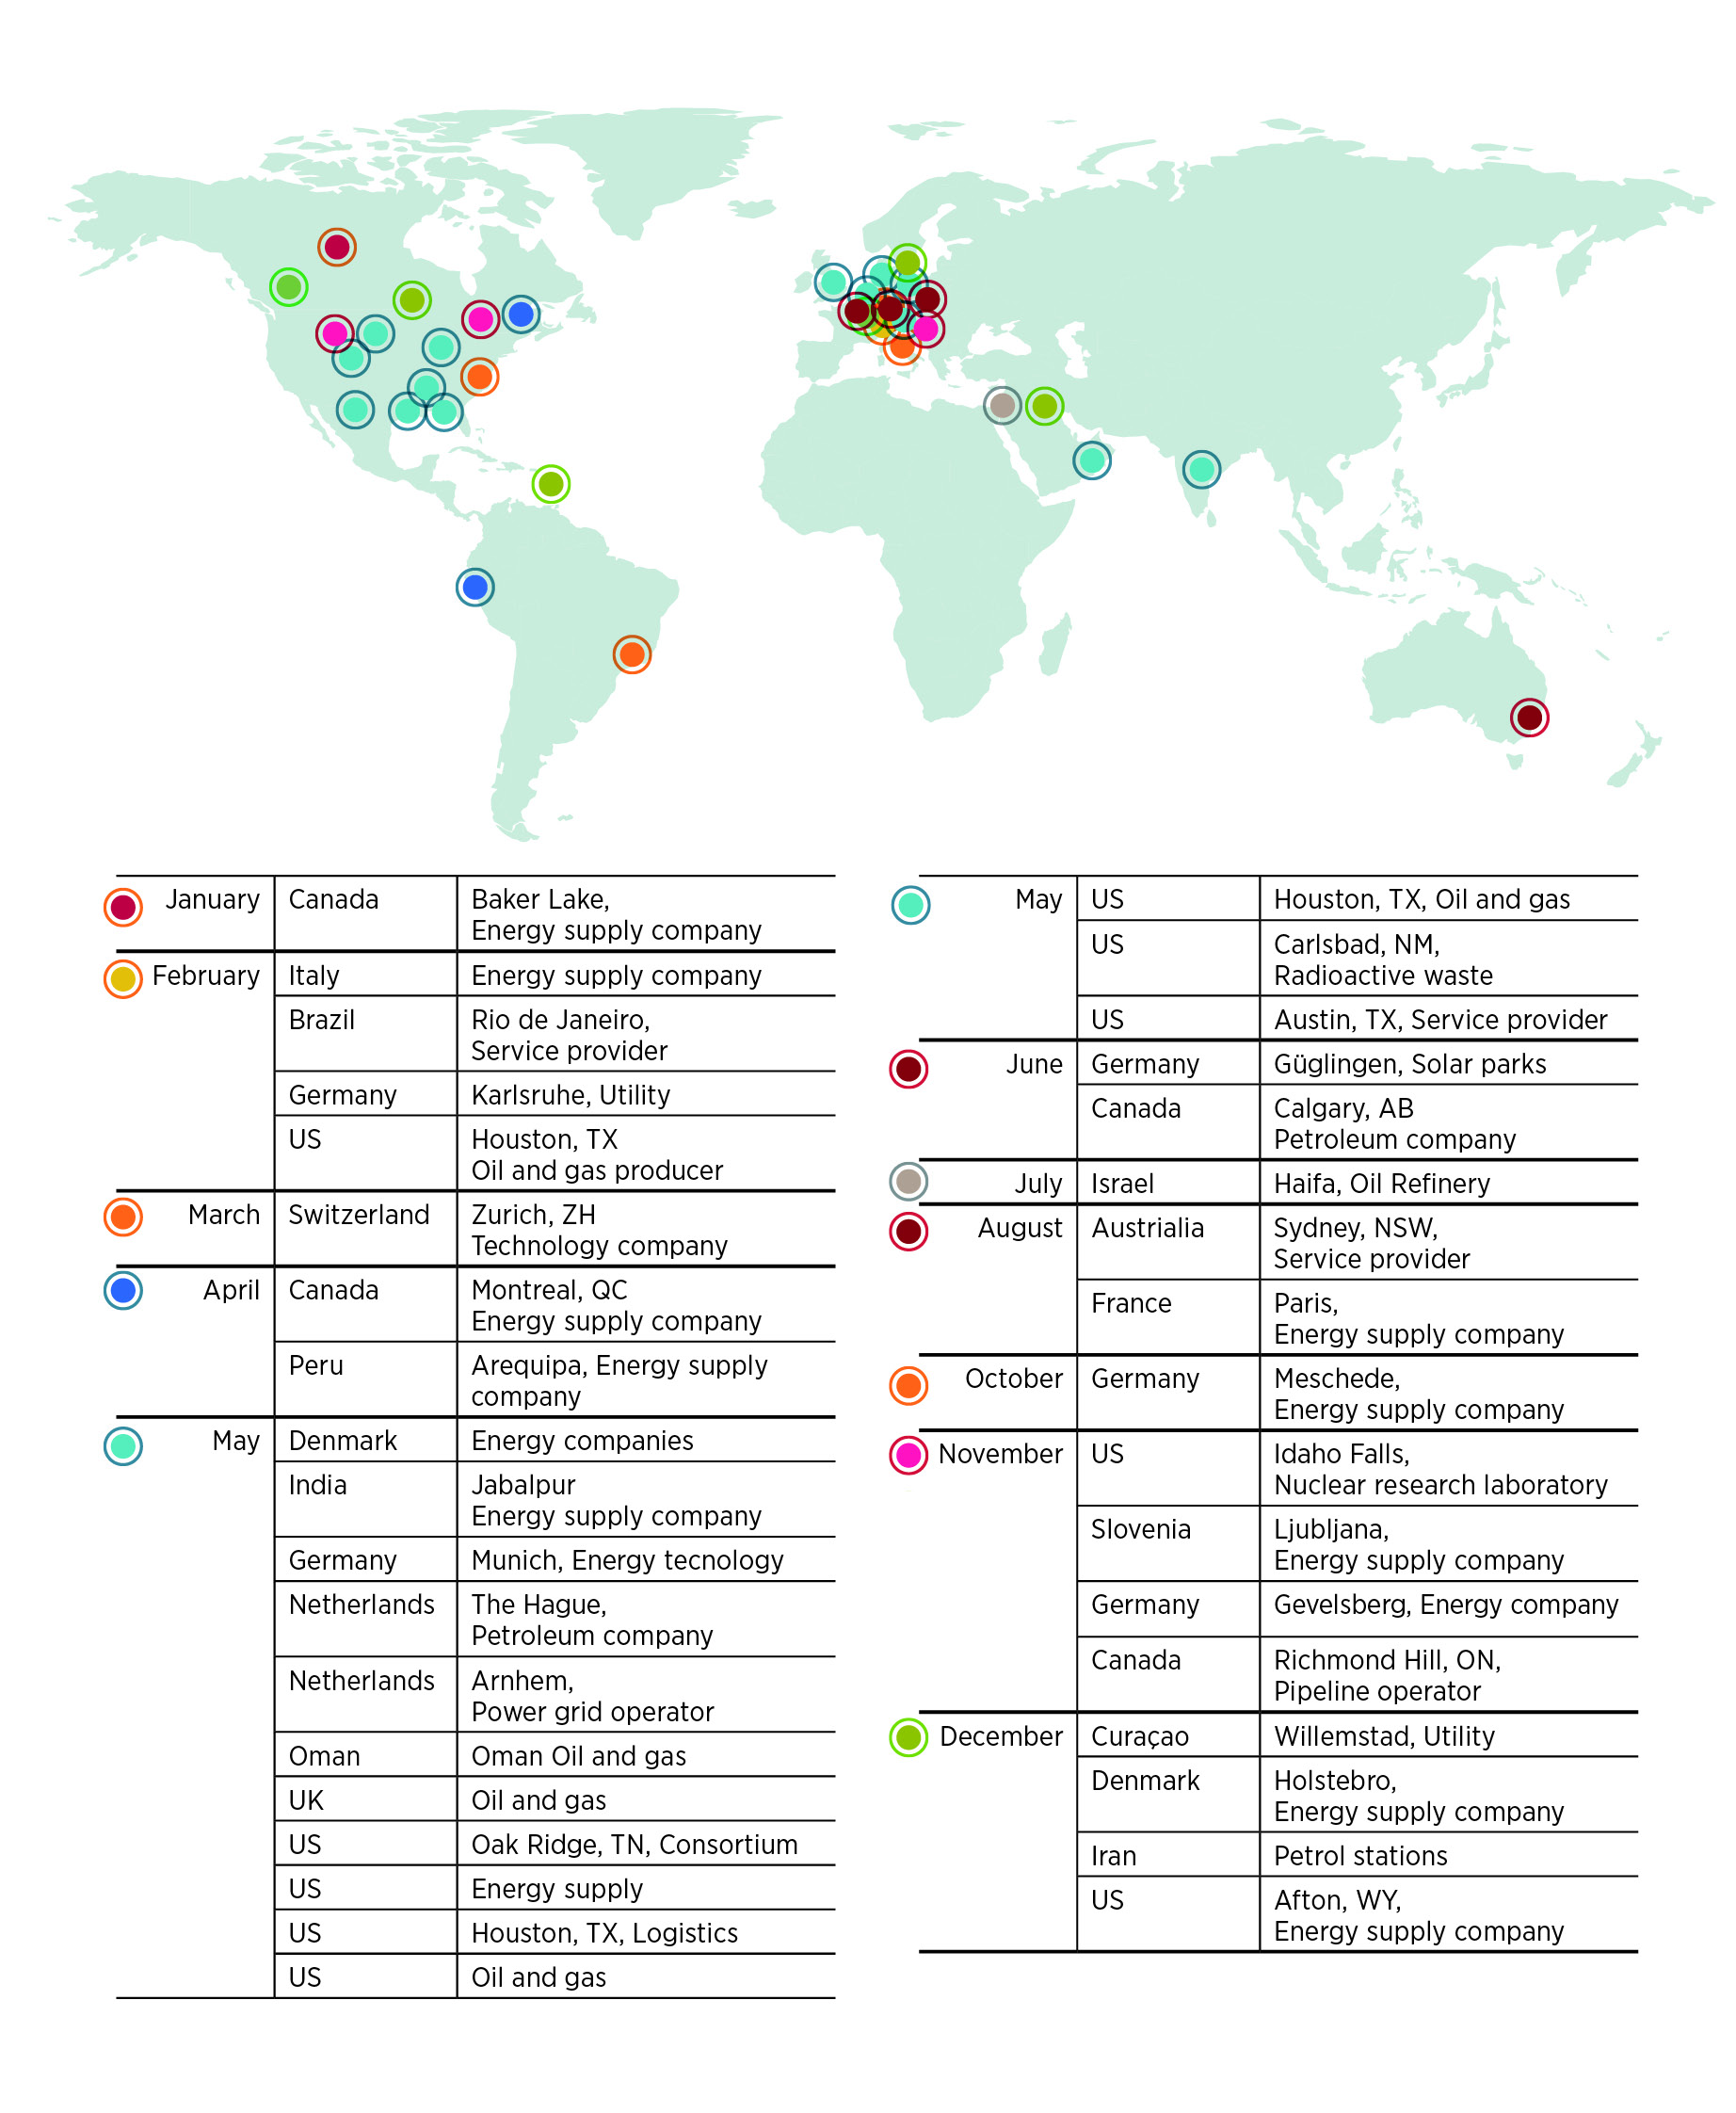
Major cyber attacks on the energy industry, 2023
Source: (KonBriefing, 2023).
Notes: UK = United Kingdom; US = United States.
Disclaimer: This map is provided for illustration purposes only. Boundaries and names shown on this map do not imply any endorsement or acceptance by IRENA

Slide 28
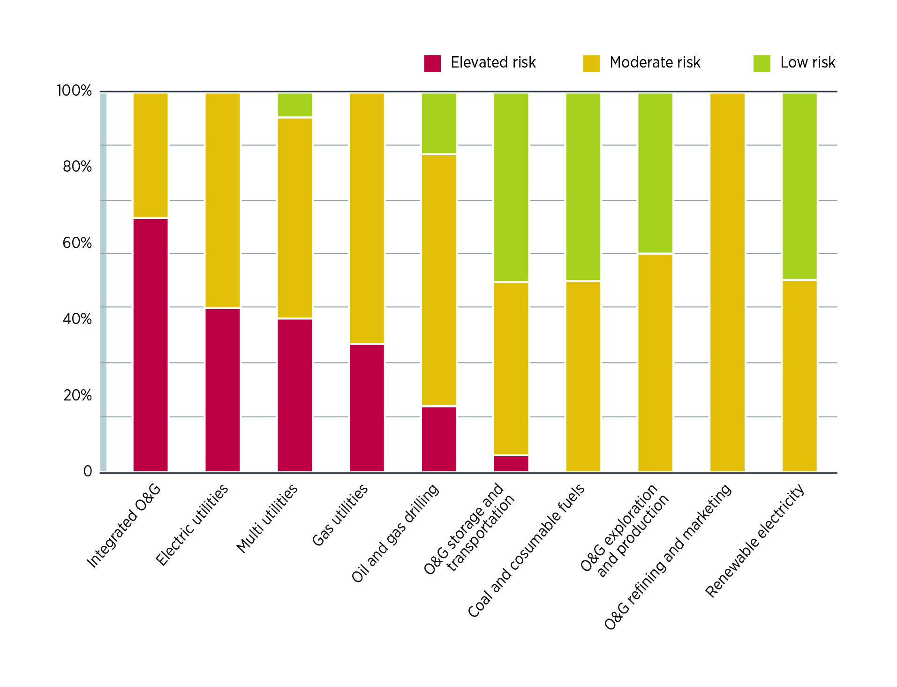
Energy sector companies at risk of successful cyberattacks (% of companies), by industry, May 2023
Source: (ISS, 2023).

Slide 29
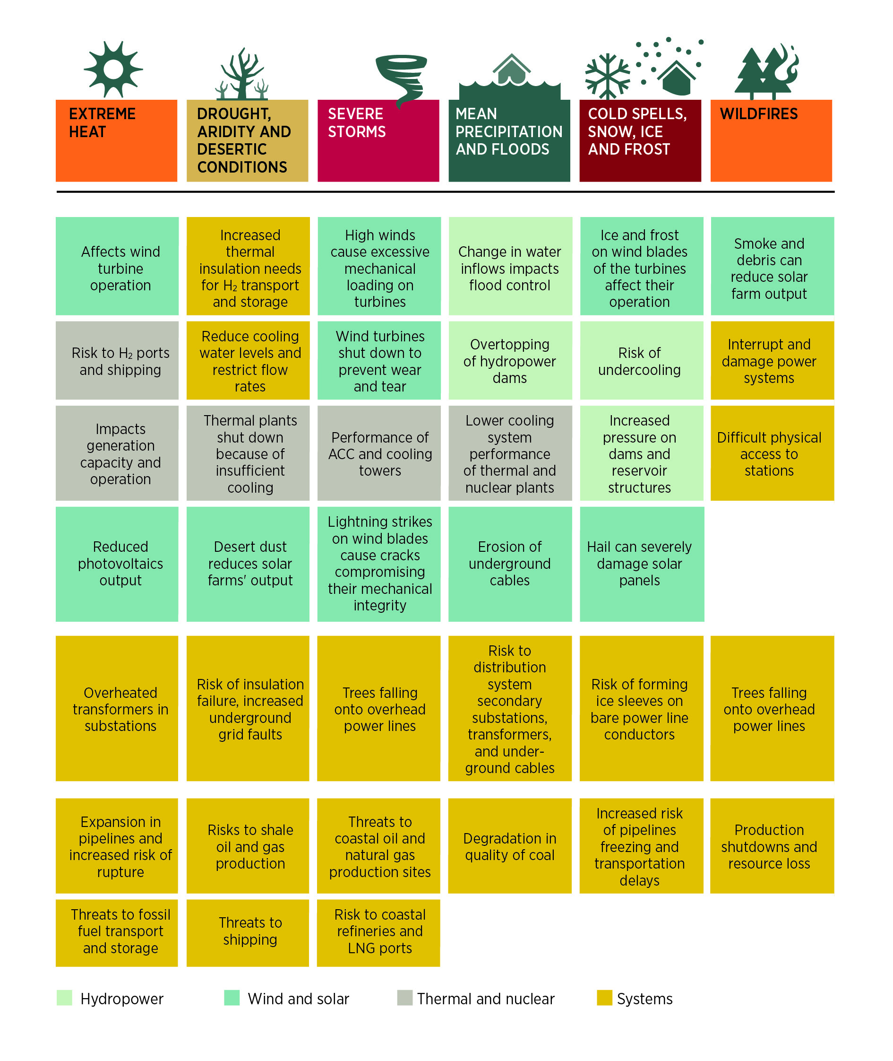
Exposure of electricity generation assets, network and supply chains to climate related risks
Source: (Eurelectric, 2022; IEA, 2022a).

Slide 30
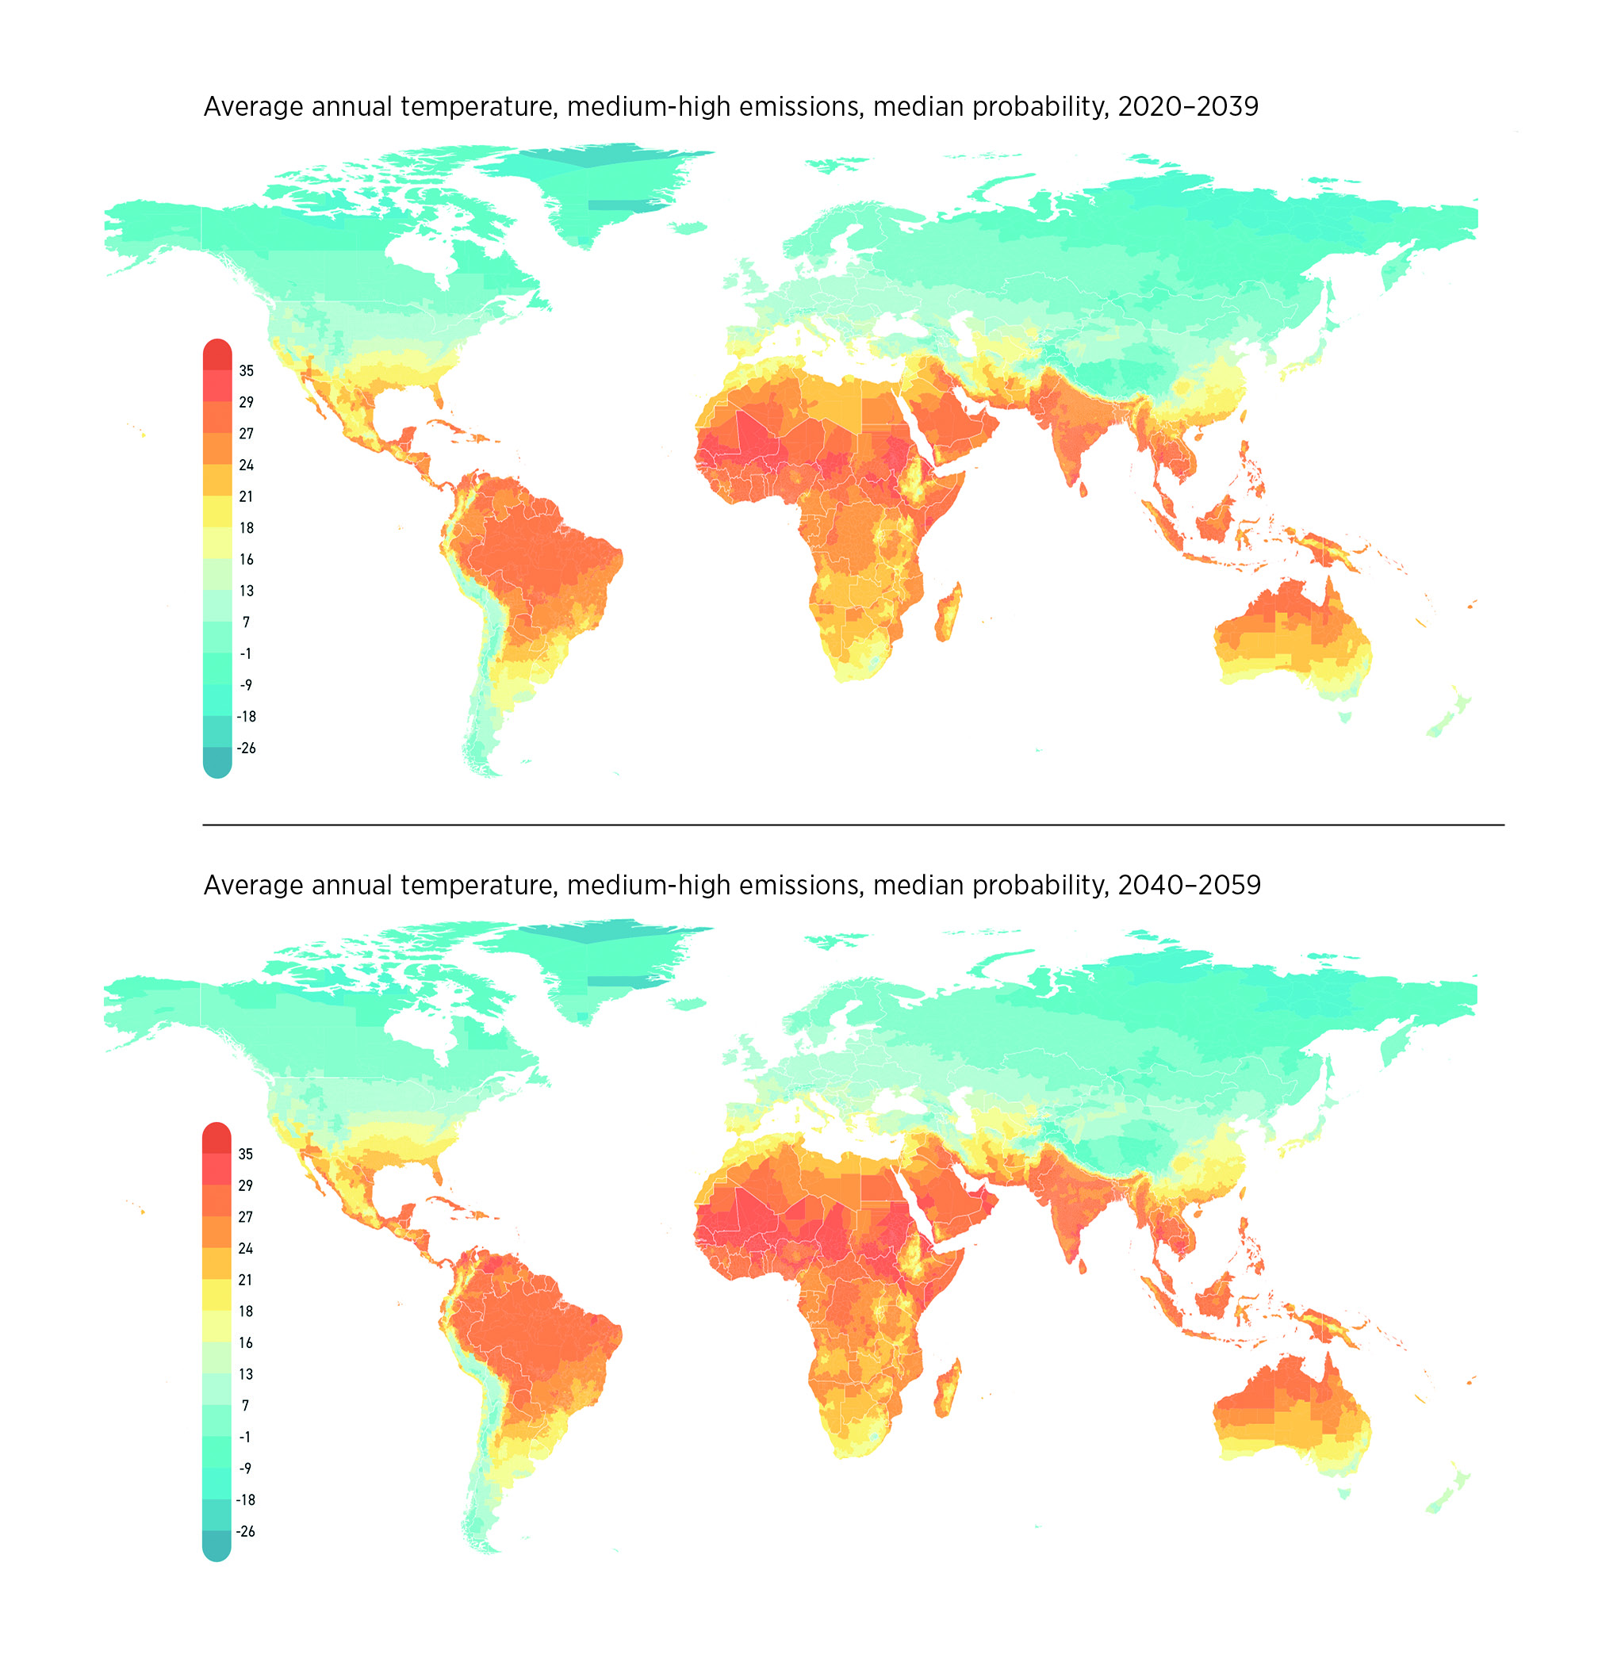
Climate impact map
Source: (Climate Impact Lab, 2023).
Notes: Climate Projections on Impact Map are based on the World Climate Research Programme’s Sixth Coupled Model Intercomparison Project, known as CMIP6. Damage (cost) Projections are based on the previous round of scenarios, CMIP5.
Disclaimer: This map is provided for illustration purposes only. Boundaries and names shown on this map do not imply any endorsement or acceptance by IRENA.

Slide 31
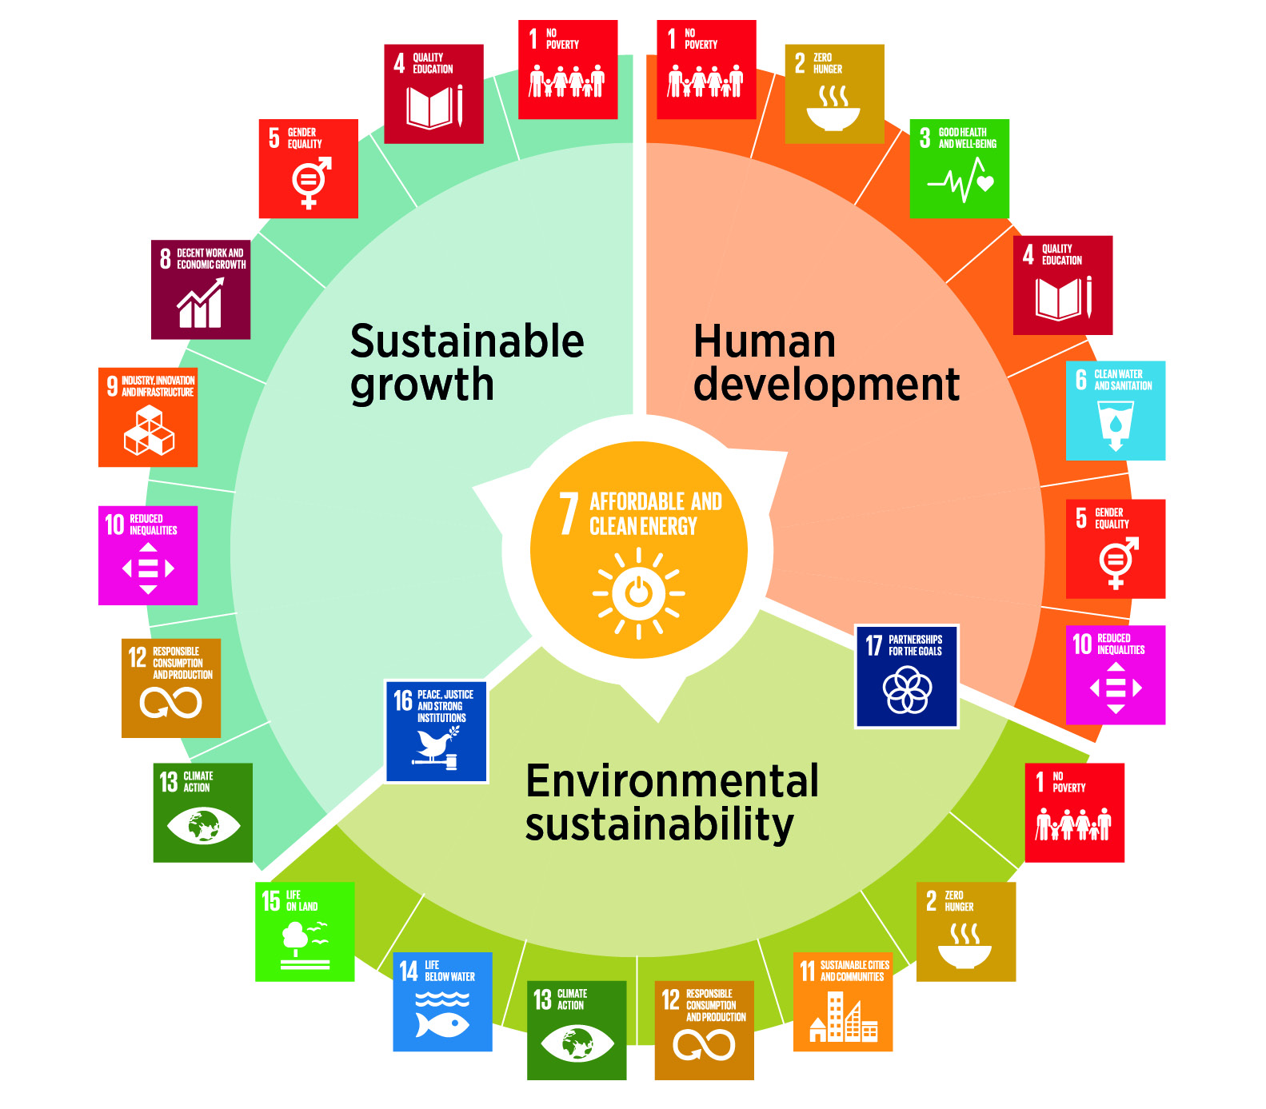
Energy and the Sustainable Development Goals
Source: (IRENA, 2017b).

Slide 32
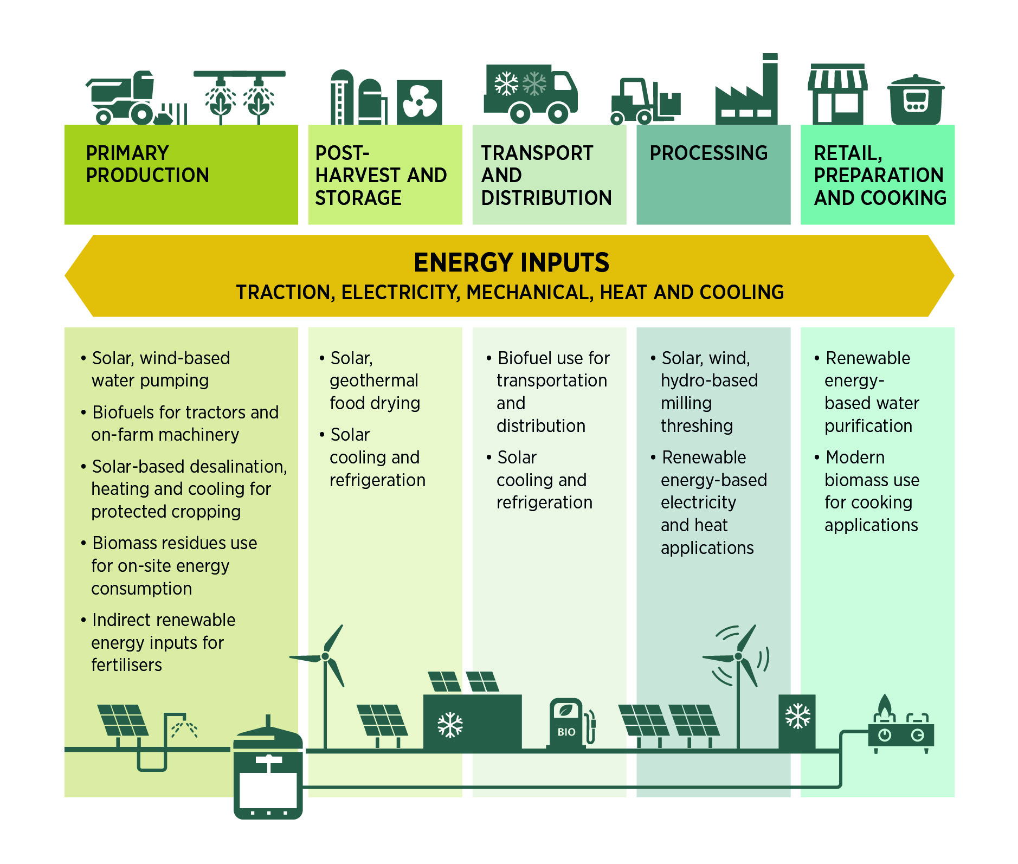
Entry points for renewable energy at different stages of the agri-food chain
Source: (IRENA, 2016).

Slide 33
For more, visit www.irena.org
Scan to get the report

