Slide 1
Enhancing Cooperation on Mitigation Action
Francesco La Camera
Director-General, IRENA
Ministerial on Climate Action
14 July 2023
Notes:
1

Slide 2
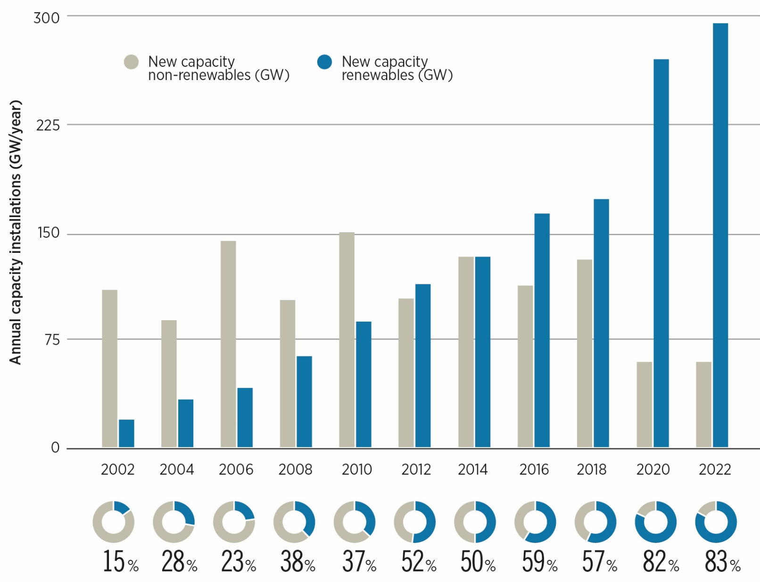
Record 295GW in renewables power capacity additions in 2022
A CONTRIBUTION TO THE COP 28 GLOBAL STOCKTAKE
2

Slide 3
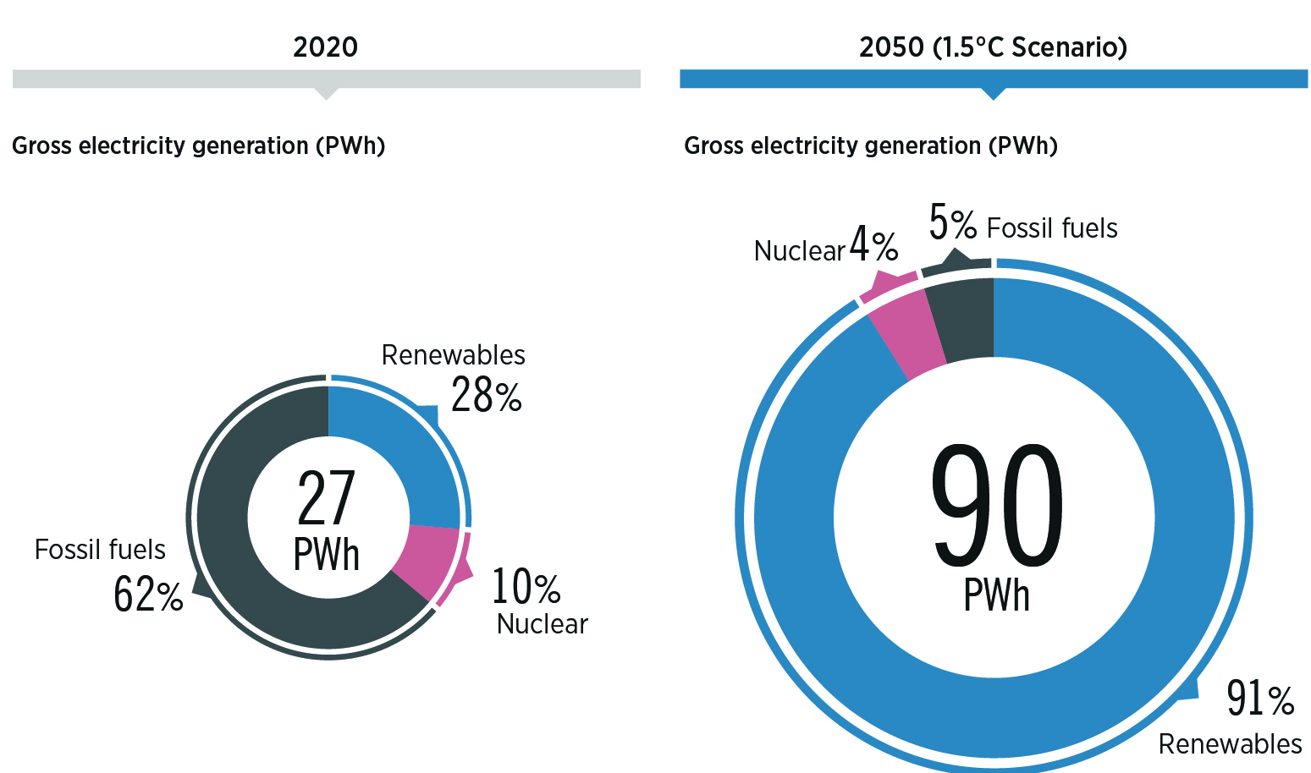

Power generation needs annual deployment of 1000GW
3

Slide 4
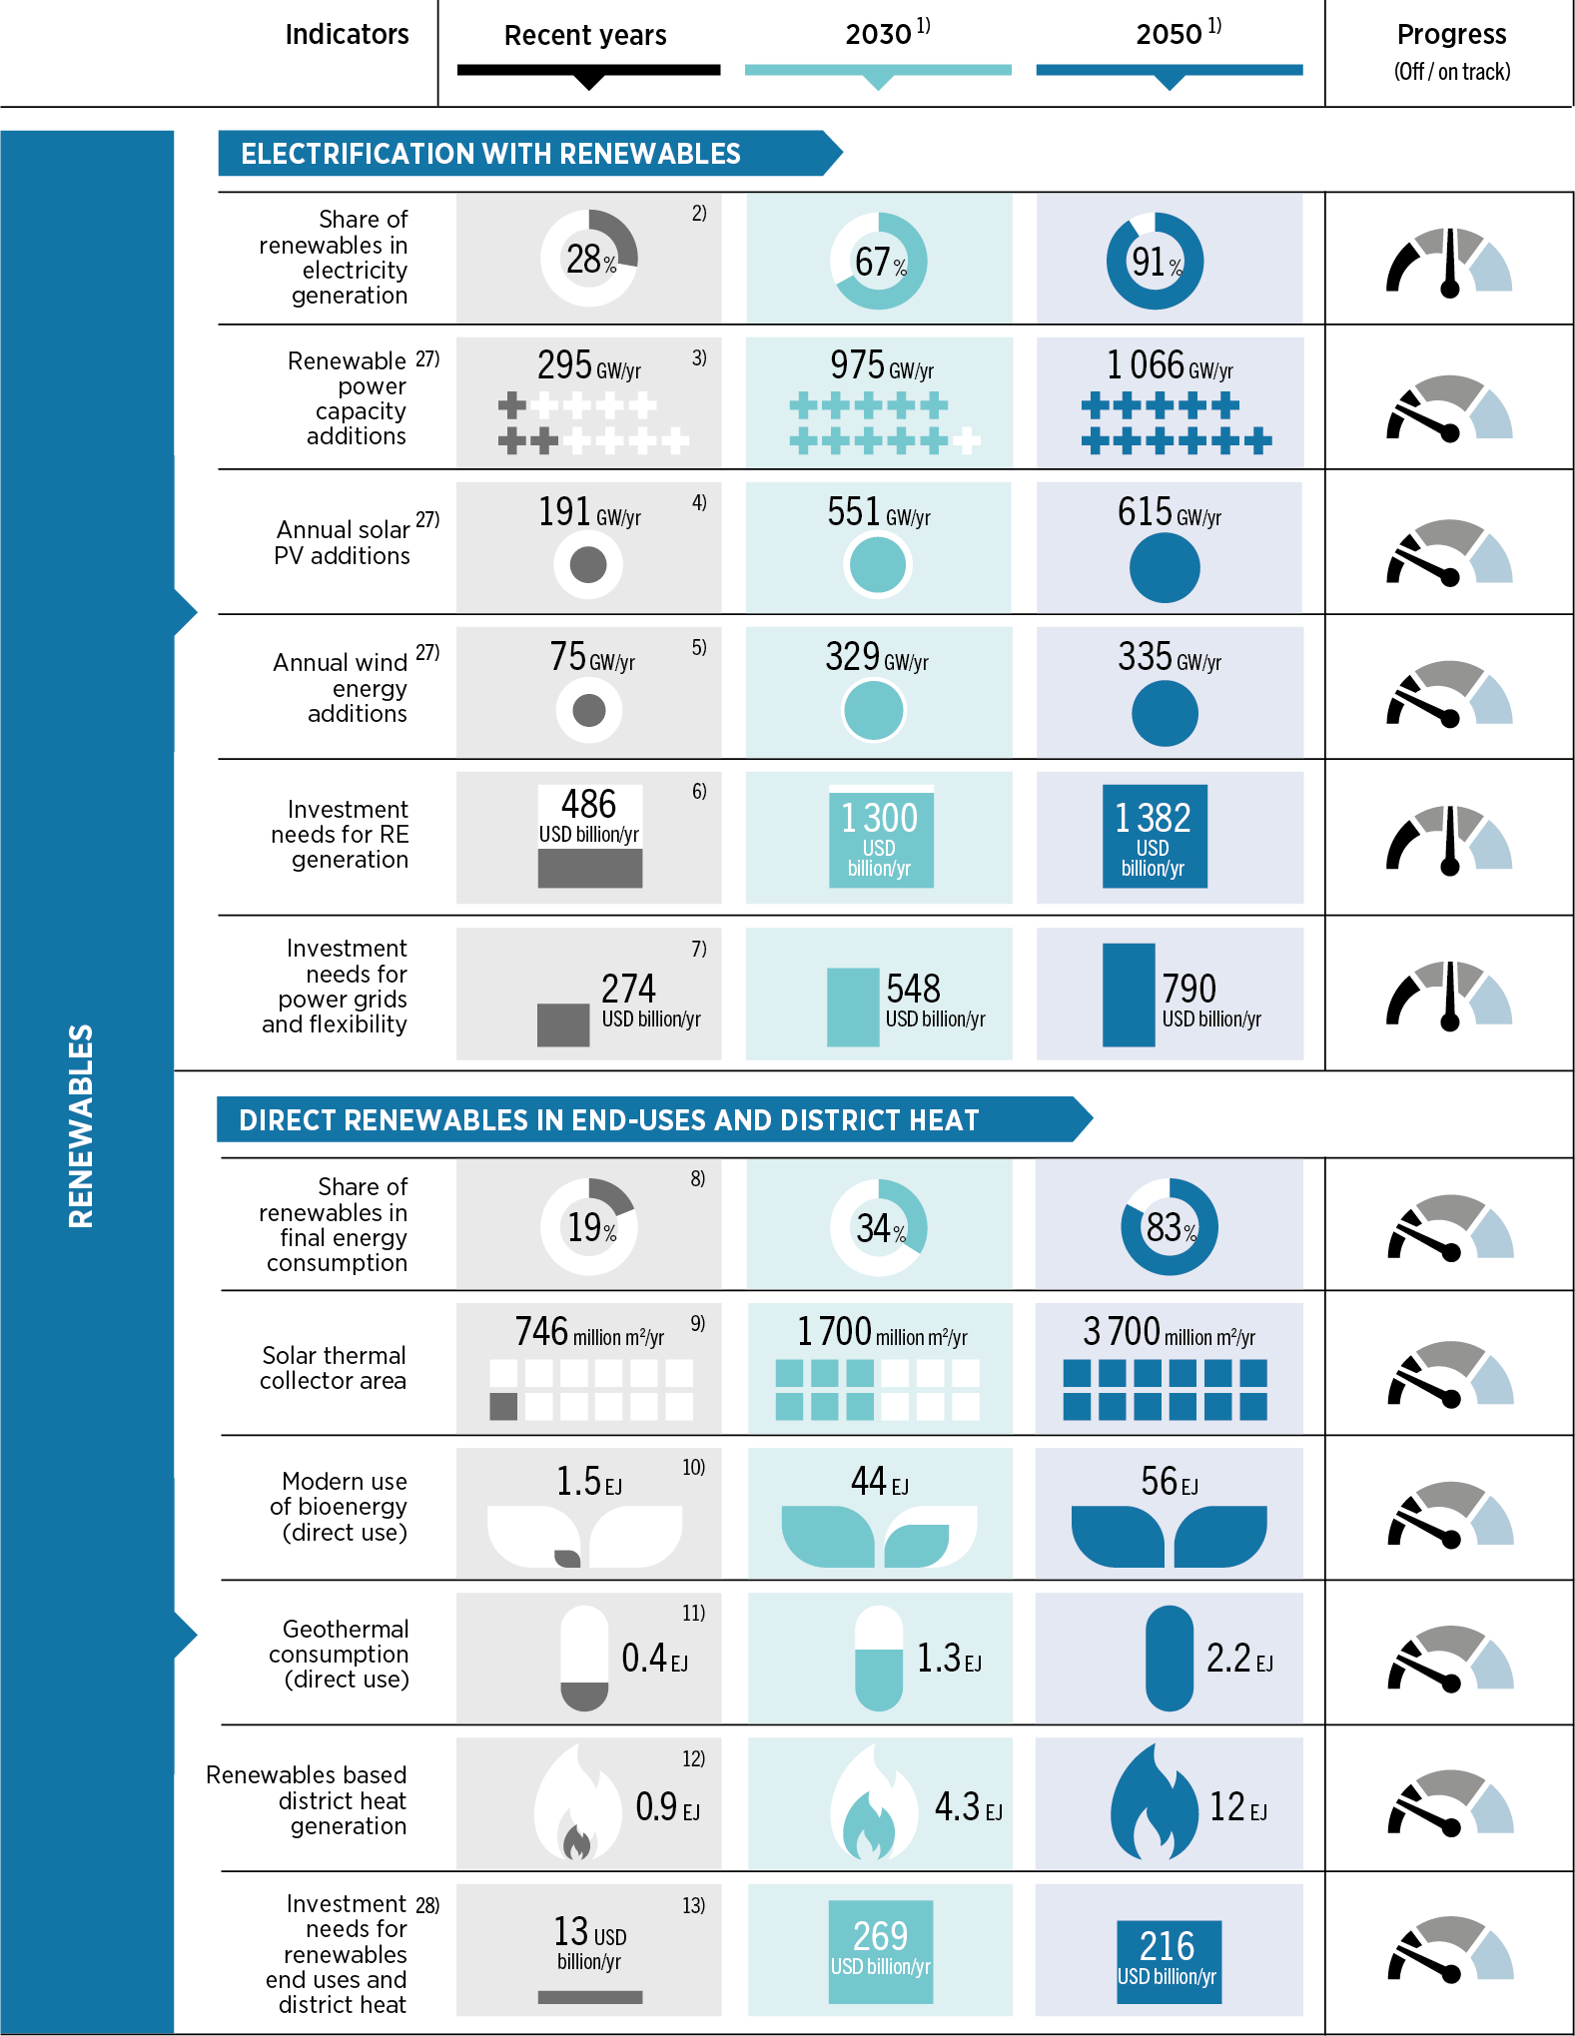
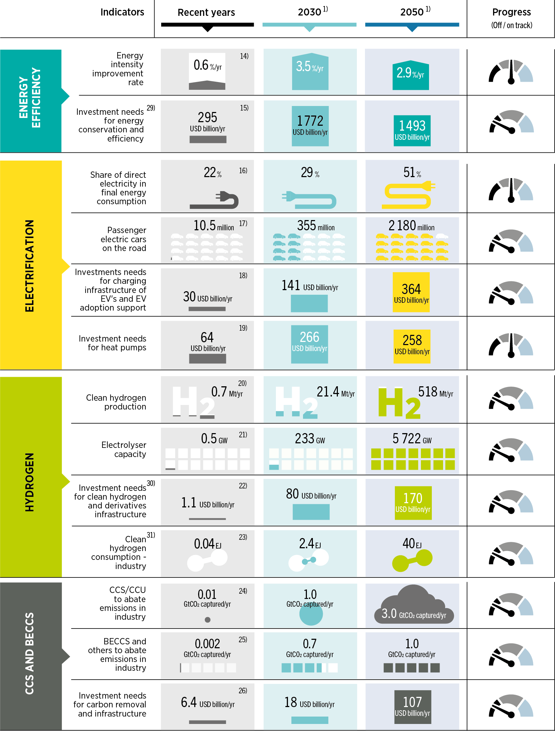
The energy transition is not on track to 1.5°C
4

Slide 5
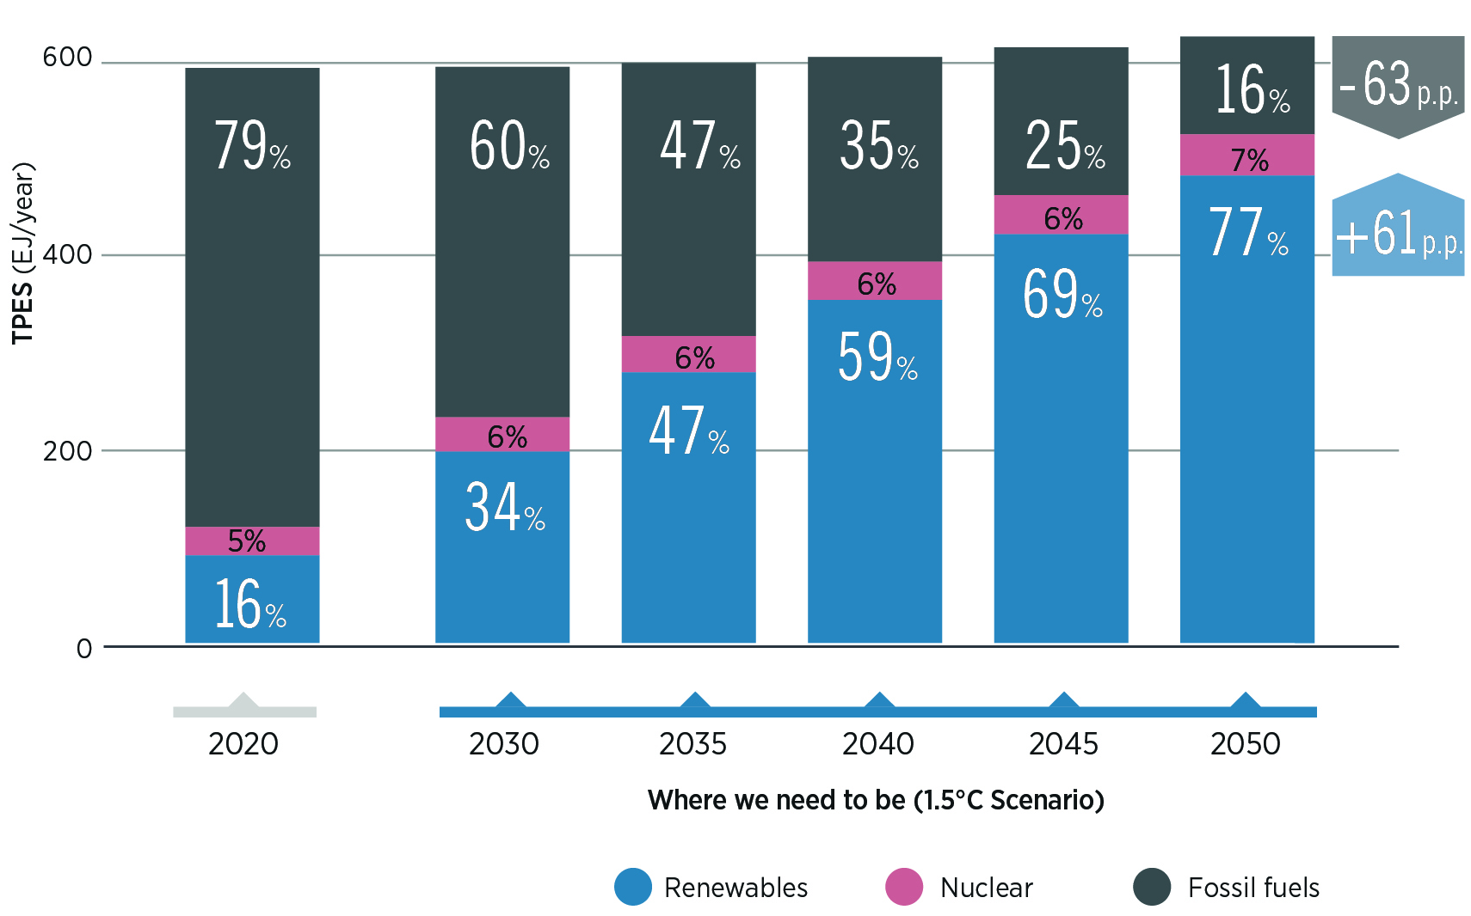
Renewables dominate total primary energy supply in 2050
5

Slide 6
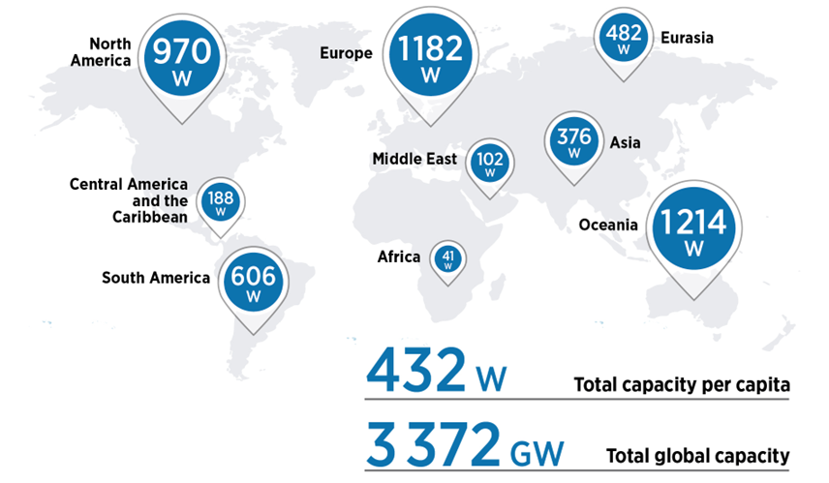
Growing inequality in investment and deployment
6

Slide 7
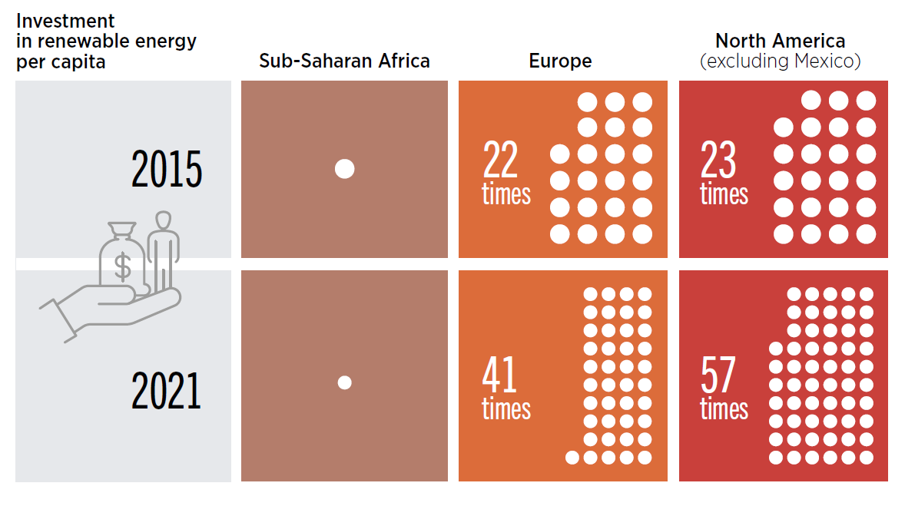
Growing inequality in investment and deployment
More than half of the world’s population receives only 15% of investments
Disparities in per capita investments have more than doubled in 2015 - 2021
7

Slide 8
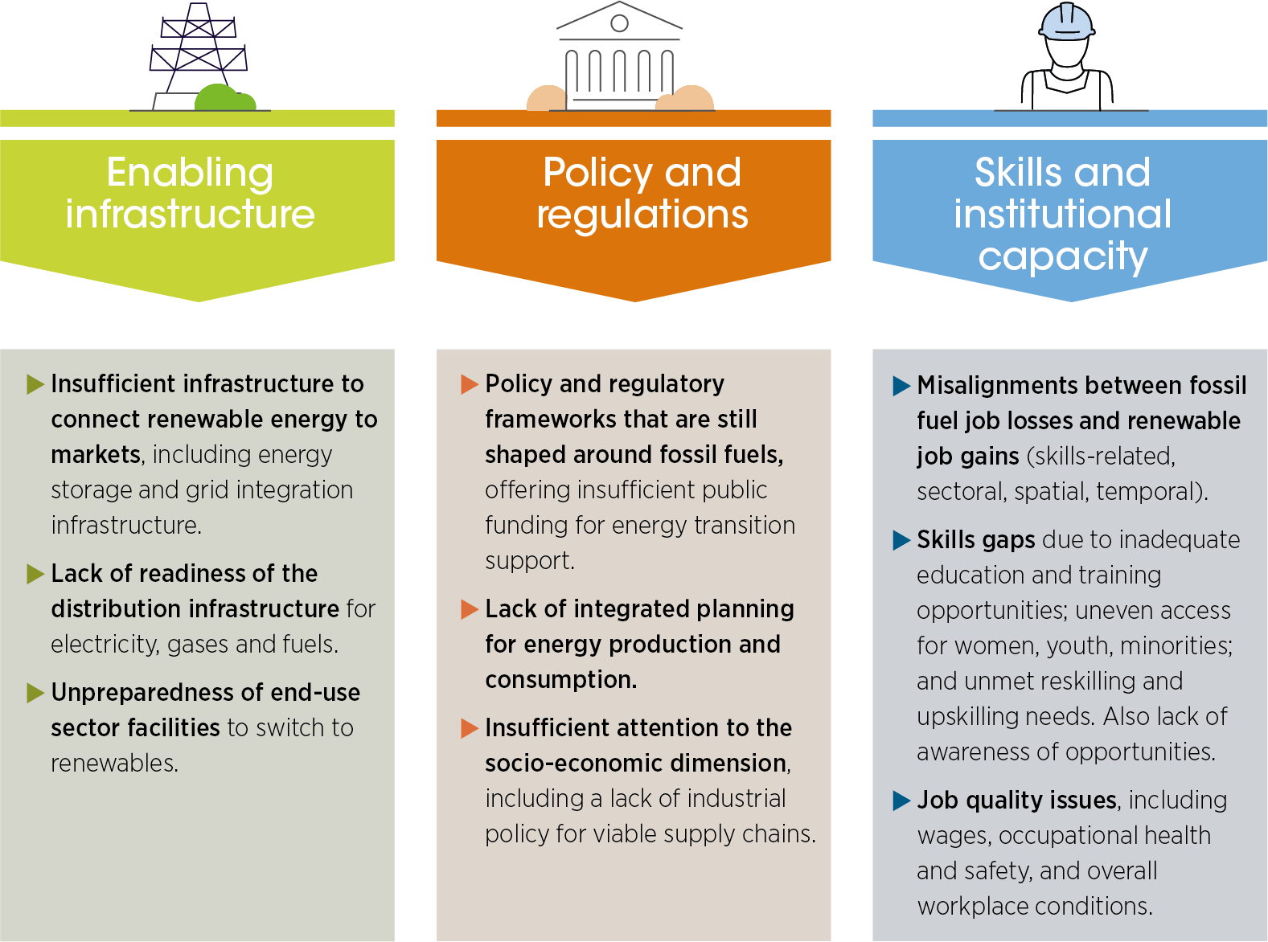

Overcoming barriers
8

Slide 9
Thank you!
www.irena.org

