Slide 1
WEBINAR
Introduction to Energy Data
Presenters:
Nicolas Coent, Statistics | Gondia Sokhna Seck, Policy Advice| Samah Elsayed, RE Education
Thursday, 19th May 2022• 16:00 – 18:00 Abu Dhabi

Slide 2
SPEAKERS
Gondia Sokhna Seck
Programme Officer, Policy Advice
Nicolas Coent
Associate Professional, Statistics
Samah Elsayed
Programme Officer,
RE Education

Slide 3
Why collect energy statistics?
Basic definitions
Measurements and estimations
How is energy data presented?
Reading energy balances
Data published by IRENA
Conclusions
AGENDA
Introduction to energy data
Notes:
Basic definitions (capacity, generation, TPES, TFEC etc., units)
Estimation (converting from capacity to generation)
Commodity vs Energy balance
How to read an energy balance and how this can apply to real world challenges
Renewable energy targets – why are they needed? Data needs
Overview of the data published by IRENA and how to access it for their studies
Panel Discussion
Digital Break
Q&A

Slide 4
Slido.com
#EnergyData

Slide 5
1
Why collect energy statistics ?
Notes:
Open ended question here- 30 seconds to answer

Slide 6
What are some of the uses of energy statistics?
ⓘ Start presenting to display the poll results on this slide.
Notes:
📣 This is Slido interaction slide, please don't delete it. ✅ Click on 'Present with Slido' and the poll will launch automatically when you get to this slide.

Slide 7
Main uses of energy statistics
Economic planning and development
Socio-economic development
Environmental impacts
Policy development and monitoring
National targets: SDGs, NDCs and other targets
Notes:
There are many possible uses of energy statistics as many of you have answered. Such as ……
In general , accurate, complete and timely energy data is required to support countries in decision making, refining and supporting national policies and plans and providing solutions to energy related problems.

Slide 8
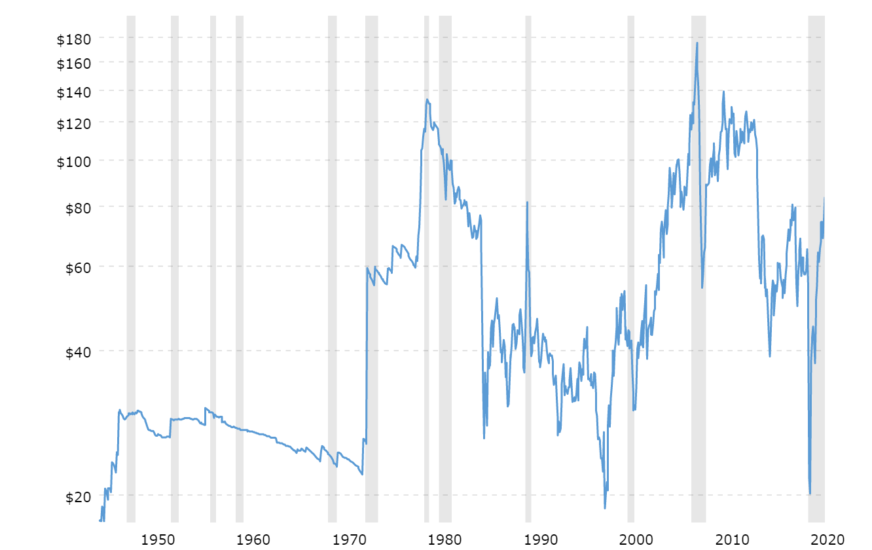
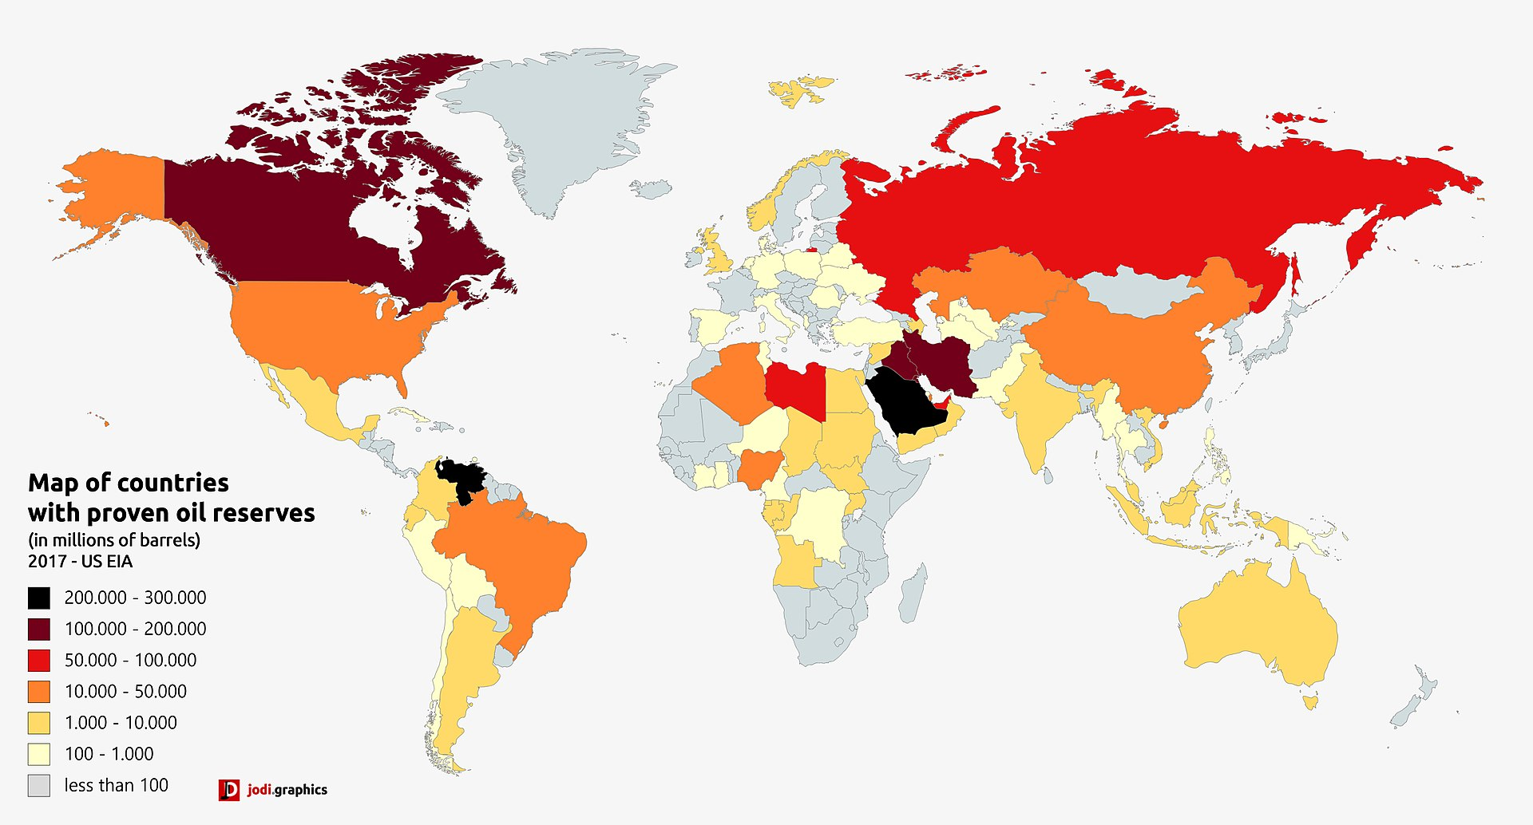
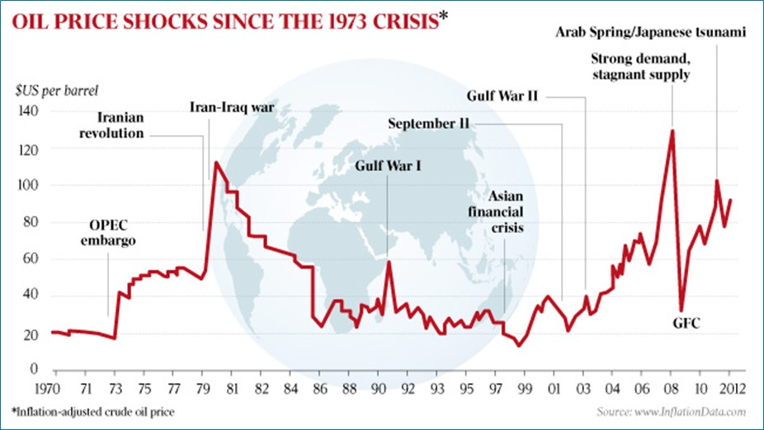
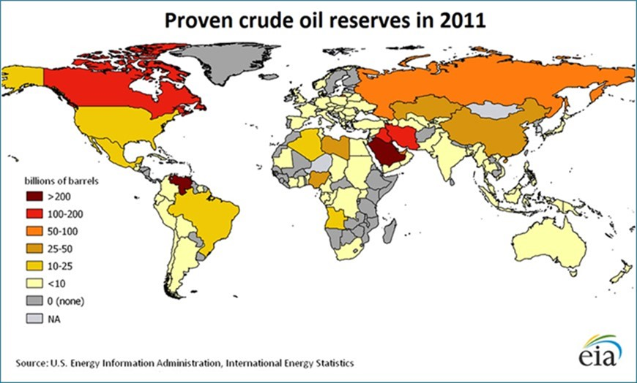
Economic planning and development
Short-term planning
Long-term planning
Inflation adjusted crude oil price ($US per barrel)
Strong demand, stagnant supply
Iran-Iraq war
Gulf War I
Gulf War II
GFC
Iranian revolution
Black Monday
September 11
OPEC embargo
Asian Financial crisis
COVID 19
Source: macrotrends.net
Source: Energy Information Administration
Interest in energy statistics has often been driven by market developments
Notes:
History of energy statistics: One of the strongest forces that has driven demands for improvement in energy statistics has been short-term market developments. For example, the UN Statistics Division has been collecting energy statistics since the 1950s, but the main event that raised awareness of the importance of energy statistics was the sudden and dramatic increase in oil prices in 1973. One year later, the International Energy Agency (IEA) was established for OECD countries and the Latin American Energy Organization (OLADE) was established for countries in the Latin America and Caribbean region. Both of these organisations recognized the importance of energy statistics and rapidly built strong programmes for energy data collection and capacity building in this area. With the rapid development of renewable energy in the last decades, IRENA was fully established in 2011, with a mandate to improve knowledge and disseminate information about the benefits and potential of renewable energy. This has included the collection and dissemination of renewable energy statistics since 2013.
Resource availability and use: Concerns about the long-term availability of resources also emerged in the early 1970s and now it is common to compare the consumption of commodities with estimates of their availability. This is particularly true for non-renewable resources such as fossil fuels, but potential ressources of Wind, Solar or Geothermal energy are also looked at.
Statistics about resource availability are also used for planning investments in the sector and projecting future trade patterns.

Slide 9
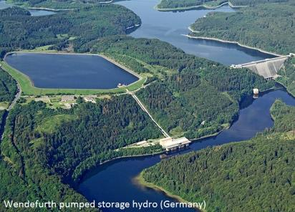
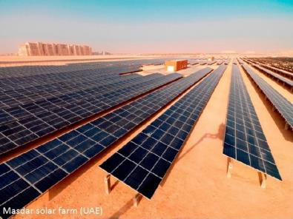
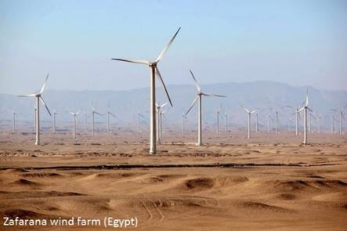
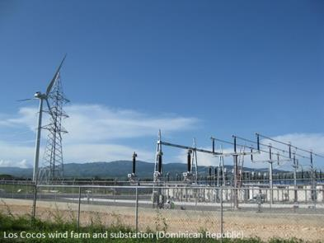
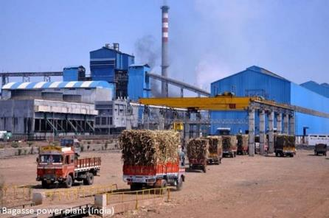
Energy security: short-term
Grid integration, especially variable resources
Notes:
Grid integration: Statistics about the development of renewable generating capacity are also important for managing the reliability of electricity generation in the short-term. Solar and wind energy are variable or intermittent energy resources, which means that the electricity generated from these sources can vary considerably during the day. The generation of electricity from grid-connected rooftop solar panels can also be unpredictable due to changes in the use of electricity within the buildings they serve.
Renewable energy sources have other characteristics that are very different to the predictability of electricity generation from fossil fuels. For example, solar panels do not generate electricity at night and electricity generation from bioenergy may vary at different time of the year, depending on when biomass processing facilities are operating. On the other hand, the generation of electricity from hydro resources can be controlled with a great level of accuracy and can even be used to store water through pumped storage to meet peaks in demand (load balancing).
Renewable capacity statistics can help electricity companies to plan their operations in the short-term and anticipate future developments in supply and demand management.

Slide 10
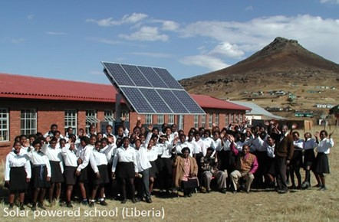
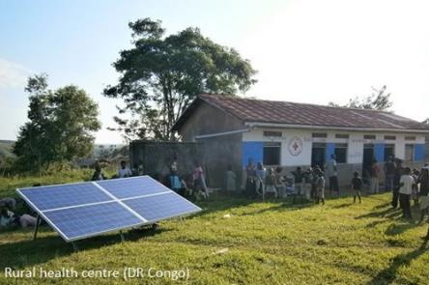
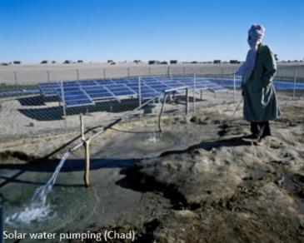
Socioeconomic analysis
One of the main socioeconomic benefits derived from energy is its contribution to the fulfilment of basic human needs for food, water, shelter, health and education.
Notes:
Energy is essential for people to meet some of their most basic needs for food, water shelter, health and education.
Bioenergy (especially woodfuel and charcoal) is still the most commonly used renewable energy in the World, due to the more than 2.6 billion of people using it to cook in many developing countries. Energy for cooking is essential to turn food crops into healthy nutrition. Using wood to boil water is also the most common way to sterilize drinking water in many of these places.
Even small amounts of electricity can also bring tremendous benefits to the education and health of people in rural communities. Off-grid solar power enables children to study at night and schools to offer a little more than the most basic education. By powering rural health centres, it can also increase the effectiveness of healthcare by enabling them to refrigerate vaccines, use electrically powered medical devices and provide emergency care after dark.

Slide 11
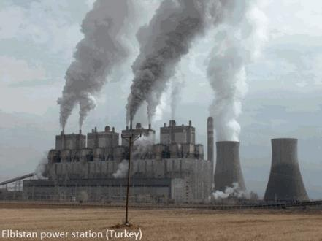
Environmental impacts
Measures of environmental impact:
Carbon-dioxide and other emissions
Water use, land use
Sustainability of bioenergy production
Notes:
Environmental impacts: Another important dimension of the energy sector is the environmental impacts associated with the production and consumption of energy. Most forms of renewable energy have lower environmental impacts compared to other types of energy, but reliable data is required to highlight those differences.
GHG emissions: The most obvious environmental benefit of renewable energy is that most renewables do not produce greenhouse gas (GHG) emissions. Statistics about renewable energy use can be used to show the amount of emissions that have been avoided (by not burning fossil fuels to produce that energy).
Land and water use: Water and land are two other resources where there are concerns about scarcity and renewable energy performs generally better than other types of energy. Statistics about the use of natural resources in the production of all forms of energy can show the impacts of different types of energy and assist with energy planning and decision making (e.g. allocation of future sites for renewable energy developments).
Bioenergy: Bioenergy is the one component of renewable energy where fuels are used, so it can have many of the same environmental issues as fossil fuels (emissions, land and water use). In addition, biomass has other uses and biofuels can only be harvested as quickly as they grow (if they are to be renewable). Good bioenergy statistics can help with decision making and planning, which is particularly important given that bioenergy is a major part of renewable energy policies in many countries.

Slide 12
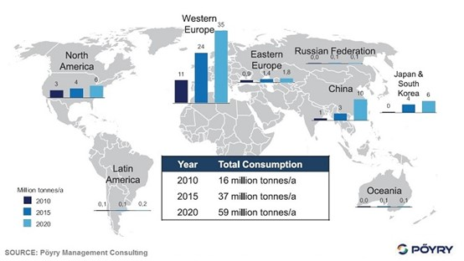
Trade analysis
Wood pellet trade outlook: four-fold increase in 10 years
Notes:
Trade analysis: Although most renewable energy is produced and consumed within a country, bioenergy is produced from the combustion of biofuels and these can be traded in significant quantities.
For example, wood pellets are a major source of fuel used in the production of electricity from solid biofuels in Europe. Given the anticipated increase in demand for renewable energy over the current decade, it is expected that World trade in wood pellets will increase four-fold over the period 2010 – 2020. A similar increase is also expected in international trade in liquid biofuels.
Statistics about trade in biofuels are used for anlaysing current and future patterns in biofuel trade, particularly when the point of using these fuels is to reduce carbon emissions and the sustainability of their production is an issue.
Where electricity is traded across borders, statistics about electricity production from renewables can also be useful for managing electricity loads and cross-border electricity flows in the same way as described in the previous slide.

Slide 13
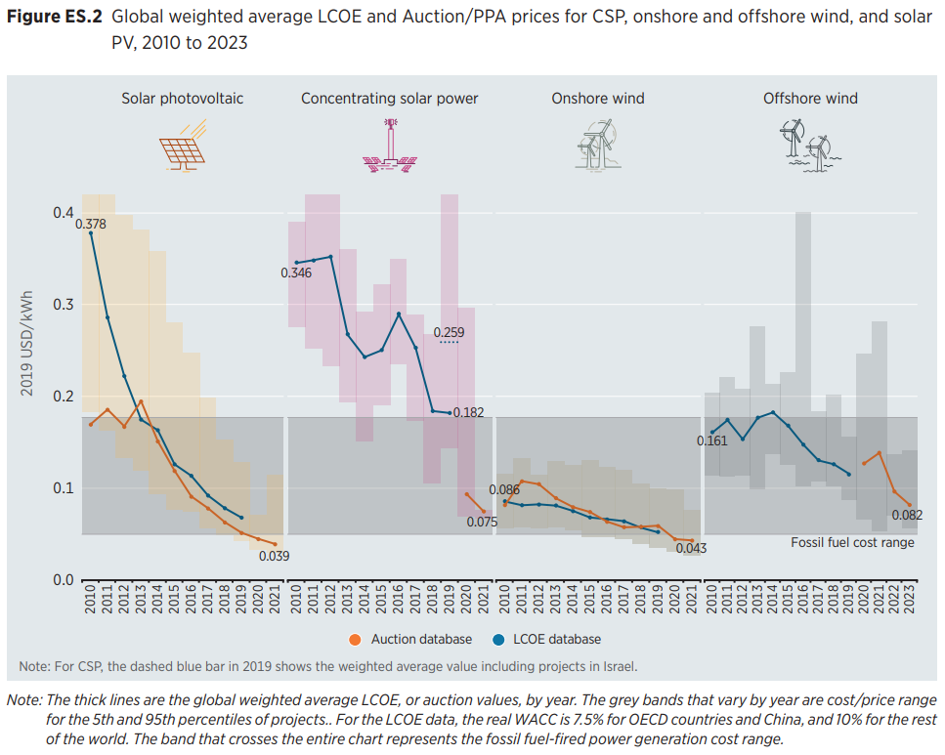
Production cost analysis
Cost of electricity generation from renewables is falling
Source: Renewable Power Generation Costs in 2019, IRENA
Notes:
Renewable generation costs: Statistics about the costs of renewable technologies (installation, operation and maintenance costs) are useful for comparing with electricity price statistics, to assess the economic viability of electricity production from renewable energy sources. IRENA’s cost data suggests that the cost of electricity generation from renewables is already competitive with fossil-fuel generation costs for some technologies (onshore wind, hydro, bioenergy, geothermal). Solar is already competitive against off-grid fossil-fuel generation costs and the costs of solar have been falling dramatically, suggesting it will become more competitive in many countries.

Slide 14
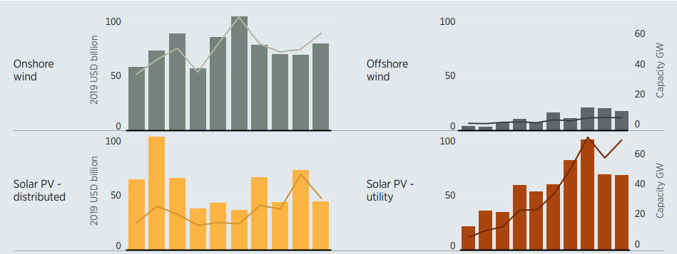
Investment analysis
Source: Renewable Power Generation Costs in 2019, IRENA
Investment value and new capacity added by renewable power technology, 2010-2019
Notes:
Investment analysis: Statistics about trends in capacity growth are also used to analyse current and future investment needs. Statistics about investments can be obtained from market data (loans and newly issued bonds and equity), but the details of many investments are not made public. Therefore, investment trends are often estimated by multiplying capacity statistics by the capital costs (per MW) of investment in different countries and technologies. This approach is particularly useful when making projections of the level of investment needed to meet renewable energy plans and targets.
For example, this graph shows the amount of investment in electricity generating capacity (from renewables) over the last decade. As it shows, annual investment has grown to about USD 250 billion per year in each of the last five years, with a growing share of this investment in developing countries (particularly, Brazil, China and India). This information is useful for banks, investment funds, equipment manufacturers and global energy companies for planning their long-term investment and marketing strategies.

Slide 15
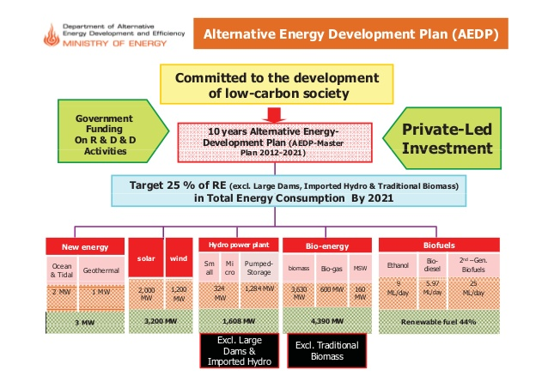
Policy monitoring
Thailand: Targets for alternative energy
Notes:
Policy monitoring: Another very important use of energy statistics is to monitor energy policies, plans and targets. At a broad scale, government agencies, institutions and companies set targets for energy and receive funding to implement policies and plans. Reporting on the achievement of these policies, plans and targets is important to show what has been achieved with this funding in terms of infrastructure development, energy production and consumption.
For example, Thailand has a very detailed energy plan that calls for an expansion of renewable energy over ten years with a detailed timeline for implementation, proposals for changes to laws and regulations, investment plans, projections of economic benefits in terms of reduced oil imports and carbon credit sales, as well as projections of carbon emission reductions and development of bioenergy crops. Comprehensive statistics will be required to measure achievement of the ambitious goals set-out in this plan.

Slide 16
Energy SDG and other national targets
Ensure universal access to affordable, reliable and modern energy services
Increase substantially the share of renewable energy in the global energy mix
Double the global rate of improvement in energy efficiency
Enhance international cooperation to facilitate access to clean energy research and technology…..
Expand infrastructure and upgrade technology for supplying modern and sustainable energy services….
Notes:
In September 2015, countries adopted a new set of sustainable development goals for 2030 to replace the Millennium Development Goals. These SDGs include a goal on energy and five targets. Indicators for the five targets have been developed, including one on the share of renewable energy in energy consumption.
Countries (including donors) are expected to prioritize investments that contribute to the achievement of these goals, so it will be very important to collect reliable statistics showing progress towards meeting these goals and highlight areas where further investment is needed.
In the area of energy, this is likely to require an emphasis on improving renewable energy statistics, particularly associated with expansion of renewables as sources of off-grid electricity and improvements in the availability and use of domestic energy technologies (cookstoves and heating appliances).

Slide 17
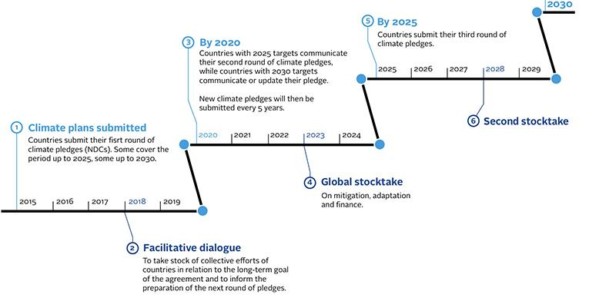
Nationally Determined Contributions
Article 4.13 of the Paris Agreement: “Parties shall account for their nationally determined contributions. In accounting for anthropogenic emissions and removals corresponding to their nationally determined contributions, Parties shall promote environmental integrity, transparency, accuracy, completeness, comparability and consistency, and ensure the avoidance of double counting...”
Source: https://unfccc.int/files/meetings/paris_nov_2015/application/pdf/paris_agreement_english_.pdf
Notes:
In 2015, the Paris Agreement on climate change was approved and signed by nearly all countries around the world. The Agreement calls for holding the increase in global average temperature to well below 2°C above preindustrial levels, and for pursuing efforts to limit the increase to 1.5°C by the end of this century.
A key element of the Paris Agreement are Nationally Determined Contributions or NDCs which are national plans outlining each country’s pledge to reduce greenhouse gas emissions and adapt to the impacts of climate change.
The first NDCs were submitted in 2015 and are expected to be revised every 5 years with targets progressively more ambitious each time. In 2020 countries were expected to submit their first updated NDCs, however the COVID pandemic has slowed down the revision process in most countries, which are planning to update their NDCs in 2021.

Slide 18
Targets are not easy to establish
Here are a few examples of issues and common mistakes countries make when setting targets:
Not specific enough
Energy carrier not clearly defined
Use of “energy” instead of “electricity”
Use of “biomass” for all bioenergy
No baseline year/value
No target year/value
Multiple targets in one
Use of installed capacity (MW) instead of electricity generation (MWh)
Sector targets inside national targets
Multiple target years, or same target
Contradicting targets (industries development…)

Slide 19
Targets are not easy to establish
Unclear tracking
Data issues for tracking
Unknown data needs
Unavailable data
Tracking indicators issues
Unmeasurable targets
No assessment made before
Emissions reduction targets
Qualitative targets
Unclear data responsibilities
No measuring / estimation in place
Information walls
No data sharing agreements / legal framework
Undeclared indicator
Wrong/missing units
Undefined methodology
Overly complicated
Modelled reductions
Unclear calculation methodology
Lack of funds assigned to the data collection

Slide 20
Targets are not easy to establish
Undeclared support info
No mitigation actions
No ICTU guidelines
No links to avoided emissions

Slide 21
UAE Second Nationally Determined Contribution
“Reduction of 23.5% in GHG emissions for the year 2030, relative to BAU (Business As Usual).
BAU scenario emissions in 2030 stand at about 310 million tonnes, assuming a
moderate annual economic growth rate based on historical growth trends.”
More details here. (UNFCCC website)

Slide 22
2
Basic definitions

Slide 23
International Recommendations for Energy Statistics (IRES)
Published by United Nations Statistics Division
Covers concepts, definitions and classifications, data compilation strategies, energy balances, data quality and statistical dissemination https://unstats.un.org/unsd/energy/ires/
IRENA follows the UN International Recommendations for Energy Statistics (IRES) and broadly inline with other international recommendations (more details for bioenergy).
🡪 Harmonization of data methodologies is essential for comparability, supporting decision making and analysis
Q: what is the difference between ‘Fuel’, ‘energy’ and ‘energy commodity’?
Notes:
As a 1st step energy statistician must be aware of the conventions and definitions used for the collection and presentation of energy statistics.
Enables organizations in the energy arena to speak the language
Additionally, he or she must be able to move comfortably between the unit of measurement for fuels and energy and have a working knowledge of the main fuel conversion process.

Slide 24
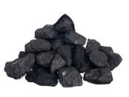
Basic definitions
Fuel and energy are not the same!
Fuel = materials used to produce energy
Fossil fuels
Nuclear fuel
Others (biofuels and waste)
Energy (useful energy):
Heat
Power (electricity, motion)
Notes:
Fuel-refers to energy sources, whether primary or secondary, that must be subjected to combustion or fission in order to release for use the energy stored up in them. i.e. Any substance burned as a source of heat or power
Energy- refers to both heat and electricity.
Energy commodity-energy products. Term used to cover both fuels and heat and power. you will be able to see how these energy commodities are represented in te energy balances section.

Slide 25
Different types of energy
Primary energy (commodities): Fuel and energy extracted or captured directly from natural resources. (sources, raw materials)
Primary can be transformed into:
Secondary energy (commodities): Fuel and energy produced from primary energy commodities, including heat and electricity.
Q: Are the commodities in the figures below considered primary or secondary?
Primary Fuelwood -> Secondary Charcoal+Heat
Primary Geothermal-> Secondary Electricity

Slide 26
Scope of energy statistics
Electricity
Heat that is actively produced
Materials used as fuel for energy production
Energy statistics exclude
Direct uses of motive power (e.g. windmills)
Passive heat production (e.g. greenhouses)
Non-energy uses of fuel (e.g. bio-plastics)

Slide 27
Installed capacity vs. electricity generation
Installed capacity- maximum output of electricity that a generator can produce under ideal conditions, usually measured in kW, MW, GW.
Electricity generated- amount of electricity that is produced over a specific period, usually measured in kWh, MWh, TWh.
“According to the EIA [USA], wind turbines accounted for 8% of U.S. installed electricity generation “capacity,” as of December 2016. This means under ideal conditions, utilities would be able to supply 8% of the country’s electricity needs with wind power, but this won’t necessarily be the actual amount of electricity produced.”
Source: https://www.energy.gov/
Notes:
The difference between the installed capacity and electricity generation of energy sources?
Is commonly misunderstood.
In the energy world, these two terms are often used to describe the growth of energy resources in a country,
capacity as the maximum output of electricity that a generator can produce under ideal conditions. Capacity levels are normally determined as a result of performance tests and allow utilities to project the maximum electricity load that a generator can support.
electricity generation, on the other hand, refers to the amount of electricity that IS produced over a specific period of time. This is usually measured in kilowatt-hours, megawatt-hours, or terawatt-hours (1 terawatt equals 1 million megawatts). To understand the unit of megawatt-hours (MWh), consider a wind turbine with a capacity of 1.5 megawatts that is running at its maximum capacity for 2 hours. In this scenario, at the end of the second hour, the turbine would have generated 3 megawatt-hours of energy (i.e. 1.5 megawatts X 2 hours).

Slide 28
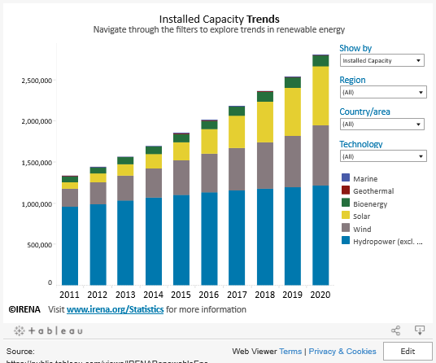
Exercise: Installed capacity vs. electricity generation
- What was the installed solar capacity for Jordan in 2018?
How much electricity was generated from solar in 2018 for Jordan?
Link to RE insights dashboard
Notes:
hat’s the difference between the installed capacity and electricity generation of energy sources?
It’s a good question and one that’s commonly misunderstood.
In the energy world, these two terms are often used to describe the growth of energy resources in

Slide 29
Capacity factors
Solution: CP= 5000/(1*8760) = 57%
Notes:
The engineers with us are probably familiar with capacity factors can be also to estimate production from capacity figures or vice versa.

Slide 30
3
Measurements and Estimations
Notes:
Energy products are measured in physical units by their mass, volume, and energy content. The measurement units that are specific to an energy product and employed at the point of measurement of an energy flow are often referred to as “original” or “natural” units

Slide 31
Measurement Units
Energy products measured in (natural) physical units
Mass
Volume
Energy content
Energy balances convert these into common (energy) units for comparison
5
Notes:
Energy products are measured in physical units by their mass, volume, and energy content. The measurement units that are specific to an energy product and employed at the point of measurement of an energy flow are often referred to as “original” or “natural” units

Slide 32
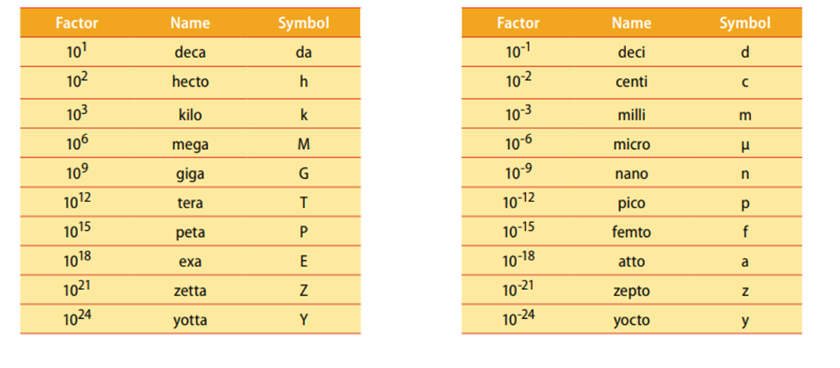
Measurement Units - Prefixes
5
Notes:
Mega. Giga, kilo

Slide 33
Measurement Units – Mass Units
Mass Units
Solid fuels (biomass, coal etc.) typically measured in mass units
SI unit = kg
One metric ton = 1000 kg
Mass Equivalents
Source: IRES
5

Slide 34
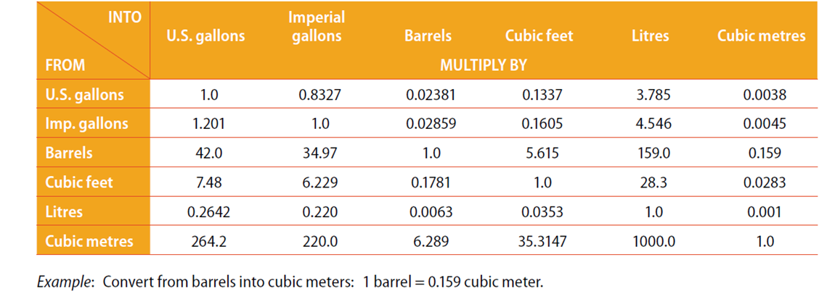
Measurement Units – Volume Units
Most liquid and gaseous fuels typically measured in volume units
- SI unit = m³
- 1 m³ = 1000 litres
Barrels often used in petroleum sector
Note: renewable % of certain biofuels e.g.:
% by volume of bioETBE calculated as biofuel is 47%
% by volume of bioMTBE calculated as biofuel is 36%
Volume Equivalents
Source: IRES
5

Slide 35
Measurement Units – Energy Units
SI unit = joule
British thermal unit (Btu) → measure of heat (1Btu = 1055.06J)
Ton of coal equivalent (1 tce = 29.3076 GJ)
Ton of oil equivalent (1 toe = 41.868 GJ)
Power → rate at which work is done.
1 watt = 1 joule per second
Kilowatt hour (kWh) → 1000 watt (j/s) x 1 hour period = 1000 x 60x60 = 3.6 MJ
1 GWh = 3.6 TJ
Other energy units calories, Tonnes of Standard Fuel Equivalents
5

Slide 36
Measurement and Estimation
Electricity generation:
Large-scale: metered, no estimates are usually required.
Small-scale, off-grid:
Mostly likely will need to be estimated.
Capacity utilisation factor (CUF) could be used
(Capacity x 8,760 x CUF% = annual generation)
e.g. A 20kW generator used for 6 hours per day would produce 20 x 8,760 x 6/24 = 43,800 kWh/year
Notes:
Large scale plants are metered small scall and Offgrid could measured or not in cases were estimates will need to be made

Slide 37
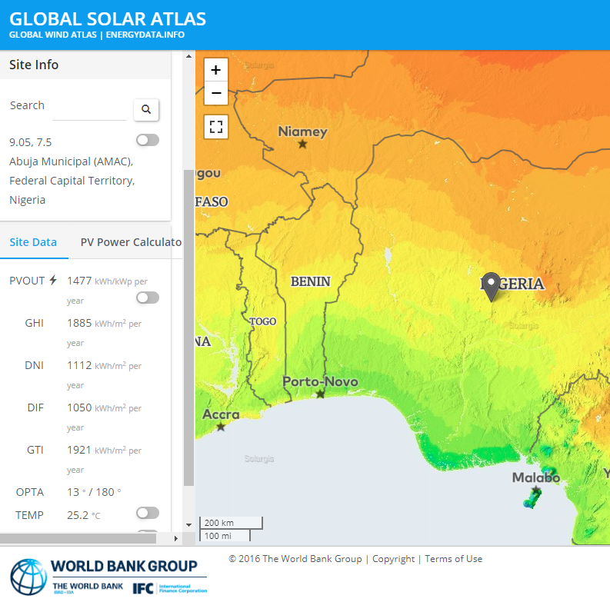
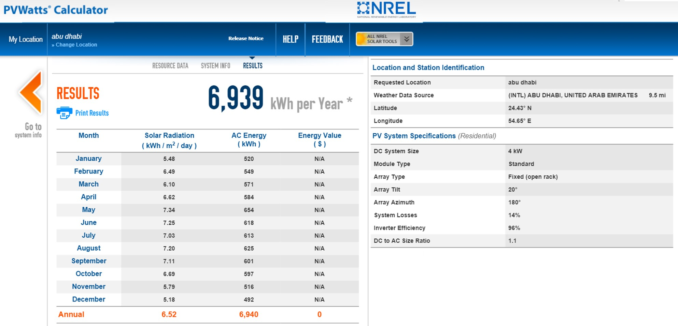
Measurement and Estimation
Solar PV Generation
Solar radiation x system size x efficiency x utilization
Many online tools to estimate production
Source: https://globalsolaratlas.info
Source: http://pvwatts.nrel.gov
Notes:
PVWatts you add the size and tells you the generation
Global Solar Atlas tells you the estimated generation per kW installed

Slide 38
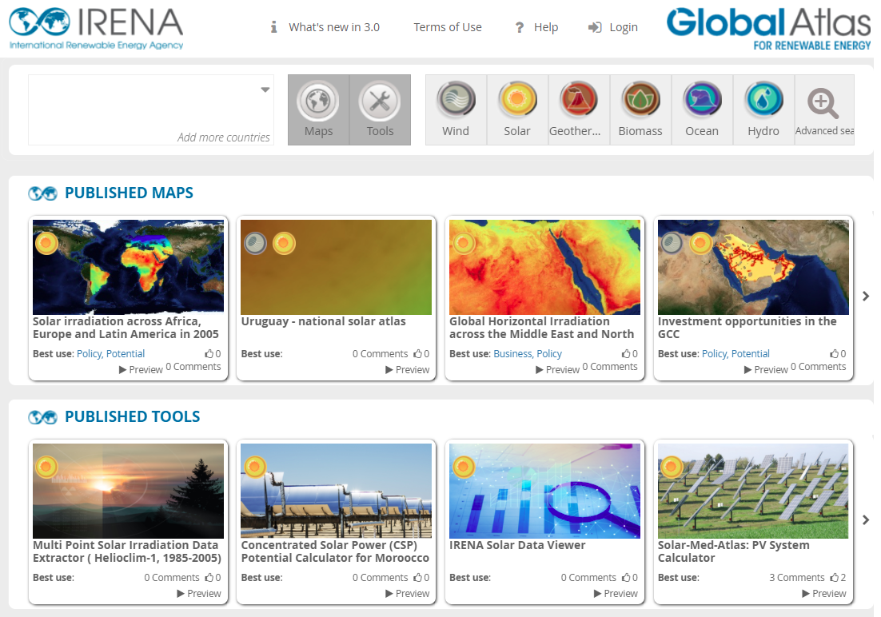
IRENA Global Atlas
The Global Atlas for Renewable Energy is a web platform that allows its users to find maps of renewable energy resources for locations across the world.
Other related tools:
Solar City engine : for rooftop PV
Bioenergy simulator
www.irena.org/globalatlas
Notes:
SolarCity is a web application provided by IRENA to enable households, businesses and municipal authorities to evaluate the prospects for electricity generation using rooftop-mounted solar PV installations.
-simulator for bioenergy development. Allows users navigate various options of bioenergy source, technology and end-use

Slide 39
Q & A
5 min

Slide 40
4
Commodity and Energy Balances
Notes:
Energy products are measured in physical units by their mass, volume, and energy content. The measurement units that are specific to an energy product and employed at the point of measurement of an energy flow are often referred to as “original” or “natural” units

Slide 41
Have you used an energy balance before?
ⓘ Start presenting to display the poll results on this slide.
Notes:
📣 This is Slido interaction slide, please don't delete it. ✅ Click on 'Present with Slido' and the poll will launch automatically when you get to this slide.

Slide 42
Definition
“An energy balance is an accounting framework for the compilation and reconciliation of data on all energy products entering, exiting and used within the national territory of a given country during a reference period”.
International Recommendations for Energy Statistics (UN)
Notes:
It shows how much energy is available for use in an economy, how much is converted into other types of energy and, finally, how much is consumed.

Slide 43
Relevance of a national energy balance
It offers a complete view of the energy situation of a country
Can be used as a baseline for modeling national energy scenarios
It is a starting point for any sound policy making. Key to define and monitor indicators.
Notes:
Important indicators:
Self-sufficiency: Production/TPES,
Energy intensity: TPES/GDP or TPES/population,
Share of renewables in TPES and TFC
The ratio between production and TPES shows the energy dependency or self-sufficiency of a country.

Slide 44
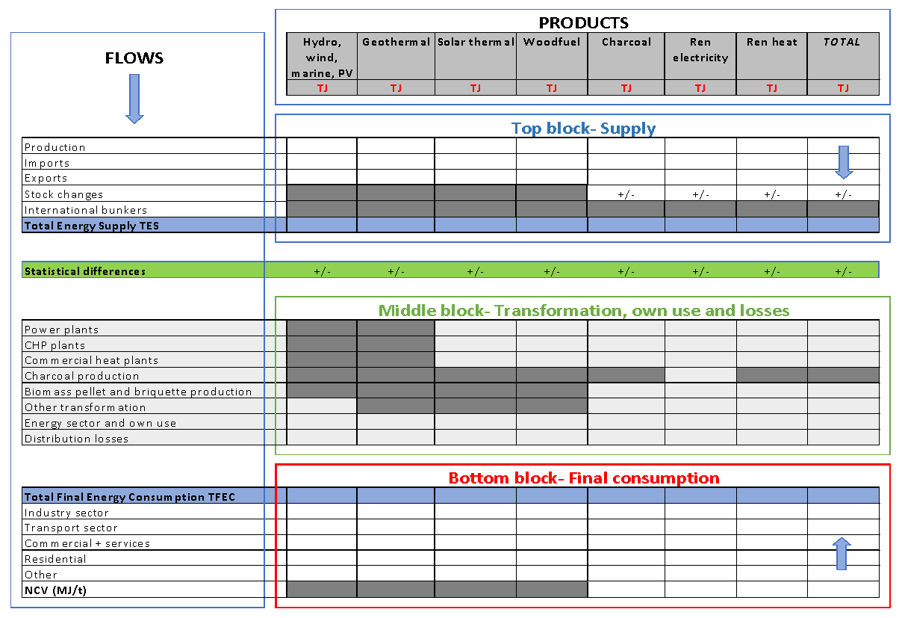
Energy Balance
Structure
Notes:
In this basic structure, the energy flows are arranged into three main blocks. Rows at the top show how much energy is available for use. The next block shows how much of each type of energy is converted or transformed into other types of energy, both as an input to transformation and output from transformation. The rows at the bottom show the final consumption of each energy source/type, divided into different end-uses (economic sectors).

Slide 45
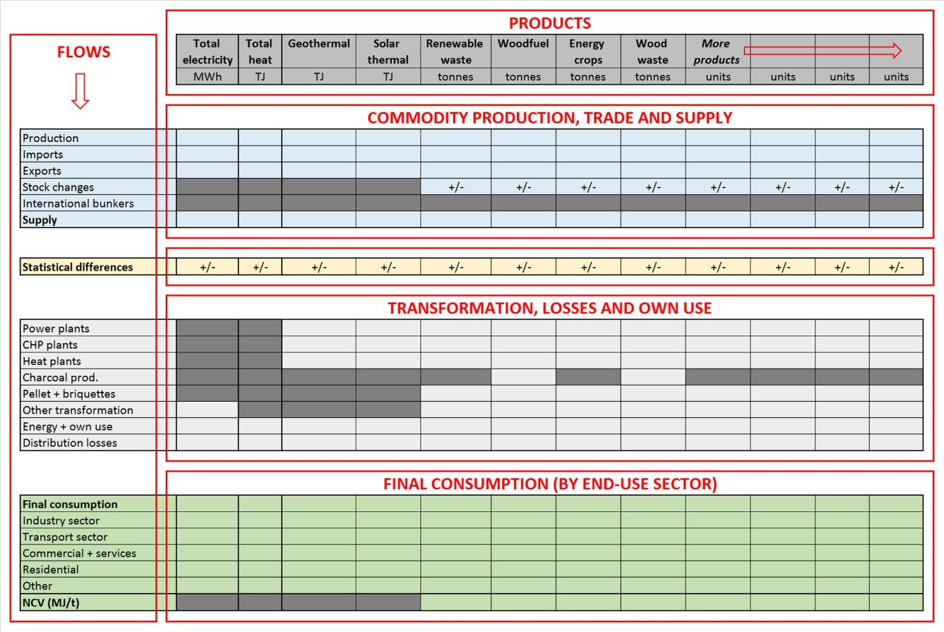
Commodity Balance
Expressed in original measurement units.
Energy balances convert these into common (energy) units for comparison
Notes:
Expressed in original measurement units
Conversion into energy. X3.6 to convert kWh to MJ

Slide 46
Mass to Energy Conversion → Calorific Values
Net calorific values (NCV) and Gross calorific values(GCV)
- Calorific values or heating values = heat obtained from one unit of the fuel
- When a fuel is combusted-> Heat + water vapor is produced (rarely can be used for energy purposes)
NCV versus GCV- GCV includes water vapor, NCV doesn’t.
NCV recommended for expressing energy content of fuels (e.g. MJ/tonne)
Source: IEA
Notes:
The net calorific value (NCV), or low heat value, excludes the latent heat. The NCV is that amount of heat from the combustion process that is actually available in practice for capture and use. The higher the moisture of a fuel or its hydrogen content, the greater is the difference between GCV and NCV. For some fuels with very little or no hydrogen content (e.g., some types of coke, blast furnace gas) this difference is negligible. In terms of magnitude, the difference between gross and net calorific values of fossil fuels (coal, oil, oil products and gas) is typically less than 10 per cent, while that of biomass energy (fuelwood, bagasse) is usually more than 10 per cent

Slide 47
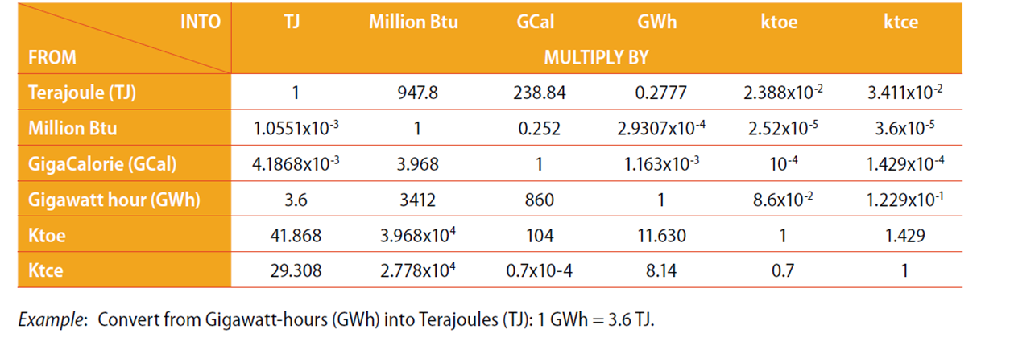
Measurement Units
Energy Equivalents
Source: IRES
5

Slide 48
Energy Balance
Structure
5
Notes:
In this basic structure, the energy flows are arranged into three main blocks. Rows at the top show how much energy is available for use. The next block shows how much of each type of energy is converted or transformed into other types of energy, both as an input to transformation and output from transformation. The rows at the bottom show the final consumption of each energy source/type, divided into different end-uses (economic sectors).

Slide 49
Supply Block (Energy Balance)
Total Primary Energy Supply (TPES) is calculated as:
Production + imports – exports +/- stock change – international bunkers
If stocks increase, the increase should be subtracted from supply, while a reduction in stocks would be added to supply.
TPES by source reflects the diversity of the energy mix of a country
Notes:
TES By source reflects the diversity of the energy mix of a country
International bunker: Fuel loaded for consumption by that vessel -international aviation and maritime transport

Slide 50
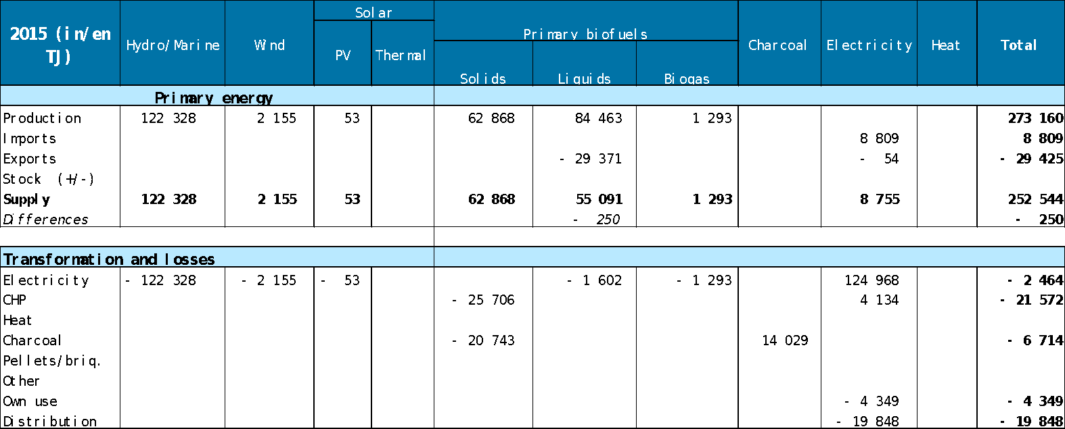
Transformation (Energy Balance)
The middle block records the flows of energy that are converted from one type to another (transformation) and any losses and uses of energy within the energy sector.
Notes:
Transformation flows are constructed from paired observations.
Secondary products may also be transformed into other secondary products, electricity is converted into heat in heat pumps.
For renewable energy, the only fuel transformation recognised by the UN is the conversion of wood fuel into charcoal, but IRENA also recognises as transformation activities the conversion of solid biofuels into biomass pellets or liquid biofuels.
Distribution losses are mostly reported in the heat and electricity columns of an energy balance, but may also appear in other columns (e.g. if fuels are lost in accidents such as leaks and fires).

Slide 51
Consumption (Energy Balance)
The lower block shows the Total Final Energy Consumption TFEC, divided into end-use sectors.
The energy balance highlights that the energy supply used in a country is generally much higher than the final energy consumption. (Taking into account own consumption, distribution losses and most importantly the energy lost during energy transformation processes).
Total Final Consumption TFC =TFEC+ non-energy use
Notes:
Transport fuels and energy use in transport are not the same! Renewable use in transport includes electricity and biogas

Slide 52
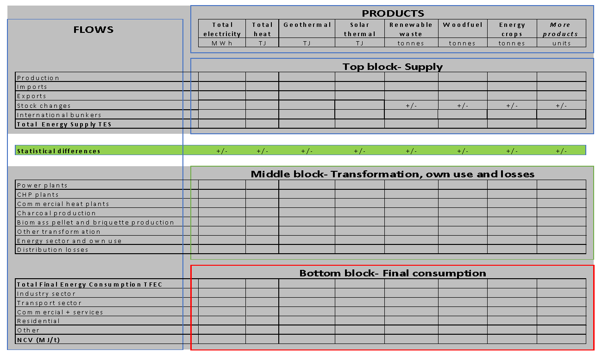
Statistical Difference
Statistical difference = Total Energy Supply - Transformations, own use, losses - Total Final Energy Consumption.
5
Notes:
Statistical differences occur when the data collected from energy suppliers and traders does not match the data collected from energy consumers (final consumers and enterprises converting one type of energy into another).

Slide 53
Total primary energy supply (TPES) vs. Total final energy consumption (TFEC) - TPES- total amount of primary energy that a country has at their disposal. TPES= Imported energy +energy production –exported energy+ stock changes - TFEC- sum of energy that can readily be used by consumers to serve their energy needs (end use energy)
Source: https://energyeducation.ca/
Notes:
In order to capture energy data of country. The breakdown b between supply and demand will have to be considered. While TPES is an aggregate of all of the energy going into the energy sector. This consumer0 based focus is why losses due to the transportation from the power plants to the consumer is subtracted off focuses on the end use of energy . We will go through this in the second half of the session. WE will see this in second hald in the energy balance session
Stock changes. For the purposes of energy statistics, stocks are quantities of energy products that are held on the national territory and can be used to: (a) maintain service under conditions where supply and demand are variable in their timing or amount due to normal market fluctuations, or (b) supplement supply in the case of a supply disruption.43 Stocks used to manage a supply disruption may be called ”strategic” or “emergency” stocks and are often held separately from stocks designed to meet normal market fluctuations, but both are considered here. Stock changes are defined as the increase (stock build) or decrease 39 Such fuels should be classified as “international marine bunkers” or “international aviation bunkers”, respectively, in the country where such bunkering is carried out (see paras. 5.14, 5.15). 40 These quantities are recorded as “international marine bunkers” and “aviation bunkers”, respectively. 41 See International Merchandise Trade Statistics: Concepts and Definitions 2010, United Nations (2010). 42 These definitions differ from those used in the national accounts where exports and imports are defined as transactions between residents and non-residents. Therefore, compilers of energy accounts should make necessary adjustments to basic energy statistics before using them. 43 The notion of stocks dealt with in this chapter corresponds to what in economic statistics and national accounts is referred to as inventories. 58 International Recommendations for Energy Statistics (IRES) (stock draw) in the quantity of stocks over the reporting period and thus are calculated as a difference between the closing and opening stocks.
e.g. International marine bunkers (row 4) are quantities of fuels delivered to merchant (including passenger) ships, of any nationality, for consumption during international voyages transporting goods or passengers. International voyages take place when the ports of departure and arrival are in different national territories

Slide 54
5
Using an Energy Balance
Notes:
Energy products are measured in physical units by their mass, volume, and energy content. The measurement units that are specific to an energy product and employed at the point of measurement of an energy flow are often referred to as “original” or “natural” units

Slide 55
Exercise: How to read an energy balance
Please look at the UN energy balance of South Africa for 2016.

Slide 56
TOTAL ENERGY
Can this country’s production cover its energy demand (measured by TPES)? Is it energy self-sufficient?

Slide 57
Is South Africa energy self-sufficient?
ⓘ Start presenting to display the poll results on this slide.
Notes:
📣 This is Slido interaction slide, please don't delete it. ✅ Click on 'Present with Slido' and the poll will launch automatically when you get to this slide.

Slide 58
Can this country‘s production cover its energy demand (measured by TPES)? Is it energy self-sufficient?
Yes. Self-sufficiency can be calculated as the ratio between production and TES. A ratio smaller than 1 indicates, that the country is not self-sufficient and depends on imports, while a ratio larger than 1 indicates, that the country is self-sufficient. For large exporters, this ratio is much larger than 1. Self-sufficiency can be calculated as a whole, or for the individual primary energy sources, such as oil, coal, gas.
In this case: production/TES= 6857896/6275709 = 1.09 > 1

Slide 59
TOTAL ENERGY
How much is the difference between the total energy supply (TES) and the total final consumption? Where is this energy used/lost?

Slide 60
How much is the difference between the total energy supply (TES) and the total final consumption?
ⓘ Start presenting to display the poll results on this slide.
Notes:
📣 This is Slido interaction slide, please don't delete it. ✅ Click on 'Present with Slido' and the poll will launch automatically when you get to this slide.

Slide 61
How much is the difference between the total energy supply (TES) and the total final consumption? Where is this energy used/lost?
6 275 709 TJ – 2 882 661 TJ =3 393 048 TJ
When analysing the total energy demand of a country, it is tempting to focus on final consumption, which represents the total amount of energy consumed in the different end-use sectors (industry, transport, residential, etc.). However, the energy balance highlights that the energy demand of a country is generally much higher than the final energy consumption. On top of the final energy consumption, it is important to also take into account the energy consumed by the energy producing industries, the energy lost during distribution and most importantly the energy lost during energy transformation processes.

Slide 62
BY PRODUCT
What is the fuel most used in this country (measured by TPES)?

Slide 63
What is the fuel most used in this country (measured by TPES)?
ⓘ Start presenting to display the poll results on this slide.
Notes:
📣 This is Slido interaction slide, please don't delete it. ✅ Click on 'Present with Slido' and the poll will launch automatically when you get to this slide.

Slide 64
What is the fuel most used in this country (measured by TPES)?
The share of each product in the energy mix of a country can be derived as a ratio of its TES with the total energy TES.
Coal was the first source of energy of South Africa in 2016, representing 70.3 % of the country’s energy mix: (4 410 505 TJ)/ 6 275 709 TJ.
The second energy source was oil 15%. We need to sum both Primary Oil and Oil products (999 405 – 55 723)/ 6 275 709 TJ.
In terms of what is happening with the coal produced - 57% is used in transformations, mainly in electricity plants. 27% is exported. The rest is mainly used in industry.

Slide 65
FINAL CONSUMPTION
How big is the share of energy consumption in households? Which fuel is mostly used in households?

Slide 66
How big is the share of energy consumption in households? Which fuel is mostly used in households?
ⓘ Start presenting to display the poll results on this slide.
Notes:
📣 This is Slido interaction slide, please don't delete it. ✅ Click on 'Present with Slido' and the poll will launch automatically when you get to this slide.

Slide 67
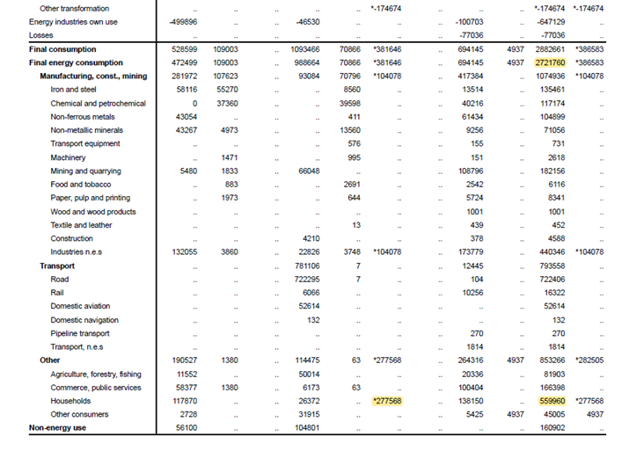
FINAL CONSUMPTION
How big is the share of energy consumption in households? Which fuel is mostly used in households?
559960 / 2721760 = 20.5%.
Most common fuel is biofuels (i.e. wood fuel)

Slide 68
6
Demo: IRENA data and statistics

Slide 69
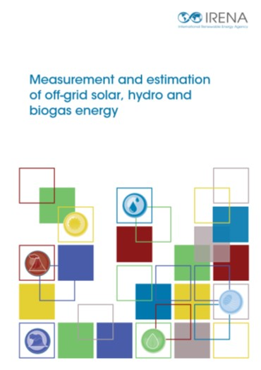
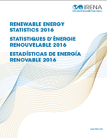
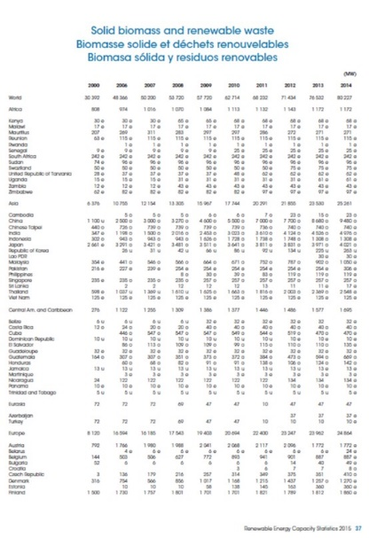
Data published by IRENA
IRENA has several publications describing
methodologies to measure or estimate renewable
energy production and other analytical reports
https://irena.org/publications
Interactive chats are raw data can be
downloaded from:
www.irena.org/statistics

Slide 70
7
Conclusions

Slide 71
Conclusion
Energy statistics are at the centre of analysis of targets, NDCs, other development goals and investment plans
Energy policies and targets
Finance
NDCs
ENERGY STATISTICS
GHG emissions
Electricity generation
Electricity capacity
Investment needs
Emissions factors
CUF
Capital cost data
Other benefits:
- Energy security
- Import substitution
- Electricity access
- Electricity quality
- Economic development
- Environmental impacts
Other benefits:
- Local income
- Local employment
Energy modeling:
- Basis for any models used for the establishment of policies.

Slide 72
THANK YOU FOR JOINING US!
SEE YOU IN OUR NEXT WEBINAR
www.irena.org

Slide 73
THANK YOU FOR JOINING US!
SEE YOU IN OUR NEXT WEBINAR
www.irena.org

