Slide 1
Showcasing the Global Green Hydrogen Opportunity
REUTERS HYDROGEN 2021
Francesco La Camera
IRENA Director-General
20 May 2021

Slide 2
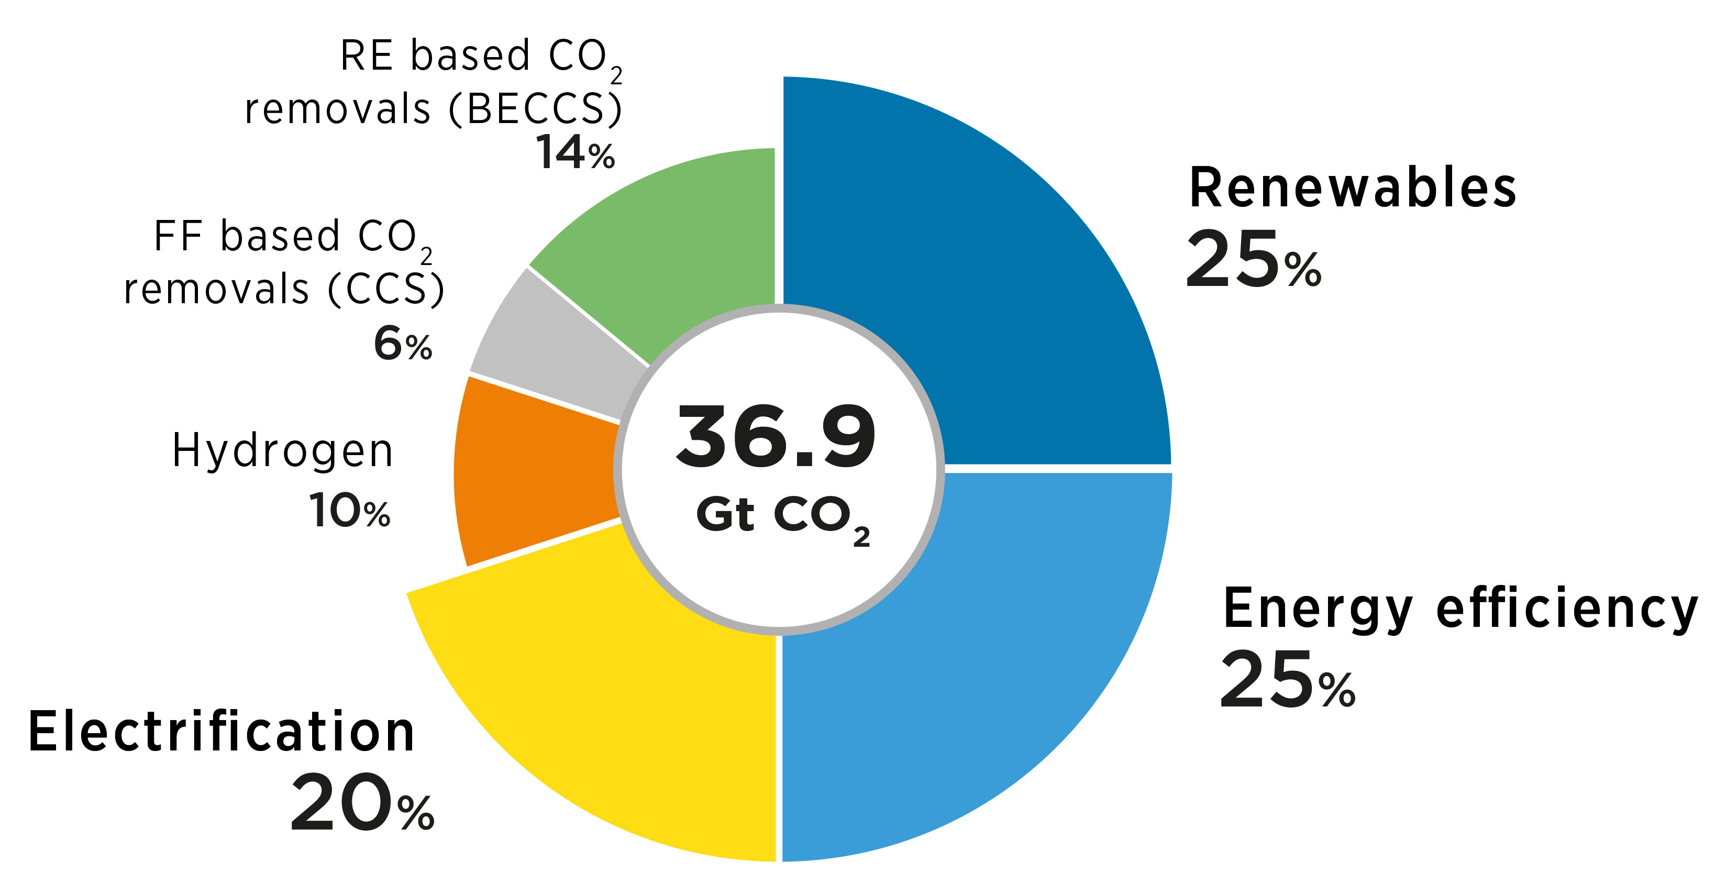
World Energy Transitions Outlook: Net-Zero by 2050
Six components of the energy transition strategy
Green hydrogen can complement electrification and energy efficiency as key pillars of climate efforts.
Notes:
In the last decade capital cost of electrolysis has fallen by 60%
LCOH decreased from a range of USD 10-15/kg to as low as USD 4-6/kg
However, about 95% of all the hydrogen used today is still grey hydrogen (USD 1-2/kg)
Water electrolysis for the production of green hydrogen is limited to about 150 MW of electrolyser capacity
Multiple announcements for GW-scale electrolysers in the last years
However, there are still some challenges
Renewable power generation has become increasingly competitive with, or in many situations less costly than, fossil-based or nuclear power

Slide 3
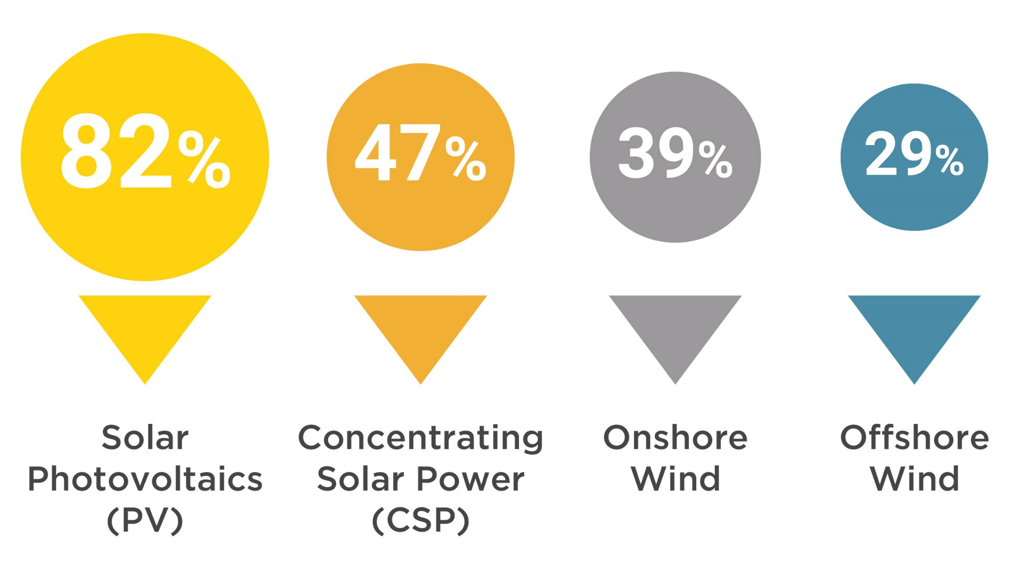
Why the renewed interest in hydrogen ?
A net-zero emissions systems requires solutions for hard-to-decarbonise sectors
Hydrogen is a clean energy carrier and compromise for the renewables and gas industry
It opens a transition for oil and gas exporting countries and can help to decarbonise industry and transport
Falling renewable electricity costs make green hydrogen a feasible solution
Notes:
In the last decade capital cost of electrolysis has fallen by 60%
LCOH decreased from a range of USD 10-15/kg to as low as USD 4-6/kg
However, about 95% of all the hydrogen used today is still grey hydrogen (USD 1-2/kg)
Water electrolysis for the production of green hydrogen is limited to about 150 MW of electrolyser capacity
Multiple announcements for GW-scale electrolysers in the last years
However, there are still some challenges
Renewable power generation has become increasingly competitive with, or in many situations less costly than, fossil-based or nuclear power

Slide 4
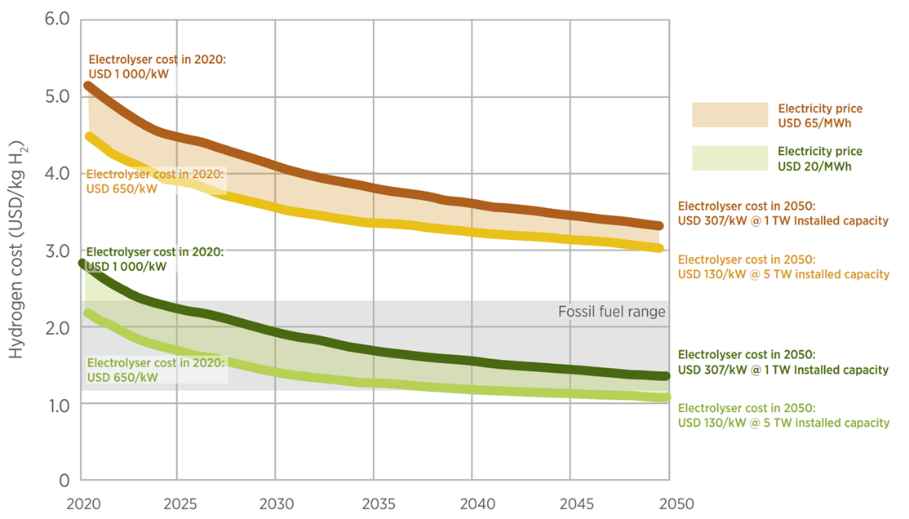
Hydrogen production costs
Green hydrogen trends:
Cost-competitive with fossil-based hydrogen by 2030
70% of all hydrogen consumed by 2050 will be green
Source: IRENA (2020)
Notes:
In the last decade capital cost of electrolysis has fallen by 60%
LCOH decreased from a range of USD 10-15/kg to as low as USD 4-6/kg
However, about 95% of all the hydrogen used today is still grey hydrogen (USD 1-2/kg)
Water electrolysis for the production of green hydrogen is limited to about 150 MW of electrolyser capacity
Multiple announcements for GW-scale electrolysers in the last years
However, there are still some challenges
Renewable power generation has become increasingly competitive with, or in many situations less costly than, fossil-based or nuclear power

Slide 5
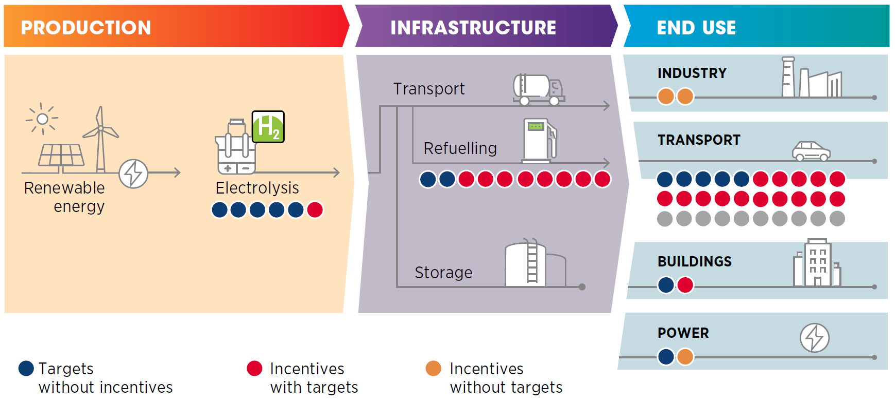
Four pillars for green hydrogen policy making
Policy priorities
National hydrogen strategies
Governance system and enabling policies
Guarantees of origin
Establish policy priorities
Notes:
In the last decade capital cost of electrolysis has fallen by 60%
LCOH decreased from a range of USD 10-15/kg to as low as USD 4-6/kg
However, about 95% of all the hydrogen used today is still grey hydrogen (USD 1-2/kg)
Water electrolysis for the production of green hydrogen is limited to about 150 MW of electrolyser capacity
Multiple announcements for GW-scale electrolysers in the last years
However, there are still some challenges
Renewable power generation has become increasingly competitive with, or in many situations less costly than, fossil-based or nuclear power

Slide 6
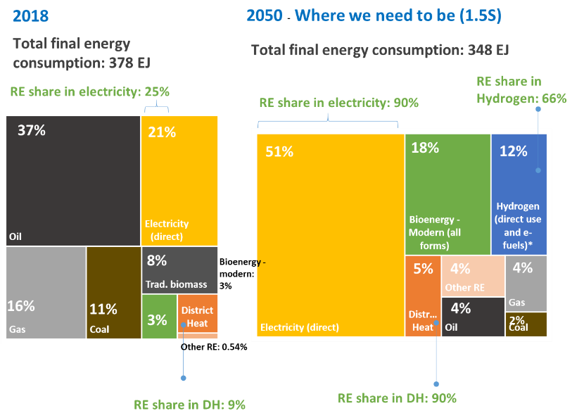
Green hydrogen will dominate
Share of hydrogen produced by renewables will be 66%
Notes:
In the last decade capital cost of electrolysis has fallen by 60%
LCOH decreased from a range of USD 10-15/kg to as low as USD 4-6/kg
However, about 95% of all the hydrogen used today is still grey hydrogen (USD 1-2/kg)
Water electrolysis for the production of green hydrogen is limited to about 150 MW of electrolyser capacity
Multiple announcements for GW-scale electrolysers in the last years
However, there are still some challenges
Renewable power generation has become increasingly competitive with, or in many situations less costly than, fossil-based or nuclear power

