Slide 1


A New Energy Future
The way to a sustainable recovery
Francesco La Camera
IRENA Director-General
Keynote at REvision 2021 • Webcast • 10 March 2021

Slide 2
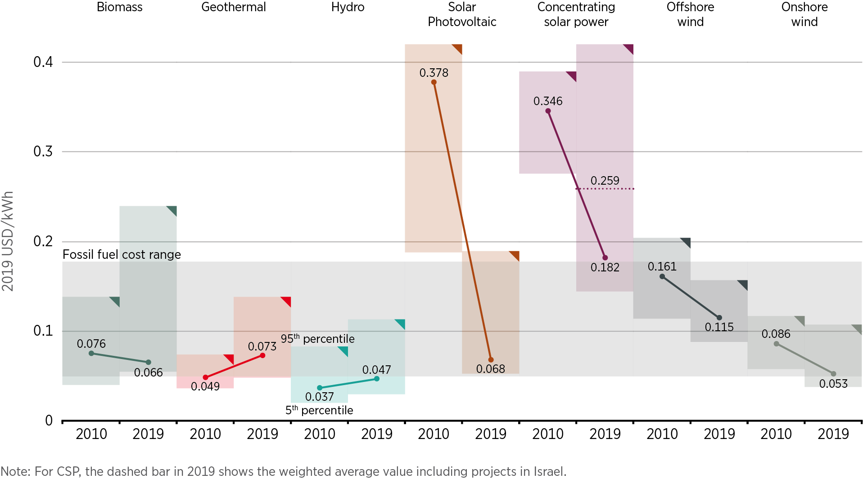
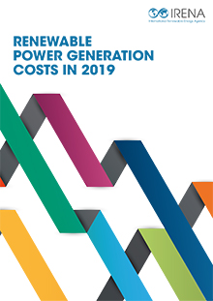

In most of the world, RE are now the lowest cost option for new power generation

Slide 3
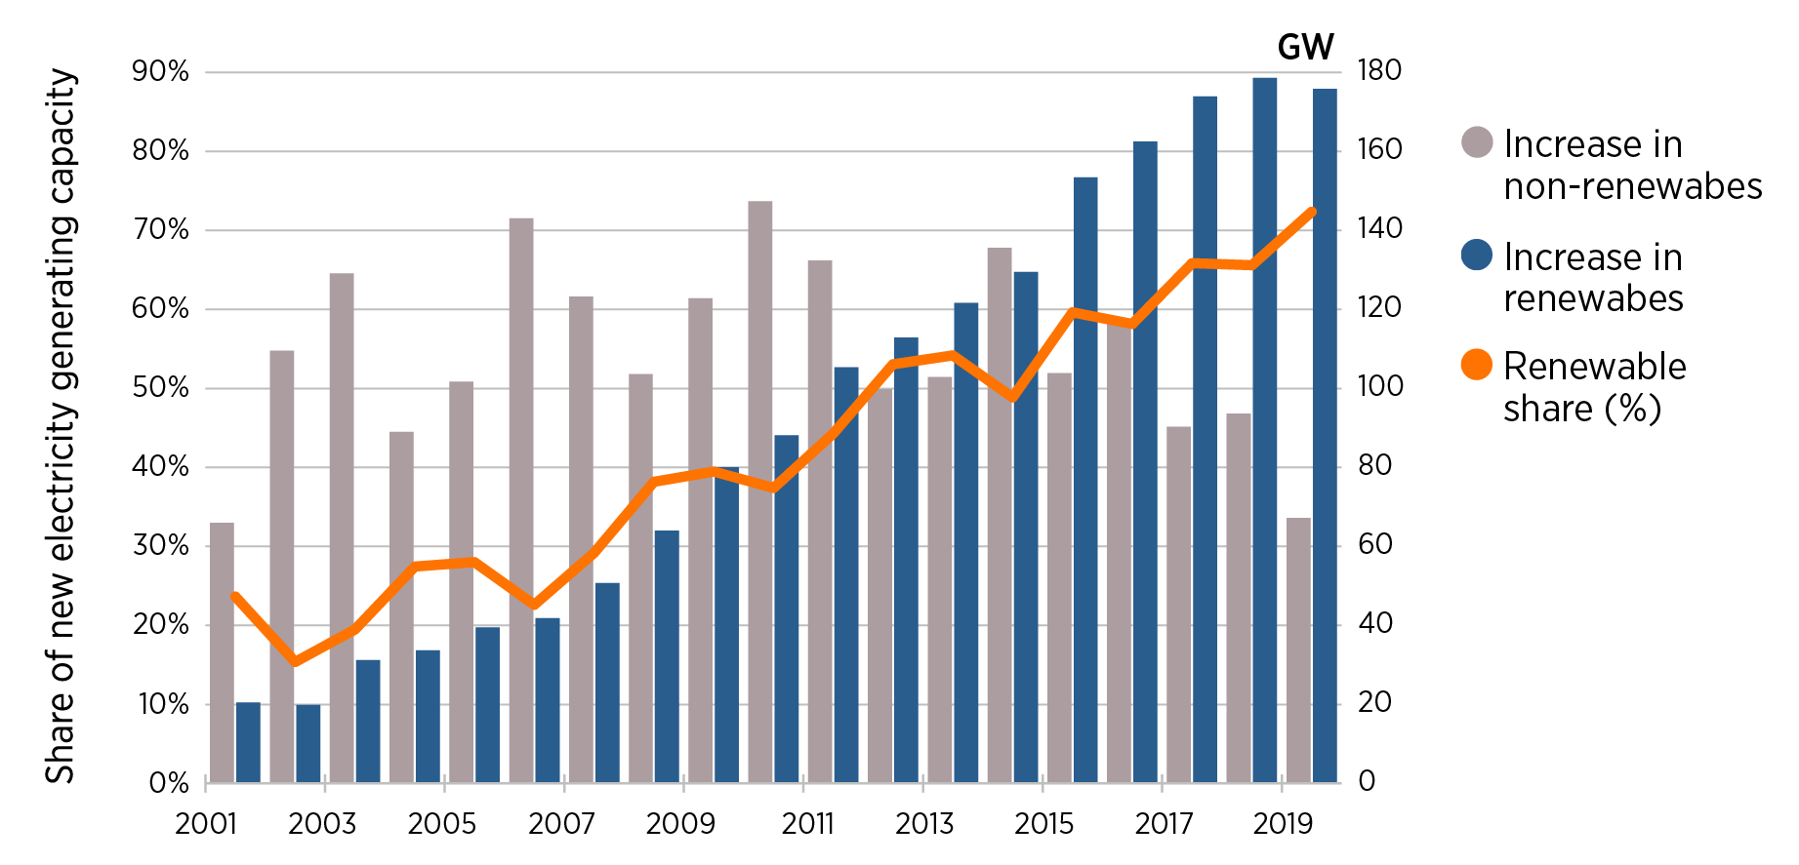
The energy transition is underway
Renewables now account for one third of global power capacity today

Slide 4
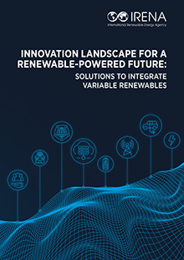
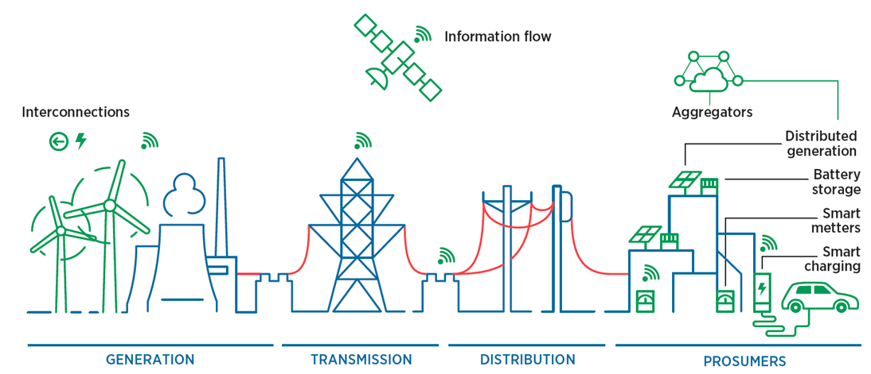
Innovations enable flexibility for a renewables-powered future

Slide 5
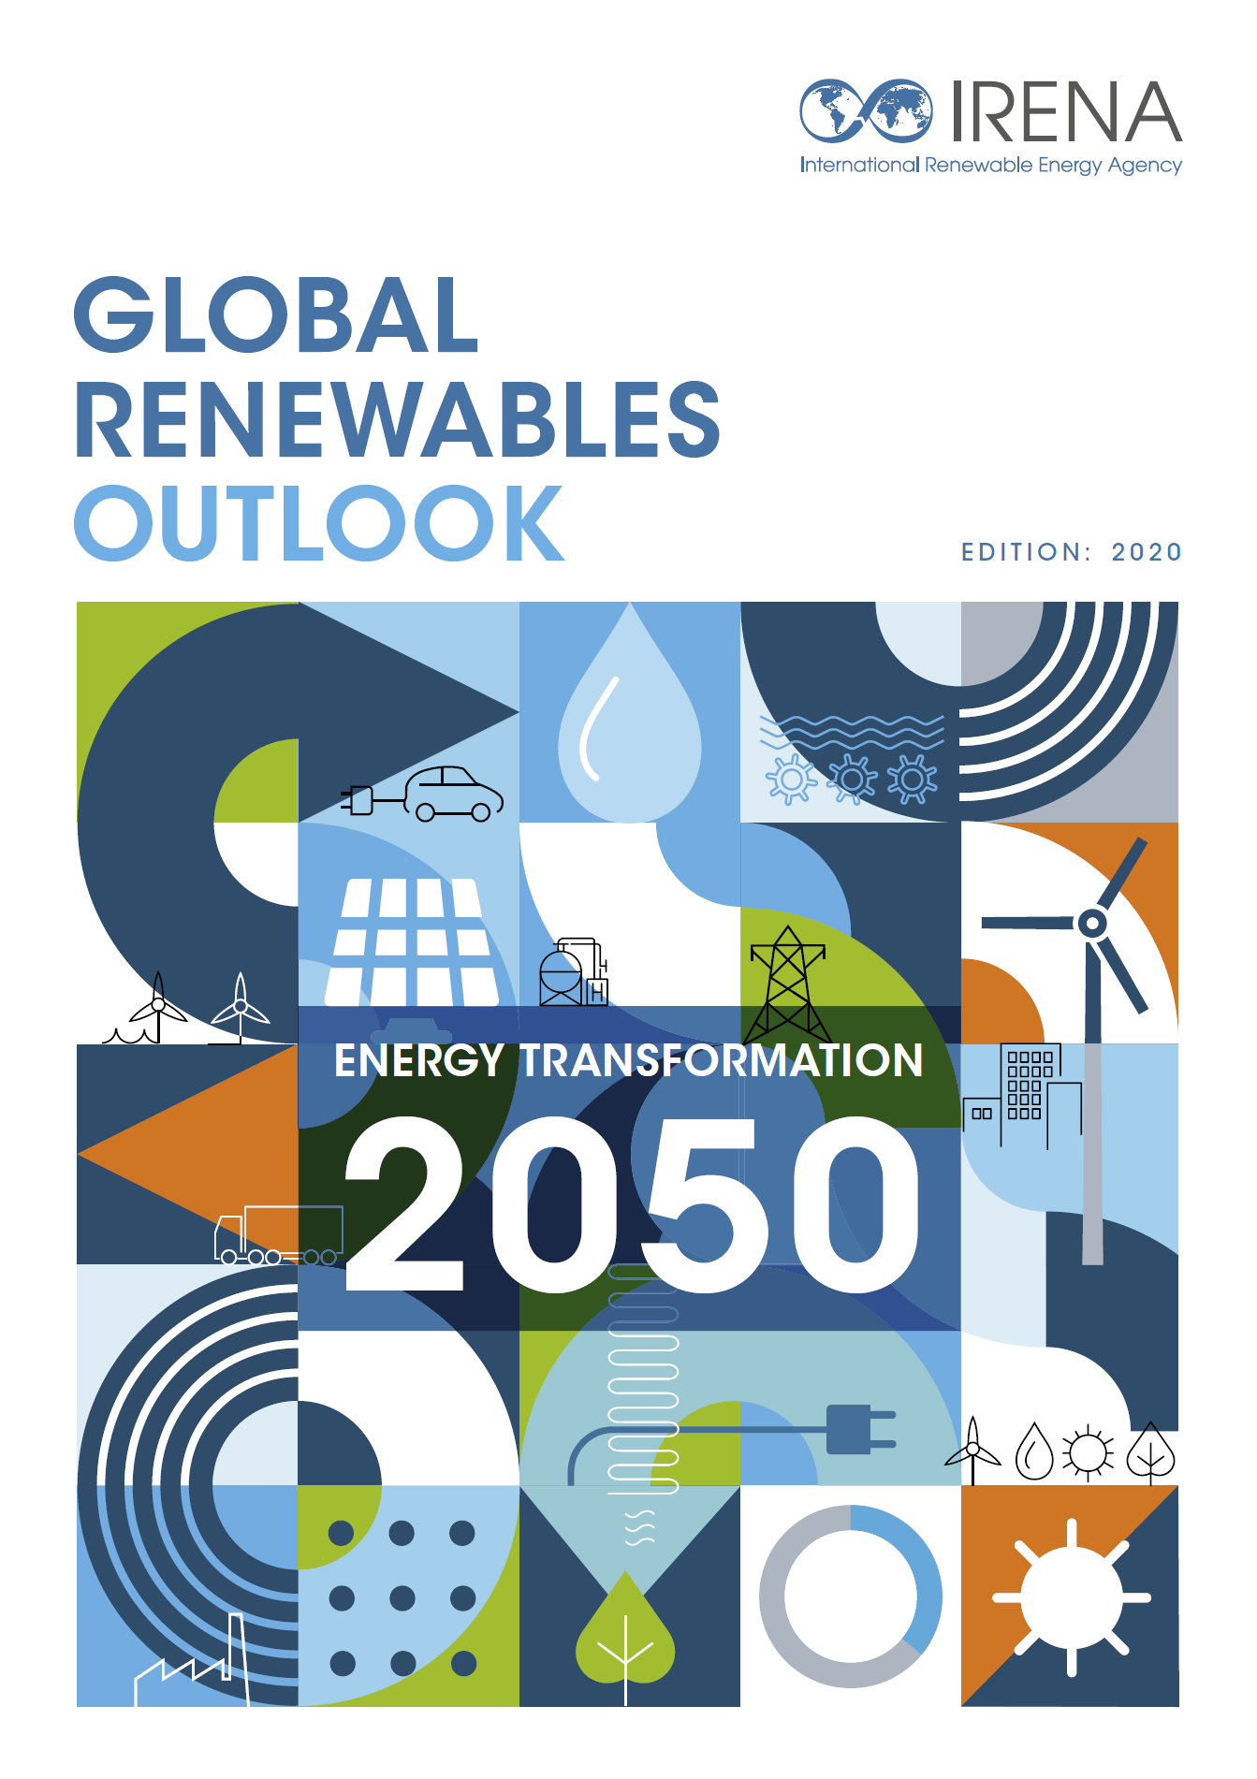
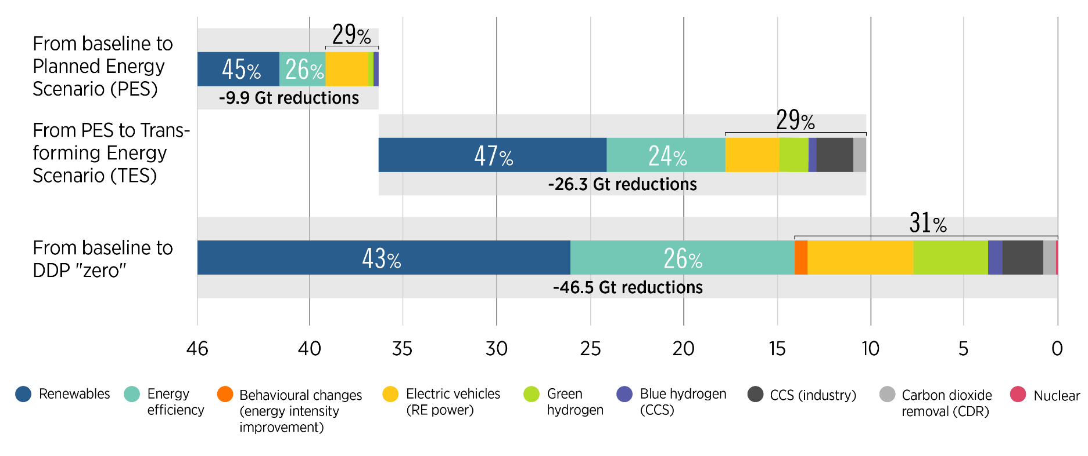
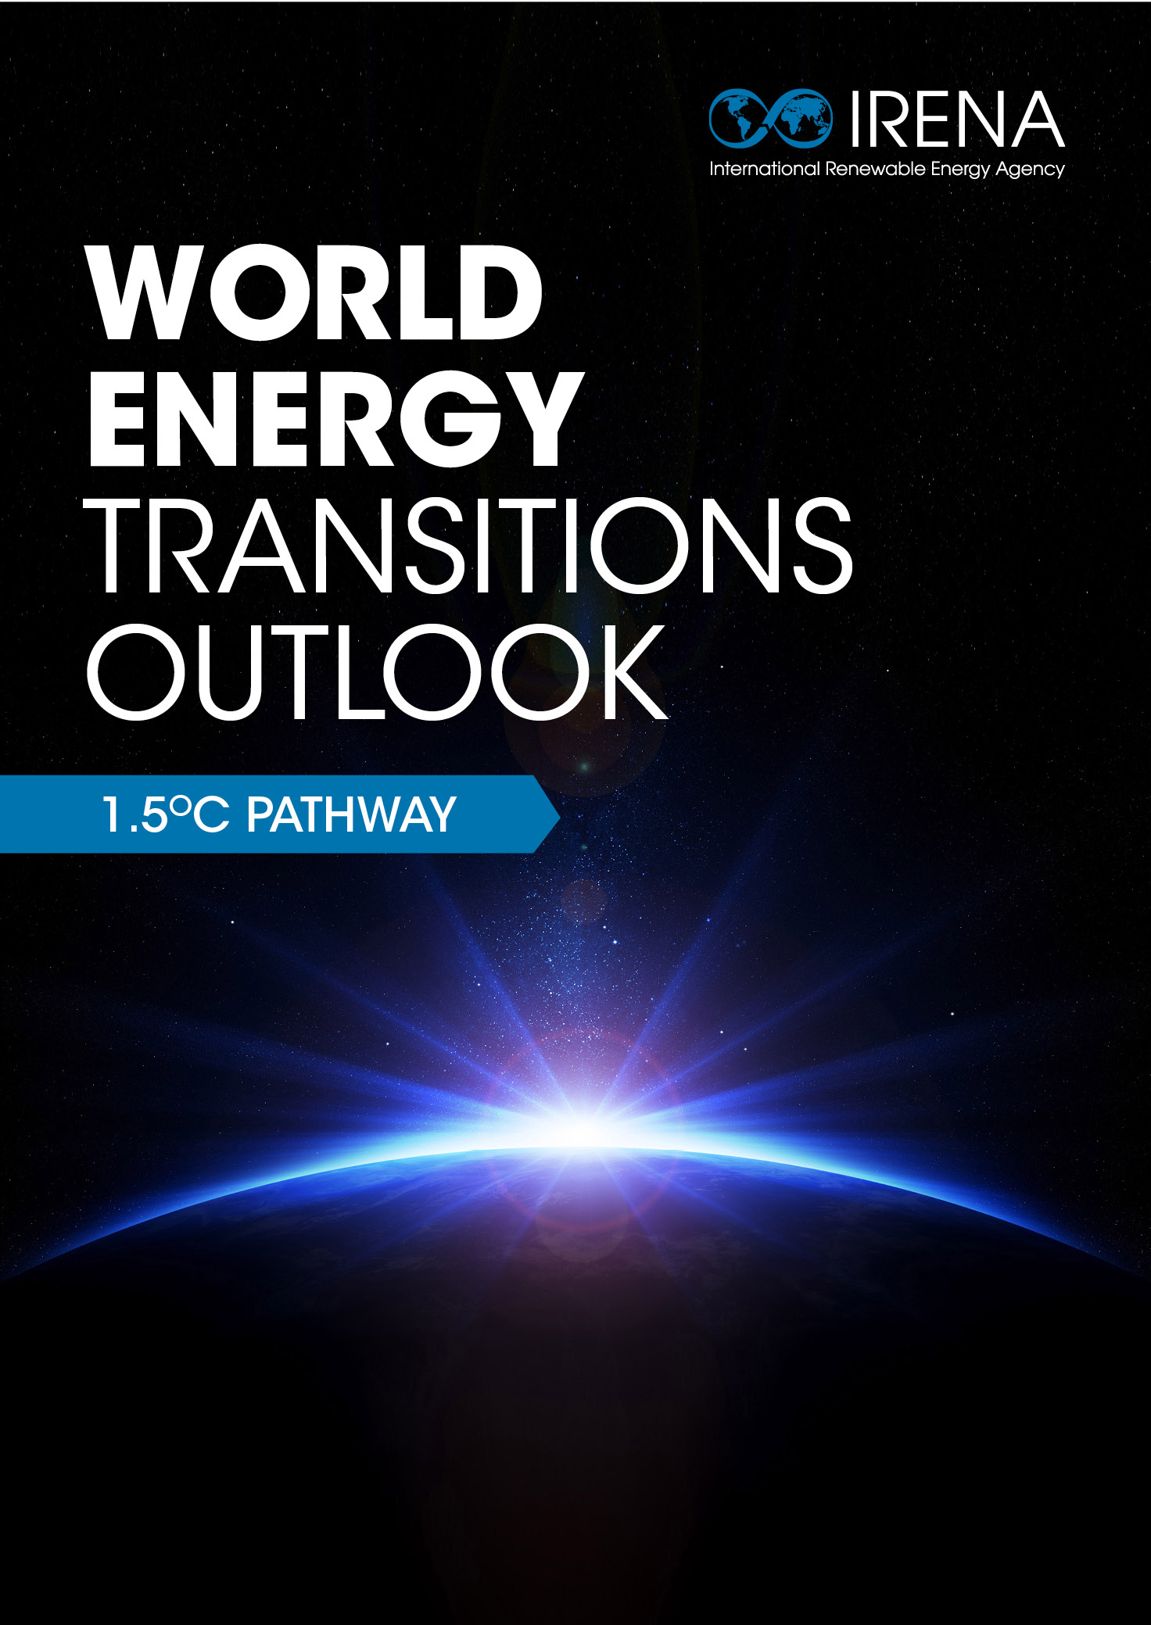
Pathways to cut energy-related CO₂ emissions to 2050 in line with the Paris Agreement
Energy and industrial process-related CO2 emission reductions (Gt CO₂/y by 2050)
2 degrees
1.5 degrees
H₂
Energy efficiency, renewables, end-use electrification, green hydrogen and synthetic fuels will play a crucial role in global decarbonisation.

Slide 6
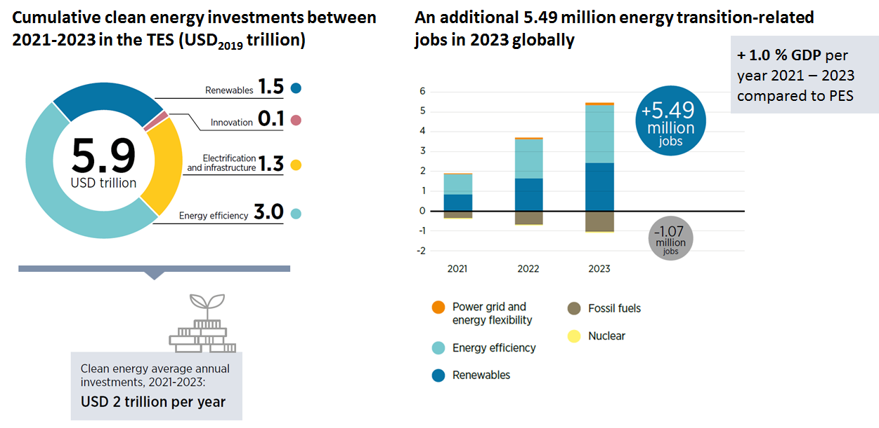
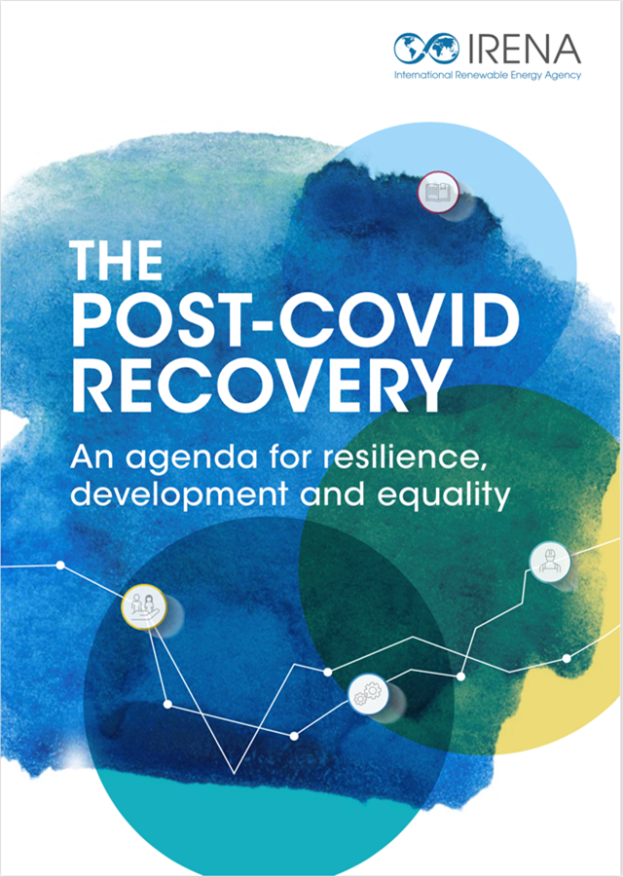
Sustainable recovery: Short-term benefits from investing in the energy transition

Slide 7
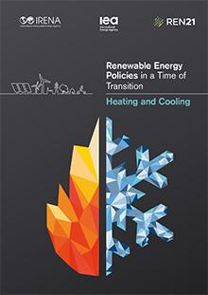
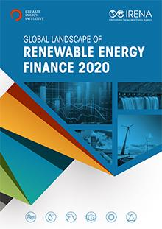
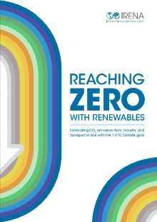
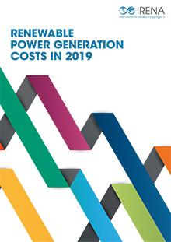
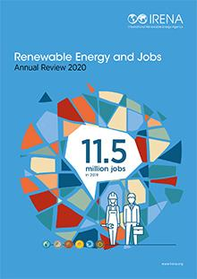
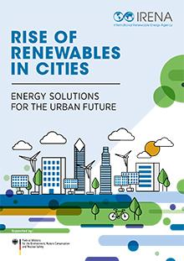
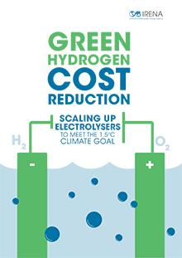
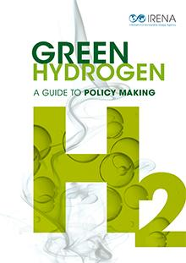
Thank you!
www.irena.org

