Slide 1

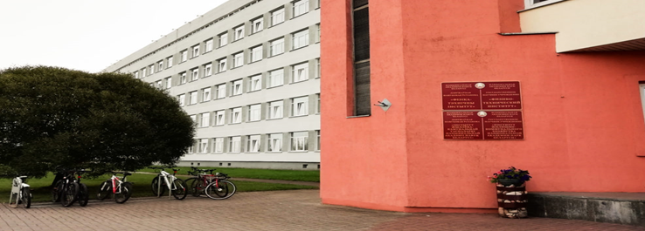
STATE SCIENTIFIC INSTITUTION
INSTITUTE OF THE HOUSING AND UTILITIES SECTOR
OF THE NATIONAL ACADEMY OF SCIENCES OF BELARUS
ANALYSIS OF THE CONDITIONS FOR LARGE-SCALE USE OF RENEWABLE ENERGY IN THE RESIDENTIAL AND MUNICIPAL SECTORS
Director, Doctor of Engineering, Professor
Vadim Olegovich Kitikov

Slide 2
STATE SCIENTIFIC INSTITUTION
INSTITUTE OF THE HOUSING AND UTILITIES SECTOR
OF THE NATIONAL ACADEMY OF SCIENCES OF BELARUS
Breakdown of the final consumption of fuel and energy resources in the residential sector

Slide 3
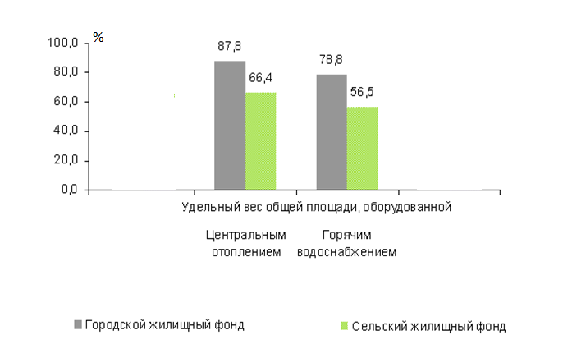
STATE SCIENTIFIC INSTITUTION
INSTITUTE OF THE HOUSING AND UTILITIES SECTOR
OF THE NATIONAL ACADEMY OF SCIENCES OF BELARUS
Upgrading housing facilities
(including individuals’ housing facilities; percent)
Proportion of the total area equipped with
Central heating
Hot water supply
Municipal housing facilities
Rural housing facilities

Slide 4
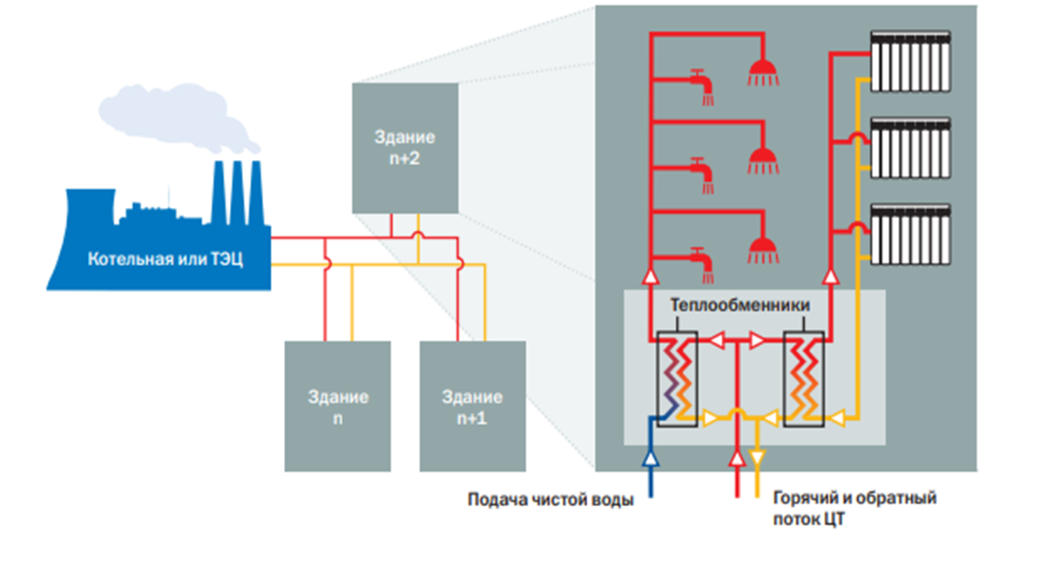
STATE SCIENTIFIC INSTITUTION
INSTITUTE OF THE HOUSING AND UTILITIES SECTOR
OF THE NATIONAL ACADEMY OF SCIENCES OF BELARUS
District heating systems in the housing and utilities sector, operational features
The average energy efficiency ratio in the energy balance of the boiler house - heating network - heating system of a building (or process heating) is no more than 40%.
Building
n+2
Boiler house or CHP
Heat exchange unit
Building
n
Building
n+1
Pure water supply
Hot and return flow [ЦТ]
Closed district heating system

Slide 5
STATE SCIENTIFIC INSTITUTION
INSTITUTE OF THE HOUSING AND UTILITIES SECTOR
OF THE NATIONAL ACADEMY OF SCIENCES OF BELARUS
Main factors affecting the efficiency of district heating systems
a high proportion of physically obsolete equipment;
different balance sheet attribution of heat supply system elements;
a large branching of heat networks from a single heat source and high heat losses in them;
the separation of process control systems for heat supply and heat consumption.

Slide 6
STATE SCIENTIFIC INSTITUTION
INSTITUTE OF THE HOUSING AND UTILITIES SECTOR
OF THE NATIONAL ACADEMY OF SCIENCES OF BELARUS
Current requirements for district heating systems
1. Minimum network losses
2. Interoperation with smart energy systems
3. Interoperation with renewable heat sources (integration through intelligent information and communication management systems);
4. Participation in digital processes through information and communication technology.

Slide 7
STATE SCIENTIFIC INSTITUTION
INSTITUTE OF THE HOUSING AND UTILITIES SECTOR
OF THE NATIONAL ACADEMY OF SCIENCES OF BELARUS
Modernisation of systems and transition to low-carbon technologies for the heat supply of housing and public facilities using electricity and renewable energy sources (RES)
Modernisation and upgrading of the energy efficiency of heating networks and housing and communal facilities
DEVELOPMENTS IN IMPROVING THE EFFICIENCY OF HEAT SUPPLY TO HOUSING AND PUBLIC FACILITIES IN THE REPUBLIC OF BELARUS
Optimisation of district heating schemes and decentralisation of heat supply systems for housing and public facilities
Modernisation of district heating systems and boiler houses in the housing and utilities sector, based on the integrated use of local fuel types, electricity and RES

Slide 8

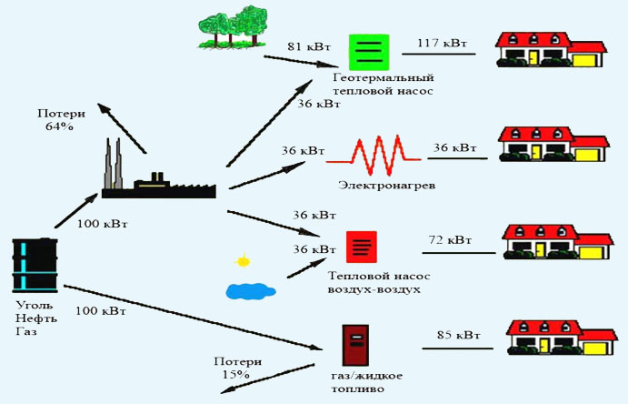
STATE SCIENTIFIC INSTITUTION
INSTITUTE OF THE HOUSING AND UTILITIES SECTOR
OF THE NATIONAL ACADEMY OF SCIENCES OF BELARUS
OPTIONS FOR THE EFFICIENT USE OF RENEWABLE ENERGY SOURCES IN THE HEAT SUPPLY OF HOUSING AND PUBLIC FACIITIES
81 kW
117 kW
Geothermal heat pump
Losses
64%
36 kW
36 kW
36 kW
Electric heating
100 kW
36 kW
36 kW
72 kW
Heat pump air air
Coal Oil
Gas
100 kW
85 kW
Losses
15%
Gas/fuel oil

Slide 9
STATE SCIENTIFIC INSTITUTION
INSTITUTE OF THE HOUSING AND UTILITIES SECTOR
OF THE NATIONAL ACADEMY OF SCIENCES OF BELARUS
Classification of housing and public services
Housing and public facilities
Housing sector facilities
Multi-storey apartment buildings
Low-rise apartment buildings
Public sector facilities
Social sector facilities
Individual residential buildings
Production facilities
Housing and public sector business facilities
Healthcare facilities
Educational facilities
Service sector facilities
Housing and public sector heat supply facilities
Wastewater disposal facilities

Slide 10
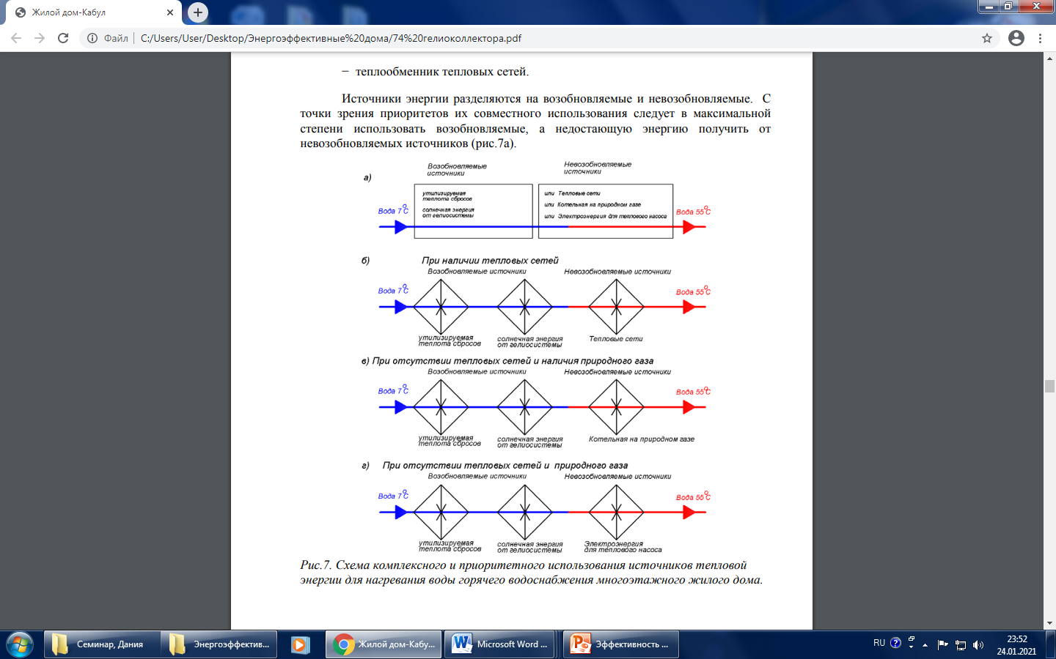
STATE SCIENTIFIC INSTITUTION
INSTITUTE OF THE HOUSING AND UTILITIES SECTOR
OF THE NATIONAL ACADEMY OF SCIENCES OF BELARUS
An integrated approach to the use of RES in the heat supply
of the housing sector
Renewable sources
Non-renewable sources
а)
Water 7°C
Water 55°C
b) If heating networks are available
Renewable sources
Non-renewable sources
Water 7°C
Water 55°C
recoverable waste heat
solar energy from a solar system
Heating networks
c) If there are no heating networks but there is natural gas available
Renewable sources
Non-renewable sources
Water 7°C
Water 55°C
recoverable waste heat
solar energy from a solar system
Natural gas boiler house
d) If there are no heating networks or natural gas availability
Renewable sources
Non-renewable sources
Water 7°C
Water 55°C
recoverable waste heat
solar energy from a solar system
Electricity for a heat pump
Structural diagram of the integrated use of heat sources for heating hot water in a multi-storey residential building

Slide 11
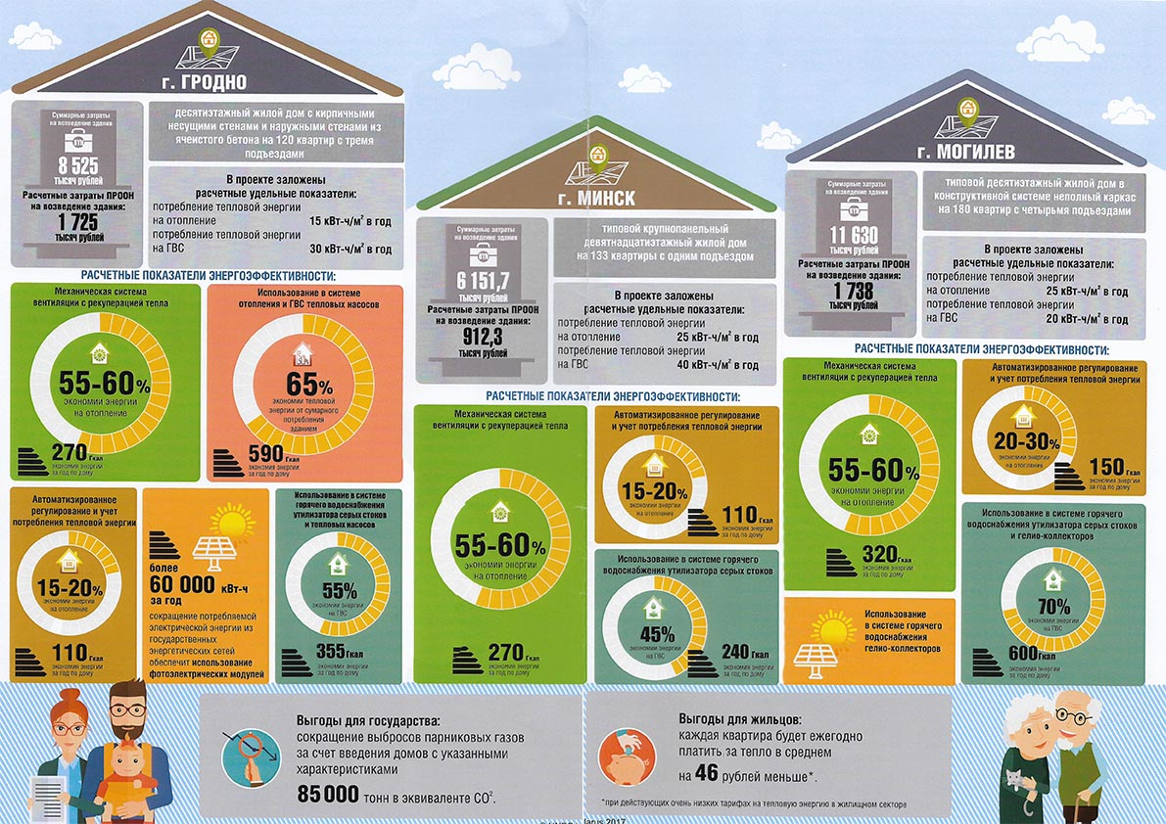
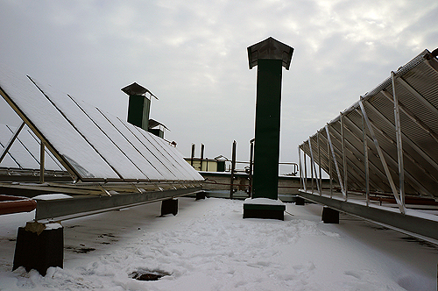
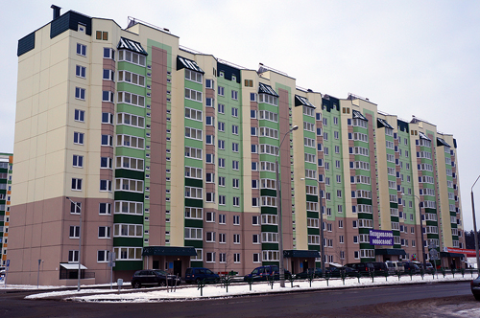
STATE SCIENTIFIC INSTITUTION
INSTITUTE OF THE HOUSING AND UTILITIES SECTOR
OF THE NATIONAL ACADEMY OF SCIENCES OF BELARUS
250 solar collectors are installed on the roof

Slide 12
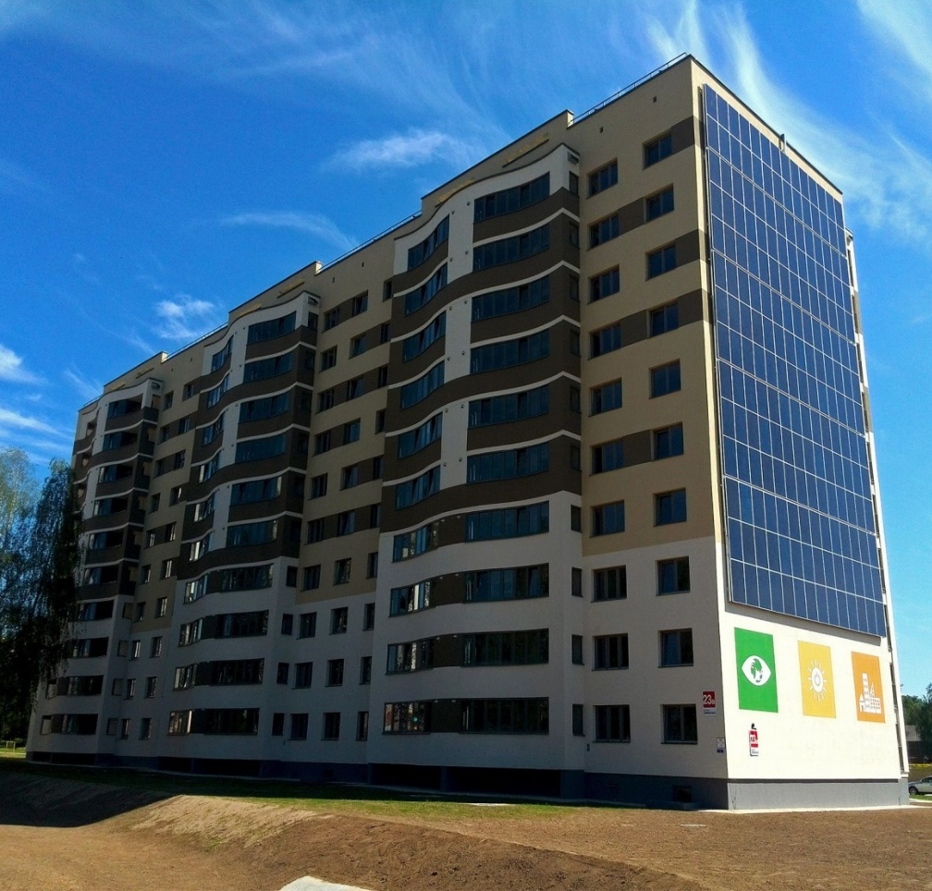
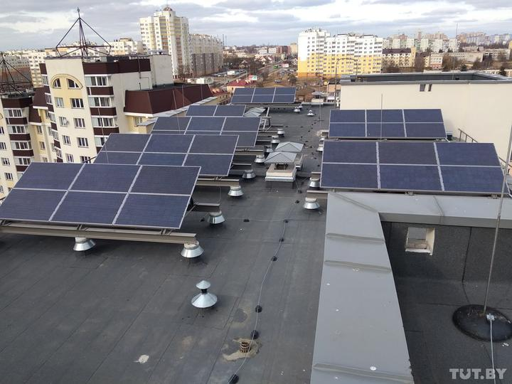
STATE SCIENTIFIC INSTITUTION
INSTITUTE OF THE HOUSING AND UTILITIES SECTOR
OF THE NATIONAL ACADEMY OF SCIENCES OF BELARUS
Preparations for the transition of the district heating systems of multi-storey residential buildings to a new technological level
View of the solar power plant panels: total area of the solar panels – 250 m²
output – 74 kW.

Slide 13
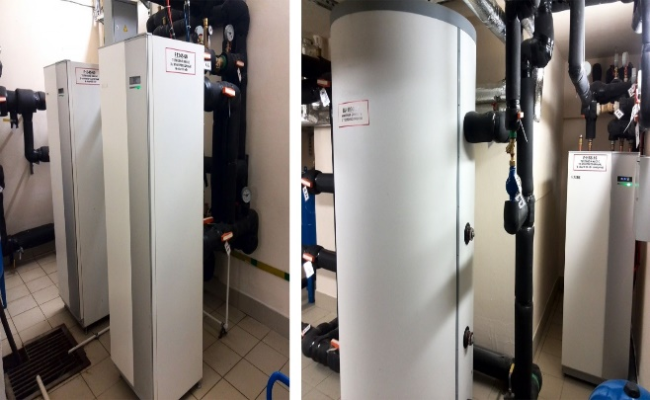
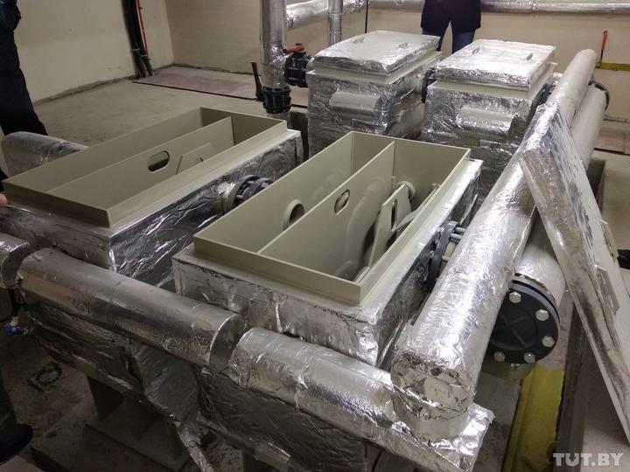
STATE SCIENTIFIC INSTITUTION
INSTITUTE OF THE HOUSING AND UTILITIES SECTOR
OF THE NATIONAL ACADEMY OF SCIENCES OF BELARUS
There are three heat pumps for the whole house. Two of them are powered by the collector. The other receives heat from the ground beneath the foundation. Inside the 34 piles of the house there is a heat pump heat exchanger
View of heat pumps and storage tank
A view of the greywater recycler

Slide 14
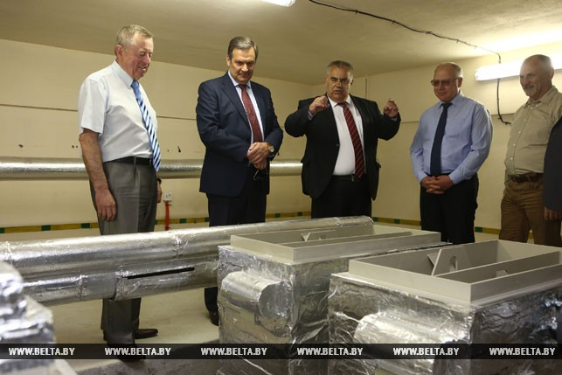
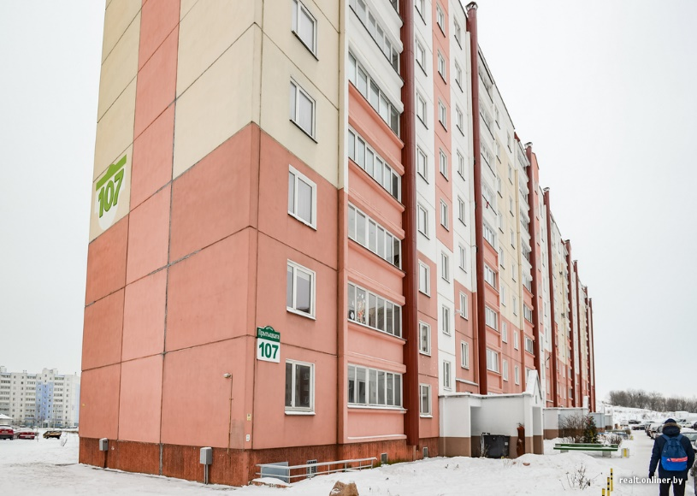
STATE SCIENTIFIC INSTITUTION
INSTITUTE OF THE HOUSING AND UTILITIES SECTOR
OF THE NATIONAL ACADEMY OF SCIENCES OF BELARUS
A view of the greywater recycler
The actual heating energy costs for this house are 60-70% lower than for similar buildings in this series.

Slide 15
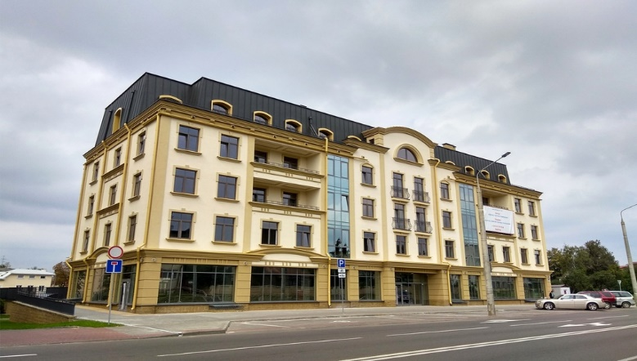
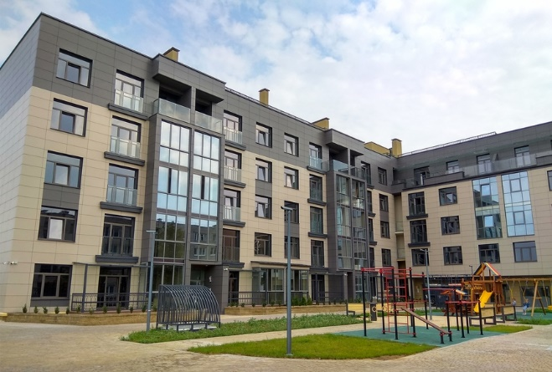
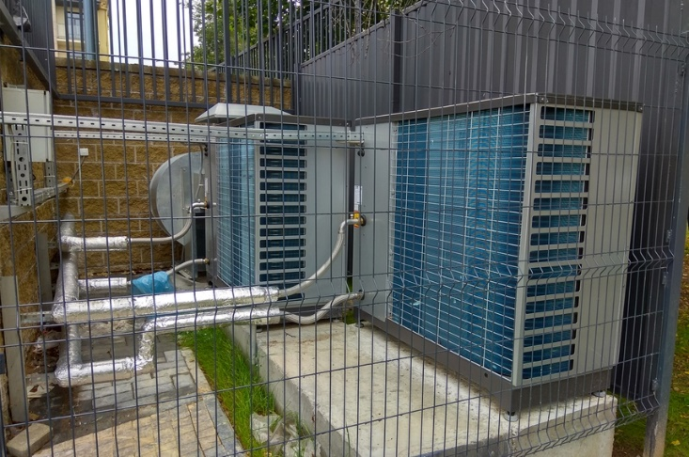
STATE SCIENTIFIC INSTITUTION
INSTITUTE OF THE HOUSING AND UTILITIES SECTOR
OF THE NATIONAL ACADEMY OF SCIENCES OF BELARUS
The district heating system for low-rise residential buildings is integrated with the use of low-temperature energy sources
Multiple-dwelling low-rise residential building in the centre of Grodno
The district heating supply integrates a hot water system using low-temperature energy sources.
The hot water supply of the residential building in the off-heating period is provided by two air-to-water heat pumps and a set of storage tanks

Slide 16
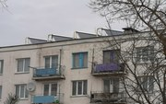
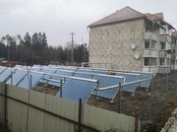
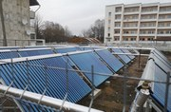
STATE SCIENTIFIC INSTITUTION
INSTITUTE OF THE HOUSING AND UTILITIES SECTOR
OF THE NATIONAL ACADEMY OF SCIENCES OF BELARUS
District heating supply for low-rise residential buildings using local fuel and energy resources and solar energy
Orsha district, Vitebsk region
Modernisation of hot water supply system with installation of solar water heater on the roof of a 5-storey residential building in Obukhovo village, 8 Svyazistov st.
Installed solar collectors for the provision of hot water in two residential buildings 1 and 2 in the village of Zvezdnaya, Internatovskaya st. 24 SCH30 solar panels, consisting of vacuum tubes, are placed outdoors near building number 2. The rest of the heating equipment is situated in the basement of the apartment building.

Slide 17
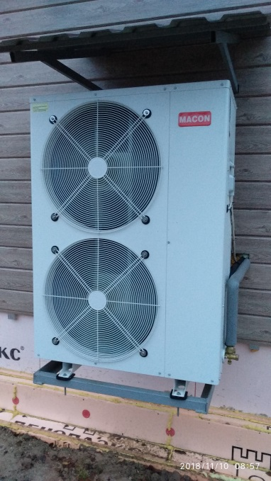
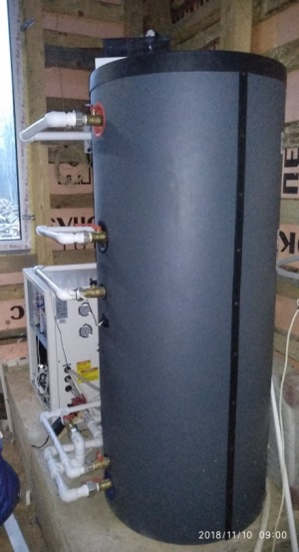
STATE SCIENTIFIC INSTITUTION
INSTITUTE OF THE HOUSING AND UTILITIES SECTOR
OF THE NATIONAL ACADEMY OF SCIENCES OF BELARUS
Heat supply system for individual residential buildings using RES
The air-to-water heat pump used in an individual home heating system consists of the following equipment:
- the outdoor unit, which is an outdoor inverter unit. It is similar to a standard unit used for space conditioning. To protect the unit from precipitation, a canopy can be fit over it;
- indoor unit - hydraulic module. The design is ultra-stable with a built-in, predictor-corrector regulator. It allows the supply of hydraulic fluid to be changed automatically depending on the actual hydraulic demand in real time, without changing the phase shift.

Slide 18
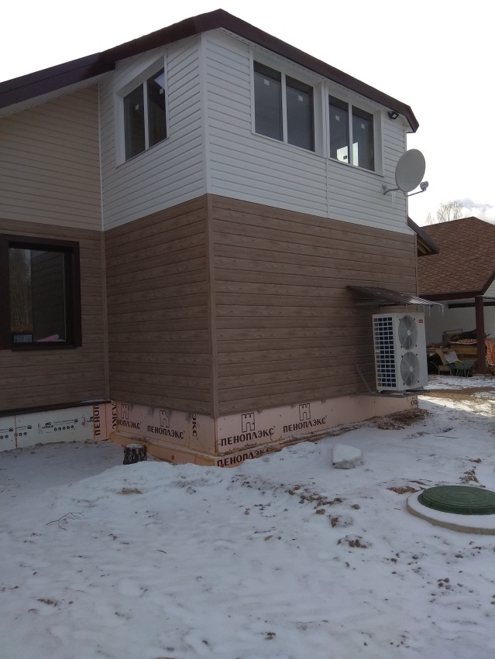

STATE SCIENTIFIC INSTITUTION
INSTITUTE OF THE HOUSING AND UTILITIES SECTOR
OF THE NATIONAL ACADEMY OF SCIENCES OF BELARUS
Heating a private home with an air-to-water heat pump
Sebezh

Slide 19
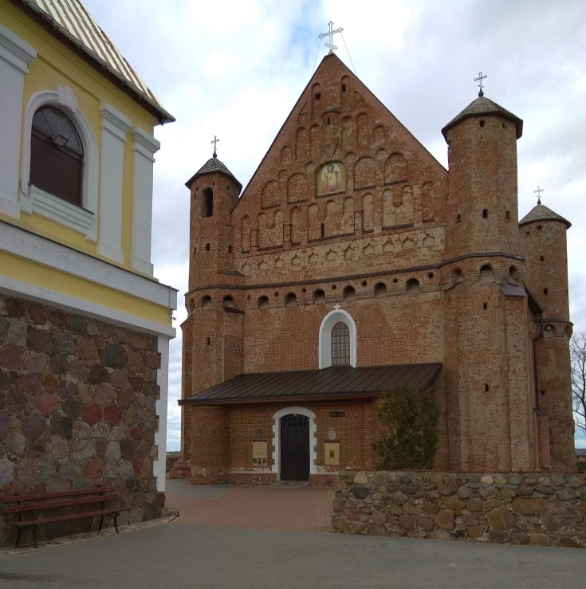
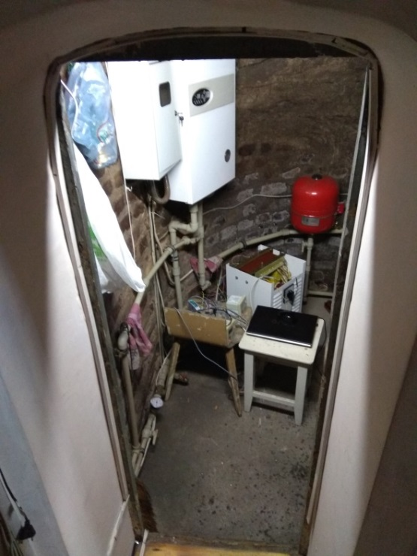
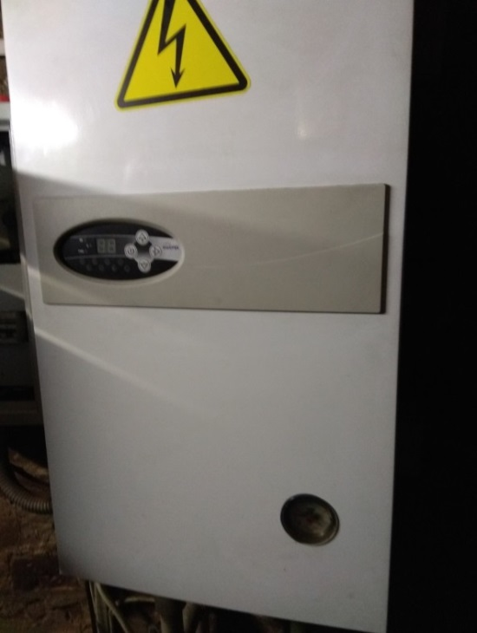
STATE SCIENTIFIC INSTITUTION
INSTITUTE OF THE HOUSING AND UTILITIES SECTOR
OF THE NATIONAL ACADEMY OF SCIENCES OF BELARUS
Heat supply system for social facilities using alternative energy sources
Heating the facility in the Synkovichi building
Church of St. Michael
Building of the State Register of Historical and Cultural Values of the Republic of Belarus. The historical value of the church does not allow it to be connected to central heating.
Heating and cooling using an air-to-water heat pump, the cost of the equipment, together with the commissioning work, was 13,860 roubles. Operating costs in the form of electricity bills have decreased fourfold.

Slide 20
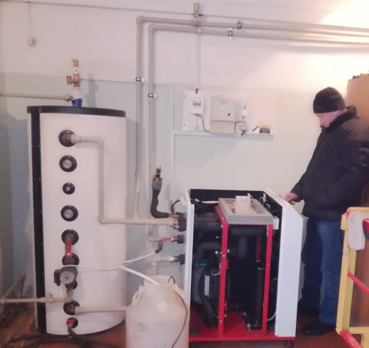
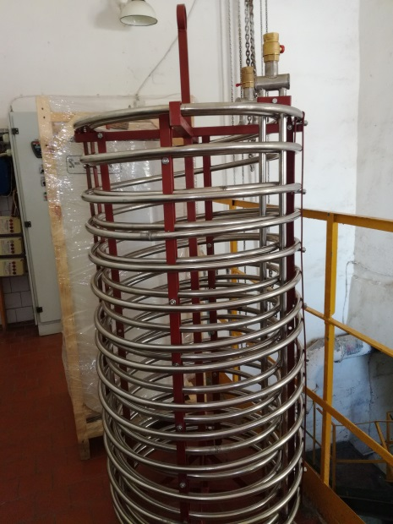
STATE SCIENTIFIC INSTITUTION
INSTITUTE OF THE HOUSING AND UTILITIES SECTOR
OF THE NATIONAL ACADEMY OF SCIENCES OF BELARUS
Heat supply systems for wastewater disposal facilities using RES
Molodechnovodokanal District Heating Company wastewater pump system in the city of Maladzyechna
A geothermal heat pump has been installed.
A spiral heat exchanger was installed in the wastewater inlet of the sewage pumping station, which made it possible to eliminate drilling work and reduce the cost of the equipment with installation to 15,492 roubles. The design of the heat exchanger in the form of a tubular coil to the heat pump has reduced the cost of the equipment by up to 40%.
The average heat consumption in the existing system was 180 kW per day, the heat pump wastes 55 kW per day. Monetary savings over the heating season amounted to 6,100 roubles, which indicates a return on investment of 2.5 years excluding hot water.

Slide 21
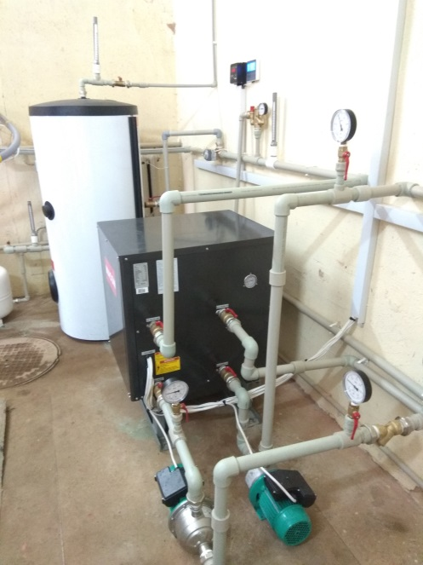
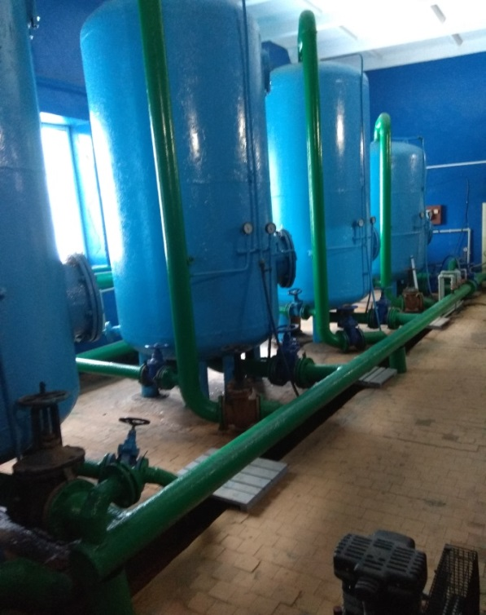
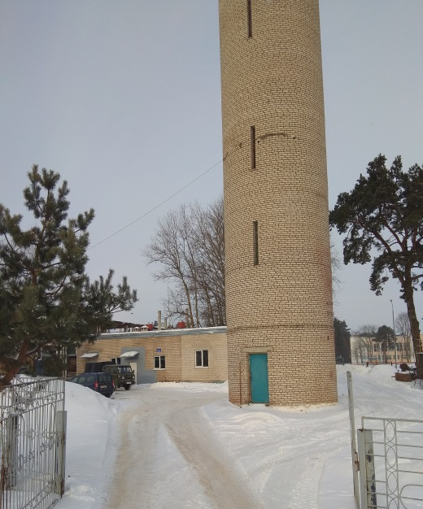
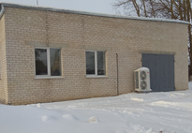
STATE SCIENTIFIC INSTITUTION
INSTITUTE OF THE HOUSING AND UTILITIES SECTOR
OF THE NATIONAL ACADEMY OF SCIENCES OF BELARUS
Novopolotskvodokanal branch of the Vitebskolvodokanal District Heating Company Deferrization plant
City of Verkhnyadzvinsk
the area of the room 221.5 m2
water heat source extracted; after water treatment, the heat pump is connected to the water supply
hydrothermal heat pump with a heat output of 24 kW

Slide 22
STATE SCIENTIFIC INSTITUTION
INSTITUTE OF THE HOUSING AND UTILITIES SECTOR
OF THE NATIONAL ACADEMY OF SCIENCES OF BELARUS
Conclusions
1. Ensuring savings of 10% or more of heat energy for heating the housing sector, based on the use of renewable energy sources, can provide an energy effect of 300,000 or more tonnes of oil equivalent per year of final consumption of fuel and energy resources for thermal energy production.
2. In the short term, the following is required:
— development and implementation of comprehensive research projects on the use of hybrid systems based on district heating and renewable energy sources for the heating and hot water supply of public utilities;
— creation of a systems management infrastructure for the effective implementation of these schemes;
— interoperation with renewable heat sources (integration through intelligent information and communication management systems);
— participation in digital processes through information and communication technology;
3. In the reconstruction, design and construction of new facilities, a group of housing units, the use of RES as part of hybrid heat supply systems should be envisaged in addition to a decentralised heat supply.

Slide 23
STATE SCIENTIFIC INSTITUTION
INSTITUTE OF THE HOUSING AND UTILITIES SECTOR
OF THE NATIONAL ACADEMY OF SCIENCES OF BELARUS
State Scientific Institution – Institute of the Housing and Utilities Sector of the National Academy of Sciences of Belarus
220024, Republic of Belarus, Minsk, 10 Akademika Kuprevicha st.
Email: institut-gkh@tut.by
Front desk: Tel./fax: (017) 360-38-35; mob.:(033) 392-45-09

