Slide 1



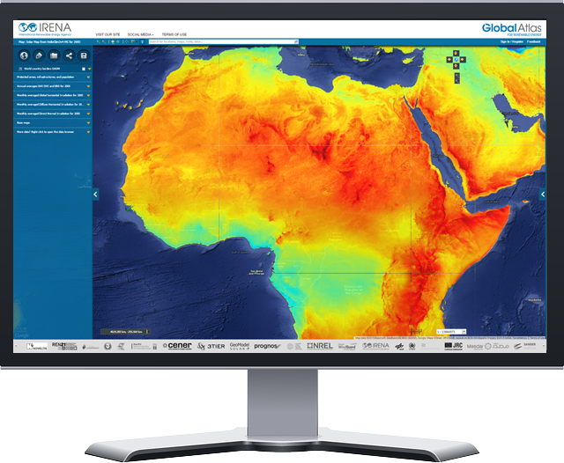
Launch of the Global Wind Atlas
Oct 21, 2015
The IRENA Global Atlas for Renewable Energy

Slide 2
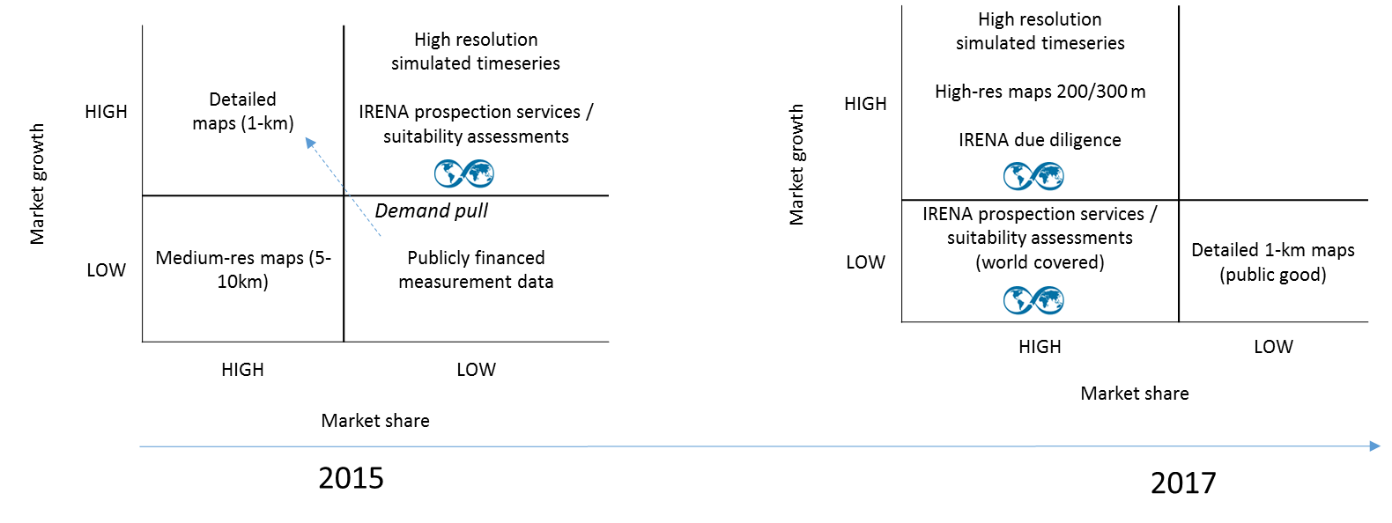
Market disruption

Slide 3
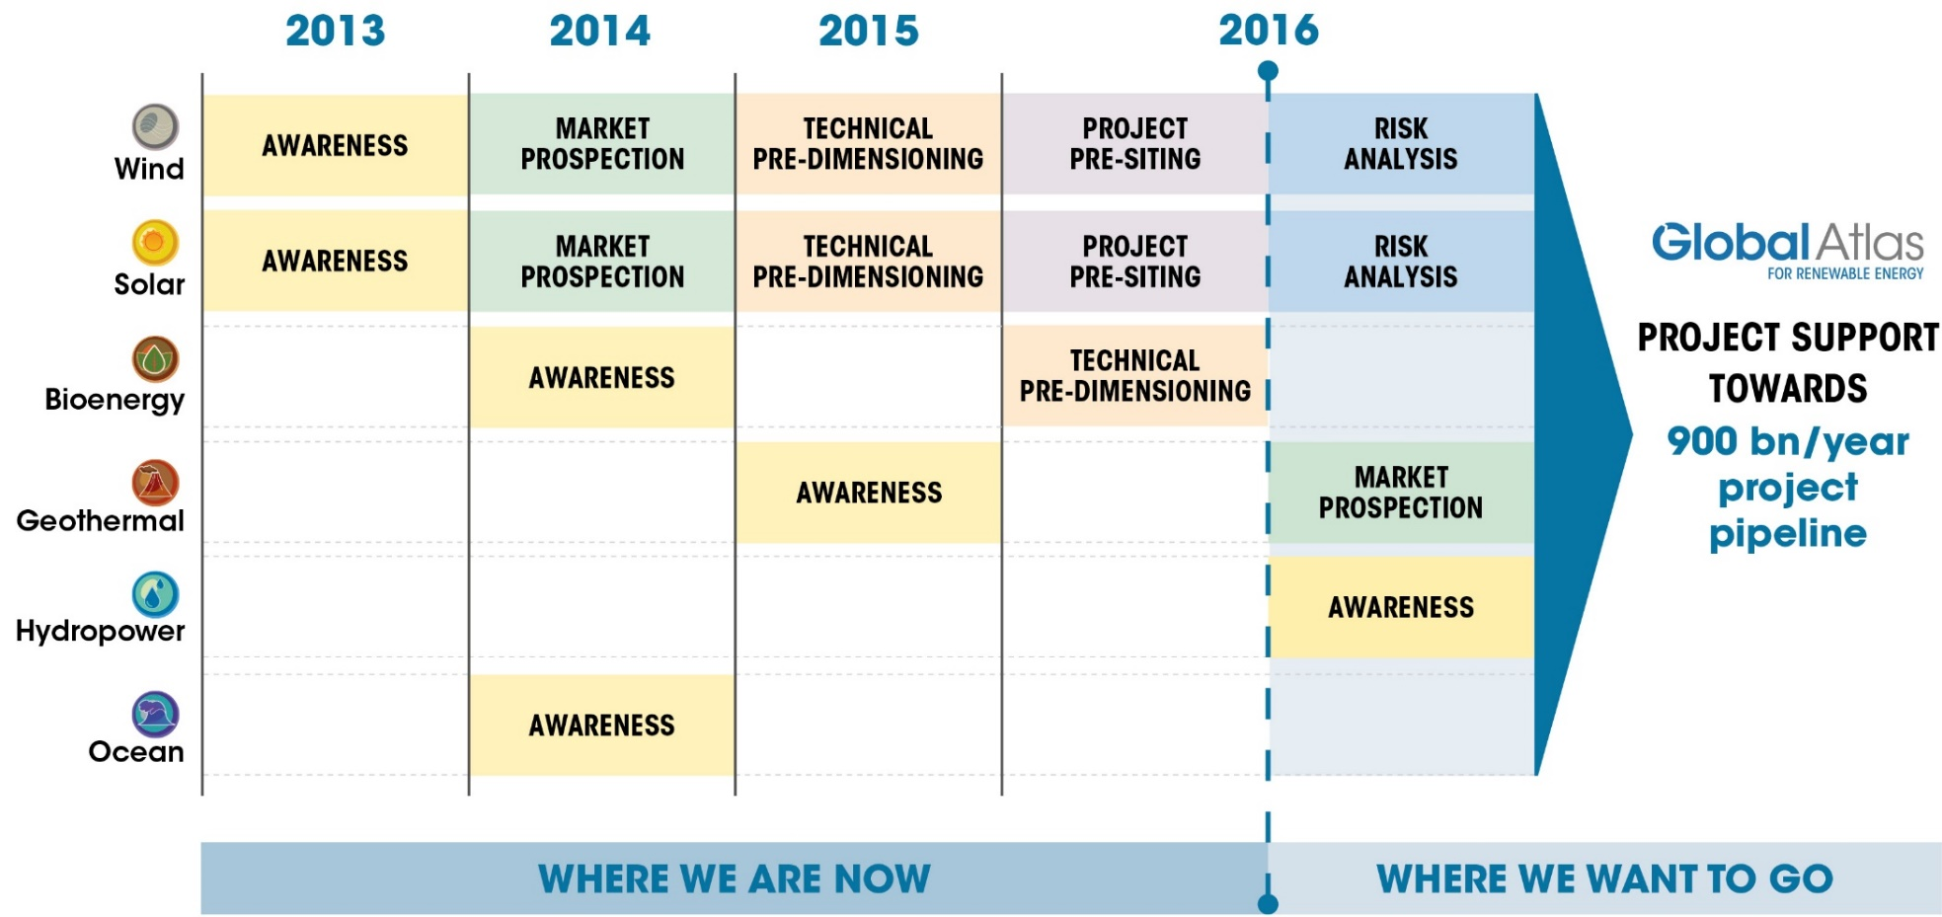
Global Atlas Strategy

Slide 4






Integrated service chain
Project concept
Pre-feasibility
Feasibility
Investor ready
Deployment
Site characterization
Success stories
Country profiles
Project pipelines
Corridors, SIDS Lighthouse, Readiness
Assistance to financial closure and debt facility
Bankable project development guidelines
Evaluate, technical assistance

