Slide 1
New Zealand Aid Programme
Expanding access to affordable, reliable and clean energy
Workshop on financing for renewable energy in SIDS
December 2016

Slide 2
New Zealand Aid funding by region
20%
Multilateral
59%
Pacific
3%
Africa
1%
17% Asia
Latin America &
Caribbean

Slide 3
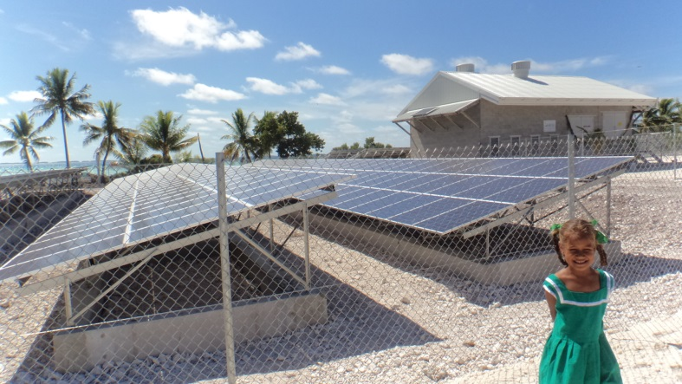
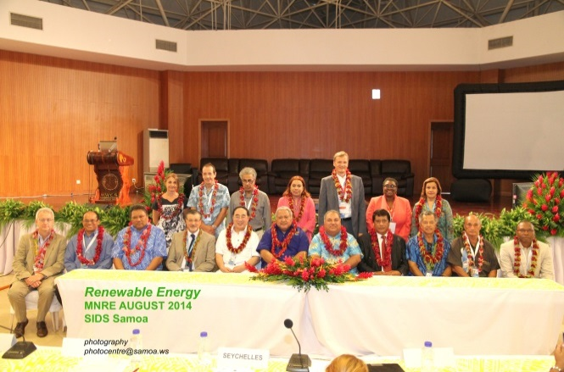
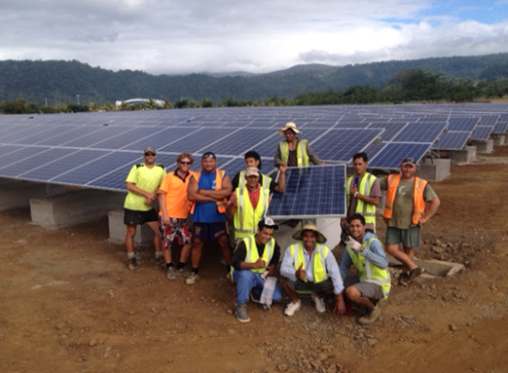
NZ Aid Programme Strategy
Expand access to reliable, affordable and clean energy
Invest in renewable energy generation and infrastructure, including private sector involvement
Improve energy sector planning, asset management and technical assistance

Slide 4

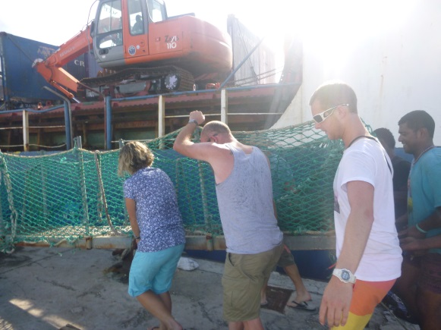
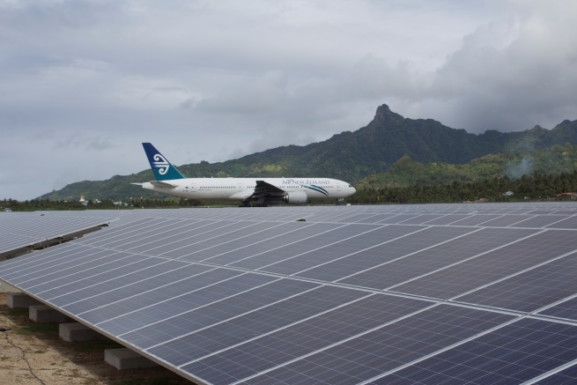
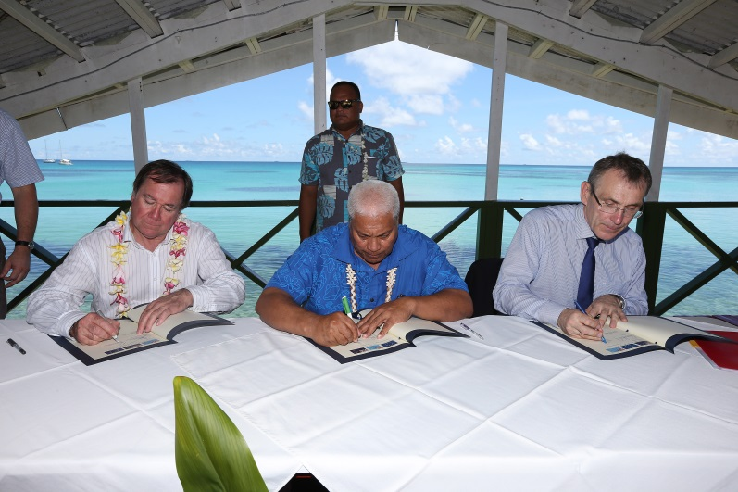
Since 2013 NZ has committed >$100m to support 25 projects in 8 countries. 14 projects completed in:
Cook Islands
Samoa
Tuvalu
Solomon Islands
Further projects in:
Kiribati
Papua New Guinea
Tonga
Vanuatu
Notes:
.

Slide 5
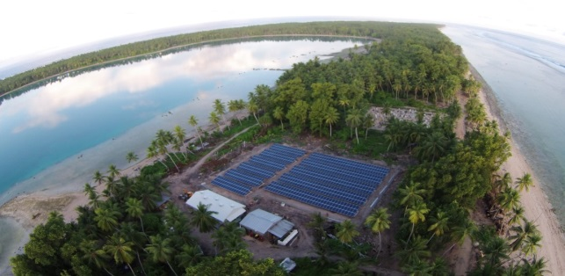
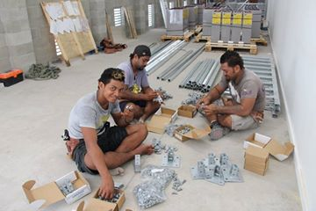
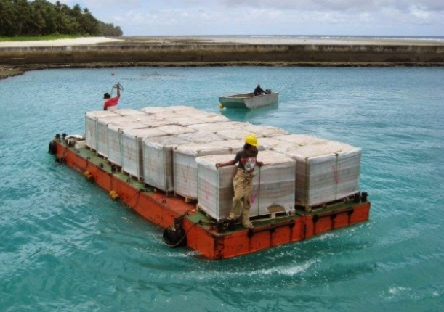
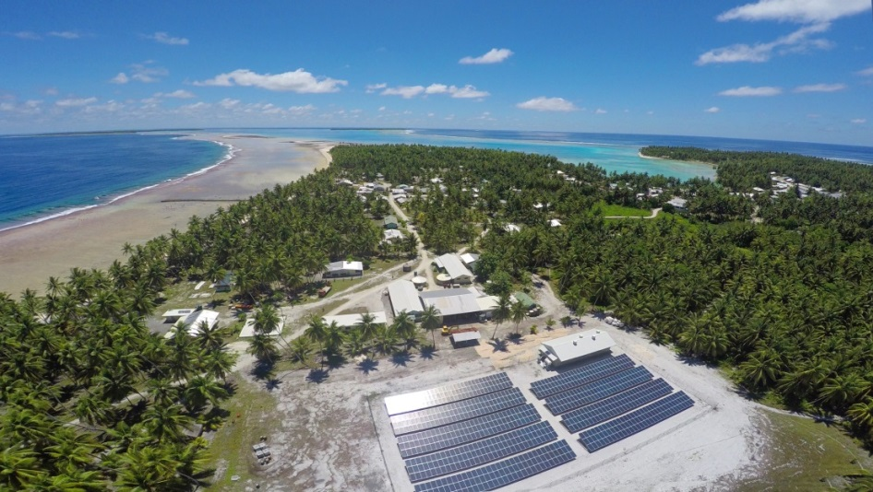
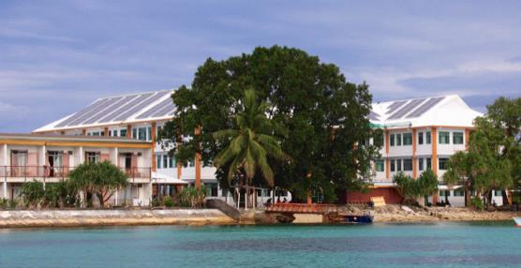
Tuvalu and Cook Islands
Tuvalu
PV hybrid mini-grid systems with battery storage on 4 Outer Islands
170kW rooftop PV
Technical assistance and capacity building
Cook Islands
960kWp grid-connected solar array at the airport on Rarotonga.
Eight PV hybrid mini-grid systems with battery storage on 6 Outer Islands

Slide 6
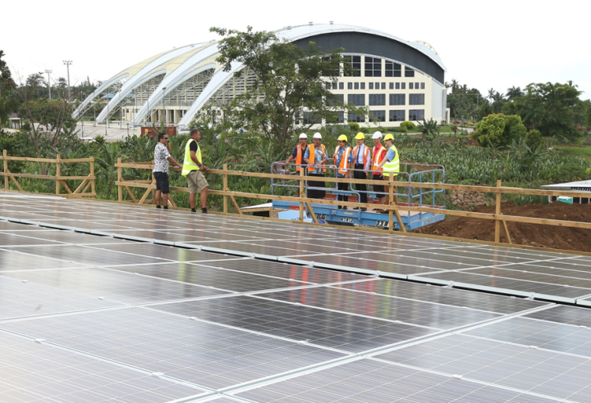
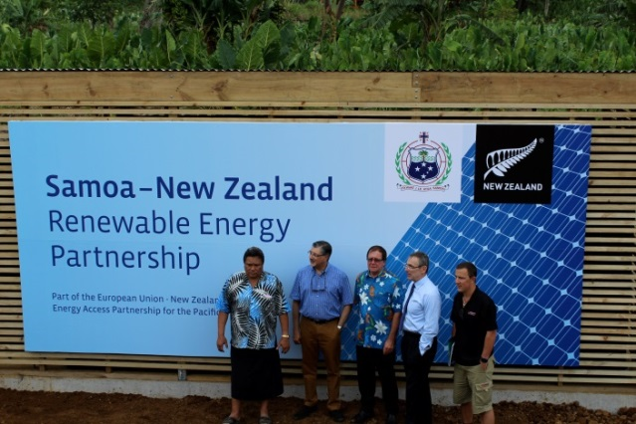
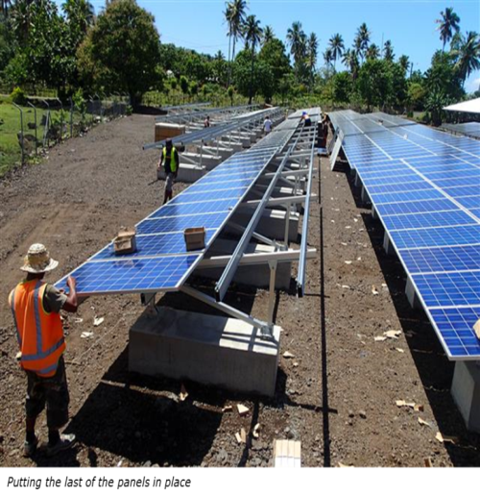
Samoa and Tonga
Samoa
2.2MW on Racecourse.
240kWp rooftop on Sports Complex.
150kWp grid-connected array on Savaii
Support ADB-led hydro projects
EPC least cost generation plan
Tonga
  Tonga Village Network Upgrade Project Phase 2 & 3
  Wind feasibility study
  Other projects: Solomon Islands, Kiribati, Vanuatu, PNG.

Slide 7

Pacific Energy Conference Outcomes
New Zealand and the European Union hosted the Pacific Energy Conference, 7th June 2016.
Donors committed over $1 billion by 2024 for sustainable energy projects in the Pacific
Pacific Energy Conference ambitions include support for:
- Polynesia to achieve >50% renewable energy by 2024;
- Melanesia provide access to electricity to approx 1 million people;
- Micronesia to double renewable energy generation.

Slide 8
Pacific Energy Conference Themes
Conference themes recognised the benefits of increasing focus on climate finance, sustainable transport and sustainable agriculture
A ‘Blue Book’ or Pacific Energy Country Profiles book was published to provide a snapshot of each countries progress since the 2013 Pacific Energy Summit and proposed projects for private sector /donor investment.

Slide 9
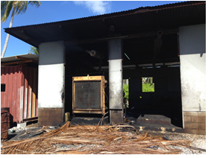
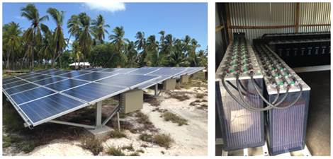
New Zealand Commitment
New Zealand has committed $100 million to energy projects in 10 Pacific countries, 2016-2024.
Melanesia: Increase access to electricity
Polynesia: Encourage private sector investment, technical assistance, regulatory amendments
Micronesia: Increase renewable energy generation
Partnerships: Focus on existing and new opportunities.

