Slide 1

Financing renewable energy in small island developing states (SIDS)
Funding proposal with Pacific SIDS
A Regional Renewable Energy Initiative with GCF
Pacific Subregional Office, Suva
Asian Development Bank
Pacific Subregional Office

Slide 2
Brief Recap & GCF Collaboration
ADB in the Pacific Renewable Energy Sector
GCF application for Fiji 2015 – Fiji Urban Water Supply and Wastewater Management Project.
    Background
    Project due diligence
Lessons learned moving forward
    Project Modalities for streamlining processing
    Donor niche
Notes:
Existing loan/grants in 8 Pacific countries
Existing portfolio approx. $350 million
8 technical assistance grants - $16 million
Pipeline 14 projects in 9 countries proposed investment $305 million
Largest financier to energy sector in the Pacific

Slide 3
The Pacific Financing Facility Approach
Multi-Tranche Financing Facility
A Multi-Country MFF - overall umbrella program, delegating approval for specific projects that meet specific criteria.
Technical Assistance - mobilize $5m in TA to assist clients to prepare detailed feasibilities.

Slide 4
The pacific regional program
The proposed program will support a paradigm shift from diesel power generation to renewable energy in 8 Pacific Small Island Developing States (SIDS) and place the SIDS on a sustainable, climate resilient development pathway.
Participating SIDS include Cook Islands, Federated States of Micronesia, Nauru, Papua New Guinea, Republic of Marshall Islands, Samoa, Tonga and Tuvalu.
The proposed investments have all been identified by the SIDS as national priorities and
    (i) are all included under national energy sector development plans
    (ii) are included as priority areas to action under each SIDS intended nationally determined contributions (INDC’s)
    (iii) existing program in country

Slide 5
Cook Islands
The subproject in the Cook Islands has been fully developed and is ready for GCF consideration.
Cook Islands Renewable Energy Project (CIREP) – complementary initiative.
Subsequent subprojects in the remaining seven SIDS will be prepared separately over a three year period and presented to GCF for financing consideration when fully prepared

Slide 6
Program’s comparative advantage
GCF to address a number of regional barriers by supporting
    (i) improved sector reform on a regional basis,
    (ii) knowledge transfer between subprojects in a single program,
    (iii) improved procurement procedures from a centralized management unit,
    (iv) improved sector planning due to long term financing security, and
    (v) promotion of the private sector engagement across a program of activities.
Notes:
Private sector investments (2010-2016 = from 50MW to 112MW …… 2016-2021 = 112MW to 745MW) – requiring an estimated cumulative investment of US$2.7b
The remaining 25% of investments are involved in expanding/upgrading distribution networks
By number of power generation facilities solar is followed by biomass, hydro, wind and diesel – diesel in most cases doing the heavy lifting with the provision of base load.

Slide 7
For SIDS
Lessons learnt from the transformation of the small island grids will provide new approaches in decarbonizing power systems which are directly translatable to other regions.
Lessons learnt will be especially valuable to isolated load centers and small remote areas yet to be electrified.
The program will support the renewable energy targets of many SIDS.

Slide 8
Renewable Energy Targets
Country |  | Current Renewable Energy % | National Renewable Energy Target | Annual Electricity Generation (MWh/annum)
1. | COO | 15.0% | 100% by 2020 | 34,500
2. | TON | 13.0% | 50% by 2020 | 55,400
3. | RMI | 0.4% | 20% by 2020 | 101,000
4. | FSM | 5.0% | 30% by 2020 | 72,000
5. | TUV | 29.0% | 100% by 2025 | 5,200
6. | NAU | 3.2% | 50% by 2020 | 31,700
7. | PNG | 49.9% | No target | 217,250
8. | SAM | 26.0% | 100% by 2017 | 140,000

Slide 9
Program’s contribution to targets
 |  | Current % Renewable Energy | Renewable energy % after program | Target % renewable energy | Reductions in CO₂ emissions (%) | Reductions in CO₂ (tCO_{2e}/annum)
1. | COO | 15.0% | 49.6% | 100% by 2020 | TBD | 6,730
2. | TON | 13.0% | 57.0% | 50% by 2020 | TBD | TBD
3. | RMI | 1.9% | 5.7% | 20% by 2020 | 5.3% | 9,800
4. | FSM Yap | 18.0% | 38.0% | 30% by 2020 | TBD | TBD
 | FSM Pohnpei | TBD | TBD | 30% by 2020 | TBD | TBD
 | FSM Chuuk | TBD | TBD | 30% by 2020 | TBD | TBD
 | FSM Kosrae | TBD | TBD | 30% by 2020 | 10.0% | TBD
5. | PNG | 49.9% | TBD | No target | TBD | TBD
6. | TUV | 29.0% | 85.0% | 100% by 2025 | 31.5% | 6,300
7. | NAU | 3.2% | TBD | 50% by 2020 | TBD | TBD
8. | SAM | 26.0% | TBD | 100% by 2017 | TBD | TBD

Slide 10
Mitigation component
The proposed mitigation investments will include the following:
    Solar power generation (33MW at approximately 14 sites in 5 SIDS);
    Wind power generation (10MW in 3 SIDS);
    Hydropower generation (19MW at 6 sites in 2 SIDS)
    Energy storage facilities in 7 SIDS;
    Improved energy access; 25 renewable energy mini-grids (3 SIDS) and solar home systems (2 SIDS).

Slide 11
Adaptation component
The proposed adaptation investments will include the following:
    Yap State, FSM: floating solar panels on water reservoir to minimize evaporation and secure water supply;
    Kosrae State, FSM will relocate distribution lines which currently are located along the main island coastline and are being threatened by coastal erosion and storm-surge flooding;
    Samoa: flood diversion dam/hydropower reservoir to prevent flash flooding after cyclone activities, and
    All infrastructure supported by the investment program will incorporate climate proofing into technical design.

Slide 12
Program investment summary
1. | COO | IPP support and Upscale Renewable Energy: 3MW battery storage
2. | TON | Energy Access: 6 mini-solar grids with battery storage, solar home systems Upscale Renewable Energy: 8MW grid-connected solar (6 sites), 6.6MW wind (3 sites), battery storage capacity of 9.8MW/ 21.1MWh
3. | RMI | Upscale Renewable Energy: diesel control upgrades, network strengthening, 2MW solar, battery storage
4a. | FSM Yap | Upscale Renewable Energy: 2 wind turbines (2x275kW), battery storage Adaptation/Upscale Renewable Energy: 1.5MW floating solar
 | FSM Pohnpei | Upscale Renewable Energy: 9MW Pohnlangas Solar, 5.5MW Lehnmesi/Nankawad Hydropower, battery
 | FSM Chuuk | Energy access: 9 solar-diesel hybrid systems, solar home systems
 | FSM Kosrae | Upscale Renewable Energy: 0.5MW solar, Adaptation: 42km distribution grid replacement/relocation
5. | PNG | Energy access: converting 10 provincial diesel centers to renewable energy (hydropower or solar)
6. | TUV | Upscaling Renewable Energy: Solar power (3.85MW) and battery storage
7. | NAU | Upscale Renewable Energy: 8MW solar, battery storage
8. | SAM | Upscale Renewable Energy: Savaii Hydro (2MW), Savaii Wind Farm (2.75MW), rehabilitation of 2 hydropower plants damaged by Cyclone Evan (8MW) Adaptation: Alaoa Flood Control Dam and Hydropower (3MW)

Slide 13
Sector reform
The program will include the following sector reform components:
    Sector planning (roadmaps and grid integration studies).
    Power utility management reform and capacity building.
    Tariff review and reform.
    Review and revision of regulatory and policy frameworks, and
    Promote private sector by identifying opportunities for independent power providers (IPP’s), providing transaction advice and designing guarantee products.

Slide 14
Paradigm shift
Transition to low-carbon energy sector. The program will create a paradigm shift by supporting the SIDS to overcome the investment and technical barriers to higher integration percentages of renewable energy. Technical integration of intermittent renewable energy poses significant challenges on small grids managed by utilities with relatively low capacity.
Private sector engagement. The program will support a paradigm shift of introducing private sector to support the structural shift towards renewable energy. This will be particularly important in SIDS which are unable to mobilize sufficient sovereign financing and require technical support to manage the transition.

Slide 15
Energy Access. There are currently significant disincentives for Pacific corporatized power utilities to increase customers for high cost diesel based generation centers. While grid extension should be a community service obligation, most Pacific countries lack budget to support rural electrification programs.
Renewable energy for rural electrification offers a paradigm shift as low cost power generation will allow power utilities to extend grids with lower cost power generation (Hybrid models).

Slide 16
Program financing
Subproject |  | ADB Loan | ADB Grant | Co-financing (grant) | Gov | GCF (grant) | Total
1. | COO | 0 | 0 | 0 | 4 | 12 | 16
2. | TON | 7 | 7 | 5 | 3 | 50 | 72
3. | RMI | 0 | 3 | 0 | 2 | 15 | 20
4. | FSM Yap | 0 | 1 | 0 | 1 | 15 | 17
 | FSM Pohnpei | 0 | 1 | 0 | 12 | 55 | 68
 | FSM Chuuk | 0 | 1 | 0 | 1 | 23 | 25
 | FSM Kosrae | 0 | 1 | 0 | 1 | 13 | 15
5. | PNG | 60 | 0 | 0 | 10 | 50 | 120
6. | TUV | 0 | 2 | 2 | 2 | 20 | 26
7. | NAU | 0 | 4 | 2 | 4 | 20 | 30
8. | SAM | 5 | 5 | 4 | 5 | 44 | 63
 | Total | 72 | 25 | 13 | 45 | 317 | 472

Slide 17
Program timeline
 | Country | ADB Board Approval | Estimated Implementation start and end date
1. | COO | Q1 2017 | Q1 2017-Q1 2020
2. | TON | Q3 2017 | Q3 2017-Q3 2021
3. | RMI | Q4 2017 | Q4 2017-Q4 2021
4. | FSM | Q4 2018 | Q4 2018-Q3 2023
5. | PNG | Q3 2018 | Q3 2018-Q3 2023
6. | TUV | Q2 2019 | Q2 2019-Q2 2022
7. | NAU | Q3 2019 | Q3 2019-Q3 2022
8. | SAM | Q3 2019 | Q3 2019-Q3 2024

Slide 18
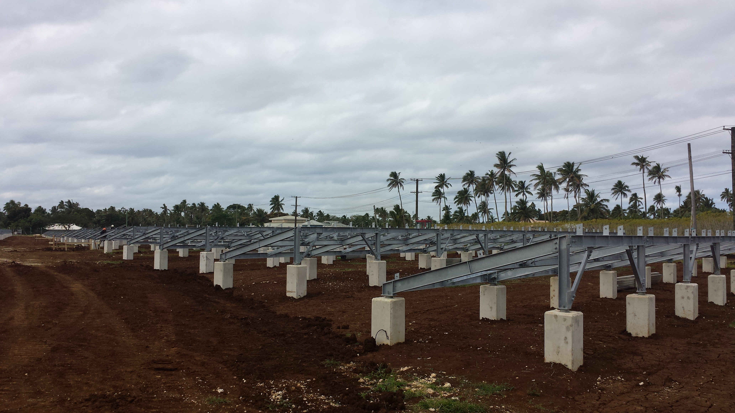
Cook island renewable energy project (cirep)

Slide 19
CIREP progam relevance
Cook Islands is planning a paradigm shift away from sovereign financing to private sector investment to finance the structural shift to renewable energy generation.
This is primarily due to ongoing restrictions on raising sovereign financing (familiar tale for SIDS) due to (i) the small size of the economy, and (ii) limited headroom for borrowing. Government is planning to increase private sector investment in renewable energy through both increased penetration of household solar and independent power providers (solar).
However, the grid requires increased battery storage to manage the intermittent supply of before it can accept any additional renewable energy. The proposed paradigm shift to private sector investment is unlikely to occur without GCF grant support as Cook Islands cannot finance the required increase in battery storage

Slide 20
Cirep program complementarity
In 2016, cofinancing from the Global Environment Facility (GEF) was mobilized to fund a 1 MW / 4 MWh Energy Storage System (ESS) to be installed on Rarotonga under the ADB CIREP.
Lithium-ion battery technology has been specified for this subproject, which is referred to as the BESS subproject. With the 1 MW BESS subproject, total grid-connected solar capacity of just under 6 MW can be accommodated without compromising grid reliability on Rarotonga, but additional storage and other grid enhancements are a prerequisite for further solar PV capacity additions.
The BESS subproject is just the first step in the transformation of Rarotonga electricity system: at least 60 MWh of additional energy storage will be required to meet the 100% renewable energy target on Rarotonga, and additional storage capacity is needed before further expansion of grid-connected solar PV capacity.

Slide 21
CIREP program complementarity
Program covers a second stage of energy storage, referred to as the R-ESS-2 subproject. The R-ESS-2 subproject is being presented for possible financial support from the Green Climate Fund (GCF) which comprises two components:
    (i) 1 MW / 4 MWh for grid stability, to be installed at the diesel power station; and
    (ii) 2 MW / 8 MWh for load shifting capability, to be installed at the airport. This additional storage capacity will enable an additional 6 MW of solar PV capacity to be connected to the grid, after which electricity supply on Rarotonga will be approximately 50% renewable energy.

Slide 22

Pacific Subregional Office

