Slide 1
Addressing flexibility in energy system models
Bonn, March 2nd 2015
Wouter NIJS
Ignacio HIDALGO
Sylvain QUOILIN
Andreas ZUCKER
Christian THIEL
Institute for Energy and Transport
Energy Technology Policy Outlook
Joint Research Centre of the European Commission

Slide 2
Outline
Conclusions from the JRC workshop "Addressing flexibility in energy system models", December 2014
JRC-IET Energy modelling landscape and flexibility in the power sector: Unit Commitment and dispatch Model DISPASET 2.0
Flexibility in the energy system model JRC-EU-TIMES: modelling approach and illustrative results

Slide 3
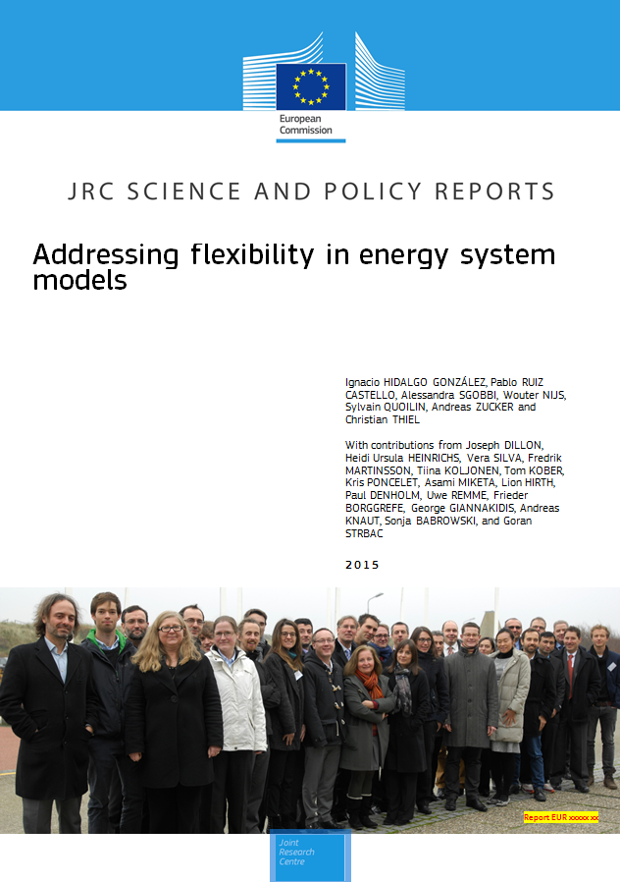
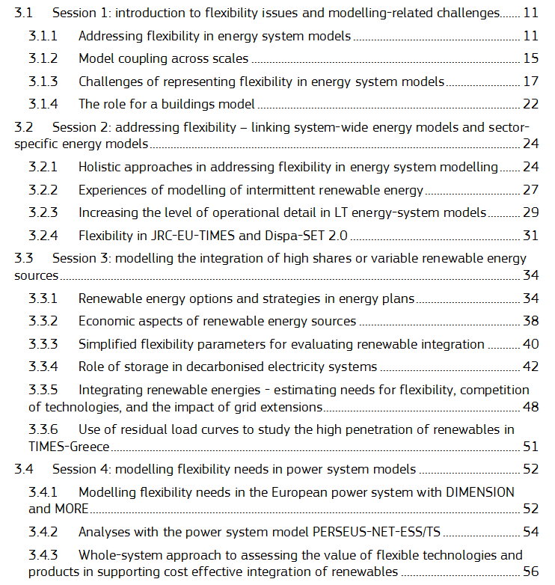
JRC workshop on flexibility
Forthcoming JRC report

Slide 4
JRC workshop on flexibility participants
Name | Affiliation
BABROWSKI, Sonja | KIT (Karlsruhe Institute of Technology)
BORGGREFE, Frieder | DLR (German Aerospace Centre)
DEANE, Paul | UCC (University College Cork)
DENHOLM, Paul | NREL (National Renewable Energy Laboratory)
DILLON, Joseph | UCD (University College Dublin)
GIANNAKIDIS, George | CRES (Centre for Renewable Energy Sources)
HEINRICHS, Heidi | Jülich (Institute for Energy and Climate Research)
HIRTH, Lion | PIK (Postdam Institute for Climate Research)
KNAUT, Andreas | EWI (Institute of Energy Economics Un. Koln)
KOBER, Tom | ECN (Energy Research Centre)
KOLJONEN, Tiina | VTT (Finnish Technical Research Centre)
LAFOND, Dominique | EdF (Electricite de France)
LÓPEZ BOTET ZULUETA, Miguel | EdF (Electricite de France)
MARTINSSON, Frederik | IVL (Swedish Environmental Research Institute)
MIKETA, Asami | IRENA (International Renewable Energy Agency)
PONCELET, Kris | KUL (University of Leuven)
RATHER, Zakir | UCD (University College Dublin)
REMME, Uwe | IEA (International Energy Agency)
SILVA, Vera | EdF (Electricite de France)
STRBAC, Goran | ICL (Imperial College London)

Slide 5
JRC workshop on flexibility conclusions
Many modellers need to analyse the transition to future systems with much higher shares of RES
There is a need for a systematic mapping of flexibility needs that have to be addressed and state-of-the-art model-based solutions or best practices for modelling
> activity coordinated by Mr. George Giannakidis (CRES) Deliverable = Matrix
Data needs to be improved for the renewable energy potentials, and to the projection of future demand response and demand profiles
> activity coordinated by Mr. Frieder Borggrefe (DLR)

Slide 6
JRC workshop on flexibility conclusions
It would be convenient to have a more permanent forum to exchange modelling approaches, for instance within the follow up of the implementation of the SET-Plan Integrated Roadmap
Energy System Models: increasing the number of time slices alone addresses only the variability itself but does not address the operational constraints
  > coupling large-size energy system model to sector- specific models
  > below one hour is not necessary or not worthy
  Most important guiding principle: know what can be simplified without compromising the accuracy and reliability of model results

Slide 7
JRC workshop on flexibility conclusions
It is necessary to improve the representation of market and regulatory aspects
Retrofitting is an important option to increase flexibility in the energy system, but modelling retrofitting is a challenge in many models and should be the object of active research
Participants stressed the importance of using and sharing open source approaches and publicly available data whenever possible

Slide 8
Our Current Energy Modelling Landscape
Energy services demand (GEM-E3, POLES?)
The long to very long view
10-50 years
Energy System Modelling
(JRC EU TIMES)
The mid-term view
(10-20 years)
Power demand
Power Flow
(NEPLAN)
Unit Commitment
DISPASET
Investment loop
Gaps identified
Issues relevant in the next 10-20 years:
Capacity mechanism
Pricing/bidding zones
RES-E market integration
Stochasticity
Plant Dispatch
Plant Investments
The short term view (or history)
(+/- 5 years)
Power Prices
Price Takers
"SPIRIT"
(Reserve Prices)
Additional modules (e.g. market modelling)

Slide 9
Addressing flexibility issues in the power sector
Ideally the representation of the power sector in JRC-EU-TIMES includes all the technical constraints within the relevant time frames.
Inter timeslice relations within TIMES !
JRC-EU-TIMES
Fully-fledged power sector model with high time resolution
Power sector module
Embedded
In practice the previous approach results in a too-complex (due to sheer size) model.
Interplay between long- and short-term dynamics are taken into account by coupling JRC-EU-TIMES to a detailed unit commitment model, while preserving some relevant constraints (work in progress).
Overall boundary conditions
Economic and demographic drivers
Energy supply and demand
Long-term capacity planning
JRC-EU-TIMES
Detailed unit commitment model
Short-term power sector constraints
Renewable sources availability
Storage
Hourly demand profiles
"Simplified" power sector module
Operational constraints or constraints on capacity expansion patterns

Slide 10
We are developing a state of the art unit commitment model
DISPASET 2.0
Unit Commitment and dispatch Model
Formulated as tight and compact MIP
Minimise total system costs over a daily horizon, across units, markets and periods of fixed, variable (fuel and emissions), start-up, shut-down, transmission costs, and load shedding)
Hourly demand balances (day ahead, and up and down reserves)
Bounds on power output (minimum stable generation, previous status, installed capacity and availability factors)
Ramping constraints
Minimum up and down times
Storage-related constraints (bounds on stored levels, pumping, discharge, inter-period storage balances)
NTC based market coupling
Options for emission limits, curtailment of intermittent generation and load shedding
Forthcoming JRC technical report

Slide 11
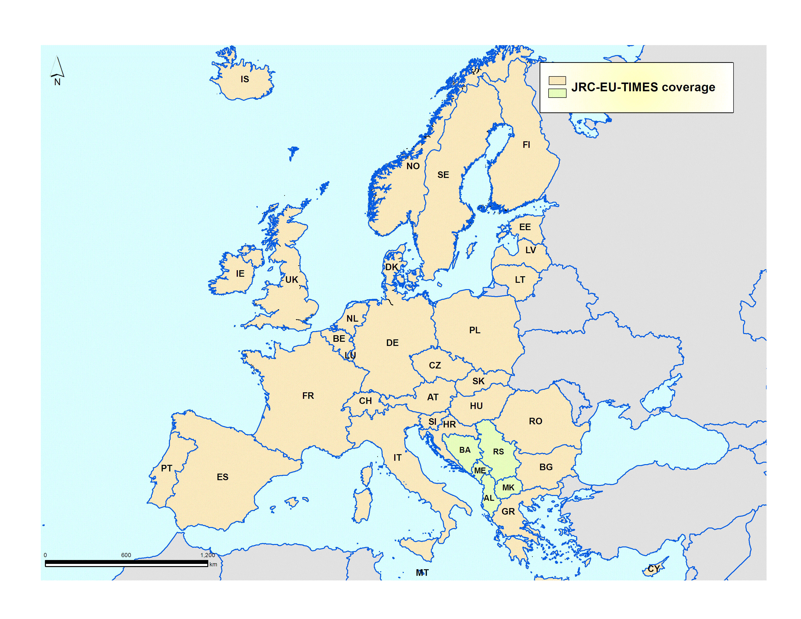
JRC-EU-TIMES: key characteristics
Model horizon: 2005-2050 (2075)
70 exogenous demands for energy services across 5 demand sectors (agriculture, residential, commercial, industry, and transport)
Economic drivers taken from latest EU Energy Reference Scenario (since 2014)
Explicit representation of country-to-country electricity and gas flows, incl. import / exports with non-European regions
Electricity multi-grid model (high, medium and low voltage grid), tracking demand-supply via 12 time slices (4 seasons, 3 diurnal periods), and gas across 4 seasons
Country specific differences for characterisation of the conversion and end-use technologies
Renewable potentials (onshore wind, offshore wind, geothermal, biomass, biogas, hydro)
Notes:
How much variable electricity from renewable sources
How much could be stored or curtailed in the long term (not current markets), given the value it gets from mainly arbitrage resulting from price differences resulting from high shares of variable electricity ?
How determining is the impact of climate policy ?
What is the value of storage ?
Energy system model with low granularity in time is not suited for evaluating the value for flexibility at short timeframes
And also it gets value…and to some extent from system load –transnational- and from reserve market –long term (> 1 hour)
The JRC-EU-TIMES energy system model is used in general to model the future prospects of low-carbon technologies
Refer to ETRI

Slide 12
JRC-EU-TIMES coverage
flexibility needs
Maintenance
Primary reserve (Frequency control)
Up/down ramp rates (operational reserves)
Min up and down time
Part load efficiency
Start-up costs
Min. stable generation
Max. generation
Grid congestion
Energy balance, variability of RES supply
Important when high penetration of variable RES
Notes:
Italic = included or partially included
There is a distinction between TIER 1 and TIER 2.
TIER 2 is point nr. 10 and it is crucial.
Cfr include operational constraints into an energy system model that cannot cope with "TIER 1 and 2" does not make sense.
What is high penetration ? For some technologies it is rather quick. Cfr if PV is producing 15% of the electricity it means that the peak power of all PV systems is surpassing electricity demand.
Reason: low Capacity Factor.

Slide 13
Dealing with RES variability
Example summer day hours
Demand
OTHER (20)
RES (80)
TRADITIONAL
Notes:
Without additional constraints, the representation within a time slice implicitly assumes that the electricity can be produced or consumed with constant power during the hours of this time slice. This is sufficient if only a limited share of the electricity is produced by variable sources or used by variable consumers.
Double the production of non-variable electricity !
JRC PV Gis cannot be used for this as it contains only data for a single spot

Slide 14
Dealing with RES variability
Example summer day hours
RES (30)
Demand
OTHER (20)
RES (80)
RES (50)
OTHER (50)
TRADITIONAL
Notes:
Without additional constraints, the representation within a time slice implicitly assumes that the electricity can be produced or consumed with constant power during the hours of this time slice. This is sufficient if only a limited share of the electricity is produced by variable sources or used by variable consumers.
Double the production of non-variable electricity !

Slide 15
Dealing with RES variability
Forcing a certain minimum share of dispatchable NOT ENOUGH
RES (80)
Demand
OTHER (20)
OTHER (50)
RES (80)
TRADITIONAL
Notes:
Without additional constraints, the representation within a time slice implicitly assumes that the electricity can be produced or consumed with constant power during the hours of this time slice. This is sufficient if only a limited share of the electricity is produced by variable sources or used by variable consumers.
Double the production of non-variable electricity !
JRC PV Gis cannot be used for this as it contains only data for a single spot

Slide 16
Dealing with RES variability
Forcing a certain minimum share of dispatchable NOT ENOUGH
Demand
OTHER (20)
OTHER (50)
RES (50)
RES (80)
TRADITIONAL
Notes:
Without additional constraints, the representation within a time slice implicitly assumes that the electricity can be produced or consumed with constant power during the hours of this time slice. This is sufficient if only a limited share of the electricity is produced by variable sources or used by variable consumers.
Double the production of non-variable electricity !
JRC PV Gis cannot be used for this as it contains only data for a single spot

Slide 17
Dealing with RES variability
Example summer day hours
By using the production profile information
Possible excess electricity
Based on the total Variable electricity production.
Maximum Power of the combined variable RES systems in a timeslice/region
RES (30)
Demand
OTHER (20)
RES (80)
RES (50)
OTHER (50)
20% of Demand
TRADITIONAL
NEW
Notes:
Without additional constraints, the representation within a time slice implicitly assumes that the electricity can be produced or consumed with constant power during the hours of this time slice. This is sufficient if only a limited share of the electricity is produced by variable sources or used by variable consumers.
Double the production of non-variable electricity !
Valide questions at this stage:
HOW Much Electricity is to be curtailed or stored ?
HOW Often Electricity is to be curtailed or stored ?

Slide 18
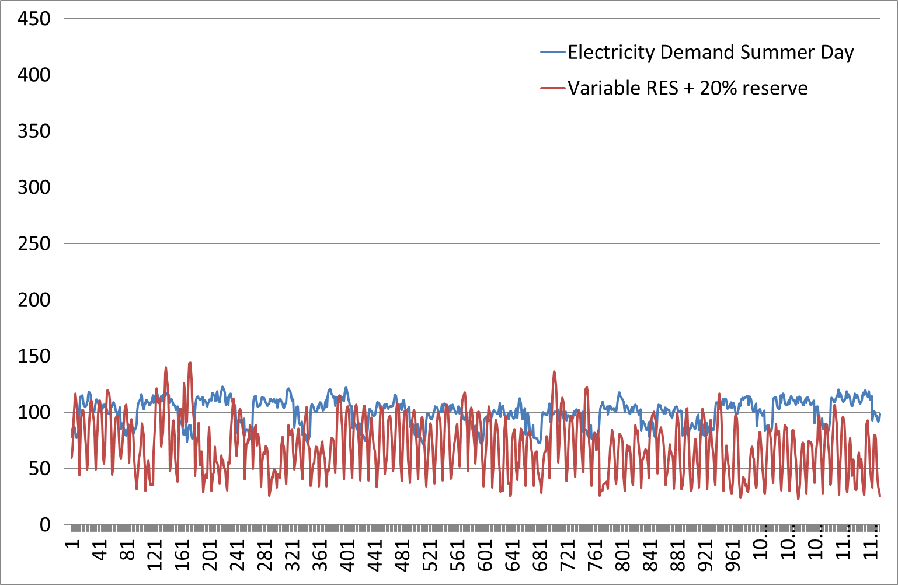
80%PV and 20% wind
RES = 50% of Demand
Dealing with RES variability
Data for Belgium
from 9h-20h

Slide 19
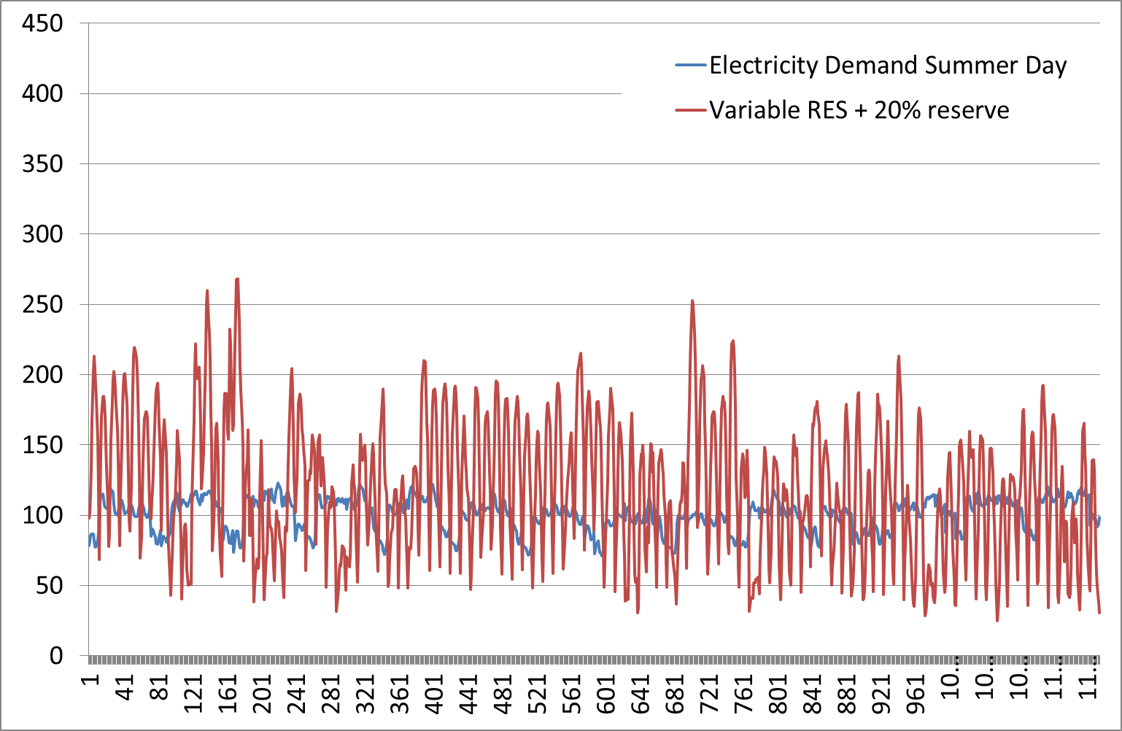
Dealing with RES variability
80%PV and 20% wind
RES = 100% of Demand
Data for Belgium
from 9h-20h

Slide 20
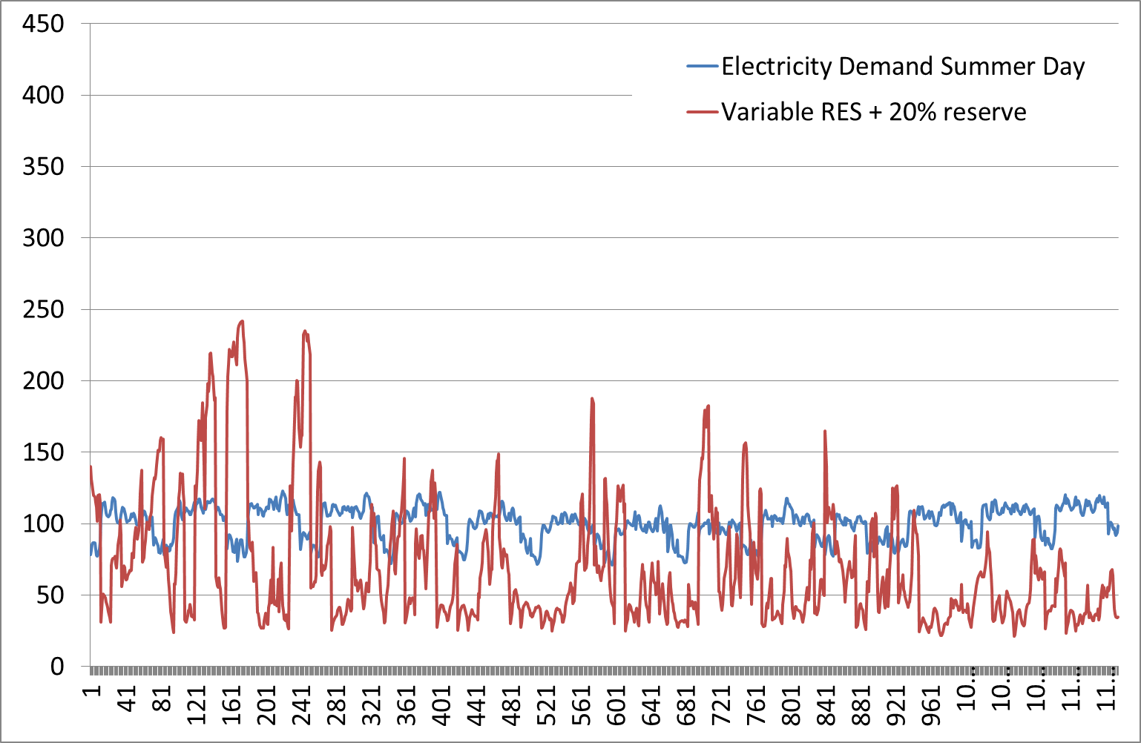
Dealing with RES variability
20%PV and 80% wind
RES = 50% of Demand
Data for Belgium
from 9h-20h

Slide 21
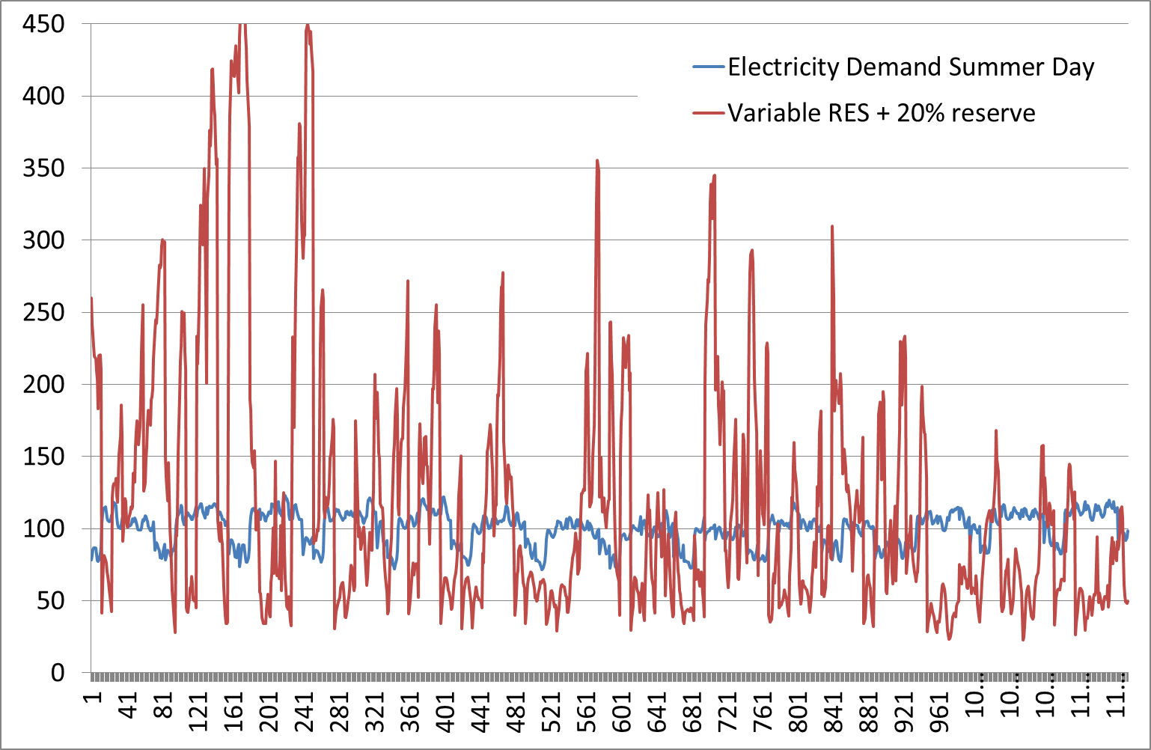
Dealing with RES variability
20%PV and 80% wind
RES = 100% of Demand
Data for Belgium
from 9h-20h

Slide 22
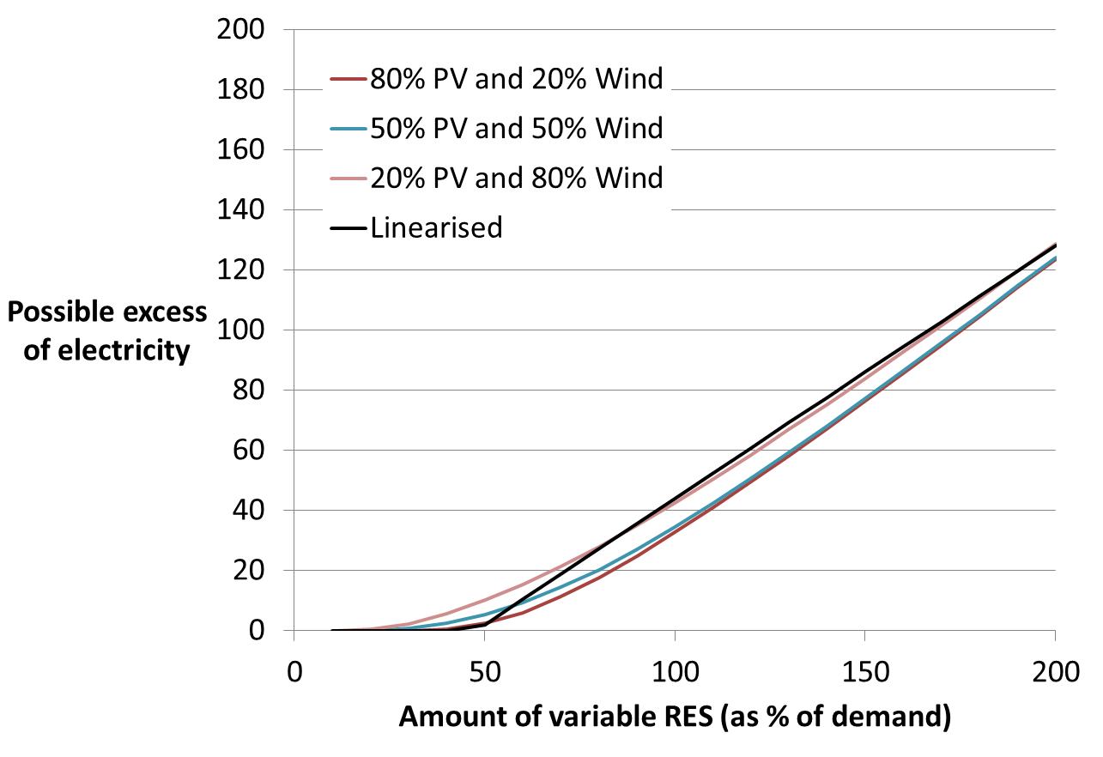

Linearisation of possible excess electricity
Dealing with RES variability
$$0.85RES−0.4D$$
Interestingly, the coefficients are rather robust for different demand and RES profiles in different timeslices.
Implications of this relation !

Slide 23
Limited timeslices
Dealing with RES variability
JRC-EU-TIMES power sector
Force possible excess electricity from PV, wind and wave to be used by flexible demand, curtailed or converted into another carrier
Allow excess electricity from PV to be stored
Adjust the load hours from the dispatchable power.
Stochastic modelling of intermittent renewables with two stages: investment and operational decisions
Increased number of timeslices
Test representing every single hour as well as limited number of representative days
Notes:
+ ensure sufficient storage capacity.
To ensure that the model invests not only in sufficient storage capacity in energy terms, but also in sufficient storage capacity in power terms

Slide 24
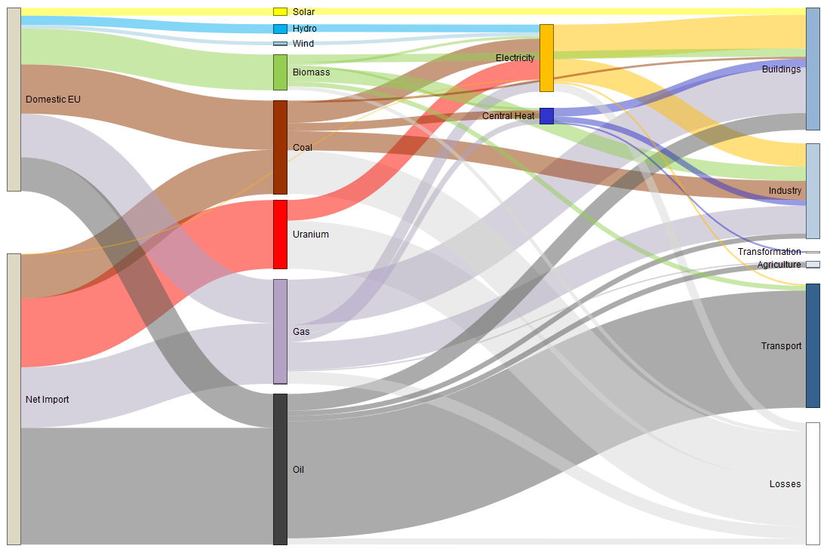
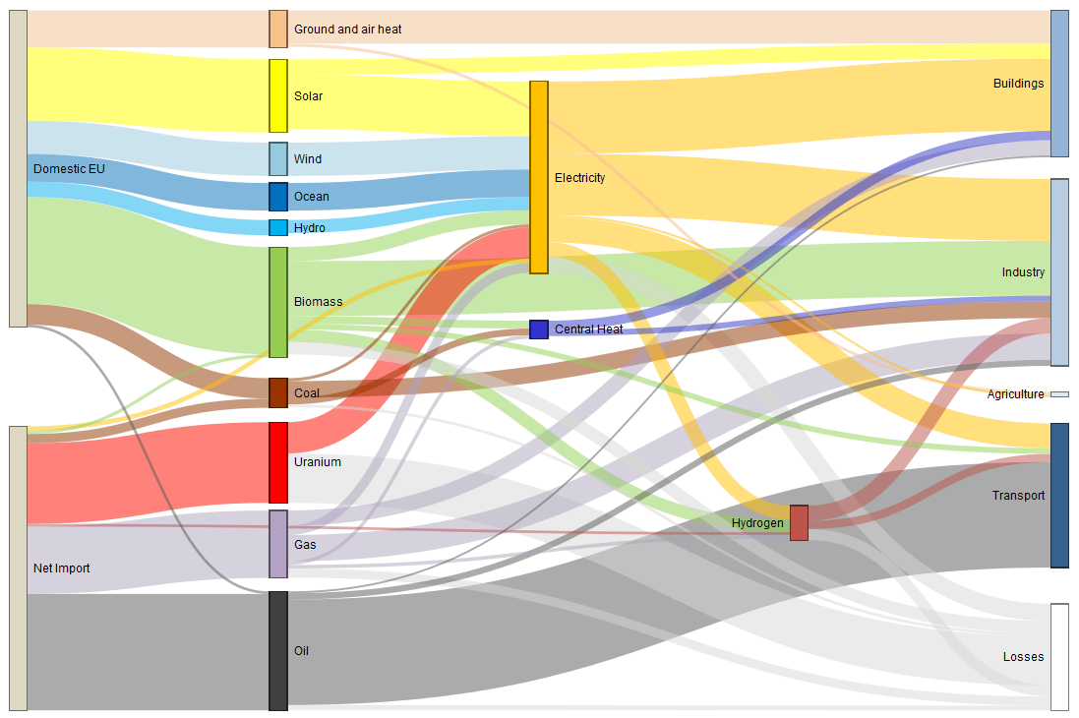
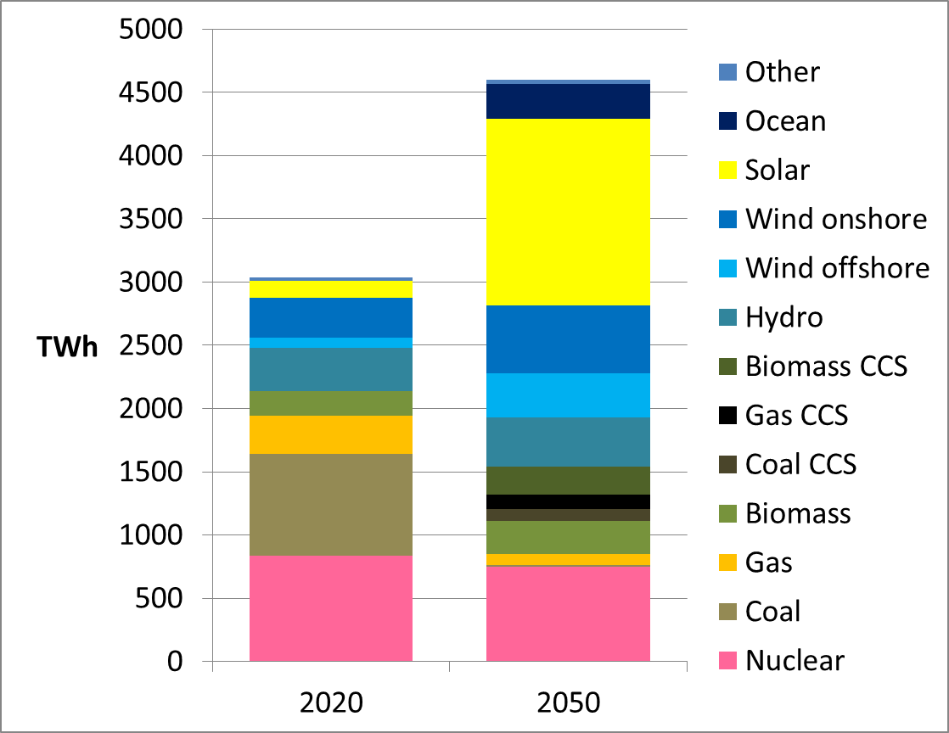
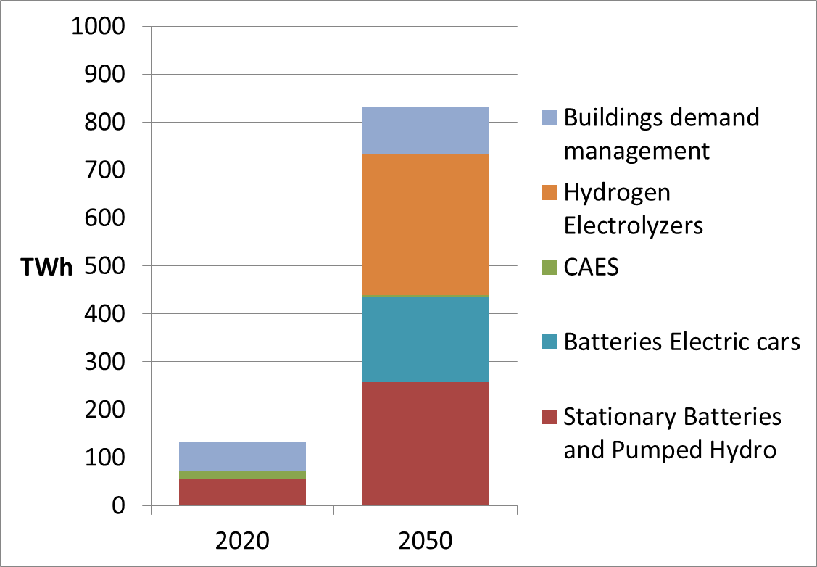
JRC-EU-TIMES illustrative results
2010
2050
Electricity production
Flexibility for storage and DSM
Notes:
Impact 80% reduction of CO2 TOP = Sankey BOTTOM=power sector.
Decrease of primary eneryg use.
Fossil is being reduced, renewables increase and there is a strong electrification.
Some flexibility options:
Importance of electric cars
Low curtailment linked to cost assumptions of the storage options and impact of hydrogen production.
Hydrogen is going to industry and transport

Slide 25







Thank you!
Please visit the SETIS website: http://setis.ec.europa.eu
The Commission's Strategic Energy
Technologies Information System

Slide 26
Backup

Slide 27
Electricity storage technologies in JRC-EU-TIMES
Existing pumped hydro
New pumped hydro
Electric cars
Hydrogen production (multi-sectoral use) – Power2Gas
Stationary batteries
Curtailment
Strong interaction between sectors (electricity, transport, industry, heating,…)
Characteristics in the scope of JRC-EU-TIMES: efficiency loss, lifetime, power specific and energy specific investment cost,..
Notes:
NOT MANY Models have storage !
Explain reservoir and power system. Sometimes one and the same.
Also fixed relations between power capacity and energy storage capacity
Example Li-Ion batteries with 1000 full cycles would need an electricity gap of 1000 €/MWh !
So 20 000 half cycles for an electricity price difference of 100 €/MWh
The NaS batteries only needs 4 000 half cycles for the same difference of 100 €/MWh

Slide 28
Hydrogen chain in JRC-EU-TIMES

Slide 29
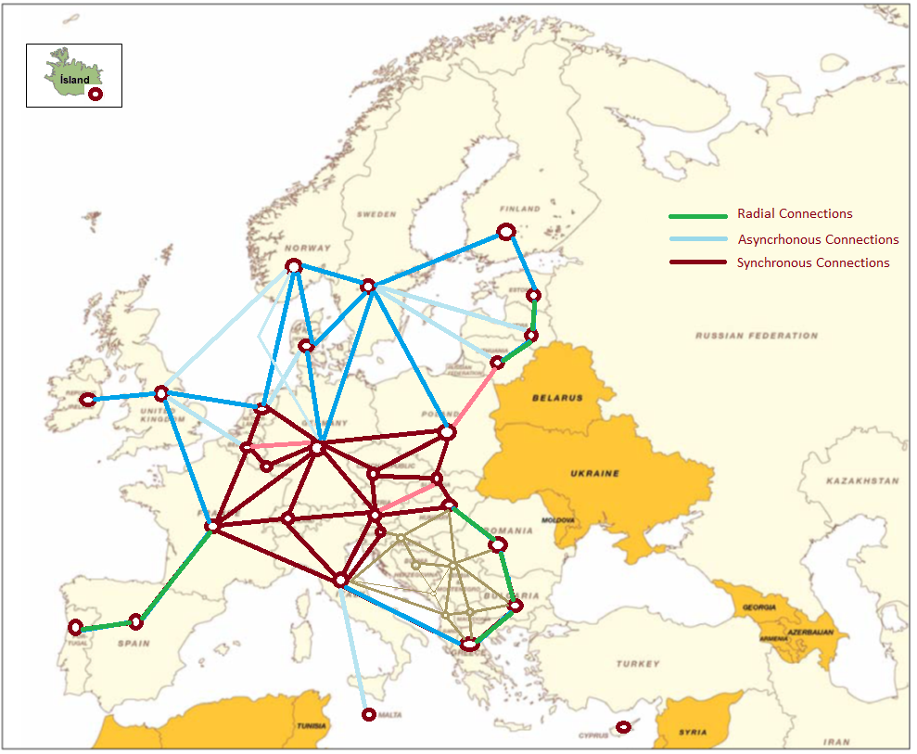
Grid representation
Endogenous grid investments (function of maximum power)
DC power flow equations are integrated for Central Europe. With this improved representation JRC-EU-TIMES can:
    Represent the physical flows depending on the grid characteristics and loads/injection patterns of the different countries in all time slices.
Estimate the trans-boundary investments for a secure network
Investigate large changes in Member States' net production or consumption of electricity

