Slide 1
Approaches to improve long-term models
Falko Ueckerdt, IRENA consultant
Expert Workshop, 2-3 March 2015, Bonn, IRENA IITC
Addressing Variable Renewables in Long-Term Planning (AVRIL)

Slide 2
Improving long-term energy models
 | Generation (+ load, DSM and storage) | Networks (T&D)
Adequacy | Sufficient firm capacity | Sufficient and reliable transport and distribution capacity
Security | Flexibility of the system Robustness to contingency including stability | Voltage control capability Robustness to contingency including stability
In addition: The temporal matching of VRE supply and demand is crucial to the optimal capacity expansion path
Reduced load factor (annual full-load hours) of thermal power plants
This is an economic VRE impact, not a reliability issue

Slide 3
Temporal matching of load and VRE supply affects the economics of VRE and the total capacity mix
USA
India
Load (normalized)
Wind power
Solar PV
Hours of a year
Hours of a year
DLR/PIK analysis

Slide 4
Temporal matching of load and VRE supply affects the economics of VRE and the total capacity mix
Residual load curve
Residual load duration curve
(25% wind power and
25% solar PV, India)
Low capacity credit
Variable
renewables
Dispatchable
plants
Load (normalized)
min. thermal
generation
Reduced full-load hours
Curtailment
Hours of a year
Hours of a year (sorted)
DLR/PIK analysis

Slide 5
Temporal matching of load and VRE supply affects the economics of VRE and the total capacity mix
Wind
Solar PV
India
Residual load/peak load
USA
Hours of a year (sorted)
Hours of a year (sorted)
DLR/PIK analysis

Slide 6
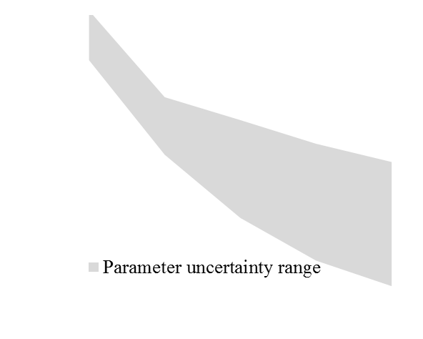
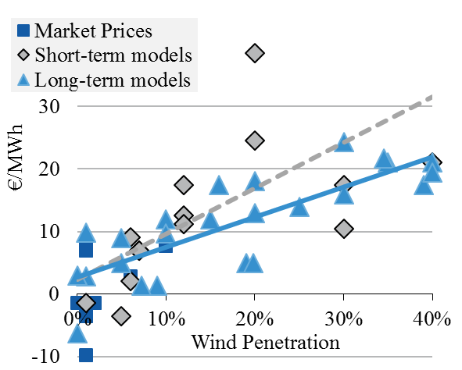
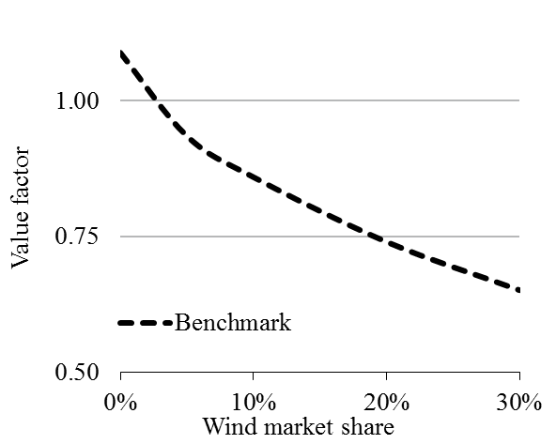
Temporal matching of load and VRE supply affects the economics of VRE and the residual capacity mix
→ affects marginal value of VRE and total system costs at high VRE shares even if the system was perfectly flexible
Value Factor =
marginal value/
average electricity price
Profile costs
(by comparing VRE to a benchmark technology that is not variable)
EMMA model
Europe
model review
Europe/US
Profile costs
Source: Hirth, Ueckerdt, Edenhofer (2015)
Source: updated from Hirth (2013): Market value. Parameters considered: CO2 price between 0 – 100 €/t, Flexible ancillary services provision, Zero / double interconnector capacity, Flexible CHP plants, Zero / double storage capacity, Double fuel price, ...
More flexibility measures/integration options can mitigate this effect, however, the effect needs to be modeled.

Slide 7
Improving long-term energy models
 | Generation (+ load, DSM and storage) | Networks (T&D)
Adequacy | Sufficient firm capacity | Sufficient and reliable transport and distribution capacity
Security | Flexibility of the system Robustness to contingency including stability | Voltage control capability Robustness to contingency including stability
There are 4 approaches to account for different VRE impacts in long-term models

Slide 8
4 approaches to account for VRE impacts in long-term planning models
Directly increasing the temporal resolution
Restructuring time to capture variability/flexibility
with a low temporal resolution
Using a highly resolved model e.g. a production cost model
Additional constraints that account for variability or flexibility
Spatial resolution
Grid
lines
Long-term
planning models
power
system
Temporal
resolution
5years
1year
days
hours
minutes
s
ms
Notes:
How can LT planning tool be informed?

Slide 9
4 approaches to account for VRE impacts in long-term planning models
Directly increasing the temporal and spatial resolution
Restructuring time to capture variability/flexibility
with a low temporal resolution
Using a highly resolved model e.g. a production cost model
Additional constraints that account for variability or flexibility
Spatial resolution
Grid
lines
Long-term
planning models
power
system
Temporal
resolution
5years
1year
days
hours
minutes
s
ms
Notes:
How can LT planning tool be informed?

Slide 10
4 approaches to account for VRE impacts in long-term planning models
Directly increasing the temporal and spatial resolution
Restructuring time to capture variability/flexibility
with a low temporal resolution
Using a highly resolved model e.g. a production cost model
Additional constraints that account for variability or flexibility
Spatial resolution
Grid
lines
Long-term
planning models
power
system
Temporal
resolution
5years
1year
days
hours
minutes
s
ms
Notes:
How can LT planning tool be informed?

Slide 11
4 approaches to account for VRE impacts in long-term planning models
Directly increasing the temporal and spatial resolution
Restructuring time to capture variability/flexibility
with a low temporal resolution
Using a highly resolved model e.g. a production cost model
Additional constraints that account for variability or flexibility
Spatial resolution
Grid
lines
Production cost models
Long-term
planning models
power
system
Temporal
resolution
5years
1year
days
hours
minutes
s
ms
Notes:
How can LT planning tool be informed?

Slide 12
4 approaches to account for VRE impacts in long-term planning models
Directly increasing the temporal and spatial resolution
Restructuring time to capture variability/flexibility
with a low temporal resolution
Using a highly resolved model e.g. a production cost model
Additional constraints that account for variability or flexibility
Spatial resolution
Grid
lines
Grid
costs
System
stability
Generation
flexibility
Long-term
planning models
Capacity
credit
power
system
Temporal
resolution
5years
1year
days
hours
minutes
s
ms
Notes:
How can LT planning tool be informed?

Slide 13
4 approaches to account for VRE impacts in long-term planning models
Approaches of accounting for variability and flexibility in long-term planning models
1. Directly increasing the temporal and spatial resolution (at the cost of increased runtime or less detail)
2. Restructuring time to capture variability/flexibility with a low temporal resolution | 2.1. Representative time slices: load-based choice Constructing temporal bins for average values of load and VRE based on load values for weekday, weekend, summer, winter; with arbitrary choice of VRE (high wind, low wind) (e.g. Standard TIMES)
 | 2.2. Representative time slices: clustering Constructing temporal bins for average values of load and VRE based on clustering points in time with similar load, wind and solar values (e.g. LIMES)
 | 2.3. Residual load duration curves (RLDCs) Optimizing based on exogenous RLDCs (can be implemented via time slices)
3. Using a production cost model | 3.1. Iteration with a production cost model Soft-coupling the two models and iterating runs
 | 3.2. Parameterizing simple constraints (see approach 4)
 | 3.3. Validation to validate other approaches of accounting for short-term aspects
4. Additional constraints that account for variability or flexibility - e.g. flexibility constraint (Sullivan et al), integration cost penalties (Pietzcker et al., Ueckerdt et al.), reserve capacity constraints (accounting for capacity credits), VRE curtailment, ramping constraints - such constraints can be parameterized by models, data analyses or technical-economic parameters
Note that different approaches can be combined.
Notes:
No silver bullet. A combination suitable.
Dig deeper into literature.

Slide 14
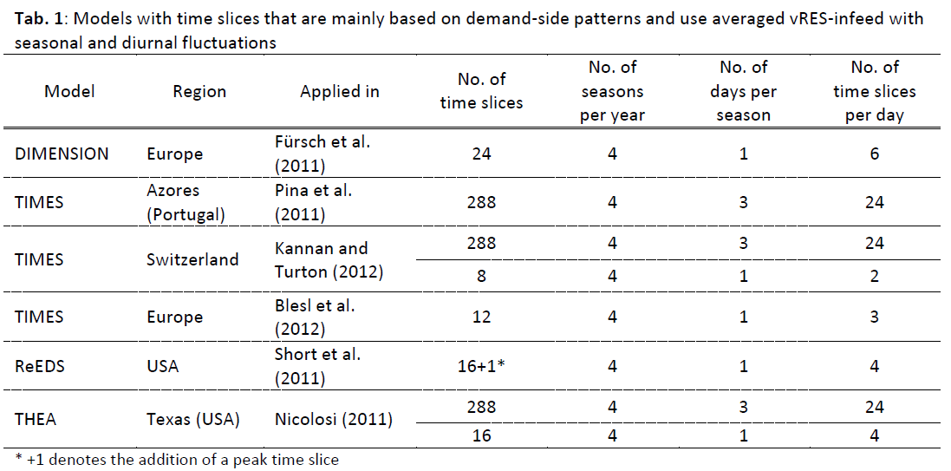
Two ways of choosing time slices
(time slice = temporal bin for average values of load and VRE)
Load-based time slices (traditional)
Slices are chosen according to load values (season, weekday/weekend, day/night)
Cluster-based time slices
Nahmmacher et al.

Slide 15
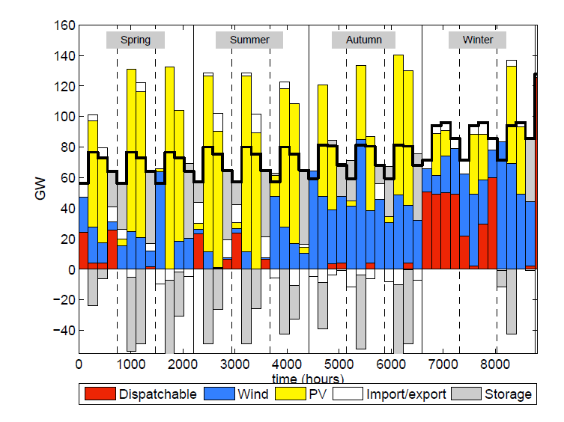
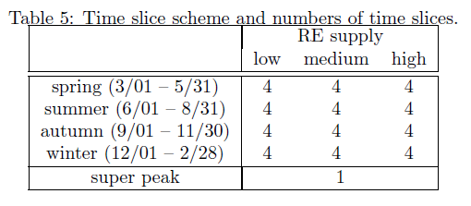
Two ways of choosing time slices
(time slice = temporal bin for average values of load and VRE)
Load-based time slices (traditional)
Slices are chosen according to load values (season, weekday/weekend, day/night)
Sometimes an heuristic choice of VRE values (low, middle, high) is combined with load-based values
Pros:
easily derived and understood
Chronological order could in principle
be kept for modeling storage and ramping (careful)
Cons:
VRE variability is not adequately captured (variance of the average VRE value in a time slice is high) → bias towards baseload&VRE
The choice of additional VRE values is often not rigorous
Cluster-based time slices

Slide 16
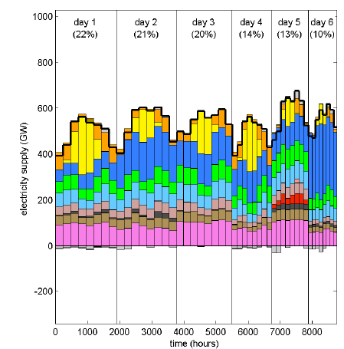
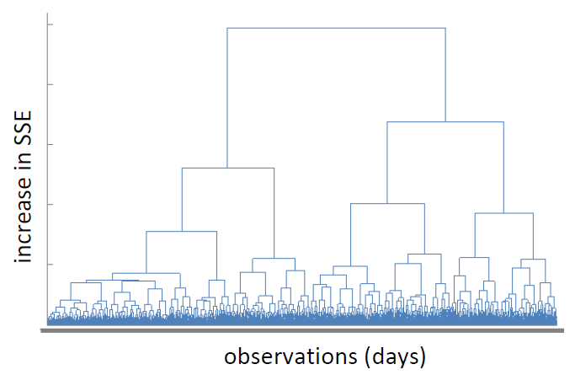
Two ways of choosing time slices
(time slice = temporal bin for average values of load and VRE)
Load-based time slices (traditional)
Slices are chosen according to load values (season, weekday/weekend, day/night)
Sometimes an heuristic choice of VRE values (low, middle, high) is combined with load-based values
Pros:
easily derived and understood
Chronological order could in principle
be kept for modeling storage and ramping (careful)
Cons:
VRE variability is not adequately captured (variance of the average VRE value in a time slice is high) → bias towards baseload&VRE
The choice of additional VRE values is often not rigorous
Cluster-based time slices
Slices are based on clustering points in time with similar load and VRE values. The difference to the real data is minimized.
Pros:
VRE and load variability and correlation can be better captured with less time slices (duration curves are better matched)
if representative days are chosen, diurnal chronology might be kept → intraday storage (how can interday storage be modeled?)
Cons:
Parameterization is more difficult to conduct and to understand
Chronological order is lost to some extend
Nahmmacher et al.
Nahmmacher et al.

Slide 17
Improving long-term energy models
 | Generation (+ load, DSM and storage) | Networks (T&D)
Adequacy | Sufficient firm capacity | Sufficient and reliable transport and distribution capacity
Security | Flexibility of the system Robustness to contingency including stability | Voltage control capability Robustness to contingency including stability
Apart from reliability, economic impacts of VRE variability need to be considered for an optimal capacity expansion path.

Slide 18
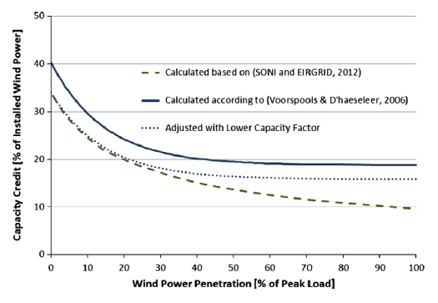
Capacity credit (generation adequacy)
Very important, in particular in growing systems
Exogenous parameterization used in a planning reserve constraint (Sullivan et al. MESSAGE IAM, Welsch et al. OSeMOSYS)
Challenge: capacity credit is a system figure. It depends on the VRE level and mix (most important), storage, grid congestion, DSM and the spread of VRE sites
Model coupling could account for all system aspects, however, too sophisticated. Focus on VRE share.
Capacity credit can be captured implicitly via time slices or RLDCs
Welsch et al. 2014

Slide 19
Improving long-term energy models
 | Generation (+ load, DSM and storage) | Networks (T&D)
Adequacy | Sufficient firm capacity | Sufficient and reliable transport and distribution capacity
Security | Flexibility of the system Robustness to contingency including stability | Voltage control capability Robustness to contingency including stability

Slide 20
Flexibility (generation security)
Balancing costs < 6€/Mwh_{VRE} (US, EUR values) → mainly technical issue.
What are the most important aspects and relevant time scales?
Operating reserves (to balance forecast errors), minimum load, ramping constraints, minimum up/down times, start up costs
Parameterization or soft-coupling are potential approaches
Typically, simplified constraints are used as a parameterization (e.g. OSeMOSYS)
Operating reserves can be implemented in long-term models for different time scales
  Reserve requirements need to be exogenously defined, e.g. according to forecast error distribution of load and VRE supply
Modeling start-up costs requires a unit commitment model
Minimum load is defined, however, not for single units but for continous capacity
Ramping and minimum up/down times are approximated by confining the change of output between time slices (often ~10 time slices → 6-12h time slice width)
Comparing an enhanced OSeMOSYS to a TIMES-PLEXOS coupling (2020, Ireland, ~30% wind): 5% difference in generation (not tested for other years or systems)

Slide 21
Improving long-term energy models
 | Generation (+ load, DSM and storage) | Networks (T&D)
Adequacy | Sufficient firm capacity | Sufficient and reliable transport and distribution capacity
Security | Flexibility of the system Robustness to contingency including stability | Voltage control capability Robustness to contingency including stability
Costs for transmission extension can be partly captured with NTC investment and a higher spatial resolution.
A high spatial resolution helps a coordinated optimization of generation and transmission
Additional costs can be parameterized with a cost function, using empirical data or a highly resolved model. In US/EUR transmission costs are ~10€/Mwh_{VRE} at moderate/high shares

Slide 22
Most important model items
Accounting for capacity credits in particular the low values of VRE generators and its dependency of the VRE share
Sensible time slices (not just load based) that reflect crucial validation indicators like RLDCs or VRE generation duration curves
A validation of long-term model results with higher-detailed models with respect to flexibility requirements

