Slide 1
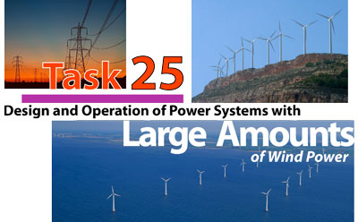

Wind integration – capturing impacts to power systems
AVRIL workshop, IRENA 2-3 March, 2015
Hannele Holttinen, VTT Technical Research Centre of Finland Ltd; Operating Agent IEA Wind Task 25
Notes:
You can use cover page with one or two photos or without photos

Slide 2


Wind power in the power system: impacts on reliability and efficiency
Adequacy
Balancing
Grid
Notes:
X-axis shows the time scale relevant for the study
Y-axis shows whether the impacts are more local or more system wide.
Task 25 looks at the system wide impacts. Division into three parts: Balancing, Grid and Adequacy of power

Slide 3
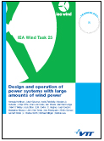
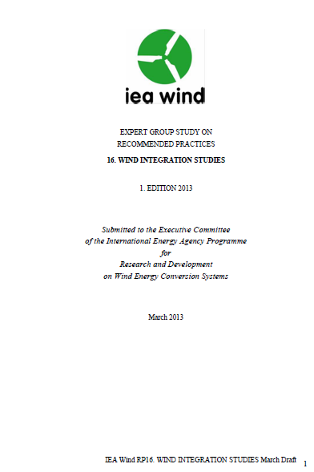
Task 25 - Reports published
Summary report:
  Recent study results and experience
Recommended Practices:
  Information about methodology
  To provide research institutes, consultants and system operators with the best available information on how to perform a wind integration study
www.ieawind.org
3

Slide 4
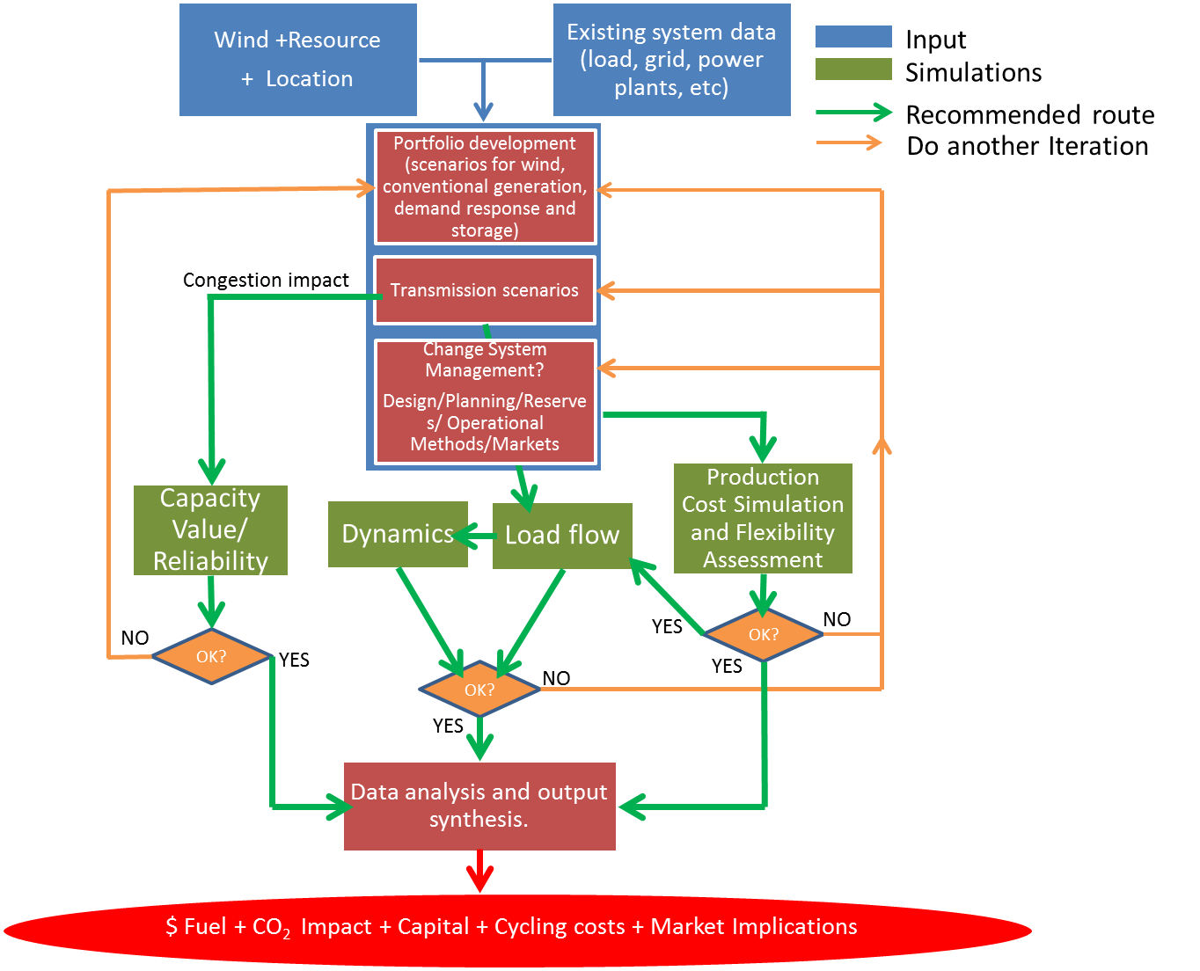
Recommendations for integration studies –flowchart
Simplified
No need to do all steps – for first studies Production cost simulation and Load flow can suffice
Recommended route
Iterations
4
Notes:
Stress the iterations that may be required
The future looking nature – 10, 20, 30 years
The number of unknowns – different markets, more transmission, price of fuels, etc.

Slide 5
Main recommendations
Input data: Synchronous wind generation and load time series
  representative for regions (smoothing impact)
  Capturing wind capacity value 10 years, for balancing 1 year ok
  Forecast data, uncertainty at different time scales
Dispatch simulations:
  Model the impact of uncertainty on commitment decisions.
  Model the limitations of flexibility (ramp/start costs, part load efficiency, minimum online load; using interconnections for balancing)
Load flow – more cases to study. Dynamic stability: for higher penetration levels, also wind support to grid
For larger penetration levels, changes in the remaining system may be required

Slide 6

Summary of recommendations
Assumptions crucial for results – neighbouring system, wind/load input, flexibility related inputs; also main set-up, remaining system, questions asked
Iteration loops are important - alternatives to future power plant mix, transmission build-out, operational practice
Field is evolving, model development ongoing
  Characterizing study limitations (over/underestimating)
Results
  Relative to penetration level – both by capacity and energy
Most things apply for solar as well → variable integration

Slide 7
Issues for long term planning models
Generally integration impacts not captured – underestimating impacts of high shares of wind and PV
  Restrictions from balancing and grid the main concerns, also capacity value of wind not straightforward
Capturing grid restrictions, especially stability issues at high penetration levels
  Iterations with grid model – for some more crucial hours
  Grid is a constraint in balancing task
  Grid needs to be prepared for higher penetration levels (usually higher means > 5-10 % of yearly energy depending on existing grid). This can take 10 years so grid studies are important to conduct separately
  Stability is an issue usually for larger shares of >20 %

Slide 8
Issues for long term planning models
Capturing balancing task difficult
  Cycling burden– capturing flexibility constraints like start-up costs, minimum load restriction, part load efficiency, ancillary services
  Variability detail – peaks/high generation hours’ flexibility problems
  Storage options needs temporal/chronological constraints
  How much can sharing with neighbours help (grid constraints /operational practices)
Mitigation options
  Iterations with more detailed models to sub-regions
  Iteration simulating a shorter time with more detail
    How to choose the weeks to simulate to capture all relevant situations with geographical interdependencies
Capturing capacity value of wind power (capacity value as function of wind share), assumptions on neighbouring areas

Slide 9
Summary
Integrating larger shares of variable generation - capturing balancing task is difficult
Balancing costs will be dependent on the generation fleet and operational practices - Flexibility needs may impact the investment decisions
Grid infra and stability issues impact the costs – may impact the balancing taska and the investment decisions
Any power system planning for larger shares would need to study operation in detail with TSO involvement and collaboration with larger areas
  but can start building the first 5-10%. Simpler models can be used for smaller shares of VRE

Slide 10






 | Country | Institution
 | Canada | Hydro Quebec (A. Robitaille); Manitoba Hydro (T. Molinski)
 | China | SGERI (Bai Jianhua, Zhang Qin)
 | Denmark | DTU Wind (P. Sørensen); TSO Energinet.dk (A. Orths)
 | EWEA | European Wind Energy Association (I. Pineda)
 | Finland | VTT (H. Holttinen, J. Kiviluoma) – Operating Agent
 | Germany | Fraunhofer IWES (B. Lange); TSO TenneT (A. Gesino)
 | Ireland | ECAR/UCD (Mark O’Malley); TSO EirGrid (J. O’Sullivan)
 | Italy | TSO Terna Rete Italia (Enrico Maria Carlini)
 | Japan | Tokyo Uni (Junji Kondoh), Kansai Uni (Yoh Yasuda)
 | Norway | SINTEF (John Olav Tande, Atle Rygg Årdal)
 | Netherlands | ECN (Jan Pierik); TUDelft (M. Gibescu)
 | Portugal | LNEG (Ana Estanquiero); TSO REN (Jose Osario); INESC-Porto (J. Pecas Lopes); UTL-IST (Ferreira Jesus)
 | Spain | University of Castilla La Mancha (Emilio Gomez Lazaro)
 | Sweden | KTH (Lennart Söder)
 | UK | DG&SEE (Goran Strbac, Imperial; O. Anaya-Lara, Strathclyde)
 | USA | NREL (M.Milligan); UWIG (J.C.Smith); DoE (C. Clark)
IEA WIND Task 25 participants
France and Mexico joining in 2015
hannele.holttinen@vtt.fi
http://www.ieawind.org/task_25.html

Slide 11


TECHNOLOGY FOR BUSINESS
Notes:
Final slide is optional in VTT’s internal presentations

Slide 12
Future work / Research needs
New simulation tools
  Uncertainty of wind power on different time scales
  Transmission planning with low capacity factor resources
  Transmission grids offshore HVDC
Wind turbine capabilities and models for simulations
Flexibility metrics and tools
Ways to set up simulation cases to extract impacts
Higher penetration studies – also stability issues
Market design issues
  Incentivize needed new generation and flexibility characteristics?
  Incentivize flexibility in operational time frame?
  How does wind power impact the market?

