Slide 1
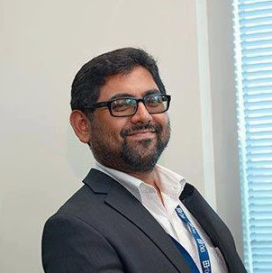
BizCube by BetterStories Dhaka, Bangladesh
BizCube is Bangladesh’s first business incubator proper, established in the year 2010 to groom the tender ideas that need nurturing to bloom from buds
BizCube offers the business advisory services a business start-up may need and groom the ideas to a prototype stage and be investment ready
The core of BizCube philosophy is modeled around a Go-to-Market strategy for startups that compels them to go out of building and make the sell
BizCube provides acceleration support to already initiated businesses that need synergetic and strategic help to expand
Although heavily focused on technology startups BizCube is sector agnostic in its approach to support high impact high growth startups in Bangladesh
MINHAZ UDDIN ANWAR, Founder and CEO
I am the ideator, connector and chief storyteller for BizCube.

Slide 2
Energy Access
Please explain the work your organization does on energy access:
Climate and Clean Technology solutions is one of the areas that we look startups to incubate in although we only had one (Bangla Bari – zero emission rural housing model) so far
We have just started a dialogue with Global Alliance for Clean Cookstoves on Improved Cook stoves entrepreneurship in Bangladesh (market size of 30 M HHs)

Slide 3
Entrepreneurship/Enterprise Development
Please explain your institution’s work on entrepreneurship / enterprise development (eg. financing, business incubation, technology development, etc):
Our methodology of incubation includes building an eco system of cooperation and mentoring and in the process creating a culture of cooperation and coexistence for mutual benefits.
BizCube Incubation Programme 2013: For 2013, the mission was to create a handful of examples of successful start-ups that will eventually create a disruptive commotion in the market. In 2013, BizCube Incubation Programme took on board a dozen promising entrepreneurial teams - drawn from World Bank Sanitation Hackathon 2012, Start-Up Weekend Dhaka 2013 and external applicants. They went through a 34-weeks long incubation programme starting from 14 April 2013. Dugdugi (http://dugdugi.com.bd/), an online music platform for Bangladeshi musicians and AmarGadget.com, an e-commerce platform are two success stories of this programme.
Bangladesh Start-Up Cup 2014: In 2014, BizCube is organising Bangladesh StartUp Cup (https://www.facebook.com/BangladeshStartUpCup), the first ever business model competition of the country, is a 7-month long Build-A-Business programme that is part of a global mentorship driven completion titled World StartUp Cup (www.startupcup.com) which is happening in 56 countries in the year 2014. We now have four finalists fighting for the Cup this year.

Slide 4
Planned activities
Please outline some of the planned activities of your organization for 2014/2015:
BizCafe: Miracles Happen When People Meet!
Global Entrepreneurship Week, 2014
Founder Institute Bangladesh
StartUp Bangladesh
Bangladesh StartUp Cup 2015
From Lab to Market

